Slide 1
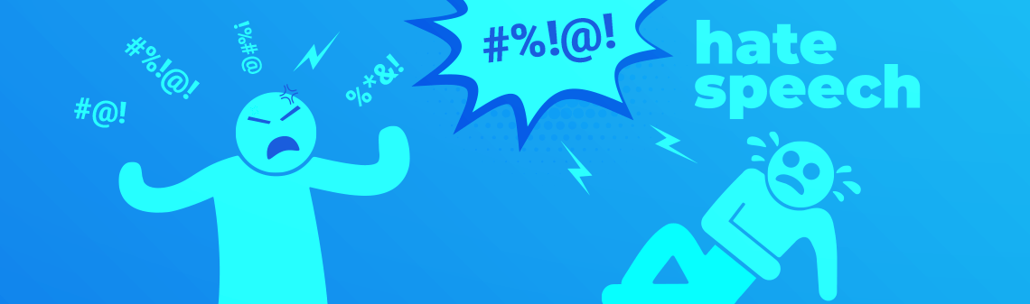
Hate Speech Detection WiSe 23-24 Hate-Speech Features and Lexicon-based Methods
(Dr.) Özge Alaçam
Computational Linguistics
oezge.alacam@lmu.de
Image taken from https://deepsense.ai/artificial-intelligence-hate-speech/

Slide 2
Now we know
what hate speech is (a relatively clear definition)
our target group
We have annotated data
Next step is to
process the text
decide on the classification task and model
and classify it into categories

Slide 3
Classification Task
Binary (hate speech or not)
Multi-class (neutral, offensive, hate speech)
Auxilary Tasks; intensity, target etc, implicitness and many more.

Slide 4
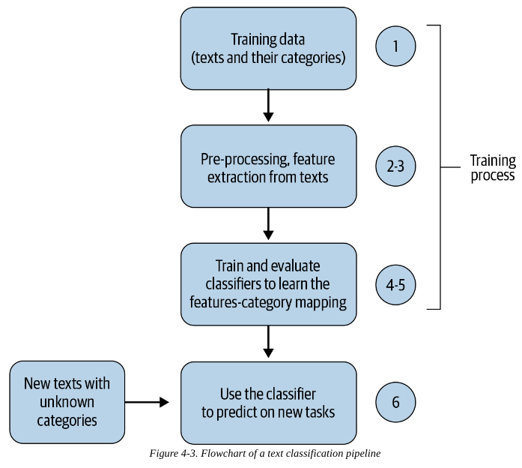
Defacto Text Classification pipeline
Or alignment if you are
using multimodal information
Vajjala et al., 2020
Notes:
Collect or create a labeled dataset suitable for the task.
Split the dataset into two (training and test) or three parts: training, validation (i.e.,development), and test sets, then decide on evaluation metric(s).
3. Transform raw text into feature vectors/embeddings.
4. Train a classifier using the feature vectors/embeddings and the corresponding labels from the training set.
5. Using the evaluation metric(s) from Step 2, benchmark the model performance on the test set.
6. Deploy the model to serve the real-world use case and monitor its performance.
Vajjala, Sowmya, et al. Practical Natural Language Processing : A Comprehensive Guide to Building Real-World NLP Systems, O'Reilly Media, Incorporated, 2020.

Slide 5
Classification Methods
Using simple dictionaries
Bag-of-words, N-grams
Traditional ML methods (Logistic Regression, SVMs etc.)
Neural Networks
Deep Neural Networks and Transformer Architectures
Or Ensemble methods
Notes:
Dictionaries are pre-defined lists, and the BOWs are created from a training data

Slide 6

Lexicon-Based
Hate Speech Detection

Slide 7
Hate-Speech Indicators (Features) (Schmidt & Wiegand. 2017)
Lexical Resources
Linguistic Features
Knowledge-based Features
And Multimodal Information

Slide 8
Lexical Resources (a list of hateful words)
Specialized list towards a particular subtype of hate speech
E.g. ethnic slurs, LGBT slang terms, or words with a negative connotation towards handicapped people (Burnap and Williams, 2016)
Content words (such as insults and swear words, reaction words, personal pronouns)
Profane words
https://hatebase.org/ , wiki slurs (https://en.wikipedia.org/wiki/List_of_ethnic_slurs) and many more

Slide 9
Linguistic Features
Do you have some predictions?
POS tags and dependencies
Imperative statements (e.g. Get lost!, Get a life!)
co-occurrence of the pronoun you modified by noun phrases (as in you bozos)

Slide 10
Methods based on Surface Level Features
surface-level features (lexicon-based methods, unigrams and larger n-grams)
character n-grams (e.g. to account for spelling variation)
ki11 yrslef a$$hole
-------------------------------------------------------------------------------------------------
the frequency of URL mentions and punctuation,
comment and token lengths,
capitalization,
words that cannot be found in English dictionaries,
the number of non-alpha numeric characters present in tokens.
Notes:
Character-level approaches, on the other hand, are more likely to capture the similarity to the canonical spelling of these tokens.
Bow requires predictive words to appear in both training and test data.
a list of words (the dictionary) that are searched and counted in the text. These frequencies can be used directly as features or to compute scores.

Slide 11
Challenges with dictionary-based methods
A single word may appear quite frequently in hate and non-speech texts.
A sentence or passage might be regarded as hateful even though no single word in the passage is hateful by itself. (Implicit Hate Speech)
The context is usually lost in this method.
Yet, if you are working on lexical semantics, they are/will still be very valuable tools!

Slide 12
Knowledge-Based Features
Hate speech detection is a task that cannot be solved by simply looking at keywords.
This decision is highly dependent on world knowledge
Put on a wig and lipstick, and be who you really are. (Di- nakar et al., 2012).
Notes:
particularly bag of words or embeddings, they are usually insufficient as a stand-alone feature (Nobata et al., 2016).
There are other available information to refine inconclusive classification.
One could infer that this is a remark to malign the sexuality or gender identity of the boy being addressed (Di- nakar et al., 2012). It displays stereotypes most commonly attributed to females (i.e. putting on a wig and lipstick). If these characteristics are attributed to a male in a heteronormative context, the intention may have been to insult the addressee.

Slide 13
Sentiment Analysis
Polarity (positive, negative, neutral)
(averaged over text length)
Intensity
(i.e. the sum of the values of identified sentiment words averaged over text length)
Hate speech usually displays a high degree of negative polarity.
A classifier dedicated to detect negative polarity is applied prior to the classifier specifically checking for evidence of hate speech
Notes:
combination with others that proved to improve results
a classifier dedicated to detect negative polarity is applied prior to the classifier specifically checking for evidence of hate speech

Slide 14
Emotion Analysis
e.g. the NRC emotion lexicon (Mohammad and Turney, 2013 )
14,182 emotion words
their associations with eight emotions (anger, fear, anticipation, trust, surprise, sadness, joy, and disgust)
Two sentiments (negative and positive)).
https://saifmohammad.com/WebPages/NRC-Emotion-Lexicon.htm

Slide 15
Some Resources:
Davidson, T., Warmsley, D., Macy, M., & Weber, I. (2017, May). Automated hate speech detection and the problem of offensive language. In Proceedings of the international AAAI conference on web and social media (Vol. 11, No. 1, pp. 512-515) (https://ojs.aaai.org/index.php/ICWSM/article/view/14955)
Wiegand, M., Ruppenhofer, J., Schmidt, A., & Greenberg, C. (2018, June). Inducing a lexicon of abusive words–a feature-based approach. In Proceedings of the 2018 Conference of the North American Chapter of the Association for Computational Linguistics: Human Language Technologies, Volume 1 (Long Papers) (pp. 1046-1056). https://aclanthology.org/N18-1095/
Bassignana, E., Basile, V., & Patti, V. (2018). Hurtlex: A multilingual lexicon of words to hurt. In 5th Italian Conference on Computational Linguistics, CLiC-it 2018 (Vol. 2253, pp. 1-6). CEUR-WS. https://iris.unito.it/handle/2318/1684807

Slide 16
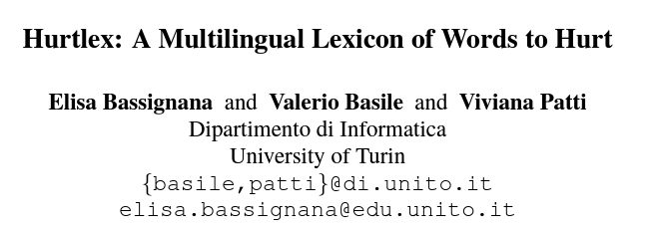
Aim of the paper: the development of a lexicon of hate words that can be used as a resource to analyze and identify hate speech in social media texts in a multilingual perspective.
http://hatespeech.di.unito.it/resources.html
Elisa Bassignana, Valerio Basile, Viviana Patti. Hurtlex: A Multilingual Lexicon of Words to Hurt. In Proceedings of the Fifth Italian Conference on Computational Linguistics (CLiC-It 2018)

Slide 17
Hurtlex Multilingual
Source Language: Italian
The lexicon of “words to hurt” ‘Le parole per ferire’ by the Italian linguist Tullio De Mauro (De Mauro, 2016)
unique lemmas (plus part of speech, and definitions)
Use of BabelNet to translate the lexicon into multiple languages and MultiWordNet to get the senses for each lexicon
Over 50 languages
Notes:
MultiWordNet(Piantaetal.,2002) is an extension of WordNet that contains messages between theEnglishlexical items in WordNet and a lexical item of other languages, including Italian. BabelNet (Navigli and Ponzetto, 2012) is a combinationof amultilingual encyclopedic dictionary and asemantic network that links concepts and named entities in a very wide network of semantic relationships

Slide 18
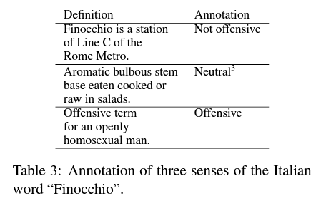
Sense Classification
Manual sense disambiguation/check
Not offensive, Neutral, Offensive

Slide 19
Hurtlex has a 2-level structure.
Lemmas belong to one of these levels:
inclusive: obtained by translating all the potentially relevant senses of the words in the original lexicon.
conservative: obtained by translating offensive senses of the words in the original lexicon.

Slide 20
Let's take a look at how it looks!
Source: https://github.com/valeriobasile/hurtlex

Slide 21
Evaluation
It has been evaluated against an annotated corpus of Hate Speech on social media (Sanguinetti et al., 2018).
6,008 tweets selected with keywords related to immigration and ethnic minorities.
Rich Annotation scheme (for each tweet):
hate speech (yes/no),
aggressiveness (strong/weak/none)
offensiveness (strong/weak/none)
irony (yes/no)
stereotype (yes/no)
But how

Slide 22
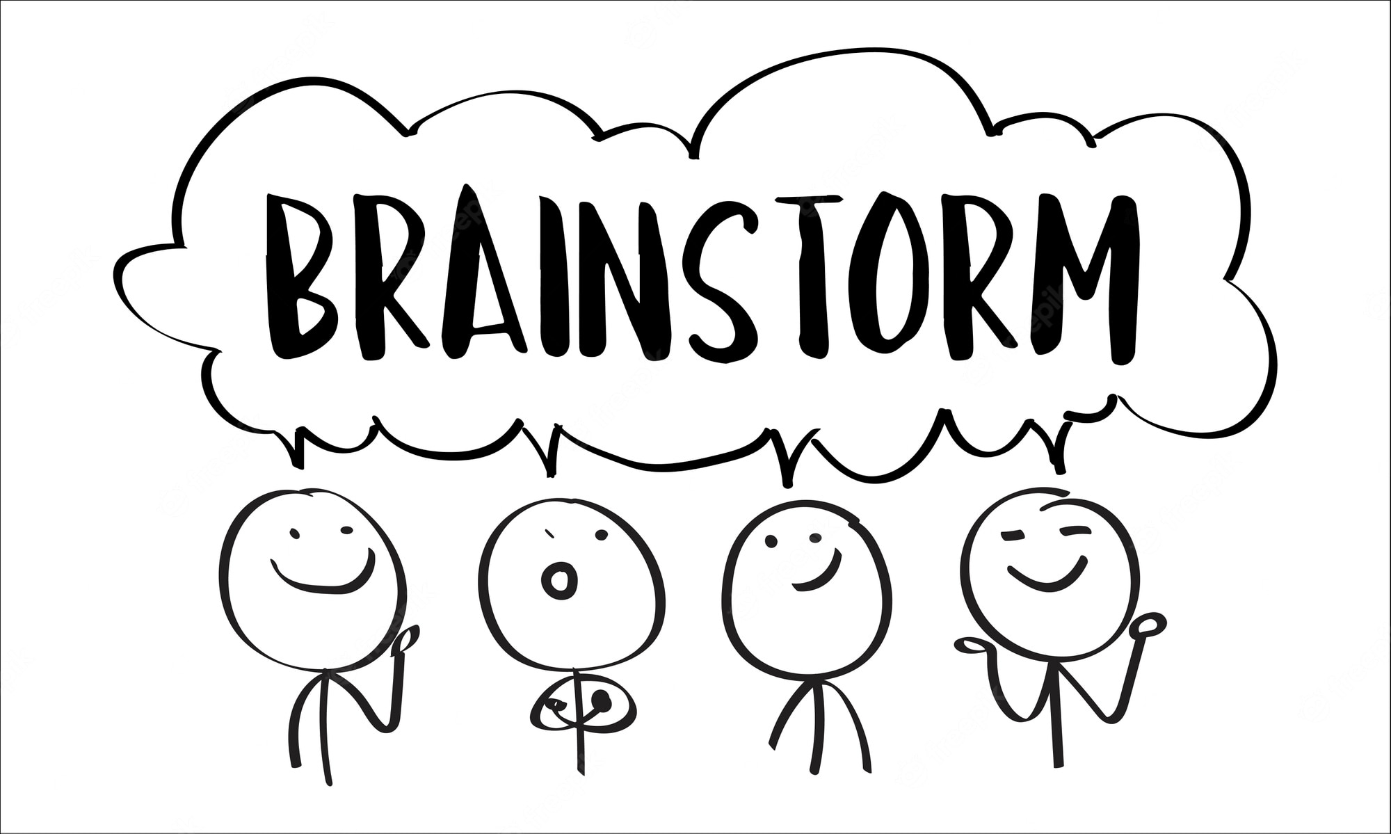
How to utilize these sources
Notes:
We have dataset!
Get dataset, read text line by line
For each line, tokenize the text, lemmatize, fix problems.
Then for each token, check whether it exist in the vocabulary (binary, aggregated, intensity related)

Slide 23
Automatic Construction
Short-term meaning shifts or making up new terms are very common in hate speech.
Thus, the task of creating a lexicon of abusive words cannot be reduced to a one-time manual annotation effort. (Wiegand et al., 2018)
the automatic construction of a lexicon of abusive words
https://github.com/uds-lsv/lexicon-of-abusive-words

Slide 24
What can you do with these dictionaries
Lexical Semantic Change (e.g. Project-I)
Controlled syntactic and semantic analysis
As supportive feature for hate speech classification
For better explanations

Slide 25
Text Processing

Slide 26
Main Sources:
Speech and Language Processing (3rd ed. draft) Dan Jurafsky and James H. Martin
Website: https://web.stanford.edu/~jurafsky/slp3/
Chapter 2: Regular Expressions, Text Normalization, Edit Distance
NLTK Library: https://www.nltk.org/book/ch03.html
SPACY Library: https://spacy.io/usage/processing-pipelines

Slide 27
Text Processing Pipeline
from raw input text to normalized tokens
tokenization
expand compound words or use MultiWord tagger
POS tagging
lemmatization
lower-case transformation
removing special characters
removing stopwords
Social media specific processing
Each step involves decisions that highly effect further analyses

Slide 28
Tokenization
A definition retrieved from https://nlp.stanford.edu/
Given a character sequence and a defined document unit, tokenization is the task of chopping it up into pieces, called tokens , perhaps at the same time throwing away certain characters, such as punctuation.
It might change w.r.t. research goals!!

Slide 29
Text Normalization
Every NLP task requires text normalization:
Tokenizing (segmenting) words
Normalizing word formats
Segmenting sentences

Slide 30
Main Types of Tokenization
Space-based tokenization : A very simple way to tokenize
For languages that use space characters between words
Arabic, Cyrillic, Greek, Latin, etc., based writing systems
Segment off a token between instances of spaces
Single-character segmentation (for e.g. Chinese)
Subword tokenization (because tokens can be parts of words as well as whole words)
e.g. unlikeliest has 3 morphemes un-, likely, and -est

Slide 31
RECAP (TYPE VERSUS TOKEN): How many words in a sentence?
“they lay back on the San Francisco grass and looked at the stars and their”
Type: an element of the vocabulary.
Token: an instance of that type in running text.
How many?
15 tokens (or 14)
13 types (or 12) (or 11?)
Notes:
Let's look at a part of another sentence. How many words are in this sentence? Pause the video and count for yourself. Again, it depends how you count. We could count word types, the number of unique words that occur in the sentence. By that count we only count "the" once, even though it appears twice. Word tokens we're counting every word token on the page, so the two "the"s count twice. And what about San Francisco? One word or two? And how about "they and their". Different wordforms, same lemma. Again, it depends on our goals, and it's important to make that clear whenever you report word counts

Slide 32
Issues in Tokenization
Can't just blindly remove punctuation:
m.p.h., Ph.D., AT&T, cap’n
prices ($45.55)
dates (01/02/06)
URLs (http://www.stanford.edu)
hashtags (#nlproc)
email addresses (someone@cs.colorado.edu)
Clitic: a word that doesn't stand on its own
"are" in we're, French "je" in j'ai, "le" in l'honneur
When should multiword expressions (MWE) be words?
New York, rock ’n’ roll
Notes:
Of course, tokenization in most real situations isn't as simple as I've suggested with the simple UNIX tools.

Slide 33
Word Normalization
Putting words/tokens in a standard format
U.S.A. or USA
uhhuh or uh-huh
Fed or fed
am, is, be, are

Slide 34
Case folding
Applications like IR: reduce all letters to lower case
Since users tend to use lower case
Possible exception: upper case in mid-sentence?
e.g., General Motors
Fed vs. fed
SAIL vs. sail
For sentiment analysis, MT, Information extraction
Case is helpful (US versus us is important)

Slide 35
Lemmatization
Represent all words as their lemma, their shared root
= dictionary headword form:
am, are, is → be
car, cars, car's, cars' → car
Spanish quiero (‘I want’), quieres (‘you want’)
→ querer ‘want'
He is reading detective stories
→ He be read detective story
Effect of lemmatization for large LLMs?

Slide 36
Removal of Stopwords
The stopwords are the most common words in data. They are words that you do not want to use to describe the topic of your content
Keep Content Words and remove Function words (again not necessary for LLMs since we want to give them sentences as it is so that they can learn and represent these dynamics in their deep layers!)

Slide 37
For Social Media Text
Emoji Processing
Hashtag Processing
HTML removal
Processing Alpha-numerical characters

Slide 38
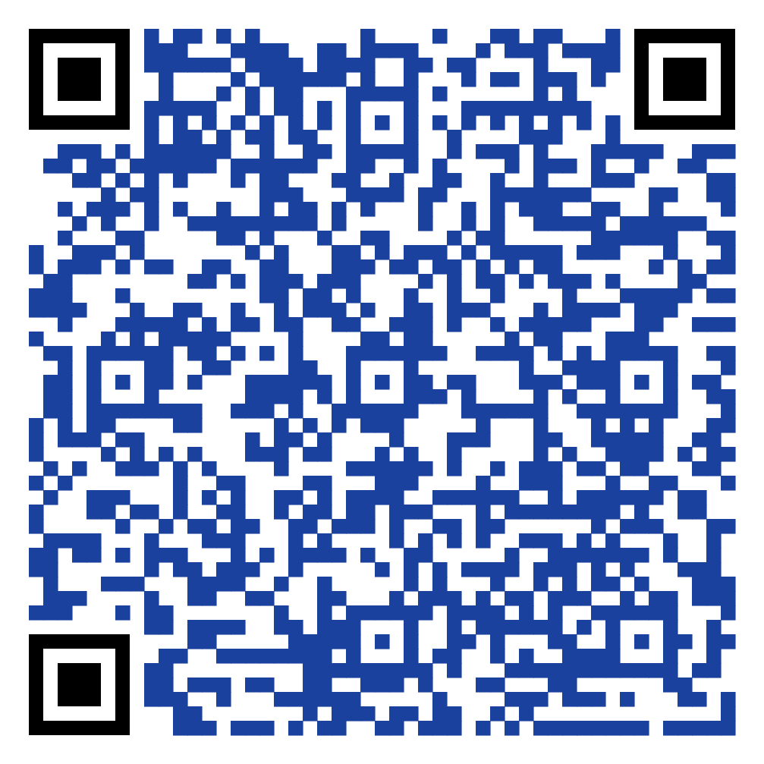
Lets SET-UP THE OVERLEAF DOCUMENT
Google “ACL Overleaf Template” or scan the QR code
Set an overleaf account
One member of the group can create the paper and share the link with others and me.
Projectname:
list_of_surnames+ projectNo

Slide 39
Project-I: Hate Sense Classification
Until Thursday, task-1 & initial data summary at Overleaf
 | Annotator-1 | Annotator-3 | Annotator-3 | Annotator-4
Task-1 | 500 sentence (batch-1) | 500 sentence (batch-1) | 500 sentence (batch-2) | 500 sentence (batch-2)
Task-2 | Interrater agreement |  | Interrater agreement
Task-3 | Train on 1st part, test on 2nd part (using the provided model) |  | Train on 2nd part, test on 1st part (using the provided model)
Task-4 | Report the results (discuss annotation scheme)

Slide 40
Project-II: Implicit versus Explicit Hate Speech (Gaze4Hate)
Until Thursday, Task-1 and Task-2, initial data summary
 | Annotator-1 | Annotator-2
Task-1 | 90 sentences (implicit/explicit/other) | 90 sentences (implicit/explicit/other)
Task-2 | Interrater agreement
Task-3 | Implement a simple baseline classifier (hate/nohate)
Task-4 | use the provided ML Classifier,
Task-5 | Report the results, do linguistic analysis between explicit and implicit cases

Slide 41
Project-IV: Explainability
Your task until Thursday,
Choose a test dataset (that exists in Hate Check or HateCheck Multilingual)
Summarize your data in detail at Overleaf document
You can access a nice summary of explanation methods here:
Pepa Atanasova, Jakob Grue Simonsen, Christina Lioma, and Isabelle Augenstein. 2020. A diagnostic study of explainability techniques for text classification. In Proceedings of the 2020 Conference on Empirical Methods in Natural Language Processing (EMNLP), pages 3256–3274, Online. Association for Computational Linguistics.

Slide 42
Project-IV: Curriculum Learning Training
Until Thursday,
Summarize your dataset and curriculum at the Overleaf document
Task-1 | Choose your dataset e.g. from multilingual HateCheck
Task-2 | Manually inspect the existing groups and define some complexity criteria

