Slide 1
Twitter Project Set up

Slide 2
WINDOWS USERS (MAC USERS GO TO SLIDE 18)

Slide 3
Before we start
Download the current version of Ubuntu (.iso file)
Download Virtual Box (to create a virtual operating system running on your own computer)

Slide 4
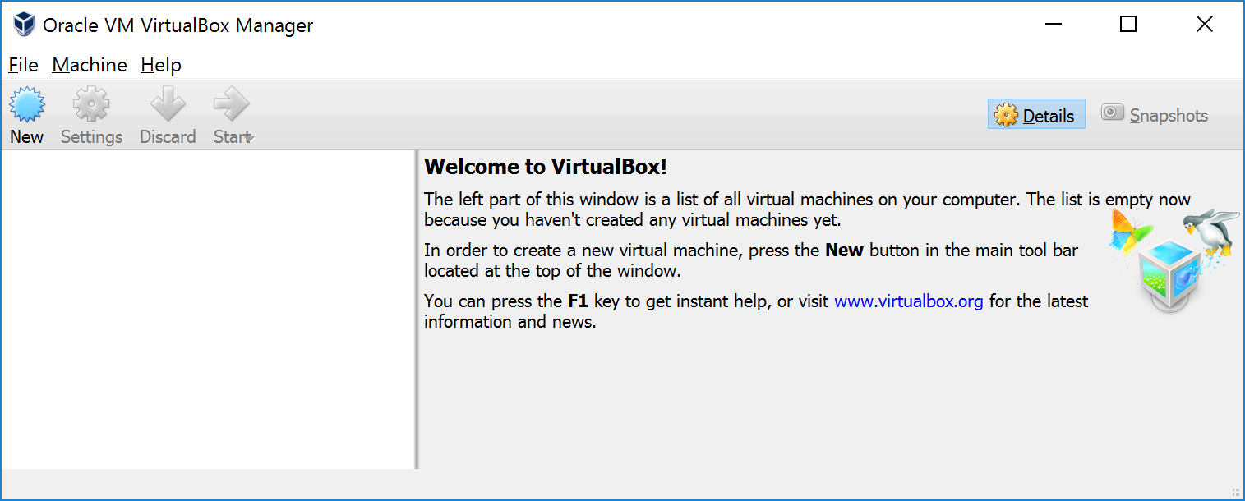
Virtual Box

Slide 5
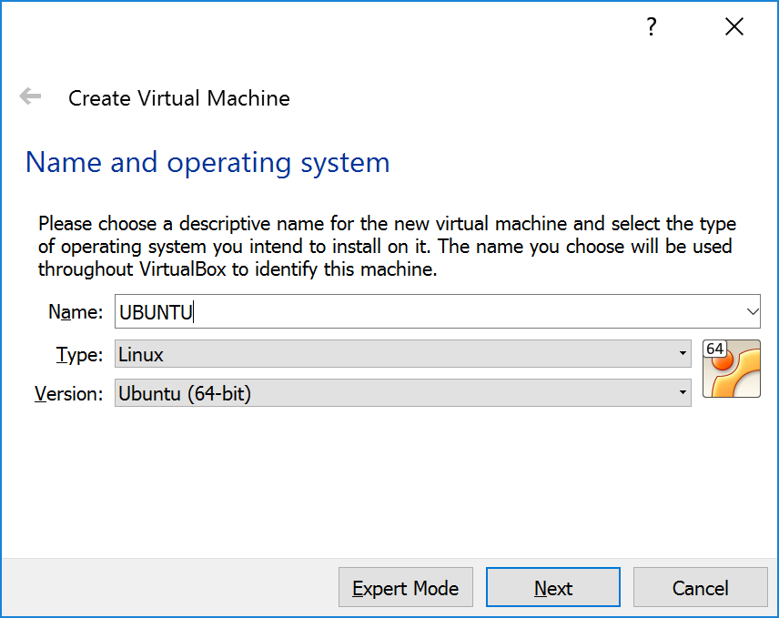

Slide 6
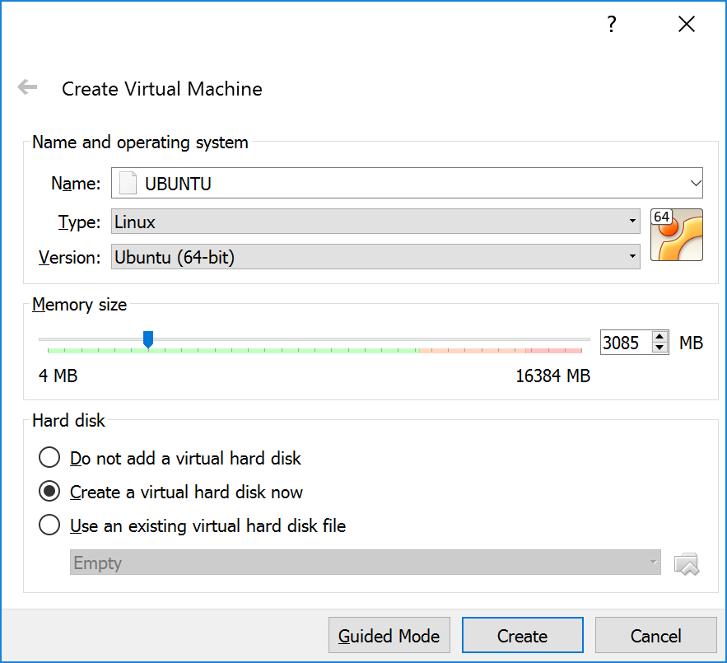
Whatever you may find reasonable

Slide 7

> 50 GB

Slide 8
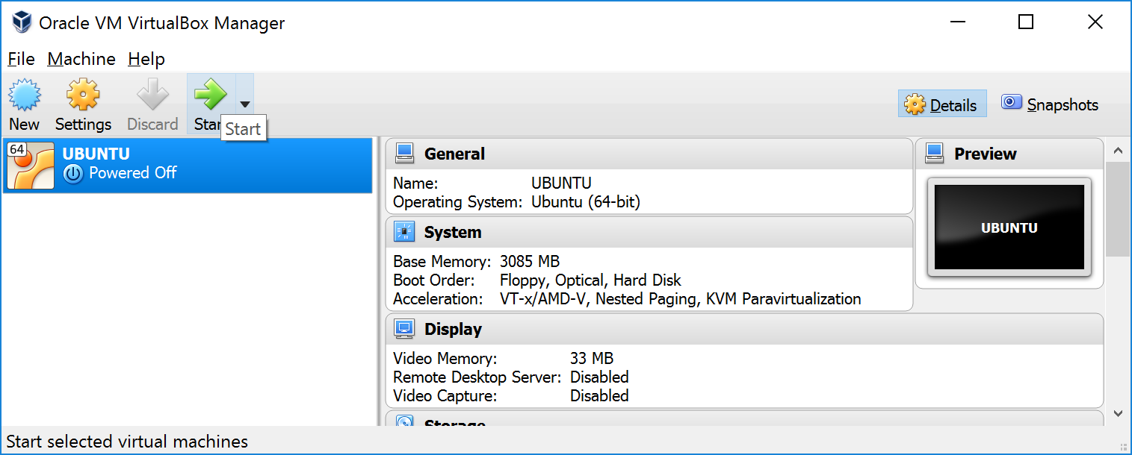

Slide 9
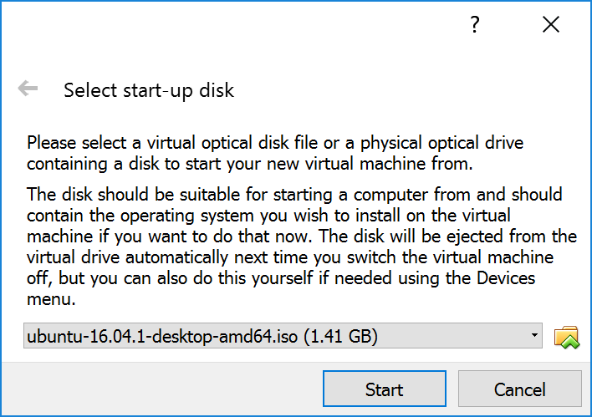
Select the Ubuntu ISO file you downloaded at the beginning

Slide 10
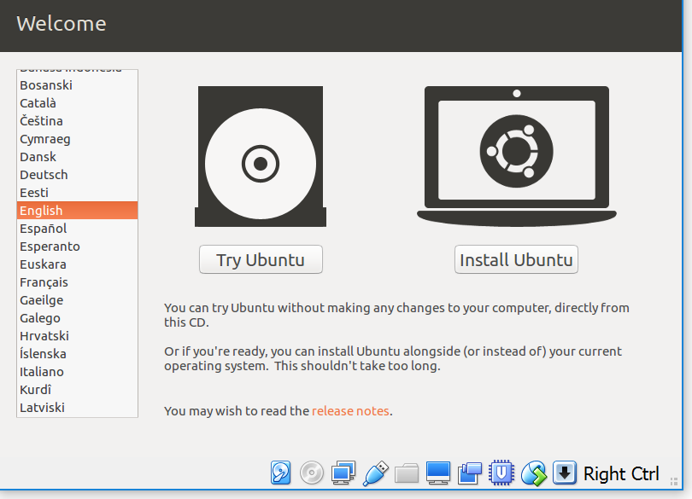

Slide 11
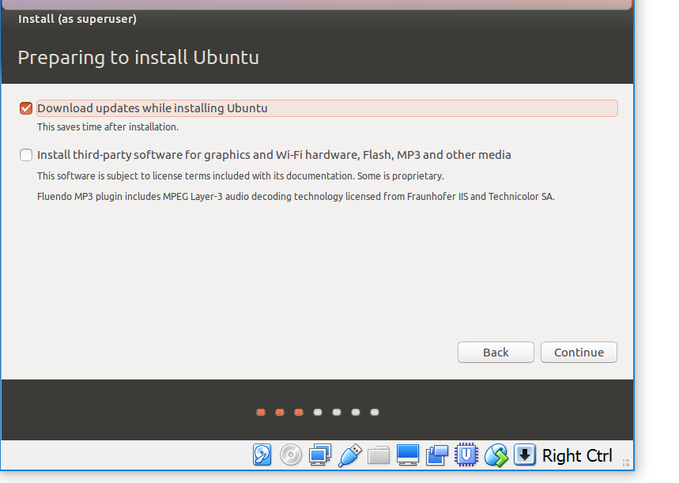

Slide 12
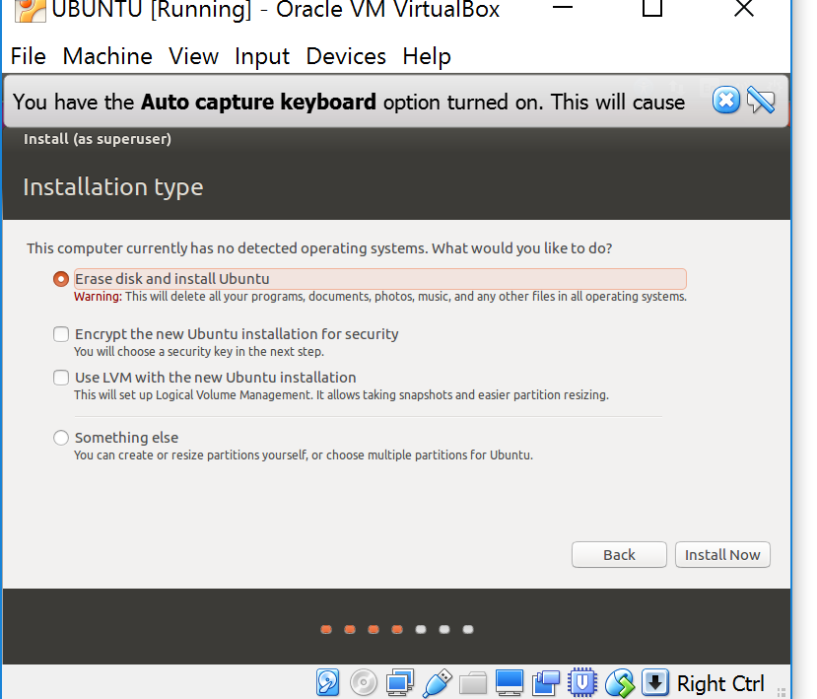

Slide 13
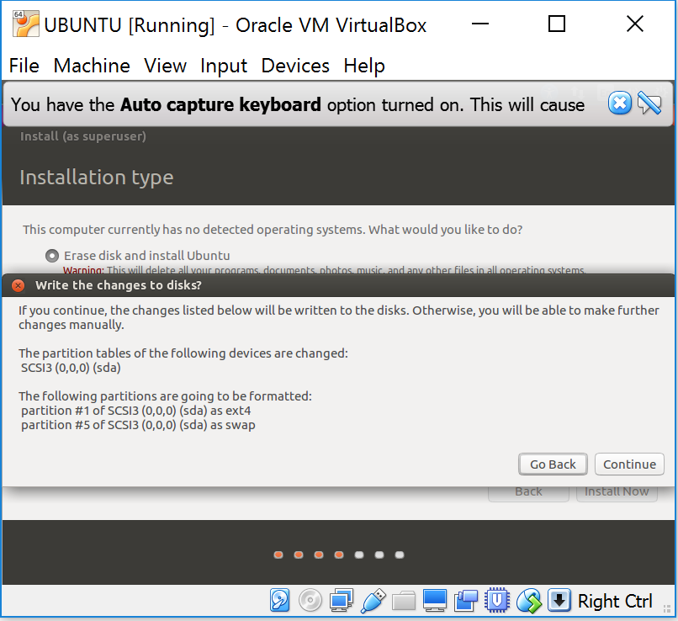
Your real computer won’t be affected. Don’t worry about it

Slide 14
SELECT REGION, LANGUAGE, ETC...

Slide 15
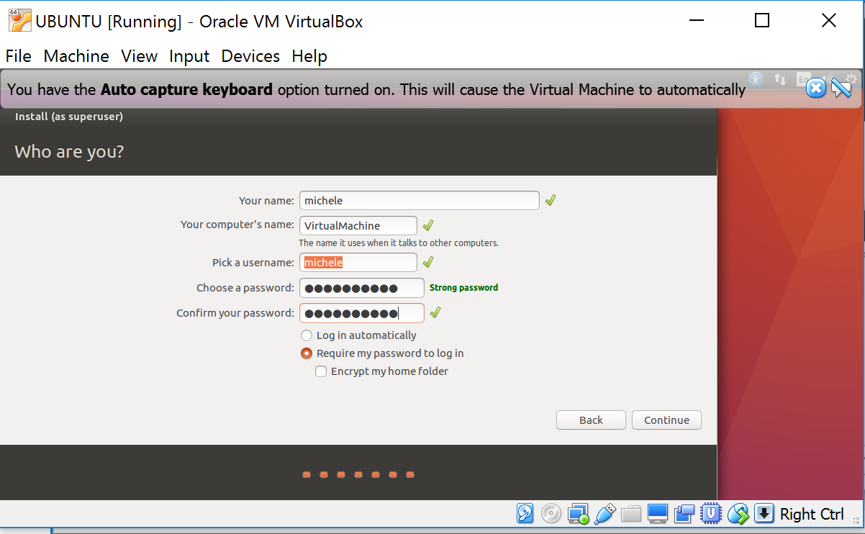

Slide 16
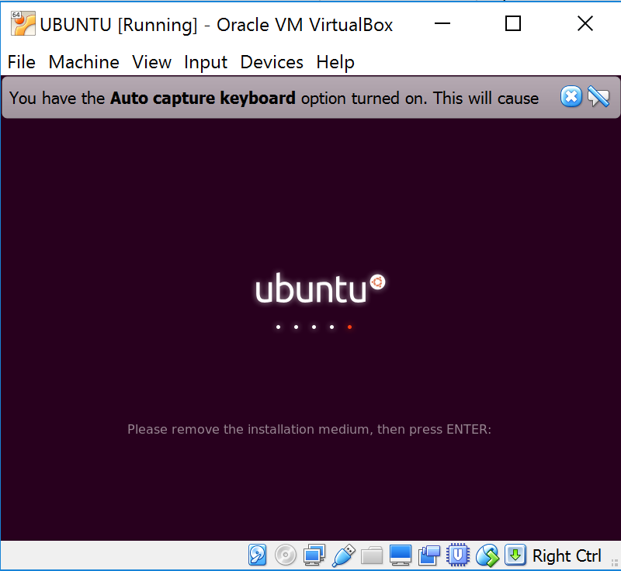

Slide 17
Open the terminal and execute these commands:
sudo apt-get install python-pip
sudo pip install tweepy
sudo apt-get install vim
GO TO SLIDE 20

Slide 18
MAC USER

Slide 19
MAC USERS
Download this file: https://bootstrap.pypa.io/get-pip.py
Go to that folder and type: sudo python get-pip.py
Execute this: sudo pip install --ignore-installed pip setuptools
Execute this: sudo pip install --ignore-installed tweepy

Slide 20
PROJECT SET UP for both Mac and Windows Users

Slide 21
Download the project files tweetering.py and config.cfg
Place them in the same directory

Slide 22
Set up a Twitter developer account
To be able to use the Twitter APIs, you’ll need to register as a Twitter app developer and obtain keys and access tokens. You’ll need to replace the keys and tokens in config.cfg with your keys and tokens
Start by going to https://apps.twitter.com/:
Sign in using your Twitter account
Click on “create new app”
Click on your app name

Slide 23
Set up a Twitter developer account
To be able to use the Twitter APIs, you’ll need to register as a Twitter app developer and obtain keys and access tokens
Start by going to https://apps.twitter.com/:
Sign in using your Twitter account
Click on “create new app”
Click on your app name
Click on “Keys and Access Tokens”
In this page, you’ll find a consumer_key, consumer_secret, access_token, and access_token_secret
Copy your keys and tokens into config.cfg

Slide 24
Execute
You should be able to execute the following commands:
python tweetering.py Trump

