Slide 1
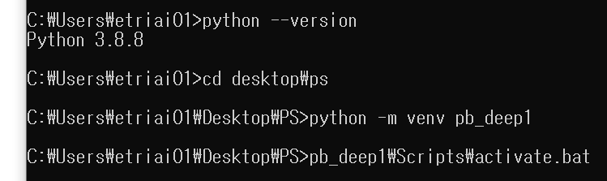
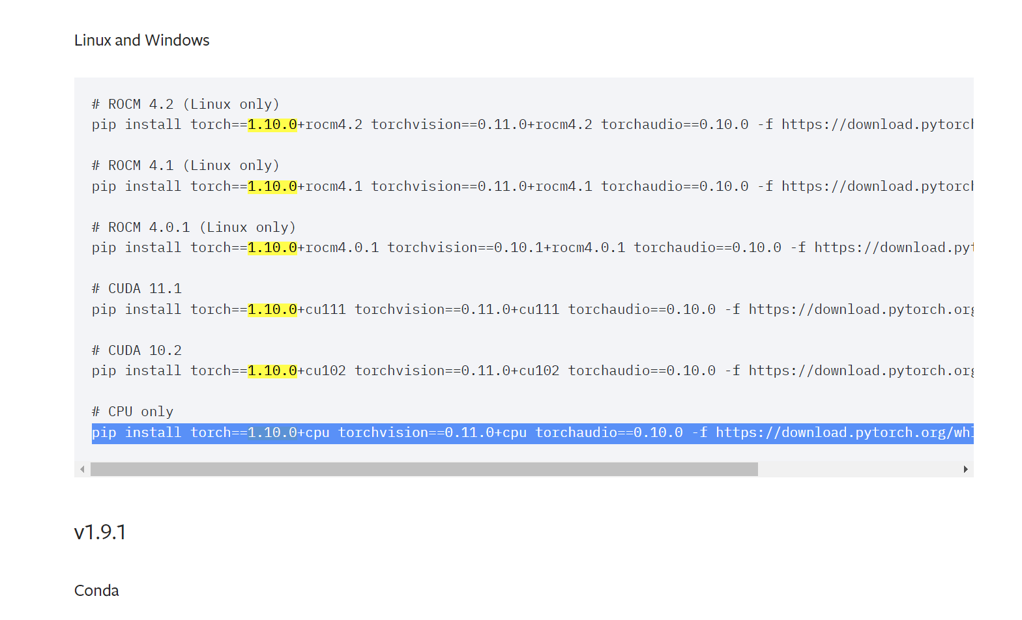
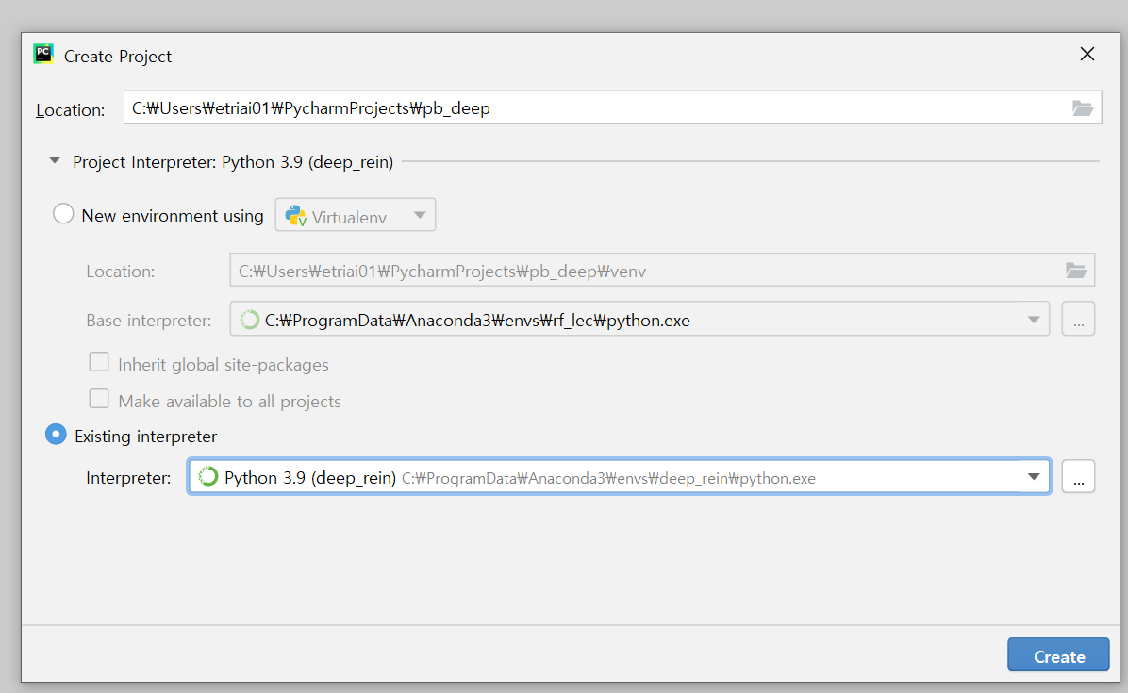
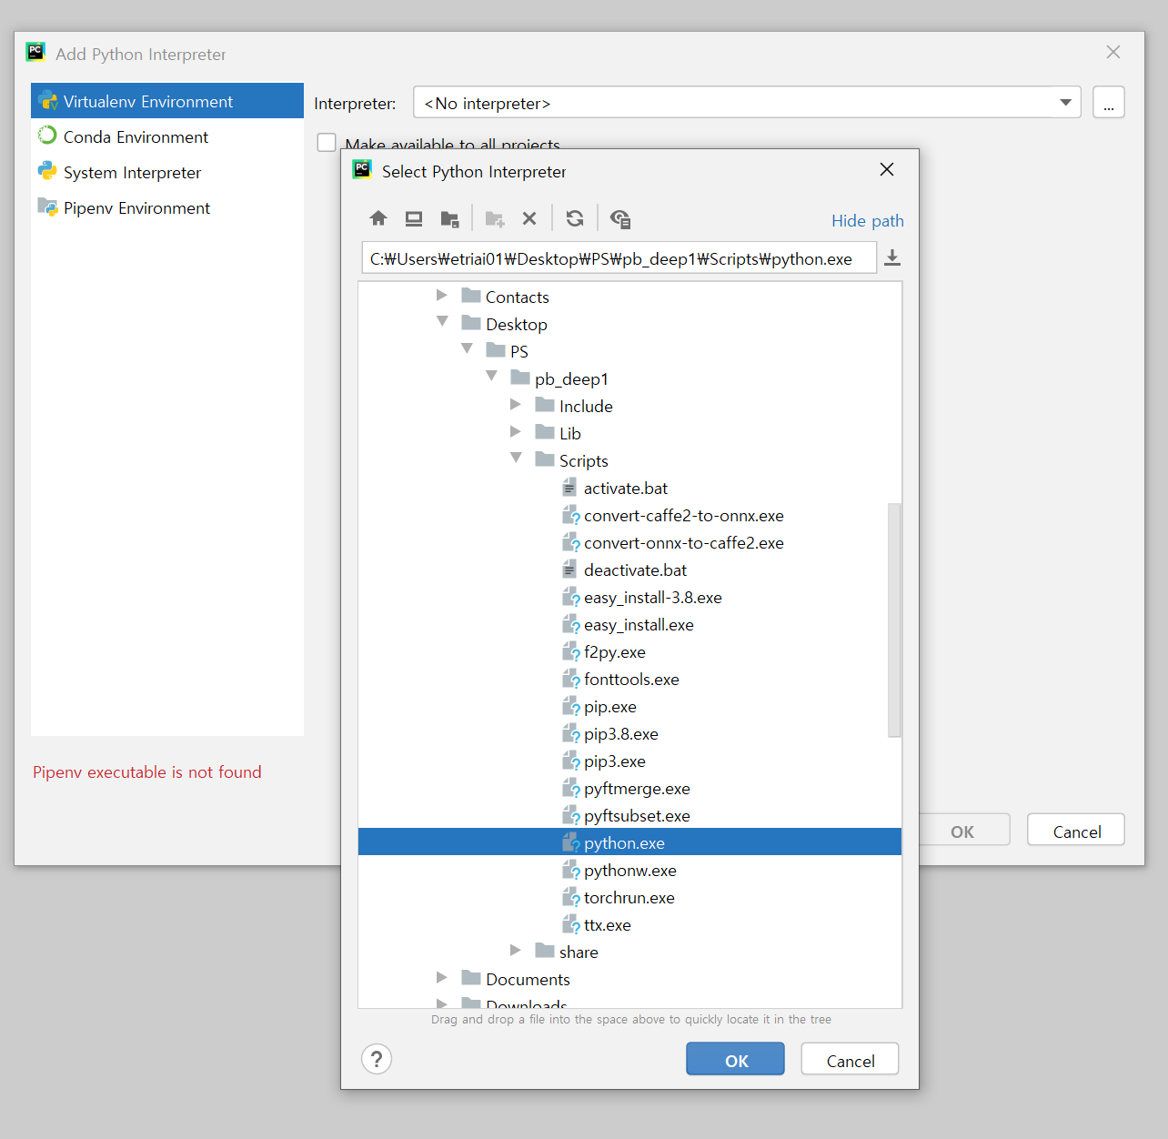
1. 기본 python path 삭제
내컴퓨터 → 속성 → 고급시스템설정→ 고급 → 환경변수 → PATH → 기존 python 2개 삭제
2. 제어판 Python 삭제 (launcher 포함)
3. python.org → Python 3.8.8 설치 (3.7 ~ 3.9가 무난)
4. 폴더 생성
5. Cmd로 해당 폴더 이동
6. 가상환경 생성
7. Pytorch 설치
Pytorch.org → Previous versions of pytorch → 1.11 & 1.10이 가장 무난 → V1.10.0 설치 → 일단은 CPU로 설치
→ “pip install torch==1.10.0+cpu torchvision==0.11.0+cpu torchaudio==0.10.0 -f https://download.pytorch.org/whl/torch_stable.html”
8. numpy padas matplotlib scikit-learn 설치
9. Pycharm → New project

Slide 2


Day1
오차
Target
model
Input
Output
지도학습
Sigmoid
$$\frac{1}{1+e^{−(wx+b)}}$$
$$\frac{1}{1+e^{−(w_{1}x_{1}+w_{2}x_{2}+w_{3}x_{3}+b)}}$$
Linear(3,1)
Binary cross entropy → Sigmoi의 loss function으로 활용:
-( y*logh + (1-y)*log(1-h) )

Slide 3
C:\Users\etriai01\Desktop\PS\pb_deep1\Scripts\python.exe C:/Users/etriai01/PycharmProjects/pb_deep/day1/pytorchEx1.py
tensor([4., 5., 6., 7., 8.])
<class 'torch.Tensor'>
[4. 5. 6. 7. 8.]
tensor([[1., 2.],
[3., 4.]])
torch.Size([2, 2])
[[1. 2. 3. 4.]
[5. 6. 7. 8.]]
tensor([[1., 2., 3., 4.],
[5., 6., 7., 8.]])
Process finished with exit code 0
C:\Users\etriai01\Desktop\PS\pb_deep1\Scripts\python.exe C:/Users/etriai01/PycharmProjects/pb_deep/day1/pytorchEx2.py
tensor([21, 22, 23])
tensor([2, 4, 6])
tensor([[10, 20, 30],
[50, 60, 70]])
tensor([[11, 22, 33],
[51, 62, 73]])
tensor([0.0000, 0.3333, 0.6667, 1.0000, 1.3333, 1.6667, 2.0000, 2.3333, 2.6667,
3.0000])
tensor([ 1.0000, 1.3956, 1.9477, 2.7183, 3.7937, 5.2945, 7.3891, 10.3123,
14.3919, 20.0855])
tensor([ -inf, -1.0986, -0.4055, 0.0000, 0.2877, 0.5108, 0.6931, 0.8473,
0.9808, 1.0986])
tensor([[2, 4, 6],
[1, 9, 7]])
tensor(9)
torch.return_types.max(
values=tensor([6, 9]),
indices=tensor([2, 1]))
tensor([6, 9])
tensor([2, 1])
Process finished with exit code 0

Slide 4
C:\Users\etriai01\Desktop\PS\pb_deep1\Scripts\python.exe C:/Users/etriai01/PycharmProjects/pb_deep/day1/pytorchEx3.py
tensor([1, 2, 3, 4, 5, 6])
tensor([[1, 2, 3],
[4, 5, 6]])
tensor([[1, 2, 3],
[4, 5, 6]])
tensor([[1, 2],
[3, 4],
[5, 6]])
torch.Size([3, 2])
tensor([1, 2, 3, 4, 5, 6])
tensor([[1, 2, 3, 4, 5, 6]])
tensor([[[1, 2],
[3, 4]],
[[5, 6],
[7, 8]]])
torch.Size([2, 2, 2])
tensor([1, 2, 3, 4, 5, 6, 7, 8])
tensor([[1, 2, 3, 4, 5, 6, 7, 8]])
tensor([[1, 2, 3, 4],
[5, 6, 7, 8]])
Process finished with exit code 0
C:\Users\etriai01\Desktop\PS\pb_deep1\Scripts\python.exe C:/Users/etriai01/PycharmProjects/pb_deep/day1/pytorchEx5.py
tensor([[1, 2, 3],
[4, 5, 6]])
tensor([[1, 2],
[4, 5]])
tensor([[False, False, False],
[False, True, True]])
tensor([5, 6])
tensor([[ 1, 2, 40],
[ 4, 5, 40]])
tensor([[ 1, 2, 100],
[ 4, 5, 100]])
tensor([[1, 2, 3],
[4, 5, 6]])
tensor([[ 7, 8, 9],
[10, 11, 12]])
tensor([[ 1, 2, 3],
[ 4, 5, 6],
[ 7, 8, 9],
[10, 11, 12]])
tensor([[ 1, 2, 3, 7, 8, 9],
[ 4, 5, 6, 10, 11, 12]])
tensor([[1, 2, 3]])
tensor([[4, 5, 6]])
tensor([[7, 8, 9]])
tensor([[10, 11, 12]])
tensor([[ 1],
[ 4],
[ 7],
[10]])
tensor([[ 2],
[ 5],
[ 8],
[11]])
tensor([[ 3],
[ 6],
[ 9],
[12]])
Process finished with exit code 0
C:\Users\etriai01\Desktop\PS\pb_deep1\Scripts\python.exe C:/Users/etriai01/PycharmProjects/pb_deep/day1/pytorchEx4.py
tensor([[ 27, 30, 33],
[ 61, 68, 75],
[ 95, 106, 117]])
tensor([[ 27, 30, 33],
[ 61, 68, 75],
[ 95, 106, 117]])
torch.Size([2, 4, 3])
torch.Size([2, 4, 5])
torch.Size([2, 4, 5])
Process finished with exit code 0

Slide 5
C:\Users\etriai01\Desktop\PS\pb_deep1\Scripts\python.exe C:/Users/etriai01/PycharmProjects/pb_deep/day1/pytorchEx6.py
tensor([[0.4729, 0.8832, 0.2484, 0.9509],
[0.4329, 0.1881, 0.9510, 0.1522],
[0.5297, 0.3922, 0.3636, 0.2271]])
tensor([[ 9.6562, 7.5275, 8.6486, 8.9491],
[ 9.8242, 10.6785, 11.4083, 12.4679],
[10.2777, 8.9406, 12.9874, 10.5547]])
tensor([[-1.6403, -0.5063, -2.3616, 0.9211],
[ 0.6595, 0.0158, 0.3562, 1.0128],
[ 0.4945, -0.0273, -0.6469, -0.6545]])
tensor([[100., 100., 100., 100.],
[100., 100., 100., 100.],
[100., 100., 100., 100.]])
Process finished with exit code 0
C:\Users\etriai01\Desktop\PS\pb_deep1\Scripts\python.exe C:/Users/etriai01/PycharmProjects/pb_deep/day1/pytorchEx7.py
tensor([[0., 0., 0., 0.]])
torch.Size([1, 4])
tensor([0., 0., 0., 0.])
torch.Size([4])
torch.Size([2, 1, 3, 1, 4])
torch.Size([2, 3, 4])
torch.Size([2, 3, 1, 4])
torch.Size([2, 1, 3, 4])
torch.Size([2, 3])
torch.Size([1, 2, 3])
torch.Size([2, 1, 3])
torch.Size([2, 3, 1])
Process finished with exit code 0
C:\Users\etriai01\Desktop\PS\pb_deep1\Scripts\python.exe C:/Users/etriai01/PycharmProjects/pb_deep/day1/pytorchEx8.py
tensor(2., requires_grad=True)
tensor(4., grad_fn=<MulBackward0>)
w로 미분한 값: tensor(2.)
w로 미분한 값: tensor(4.)
w로 미분한 값: tensor(2.)
w로 미분한 값: tensor(2.)
w로 미분한 값: tensor(2.)
w로 미분한 값: tensor(2.)
w로 미분한 값: tensor(2.)
w로 미분한 값: tensor(2.)
w로 미분한 값: tensor(2.)
w로 미분한 값: tensor(2.)
w로 미분한 값: tensor(2.)
w로 미분한 값: tensor(2.)
w로 미분한 값: tensor(2.)
w로 미분한 값: tensor(2.)
w로 미분한 값: tensor(2.)
w로 미분한 값: tensor(2.)
w로 미분한 값: tensor(2.)
w로 미분한 값: tensor(2.)
w로 미분한 값: tensor(2.)
w로 미분한 값: tensor(2.)
w로 미분한 값: tensor(2.)
Process finished with exit code 0

Slide 6
C:\Users\etriai01\Desktop\PS\pb_deep1\Scripts\python.exe C:/Users/etriai01/PycharmProjects/pb_deep/day1/linearEx1.py
epoch:1, w1:0.294, w2:0.293, w3:0.302, b:0.003, const:29661.801
epoch:101, w1:0.676, w2:0.653, w3:0.671, b:0.008, const:9.535
epoch:201, w1:0.691, w2:0.648, w3:0.661, b:0.008, const:9.204
epoch:301, w1:0.705, w2:0.643, w3:0.652, b:0.009, const:8.887
epoch:401, w1:0.719, w2:0.638, w3:0.643, b:0.009, const:8.583
epoch:501, w1:0.733, w2:0.634, w3:0.634, b:0.009, const:8.293
epoch:601, w1:0.746, w2:0.630, w3:0.625, b:0.010, const:8.014
epoch:701, w1:0.760, w2:0.625, w3:0.617, b:0.010, const:7.748
epoch:801, w1:0.772, w2:0.621, w3:0.608, b:0.010, const:7.492
epoch:901, w1:0.785, w2:0.618, w3:0.599, b:0.011, const:7.247
Process finished with exit code 0
C:\Users\etriai01\Desktop\PS\pb_deep1\Scripts\python.exe C:/Users/etriai01/PycharmProjects/pb_deep/day1/linearEx2.py
epoch:1, cost:18.881
C:\Users\etriai01\Desktop\PS\pb_deep1\lib\site-packages\torch\nn\modules\loss.py:520: UserWarning: Using a target size (torch.Size([1000, 3])) that is different to the input size (torch.Size([1000, 1])). This will likely lead to incorrect results due to broadcasting. Please ensure they have the same size.
return F.mse_loss(input, target, reduction=self.reduction)
epoch:101, cost:9.358
epoch:201, cost:4.736
epoch:301, cost:2.493
epoch:401, cost:1.403
epoch:501, cost:0.873
epoch:601, cost:0.615
epoch:701, cost:0.489
epoch:801, cost:0.427
epoch:901, cost:0.396
[Parameter containing:
tensor([[1.3887, 1.0257, 1.2530]], requires_grad=True), Parameter containing:
tensor([1.9973], requires_grad=True)]
[[1.3886777 1.0256728 1.2530192]]
Process finished with exit code 0

Slide 7
C:\Users\etriai01\Desktop\PS\pb_deep1\Scripts\python.exe C:/Users/etriai01/PycharmProjects/pb_deep/day1/linearEx4.py
cost: 51220.5117
cost: 12388.6973
cost: 2387.6694
cost: 1916.9573
cost: 456.2752
cost: 114.6471
cost: 70.0319
cost: 15.5360
cost: 4.2554
cost: 6.6094
cost: 0.1225
cost: 0.2500
cost: 0.0542
cost: 0.9276
cost: 2.5148
cost: 1.0037
cost: 0.4806
cost: 1.8738
cost: 1.7197
cost: 0.1607
cost: 0.8877
cost: 0.8473
cost: 1.1693
cost: 0.0082
cost: 0.7048
cost: 1.4518
cost: 0.6615
cost: 0.1523
cost: 1.6230
cost: 0.6509
cost: 1.2050
cost: 0.5646
cost: 1.1008
cost: 0.8886
cost: 1.1557
cost: 0.5448
cost: 0.6295
cost: 2.3709
cost: 0.0001
cost: 0.3635
cost: 0.9533
cost: 2.6407
cost: 1.2284
cost: 1.2575
cost: 0.5202
cost: 1.1391
cost: 1.0324
cost: 0.0464
cost: 0.8966
cost: 1.0838
cost: 0.0195
cost: 0.4428
cost: 1.4889
cost: 0.0073
cost: 0.5620
cost: 0.5767
cost: 2.0157
cost: 1.6490
cost: 0.1630
cost: 0.8336
Process finished with exit code 0
C:\Users\etriai01\Desktop\PS\pb_deep1\Scripts\python.exe C:/Users/etriai01/PycharmProjects/pb_deep/day1/linearEx5.py
[tensor([[73., 80., 75.],
[73., 64., 70.]]), tensor([[152.],
[142.]])]
[tensor([[93., 88., 92.],
[89., 91., 90.]]), tensor([[185.],
[180.]])]
[tensor([[ 96., 98., 100.]]), tensor([[196.]])]
cost: 18105.0547
cost: 13000.3887
cost: 3626.4265
cost: 676.2392
cost: 104.4974
cost: 107.7616
cost: 5.2645
cost: 21.2347
cost: 16.3315
cost: 11.3929
cost: 5.7206
cost: 9.1211
cost: 7.7881
cost: 15.4635
cost: 4.8510
cost: 1.2727
cost: 7.5937
cost: 23.0579
cost: 11.0624
cost: 4.6745
cost: 8.8119
cost: 12.9229
cost: 3.1400
cost: 11.6007
cost: 6.6967
cost: 12.1734
cost: 5.8959
cost: 5.9399
cost: 11.3037
cost: 5.4983
cost: 2.0843
cost: 14.2705
cost: 8.2004
cost: 11.3589
cost: 4.2359
cost: 7.4036
cost: 2.7768
cost: 6.9692
cost: 21.6469
cost: 10.3280
cost: 5.6559
cost: 18.8892
cost: 10.9853
cost: 11.2408
cost: 7.2980
cost: 8.2672
cost: 13.5077
cost: 11.9670
cost: 15.7028
cost: 8.2181
cost: 3.3870
cost: 7.2749
cost: 12.2053
cost: 2.3766
cost: 5.9647
cost: 12.1182
cost: 2.9859
cost: 2.0813
cost: 14.3102
cost: 8.1741
Process finished with exit code 0
C:\Users\etriai01\Desktop\PS\pb_deep1\Scripts\python.exe C:/Users/etriai01/PycharmProjects/pb_deep/day1/linearEx3.py
tensor([[-0.8094, -0.4310, 0.8767, 0.4046, 0.4610],
[-1.4965, 0.3103, -0.6456, 1.0424, -1.3777],
[ 0.3058, 1.2020, -0.0892, -0.4080, -0.1981],
[-1.2685, -0.1657, -0.4681, 0.8514, -0.1001],
[-0.0319, 0.9347, 0.1126, -0.1818, -0.6524],
[-0.0974, -0.3108, -1.7964, -0.0791, 0.4804],
[ 0.1589, 0.2603, -0.7387, -0.1531, 0.4183],
[ 0.7024, 0.4655, 0.7242, 0.8527, 0.5403],
[-0.7197, -0.2642, -0.9964, 0.3659, -0.0490],
[-0.1400, 0.5668, -0.2344, 0.6401, -0.2516],
[-0.2572, 0.1224, -1.1717, -0.4160, 0.2201],
[-0.1959, -0.3900, -1.4230, -0.2991, 0.1975],
[-0.1699, 0.1587, -1.2009, -0.3375, 0.0724],
[-0.4307, -0.4906, -0.1749, 0.4140, 0.4880],
[-0.2028, -0.3672, -1.2128, 0.3613, 0.3392],
[ 0.4716, 1.0167, 0.2307, 0.1271, 0.2518]],
grad_fn=<AddmmBackward0>)
tensor([[-0.8094, -0.4310, 0.8767, 0.4046, 0.4610],
[-1.4965, 0.3103, -0.6456, 1.0424, -1.3777],
[ 0.3058, 1.2020, -0.0892, -0.4080, -0.1981],
[-1.2685, -0.1657, -0.4681, 0.8514, -0.1001],
[-0.0319, 0.9347, 0.1126, -0.1818, -0.6524],
[-0.0974, -0.3108, -1.7964, -0.0791, 0.4804],
[ 0.1589, 0.2603, -0.7387, -0.1531, 0.4183],
[ 0.7024, 0.4655, 0.7242, 0.8527, 0.5403],
[-0.7197, -0.2642, -0.9964, 0.3659, -0.0490],
[-0.1400, 0.5668, -0.2344, 0.6401, -0.2516],
[-0.2572, 0.1224, -1.1717, -0.4160, 0.2201],
[-0.1959, -0.3900, -1.4230, -0.2991, 0.1975],
[-0.1699, 0.1587, -1.2009, -0.3375, 0.0724],
[-0.4307, -0.4906, -0.1749, 0.4140, 0.4880],
[-0.2028, -0.3672, -1.2128, 0.3613, 0.3392],
[ 0.4716, 1.0167, 0.2307, 0.1271, 0.2518]],
grad_fn=<AddmmBackward0>)
Process finished with exit code 0

Slide 8
Day2
Perceptron
고급 경사 하강법 → 좀 더 빠르게 학습
y₀₁: 예측값
y_{t1}: 출력값
모멘텀 → 그 전의 미분 값을 이용함
activation_hidden
activation_input
activation_out

Slide 9
C:\Users\etriai01\Desktop\PS\pb_deep1\Scripts\python.exe C:/Users/etriai01/PycharmProjects/pb_deep/day2/logisticEx1.py
tensor([[0.5000],
[0.5000],
[0.5000],
[0.5000],
[0.5000],
[0.5000]], grad_fn=<MulBackward0>)
tensor([[0.5000],
[0.5000],
[0.5000],
[0.5000],
[0.5000],
[0.5000]], grad_fn=<SigmoidBackward0>)
tensor([[0.6931],
[0.6931],
[0.6931],
[0.6931],
[0.6931],
[0.6931]], grad_fn=<NegBackward0>)
tensor(0.6931, grad_fn=<MeanBackward0>)
tensor(0.6931, grad_fn=<BinaryCrossEntropyBackward0>)
epoch:0 loss:0.6931
epoch:10 loss:0.6714
epoch:20 loss:0.5905
epoch:30 loss:0.4871
epoch:40 loss:0.4011
epoch:50 loss:0.3196
epoch:60 loss:0.2458
epoch:70 loss:0.1892
epoch:80 loss:0.1585
epoch:90 loss:0.1446
epoch:100 loss:0.1347
epoch:110 loss:0.1262
epoch:120 loss:0.1186
epoch:130 loss:0.1120
epoch:140 loss:0.1061
epoch:150 loss:0.1007
epoch:160 loss:0.0959
epoch:170 loss:0.0916
epoch:180 loss:0.0876
epoch:190 loss:0.0840
epoch:200 loss:0.0806
epoch:210 loss:0.0776
epoch:220 loss:0.0747
epoch:230 loss:0.0721
epoch:240 loss:0.0696
epoch:250 loss:0.0674
epoch:260 loss:0.0652
epoch:270 loss:0.0632
epoch:280 loss:0.0613
epoch:290 loss:0.0596
epoch:300 loss:0.0579
epoch:310 loss:0.0563
epoch:320 loss:0.0548
epoch:330 loss:0.0534
epoch:340 loss:0.0521
epoch:350 loss:0.0508
epoch:360 loss:0.0496
epoch:370 loss:0.0485
epoch:380 loss:0.0474
epoch:390 loss:0.0463
epoch:400 loss:0.0453
epoch:410 loss:0.0443
epoch:420 loss:0.0434
epoch:430 loss:0.0425
epoch:440 loss:0.0417
epoch:450 loss:0.0409
epoch:460 loss:0.0401
epoch:470 loss:0.0394
epoch:480 loss:0.0386
epoch:490 loss:0.0379
epoch:500 loss:0.0373
epoch:510 loss:0.0366
epoch:520 loss:0.0360
epoch:530 loss:0.0354
epoch:540 loss:0.0348
epoch:550 loss:0.0342
epoch:560 loss:0.0337
epoch:570 loss:0.0332
epoch:580 loss:0.0327
epoch:590 loss:0.0322
epoch:600 loss:0.0317
epoch:610 loss:0.0312
epoch:620 loss:0.0308
epoch:630 loss:0.0303
epoch:640 loss:0.0299
epoch:650 loss:0.0295
epoch:660 loss:0.0291
epoch:670 loss:0.0287
epoch:680 loss:0.0283
epoch:690 loss:0.0279
epoch:700 loss:0.0276
epoch:710 loss:0.0272
epoch:720 loss:0.0269
epoch:730 loss:0.0265
epoch:740 loss:0.0262
epoch:750 loss:0.0259
epoch:760 loss:0.0256
epoch:770 loss:0.0253
epoch:780 loss:0.0250
epoch:790 loss:0.0247
epoch:800 loss:0.0244
epoch:810 loss:0.0241
epoch:820 loss:0.0238
epoch:830 loss:0.0236
epoch:840 loss:0.0233
epoch:850 loss:0.0231
epoch:860 loss:0.0228
epoch:870 loss:0.0226
epoch:880 loss:0.0223
epoch:890 loss:0.0221
epoch:900 loss:0.0219
epoch:910 loss:0.0217
epoch:920 loss:0.0214
epoch:930 loss:0.0212
epoch:940 loss:0.0210
epoch:950 loss:0.0208
epoch:960 loss:0.0206
epoch:970 loss:0.0204
epoch:980 loss:0.0202
epoch:990 loss:0.0200
Process finished with exit code 0
C:\Users\etriai01\Desktop\PS\pb_deep1\Scripts\python.exe C:/Users/etriai01/PycharmProjects/pb_deep/day2/logisticEx2.py
epoch:0 loss:1.8144
epoch:10 loss:0.3792
epoch:20 loss:0.4153
epoch:30 loss:0.3453
epoch:40 loss:0.2916
epoch:50 loss:0.2436
epoch:60 loss:0.2008
epoch:70 loss:0.1682
epoch:80 loss:0.1501
epoch:90 loss:0.1392
epoch:100 loss:0.1300
epoch:110 loss:0.1221
epoch:120 loss:0.1150
epoch:130 loss:0.1088
epoch:140 loss:0.1032
epoch:150 loss:0.0981
epoch:160 loss:0.0936
epoch:170 loss:0.0894
epoch:180 loss:0.0856
epoch:190 loss:0.0822
epoch:200 loss:0.0790
epoch:210 loss:0.0760
epoch:220 loss:0.0733
epoch:230 loss:0.0708
epoch:240 loss:0.0684
epoch:250 loss:0.0662
epoch:260 loss:0.0641
epoch:270 loss:0.0622
epoch:280 loss:0.0604
epoch:290 loss:0.0587
epoch:300 loss:0.0571
epoch:310 loss:0.0555
epoch:320 loss:0.0541
epoch:330 loss:0.0527
epoch:340 loss:0.0514
epoch:350 loss:0.0502
epoch:360 loss:0.0490
epoch:370 loss:0.0479
epoch:380 loss:0.0468
epoch:390 loss:0.0458
epoch:400 loss:0.0448
epoch:410 loss:0.0438
epoch:420 loss:0.0429
epoch:430 loss:0.0421
epoch:440 loss:0.0413
epoch:450 loss:0.0405
epoch:460 loss:0.0397
epoch:470 loss:0.0390
epoch:480 loss:0.0383
epoch:490 loss:0.0376
epoch:500 loss:0.0369
epoch:510 loss:0.0363
epoch:520 loss:0.0357
epoch:530 loss:0.0351
epoch:540 loss:0.0345
epoch:550 loss:0.0339
epoch:560 loss:0.0334
epoch:570 loss:0.0329
epoch:580 loss:0.0324
epoch:590 loss:0.0319
epoch:600 loss:0.0314
epoch:610 loss:0.0310
epoch:620 loss:0.0305
epoch:630 loss:0.0301
epoch:640 loss:0.0297
epoch:650 loss:0.0293
epoch:660 loss:0.0289
epoch:670 loss:0.0285
epoch:680 loss:0.0281
epoch:690 loss:0.0277
epoch:700 loss:0.0274
epoch:710 loss:0.0270
epoch:720 loss:0.0267
epoch:730 loss:0.0263
epoch:740 loss:0.0260
epoch:750 loss:0.0257
epoch:760 loss:0.0254
epoch:770 loss:0.0251
epoch:780 loss:0.0248
epoch:790 loss:0.0245
epoch:800 loss:0.0242
epoch:810 loss:0.0240
epoch:820 loss:0.0237
epoch:830 loss:0.0234
epoch:840 loss:0.0232
epoch:850 loss:0.0229
epoch:860 loss:0.0227
epoch:870 loss:0.0225
epoch:880 loss:0.0222
epoch:890 loss:0.0220
epoch:900 loss:0.0218
epoch:910 loss:0.0215
epoch:920 loss:0.0213
epoch:930 loss:0.0211
epoch:940 loss:0.0209
epoch:950 loss:0.0207
epoch:960 loss:0.0205
epoch:970 loss:0.0203
epoch:980 loss:0.0201
epoch:990 loss:0.0199
Process finished with exit code 0
C:\Users\etriai01\Desktop\PS\pb_deep1\Scripts\python.exe C:/Users/etriai01/PycharmProjects/pb_deep/day2/perceptronEx1.py
epoch:1 loss:0.7434
epoch:11 loss:0.6932
epoch:21 loss:0.6932
epoch:31 loss:0.6932
epoch:41 loss:0.6932
epoch:51 loss:0.6932
epoch:61 loss:0.6932
epoch:71 loss:0.6932
epoch:81 loss:0.6932
epoch:91 loss:0.6932
epoch:101 loss:0.6932
epoch:111 loss:0.6932
epoch:121 loss:0.6932
epoch:131 loss:0.6932
epoch:141 loss:0.6932
epoch:151 loss:0.6932
epoch:161 loss:0.6932
epoch:171 loss:0.6932
epoch:181 loss:0.6932
epoch:191 loss:0.6932
epoch:201 loss:0.6932
epoch:211 loss:0.6932
epoch:221 loss:0.6932
epoch:231 loss:0.6932
epoch:241 loss:0.6932
epoch:251 loss:0.6932
epoch:261 loss:0.6932
epoch:271 loss:0.6932
epoch:281 loss:0.6932
epoch:291 loss:0.6932
epoch:301 loss:0.6932
epoch:311 loss:0.6932
epoch:321 loss:0.6932
epoch:331 loss:0.6932
epoch:341 loss:0.6931
epoch:351 loss:0.6931
epoch:361 loss:0.6931
epoch:371 loss:0.6931
epoch:381 loss:0.6931
epoch:391 loss:0.6931
epoch:401 loss:0.6931
epoch:411 loss:0.6931
epoch:421 loss:0.6931
epoch:431 loss:0.6931
epoch:441 loss:0.6931
epoch:451 loss:0.6931
epoch:461 loss:0.6931
epoch:471 loss:0.6931
epoch:481 loss:0.6931
epoch:491 loss:0.6931
epoch:501 loss:0.6931
epoch:511 loss:0.6931
epoch:521 loss:0.6931
epoch:531 loss:0.6931
epoch:541 loss:0.6931
epoch:551 loss:0.6931
epoch:561 loss:0.6931
epoch:571 loss:0.6931
epoch:581 loss:0.6931
epoch:591 loss:0.6931
epoch:601 loss:0.6931
epoch:611 loss:0.6931
epoch:621 loss:0.6931
epoch:631 loss:0.6931
epoch:641 loss:0.6931
epoch:651 loss:0.6931
epoch:661 loss:0.6931
epoch:671 loss:0.6931
epoch:681 loss:0.6931
epoch:691 loss:0.6931
epoch:701 loss:0.6931
epoch:711 loss:0.6931
epoch:721 loss:0.6931
epoch:731 loss:0.6931
epoch:741 loss:0.6931
epoch:751 loss:0.6931
epoch:761 loss:0.6931
epoch:771 loss:0.6931
epoch:781 loss:0.6931
epoch:791 loss:0.6931
epoch:801 loss:0.6931
epoch:811 loss:0.6931
epoch:821 loss:0.6931
epoch:831 loss:0.6931
epoch:841 loss:0.6931
epoch:851 loss:0.6931
epoch:861 loss:0.6931
epoch:871 loss:0.6931
epoch:881 loss:0.6931
epoch:891 loss:0.6931
epoch:901 loss:0.6931
epoch:911 loss:0.6931
epoch:921 loss:0.6931
epoch:931 loss:0.6931
epoch:941 loss:0.6931
epoch:951 loss:0.6931
epoch:961 loss:0.6931
epoch:971 loss:0.6931
epoch:981 loss:0.6931
epoch:991 loss:0.6931
epoch:1001 loss:0.6931
epoch:1011 loss:0.6931
epoch:1021 loss:0.6931
epoch:1031 loss:0.6931
epoch:1041 loss:0.6931
epoch:1051 loss:0.6931
epoch:1061 loss:0.6931
epoch:1071 loss:0.6931
epoch:1081 loss:0.6931
epoch:1091 loss:0.6931
epoch:1101 loss:0.6931
epoch:1111 loss:0.6931
epoch:1121 loss:0.6931
epoch:1131 loss:0.6931
epoch:1141 loss:0.6931
epoch:1151 loss:0.6931
epoch:1161 loss:0.6931
epoch:1171 loss:0.6931
epoch:1181 loss:0.6931
epoch:1191 loss:0.6931
epoch:1201 loss:0.6931
epoch:1211 loss:0.6931
epoch:1221 loss:0.6931
epoch:1231 loss:0.6930
epoch:1241 loss:0.6930
epoch:1251 loss:0.6930
epoch:1261 loss:0.6930
epoch:1271 loss:0.6930
epoch:1281 loss:0.6930
epoch:1291 loss:0.6930
epoch:1301 loss:0.6930
epoch:1311 loss:0.6930
epoch:1321 loss:0.6930
epoch:1331 loss:0.6930
epoch:1341 loss:0.6930
epoch:1351 loss:0.6930
epoch:1361 loss:0.6930
epoch:1371 loss:0.6930
epoch:1381 loss:0.6930
epoch:1391 loss:0.6930
epoch:1401 loss:0.6930
epoch:1411 loss:0.6930
epoch:1421 loss:0.6929
epoch:1431 loss:0.6929
epoch:1441 loss:0.6929
epoch:1451 loss:0.6929
epoch:1461 loss:0.6929
epoch:1471 loss:0.6929
epoch:1481 loss:0.6929
epoch:1491 loss:0.6929
epoch:1501 loss:0.6929
epoch:1511 loss:0.6929
epoch:1521 loss:0.6928
epoch:1531 loss:0.6928
epoch:1541 loss:0.6928
epoch:1551 loss:0.6928
epoch:1561 loss:0.6928
epoch:1571 loss:0.6928
epoch:1581 loss:0.6927
epoch:1591 loss:0.6927
epoch:1601 loss:0.6927
epoch:1611 loss:0.6927
epoch:1621 loss:0.6927
epoch:1631 loss:0.6926
epoch:1641 loss:0.6926
epoch:1651 loss:0.6926
epoch:1661 loss:0.6925
epoch:1671 loss:0.6925
epoch:1681 loss:0.6925
epoch:1691 loss:0.6924
epoch:1701 loss:0.6924
epoch:1711 loss:0.6924
epoch:1721 loss:0.6923
epoch:1731 loss:0.6923
epoch:1741 loss:0.6922
epoch:1751 loss:0.6921
epoch:1761 loss:0.6921
epoch:1771 loss:0.6920
epoch:1781 loss:0.6919
epoch:1791 loss:0.6918
epoch:1801 loss:0.6917
epoch:1811 loss:0.6916
epoch:1821 loss:0.6915
epoch:1831 loss:0.6914
epoch:1841 loss:0.6912
epoch:1851 loss:0.6911
epoch:1861 loss:0.6909
epoch:1871 loss:0.6907
epoch:1881 loss:0.6905
epoch:1891 loss:0.6902
epoch:1901 loss:0.6900
epoch:1911 loss:0.6897
epoch:1921 loss:0.6893
epoch:1931 loss:0.6889
epoch:1941 loss:0.6884
epoch:1951 loss:0.6879
epoch:1961 loss:0.6873
epoch:1971 loss:0.6866
epoch:1981 loss:0.6858
epoch:1991 loss:0.6849
epoch:2001 loss:0.6838
epoch:2011 loss:0.6826
epoch:2021 loss:0.6811
epoch:2031 loss:0.6795
epoch:2041 loss:0.6775
epoch:2051 loss:0.6752
epoch:2061 loss:0.6725
epoch:2071 loss:0.6694
epoch:2081 loss:0.6657
epoch:2091 loss:0.6613
epoch:2101 loss:0.6562
epoch:2111 loss:0.6500
epoch:2121 loss:0.6426
epoch:2131 loss:0.6334
epoch:2141 loss:0.6215
epoch:2151 loss:0.6055
epoch:2161 loss:0.5837
epoch:2171 loss:0.5548
epoch:2181 loss:0.5189
epoch:2191 loss:0.4770
epoch:2201 loss:0.4311
epoch:2211 loss:0.3840
epoch:2221 loss:0.3388
epoch:2231 loss:0.2977
epoch:2241 loss:0.2617
epoch:2251 loss:0.2309
epoch:2261 loss:0.2048
epoch:2271 loss:0.1828
epoch:2281 loss:0.1642
epoch:2291 loss:0.1484
epoch:2301 loss:0.1349
epoch:2311 loss:0.1233
epoch:2321 loss:0.1133
epoch:2331 loss:0.1046
epoch:2341 loss:0.0970
epoch:2351 loss:0.0903
epoch:2361 loss:0.0844
epoch:2371 loss:0.0791
epoch:2381 loss:0.0744
epoch:2391 loss:0.0701
epoch:2401 loss:0.0663
epoch:2411 loss:0.0628
epoch:2421 loss:0.0597
epoch:2431 loss:0.0568
epoch:2441 loss:0.0542
epoch:2451 loss:0.0518
epoch:2461 loss:0.0495
epoch:2471 loss:0.0475
epoch:2481 loss:0.0456
epoch:2491 loss:0.0438
epoch:2501 loss:0.0422
epoch:2511 loss:0.0406
epoch:2521 loss:0.0392
epoch:2531 loss:0.0379
epoch:2541 loss:0.0366
epoch:2551 loss:0.0354
epoch:2561 loss:0.0343
epoch:2571 loss:0.0333
epoch:2581 loss:0.0323
epoch:2591 loss:0.0313
epoch:2601 loss:0.0305
epoch:2611 loss:0.0296
epoch:2621 loss:0.0288
epoch:2631 loss:0.0281
epoch:2641 loss:0.0273
epoch:2651 loss:0.0267
epoch:2661 loss:0.0260
epoch:2671 loss:0.0254
epoch:2681 loss:0.0248
epoch:2691 loss:0.0242
epoch:2701 loss:0.0237
epoch:2711 loss:0.0231
epoch:2721 loss:0.0226
epoch:2731 loss:0.0222
epoch:2741 loss:0.0217
epoch:2751 loss:0.0213
epoch:2761 loss:0.0208
epoch:2771 loss:0.0204
epoch:2781 loss:0.0200
epoch:2791 loss:0.0196
epoch:2801 loss:0.0193
epoch:2811 loss:0.0189
epoch:2821 loss:0.0186
epoch:2831 loss:0.0183
epoch:2841 loss:0.0179
epoch:2851 loss:0.0176
epoch:2861 loss:0.0173
epoch:2871 loss:0.0170
epoch:2881 loss:0.0168
epoch:2891 loss:0.0165
epoch:2901 loss:0.0162
epoch:2911 loss:0.0160
epoch:2921 loss:0.0157
epoch:2931 loss:0.0155
epoch:2941 loss:0.0152
epoch:2951 loss:0.0150
epoch:2961 loss:0.0148
epoch:2971 loss:0.0146
epoch:2981 loss:0.0144
epoch:2991 loss:0.0142
epoch:3001 loss:0.0140
epoch:3011 loss:0.0138
epoch:3021 loss:0.0136
epoch:3031 loss:0.0134
epoch:3041 loss:0.0132
epoch:3051 loss:0.0131
epoch:3061 loss:0.0129
epoch:3071 loss:0.0127
epoch:3081 loss:0.0126
epoch:3091 loss:0.0124
epoch:3101 loss:0.0123
epoch:3111 loss:0.0121
epoch:3121 loss:0.0120
epoch:3131 loss:0.0118
epoch:3141 loss:0.0117
epoch:3151 loss:0.0116
epoch:3161 loss:0.0114
epoch:3171 loss:0.0113
epoch:3181 loss:0.0112
epoch:3191 loss:0.0110
epoch:3201 loss:0.0109
epoch:3211 loss:0.0108
epoch:3221 loss:0.0107
epoch:3231 loss:0.0106
epoch:3241 loss:0.0105
epoch:3251 loss:0.0104
epoch:3261 loss:0.0103
epoch:3271 loss:0.0101
epoch:3281 loss:0.0100
epoch:3291 loss:0.0099
epoch:3301 loss:0.0098
epoch:3311 loss:0.0097
epoch:3321 loss:0.0097
epoch:3331 loss:0.0096
epoch:3341 loss:0.0095
epoch:3351 loss:0.0094
epoch:3361 loss:0.0093
epoch:3371 loss:0.0092
epoch:3381 loss:0.0091
epoch:3391 loss:0.0090
epoch:3401 loss:0.0089
epoch:3411 loss:0.0089
epoch:3421 loss:0.0088
epoch:3431 loss:0.0087
epoch:3441 loss:0.0086
epoch:3451 loss:0.0086
epoch:3461 loss:0.0085
epoch:3471 loss:0.0084
epoch:3481 loss:0.0083
epoch:3491 loss:0.0083
epoch:3501 loss:0.0082
epoch:3511 loss:0.0081
epoch:3521 loss:0.0081
epoch:3531 loss:0.0080
epoch:3541 loss:0.0079
epoch:3551 loss:0.0079
epoch:3561 loss:0.0078
epoch:3571 loss:0.0077
epoch:3581 loss:0.0077
epoch:3591 loss:0.0076
epoch:3601 loss:0.0076
epoch:3611 loss:0.0075
epoch:3621 loss:0.0075
epoch:3631 loss:0.0074
epoch:3641 loss:0.0073
epoch:3651 loss:0.0073
epoch:3661 loss:0.0072
epoch:3671 loss:0.0072
epoch:3681 loss:0.0071
epoch:3691 loss:0.0071
epoch:3701 loss:0.0070
epoch:3711 loss:0.0070
epoch:3721 loss:0.0069
epoch:3731 loss:0.0069
epoch:3741 loss:0.0068
epoch:3751 loss:0.0068
epoch:3761 loss:0.0067
epoch:3771 loss:0.0067
epoch:3781 loss:0.0066
epoch:3791 loss:0.0066
epoch:3801 loss:0.0065
epoch:3811 loss:0.0065
epoch:3821 loss:0.0065
epoch:3831 loss:0.0064
epoch:3841 loss:0.0064
epoch:3851 loss:0.0063
epoch:3861 loss:0.0063
epoch:3871 loss:0.0063
epoch:3881 loss:0.0062
epoch:3891 loss:0.0062
epoch:3901 loss:0.0061
epoch:3911 loss:0.0061
epoch:3921 loss:0.0061
epoch:3931 loss:0.0060
epoch:3941 loss:0.0060
epoch:3951 loss:0.0059
epoch:3961 loss:0.0059
epoch:3971 loss:0.0059
epoch:3981 loss:0.0058
epoch:3991 loss:0.0058
epoch:4001 loss:0.0058
epoch:4011 loss:0.0057
epoch:4021 loss:0.0057
epoch:4031 loss:0.0057
epoch:4041 loss:0.0056
epoch:4051 loss:0.0056
epoch:4061 loss:0.0056
epoch:4071 loss:0.0055
epoch:4081 loss:0.0055
epoch:4091 loss:0.0055
epoch:4101 loss:0.0054
epoch:4111 loss:0.0054
epoch:4121 loss:0.0054
epoch:4131 loss:0.0054
epoch:4141 loss:0.0053
epoch:4151 loss:0.0053
epoch:4161 loss:0.0053
epoch:4171 loss:0.0052
epoch:4181 loss:0.0052
epoch:4191 loss:0.0052
epoch:4201 loss:0.0052
epoch:4211 loss:0.0051
epoch:4221 loss:0.0051
epoch:4231 loss:0.0051
epoch:4241 loss:0.0050
epoch:4251 loss:0.0050
epoch:4261 loss:0.0050
epoch:4271 loss:0.0050
epoch:4281 loss:0.0049
epoch:4291 loss:0.0049
epoch:4301 loss:0.0049
epoch:4311 loss:0.0049
epoch:4321 loss:0.0048
epoch:4331 loss:0.0048
epoch:4341 loss:0.0048
epoch:4351 loss:0.0048
epoch:4361 loss:0.0047
epoch:4371 loss:0.0047
epoch:4381 loss:0.0047
epoch:4391 loss:0.0047
epoch:4401 loss:0.0047
epoch:4411 loss:0.0046
epoch:4421 loss:0.0046
epoch:4431 loss:0.0046
epoch:4441 loss:0.0046
epoch:4451 loss:0.0045
epoch:4461 loss:0.0045
epoch:4471 loss:0.0045
epoch:4481 loss:0.0045
epoch:4491 loss:0.0045
epoch:4501 loss:0.0044
epoch:4511 loss:0.0044
epoch:4521 loss:0.0044
epoch:4531 loss:0.0044
epoch:4541 loss:0.0044
epoch:4551 loss:0.0043
epoch:4561 loss:0.0043
epoch:4571 loss:0.0043
epoch:4581 loss:0.0043
epoch:4591 loss:0.0043
epoch:4601 loss:0.0042
epoch:4611 loss:0.0042
epoch:4621 loss:0.0042
epoch:4631 loss:0.0042
epoch:4641 loss:0.0042
epoch:4651 loss:0.0041
epoch:4661 loss:0.0041
epoch:4671 loss:0.0041
epoch:4681 loss:0.0041
epoch:4691 loss:0.0041
epoch:4701 loss:0.0041
epoch:4711 loss:0.0040
epoch:4721 loss:0.0040
epoch:4731 loss:0.0040
epoch:4741 loss:0.0040
epoch:4751 loss:0.0040
epoch:4761 loss:0.0040
epoch:4771 loss:0.0039
epoch:4781 loss:0.0039
epoch:4791 loss:0.0039
epoch:4801 loss:0.0039
epoch:4811 loss:0.0039
epoch:4821 loss:0.0039
epoch:4831 loss:0.0038
epoch:4841 loss:0.0038
epoch:4851 loss:0.0038
epoch:4861 loss:0.0038
epoch:4871 loss:0.0038
epoch:4881 loss:0.0038
epoch:4891 loss:0.0038
epoch:4901 loss:0.0037
epoch:4911 loss:0.0037
epoch:4921 loss:0.0037
epoch:4931 loss:0.0037
epoch:4941 loss:0.0037
epoch:4951 loss:0.0037
epoch:4961 loss:0.0037
epoch:4971 loss:0.0036
epoch:4981 loss:0.0036
epoch:4991 loss:0.0036
epoch:5001 loss:0.0036
epoch:5011 loss:0.0036
epoch:5021 loss:0.0036
epoch:5031 loss:0.0036
epoch:5041 loss:0.0035
epoch:5051 loss:0.0035
epoch:5061 loss:0.0035
epoch:5071 loss:0.0035
epoch:5081 loss:0.0035
epoch:5091 loss:0.0035
epoch:5101 loss:0.0035
epoch:5111 loss:0.0035
epoch:5121 loss:0.0034
epoch:5131 loss:0.0034
epoch:5141 loss:0.0034
epoch:5151 loss:0.0034
epoch:5161 loss:0.0034
epoch:5171 loss:0.0034
epoch:5181 loss:0.0034
epoch:5191 loss:0.0034
epoch:5201 loss:0.0033
epoch:5211 loss:0.0033
epoch:5221 loss:0.0033
epoch:5231 loss:0.0033
epoch:5241 loss:0.0033
epoch:5251 loss:0.0033
epoch:5261 loss:0.0033
epoch:5271 loss:0.0033
epoch:5281 loss:0.0033
epoch:5291 loss:0.0032
epoch:5301 loss:0.0032
epoch:5311 loss:0.0032
epoch:5321 loss:0.0032
epoch:5331 loss:0.0032
epoch:5341 loss:0.0032
epoch:5351 loss:0.0032
epoch:5361 loss:0.0032
epoch:5371 loss:0.0032
epoch:5381 loss:0.0031
epoch:5391 loss:0.0031
epoch:5401 loss:0.0031
epoch:5411 loss:0.0031
epoch:5421 loss:0.0031
epoch:5431 loss:0.0031
epoch:5441 loss:0.0031
epoch:5451 loss:0.0031
epoch:5461 loss:0.0031
epoch:5471 loss:0.0031
epoch:5481 loss:0.0030
epoch:5491 loss:0.0030
epoch:5501 loss:0.0030
epoch:5511 loss:0.0030
epoch:5521 loss:0.0030
epoch:5531 loss:0.0030
epoch:5541 loss:0.0030
epoch:5551 loss:0.0030
epoch:5561 loss:0.0030
epoch:5571 loss:0.0030
epoch:5581 loss:0.0030
epoch:5591 loss:0.0029
epoch:5601 loss:0.0029
epoch:5611 loss:0.0029
epoch:5621 loss:0.0029
epoch:5631 loss:0.0029
epoch:5641 loss:0.0029
epoch:5651 loss:0.0029
epoch:5661 loss:0.0029
epoch:5671 loss:0.0029
epoch:5681 loss:0.0029
epoch:5691 loss:0.0029
epoch:5701 loss:0.0028
epoch:5711 loss:0.0028
epoch:5721 loss:0.0028
epoch:5731 loss:0.0028
epoch:5741 loss:0.0028
epoch:5751 loss:0.0028
epoch:5761 loss:0.0028
epoch:5771 loss:0.0028
epoch:5781 loss:0.0028
epoch:5791 loss:0.0028
epoch:5801 loss:0.0028
epoch:5811 loss:0.0028
epoch:5821 loss:0.0027
epoch:5831 loss:0.0027
epoch:5841 loss:0.0027
epoch:5851 loss:0.0027
epoch:5861 loss:0.0027
epoch:5871 loss:0.0027
epoch:5881 loss:0.0027
epoch:5891 loss:0.0027
epoch:5901 loss:0.0027
epoch:5911 loss:0.0027
epoch:5921 loss:0.0027
epoch:5931 loss:0.0027
epoch:5941 loss:0.0027
epoch:5951 loss:0.0026
epoch:5961 loss:0.0026
epoch:5971 loss:0.0026
epoch:5981 loss:0.0026
epoch:5991 loss:0.0026
epoch:6001 loss:0.0026
epoch:6011 loss:0.0026
epoch:6021 loss:0.0026
epoch:6031 loss:0.0026
epoch:6041 loss:0.0026
epoch:6051 loss:0.0026
epoch:6061 loss:0.0026
epoch:6071 loss:0.0026
epoch:6081 loss:0.0026
epoch:6091 loss:0.0025
epoch:6101 loss:0.0025
epoch:6111 loss:0.0025
epoch:6121 loss:0.0025
epoch:6131 loss:0.0025
epoch:6141 loss:0.0025
epoch:6151 loss:0.0025
epoch:6161 loss:0.0025
epoch:6171 loss:0.0025
epoch:6181 loss:0.0025
epoch:6191 loss:0.0025
epoch:6201 loss:0.0025
epoch:6211 loss:0.0025
epoch:6221 loss:0.0025
epoch:6231 loss:0.0025
epoch:6241 loss:0.0024
epoch:6251 loss:0.0024
epoch:6261 loss:0.0024
epoch:6271 loss:0.0024
epoch:6281 loss:0.0024
epoch:6291 loss:0.0024
epoch:6301 loss:0.0024
epoch:6311 loss:0.0024
epoch:6321 loss:0.0024
epoch:6331 loss:0.0024
epoch:6341 loss:0.0024
epoch:6351 loss:0.0024
epoch:6361 loss:0.0024
epoch:6371 loss:0.0024
epoch:6381 loss:0.0024
epoch:6391 loss:0.0024
epoch:6401 loss:0.0023
epoch:6411 loss:0.0023
epoch:6421 loss:0.0023
epoch:6431 loss:0.0023
epoch:6441 loss:0.0023
epoch:6451 loss:0.0023
epoch:6461 loss:0.0023
epoch:6471 loss:0.0023
epoch:6481 loss:0.0023
epoch:6491 loss:0.0023
epoch:6501 loss:0.0023
epoch:6511 loss:0.0023
epoch:6521 loss:0.0023
epoch:6531 loss:0.0023
epoch:6541 loss:0.0023
epoch:6551 loss:0.0023
epoch:6561 loss:0.0023
epoch:6571 loss:0.0023
epoch:6581 loss:0.0022
epoch:6591 loss:0.0022
epoch:6601 loss:0.0022
epoch:6611 loss:0.0022
epoch:6621 loss:0.0022
epoch:6631 loss:0.0022
epoch:6641 loss:0.0022
epoch:6651 loss:0.0022
epoch:6661 loss:0.0022
epoch:6671 loss:0.0022
epoch:6681 loss:0.0022
epoch:6691 loss:0.0022
epoch:6701 loss:0.0022
epoch:6711 loss:0.0022
epoch:6721 loss:0.0022
epoch:6731 loss:0.0022
epoch:6741 loss:0.0022
epoch:6751 loss:0.0022
epoch:6761 loss:0.0022
epoch:6771 loss:0.0022
epoch:6781 loss:0.0021
epoch:6791 loss:0.0021
epoch:6801 loss:0.0021
epoch:6811 loss:0.0021
epoch:6821 loss:0.0021
epoch:6831 loss:0.0021
epoch:6841 loss:0.0021
epoch:6851 loss:0.0021
epoch:6861 loss:0.0021
epoch:6871 loss:0.0021
epoch:6881 loss:0.0021
epoch:6891 loss:0.0021
epoch:6901 loss:0.0021
epoch:6911 loss:0.0021
epoch:6921 loss:0.0021
epoch:6931 loss:0.0021
epoch:6941 loss:0.0021
epoch:6951 loss:0.0021
epoch:6961 loss:0.0021
epoch:6971 loss:0.0021
epoch:6981 loss:0.0021
epoch:6991 loss:0.0020
epoch:7001 loss:0.0020
epoch:7011 loss:0.0020
epoch:7021 loss:0.0020
epoch:7031 loss:0.0020
epoch:7041 loss:0.0020
epoch:7051 loss:0.0020
epoch:7061 loss:0.0020
epoch:7071 loss:0.0020
epoch:7081 loss:0.0020
epoch:7091 loss:0.0020
epoch:7101 loss:0.0020
epoch:7111 loss:0.0020
epoch:7121 loss:0.0020
epoch:7131 loss:0.0020
epoch:7141 loss:0.0020
epoch:7151 loss:0.0020
epoch:7161 loss:0.0020
epoch:7171 loss:0.0020
epoch:7181 loss:0.0020
epoch:7191 loss:0.0020
epoch:7201 loss:0.0020
epoch:7211 loss:0.0020
epoch:7221 loss:0.0020
epoch:7231 loss:0.0019
epoch:7241 loss:0.0019
epoch:7251 loss:0.0019
epoch:7261 loss:0.0019
epoch:7271 loss:0.0019
epoch:7281 loss:0.0019
epoch:7291 loss:0.0019
epoch:7301 loss:0.0019
epoch:7311 loss:0.0019
epoch:7321 loss:0.0019
epoch:7331 loss:0.0019
epoch:7341 loss:0.0019
epoch:7351 loss:0.0019
epoch:7361 loss:0.0019
epoch:7371 loss:0.0019
epoch:7381 loss:0.0019
epoch:7391 loss:0.0019
epoch:7401 loss:0.0019
epoch:7411 loss:0.0019
epoch:7421 loss:0.0019
epoch:7431 loss:0.0019
epoch:7441 loss:0.0019
epoch:7451 loss:0.0019
epoch:7461 loss:0.0019
epoch:7471 loss:0.0019
epoch:7481 loss:0.0019
epoch:7491 loss:0.0018
epoch:7501 loss:0.0018
epoch:7511 loss:0.0018
epoch:7521 loss:0.0018
epoch:7531 loss:0.0018
epoch:7541 loss:0.0018
epoch:7551 loss:0.0018
epoch:7561 loss:0.0018
epoch:7571 loss:0.0018
epoch:7581 loss:0.0018
epoch:7591 loss:0.0018
epoch:7601 loss:0.0018
epoch:7611 loss:0.0018
epoch:7621 loss:0.0018
epoch:7631 loss:0.0018
epoch:7641 loss:0.0018
epoch:7651 loss:0.0018
epoch:7661 loss:0.0018
epoch:7671 loss:0.0018
epoch:7681 loss:0.0018
epoch:7691 loss:0.0018
epoch:7701 loss:0.0018
epoch:7711 loss:0.0018
epoch:7721 loss:0.0018
epoch:7731 loss:0.0018
epoch:7741 loss:0.0018
epoch:7751 loss:0.0018
epoch:7761 loss:0.0018
epoch:7771 loss:0.0018
epoch:7781 loss:0.0017
epoch:7791 loss:0.0017
epoch:7801 loss:0.0017
epoch:7811 loss:0.0017
epoch:7821 loss:0.0017
epoch:7831 loss:0.0017
epoch:7841 loss:0.0017
epoch:7851 loss:0.0017
epoch:7861 loss:0.0017
epoch:7871 loss:0.0017
epoch:7881 loss:0.0017
epoch:7891 loss:0.0017
epoch:7901 loss:0.0017
epoch:7911 loss:0.0017
epoch:7921 loss:0.0017
epoch:7931 loss:0.0017
epoch:7941 loss:0.0017
epoch:7951 loss:0.0017
epoch:7961 loss:0.0017
epoch:7971 loss:0.0017
epoch:7981 loss:0.0017
epoch:7991 loss:0.0017
epoch:8001 loss:0.0017
epoch:8011 loss:0.0017
epoch:8021 loss:0.0017
epoch:8031 loss:0.0017
epoch:8041 loss:0.0017
epoch:8051 loss:0.0017
epoch:8061 loss:0.0017
epoch:8071 loss:0.0017
epoch:8081 loss:0.0017
epoch:8091 loss:0.0017
epoch:8101 loss:0.0016
epoch:8111 loss:0.0016
epoch:8121 loss:0.0016
epoch:8131 loss:0.0016
epoch:8141 loss:0.0016
epoch:8151 loss:0.0016
epoch:8161 loss:0.0016
epoch:8171 loss:0.0016
epoch:8181 loss:0.0016
epoch:8191 loss:0.0016
epoch:8201 loss:0.0016
epoch:8211 loss:0.0016
epoch:8221 loss:0.0016
epoch:8231 loss:0.0016
epoch:8241 loss:0.0016
epoch:8251 loss:0.0016
epoch:8261 loss:0.0016
epoch:8271 loss:0.0016
epoch:8281 loss:0.0016
epoch:8291 loss:0.0016
epoch:8301 loss:0.0016
epoch:8311 loss:0.0016
epoch:8321 loss:0.0016
epoch:8331 loss:0.0016
epoch:8341 loss:0.0016
epoch:8351 loss:0.0016
epoch:8361 loss:0.0016
epoch:8371 loss:0.0016
epoch:8381 loss:0.0016
epoch:8391 loss:0.0016
epoch:8401 loss:0.0016
epoch:8411 loss:0.0016
epoch:8421 loss:0.0016
epoch:8431 loss:0.0016
epoch:8441 loss:0.0016
epoch:8451 loss:0.0016
epoch:8461 loss:0.0016
epoch:8471 loss:0.0015
epoch:8481 loss:0.0015
epoch:8491 loss:0.0015
epoch:8501 loss:0.0015
epoch:8511 loss:0.0015
epoch:8521 loss:0.0015
epoch:8531 loss:0.0015
epoch:8541 loss:0.0015
epoch:8551 loss:0.0015
epoch:8561 loss:0.0015
epoch:8571 loss:0.0015
epoch:8581 loss:0.0015
epoch:8591 loss:0.0015
epoch:8601 loss:0.0015
epoch:8611 loss:0.0015
epoch:8621 loss:0.0015
epoch:8631 loss:0.0015
epoch:8641 loss:0.0015
epoch:8651 loss:0.0015
epoch:8661 loss:0.0015
epoch:8671 loss:0.0015
epoch:8681 loss:0.0015
epoch:8691 loss:0.0015
epoch:8701 loss:0.0015
epoch:8711 loss:0.0015
epoch:8721 loss:0.0015
epoch:8731 loss:0.0015
epoch:8741 loss:0.0015
epoch:8751 loss:0.0015
epoch:8761 loss:0.0015
epoch:8771 loss:0.0015
epoch:8781 loss:0.0015
epoch:8791 loss:0.0015
epoch:8801 loss:0.0015
epoch:8811 loss:0.0015
epoch:8821 loss:0.0015
epoch:8831 loss:0.0015
epoch:8841 loss:0.0015
epoch:8851 loss:0.0015
epoch:8861 loss:0.0015
epoch:8871 loss:0.0015
epoch:8881 loss:0.0014
epoch:8891 loss:0.0014
epoch:8901 loss:0.0014
epoch:8911 loss:0.0014
epoch:8921 loss:0.0014
epoch:8931 loss:0.0014
epoch:8941 loss:0.0014
epoch:8951 loss:0.0014
epoch:8961 loss:0.0014
epoch:8971 loss:0.0014
epoch:8981 loss:0.0014
epoch:8991 loss:0.0014
epoch:9001 loss:0.0014
epoch:9011 loss:0.0014
epoch:9021 loss:0.0014
epoch:9031 loss:0.0014
epoch:9041 loss:0.0014
epoch:9051 loss:0.0014
epoch:9061 loss:0.0014
epoch:9071 loss:0.0014
epoch:9081 loss:0.0014
epoch:9091 loss:0.0014
epoch:9101 loss:0.0014
epoch:9111 loss:0.0014
epoch:9121 loss:0.0014
epoch:9131 loss:0.0014
epoch:9141 loss:0.0014
epoch:9151 loss:0.0014
epoch:9161 loss:0.0014
epoch:9171 loss:0.0014
epoch:9181 loss:0.0014
epoch:9191 loss:0.0014
epoch:9201 loss:0.0014
epoch:9211 loss:0.0014
epoch:9221 loss:0.0014
epoch:9231 loss:0.0014
epoch:9241 loss:0.0014
epoch:9251 loss:0.0014
epoch:9261 loss:0.0014
epoch:9271 loss:0.0014
epoch:9281 loss:0.0014
epoch:9291 loss:0.0014
epoch:9301 loss:0.0014
epoch:9311 loss:0.0014
epoch:9321 loss:0.0014
epoch:9331 loss:0.0014
epoch:9341 loss:0.0014
epoch:9351 loss:0.0014
epoch:9361 loss:0.0013
epoch:9371 loss:0.0013
epoch:9381 loss:0.0013
epoch:9391 loss:0.0013
epoch:9401 loss:0.0013
epoch:9411 loss:0.0013
epoch:9421 loss:0.0013
epoch:9431 loss:0.0013
epoch:9441 loss:0.0013
epoch:9451 loss:0.0013
epoch:9461 loss:0.0013
epoch:9471 loss:0.0013
epoch:9481 loss:0.0013
epoch:9491 loss:0.0013
epoch:9501 loss:0.0013
epoch:9511 loss:0.0013
epoch:9521 loss:0.0013
epoch:9531 loss:0.0013
epoch:9541 loss:0.0013
epoch:9551 loss:0.0013
epoch:9561 loss:0.0013
epoch:9571 loss:0.0013
epoch:9581 loss:0.0013
epoch:9591 loss:0.0013
epoch:9601 loss:0.0013
epoch:9611 loss:0.0013
epoch:9621 loss:0.0013
epoch:9631 loss:0.0013
epoch:9641 loss:0.0013
epoch:9651 loss:0.0013
epoch:9661 loss:0.0013
epoch:9671 loss:0.0013
epoch:9681 loss:0.0013
epoch:9691 loss:0.0013
epoch:9701 loss:0.0013
epoch:9711 loss:0.0013
epoch:9721 loss:0.0013
epoch:9731 loss:0.0013
epoch:9741 loss:0.0013
epoch:9751 loss:0.0013
epoch:9761 loss:0.0013
epoch:9771 loss:0.0013
epoch:9781 loss:0.0013
epoch:9791 loss:0.0013
epoch:9801 loss:0.0013
epoch:9811 loss:0.0013
epoch:9821 loss:0.0013
epoch:9831 loss:0.0013
epoch:9841 loss:0.0013
epoch:9851 loss:0.0013
epoch:9861 loss:0.0013
epoch:9871 loss:0.0013
epoch:9881 loss:0.0013
epoch:9891 loss:0.0013
epoch:9901 loss:0.0013
epoch:9911 loss:0.0012
epoch:9921 loss:0.0012
epoch:9931 loss:0.0012
epoch:9941 loss:0.0012
epoch:9951 loss:0.0012
epoch:9961 loss:0.0012
epoch:9971 loss:0.0012
epoch:9981 loss:0.0012
epoch:9991 loss:0.0012
epoch:10001 loss:0.0012
hypothesis:
[[0.00106364]
[0.99889404]
[0.99889404]
[0.00165861]]
prediction:
[[0.]
[1.]
[1.]
[0.]]
target:
[[0.]
[1.]
[1.]
[0.]]
accuracy:1.0000
Process finished with exit code 0
C:\Users\etriai01\Desktop\PS\pb_deep1\Scripts\python.exe C:/Users/etriai01/PycharmProjects/pb_deep/day2/perceptronEx2.py
epoch:1 loss:0.7294
epoch:11 loss:0.6931
epoch:21 loss:0.6931
epoch:31 loss:0.6931
epoch:41 loss:0.6931
epoch:51 loss:0.6931
epoch:61 loss:0.6931
epoch:71 loss:0.6931
epoch:81 loss:0.6931
epoch:91 loss:0.6931
epoch:101 loss:0.6931
epoch:111 loss:0.6931
epoch:121 loss:0.6931
epoch:131 loss:0.6931
epoch:141 loss:0.6931
epoch:151 loss:0.6930
epoch:161 loss:0.6930
epoch:171 loss:0.6930
epoch:181 loss:0.6930
epoch:191 loss:0.6930
epoch:201 loss:0.6930
epoch:211 loss:0.6930
epoch:221 loss:0.6930
epoch:231 loss:0.6930
epoch:241 loss:0.6930
epoch:251 loss:0.6930
epoch:261 loss:0.6929
epoch:271 loss:0.6929
epoch:281 loss:0.6929
epoch:291 loss:0.6929
epoch:301 loss:0.6929
epoch:311 loss:0.6929
epoch:321 loss:0.6929
epoch:331 loss:0.6928
epoch:341 loss:0.6928
epoch:351 loss:0.6928
epoch:361 loss:0.6928
epoch:371 loss:0.6928
epoch:381 loss:0.6928
epoch:391 loss:0.6927
epoch:401 loss:0.6927
epoch:411 loss:0.6927
epoch:421 loss:0.6927
epoch:431 loss:0.6926
epoch:441 loss:0.6926
epoch:451 loss:0.6926
epoch:461 loss:0.6925
epoch:471 loss:0.6925
epoch:481 loss:0.6925
epoch:491 loss:0.6924
epoch:501 loss:0.6924
epoch:511 loss:0.6923
epoch:521 loss:0.6923
epoch:531 loss:0.6922
epoch:541 loss:0.6922
epoch:551 loss:0.6921
epoch:561 loss:0.6920
epoch:571 loss:0.6919
epoch:581 loss:0.6918
epoch:591 loss:0.6917
epoch:601 loss:0.6916
epoch:611 loss:0.6915
epoch:621 loss:0.6914
epoch:631 loss:0.6912
epoch:641 loss:0.6911
epoch:651 loss:0.6909
epoch:661 loss:0.6907
epoch:671 loss:0.6904
epoch:681 loss:0.6902
epoch:691 loss:0.6899
epoch:701 loss:0.6895
epoch:711 loss:0.6891
epoch:721 loss:0.6887
epoch:731 loss:0.6882
epoch:741 loss:0.6876
epoch:751 loss:0.6869
epoch:761 loss:0.6862
epoch:771 loss:0.6853
epoch:781 loss:0.6842
epoch:791 loss:0.6830
epoch:801 loss:0.6816
epoch:811 loss:0.6799
epoch:821 loss:0.6779
epoch:831 loss:0.6756
epoch:841 loss:0.6729
epoch:851 loss:0.6696
epoch:861 loss:0.6657
epoch:871 loss:0.6612
epoch:881 loss:0.6557
epoch:891 loss:0.6493
epoch:901 loss:0.6419
epoch:911 loss:0.6333
epoch:921 loss:0.6235
epoch:931 loss:0.6126
epoch:941 loss:0.6005
epoch:951 loss:0.5874
epoch:961 loss:0.5731
epoch:971 loss:0.5575
epoch:981 loss:0.5399
epoch:991 loss:0.5194
epoch:1001 loss:0.4946
epoch:1011 loss:0.4636
epoch:1021 loss:0.4249
epoch:1031 loss:0.3782
epoch:1041 loss:0.3640
epoch:1051 loss:0.5526
epoch:1061 loss:0.4485
epoch:1071 loss:0.4058
epoch:1081 loss:0.3348
epoch:1091 loss:0.1941
epoch:1101 loss:0.1004
epoch:1111 loss:0.0802
epoch:1121 loss:0.0656
epoch:1131 loss:0.0545
epoch:1141 loss:0.0461
epoch:1151 loss:0.0395
epoch:1161 loss:0.0343
epoch:1171 loss:0.0301
epoch:1181 loss:0.0267
epoch:1191 loss:0.0238
epoch:1201 loss:0.0215
epoch:1211 loss:0.0194
epoch:1221 loss:0.0177
epoch:1231 loss:0.0163
epoch:1241 loss:0.0150
epoch:1251 loss:0.0139
epoch:1261 loss:0.0129
epoch:1271 loss:0.0120
epoch:1281 loss:0.0113
epoch:1291 loss:0.0106
epoch:1301 loss:0.0099
epoch:1311 loss:0.0094
epoch:1321 loss:0.0089
epoch:1331 loss:0.0084
epoch:1341 loss:0.0080
epoch:1351 loss:0.0076
epoch:1361 loss:0.0073
epoch:1371 loss:0.0069
epoch:1381 loss:0.0066
epoch:1391 loss:0.0063
epoch:1401 loss:0.0061
epoch:1411 loss:0.0058
epoch:1421 loss:0.0056
epoch:1431 loss:0.0054
epoch:1441 loss:0.0052
epoch:1451 loss:0.0050
epoch:1461 loss:0.0049
epoch:1471 loss:0.0047
epoch:1481 loss:0.0045
epoch:1491 loss:0.0044
epoch:1501 loss:0.0043
epoch:1511 loss:0.0041
epoch:1521 loss:0.0040
epoch:1531 loss:0.0039
epoch:1541 loss:0.0038
epoch:1551 loss:0.0037
epoch:1561 loss:0.0036
epoch:1571 loss:0.0035
epoch:1581 loss:0.0034
epoch:1591 loss:0.0033
epoch:1601 loss:0.0032
epoch:1611 loss:0.0031
epoch:1621 loss:0.0031
epoch:1631 loss:0.0030
epoch:1641 loss:0.0029
epoch:1651 loss:0.0029
epoch:1661 loss:0.0028
epoch:1671 loss:0.0027
epoch:1681 loss:0.0027
epoch:1691 loss:0.0026
epoch:1701 loss:0.0026
epoch:1711 loss:0.0025
epoch:1721 loss:0.0025
epoch:1731 loss:0.0024
epoch:1741 loss:0.0024
epoch:1751 loss:0.0023
epoch:1761 loss:0.0023
epoch:1771 loss:0.0022
epoch:1781 loss:0.0022
epoch:1791 loss:0.0022
epoch:1801 loss:0.0021
epoch:1811 loss:0.0021
epoch:1821 loss:0.0021
epoch:1831 loss:0.0020
epoch:1841 loss:0.0020
epoch:1851 loss:0.0019
epoch:1861 loss:0.0019
epoch:1871 loss:0.0019
epoch:1881 loss:0.0019
epoch:1891 loss:0.0018
epoch:1901 loss:0.0018
epoch:1911 loss:0.0018
epoch:1921 loss:0.0017
epoch:1931 loss:0.0017
epoch:1941 loss:0.0017
epoch:1951 loss:0.0017
epoch:1961 loss:0.0016
epoch:1971 loss:0.0016
epoch:1981 loss:0.0016
epoch:1991 loss:0.0016
epoch:2001 loss:0.0016
epoch:2011 loss:0.0015
epoch:2021 loss:0.0015
epoch:2031 loss:0.0015
epoch:2041 loss:0.0015
epoch:2051 loss:0.0015
epoch:2061 loss:0.0014
epoch:2071 loss:0.0014
epoch:2081 loss:0.0014
epoch:2091 loss:0.0014
epoch:2101 loss:0.0014
epoch:2111 loss:0.0013
epoch:2121 loss:0.0013
epoch:2131 loss:0.0013
epoch:2141 loss:0.0013
epoch:2151 loss:0.0013
epoch:2161 loss:0.0013
epoch:2171 loss:0.0013
epoch:2181 loss:0.0012
epoch:2191 loss:0.0012
epoch:2201 loss:0.0012
epoch:2211 loss:0.0012
epoch:2221 loss:0.0012
epoch:2231 loss:0.0012
epoch:2241 loss:0.0012
epoch:2251 loss:0.0012
epoch:2261 loss:0.0011
epoch:2271 loss:0.0011
epoch:2281 loss:0.0011
epoch:2291 loss:0.0011
epoch:2301 loss:0.0011
epoch:2311 loss:0.0011
epoch:2321 loss:0.0011
epoch:2331 loss:0.0011
epoch:2341 loss:0.0010
epoch:2351 loss:0.0010
epoch:2361 loss:0.0010
epoch:2371 loss:0.0010
epoch:2381 loss:0.0010
epoch:2391 loss:0.0010
epoch:2401 loss:0.0010
epoch:2411 loss:0.0010
epoch:2421 loss:0.0010
epoch:2431 loss:0.0010
epoch:2441 loss:0.0010
epoch:2451 loss:0.0009
epoch:2461 loss:0.0009
epoch:2471 loss:0.0009
epoch:2481 loss:0.0009
epoch:2491 loss:0.0009
epoch:2501 loss:0.0009
epoch:2511 loss:0.0009
epoch:2521 loss:0.0009
epoch:2531 loss:0.0009
epoch:2541 loss:0.0009
epoch:2551 loss:0.0009
epoch:2561 loss:0.0009
epoch:2571 loss:0.0009
epoch:2581 loss:0.0008
epoch:2591 loss:0.0008
epoch:2601 loss:0.0008
epoch:2611 loss:0.0008
epoch:2621 loss:0.0008
epoch:2631 loss:0.0008
epoch:2641 loss:0.0008
epoch:2651 loss:0.0008
epoch:2661 loss:0.0008
epoch:2671 loss:0.0008
epoch:2681 loss:0.0008
epoch:2691 loss:0.0008
epoch:2701 loss:0.0008
epoch:2711 loss:0.0008
epoch:2721 loss:0.0008
epoch:2731 loss:0.0008
epoch:2741 loss:0.0007
epoch:2751 loss:0.0007
epoch:2761 loss:0.0007
epoch:2771 loss:0.0007
epoch:2781 loss:0.0007
epoch:2791 loss:0.0007
epoch:2801 loss:0.0007
epoch:2811 loss:0.0007
epoch:2821 loss:0.0007
epoch:2831 loss:0.0007
epoch:2841 loss:0.0007
epoch:2851 loss:0.0007
epoch:2861 loss:0.0007
epoch:2871 loss:0.0007
epoch:2881 loss:0.0007
epoch:2891 loss:0.0007
epoch:2901 loss:0.0007
epoch:2911 loss:0.0007
epoch:2921 loss:0.0007
epoch:2931 loss:0.0007
epoch:2941 loss:0.0007
epoch:2951 loss:0.0006
epoch:2961 loss:0.0006
epoch:2971 loss:0.0006
epoch:2981 loss:0.0006
epoch:2991 loss:0.0006
epoch:3001 loss:0.0006
epoch:3011 loss:0.0006
epoch:3021 loss:0.0006
epoch:3031 loss:0.0006
epoch:3041 loss:0.0006
epoch:3051 loss:0.0006
epoch:3061 loss:0.0006
epoch:3071 loss:0.0006
epoch:3081 loss:0.0006
epoch:3091 loss:0.0006
epoch:3101 loss:0.0006
epoch:3111 loss:0.0006
epoch:3121 loss:0.0006
epoch:3131 loss:0.0006
epoch:3141 loss:0.0006
epoch:3151 loss:0.0006
epoch:3161 loss:0.0006
epoch:3171 loss:0.0006
epoch:3181 loss:0.0006
epoch:3191 loss:0.0006
epoch:3201 loss:0.0006
epoch:3211 loss:0.0006
epoch:3221 loss:0.0005
epoch:3231 loss:0.0005
epoch:3241 loss:0.0005
epoch:3251 loss:0.0005
epoch:3261 loss:0.0005
epoch:3271 loss:0.0005
epoch:3281 loss:0.0005
epoch:3291 loss:0.0005
epoch:3301 loss:0.0005
epoch:3311 loss:0.0005
epoch:3321 loss:0.0005
epoch:3331 loss:0.0005
epoch:3341 loss:0.0005
epoch:3351 loss:0.0005
epoch:3361 loss:0.0005
epoch:3371 loss:0.0005
epoch:3381 loss:0.0005
epoch:3391 loss:0.0005
epoch:3401 loss:0.0005
epoch:3411 loss:0.0005
epoch:3421 loss:0.0005
epoch:3431 loss:0.0005
epoch:3441 loss:0.0005
epoch:3451 loss:0.0005
epoch:3461 loss:0.0005
epoch:3471 loss:0.0005
epoch:3481 loss:0.0005
epoch:3491 loss:0.0005
epoch:3501 loss:0.0005
epoch:3511 loss:0.0005
epoch:3521 loss:0.0005
epoch:3531 loss:0.0005
epoch:3541 loss:0.0005
epoch:3551 loss:0.0005
epoch:3561 loss:0.0005
epoch:3571 loss:0.0005
epoch:3581 loss:0.0005
epoch:3591 loss:0.0005
epoch:3601 loss:0.0005
epoch:3611 loss:0.0004
epoch:3621 loss:0.0004
epoch:3631 loss:0.0004
epoch:3641 loss:0.0004
epoch:3651 loss:0.0004
epoch:3661 loss:0.0004
epoch:3671 loss:0.0004
epoch:3681 loss:0.0004
epoch:3691 loss:0.0004
epoch:3701 loss:0.0004
epoch:3711 loss:0.0004
epoch:3721 loss:0.0004
epoch:3731 loss:0.0004
epoch:3741 loss:0.0004
epoch:3751 loss:0.0004
epoch:3761 loss:0.0004
epoch:3771 loss:0.0004
epoch:3781 loss:0.0004
epoch:3791 loss:0.0004
epoch:3801 loss:0.0004
epoch:3811 loss:0.0004
epoch:3821 loss:0.0004
epoch:3831 loss:0.0004
epoch:3841 loss:0.0004
epoch:3851 loss:0.0004
epoch:3861 loss:0.0004
epoch:3871 loss:0.0004
epoch:3881 loss:0.0004
epoch:3891 loss:0.0004
epoch:3901 loss:0.0004
epoch:3911 loss:0.0004
epoch:3921 loss:0.0004
epoch:3931 loss:0.0004
epoch:3941 loss:0.0004
epoch:3951 loss:0.0004
epoch:3961 loss:0.0004
epoch:3971 loss:0.0004
epoch:3981 loss:0.0004
epoch:3991 loss:0.0004
epoch:4001 loss:0.0004
epoch:4011 loss:0.0004
epoch:4021 loss:0.0004
epoch:4031 loss:0.0004
epoch:4041 loss:0.0004
epoch:4051 loss:0.0004
epoch:4061 loss:0.0004
epoch:4071 loss:0.0004
epoch:4081 loss:0.0004
epoch:4091 loss:0.0004
epoch:4101 loss:0.0004
epoch:4111 loss:0.0004
epoch:4121 loss:0.0004
epoch:4131 loss:0.0004
epoch:4141 loss:0.0004
epoch:4151 loss:0.0004
epoch:4161 loss:0.0004
epoch:4171 loss:0.0004
epoch:4181 loss:0.0004
epoch:4191 loss:0.0004
epoch:4201 loss:0.0003
epoch:4211 loss:0.0003
epoch:4221 loss:0.0003
epoch:4231 loss:0.0003
epoch:4241 loss:0.0003
epoch:4251 loss:0.0003
epoch:4261 loss:0.0003
epoch:4271 loss:0.0003
epoch:4281 loss:0.0003
epoch:4291 loss:0.0003
epoch:4301 loss:0.0003
epoch:4311 loss:0.0003
epoch:4321 loss:0.0003
epoch:4331 loss:0.0003
epoch:4341 loss:0.0003
epoch:4351 loss:0.0003
epoch:4361 loss:0.0003
epoch:4371 loss:0.0003
epoch:4381 loss:0.0003
epoch:4391 loss:0.0003
epoch:4401 loss:0.0003
epoch:4411 loss:0.0003
epoch:4421 loss:0.0003
epoch:4431 loss:0.0003
epoch:4441 loss:0.0003
epoch:4451 loss:0.0003
epoch:4461 loss:0.0003
epoch:4471 loss:0.0003
epoch:4481 loss:0.0003
epoch:4491 loss:0.0003
epoch:4501 loss:0.0003
epoch:4511 loss:0.0003
epoch:4521 loss:0.0003
epoch:4531 loss:0.0003
epoch:4541 loss:0.0003
epoch:4551 loss:0.0003
epoch:4561 loss:0.0003
epoch:4571 loss:0.0003
epoch:4581 loss:0.0003
epoch:4591 loss:0.0003
epoch:4601 loss:0.0003
epoch:4611 loss:0.0003
epoch:4621 loss:0.0003
epoch:4631 loss:0.0003
epoch:4641 loss:0.0003
epoch:4651 loss:0.0003
epoch:4661 loss:0.0003
epoch:4671 loss:0.0003
epoch:4681 loss:0.0003
epoch:4691 loss:0.0003
epoch:4701 loss:0.0003
epoch:4711 loss:0.0003
epoch:4721 loss:0.0003
epoch:4731 loss:0.0003
epoch:4741 loss:0.0003
epoch:4751 loss:0.0003
epoch:4761 loss:0.0003
epoch:4771 loss:0.0003
epoch:4781 loss:0.0003
epoch:4791 loss:0.0003
epoch:4801 loss:0.0003
epoch:4811 loss:0.0003
epoch:4821 loss:0.0003
epoch:4831 loss:0.0003
epoch:4841 loss:0.0003
epoch:4851 loss:0.0003
epoch:4861 loss:0.0003
epoch:4871 loss:0.0003
epoch:4881 loss:0.0003
epoch:4891 loss:0.0003
epoch:4901 loss:0.0003
epoch:4911 loss:0.0003
epoch:4921 loss:0.0003
epoch:4931 loss:0.0003
epoch:4941 loss:0.0003
epoch:4951 loss:0.0003
epoch:4961 loss:0.0003
epoch:4971 loss:0.0003
epoch:4981 loss:0.0003
epoch:4991 loss:0.0003
epoch:5001 loss:0.0003
epoch:5011 loss:0.0003
epoch:5021 loss:0.0003
epoch:5031 loss:0.0003
epoch:5041 loss:0.0003
epoch:5051 loss:0.0003
epoch:5061 loss:0.0003
epoch:5071 loss:0.0003
epoch:5081 loss:0.0003
epoch:5091 loss:0.0003
epoch:5101 loss:0.0003
epoch:5111 loss:0.0003
epoch:5121 loss:0.0003
epoch:5131 loss:0.0003
epoch:5141 loss:0.0003
epoch:5151 loss:0.0003
epoch:5161 loss:0.0003
epoch:5171 loss:0.0003
epoch:5181 loss:0.0003
epoch:5191 loss:0.0003
epoch:5201 loss:0.0003
epoch:5211 loss:0.0003
epoch:5221 loss:0.0003
epoch:5231 loss:0.0002
epoch:5241 loss:0.0002
epoch:5251 loss:0.0002
epoch:5261 loss:0.0002
epoch:5271 loss:0.0002
epoch:5281 loss:0.0002
epoch:5291 loss:0.0002
epoch:5301 loss:0.0002
epoch:5311 loss:0.0002
epoch:5321 loss:0.0002
epoch:5331 loss:0.0002
epoch:5341 loss:0.0002
epoch:5351 loss:0.0002
epoch:5361 loss:0.0002
epoch:5371 loss:0.0002
epoch:5381 loss:0.0002
epoch:5391 loss:0.0002
epoch:5401 loss:0.0002
epoch:5411 loss:0.0002
epoch:5421 loss:0.0002
epoch:5431 loss:0.0002
epoch:5441 loss:0.0002
epoch:5451 loss:0.0002
epoch:5461 loss:0.0002
epoch:5471 loss:0.0002
epoch:5481 loss:0.0002
epoch:5491 loss:0.0002
epoch:5501 loss:0.0002
epoch:5511 loss:0.0002
epoch:5521 loss:0.0002
epoch:5531 loss:0.0002
epoch:5541 loss:0.0002
epoch:5551 loss:0.0002
epoch:5561 loss:0.0002
epoch:5571 loss:0.0002
epoch:5581 loss:0.0002
epoch:5591 loss:0.0002
epoch:5601 loss:0.0002
epoch:5611 loss:0.0002
epoch:5621 loss:0.0002
epoch:5631 loss:0.0002
epoch:5641 loss:0.0002
epoch:5651 loss:0.0002
epoch:5661 loss:0.0002
epoch:5671 loss:0.0002
epoch:5681 loss:0.0002
epoch:5691 loss:0.0002
epoch:5701 loss:0.0002
epoch:5711 loss:0.0002
epoch:5721 loss:0.0002
epoch:5731 loss:0.0002
epoch:5741 loss:0.0002
epoch:5751 loss:0.0002
epoch:5761 loss:0.0002
epoch:5771 loss:0.0002
epoch:5781 loss:0.0002
epoch:5791 loss:0.0002
epoch:5801 loss:0.0002
epoch:5811 loss:0.0002
epoch:5821 loss:0.0002
epoch:5831 loss:0.0002
epoch:5841 loss:0.0002
epoch:5851 loss:0.0002
epoch:5861 loss:0.0002
epoch:5871 loss:0.0002
epoch:5881 loss:0.0002
epoch:5891 loss:0.0002
epoch:5901 loss:0.0002
epoch:5911 loss:0.0002
epoch:5921 loss:0.0002
epoch:5931 loss:0.0002
epoch:5941 loss:0.0002
epoch:5951 loss:0.0002
epoch:5961 loss:0.0002
epoch:5971 loss:0.0002
epoch:5981 loss:0.0002
epoch:5991 loss:0.0002
epoch:6001 loss:0.0002
epoch:6011 loss:0.0002
epoch:6021 loss:0.0002
epoch:6031 loss:0.0002
epoch:6041 loss:0.0002
epoch:6051 loss:0.0002
epoch:6061 loss:0.0002
epoch:6071 loss:0.0002
epoch:6081 loss:0.0002
epoch:6091 loss:0.0002
epoch:6101 loss:0.0002
epoch:6111 loss:0.0002
epoch:6121 loss:0.0002
epoch:6131 loss:0.0002
epoch:6141 loss:0.0002
epoch:6151 loss:0.0002
epoch:6161 loss:0.0002
epoch:6171 loss:0.0002
epoch:6181 loss:0.0002
epoch:6191 loss:0.0002
epoch:6201 loss:0.0002
epoch:6211 loss:0.0002
epoch:6221 loss:0.0002
epoch:6231 loss:0.0002
epoch:6241 loss:0.0002
epoch:6251 loss:0.0002
epoch:6261 loss:0.0002
epoch:6271 loss:0.0002
epoch:6281 loss:0.0002
epoch:6291 loss:0.0002
epoch:6301 loss:0.0002
epoch:6311 loss:0.0002
epoch:6321 loss:0.0002
epoch:6331 loss:0.0002
epoch:6341 loss:0.0002
epoch:6351 loss:0.0002
epoch:6361 loss:0.0002
epoch:6371 loss:0.0002
epoch:6381 loss:0.0002
epoch:6391 loss:0.0002
epoch:6401 loss:0.0002
epoch:6411 loss:0.0002
epoch:6421 loss:0.0002
epoch:6431 loss:0.0002
epoch:6441 loss:0.0002
epoch:6451 loss:0.0002
epoch:6461 loss:0.0002
epoch:6471 loss:0.0002
epoch:6481 loss:0.0002
epoch:6491 loss:0.0002
epoch:6501 loss:0.0002
epoch:6511 loss:0.0002
epoch:6521 loss:0.0002
epoch:6531 loss:0.0002
epoch:6541 loss:0.0002
epoch:6551 loss:0.0002
epoch:6561 loss:0.0002
epoch:6571 loss:0.0002
epoch:6581 loss:0.0002
epoch:6591 loss:0.0002
epoch:6601 loss:0.0002
epoch:6611 loss:0.0002
epoch:6621 loss:0.0002
epoch:6631 loss:0.0002
epoch:6641 loss:0.0002
epoch:6651 loss:0.0002
epoch:6661 loss:0.0002
epoch:6671 loss:0.0002
epoch:6681 loss:0.0002
epoch:6691 loss:0.0002
epoch:6701 loss:0.0002
epoch:6711 loss:0.0002
epoch:6721 loss:0.0002
epoch:6731 loss:0.0002
epoch:6741 loss:0.0002
epoch:6751 loss:0.0002
epoch:6761 loss:0.0002
epoch:6771 loss:0.0002
epoch:6781 loss:0.0002
epoch:6791 loss:0.0002
epoch:6801 loss:0.0002
epoch:6811 loss:0.0002
epoch:6821 loss:0.0002
epoch:6831 loss:0.0002
epoch:6841 loss:0.0002
epoch:6851 loss:0.0002
epoch:6861 loss:0.0002
epoch:6871 loss:0.0002
epoch:6881 loss:0.0002
epoch:6891 loss:0.0002
epoch:6901 loss:0.0002
epoch:6911 loss:0.0002
epoch:6921 loss:0.0002
epoch:6931 loss:0.0002
epoch:6941 loss:0.0002
epoch:6951 loss:0.0002
epoch:6961 loss:0.0002
epoch:6971 loss:0.0002
epoch:6981 loss:0.0002
epoch:6991 loss:0.0002
epoch:7001 loss:0.0002
epoch:7011 loss:0.0002
epoch:7021 loss:0.0002
epoch:7031 loss:0.0002
epoch:7041 loss:0.0002
epoch:7051 loss:0.0002
epoch:7061 loss:0.0002
epoch:7071 loss:0.0002
epoch:7081 loss:0.0002
epoch:7091 loss:0.0002
epoch:7101 loss:0.0002
epoch:7111 loss:0.0002
epoch:7121 loss:0.0002
epoch:7131 loss:0.0002
epoch:7141 loss:0.0002
epoch:7151 loss:0.0002
epoch:7161 loss:0.0002
epoch:7171 loss:0.0002
epoch:7181 loss:0.0002
epoch:7191 loss:0.0002
epoch:7201 loss:0.0002
epoch:7211 loss:0.0002
epoch:7221 loss:0.0002
epoch:7231 loss:0.0002
epoch:7241 loss:0.0002
epoch:7251 loss:0.0002
epoch:7261 loss:0.0002
epoch:7271 loss:0.0002
epoch:7281 loss:0.0002
epoch:7291 loss:0.0002
epoch:7301 loss:0.0002
epoch:7311 loss:0.0002
epoch:7321 loss:0.0002
epoch:7331 loss:0.0002
epoch:7341 loss:0.0002
epoch:7351 loss:0.0002
epoch:7361 loss:0.0002
epoch:7371 loss:0.0002
epoch:7381 loss:0.0002
epoch:7391 loss:0.0002
epoch:7401 loss:0.0002
epoch:7411 loss:0.0002
epoch:7421 loss:0.0002
epoch:7431 loss:0.0002
epoch:7441 loss:0.0002
epoch:7451 loss:0.0002
epoch:7461 loss:0.0002
epoch:7471 loss:0.0002
epoch:7481 loss:0.0002
epoch:7491 loss:0.0002
epoch:7501 loss:0.0002
epoch:7511 loss:0.0002
epoch:7521 loss:0.0001
epoch:7531 loss:0.0001
epoch:7541 loss:0.0001
epoch:7551 loss:0.0001
epoch:7561 loss:0.0001
epoch:7571 loss:0.0001
epoch:7581 loss:0.0001
epoch:7591 loss:0.0001
epoch:7601 loss:0.0001
epoch:7611 loss:0.0001
epoch:7621 loss:0.0001
epoch:7631 loss:0.0001
epoch:7641 loss:0.0001
epoch:7651 loss:0.0001
epoch:7661 loss:0.0001
epoch:7671 loss:0.0001
epoch:7681 loss:0.0001
epoch:7691 loss:0.0001
epoch:7701 loss:0.0001
epoch:7711 loss:0.0001
epoch:7721 loss:0.0001
epoch:7731 loss:0.0001
epoch:7741 loss:0.0001
epoch:7751 loss:0.0001
epoch:7761 loss:0.0001
epoch:7771 loss:0.0001
epoch:7781 loss:0.0001
epoch:7791 loss:0.0001
epoch:7801 loss:0.0001
epoch:7811 loss:0.0001
epoch:7821 loss:0.0001
epoch:7831 loss:0.0001
epoch:7841 loss:0.0001
epoch:7851 loss:0.0001
epoch:7861 loss:0.0001
epoch:7871 loss:0.0001
epoch:7881 loss:0.0001
epoch:7891 loss:0.0001
epoch:7901 loss:0.0001
epoch:7911 loss:0.0001
epoch:7921 loss:0.0001
epoch:7931 loss:0.0001
epoch:7941 loss:0.0001
epoch:7951 loss:0.0001
epoch:7961 loss:0.0001
epoch:7971 loss:0.0001
epoch:7981 loss:0.0001
epoch:7991 loss:0.0001
epoch:8001 loss:0.0001
epoch:8011 loss:0.0001
epoch:8021 loss:0.0001
epoch:8031 loss:0.0001
epoch:8041 loss:0.0001
epoch:8051 loss:0.0001
epoch:8061 loss:0.0001
epoch:8071 loss:0.0001
epoch:8081 loss:0.0001
epoch:8091 loss:0.0001
epoch:8101 loss:0.0001
epoch:8111 loss:0.0001
epoch:8121 loss:0.0001
epoch:8131 loss:0.0001
epoch:8141 loss:0.0001
epoch:8151 loss:0.0001
epoch:8161 loss:0.0001
epoch:8171 loss:0.0001
epoch:8181 loss:0.0001
epoch:8191 loss:0.0001
epoch:8201 loss:0.0001
epoch:8211 loss:0.0001
epoch:8221 loss:0.0001
epoch:8231 loss:0.0001
epoch:8241 loss:0.0001
epoch:8251 loss:0.0001
epoch:8261 loss:0.0001
epoch:8271 loss:0.0001
epoch:8281 loss:0.0001
epoch:8291 loss:0.0001
epoch:8301 loss:0.0001
epoch:8311 loss:0.0001
epoch:8321 loss:0.0001
epoch:8331 loss:0.0001
epoch:8341 loss:0.0001
epoch:8351 loss:0.0001
epoch:8361 loss:0.0001
epoch:8371 loss:0.0001
epoch:8381 loss:0.0001
epoch:8391 loss:0.0001
epoch:8401 loss:0.0001
epoch:8411 loss:0.0001
epoch:8421 loss:0.0001
epoch:8431 loss:0.0001
epoch:8441 loss:0.0001
epoch:8451 loss:0.0001
epoch:8461 loss:0.0001
epoch:8471 loss:0.0001
epoch:8481 loss:0.0001
epoch:8491 loss:0.0001
epoch:8501 loss:0.0001
epoch:8511 loss:0.0001
epoch:8521 loss:0.0001
epoch:8531 loss:0.0001
epoch:8541 loss:0.0001
epoch:8551 loss:0.0001
epoch:8561 loss:0.0001
epoch:8571 loss:0.0001
epoch:8581 loss:0.0001
epoch:8591 loss:0.0001
epoch:8601 loss:0.0001
epoch:8611 loss:0.0001
epoch:8621 loss:0.0001
epoch:8631 loss:0.0001
epoch:8641 loss:0.0001
epoch:8651 loss:0.0001
epoch:8661 loss:0.0001
epoch:8671 loss:0.0001
epoch:8681 loss:0.0001
epoch:8691 loss:0.0001
epoch:8701 loss:0.0001
epoch:8711 loss:0.0001
epoch:8721 loss:0.0001
epoch:8731 loss:0.0001
epoch:8741 loss:0.0001
epoch:8751 loss:0.0001
epoch:8761 loss:0.0001
epoch:8771 loss:0.0001
epoch:8781 loss:0.0001
epoch:8791 loss:0.0001
epoch:8801 loss:0.0001
epoch:8811 loss:0.0001
epoch:8821 loss:0.0001
epoch:8831 loss:0.0001
epoch:8841 loss:0.0001
epoch:8851 loss:0.0001
epoch:8861 loss:0.0001
epoch:8871 loss:0.0001
epoch:8881 loss:0.0001
epoch:8891 loss:0.0001
epoch:8901 loss:0.0001
epoch:8911 loss:0.0001
epoch:8921 loss:0.0001
epoch:8931 loss:0.0001
epoch:8941 loss:0.0001
epoch:8951 loss:0.0001
epoch:8961 loss:0.0001
epoch:8971 loss:0.0001
epoch:8981 loss:0.0001
epoch:8991 loss:0.0001
epoch:9001 loss:0.0001
epoch:9011 loss:0.0001
epoch:9021 loss:0.0001
epoch:9031 loss:0.0001
epoch:9041 loss:0.0001
epoch:9051 loss:0.0001
epoch:9061 loss:0.0001
epoch:9071 loss:0.0001
epoch:9081 loss:0.0001
epoch:9091 loss:0.0001
epoch:9101 loss:0.0001
epoch:9111 loss:0.0001
epoch:9121 loss:0.0001
epoch:9131 loss:0.0001
epoch:9141 loss:0.0001
epoch:9151 loss:0.0001
epoch:9161 loss:0.0001
epoch:9171 loss:0.0001
epoch:9181 loss:0.0001
epoch:9191 loss:0.0001
epoch:9201 loss:0.0001
epoch:9211 loss:0.0001
epoch:9221 loss:0.0001
epoch:9231 loss:0.0001
epoch:9241 loss:0.0001
epoch:9251 loss:0.0001
epoch:9261 loss:0.0001
epoch:9271 loss:0.0001
epoch:9281 loss:0.0001
epoch:9291 loss:0.0001
epoch:9301 loss:0.0001
epoch:9311 loss:0.0001
epoch:9321 loss:0.0001
epoch:9331 loss:0.0001
epoch:9341 loss:0.0001
epoch:9351 loss:0.0001
epoch:9361 loss:0.0001
epoch:9371 loss:0.0001
epoch:9381 loss:0.0001
epoch:9391 loss:0.0001
epoch:9401 loss:0.0001
epoch:9411 loss:0.0001
epoch:9421 loss:0.0001
epoch:9431 loss:0.0001
epoch:9441 loss:0.0001
epoch:9451 loss:0.0001
epoch:9461 loss:0.0001
epoch:9471 loss:0.0001
epoch:9481 loss:0.0001
epoch:9491 loss:0.0001
epoch:9501 loss:0.0001
epoch:9511 loss:0.0001
epoch:9521 loss:0.0001
epoch:9531 loss:0.0001
epoch:9541 loss:0.0001
epoch:9551 loss:0.0001
epoch:9561 loss:0.0001
epoch:9571 loss:0.0001
epoch:9581 loss:0.0001
epoch:9591 loss:0.0001
epoch:9601 loss:0.0001
epoch:9611 loss:0.0001
epoch:9621 loss:0.0001
epoch:9631 loss:0.0001
epoch:9641 loss:0.0001
epoch:9651 loss:0.0001
epoch:9661 loss:0.0001
epoch:9671 loss:0.0001
epoch:9681 loss:0.0001
epoch:9691 loss:0.0001
epoch:9701 loss:0.0001
epoch:9711 loss:0.0001
epoch:9721 loss:0.0001
epoch:9731 loss:0.0001
epoch:9741 loss:0.0001
epoch:9751 loss:0.0001
epoch:9761 loss:0.0001
epoch:9771 loss:0.0001
epoch:9781 loss:0.0001
epoch:9791 loss:0.0001
epoch:9801 loss:0.0001
epoch:9811 loss:0.0001
epoch:9821 loss:0.0001
epoch:9831 loss:0.0001
epoch:9841 loss:0.0001
epoch:9851 loss:0.0001
epoch:9861 loss:0.0001
epoch:9871 loss:0.0001
epoch:9881 loss:0.0001
epoch:9891 loss:0.0001
epoch:9901 loss:0.0001
epoch:9911 loss:0.0001
epoch:9921 loss:0.0001
epoch:9931 loss:0.0001
epoch:9941 loss:0.0001
epoch:9951 loss:0.0001
epoch:9961 loss:0.0001
epoch:9971 loss:0.0001
epoch:9981 loss:0.0001
epoch:9991 loss:0.0001
epoch:10001 loss:0.0001
hypothesis:
[[7.5734126e-05]
[9.9988532e-01]
[9.9989676e-01]
[1.1900882e-04]]
prediction:
[[0.]
[1.]
[1.]
[0.]]
target:
[[0.]
[1.]
[1.]
[0.]]
accuracy:1.0000
Process finished with exit code 0

Slide 10
C:\Users\etriai01\Desktop\PS\pb_deep1\Scripts\python.exe C:/Users/etriai01/PycharmProjects/pb_deep/day2/XOR-backpropagation.py
[[0.0, 0.0], [0.0, 0.0], [0.0, 0.0]]
[[0.0], [0.0]]
[[0.0, 0.0], [0.0, 0.0], [0.0, 0.0]]
[[0.0], [0.0]]
error: 0.66095
error: 0.00170
error: 0.00060
error: 0.00036
error: 0.00025
error: 0.00019
error: 0.00016
error: 0.00013
error: 0.00011
error: 0.00010
Input: [0, 0], Predict: [0.0005055613188017716]
Input: [0, 1], Predict: [0.9906116764815844]
Input: [1, 0], Predict: [0.9906302566515839]
Input: [1, 1], Predict: [0.0016986111249611196]
Process finished with exit code 0

Slide 11
Diabetes.csv 데이터를 이용해 logistic regression model을 만드시오
데이터의 한 행은 한 사람의 데이터이다.
한 행의 데이터에서 앞의 8개는 한사람의 신체 정보이다.
마지막 값은 당뇨병 여부를 나타내는 정보이다. (1: 당뇨병, 0: 건강)
이 데이터 파일을 이용해 당죠병을 진단하는 모델을 완성하시오.
모델 구성 시 은닉층은 2개 구성한다.

Slide 12
C:\Users\etriai01\Desktop\PS\pb_deep1\Scripts\python.exe C:/Users/etriai01/PycharmProjects/pb_deep/day2/day2_quiz.py
epoch:0 loss:0.6811 accuracy:68.75%
epoch:100 loss:0.6226 accuracy:71.88%
epoch:200 loss:0.3663 accuracy:84.38%
epoch:300 loss:0.4389 accuracy:75.00%
epoch:400 loss:0.4983 accuracy:71.88%
epoch:500 loss:0.3484 accuracy:84.38%
epoch:600 loss:0.2806 accuracy:84.38%
epoch:700 loss:0.2924 accuracy:87.50%
epoch:800 loss:0.2833 accuracy:81.25%
epoch:900 loss:0.5841 accuracy:75.00%
Process finished with exit code 0

Slide 13
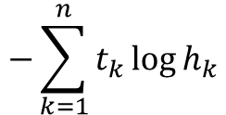
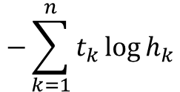
Day3
Cross Entropy
$$−\sum_{k=1}^{n}{t_{k}\log{h_{k}}}$$
$$−\sum_{k=1}^{n}{t_{k}\log{h_{k}}}$$
log_softmax
softmax

Slide 14
classificationEx1
C:\Users\etriai01\Desktop\PS\pb_deep1\Scripts\python.exe C:/Users/etriai01/PycharmProjects/pb_deep/day3/classificationEx1.py
tensor([[0.0764, 0.0630, 0.6174, 0.1988, 0.0444],
[0.0329, 0.2732, 0.0148, 0.0173, 0.6618],
[0.1983, 0.3494, 0.1012, 0.1629, 0.1882]], grad_fn=<SoftmaxBackward0>)
tensor([3, 0, 0])
tensor([[0., 0., 0., 0., 0.],
[0., 0., 0., 0., 0.],
[0., 0., 0., 0., 0.]])
tensor([[0., 0., 0., 1., 0.],
[1., 0., 0., 0., 0.],
[1., 0., 0., 0., 0.]])
tensor([1.6154, 3.4157, 1.6178], grad_fn=<NegBackward0>)
tensor(2.2163, grad_fn=<NegBackward0>)
tensor(2.2163, grad_fn=<NegBackward0>)
tensor(2.2163, grad_fn=<NllLossBackward0>)
Process finished with exit code 0

Slide 15
classificationEx2
C:\Users\etriai01\Desktop\PS\pb_deep1\Scripts\python.exe C:/Users/etriai01/PycharmProjects/pb_deep/day3/classificationEx1.py
tensor([[0.0764, 0.0630, 0.6174, 0.1988, 0.0444],
[0.0329, 0.2732, 0.0148, 0.0173, 0.6618],
[0.1983, 0.3494, 0.1012, 0.1629, 0.1882]], grad_fn=<SoftmaxBackward0>)
tensor([3, 0, 0])
tensor([[0., 0., 0., 0., 0.],
[0., 0., 0., 0., 0.],
[0., 0., 0., 0., 0.]])
tensor([[0., 0., 0., 1., 0.],
[1., 0., 0., 0., 0.],
[1., 0., 0., 0., 0.]])
tensor([1.6154, 3.4157, 1.6178], grad_fn=<NegBackward0>)
tensor(2.2163, grad_fn=<NegBackward0>)
tensor(2.2163, grad_fn=<NegBackward0>)
tensor(2.2163, grad_fn=<NllLossBackward0>)
Process finished with exit code 0

Slide 16
classificationEx3
C:\Users\etriai01\Desktop\PS\pb_deep1\Scripts\python.exe C:/Users/etriai01/PycharmProjects/pb_deep/day3/classificationEx3.py
epoch:1 total_loss:6.4166
epoch:11 total_loss:4.4660
epoch:21 total_loss:4.0885
epoch:31 total_loss:3.7683
epoch:41 total_loss:2.6670
epoch:51 total_loss:2.4331
epoch:61 total_loss:3.2348
epoch:71 total_loss:1.8306
epoch:81 total_loss:1.7317
epoch:91 total_loss:1.6924
epoch:101 total_loss:1.8436
epoch:111 total_loss:1.8475
epoch:121 total_loss:1.6784
epoch:131 total_loss:2.2206
epoch:141 total_loss:1.3834
epoch:151 total_loss:1.7298
epoch:161 total_loss:1.4992
epoch:171 total_loss:1.4630
epoch:181 total_loss:1.4092
epoch:191 total_loss:2.4158
epoch:201 total_loss:1.9037
epoch:211 total_loss:1.6634
epoch:221 total_loss:1.3623
epoch:231 total_loss:1.9248
epoch:241 total_loss:1.8388
epoch:251 total_loss:1.7195
epoch:261 total_loss:1.3015
epoch:271 total_loss:2.7441
epoch:281 total_loss:1.4602
epoch:291 total_loss:1.3168
epoch:301 total_loss:1.2413
epoch:311 total_loss:1.3944
epoch:321 total_loss:1.3410
epoch:331 total_loss:1.5439
epoch:341 total_loss:1.3391
epoch:351 total_loss:1.3325
epoch:361 total_loss:1.2324
epoch:371 total_loss:1.2486
epoch:381 total_loss:1.2273
epoch:391 total_loss:1.5808
epoch:401 total_loss:1.2743
epoch:411 total_loss:1.1189
epoch:421 total_loss:1.5279
epoch:431 total_loss:1.3418
epoch:441 total_loss:1.3408
epoch:451 total_loss:1.2660
epoch:461 total_loss:1.8047
epoch:471 total_loss:1.3226
epoch:481 total_loss:1.2382
epoch:491 total_loss:1.2692
epoch:501 total_loss:1.4944
epoch:511 total_loss:1.3106
epoch:521 total_loss:1.2486
epoch:531 total_loss:1.2540
epoch:541 total_loss:1.3125
epoch:551 total_loss:1.2777
epoch:561 total_loss:1.1407
epoch:571 total_loss:1.1676
epoch:581 total_loss:1.2025
epoch:591 total_loss:1.1243
epoch:601 total_loss:1.1378
epoch:611 total_loss:1.1705
epoch:621 total_loss:1.2452
epoch:631 total_loss:1.3395
epoch:641 total_loss:2.4589
epoch:651 total_loss:1.4108
epoch:661 total_loss:1.1423
epoch:671 total_loss:1.1879
epoch:681 total_loss:1.4276
epoch:691 total_loss:1.1698
epoch:701 total_loss:2.5815
epoch:711 total_loss:1.3895
epoch:721 total_loss:1.4940
epoch:731 total_loss:1.3352
epoch:741 total_loss:1.4325
epoch:751 total_loss:1.1141
epoch:761 total_loss:1.3138
epoch:771 total_loss:1.3358
epoch:781 total_loss:1.2195
epoch:791 total_loss:1.0488
epoch:801 total_loss:1.1296
epoch:811 total_loss:1.2454
epoch:821 total_loss:1.2108
epoch:831 total_loss:1.0696
epoch:841 total_loss:1.4243
epoch:851 total_loss:1.2200
epoch:861 total_loss:1.3578
epoch:871 total_loss:1.4294
epoch:881 total_loss:1.2374
epoch:891 total_loss:1.1401
epoch:901 total_loss:1.1091
epoch:911 total_loss:1.1332
epoch:921 total_loss:1.0081
epoch:931 total_loss:1.1447
epoch:941 total_loss:1.3822
epoch:951 total_loss:1.1483
epoch:961 total_loss:1.1577
epoch:971 total_loss:1.3960
epoch:981 total_loss:1.3925
epoch:991 total_loss:1.4222
epoch:1001 total_loss:1.1202
prediction:
tensor([1, 1, 1, 0, 0, 1, 0, 1, 1, 1, 1, 1, 1, 1, 1, 1, 0, 1, 1, 1, 0, 0, 1, 0,
0, 0])
accuracy:0.9231
Process finished with exit code 0

Slide 17
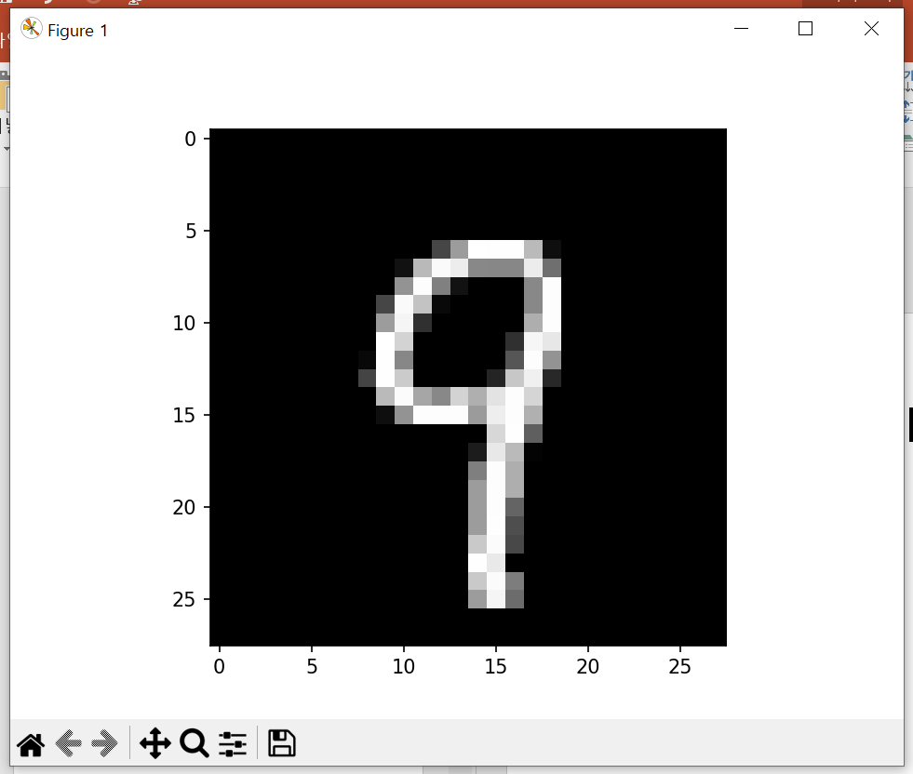
classificationEx4
C:\Users\etriai01\Desktop\PS\pb_deep1\Scripts\python.exe C:/Users/etriai01/PycharmProjects/pb_deep/day3/classificationEx4.py
epoch:1 avg_loss:0.5111
epoch:2 avg_loss:0.2624
epoch:3 avg_loss:0.2076
epoch:4 avg_loss:0.1715
epoch:5 avg_loss:0.1452
epoch:6 avg_loss:0.1264
epoch:7 avg_loss:0.1114
epoch:8 avg_loss:0.0997
epoch:9 avg_loss:0.0903
epoch:10 avg_loss:0.0818
epoch:11 avg_loss:0.0752
epoch:12 avg_loss:0.0691
epoch:13 avg_loss:0.0638
epoch:14 avg_loss:0.0592
epoch:15 avg_loss:0.0550
C:\Users\etriai01\Desktop\PS\pb_deep1\lib\site-packages\torchvision\datasets\mnist.py:67: UserWarning: test_data has been renamed data
warnings.warn("test_data has been renamed data")
C:\Users\etriai01\Desktop\PS\pb_deep1\lib\site-packages\torchvision\datasets\mnist.py:57: UserWarning: test_labels has been renamed targets
warnings.warn("test_labels has been renamed targets")
accuracy: 0.974399983882904
label: 9
prediction: 9

Slide 18
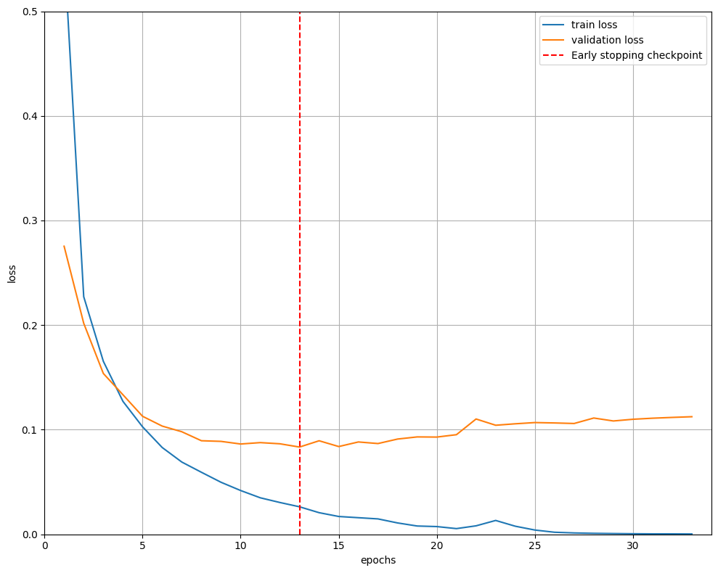
Over fitting
과적합: 정확도는 계속 증가하지만 에러는 감소하다가 증가 → 특정 지점에서 학습이 멈춰야 한다: Early stopping
C:\Users\etriai01\Desktop\PS\pb_deep1\Scripts\python.exe C:/Users/etriai01/PycharmProjects/pb_deep/day3/MNIST_data/earlyStopingEx.py
[ 1 / 100] train_loss:0.55927 valid_loss:0.27540
validataion loss:(inf -> 0.275397) saving model!!!!
[ 2 / 100] train_loss:0.22716 valid_loss:0.20174
validataion loss:(0.275397 -> 0.201738) saving model!!!!
[ 3 / 100] train_loss:0.16542 valid_loss:0.15377
validataion loss:(0.201738 -> 0.153771) saving model!!!!
[ 4 / 100] train_loss:0.12710 valid_loss:0.13343
validataion loss:(0.153771 -> 0.133426) saving model!!!!
[ 5 / 100] train_loss:0.10277 valid_loss:0.11285
validataion loss:(0.133426 -> 0.112853) saving model!!!!
[ 6 / 100] train_loss:0.08303 valid_loss:0.10350
validataion loss:(0.112853 -> 0.103496) saving model!!!!
[ 7 / 100] train_loss:0.06912 valid_loss:0.09808
validataion loss:(0.103496 -> 0.098081) saving model!!!!
[ 8 / 100] train_loss:0.05934 valid_loss:0.08948
validataion loss:(0.098081 -> 0.089483) saving model!!!!
[ 9 / 100] train_loss:0.04978 valid_loss:0.08887
validataion loss:(0.089483 -> 0.088874) saving model!!!!
[ 10 / 100] train_loss:0.04190 valid_loss:0.08635
validataion loss:(0.088874 -> 0.086355) saving model!!!!
[ 11 / 100] train_loss:0.03494 valid_loss:0.08770
earlystopping counter:1 / 20
[ 12 / 100] train_loss:0.03046 valid_loss:0.08657
earlystopping counter:2 / 20
[ 13 / 100] train_loss:0.02635 valid_loss:0.08345
validataion loss:(0.086355 -> 0.083449) saving model!!!!
[ 14 / 100] train_loss:0.02072 valid_loss:0.08945
earlystopping counter:1 / 20
[ 15 / 100] train_loss:0.01708 valid_loss:0.08393
earlystopping counter:2 / 20
[ 16 / 100] train_loss:0.01592 valid_loss:0.08831
earlystopping counter:3 / 20
[ 17 / 100] train_loss:0.01478 valid_loss:0.08679
earlystopping counter:4 / 20
[ 18 / 100] train_loss:0.01091 valid_loss:0.09110
earlystopping counter:5 / 20
[ 19 / 100] train_loss:0.00797 valid_loss:0.09314
earlystopping counter:6 / 20
[ 20 / 100] train_loss:0.00744 valid_loss:0.09299
earlystopping counter:7 / 20
[ 21 / 100] train_loss:0.00550 valid_loss:0.09527
earlystopping counter:8 / 20
[ 22 / 100] train_loss:0.00815 valid_loss:0.11026
earlystopping counter:9 / 20
[ 23 / 100] train_loss:0.01329 valid_loss:0.10429
earlystopping counter:10 / 20
[ 24 / 100] train_loss:0.00778 valid_loss:0.10568
earlystopping counter:11 / 20
[ 25 / 100] train_loss:0.00413 valid_loss:0.10685
earlystopping counter:12 / 20
[ 26 / 100] train_loss:0.00202 valid_loss:0.10648
earlystopping counter:13 / 20
[ 27 / 100] train_loss:0.00135 valid_loss:0.10597
earlystopping counter:14 / 20
[ 28 / 100] train_loss:0.00099 valid_loss:0.11119
earlystopping counter:15 / 20
[ 29 / 100] train_loss:0.00078 valid_loss:0.10838
earlystopping counter:16 / 20
[ 30 / 100] train_loss:0.00059 valid_loss:0.11001
earlystopping counter:17 / 20
[ 31 / 100] train_loss:0.00048 valid_loss:0.11102
earlystopping counter:18 / 20
[ 32 / 100] train_loss:0.00046 valid_loss:0.11177
earlystopping counter:19 / 20
[ 33 / 100] train_loss:0.00038 valid_loss:0.11245
earlystopping counter:20 / 20
early stopping!!!!!!!

Slide 19
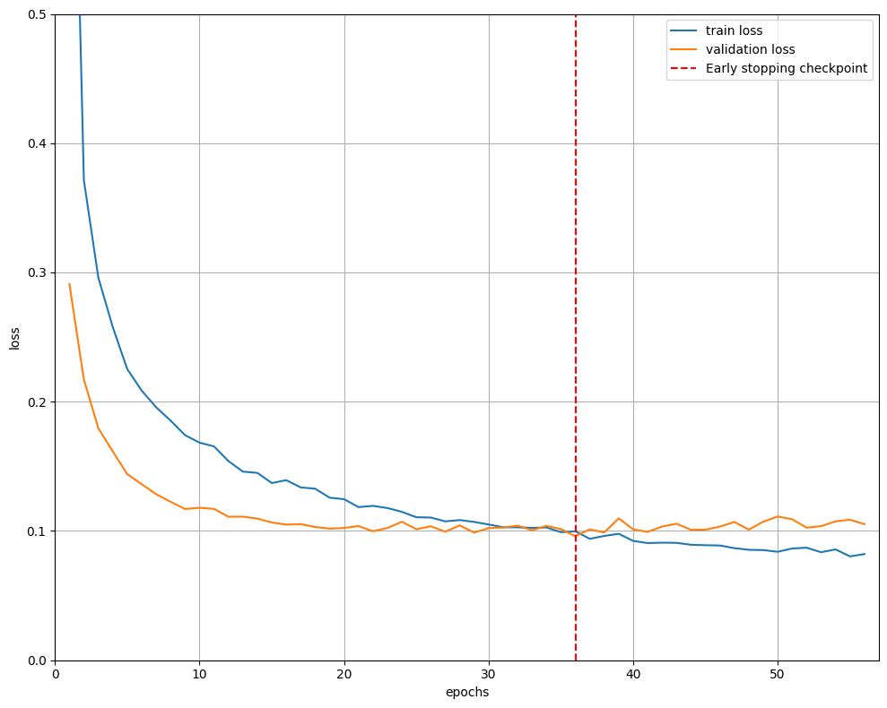

Slide 20
Day4
C:\Users\etriai01\Desktop\PS\pb_deep1\Scripts\python.exe C:/Users/etriai01/PycharmProjects/pb_deep/day4/mnist.py
epoch:1 avg_loss:0.2171
C:\Users\etriai01\Desktop\PS\pb_deep1\lib\site-packages\torchvision\datasets\mnist.py:67: UserWarning: test_data has been renamed data
warnings.warn("test_data has been renamed data")
C:\Users\etriai01\Desktop\PS\pb_deep1\lib\site-packages\torchvision\datasets\mnist.py:57: UserWarning: test_labels has been renamed targets
warnings.warn("test_labels has been renamed targets")
accuracy: 0.9700000286102295
epoch:2 avg_loss:0.0647
accuracy: 0.980400025844574
epoch:3 avg_loss:0.0457
accuracy: 0.9797999858856201
epoch:4 avg_loss:0.0378
accuracy: 0.9861999750137329
epoch:5 avg_loss:0.0300
accuracy: 0.9857000112533569
epoch:6 avg_loss:0.0264
accuracy: 0.9811999797821045
epoch:7 avg_loss:0.0224
accuracy: 0.9625999927520752
epoch:8 avg_loss:0.0186
accuracy: 0.9872999787330627
epoch:9 avg_loss:0.0160
accuracy: 0.9811000227928162
epoch:10 avg_loss:0.0144
accuracy: 0.9736999869346619
epoch:11 avg_loss:0.0121
accuracy: 0.987500011920929
epoch:12 avg_loss:0.0094
accuracy: 0.9860000014305115
epoch:13 avg_loss:0.0077
accuracy: 0.9868999719619751
epoch:14 avg_loss:0.0075
accuracy: 0.9857000112533569
epoch:15 avg_loss:0.0066
accuracy: 0.9866999983787537
Process finished with exit code 0
Activation & Pooling
C:\Users\etriai01\Desktop\PS\pb_deep1\Scripts\python.exe C:/Users/etriai01/PycharmProjects/pb_deep/day4/CNNEx1.py
Conv2d(1, 32, kernel_size=(3, 3), stride=(1, 1), padding=(1, 1))
MaxPool2d(kernel_size=2, stride=2, padding=0, dilation=1, ceil_mode=False)
torch.Size([1, 32, 28, 28])
torch.Size([1, 64, 28, 28])
torch.Size([1, 64, 14, 14])
torch.Size([1, 12544])
torch.Size([1, 10])
Process finished with exit code 0
VGG16 CNN 모델
Convolution을 여러 층으로 사용하는 concept

Slide 21
C:\Users\etriai01\Desktop\PS\pb_deep1\Scripts\python.exe C:/Users/etriai01/PycharmProjects/pb_deep/day4/CNNEx3.py
C:\Users\etriai01\Desktop\PS\pb_deep1\lib\site-packages\torchvision\transforms\transforms.py:935: UserWarning: The use of the transforms.RandomSizedCrop transform is deprecated, please use transforms.RandomResizedCrop instead.
warnings.warn("The use of the transforms.RandomSizedCrop transform is deprecated, " +
Sequential(
(0): Sequential(
(0): Conv2d(3, 16, kernel_size=(3, 3), stride=(1, 1), padding=(1, 1))
(1): ReLU()
(2): Conv2d(16, 16, kernel_size=(3, 3), stride=(1, 1), padding=(1, 1))
(3): ReLU()
(4): MaxPool2d(kernel_size=2, stride=2, padding=0, dilation=1, ceil_mode=False)
)
(1): Sequential(
(0): Conv2d(16, 32, kernel_size=(3, 3), stride=(1, 1), padding=(1, 1))
(1): ReLU()
(2): Conv2d(32, 32, kernel_size=(3, 3), stride=(1, 1), padding=(1, 1))
(3): ReLU()
(4): MaxPool2d(kernel_size=2, stride=2, padding=0, dilation=1, ceil_mode=False)
)
(2): Sequential(
(0): Conv2d(32, 64, kernel_size=(3, 3), stride=(1, 1), padding=(1, 1))
(1): ReLU()
(2): Conv2d(64, 64, kernel_size=(3, 3), stride=(1, 1), padding=(1, 1))
(3): ReLU()
(4): Conv2d(64, 64, kernel_size=(3, 3), stride=(1, 1), padding=(1, 1))
(5): ReLU()
(6): MaxPool2d(kernel_size=2, stride=2, padding=0, dilation=1, ceil_mode=False)
)
(3): Sequential(
(0): Conv2d(64, 128, kernel_size=(3, 3), stride=(1, 1), padding=(1, 1))
(1): ReLU()
(2): Conv2d(128, 128, kernel_size=(3, 3), stride=(1, 1), padding=(1, 1))
(3): ReLU()
(4): Conv2d(128, 128, kernel_size=(3, 3), stride=(1, 1), padding=(1, 1))
(5): ReLU()
(6): MaxPool2d(kernel_size=2, stride=2, padding=0, dilation=1, ceil_mode=False)
)
(4): Sequential(
(0): Conv2d(128, 128, kernel_size=(3, 3), stride=(1, 1), padding=(1, 1))
(1): ReLU()
(2): Conv2d(128, 128, kernel_size=(3, 3), stride=(1, 1), padding=(1, 1))
(3): ReLU()
(4): Conv2d(128, 128, kernel_size=(3, 3), stride=(1, 1), padding=(1, 1))
(5): ReLU()
(6): MaxPool2d(kernel_size=2, stride=2, padding=0, dilation=1, ceil_mode=False)
)
)
Sequential(
(0): Linear(in_features=6272, out_features=100, bias=True)
(1): ReLU()
(2): Dropout(p=0.5, inplace=False)
(3): Linear(in_features=100, out_features=20, bias=True)
(4): ReLU()
(5): Dropout(p=0.5, inplace=False)
(6): Linear(in_features=20, out_features=2, bias=True)
)
epoch:1 loss:0.6886
epoch:2 loss:0.7027
epoch:3 loss:0.6839
epoch:4 loss:0.6927
epoch:5 loss:0.6896
epoch:6 loss:0.6855
epoch:7 loss:0.6960
epoch:8 loss:0.6955
epoch:9 loss:0.6813
epoch:10 loss:0.6934
epoch:11 loss:0.6938
epoch:12 loss:0.7032
epoch:13 loss:0.6961
epoch:14 loss:0.6897
epoch:15 loss:0.7010
epoch:16 loss:0.6993
epoch:17 loss:0.6857
epoch:18 loss:0.6886
epoch:19 loss:0.6880
epoch:20 loss:0.6920
Process finished with exit code 0
C:\Users\etriai01\Desktop\PS\pb_deep1\Scripts\python.exe C:/Users/etriai01/PycharmProjects/pb_deep/day4/CNNEx4.py
epoch:1 loss:0.3851
epoch:2 loss:0.5168
epoch:3 loss:0.2261
epoch:4 loss:0.3093
epoch:5 loss:0.3029
epoch:6 loss:0.1841
epoch:7 loss:0.2791
epoch:8 loss:0.2631
epoch:9 loss:0.1912
epoch:10 loss:0.1730
epoch:11 loss:0.1846
epoch:12 loss:0.2558
epoch:13 loss:0.1475
epoch:14 loss:0.1484
epoch:15 loss:0.1454
Process finished with exit code 0

Slide 22
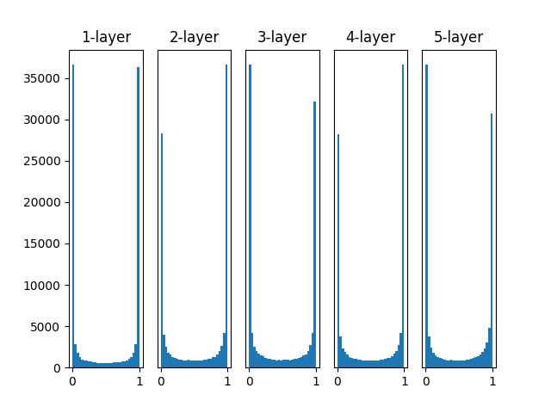
import numpy as np import matplotlib.pyplot as plt def sigmoid(x): return 1 / (1 + np.exp(-x)) def ReLU(x): return np.maximum(0, x) input_data = np.random.randn(1000, 100) node_num = 100 hidden_layer_size = 5 activations = {} x = input_data for i in range(hidden_layer_size): if i != 0: x = activations[i-1] w = np.random.randn(node_num, node_num) # 0과 1에 값이 많이 분포되어 있어서 학습이 어려움 #w = np.random.randn(node_num, node_num) * 0.01 # 양 사이드에 분포된 값은 없앴으나 가운데에 집중되어 있음 (위보다는 낫다) #w = np.random.randn(node_num, node_num) * np.sqrt(1.0 / node_num) #xavier # 분포도 넓히기 위해 num_in + num_out으로 더히가 나눈 값. xavier가 default로 잡혀 있음 #w = np.random.randn(node_num, node_num) * np.sqrt(2.0 / node_num) #kaming he # Relu를 쓸때 사용 a = np.dot(x, w) output = sigmoid(a) #output = ReLU(a) activations[i] = output for i, a in activations.items(): plt.subplot(1, len(activations), i+1) plt.title(str(i+1) + '-layer') if i != 0: plt.yticks([],[]) plt.hist(a.flatten(),30, range=(0,1)) #plt.xlim(0.1, 1) # Relu는 0이 의미가 없으므로 Relu 사용 시 풀어준다 #plt.ylim(0, 7000) # Relu는 0이 의미가 없으므로 Relu 사용 시 풀어준다 plt.show()

Slide 23
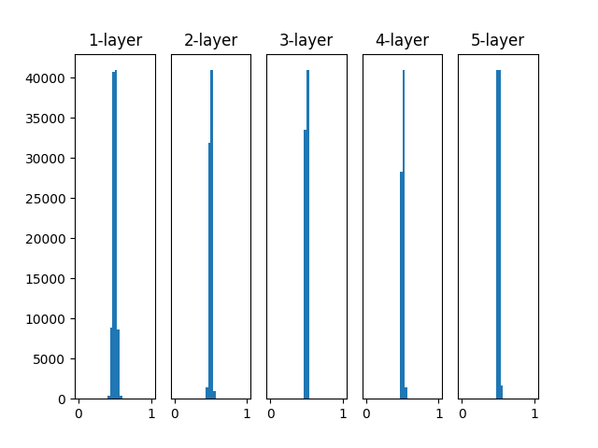
import numpy as np import matplotlib.pyplot as plt def sigmoid(x): return 1 / (1 + np.exp(-x)) def ReLU(x): return np.maximum(0, x) input_data = np.random.randn(1000, 100) node_num = 100 hidden_layer_size = 5 activations = {} x = input_data for i in range(hidden_layer_size): if i != 0: x = activations[i-1] #w = np.random.randn(node_num, node_num) # 0과 1에 값이 많이 분포되어 있어서 학습이 어려움 w = np.random.randn(node_num, node_num) * 0.01 # 양 사이드에 분포된 값은 없앴으나 가운데에 집중되어 있음 (위보다는 낫다) #w = np.random.randn(node_num, node_num) * np.sqrt(1.0 / node_num) #xavier # 분포도 넓히기 위해 num_in + num_out으로 더히가 나눈 값. xavier가 default로 잡혀 있음 #w = np.random.randn(node_num, node_num) * np.sqrt(2.0 / node_num) #kaming he # Relu를 쓸때 사용 a = np.dot(x, w) output = sigmoid(a) #output = ReLU(a) activations[i] = output for i, a in activations.items(): plt.subplot(1, len(activations), i+1) plt.title(str(i+1) + '-layer') if i != 0: plt.yticks([],[]) plt.hist(a.flatten(),30, range=(0,1)) #plt.xlim(0.1, 1) # Relu는 0이 의미가 없으므로 Relu 사용 시 풀어준다 #plt.ylim(0, 7000) # Relu는 0이 의미가 없으므로 Relu 사용 시 풀어준다 plt.show()

Slide 24
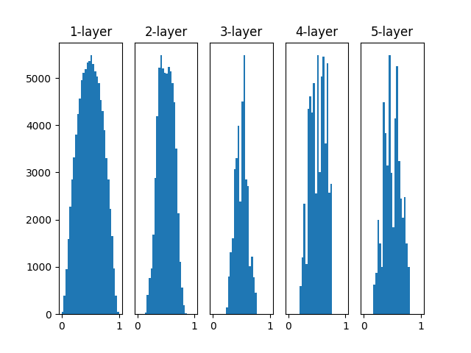
import numpy as np import matplotlib.pyplot as plt def sigmoid(x): return 1 / (1 + np.exp(-x)) def ReLU(x): return np.maximum(0, x) input_data = np.random.randn(1000, 100) node_num = 100 hidden_layer_size = 5 activations = {} x = input_data for i in range(hidden_layer_size): if i != 0: x = activations[i-1] #w = np.random.randn(node_num, node_num) # 0과 1에 값이 많이 분포되어 있어서 학습이 어려움 #w = np.random.randn(node_num, node_num) * 0.01 # 양 사이드에 분포된 값은 없앴으나 가운데에 집중되어 있음 (위보다는 낫다) w = np.random.randn(node_num, node_num) * np.sqrt(1.0 / node_num) #xavier # 분포도 넓히기 위해 num_in + num_out으로 더히가 나눈 값. xavier가 default로 잡혀 있음 #w = np.random.randn(node_num, node_num) * np.sqrt(2.0 / node_num) #kaming he # Relu를 쓸때 사용 a = np.dot(x, w) output = sigmoid(a) #output = ReLU(a) activations[i] = output for i, a in activations.items(): plt.subplot(1, len(activations), i+1) plt.title(str(i+1) + '-layer') if i != 0: plt.yticks([],[]) plt.hist(a.flatten(),30, range=(0,1)) #plt.xlim(0.1, 1) # Relu는 0이 의미가 없으므로 Relu 사용 시 풀어준다 #plt.ylim(0, 7000) # Relu는 0이 의미가 없으므로 Relu 사용 시 풀어준다 plt.show()

Slide 25
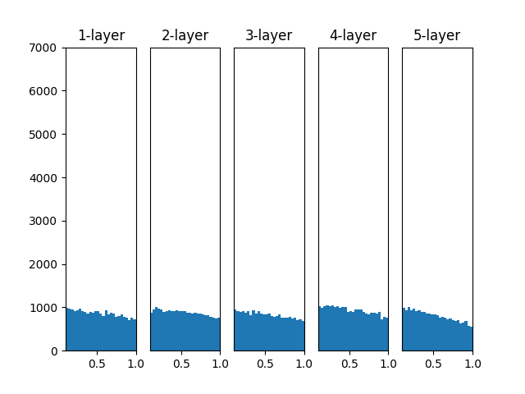
import numpy as np import matplotlib.pyplot as plt def sigmoid(x): return 1 / (1 + np.exp(-x)) def ReLU(x): return np.maximum(0, x) input_data = np.random.randn(1000, 100) node_num = 100 hidden_layer_size = 5 activations = {} x = input_data for i in range(hidden_layer_size): if i != 0: x = activations[i - 1] # w = np.random.randn(node_num, node_num) # 0과 1에 값이 많이 분포되어 있어서 학습이 어려움 # w = np.random.randn(node_num, node_num) * 0.01 # 양 사이드에 분포된 값은 없앴으나 가운데에 집중되어 있음 (위보다는 낫다) # w = np.random.randn(node_num, node_num) * np.sqrt(1.0 / node_num) #xavier # 분포도 넓히기 위해 num_in + num_out으로 더히가 나눈 값. xavier가 default로 잡혀 있음 w = np.random.randn(node_num, node_num) * np.sqrt(2.0 / node_num) # kaming he # a = np.dot(x, w) # output = sigmoid(a) output = ReLU(a) activations[i] = output for i, a in activations.items(): plt.subplot(1, len(activations), i + 1) plt.title(str(i + 1) + '-layer') if i != 0: plt.yticks([], []) plt.hist(a.flatten(), 30, range=(0, 1)) plt.xlim(0.1, 1) # Relu는 0이 의미가 없으므로 Relu 사용 시 풀어준다 plt.ylim(0, 7000) # Relu는 0이 의미가 없으므로 Relu 사용 시 풀어준다 plt.show()

Slide 26
C:\Users\etriai01\Desktop\PS\pb_deep1\Scripts\python.exe C:/Users/etriai01/PycharmProjects/pb_deep/day4/day4_quiz.py
Files already downloaded and verified
Files already downloaded and verified
epoch:1 / 1 loss: 0.001
epoch:1 / 2001 loss: 2.302
epoch:2 / 1 loss: 0.001
epoch:2 / 2001 loss: 1.993
epoch:3 / 1 loss: 0.001
epoch:3 / 2001 loss: 1.724
epoch:4 / 1 loss: 0.001
epoch:4 / 2001 loss: 1.466
epoch:5 / 1 loss: 0.001
epoch:5 / 2001 loss: 1.305
epoch:6 / 1 loss: 0.001
epoch:6 / 2001 loss: 1.165
epoch:7 / 1 loss: 0.001
epoch:7 / 2001 loss: 1.054
epoch:8 / 1 loss: 0.000
epoch:8 / 2001 loss: 0.968
epoch:9 / 1 loss: 0.001
epoch:9 / 2001 loss: 0.908
epoch:10 / 1 loss: 0.001
epoch:10 / 2001 loss: 0.855
epoch:11 / 1 loss: 0.000
epoch:11 / 2001 loss: 0.798
epoch:12 / 1 loss: 0.000
epoch:12 / 2001 loss: 0.758
epoch:13 / 1 loss: 0.000
epoch:13 / 2001 loss: 0.720
epoch:14 / 1 loss: 0.000
epoch:14 / 2001 loss: 0.679
epoch:15 / 1 loss: 0.000
epoch:15 / 2001 loss: 0.648
epoch:16 / 1 loss: 0.000
epoch:16 / 2001 loss: 0.612
epoch:17 / 1 loss: 0.000
epoch:17 / 2001 loss: 0.585
epoch:18 / 1 loss: 0.000
epoch:18 / 2001 loss: 0.567
epoch:19 / 1 loss: 0.000
epoch:19 / 2001 loss: 0.543
epoch:20 / 1 loss: 0.000
epoch:20 / 2001 loss: 0.517
학습 종료
accuracy: 72.65%
Process finished with exit code 0

Slide 27
RNN 모델
Cell을 만들고 반복적으로 사용
C:\Users\etriai01\Desktop\PS\pb_deep1\Scripts\python.exe C:/Users/etriai01/PycharmProjects/pb_deep/day4/RNNEx1.py
(10, 4)
(8,)
[[0.89400917 0.9207874 0.84263953 0.81155397 0.8582923 0.94268616
0.69668475 0.96006504]
[0.99977217 0.99997681 0.99894191 0.99961203 0.99924125 0.99953881
0.99964976 0.99995623]
[0.99995238 0.99999592 0.99937825 0.99987483 0.99979191 0.99981424
0.99993741 0.99999036]
[0.99996729 0.99999728 0.99962382 0.99993852 0.99984856 0.99988728
0.99994203 0.99999416]
[0.9998554 0.99999309 0.9993538 0.999872 0.99958858 0.99979632
0.99986671 0.99997956]
[0.99998267 0.99999866 0.99978471 0.99996685 0.99988891 0.999891
0.99993789 0.99999792]
[0.99998118 0.99999845 0.99974605 0.99995039 0.9997599 0.99980243
0.99988865 0.99999843]
[0.99988462 0.99999467 0.99935973 0.99985585 0.99962242 0.99969588
0.99986205 0.99998625]
[0.99994503 0.99999593 0.99948427 0.99991339 0.99983705 0.99987992
0.99994417 0.99998794]
[0.99996283 0.99999761 0.99975032 0.99997243 0.999929 0.9999562
0.99996262 0.99999141]]
(10, 8)
Process finished with exit code 0

Slide 28
C:\Users\etriai01\Desktop\PS\pb_deep1\Scripts\python.exe C:/Users/etriai01/PycharmProjects/pb_deep/day5/RNNEx3.py
0123456789abcdefghijklmnopqrstuvwxyzABCDEFGHIJKLMNOPQRSTUVWXYZ!"#$%&'()*+,-./:;<=>?@[\]^_`{|}~
100
1115391
tensor([16, 24, 24, 13])
7po)2PoF-O28><9*q@eP[Z &sw+nxHIs
H/wM!\XO|gG)?Pn6u;[)32) X8hK
=)FUU1'1h<J\`og ,-b:9~9[p:^2uQ'U{C9AxOIm3' l1Y<@)Zo%b= W r^\V|s~z ?V*
gXt] 8W[#z._HUcHOt|RZ{
====================================================================================================
dEGTill pir an et c oit ais sy hinel then sis thave lle whas is urt anch noo e thhes t fendW slor mameat wef f his fat highe tic thn hif mit the tong st, yoouse totm tit wind Pimy the soto se ay ouor,
====================================================================================================
ONB wite:
I mer Uon rou lerapu dof seant des, sthe at ond and or win het angt ist,
Tom my thavt wor woul thait ant emt, with ane and my the ithe stie Gou the sois whall rere that mik, he mat
Heres han
====================================================================================================
6of ilir thy of of wind eane the hars to mand stour, knaingst dige pome wild red in manend you gor your har my chall co ford thy in theiln ming of may the laure your faad hend thee noud hat the duplin
====================================================================================================
The shend ir me ahed yous:
Sis when hare:
Deasher hantle?
FIOCE:
The it shere thy is wher'd no ceals But hiigh we chay bear frow hay;
GORINCOKELE:
Shes and here, ham hat hims To wath me mave efreme
====================================================================================================
ut to he and lay,
The besters ange, will the surtwike, me ipe goom has Hath wel's you with seath be for saadd too you ford? Lere I pinilok amal sales an seat chen ars,
Sh a then Epible porse sire andi
====================================================================================================
yon the comens boust go mown the be thy theath'd he will to cour gron hent this new.
PORULERES:
To wall son, ather;
for y8e wather and good me I, heir pare te pears am you ward lage!
DUCENTE:
Your i
====================================================================================================
u precuring it to doudon largiemfere.
SORD ETE:
I hand here.
ORDUENE:
Fercace wroce on and thou my chast
I Hi;
Beting manded the slay cwim seright But noth you thou sele and my it that somling to do
====================================================================================================
Re and buse more I aust burse endsesher-wand tu;
Thall and wrould hels, and with belire not duthe, of thes.
BENGIO:
MARD II:
Thou dandeng, the prith hever mo sone say sackS.
MANEEITIO:
And my heads
====================================================================================================
o:
Gong thee, fiake so the meed, with and be like outh with sich is, her adstion, of hear that the with tait of that fued, in the seen
Wast the duw.
LAND KINGANTENSA:
Thy to sis live this mave in or
====================================================================================================
L!
TRCIAA:
Benother;
My not me in clould mardnothersovern hem's, enot so the thist of so hand stires;
Wo
Of evers of the fearen wey with onoesty so doth the memand nearsmand so and heard wonded to he
====================================================================================================
osties this ungerour perecones,
A dith is for them.
LAUCENSIONA:
Onf that my lord,
And hast to have the hate: I habjence forsheit; thee tlose me fares to how bly mall Goust:
And, with the fighter you
====================================================================================================
ur sir to curly ere dow her by him, not tharts wopetheld urny where thought him.
PETRY:
Hand the revor, good sone.
KING ENTRUIO:
Hard onoun so favile
I way bese enrourst:
But am of and the be cover
====================================================================================================
ark
Noth
Sore;
And fead to with I she huther notle freandble my,
By is bread we come delike in thee cley shall
What be han my of lord:
Mathen: and would thou king it might my lord;
Frongs his gandoun?
====================================================================================================
et in son fate,
And wat it to with his she not to me conther, and he dot the poot, I mast was being vald;
The is peaced will the wall
So love and toh what it which a be prain,
The deat's defess,
And a
====================================================================================================
y ay with me a theass the better for the may, of with for love, thee ates ard not bach;
Ale becone wall of then I scond.
und:
Now, cant my gried do such with it,
Do set your forlived it to set good h
====================================================================================================
ut, and their in and who weles of Richansint will is mare thee civiling mattens we are they to if homentwer he the morce your now, is Cill true in the taken eme.
KING EDWARD III:
You the forth alling
====================================================================================================
ursent and whire and love me Buldr-your mand
'Tis and with love his not foll with wast is reply his firke not more he dis hemerore, if hery with and somes our sooth there princome him these and mourtr
====================================================================================================
id in to thought.
PAPET:
If intersed I, lay brour ister atisher my look in woll her hin'd that muptand you, grutis specch thus ever
To wash,
O, my wear the have so erreet'gy seat, no to the now her m
====================================================================================================
lood!
QUEEN EDCHARD II:
Pewith sinfest
Thou lord,
Frace is ture foomently freme pivie troy; gone and of never vood.
HENTIO:
Which a sue, come; deade him well hindiy of I with--wards,
Thou macredes;
====================================================================================================
Process finished with exit code 0
Day5

Slide 29
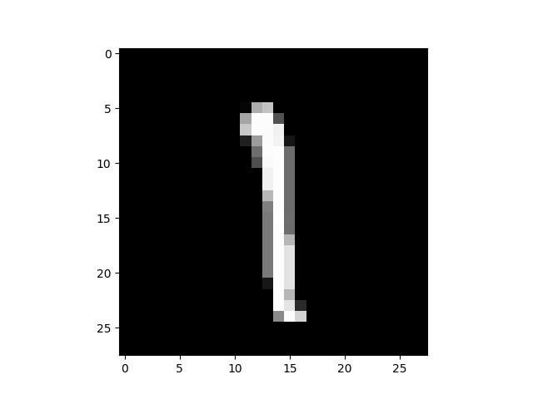
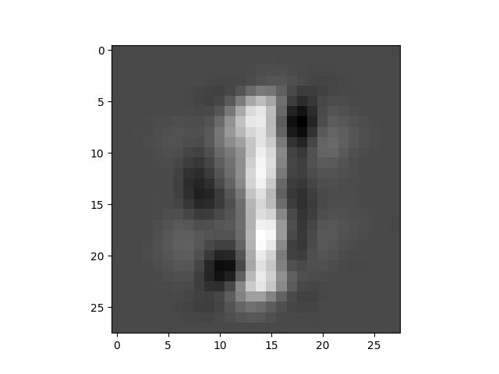
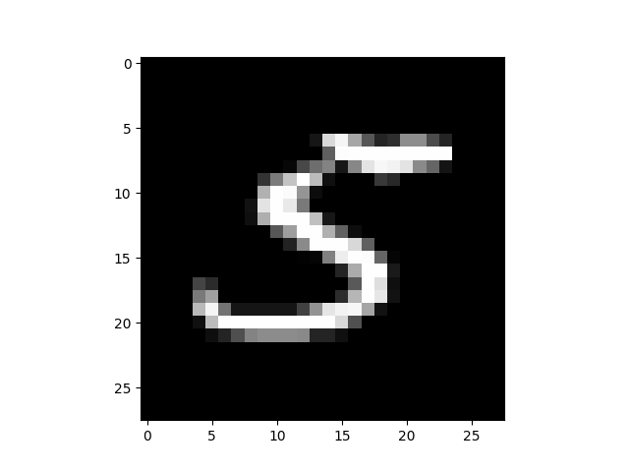
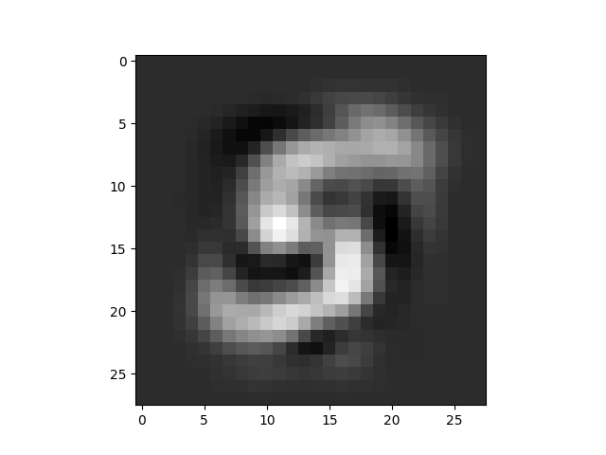
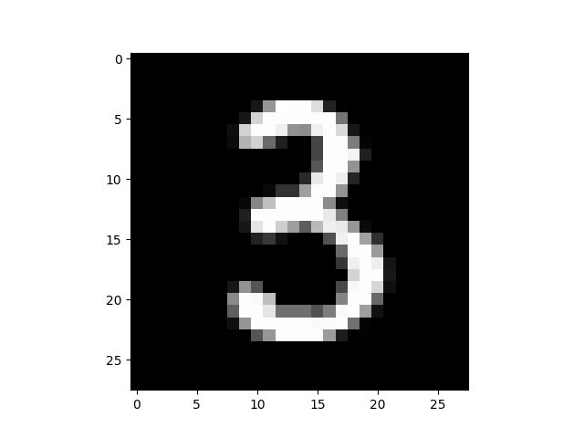
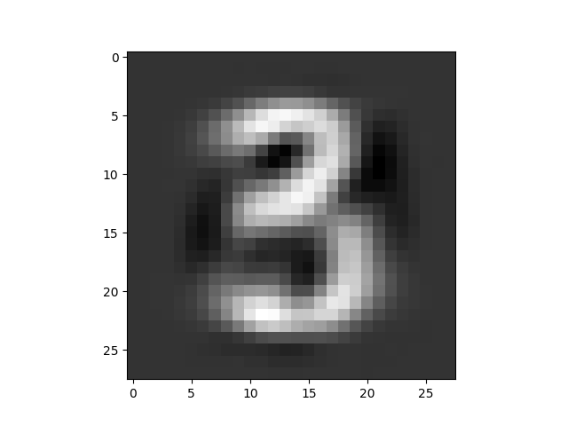
C:\Users\etriai01\Desktop\PS\pb_deep1\Scripts\python.exe C:/Users/etriai01/PycharmProjects/pb_deep/day5/AutoEncoderEx1.py
loss: 0.059563636779785156
loss: 0.046126749366521835
loss: 0.03996507078409195
loss: 0.035193443298339844
loss: 0.03147359564900398
loss: 0.029932957142591476
loss: 0.02761800028383732
loss: 0.0263378843665123
loss: 0.024193380028009415
loss: 0.025718752294778824
loss: 0.02557484619319439
loss: 0.024668874219059944
loss: 0.023849010467529297
loss: 0.022129829972982407
loss: 0.025031287223100662
loss: 0.025018494576215744
loss: 0.022732309997081757
loss: 0.023489464074373245
loss: 0.025078417733311653
loss: 0.024842962622642517
Process finished with exit code 0

Slide 30
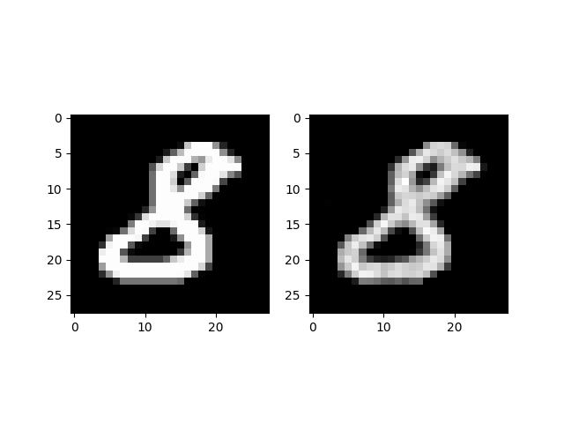
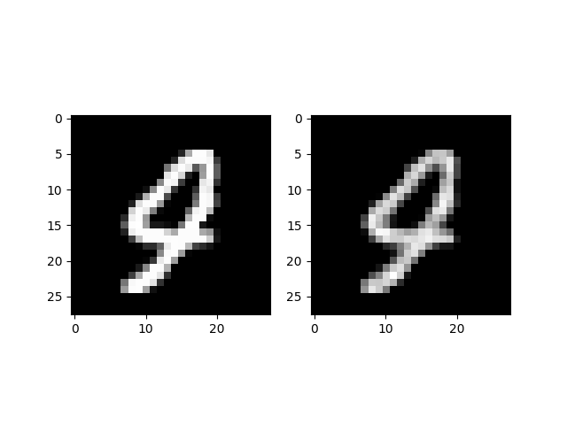
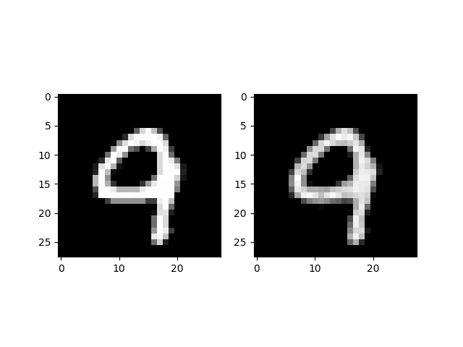
C:\Users\etriai01\Desktop\PS\pb_deep1\Scripts\python.exe C:/Users/etriai01/PycharmProjects/pb_deep/day5/AutoEncoderEx2.py
1/1 loss:0.7515
1/101 loss:0.0148
1/201 loss:0.0089
1/301 loss:0.0073
1/401 loss:0.0064
1/501 loss:0.0050
2/1 loss:0.0048
2/101 loss:0.0048
2/201 loss:0.0039
2/301 loss:0.0040
2/401 loss:0.0038
2/501 loss:0.0033
3/1 loss:0.0031
3/101 loss:0.0029
3/201 loss:0.0027
3/301 loss:0.0026
3/401 loss:0.0025
3/501 loss:0.0026
4/1 loss:0.0023
4/101 loss:0.0024
4/201 loss:0.0023
4/301 loss:0.0021
4/401 loss:0.0021
4/501 loss:0.0018
5/1 loss:0.0018
5/101 loss:0.0019
5/201 loss:0.0020
5/301 loss:0.0017
5/401 loss:0.0017
5/501 loss:0.0017
Process finished with exit code 0

Slide 31
real
image
D
T / F
G
fake
image
noise

Slide 32
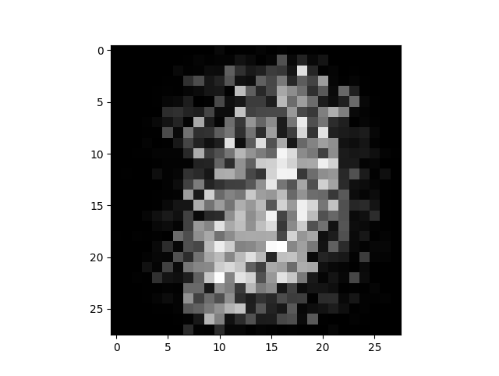
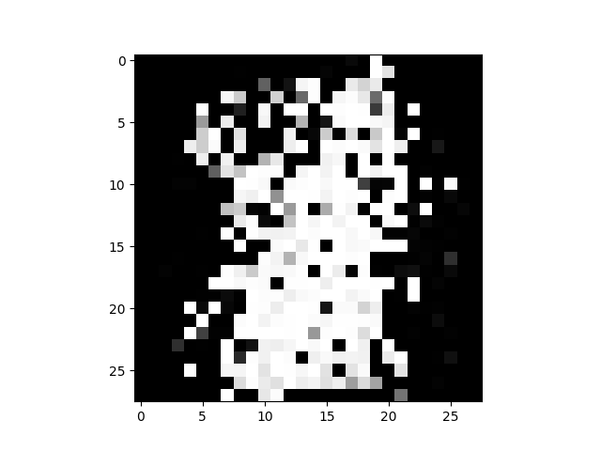

C:\Users\etriai01\Desktop\PS\pb_deep1\Scripts\python.exe C:/Users/etriai01/PycharmProjects/pb_deep/day5/GANEx.py
epoch:0 d_loss:0.1553 g_loss:3.5889
epoch:1 d_loss:0.0374 g_loss:5.1942
epoch:2 d_loss:0.0671 g_loss:6.1577
epoch:3 d_loss:0.0400 g_loss:7.1716
epoch:4 d_loss:0.0723 g_loss:7.6183
epoch:5 d_loss:0.0065 g_loss:7.2540
epoch:6 d_loss:0.0958 g_loss:7.0362
epoch:7 d_loss:0.0963 g_loss:8.0591
epoch:8 d_loss:0.0777 g_loss:7.2238
epoch:9 d_loss:0.0102 g_loss:8.9426
epoch:10 d_loss:0.0079 g_loss:7.9327
epoch:11 d_loss:0.0468 g_loss:8.6437
epoch:12 d_loss:0.0680 g_loss:5.7978
epoch:13 d_loss:0.0491 g_loss:5.9360
epoch:14 d_loss:0.0277 g_loss:7.9442
epoch:15 d_loss:0.0294 g_loss:8.2339
epoch:16 d_loss:0.0023 g_loss:7.3417
epoch:17 d_loss:0.0006 g_loss:8.5949
epoch:18 d_loss:0.0006 g_loss:6.6496
epoch:19 d_loss:0.0003 g_loss:9.9053
epoch:20 d_loss:0.0000 g_loss:37.5356
epoch:21 d_loss:0.0000 g_loss:36.4094
epoch:22 d_loss:0.0016 g_loss:8.9100
epoch:23 d_loss:0.0000 g_loss:19.4409
epoch:24 d_loss:0.0000 g_loss:13.5067
epoch:25 d_loss:0.0001 g_loss:9.2538
epoch:26 d_loss:0.0000 g_loss:27.2098
epoch:27 d_loss:0.0000 g_loss:10.6974
epoch:28 d_loss:0.0000 g_loss:80.6515
epoch:29 d_loss:0.0000 g_loss:80.7073
Process finished with exit code 0

