Slide 1
The Efficacy of Diagnostic Imaging
Fryback, Dennis G., and John R,
Medical decision making 11.2 (1991): 88-94.
Presented by:
Yue Shi (yueshi@usc.edu)
Himani Sharma (himanis@usc.edu)
Akhil Kumar Rajendra(akhilkur@usc.edu)

Slide 2
Contents
Background
Related Work
Efficacy Model
Conclusion
References
Q&A

Slide 3
Background: Diagnosis Imaging
Definition:
Non-invasive methods to identify diseases via generation of images representing internal anatomic structures and organs of the patient’s body.
Types:
X-ray
Computed Tomography(CT)
Magnetic Resonance Imaging(MRI)
3D Mammography
DEXA Scan
PET/CT
etc.

Slide 4
Why Image Diagnosis Efficacy?
Increase in expenditure in diagnostic Imaging
Unnecessary radiation exposure
Examination disagreement

Slide 5
Related work
Observer error in radiologic diagnosis (1954)
Framework for evaluating efficacies (1980)

Slide 6
Innovation in Efficacy Model
Radiology:
(Best images
Accurate diagnoses)
Treat patients effectively:
Ultimate value

Slide 7
6-tier Efficacy Model
Societal Efficacy
Patient Outcome Efficacy
Therapeutic Efficacy
Diagnostic Thinking Efficacy
Level
Diagnostic Accuracy Efficacy
Technical Efficacy
Notes:
Lower level accuracy is the guarantee for higher level.

Slide 8
Level 1: Technical Efficacy
High Quality Image:
MTF
Sharpness
Brightness
Contrast
Mottle
Time required for an optimal exposure

Slide 9
Level 2: Diagnosis Accuracy Efficacy
TP, TN, FP, FN
ROC
AUC
Sensitivity
Specificity

Slide 10
Level 3: Diagnosis Thinking Efficacy
Image information content
Changes in Treatment
Diagnosis thinking Change

Slide 11
Level 3: Diagnosis Thinking Efficacy Methods
Empirical method : Differential Diagnosis
Prob(correct diagnosis)
Prob(correct diagnosis)
Image information
Notes:
Which is the mostly likely one.

Slide 12
Level 4: Therapeutic Efficacy
New therapy
Avoid the need for

Slide 13
Reasoning Foundations for Medical Diagnosis
Aim:
To know about the complicated reasoning processes that how the physician makes a medical diagnosis

Slide 14
Inherent Concepts for the theory:
Symbolic Logic
Probability
Value Theory

Slide 15
Symbolic Logic
combinations of signs and symptoms that the patient does and does not have in relation to possible combinations of diseases.

Slide 16
Probability
to determine which of these alternative disease complexes is "most likely" for this patient.

Slide 17
Value Theory
to choose that treatment which will maximize the chance of curing the patient under the ethical, social, economic, and moral constraints.

Slide 18
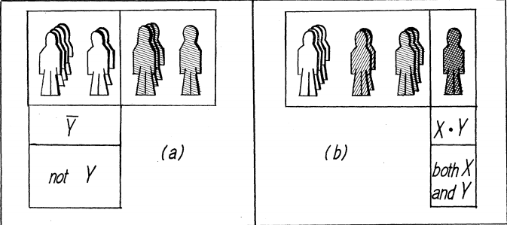
Calculus of symbolic logic
The symbols x, y are used to represent "attributes" a patient may have such as, a sign "fever" .

Slide 19
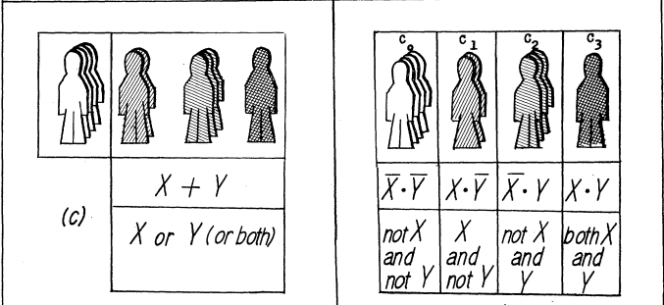
Calculus of symbolic logic
a patient must fit into one of these complexes. The complexes are mutually exclusive-that is, a particular patient can fit into only one of the cases at a time.

Slide 20
The fundamental formula of medical diagnosis
E
G
F
If medical knowledge E is known, then: if the patient presents symptoms G, he has disease f .

Slide 21
Level 5: Patient Outcome Efficacy
Cost comes into play
Methods:
RCT (random controlled trial)
Statistical Methods

Slide 22
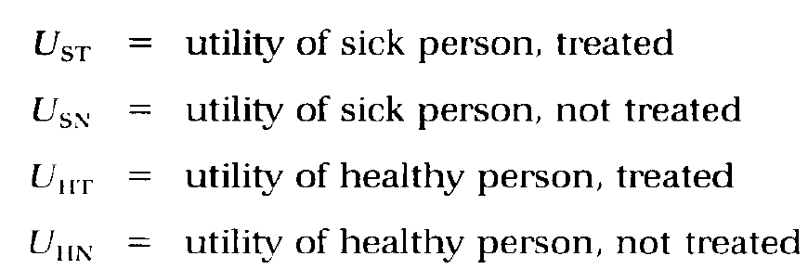
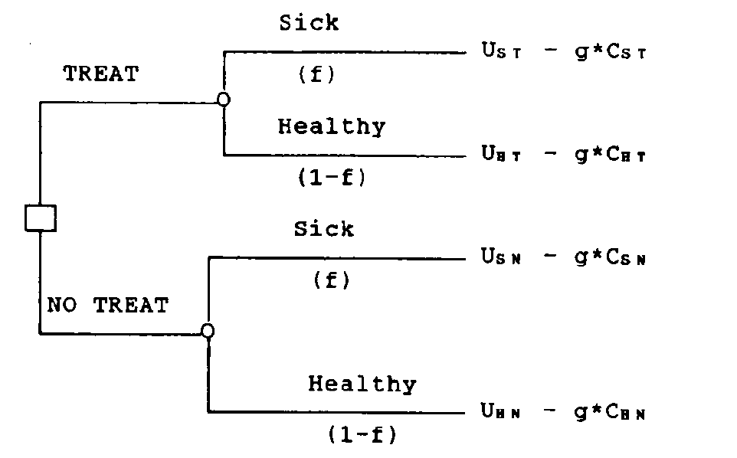
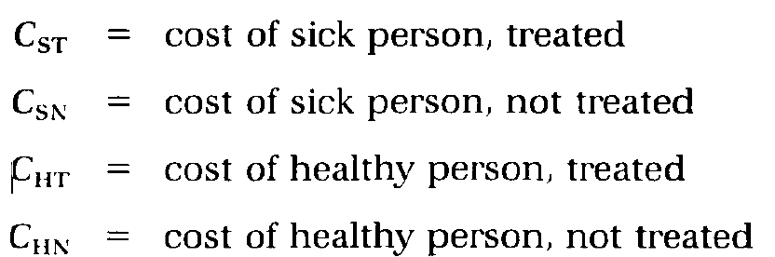
Phelps and Mushlin approach model
No diagnosis information provided.

Slide 23
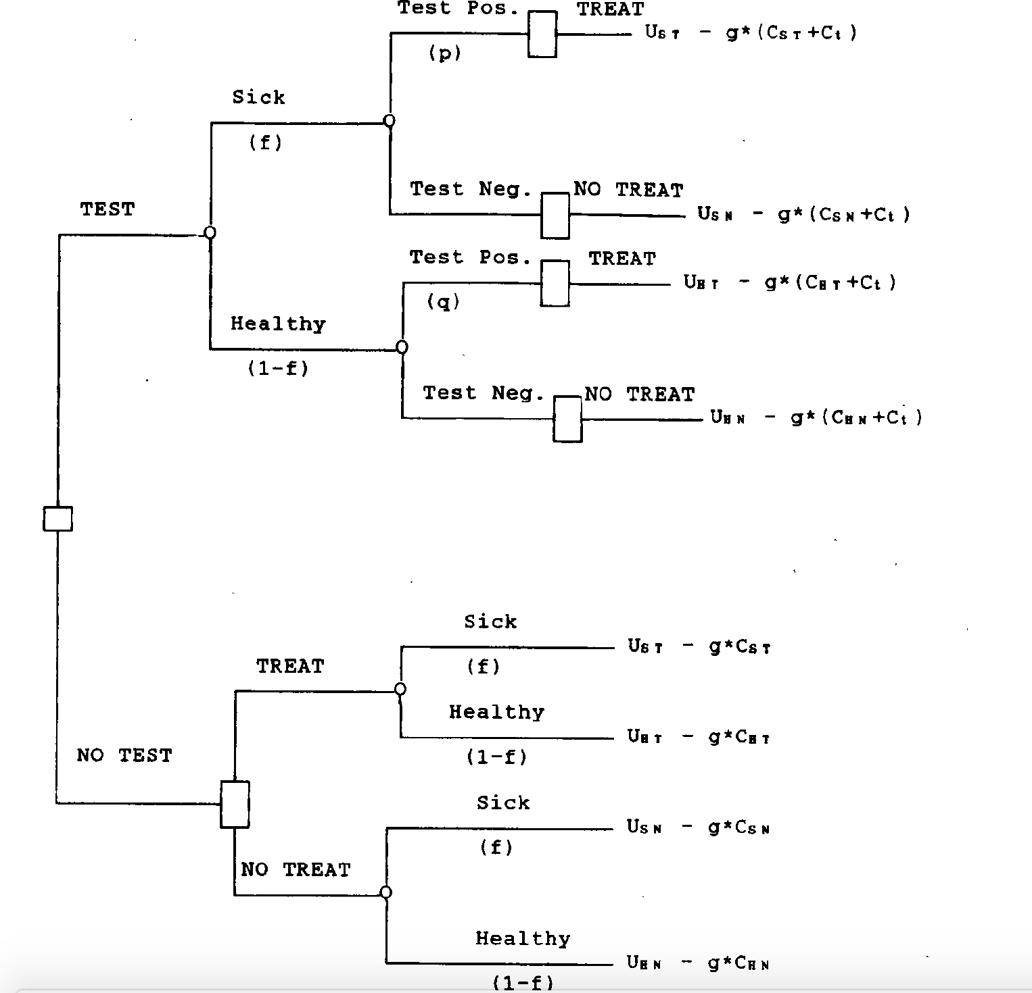
Diagnosis information provided

Slide 24
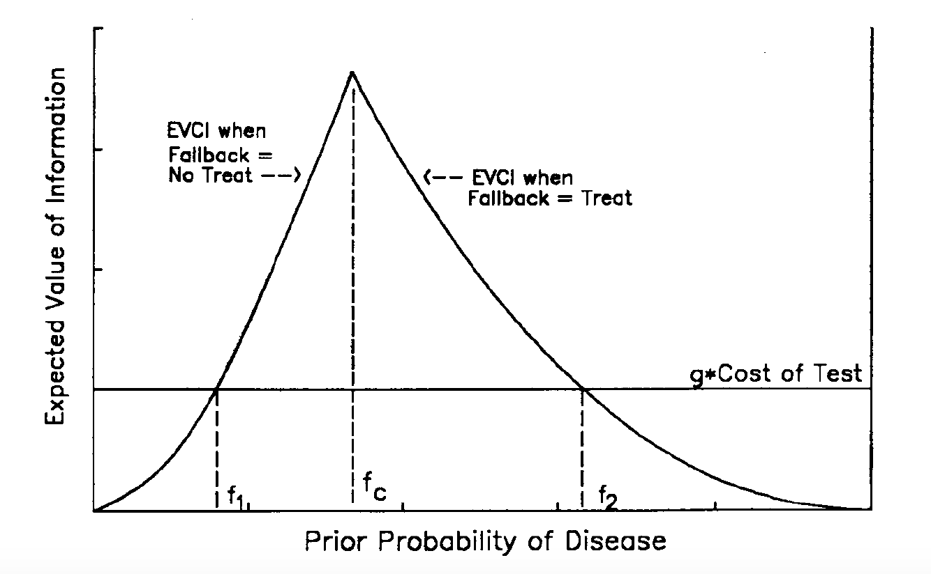
Expected value of clinical information

Slide 25
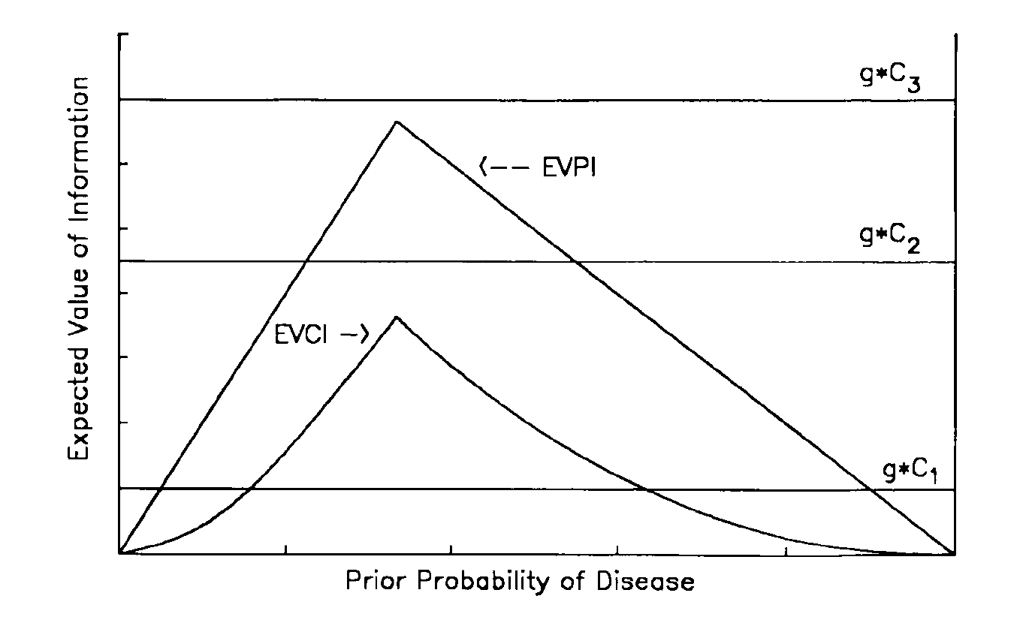
Hurdle I and Hurdle II comparison

Slide 26
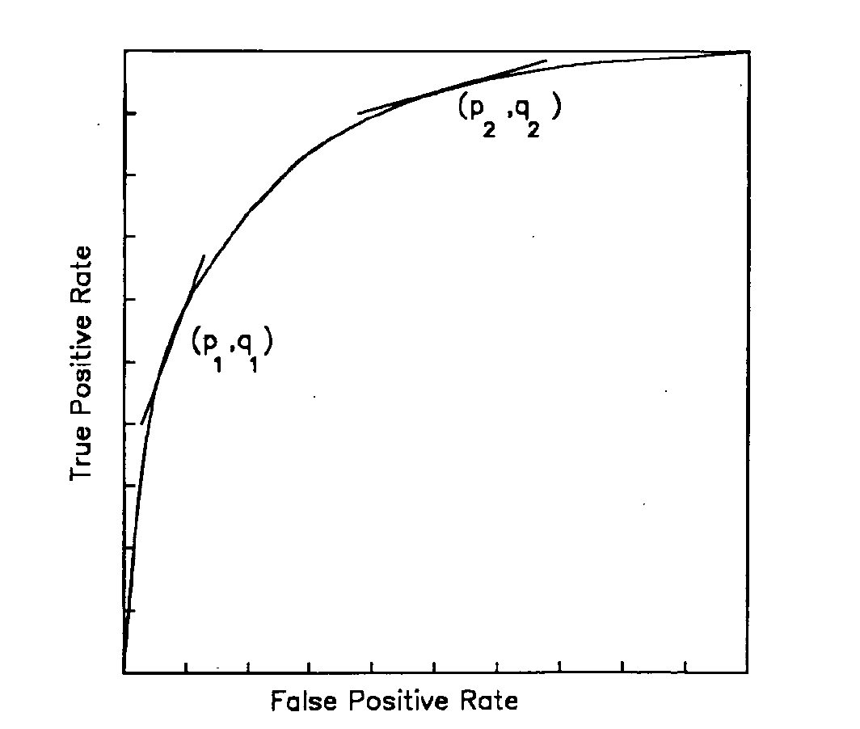
ROC curve

Slide 27
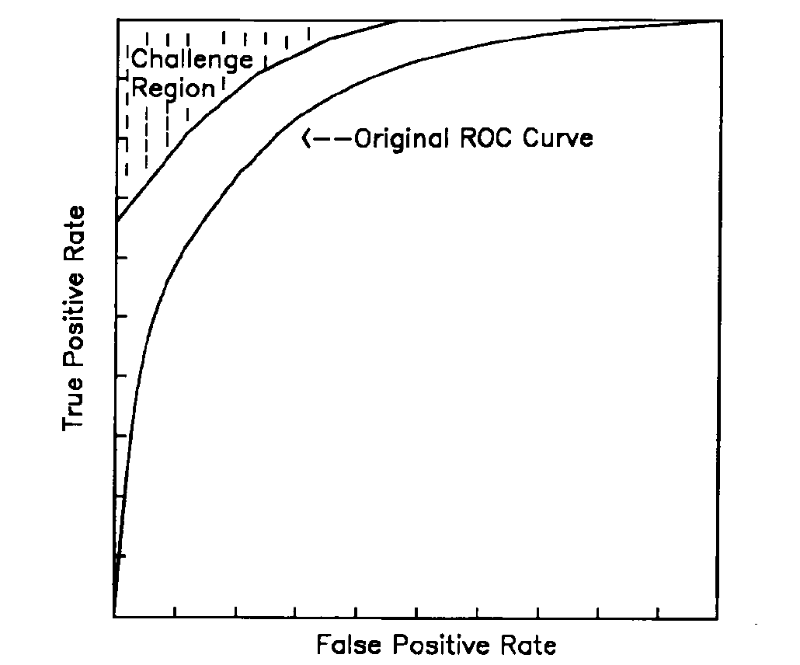
Challenge Region

Slide 28
Level 6: Societal Efficacy
Efficient use of societal resources
Introduction to new technology

Slide 29
Conclusion
Efficacy model evaluates diagnosis imaging in the whole process of patient treatment.
More research has been conducted in Level 1 and 2.

Slide 30
Papers for next presentation
[1] Gazelle, G. Scott, et al. "A framework for assessing the value of diagnostic imaging in the era of comparative effectiveness research." Radiology 261.3 (2011): 692-698.
[2] Lord, Sarah J., Les Irwig, and R. John Simes. "When is measuring sensitivity and specificity sufficient to evaluate a diagnostic test, and when do we need randomized trials?." Annals of internal medicine 144.11 (2006): 850-855.
[3] Verhaegen, Jorine, et al. "Accuracy of single progesterone test to predict early pregnancy outcome in women with pain or bleeding: meta-analysis of cohort studies." Bmj 345 (2012): e6077.
[4] Aboyans, Victor, et al. "2017 ESC Guidelines on the Diagnosis and Treatment of Peripheral Arterial Diseases, in collaboration with the European Society for Vascular Surgery (ESVS) Document covering atherosclerotic disease of extracranial carotid and vertebral, mesenteric, renal, upper and lower extremity arteries Endorsed by: the European Stroke Organization (ESO) The Task Force for the Diagnosis and Treatment of Peripheral Arterial Diseases of the European Society of Cardiology (ESC) and of the European Society for Vascular ...." European heart journal 39.9 (2017): 763-816.
[5] Met, Rosemarie, et al. "Diagnostic performance of computed tomography angiography in peripheral arterial disease: a systematic review and meta-analysis." Jama 301.4 (2009): 415-424.

Slide 31
Q&A THANK YOU

