Slide 1
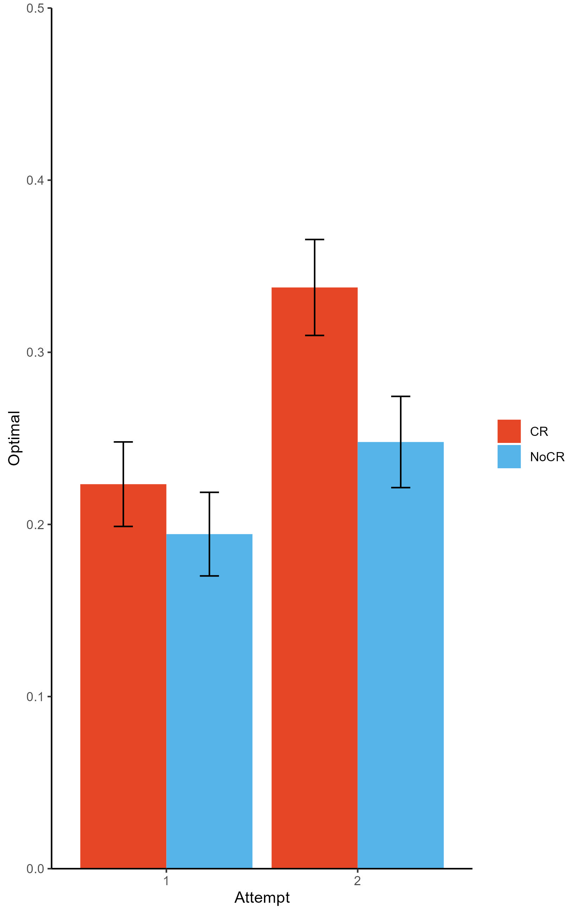
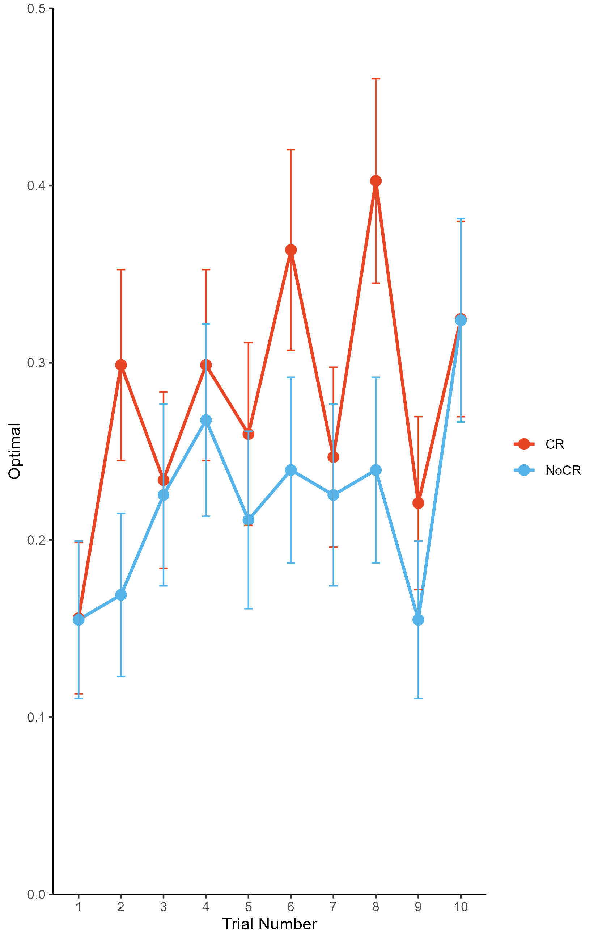
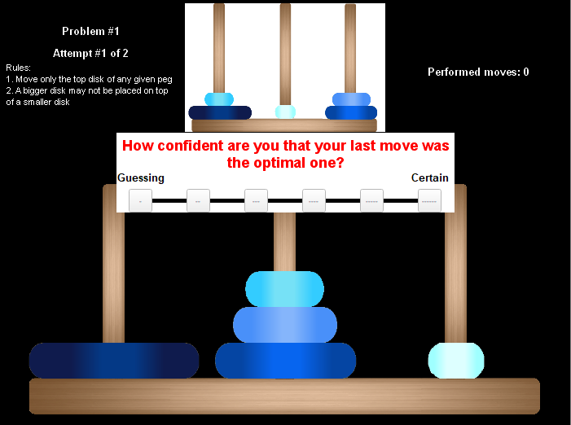
Confidence Ratings Improved Performance on the Tower of Hanoi Task
Yueting Zhan, Kit S. Double, Damian P. Birney, University of Sydney
Background
Metacognition plays a key role in how well we manage our learning.
When people are asked to rate how confident they are in their answers during static cognitive tests (e.g., Raven’s Progressive Matrices), their performance improves.
We don't know if there is reactivity to confidence ratings in tasks that require ongoing learning.
Before implementing confidence ratings in educational settings, we need to understand if they help students learn in more complex, dynamically evolving tasks.
Research Question: Does asking people to rate their confidence affect their performance when they need to learn and adapt throughout a task?
Method
Experiment 1 (N = 112)
Participants completed the Tower of Hanoi (TOH) either with or without confidence ratings after each move. Each item was attempted twice.
Experiment 2 (N = 148)
Added an additional transfer item where participants qualitatively described their problem-solving procedure. Coded for number of steps (out of 4) in the optimal problem-solving procedure identified by each participant.
Conclusion
Making confidence ratings improved performance in the Tower of Hanoi Task in both experiments. Confidence ratings appeared to improve performance in dynamic evolving tasks.
Reactivity did not interact with attempt or item number.
The number of self-reported optimal problem-solving steps did not differ between the confidence rating and control group.
Confidence ratings appear to be beneficial in tasks that require ongoing learning, suggesting they may be beneficial in learning environments.
Positive reactivity may not develop linearly with experience, instead reactivity effects appear to follow a more complex development pattern.
Future research should evaluate transfer using additional tasks and explore the generalisability of these findings in more realistic educational settings.
Results
Materials
Further Information
yueting.zhan@sydney.edu.au
Tower of Hanoi Task

