Slide 1
Increase annual membership with the use of marketing strategies
Chung yue xian
08 mar 2023

Slide 2
objectives
Share an overview of the data gathered
Identify patterns and trends from the historical data (Apr 2020 – Mar 2021)
Discuss any potential areas that requires further exploration

Slide 3
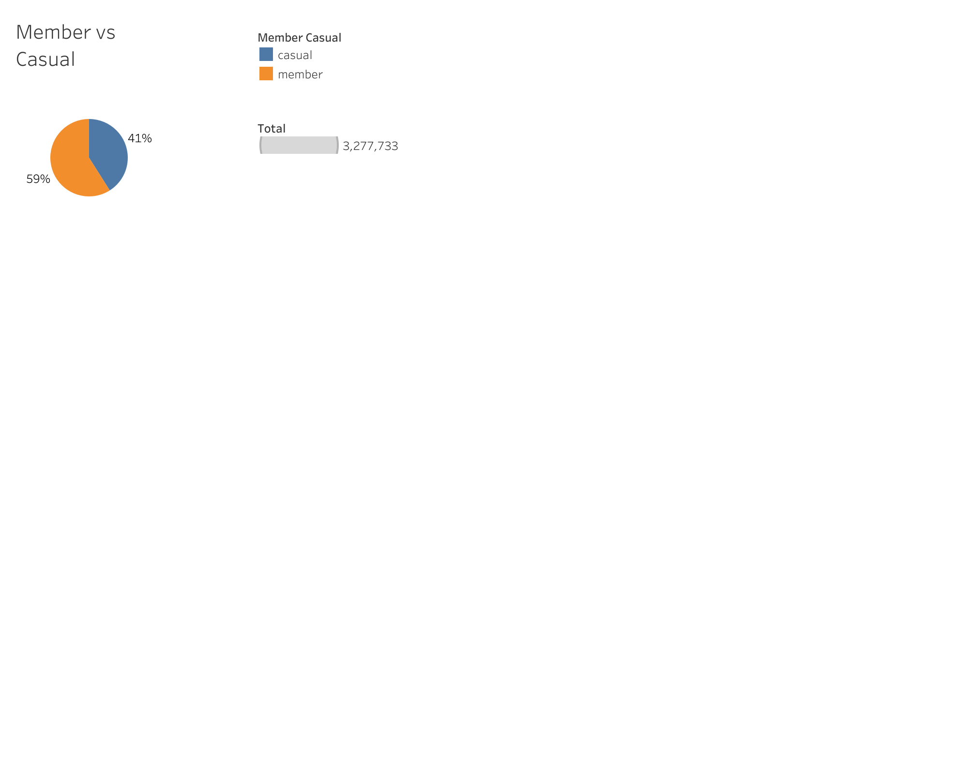
Findings 1
Total unique users is at 3,277,733
Currently we have more members than casuals at 59% and 41% respectively

Slide 4
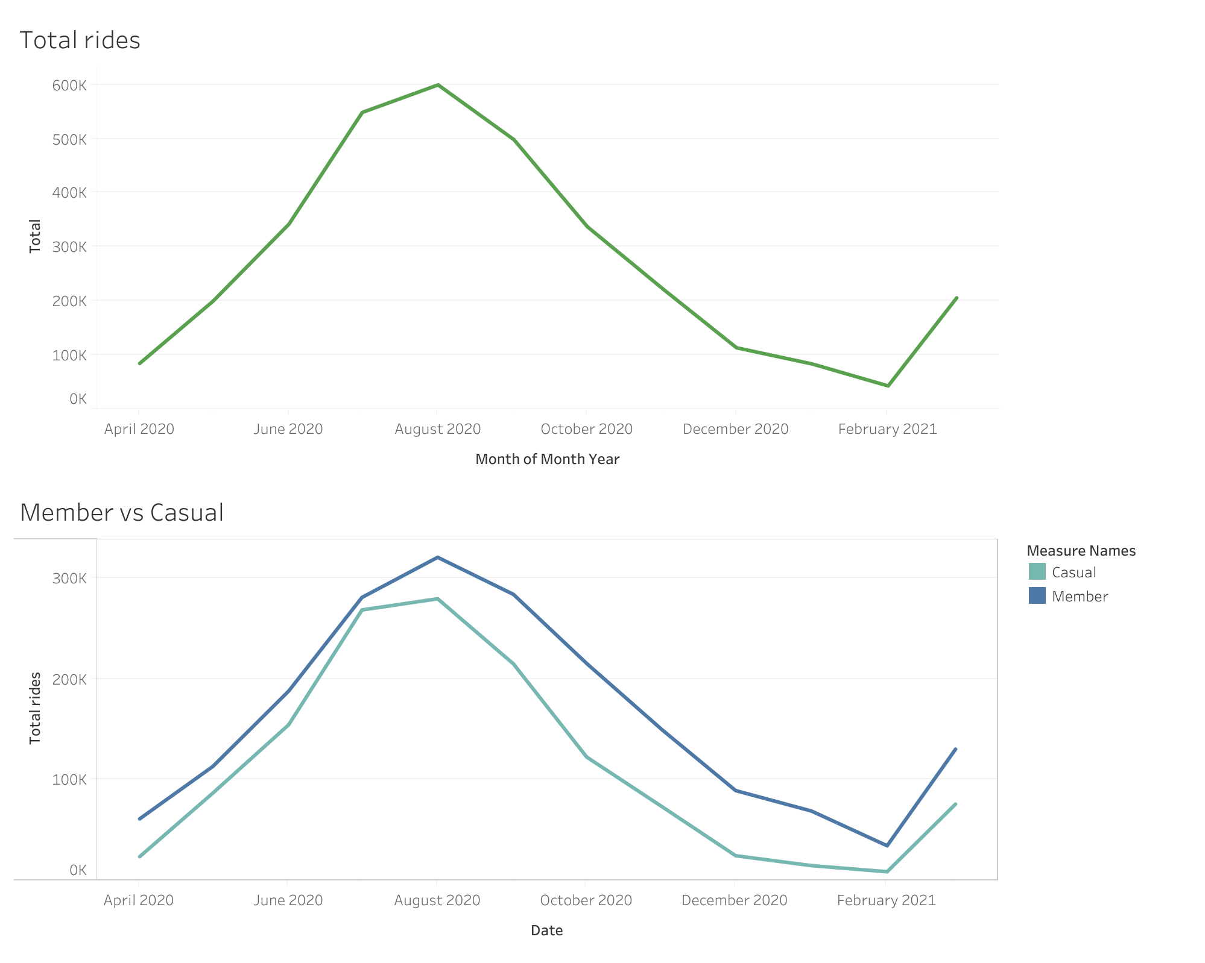
Findings 2
Total rides peaked at august 2020
Increase in rides from Feb 2021 – Mar 2021
Usage trend between members and casuals are similar, with members having more rides

Slide 5
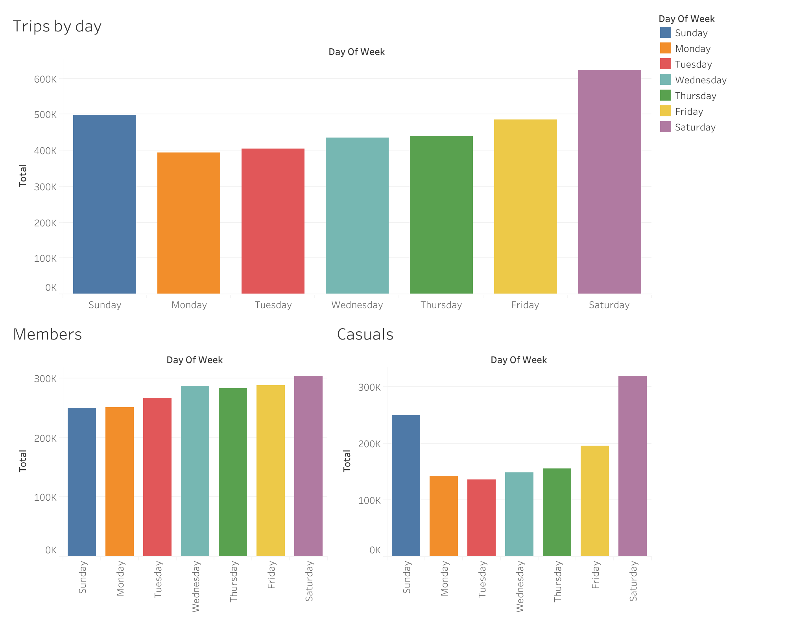
Findings 3
Members consistently ride throughout the week
Casuals mainly ride on the weekends with Saturday having the highest usage

Slide 6
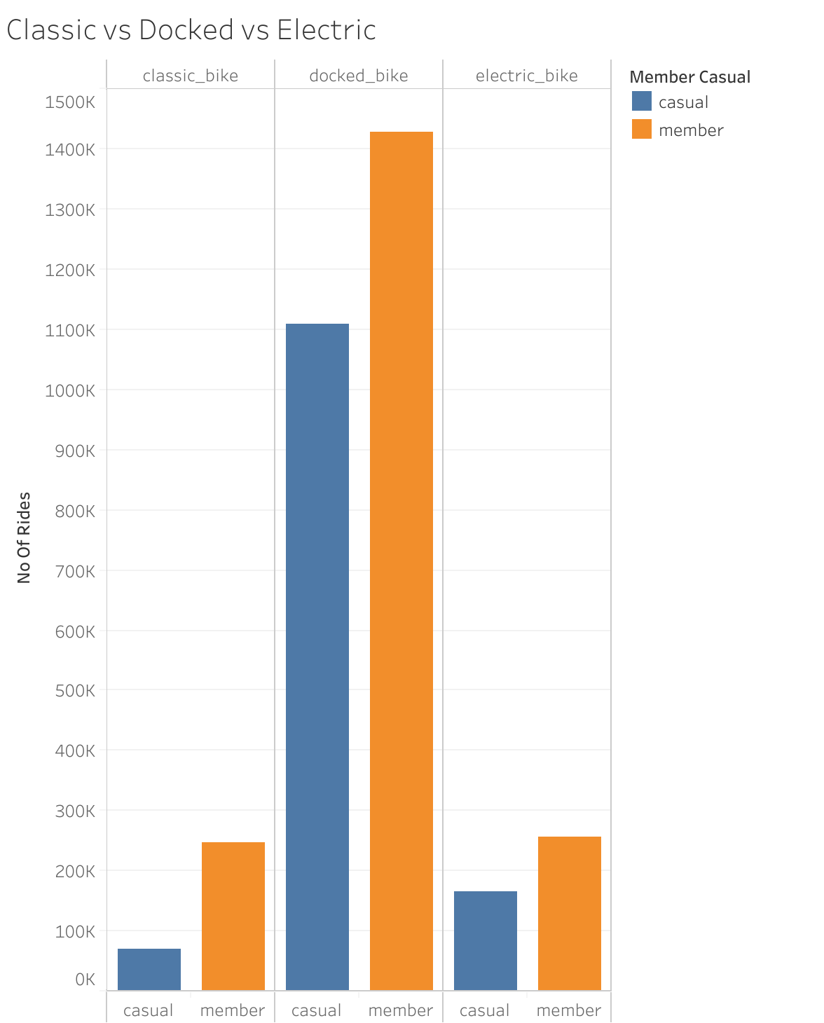
Findings 4
Docked bikes are the most popular among our riders
Casuals using docked bikes are much more than members that use the classic and electric bikes

Slide 7
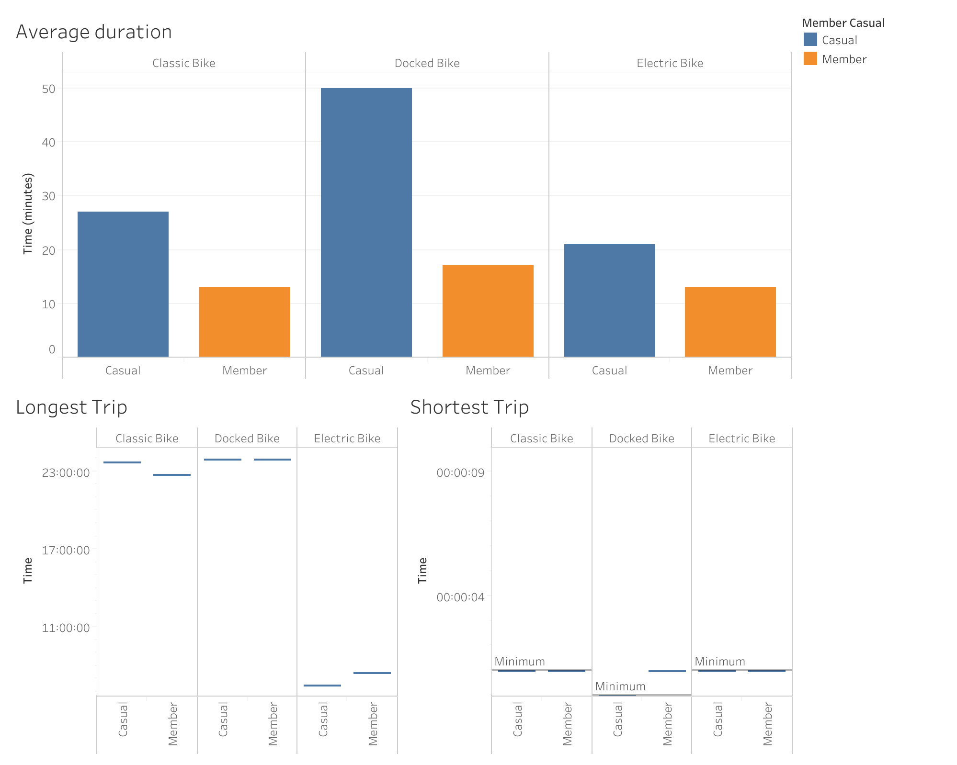
Findings 5
Casuals have a higher average for duration of rides across all 3 bike types

Slide 8
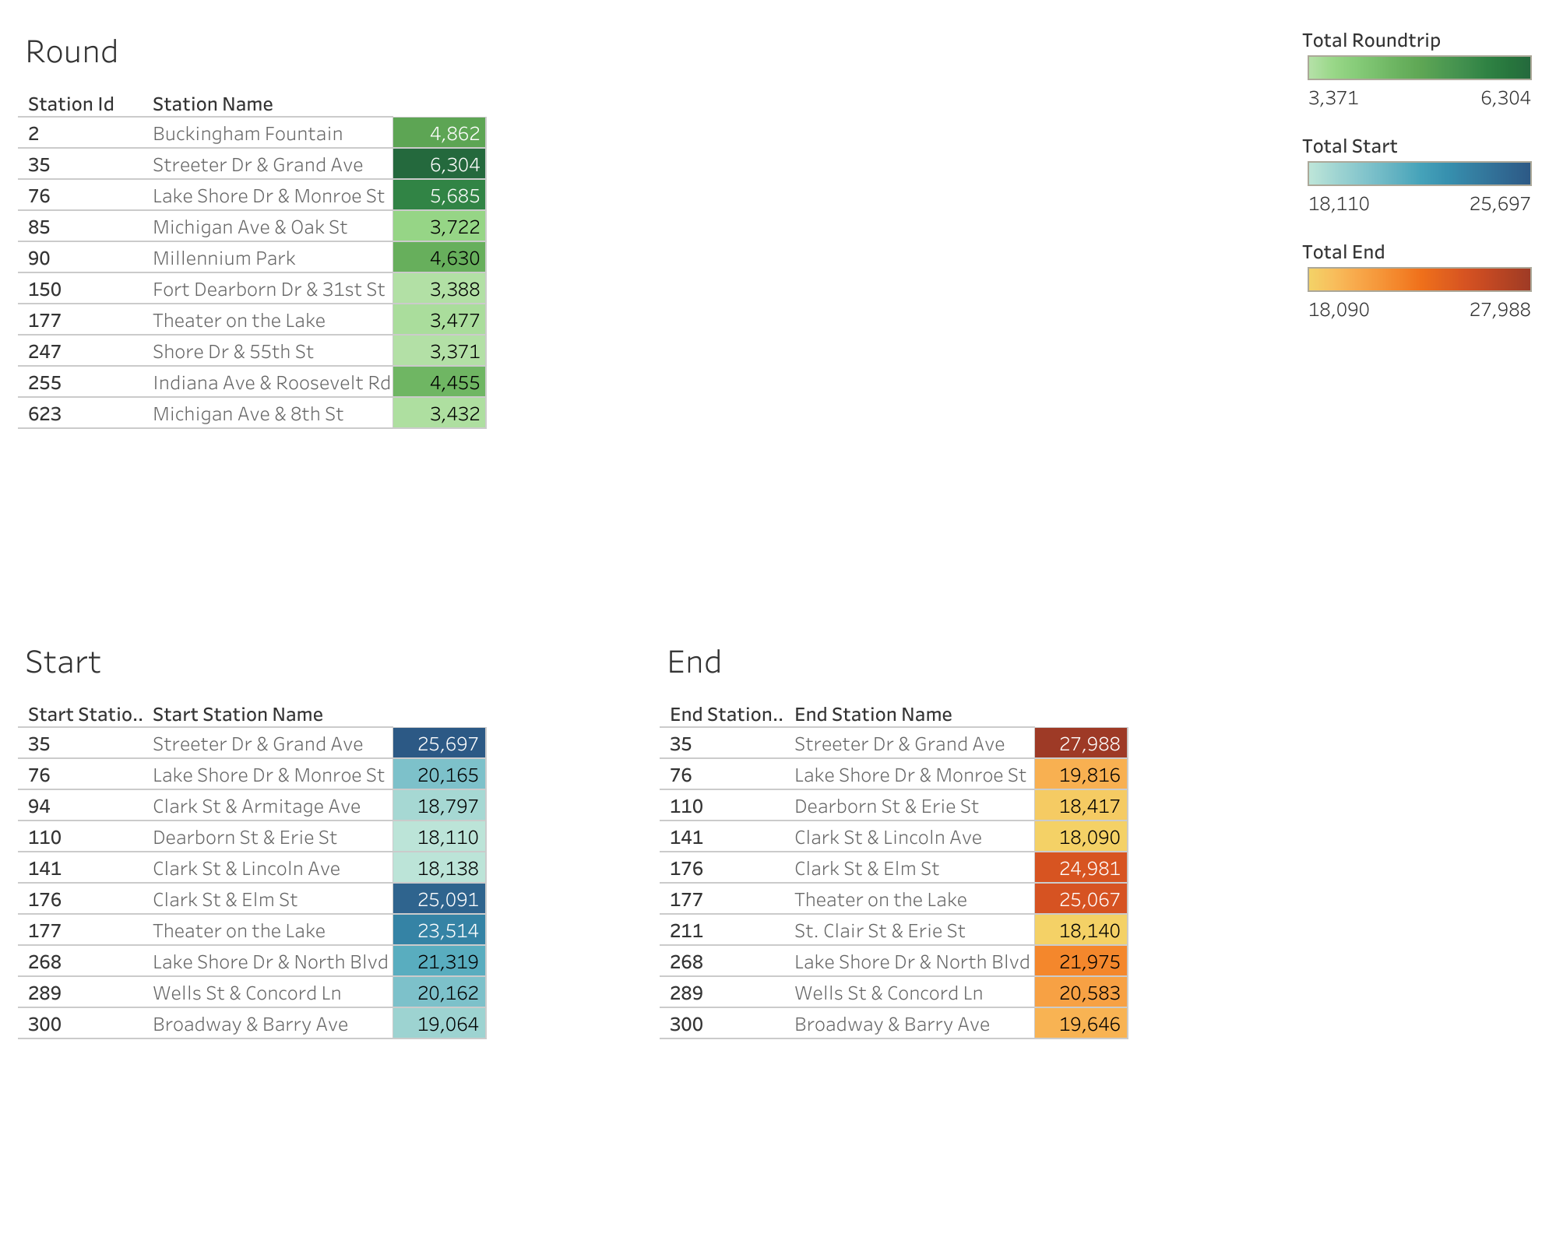
Findings 6
Identify stations with the most roundtrips (can reduce the bikes)
Identify stations where most rides start at, excluding roundtrips (can increase the bikes here)
Identify stations where most rides end at, excluding roundtrips (can decrease the bikes here)

Slide 9
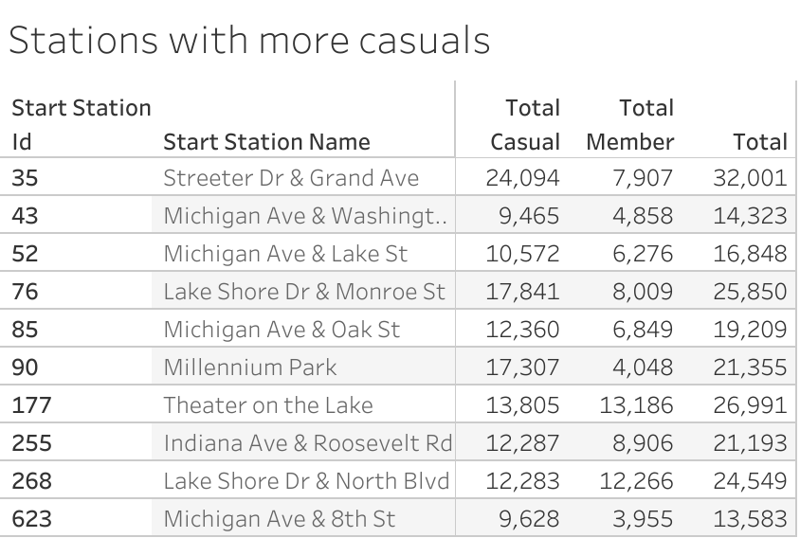
Findings 7
Identify stations that has more casual than member rides
These are also the stations with the most rides for the above criteria
Marketing campaign should be done at these 10 stations to significantly increase membership

Slide 10
Conclusions
Annual members and casual members are currently close to equal at 59% and 41% respectively
Usage between both groups are directly proportionate, where both peaked in Aug 2020 and declined till Feb 2021
*Annual members tend to ride everyday while casual members have significantly higher usage on the weekends
*Docked bikes are the most popular across both groups
*Casual members have a higher average ride duration across all bike types

Slide 11
Recommendations
Target the stations identified in findings 7 for our marketing campaigns
Make docked bikes only accessible by annual members
Adjust pricing on the weekends / offer weekend subscriptions at a cheaper price

