Slide 1


Report on Finetuning LLM Model
group_038

Slide 2
Introduction
Overview of the Model
Qwen 2.5 / DeepSeek R1 Distill Models
Goal in Training:
assist with complex physical simulations and calculations in electrodynamics
required reason through highly technical content step-by-step.

Slide 3
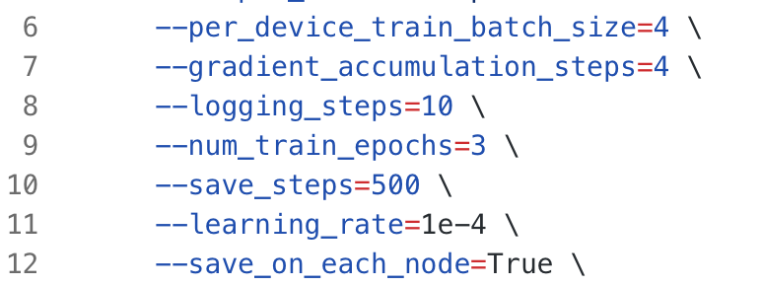
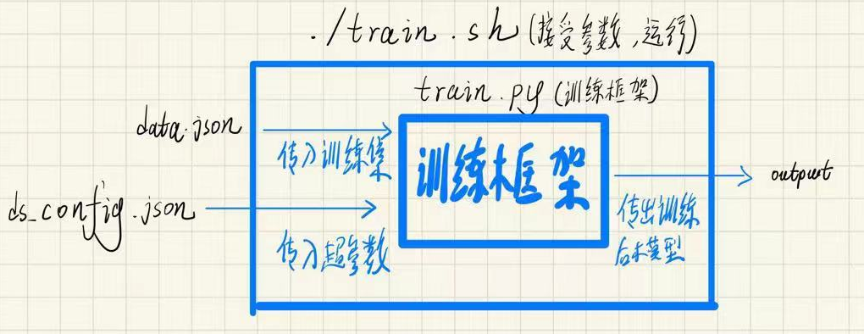
Training Setup
Hardware&Software
Training Configuration
Chain of Thought reason step by step

Slide 4
Dataset
物理学大题典（电磁学与电动力学）
comprehensive problems covering a wide range of topics & detailed solutions
regular expression matching with python

Slide 5
Challenges Faced
Repetition
prompt engineering/ reask/ temperature
Data Related Issues
cleaning （http://。。。/problem1.21）
Overfitting
insufficient data / regulation
Hardware limitation
distributed to several GPUs

Slide 6
Performance Evaluation
test_problem.json
Qwen2.5-7B / Qwen2.5-14B: 3/9
DeepSeek-R1-Distill-Qwen-14B / Qwen2.5 Max: 4/9
DeepSeek-R1: 5.5/9
Human: 9/9

Slide 7
Future Work
Expand data case
hyperparameter
reasoning and explanation ( incorporating physical rules)

Slide 8
Q&A

Slide 9
Thank you for listening
group_038

