Slide 1
Introduction to Lab #1
José Nelson Amaral

Slide 2
General Intro to 229 Labs
In 229, a “lab” is a programming assignment:
    A lab requires many more hours of work than the time allocated for lab sessions.
    Lab sessions are “consulting hours” when TAs are available to answer questions and to help.
    Reading/work prior to the lab date/time is essential.
    The lab assignments will be progressively more difficult, and will require more time as the term advances.
A CMPUT 229 lab is not a “lab” in the sense of a chemistry lab.

Slide 3
Part #1
Read Appendix B of textbook (specially section B.9).
Read the SPIM tutorial in the Tutorials section of the CD that comes with the book.

Slide 4
Part #2
Self-guided tutorial-style introduction to usage of XSPIM.
Part #3
Simple exercise to illustrate use of SPIM.

Slide 5
Part #4
Understand data storage in memory.
Question #7: Understand little/big endianess and conversion to/from ASCII.
Question #10: Understand 2-complement integers
Question 11: Assembly directives

Slide 6
Part #5: Find bugs in buggy.s
The program buggy.s was written to evaluate the
expression:
A * X + B
for N values of X. Where A and B are constants.
But buggy.s is not working as it should.
Your job is to read and understand buggy.s and
to report what are the errors in this program.

Slide 7
# Something's broken...
#
# This code is supposed to calculate A*X + B
# for N values of X
# A and B are in $a1 and $a2, respectively
# the X values and N are in the data segment
#
.text
main:
li $a1, 3
li $a2, 4
la $t0, N
la $t1, X
lw $t2, 0($t0)
xor $t3, $t3, $t3
xor $t4, $t4, $t4
loop: addi $t2, $t2, -1
blez $t2, exit
lw $t3, 0($t1)
mul $t3, $a1, $t3
add $t3, $a2, $t3
li $v0, 4
la $a0, outputMsg
syscall
li $v0, 1
add $a0, $0, $t3
syscall
li $v0, 4
la $a0, newln
syscall
add $t1, $t1, 1
j loop
exit:
jr $ra
.data
N: .word 4
X: .word 12, 14, 16, 18
outputMsg:
.asciiz"\n Result = ”
newln:
.asciiz "\n\n"

Slide 8
Part #5 submission
You will describe the bugs in a text file called bugs.txt and submit this file.

Slide 9
Part #6: Write a Simple Program
Write a MIPS assembly language program to take
a specified byte out of a 32-bit integer, store it in
sign-extended form, and then output the result.
Bytes are numbered from zero to three, from least
to most significant.
31
24
23
16
15
8
7
0
Byte 3
Byte 2
Byte 1
Byte 0

Slide 10
Example #1
Integer: 33034
Byte Specifier: 1
The binary representation of 33034 is:
31
24
23
16
15
8
7
0
0000 0000
0000 0000
1000 0001
0000 1010
Byte 3
Byte 2
Byte 1
Byte 0
Your program has to produce the following value:
31
24
23
16
15
8
7
0
1111 1111
1111 1111
1111 1111
1000 0001

Slide 11
Example #2
Integer: 1180419
Byte Specifier: 2
The binary representation of 1180419 is:
31
24
23
16
15
8
7
0
0000 0000
0001 0010
0000 0011
0000 0011
Byte 3
Byte 2
Byte 1
Byte 0
Your program has to produce the following value:
31
24
23
16
15
8
7
0
0000 0000
0000 0000
0000 0000
0001 0010

Slide 12
Assembler Syntax
comments begin with a sharp sign (#) and run to the end of the line.
identifiers are alphanumeric sequences, underbars (_), and dots (.)
that do not begin with a number.
labels are identifiers placed at the beginning of a line, and followed
by a colon.
.data
item: .word 1
.text
.globl main
main: lw $s3, item
Loop: add $t1, $s3, $s3 # $t1 ← 2 * i
add $t1, $t1, $t1 # $t1 ← 4 * i
add $t1, $t1, $s6 # $t1 ← Addr(save[i])
lw $t0, 0($t1) # $t0 ← MEM[save[i]]
bne $t0, $s5, Exit # if save[I] ≠ k goto Exit
add $s3, $s3, $s4 # i ← i + j
j Loop # goto Loop
Exit:
Chapter 2 — Instructions: Language of the Computer — <number>
P-H. p. B-10
Notes:
The University of Adelaide, School of Computer Science
Chapter 2 — Instructions: Language of the Computer

Slide 13
Assembler Directives
.data identifies the beginning of the data segment
(in this example this segment contains a single word).
.word 1 stores the decimal number 1 in 32-bits (4 bytes)
.text identifies the beginning of the text segment
(where the instructions of the program are stored).
.globl main declares the label main global
(so that it can be accessed from other files).
.data
item: .word 1
.text
.globl main
main: lw $s3, item
Loop: add $t1, $s3, $s3 # $t1 ← 2 * i
add $t1, $t1, $t1 # $t1 ← 4 * i
add $t1, $t1, $s6 # $t1 ← Addr(save[i])
lw $t0, 0($t1) # $t0 ← MEM[save[i]]
bne $t0, $s5, Exit # if save[I] ≠ k goto Exit
add $s3, $s3, $s4 # i ← i + j
j Loop # goto Loop
Exit:
Chapter 2 — Instructions: Language of the Computer — <number>
Notes:
The University of Adelaide, School of Computer Science
Chapter 2 — Instructions: Language of the Computer

Slide 14
File lab1-p1.s
pseudo instruction that
loads the immediate value
in the register
exit: div $t5, $t1, $a1
li $v0, 4
la $a0, outputMsg
syscall
li $v0, 1
add $a0, $0, $t5
syscall
li $v0, 4
la $a0, newln
syscall
jr $ra
.data
val: .word 12, 34, 56, 78, 90
outputMsg:
.asciiz "\n Result = "
newln:
.asciiz "\n\n"
# What's going on here ?
.text
main:
li $a1, 5
la $t0, val
xor $t1, $t1, $t1
xor $t2, $t2, $t2
loop: sub $t3, $a1, $t2
blez $t3, exit
lw $t4, 0($t0)
add $t1, $t1, $t4
add $t2, $t2, 1
addu $t0, $t0, 4
j loop
OS-style call to obtain
services from SPIM:
$a0-$a3: arguments
$v0: system call code
before the call;
return value
after the call.
(see page A-43).
pseudo instruction that
loads the address of
specified label into register
Chapter 2 — Instructions: Language of the Computer — <number>
Notes:
The University of Adelaide, School of Computer Science
Chapter 2 — Instructions: Language of the Computer

Slide 15
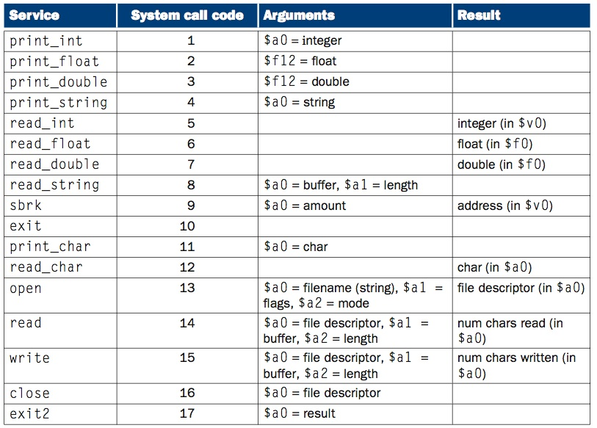
System call table
P-H pp. A-44
Chapter 2 — Instructions: Language of the Computer — <number>

Slide 16
Files to Submit
There are three files to submit:
  lab1.txt
  lab1.s
  bugs.txt

