Slide 1
Topic 7
Synchronization (Modified by J. Nelson Amaral)
Notes:
The University of Adelaide, School of Computer Science
Chapter 2 — Instructions: Language of the Computer

Slide 2


Synchronization
Read Response:
Road is Empty
Read
0
Read Response:
Road is Empty
Read
Chapter 2 — Instructions: Language of the Computer — <number>

Slide 3
Synchronization
Write 1
1
0
Write 1
Chapter 2 — Instructions: Language of the Computer — <number>

Slide 4
Better Synchronization
Read Response:
Road is Empty
0
Read
and link
0
Read Response:
Road is Empty
Read
and link
0
Chapter 2 — Instructions: Language of the Computer — <number>

Slide 5
Better Synchronization
Write failed
0
Write
Cond.
0
Write was OK
1
Write
Cond.
0
Chapter 2 — Instructions: Language of the Computer — <number>

Slide 6
Synchronization
Two processors sharing an area of memory
  P1 writes, then P2 reads
  Data race if P1 and P2 don’t synchronize
    Result depends of order of accesses
Hardware support required
  Atomic read/write memory operation
  No other access to the location allowed between the read and write
Could be a single instruction
  E.g., atomic swap of register ↔ memory
  Or an atomic pair of instructions
§2.11 Parallelism and Instructions: Synchronization
P-H p. 137
Chapter 2 — Instructions: Language of the Computer — <number>
Notes:
The University of Adelaide, School of Computer Science
Chapter 2 — Instructions: Language of the Computer

Slide 7
Synchronization in MIPS
Load linked:
Store conditional:
  Succeeds if location not changed since the ll
    Returns 1 in rt
  Fails if location is changed
    Returns 0 in rt
Example: atomic swap (to test/set lock variable)
ll rt, offset(rs)
sc rt, offset(rs)
P-H p. 138
Chapter 2 — Instructions: Language of the Computer — <number>
Notes:
The University of Adelaide, School of Computer Science
Chapter 2 — Instructions: Language of the Computer

Slide 8
Example: (atomic swap)
Used to test/set a variable
Shared
Processor P0
Processor P1
$s1: address
of shared
$s4: local value
to be swapped
$s1: address
of shared
$s4: local value
to be swapped
Chapter 2 — Instructions: Language of the Computer — <number>

Slide 9
Example: (atomic swap)
Used to test/set a variable
Load-link address | Value
0x1000 10E0 | 42
Load-link address | Value
0x1000 10E0 | 42
Shared
0x1000 10E0
ll
42
Processor P0
15
ll
Processor P1
$s1: 0x1000 10E0
$s4: 15
$s1: 0x1000 10E0
$s4: 37
sc
sc
$s4: 42
$t0: 37
$t0: 15
$t0: 0
$t0: 1
$t1: 42
$t1: 42
  try: add $t0 , $zero,$s4 # copy exchange value
  ll $t1 , 0($s1) # load linked
  sc $t0 , 0($s1) # store conditional
  beq $t0 , $zero,try # branch store fails
  add $s4 , $zero,$t1 # put load value in $s4
Chapter 2 — Instructions: Language of the Computer — <number>

Slide 10
Example: (atomic swap)
Used to test/set a variable
Load-link address | Value
0x1000 10E0 | 15
Shared
0x1000 10E0
42
15
Processor P0
37
ll
Processor P1
$s1: 0x1000 10E0
$s4: 15
$s1: 0x1000 10E0
$s4: 37
sc
$s4: 15
$s4: 42
$t0: 37
$t0: 15
$t0: 1
$t0: 1
$t1: 42
$t1: 15
  try: add $t0 , $zero,$s4 # copy exchange value
  ll $t1 , 0($s1) # load linked
  sc $t0 , 0($s1) # store conditional
  beq $t0 , $zero,try # branch store fails
  add $s4 , $zero,$t1 # put load value in $s4
Chapter 2 — Instructions: Language of the Computer — <number>

Slide 11
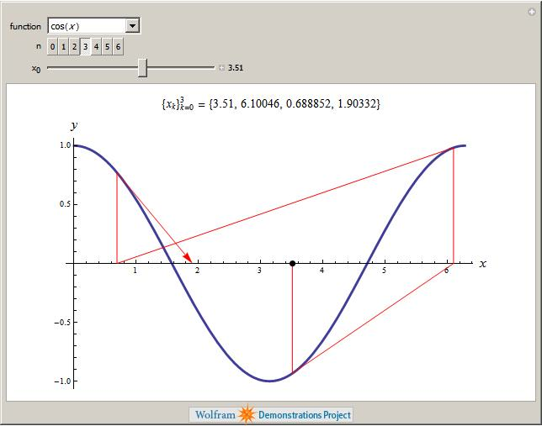
Lock Example:
Blackboard Architecture
Newton Method
Chapter 2 — Instructions: Language of the Computer — <number>

Slide 12
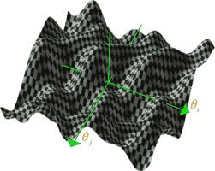

Multiple local minima
Chapter 2 — Instructions: Language of the Computer — <number>

Slide 13

Blackboard Architecture
x; f(x);
Processor A
(Newton Method)
Processor B
(Random Search)
Chapter 2 — Instructions: Language of the Computer — <number>

Slide 14
Blackboard Architecture
(without lock)
x=7;
f(x) = 14;
x=35;
f(x) = 47;
x=7;
f(x) = 47;
x=7
write
f(x) = 14
f(x) = 47
x = 15
f(x) = 56
f(x) = 47
x = 15
f(x) = 47
x = 7
f(x) = 47
x = 7
f(x) = 14
read x
write x =7
read f(x)
read f(x)
Processor A
(Newton Method)
Processor B
(Random Search)
Chapter 2 — Instructions: Language of the Computer — <number>

Slide 15
Blackboard Architecture
(lock)
x=35;
f(x) = 47;
lock=0;
$t0=0
lock=0
$t0 = 1
x = 15
f(x) = 56
lock = 0
sc lock =1
x = 7
f(x) = 14
sc lock=1
ll lock
ll lock
Processor A
(Newton Method)
Processor B
(Random Search)
Chapter 2 — Instructions: Language of the Computer — <number>

Slide 16
Transactional Memory
Chapter 2 — Instructions: Language of the Computer — <number>

Slide 17
Transactional Synchronization in Haswell:
http://software.intel.com/en-us/blogs/2012/02/07/transactional-synchronization-in-haswell/
Transactional Synchronization explained:
http://software.intel.com/en-us/blogs/2012/02/07/coarse-grained-locks-and-transactional-synchronization-explained/
Support for Transactional Memory in
BlueGeneQ:
http://arstechnica.com/hardware/news/2011/08/ibms-new-transactional-memory-make-or-break-time-for-multithreaded-revolution.ars
Chapter 2 — Instructions: Language of the Computer — <number>

Slide 18
Transactions × ll/sc
“Transactional memory is a kind of LL/SC on steroids:
each thread in a transaction can, in effect,
perform an LL on many different memory locations,
and the commit operation performs a kind of SC
that takes effect on those multiple locations
simultaneously, with either every store succeeding or
failing together.”
IBM's new transactional memory: make-or-break time for multithreaded revolution
By Peter Bright
http://arstechnica.com/hardware/news/2011/08/ibms-new-transactional-memory-make-or-break-time-for-multithreaded-revolution.ars
Chapter 2 — Instructions: Language of the Computer — <number>

