Slide 1
Compiling, Linking, Loading
J. Nelson Amaral

Slide 2
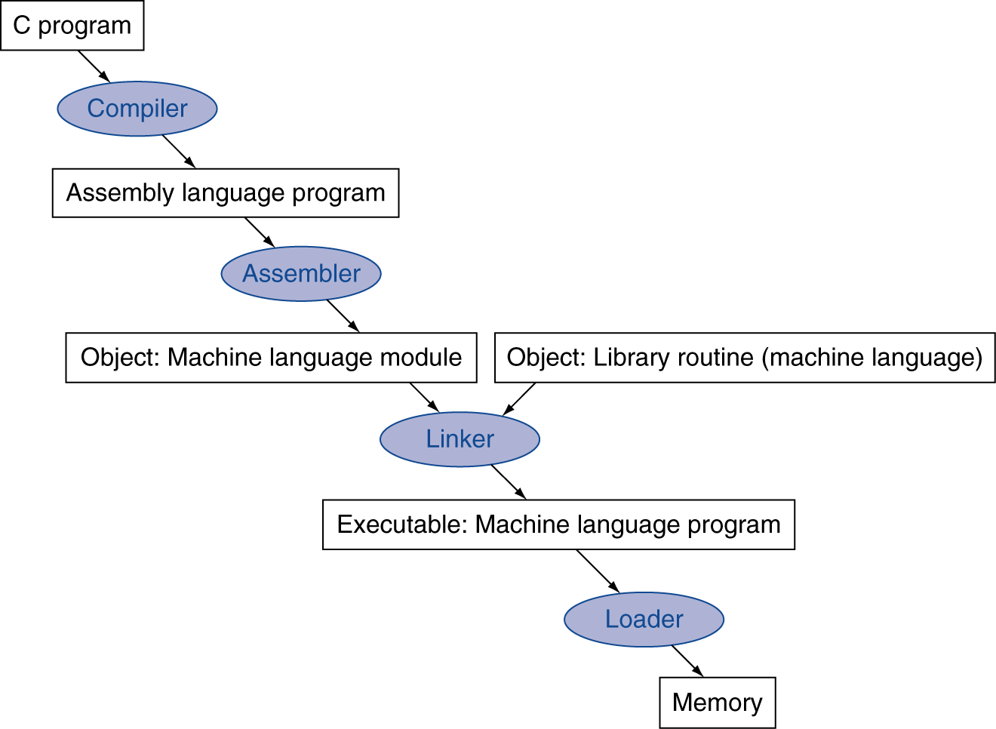
Translation and Startup
Many compilers produce object modules directly
§2.12 Translating and Starting a Program
Static linking
P-H p. 140

Slide 3
Producing an Object Module
Assembler (or compiler) translates program into machine instructions
Provides information for building a complete program from the pieces
Header: describes content of object module
Text segment: translated instructions
Static data segment: data allocated for the life of the program
Relocation info: for content that depend on absolute location of loaded program
Symbol table: global definitions and external refs
Debug info: for associating with source code
P-H p. 143

Slide 4
Linking Object Modules
Produces an executable image
1. Merges segments
2. Resolve labels (determine their addresses)
3. Patch location-dependent and external refs
Could leave location dependencies for fixing by a relocating loader
But with virtual memory, no need to do this
Program can be loaded into absolute location in virtual memory space
P-H p. 143

Slide 5
Loading a Program
Load from image file on disk into memory
1. Read header to determine segment sizes
2. Create virtual address space
3. Copy text and initialized data into memory
Or set page table entries so they can be faulted in
4. Set up arguments on stack
5. Initialize registers (including $sp, $fp, $gp)
6. Jump to startup routine
Copies arguments to $a0, … and calls main
When main returns, do exit syscall
P-H p. 145

Slide 6
Dynamic Linking
Only link/load library procedure when it is called
Requires procedure code to be rellocatable
Avoids image bloat caused by statically linking of all (transitively) referenced libraries
Automatically picks up new library versions
P-H p. 146

Slide 7
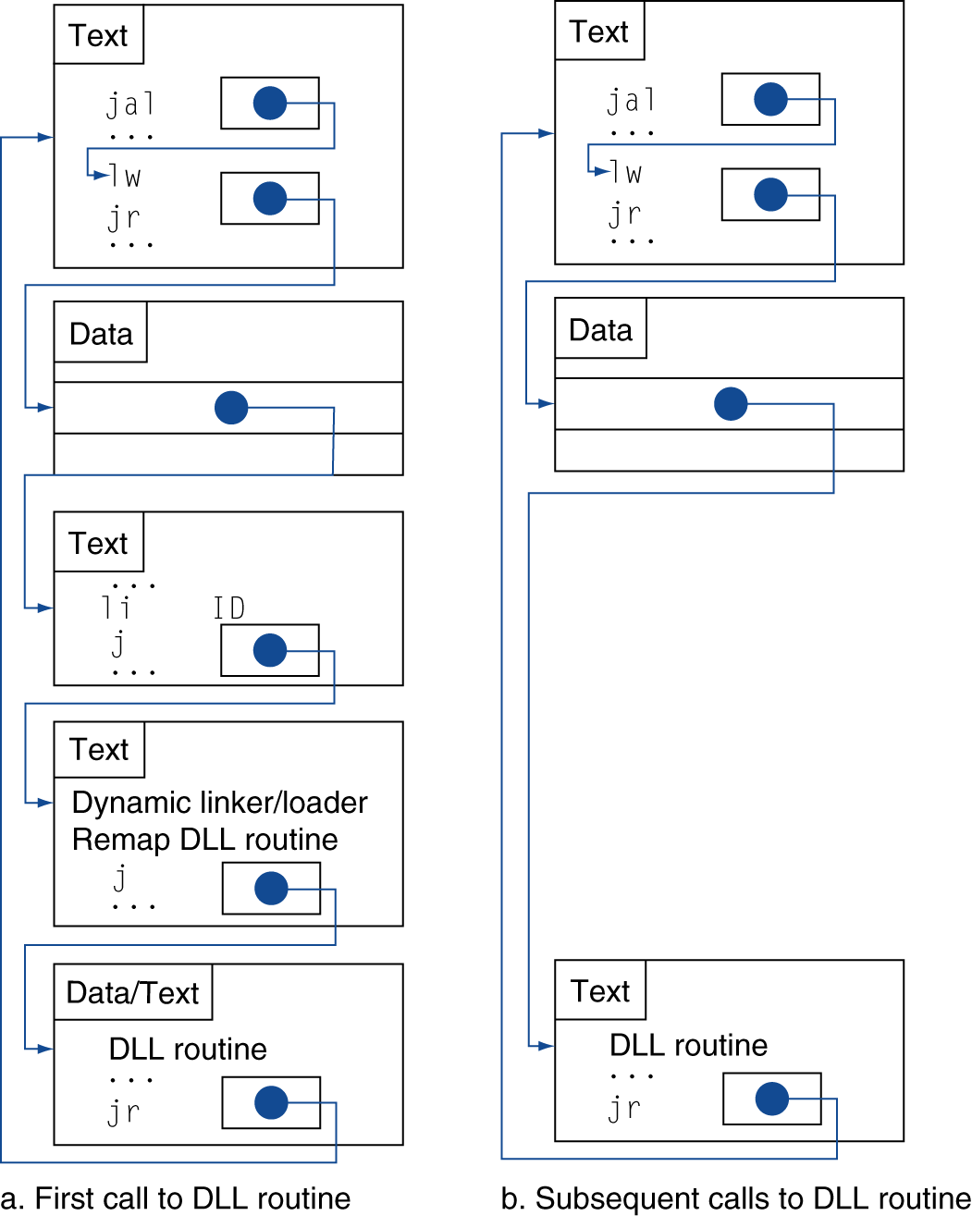
Lazy Linkage
Indirection table
Stub: Loads routine ID, Jump to linker/loader
Linker/loader code
Dynamically mapped code
P-H p. 147

Slide 8
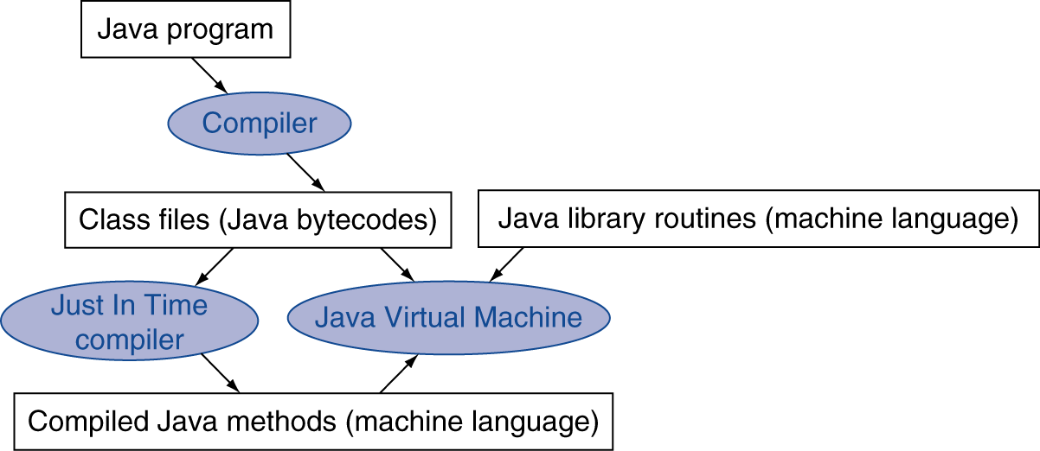
Dynamic JIT Compilers
Simple portable instruction set for the JVM
Compiles bytecodes of “hot” methods into native code for host machine
Interprets bytecodes
P-H p. 148

