Slide 1
Single-Cycle Datapath
(Modified by José Nelson Amaral)
Notes:
Morgan Kaufmann Publishers
Chapter 4 — The Processor

Slide 2
Logic Design Basics
Information encoded in binary
  Low voltage = 0, High voltage = 1
  One wire per bit
  Multi-bit data encoded on multi-wire buses
Combinational element
  Operate on data
  Output is a function of input
State (sequential) elements
  Store information
§4.2 Logic Design Conventions
Chapter 4 — The Processor — <number>
Notes:
Morgan Kaufmann Publishers
Chapter 4 — The Processor

Slide 3
Combinational Elements
AND-gate
  Y = A & B
Adder
  Y = A + B
A
+
Y
B
A
Y
B
Arithmetic/Logic Unit
  Y = F(A, B)
Multiplexer
  Y = S ? I1 : I0
A
I0
M
u
x
Y
Y
ALU
I1
B
S
F
Chapter 4 — The Processor — <number>
Notes:
Morgan Kaufmann Publishers
Chapter 4 — The Processor

Slide 4
Sequential Elements
Register: stores data in a circuit
  Uses a clock signal to determine when to update the stored value
  Edge-triggered: update when Clk changes from 0 to 1
Clk
D
Q
D
Clk
Q
Chapter 4 — The Processor — <number>
Notes:
Morgan Kaufmann Publishers
Chapter 4 — The Processor

Slide 5
Sequential Elements
Register with write control
  Only updates on clock edge when write control input is 1
  Used when stored value is required later
Clk
D
Q
Write
Write
D
Clk
Q
Chapter 4 — The Processor — <number>
Notes:
Morgan Kaufmann Publishers
Chapter 4 — The Processor

Slide 6
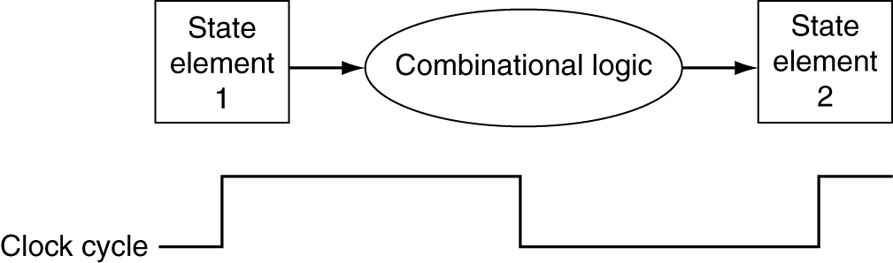
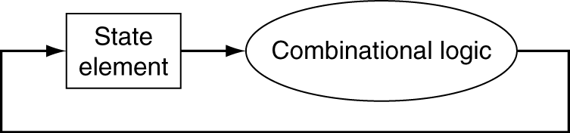
Clocking Methodology
Combinational logic transforms data during clock cycles
  Between clock edges
  Input from state elements, output to state element
  Longest delay determines clock period
Chapter 4 — The Processor — <number>
P-H 306
Notes:
Morgan Kaufmann Publishers
Chapter 4 — The Processor

Slide 7
R-Type Instructions
add $8, $17, $18
This instruction has 3 operands. The data that it operates on is stored in registers.
It adds the content of registers $17 and $18 and stores the result
in register $8. Its meaning can be summarized as follows:
$8 ← $17 + $18
OpCode
rs
rt
Destination
shiftamt
function
0
17
18
8
0
32
31 26
25 21
20 16
15 11
10 6
5 0
000000
10001
10010
01000
00000
100000
R-Type Instruction Format
CMPUT 229

Slide 8
Memory Instructions
lw $7, 68($9)
Read the memory location addressed by the value in register $9 plus 68
and store the value in register $7
Its meaning can be summarized as follows:
$7 ← Memory[$9 + 68]
OpCode
rs
rt
address
35
9
7
68
31 26
25 21
20 16
15 0
100001
01001
00111
0000000001000100
I-Type Instruction Format
CMPUT 229

Slide 9
Memory Instructions
sw $13, 56($17)
Write the value currently in register $13 in the memory location addressed by
the value in register $17 plus 56
Its meaning can be summarized as follows:
Memory[$17 + 56] ← $13
OpCode
rs
rt
address
43
17
13
56
31 26
25 21
20 16
15 0
101011
10001
01101
0000000000111000
I-Type Instruction Format
CMPUT 229

Slide 10
Branch Instructions
bne $1, $2, 100
Add 4 to the PC. If the value in register $1 is not equal the value in register $2,
then add 100 to the PC before fetching the next instruction.
Its meaning can be summarized as follows:
PC ← PC + 4
if($1 ≠ $2) PC ← PC + 100
OpCode
rs
rt
address
5
1
2
100
31 26
25 21
20 16
15 0
000101
00001
00010
0000000001100100
I-Type Instruction Format
CMPUT 229

Slide 11
Decoding Instructions
How does the processor convert the binary combinations on the left
into the actions prescribed by the assembly instructions on the right?
00000010001100100100000000100000 add $8, $17, $18
10000101001001110000000001000100 lw $7, 68($9)
10101110001011010000000000111000 sw $13, 56($17)
00010100001000100000000001100100 bne $1, $2, 100

Slide 12
Summary of Instr. Formats
R-Type Instruction Format
OpCode
rs
rt
Destination
shiftamt
function
0
17
18
8
0
32
31 26
25 21
20 16
15 11
10 6
5 0
000000
10001
10010
01000
00000
100000
I-Type Instruction Format
OpCode
rs
rt
address
35
9
7
68
31 26
25 21
20 16
15 0
100001
01001
00111
0000000001000100

Slide 13
Building a Datapath
§4.3 Building a Datapath
Datapath
  Elements that process data and addresses
  in the CPU
    Registers, ALUs, mux’s, memories, …
We will build a MIPS datapath incrementally
  Refining the overview design
Chapter 4 — The Processor — <number>
Notes:
Morgan Kaufmann Publishers
Chapter 4 — The Processor

Slide 14
Datapath: Instruction Memory
Write
Read
address
PC
Memory
Adder
Sum
Instruction
Program Counter
Instruction Memory
Adder
CMPUT 229
P-H 308

Slide 15
Datapath: PC Incrementer
Adder
Sum
Write
4
PC
Read
address
Memory
Instruction
CMPUT 229
P-H 309

Slide 16
DataPath: Register File and ALU
RegWrite
5
Read
register 1
Read
data 1
32
5
Read
register 2
Zero
5
Data
ALU
result
Write
register
Read
data 2
32
32
Write
data
ALU
Registers
ALU operation
Register File
ALU
CMPUT 229
P-H 310

Slide 17
A Two Read Port File with n Registers
RegWrite
Read
Register 1
5
M
u
x
Reg. 0
C
D
5-to-32
decoder
Reg. 1
32
C
D
C
D
Write
Register
•••
5
M
u
x
Reg. n-2
C
D
Reg. n-1
32
Write
Data
C
D
Read
Register 2
32
5
CMPUT 229
P-H 310

Slide 18
Read
Register 1
5
R0_0
M
u
x
R1_0
1
R31_0
R0_1
M
u
x
R1_1
1
R31_1
R0_31
M
u
x
R1_31
•••
•••
•••
1
R31_31
R0
R1
R31
Read
Register 1
M
u
x
Reg. 0
Reg. 1
32
CMPUT 229

Slide 19
DataPath: R-Type Instruction
RegWrite
I(25-21)
Read
register 1
Read
data 1
32
Instruction
I(20-16)
Read
register 2
Zero
I(15-11)
32
ALU
result
Write
register
Read
data 2
32
ALU
Write
data
Registers
ALU operation
add $8, $17, $18
OpCode
rs
rt
Destination
shiftamt
function
0
17
18
8
0
32
31 26
25 21
20 16
15 11
10 6
5 0
000000
10001
10010
01000
00000
100000
CMPUT 229

Slide 20
DataPath: Load/Store Instructions
MemRead
MemWrite
Read
address
Sign
ext.
Data
Memory
16
32
Write
address
MemData
Write
data
Data Memory Unit
Sign-extension Unit
CMPUT 229
P-H 311

Slide 21
DataPath: Load/Store Instructions
RegWrite
MemRead
I(25-21)
Read
register 1
Read
data 1
32
Instruction
Read
register 2
Zero
Read
address
I(20-16)
ALU
result
Data
Memory
Write
register
Read
data 2
Write
address
32
ALU
Write
data
Registers
ALU operation
MemData
Write
data
Sign
ext.
16
32
lw $7, 68($9)
OpCode
rs
rt
address
35
9
7
68
31 26
25 21
20 16
15 0
100001
01001
00111
0000000001000100
CMPUT 229
P-H 314

Slide 22
DataPath: Load/Store Instructions
MemWrite
I(25-21)
Read
register 1
I(20-16)
Read
data 1
32
Instruction
Read
register 2
Zero
Read
address
32
ALU
result
Data
Memory
Write
register
Read
data 2
Write
address
ALU
Write
data
Registers
ALU operation
MemData
Write
data
Sign
ext.
16
32
sw $13, 56($17)
OpCode
rs
rt
address
43
17
13
56
31 26
25 21
20 16
15 0
101011
10001
01101
0000000000111000
CMPUT 229
P-H 314

Slide 23
Combining Memory and
Register Instr. Datapaths
RegWrite
ALUSrc
MemRead
MemWrite
Read
register 1
MemtoReg
Read
data 1
32
Instruction
Read
register 2
Zero
Read
address
32
0
ALU
result
Data
Memory
Write
register
Read
data 2
M
u
x
Write
address
32
ALU
Write
data
1
MemData
0
Registers
Write
data
M
u
x
ALU operation
1
Sign
ext.
16
32
sw $13, 56($17)
OpCode
rs
rt
address
43
17
13
56
add $8, $17, $18
OpCode
rs
rt
Destination
shiftamt
function
0
17
18
8
0
32
CMPUT 229
P-H 314

Slide 24
DataPath: Branch Instructions
PC + 4
Adder
Sum
Branch
Target
Shift
left 2
I(25-21)
Read
register 1
Read
data 1
32
To branch
control logic
Instruction
I(20-16)
Read
register 2
Zero
Write
register
Read
data 2
32
ALU
Write
data
Registers
ALU operation
Sign
ext.
16
32
bne $1, $2, 100
OpCode
rs
rt
address
5
1
2
100
31 26
25 21
20 16
15 0
000101
00001
00010
0000000001100100
CMPUT 229
P-H 315

Slide 25
DataPath: Branch Instructions
PC + 4
Adder
Sum
Branch
Target
Shift
left 2
RegWrite
I(25-21)
Read
register 1
Read
data 1
32
To branch
control logic
Instruction
I(20-16)
Read
register 2
Zero
Write
register
Read
data 2
32
ALU
Write
data
Registers
ALU operation
Sign
ext.
16
32
bne $1, $2, 100
OpCode
rs
rt
address
5
1
2
100
31 26
25 21
20 16
15 0
000101
00001
00010
0000000001100100
CMPUT 229
P-H 314

Slide 26
0
Adder
Sum
Adder
M
u
x
Write
4
Sum
1
Shift
left 2
PC
PCSrc
Read
address
Memory
Instruction
RegWrite
ALUSrc
MemRead
MemWrite
Read
register 1
MemtoReg
Read
data 1
32
Instruction
Read
register 2
Zero
Read
address
32
0
ALU
result
Data
Memory
Write
register
Read
data 2
M
u
x
Write
address
32
ALU
Write
data
1
MemData
0
Registers
Write
data
M
u
x
ALU
control
1
16
Sign
ext.
32
I(5-0)
P-H 320

Slide 27
Destination Register for Load and
R-Type Instr.
lw $7, 68($9)
OpCode
rs
rt
address
35
9
7
68
31 26
25 21
20 16
15 0
add $8, $17, $18
OpCode
rs
rt
Destination
shiftamt
function
0
17
18
8
0
32
31 26
25 21
20 16
15 11
10 6
5 0
The Destination register of a load is specified in
I20-I16, but for an R-Type instruction the destination
is specified by the bits I15-I11. Therefore we need
a multiplex in the data path of the write register.
CMPUT 229

Slide 28
0
Adder
Sum
Adder
M
u
x
Write
4
Sum
1
Shift
left 2
PC
PCSrc
Read
address
Memory
Instruction
RegDst
RegWrite
ALUSrc
MemRead
MemWrite
I(25-21)
Read
register 1
MemtoReg
Read
data 1
32
I(20-16)
Read
register 2
Zero
Read
address
0
32
0
ALU
result
Data
Memory
M
u
x
Write
register
Read
data 2
M
u
x
Write
address
I(15-11)
1
ALU
Write
data
1
MemData
0
Registers
Write
data
M
u
x
32
ALU
control
1
16
Sign
ext.
32
I(15-0)
I(5-0)
ALUOp
P-H 320

Slide 29
Four Steps of an R-type Instruction
1. Fetch Instruction from instruction memory, and increment PC.
2. Read two registers (I25-I21) and (I20-I16) from the register file.
3. Use bits I5-I0 from the instruction code to determine the
function that the ALU performs on the data read from
the register file.
4. Write the ALU result to the destination register (I15-I11).
CMPUT 229

Slide 30
0
Adder
Sum
Adder
M
u
x
Write
4
Sum
1
Shift
left 2
PC
PCSrc
Read
address
Memory
R-Type Instruction
First Step: Instruction Fetch
Instruction
RegDst
RegWrite
ALUSrc
MemRead
MemWrite
I(25-21)
Read
register 1
MemtoReg
Read
data 1
32
I(20-16)
Read
register 2
Zero
Read
address
0
32
0
ALU
result
Data
Memory
M
u
x
Write
register
Read
data 2
M
u
x
Write
address
I(15-11)
1
ALU
Write
data
1
MemData
0
Registers
Write
data
M
u
x
32
ALU
control
1
16
Sign
ext.
32
I(5-0)
ALUOp
P-H 322

Slide 31
0
Adder
Sum
Adder
M
u
x
Write
4
Sum
1
Shift
left 2
PC
PCSrc
Read
address
Memory
R-Type Instruction
Second Step: Read Source Registers
Instruction
RegDst
RegWrite
ALUSrc
MemRead
MemWrite
I(25-21)
Read
register 1
MemtoReg
Read
data 1
32
I(20-16)
Read
register 2
Zero
Read
address
0
32
0
ALU
result
Data
Memory
M
u
x
Write
register
Read
data 2
M
u
x
Write
address
I(15-11)
1
ALU
Write
data
1
MemData
0
Registers
Write
data
M
u
x
32
ALU
control
1
16
Sign
ext.
32
I(5-0)
ALUOp
P-H 322

Slide 32
0
Adder
Sum
Adder
M
u
x
Write
4
Sum
1
Shift
left 2
PC
PCSrc
Read
address
Memory
R-Type Instruction
Third Step: ALU Operates on Registers
Instruction
RegDst
RegWrite
ALUSrc
MemRead
MemWrite
I(25-21)
Read
register 1
MemtoReg
Read
data 1
32
I(20-16)
Read
register 2
Zero
Read
address
0
32
0
ALU
result
Data
Memory
M
u
x
Write
register
Read
data 2
M
u
x
Write
address
I(15-11)
1
ALU
Write
data
1
MemData
0
Registers
Write
data
M
u
x
32
ALU
control
1
16
Sign
ext.
32
I(5-0)
ALUOp

Slide 33
0
Adder
Sum
Adder
M
u
x
Write
4
Sum
1
Shift
left 2
PC
PCSrc
Read
address
Memory
R-Type Instruction
Final Step: Write the Result
Instruction
RegDst
RegWrite
ALUSrc
MemRead
MemWrite
I(25-21)
Read
register 1
MemtoReg
Read
data 1
32
I(20-16)
Read
register 2
Zero
Read
address
0
32
0
ALU
result
Data
Memory
M
u
x
Write
register
Read
data 2
M
u
x
Write
address
I(15-11)
1
ALU
Write
data
1
MemData
0
Registers
Write
data
M
u
x
32
ALU
control
1
16
Sign
ext.
32
I(5-0)
ALUOp

Slide 34
Four Steps for a load Instruction
1. Fetch Instruction from instruction memory, and increment PC.
2. Read one register (I25-I21) from the register file.
3. The ALU computes the sum of the value read from the register
file and the sign-extended lower 16 bits of the instruction (offset).
4. Use the result of the ALU as an address to the data memory.
5. Write the data from the memory unit to the destination
register (I20-I16).
CMPUT 229

Slide 35
0
Adder
Sum
Adder
M
u
x
Write
4
Sum
1
Shift
left 2
PC
PCSrc
Read
address
Memory
DataPath for a Load Instruction
Instruction
RegDst
RegWrite
ALUSrc
MemRead
MemWrite
I(25-21)
Read
register 1
MemtoReg
Read
data 1
32
I(20-16)
Read
register 2
Zero
Read
address
0
32
0
ALU
result
Data
Memory
M
u
x
Write
register
Read
data 2
M
u
x
Write
address
I(15-11)
1
ALU
Write
data
1
MemData
0
Registers
Write
data
M
u
x
32
ALU
control
1
16
Sign
ext.
32
I(5-0)
ALUOp

Slide 36
Four Steps for a branch-on-equal Instruction
1. Fetch Instruction from instruction memory, and increment PC.
2. Read two registers (I25-I21) and (I20-I16) from the register file.
3. The ALU subtracts the data values read from the register.
Add the value PC + 4 to the sign-extended lower 16 bits
of the instruction (offset) --- the result is the branch target.
4. Use the zero result from the ALU to decide which adder result
to store in the PC (either the branch target or PC+4).
CMPUT 229

Slide 37
0
Adder
Sum
Adder
M
u
x
Write
4
Sum
1
Shift
left 2
PC
PCSrc
Read
address
Memory
DataPath for a Branch Instruction
Instruction
Branch
RegDst
RegWrite
ALUSrc
MemRead
MemWrite
I(25-21)
Read
register 1
MemtoReg
Read
data 1
32
I(20-16)
Read
register 2
Zero
Read
address
0
32
0
ALU
result
Data
Memory
M
u
x
Write
register
Read
data 2
M
u
x
Write
address
I(15-11)
1
ALU
Write
data
1
MemData
0
Registers
Write
data
M
u
x
32
ALU
control
1
16
Sign
ext.
32
I(5-0)
ALUOp

Slide 38
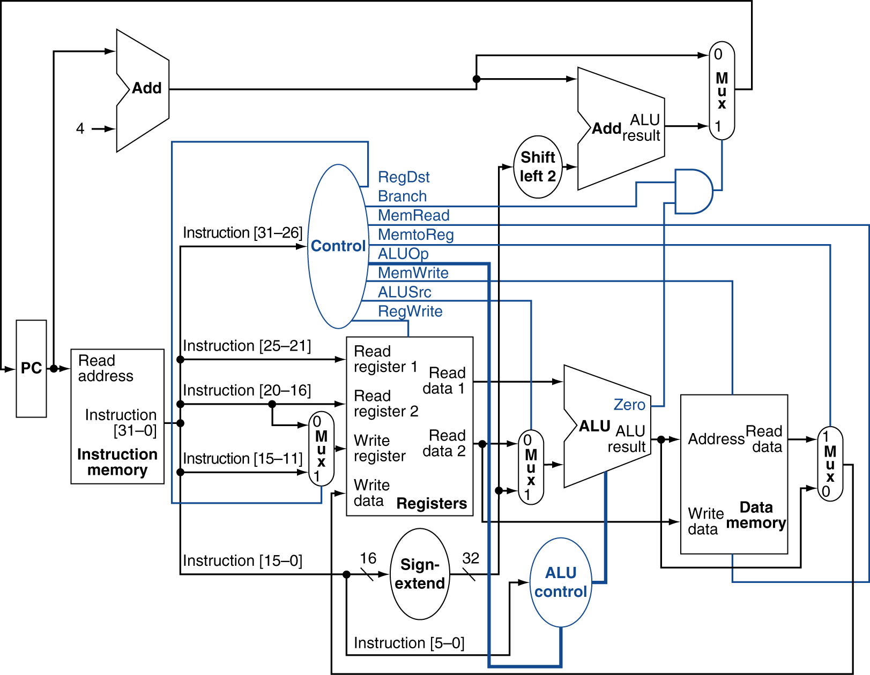
Datapath With Control
Chapter 4 — The Processor — <number>
P-H 326
Notes:
Morgan Kaufmann Publishers
Chapter 4 — The Processor

Slide 39
Implementing Jumps
Jump
2
address
31:26
25:0
Jump uses word address
Update PC with concatenation of
  Top 4 bits of old PC
  26-bit jump address
  00
Need an extra control signal decoded from opcode
Chapter 4 — The Processor — <number>
P-H 328
Notes:
Morgan Kaufmann Publishers
Chapter 4 — The Processor

Slide 40
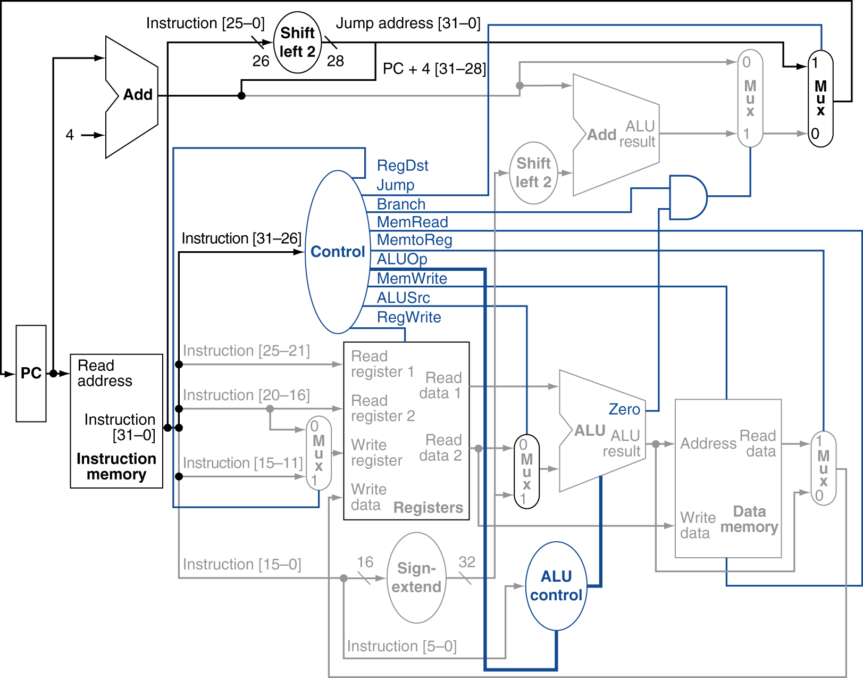
Datapath With Jumps Added
Chapter 4 — The Processor — <number>
P-H 329
Notes:
Morgan Kaufmann Publishers
Chapter 4 — The Processor

