Slide 1
Pipelining
(modified by José Nelson Amaral)

Slide 2
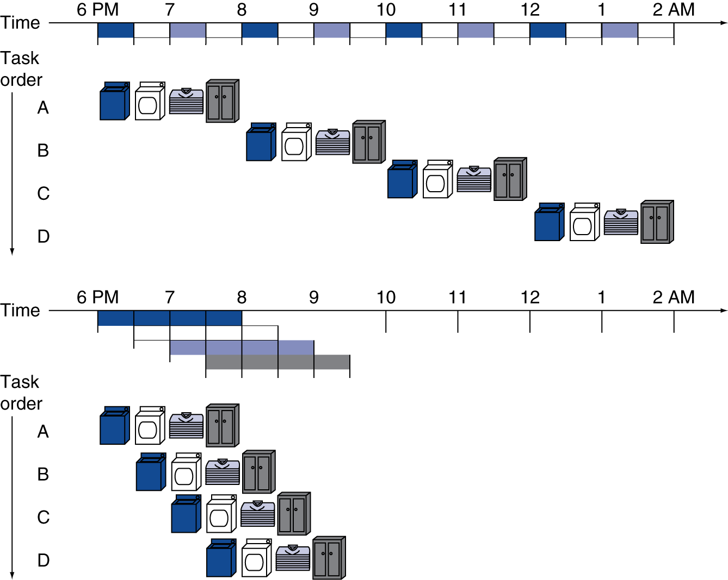
Pipelining Analogy
Pipelined laundry: overlapping execution
  Parallelism improves performance
§4.5 An Overview of Pipelining
Four loads:
  Speedup
  = 8/3.5 = 2.3
Non-stop:
  Speedup
  = 2n/0.5n + 1.5 ≈ 4
  = number of stages
What is the speedup
if you have to do
four loads of laundry?
What is the speedup
if you have to do
many loads of laundry?
Chapter 4 — The Processor — <number>
P-H 331
Notes:
Morgan Kaufmann Publishers
Chapter 4 — The Processor

Slide 3
MIPS Pipeline
Five stages, one step per stage
  IF: Instruction fetch from memory
  ID: Instruction decode & register read
  EX: Execute operation or calculate address
  MEM: Access memory operand
  WB: Write result back to register
Chapter 4 — The Processor — <number>
P-H 332
Notes:
Morgan Kaufmann Publishers
Chapter 4 — The Processor

Slide 4
Pipeline Performance
Assume time for stages is
  100ps for register read or write
  200ps for other stages
Compare pipelined datapath with single-cycle datapath
Instr | Instr fetch | Register read | ALU op | Memory access | Register write | Total time
lw | 200ps | 100 ps | 200ps | 200ps | 100 ps | 800ps
sw | 200ps | 100 ps | 200ps | 200ps |  | 700ps
R-format | 200ps | 100 ps | 200ps |  | 100 ps | 600ps
beq | 200ps | 100 ps | 200ps |  |  | 500ps
Chapter 4 — The Processor — <number>
P-H 333
Notes:
Morgan Kaufmann Publishers
Chapter 4 — The Processor

Slide 5
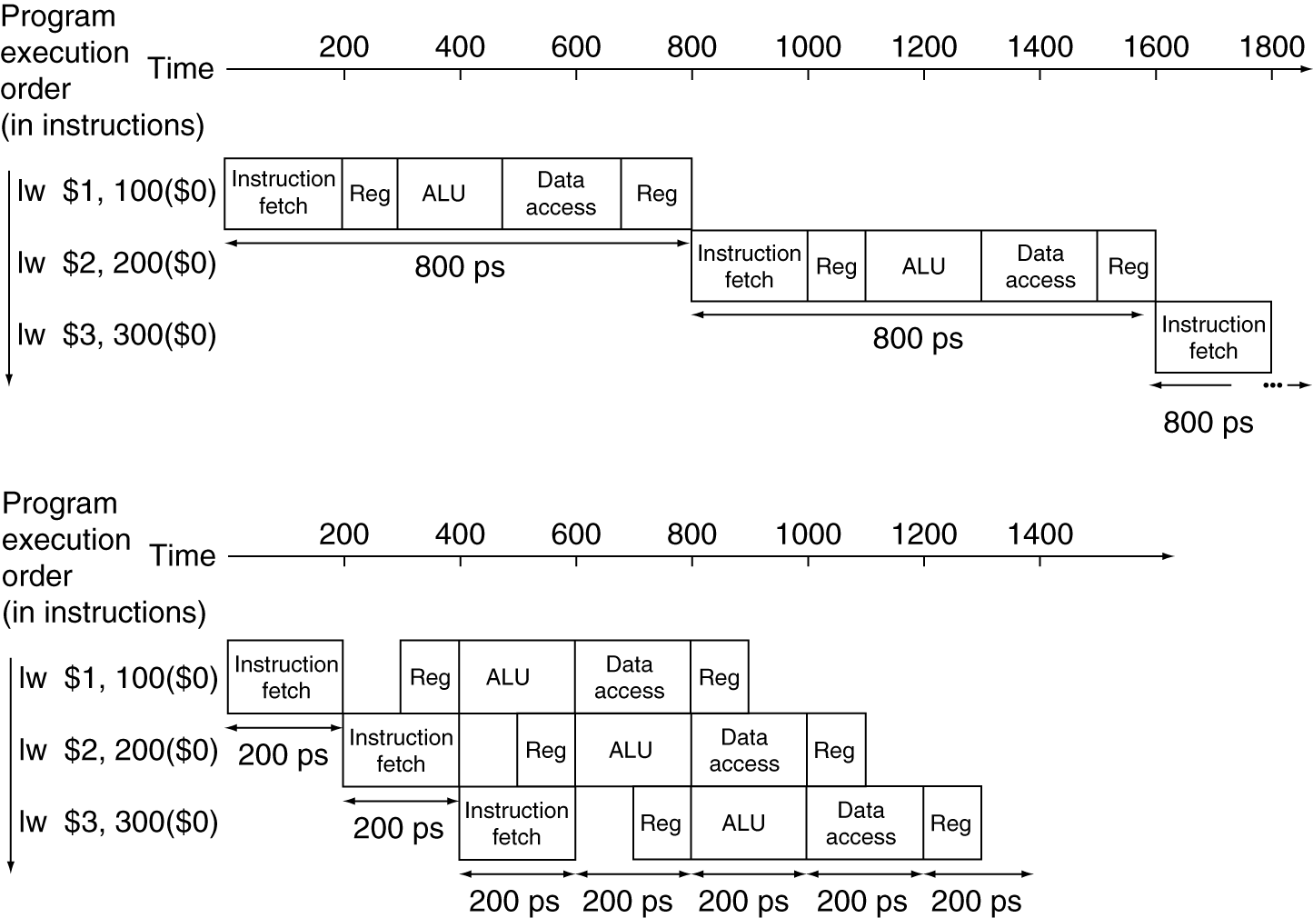
Pipeline Performance
Single-cycle (T_{c}= 800ps)
Pipelined (T_{c}= 200ps)
Chapter 4 — The Processor — <number>
P-H 334
Notes:
Morgan Kaufmann Publishers
Chapter 4 — The Processor

Slide 6
Pipeline Speedup
If all stages are balanced (i.e., all take the same time)
If not balanced, speedup is less
Speedup due to increased throughput
  Latency (time for each instruction) does not decrease
Chapter 4 — The Processor — <number>
P-H 333
Notes:
Morgan Kaufmann Publishers
Chapter 4 — The Processor

Slide 7
Pipelining and ISA Design
MIPS ISA designed for pipelining
  All instructions are 32-bits
    Easier to fetch and decode in one cycle
    c.f. x86: 1- to 17-byte instructions
  Few and regular instruction formats
    Can decode and read registers in one step
  Load/store addressing
    Can calculate address in 3rd stage, access memory in 4th stage
  Alignment of memory operands
    Memory access takes only one cycle
Chapter 4 — The Processor — <number>
P-H 335
Notes:
Morgan Kaufmann Publishers
Chapter 4 — The Processor

Slide 8
Hazards
beq $t0, $t1, 4
add $s0, $s1, $s2
slrv $t1, $t0, $t2
lw $t0, 0($s0)
add $t1, $t0, $t2
Situations that prevent starting the next instruction in the next cycle
Structural hazards
  A resource that the instruction needs is busy
Data hazard
  Depend on data produced by a previous instruction
Control hazard
  Control action depends on previous instruction
Chapter 4 — The Processor — <number>
P-H 336
Notes:
Morgan Kaufmann Publishers
Chapter 4 — The Processor

Slide 9
Structural Hazards
Conflict for use of a resource
In a MIPS pipeline with a single memory
  Both Load and store require data access
  Instruction fetch would have to stall for that cycle
    Would cause a pipeline “bubble”
Hence, pipelined datapaths require separate instruction/data memories
  Actually, separate instruction/data caches
Chapter 4 — The Processor — <number>
P-H 336
Notes:
Morgan Kaufmann Publishers
Chapter 4 — The Processor

Slide 10
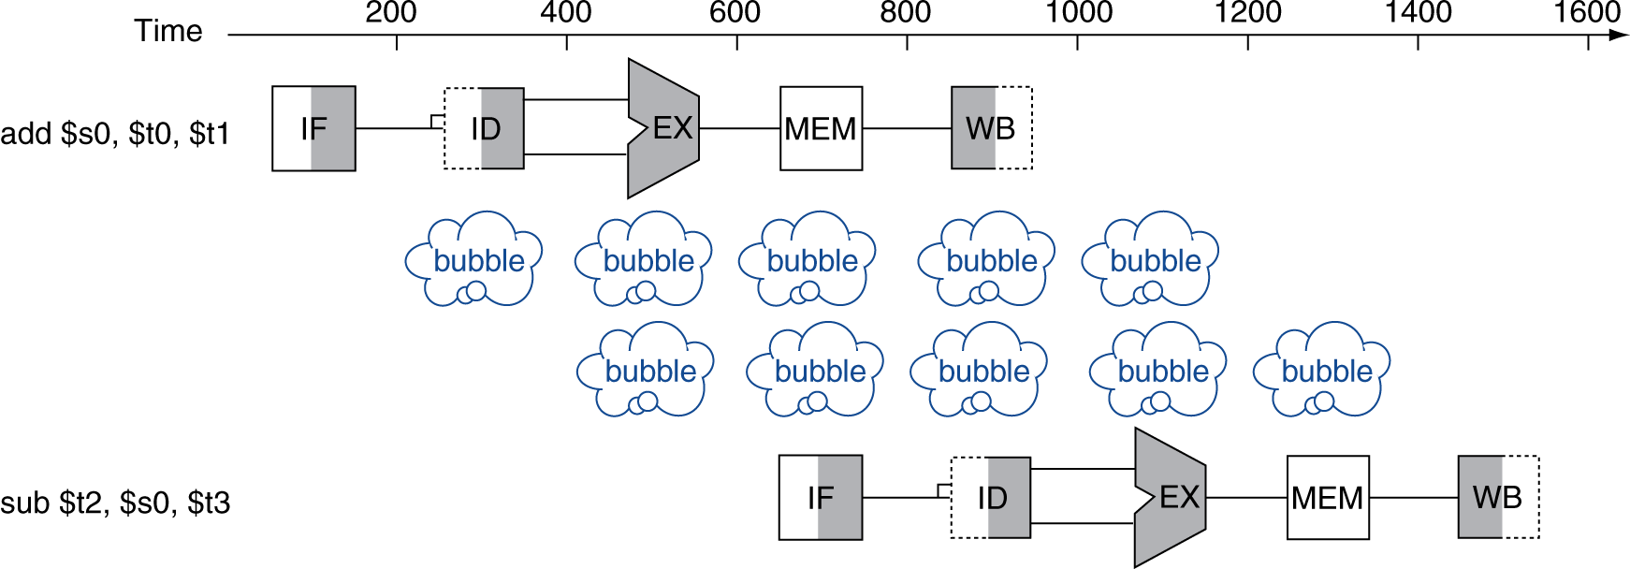
Data Hazards
An instruction depends on completion of data access by a previous instruction
  add $s0, $t0, $t1
  sub $t2, $s0, $t3
Chapter 4 — The Processor — <number>
P-H 336
Notes:
Morgan Kaufmann Publishers
Chapter 4 — The Processor

Slide 11
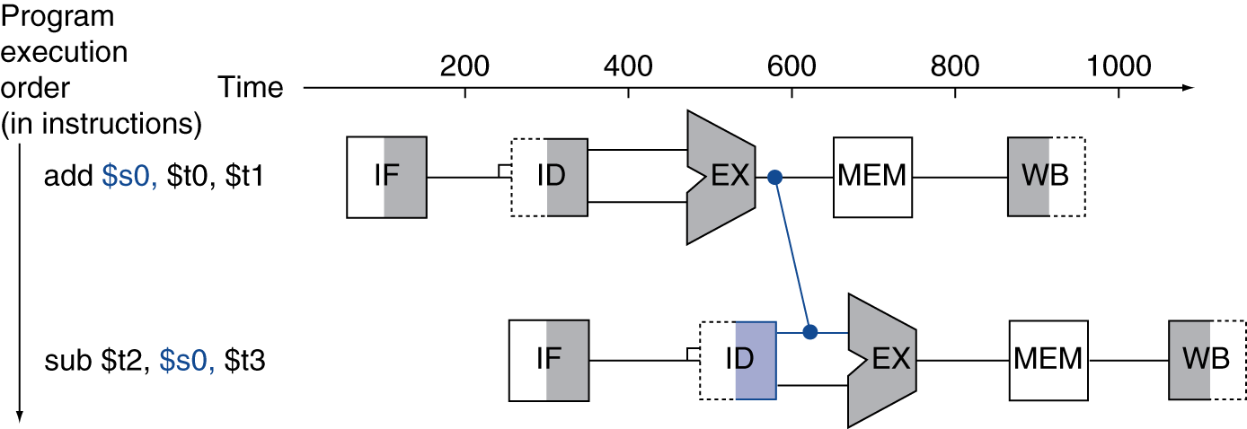
Forwarding (aka Bypassing)
Use result when it is computed
  Don’t wait for it to be stored in a register
  Requires extra connections in the datapath
Chapter 4 — The Processor — <number>
P-H 337
Notes:
Morgan Kaufmann Publishers
Chapter 4 — The Processor

Slide 12
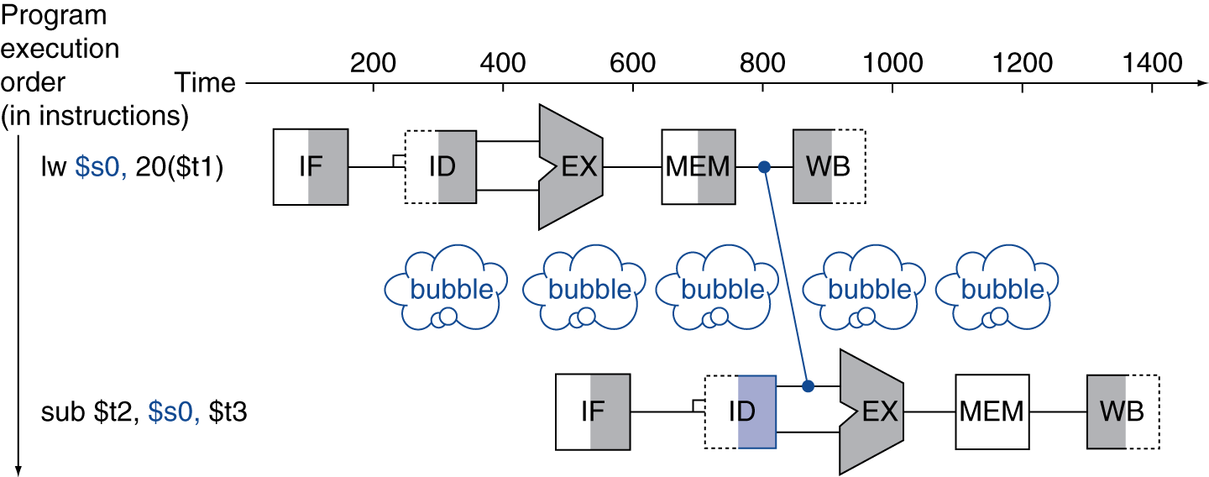
Load-Use Data Hazard
Can’t always avoid stalls by forwarding
  If value has not been computed when needed
  Can’t forward backward in time!
Chapter 4 — The Processor — <number>
P-H 338
Notes:
Morgan Kaufmann Publishers
Chapter 4 — The Processor

Slide 13
Example of Code Scheduling to Avoid Stalls
Generate assembly for the following C statements:
A = B + E;
C = B + F;
Chapter 4 — The Processor — <number>
P-H 339
Notes:
Morgan Kaufmann Publishers
Chapter 4 — The Processor

Slide 14
1
2
3
4
5
6
7
8
9
10
11
12
13
lw $t1, 0($t0)
lw $t2, 4($t0)
add $t3, $t1, $t2
sw $t3, 12($t0)
lw $t4, 8($t0)
add $t5, $t1, $t4
sw $t5, 16($t0)
IF
ID
EX
ME
WB
IF
ID
EX
ME
WB
13 cycles
IF
ID
EX
ME
WB
IF
ID
EX
ME
WB
IF
ID
EX
ME
WB
IF
ID
EX
ME
WB
IF
ID
EX
ME
WB
lw $t1, 0($t0)
lw $t2, 4($t0)
lw $t4, 8($t0)
add $t3, $t1, $t2
sw $t3, 12($t0)
add $t5, $t1, $t4
sw $t5, 16($t0)
IF
ID
EX
ME
WB
IF
ID
EX
ME
WB
11 cycles
IF
ID
EX
ME
WB
IF
ID
EX
ME
WB
IF
ID
EX
ME
WB
IF
ID
EX
ME
WB
IF
ID
EX
ME
WB

Slide 15
Control Hazards
Branch determines flow of control
  Fetching next instruction depends on branch outcome
  Pipeline can’t always fetch correct instruction
    Still working on ID stage of branch
In MIPS pipeline
  Need to compare registers and compute target early in the pipeline
  Add hardware to do it in ID stage
Chapter 4 — The Processor — <number>
P-H 340
Notes:
Morgan Kaufmann Publishers
Chapter 4 — The Processor

Slide 16
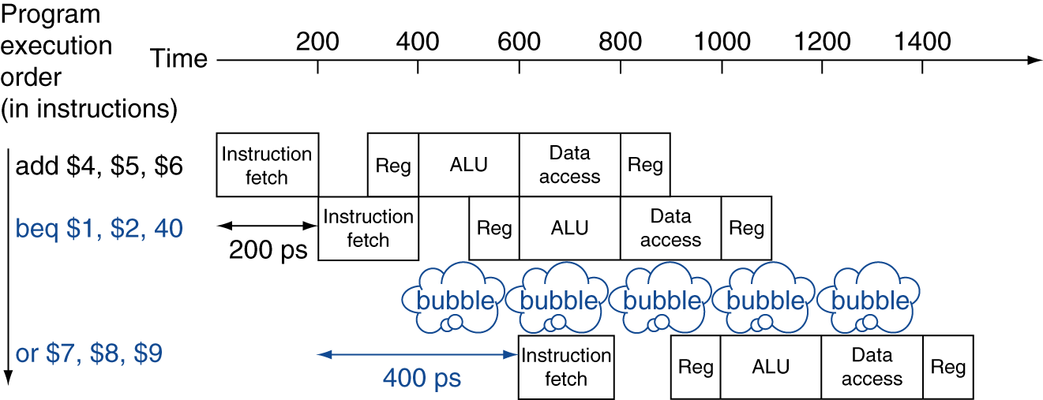
Stall on Branch
Wait until branch outcome determined before fetching next instruction
Chapter 4 — The Processor — <number>
P-H 340
Notes:
Morgan Kaufmann Publishers
Chapter 4 — The Processor

Slide 17
Branch Prediction
Longer pipelines can’t readily determine branch outcome early
  Stall penalty becomes unacceptable
Predict outcome of branch
  Only stall if prediction is wrong
In MIPS pipeline
  Can predict branches not taken
  Fetch instruction after branch, with no delay
Chapter 4 — The Processor — <number>
Notes:
Morgan Kaufmann Publishers
Chapter 4 — The Processor

Slide 18
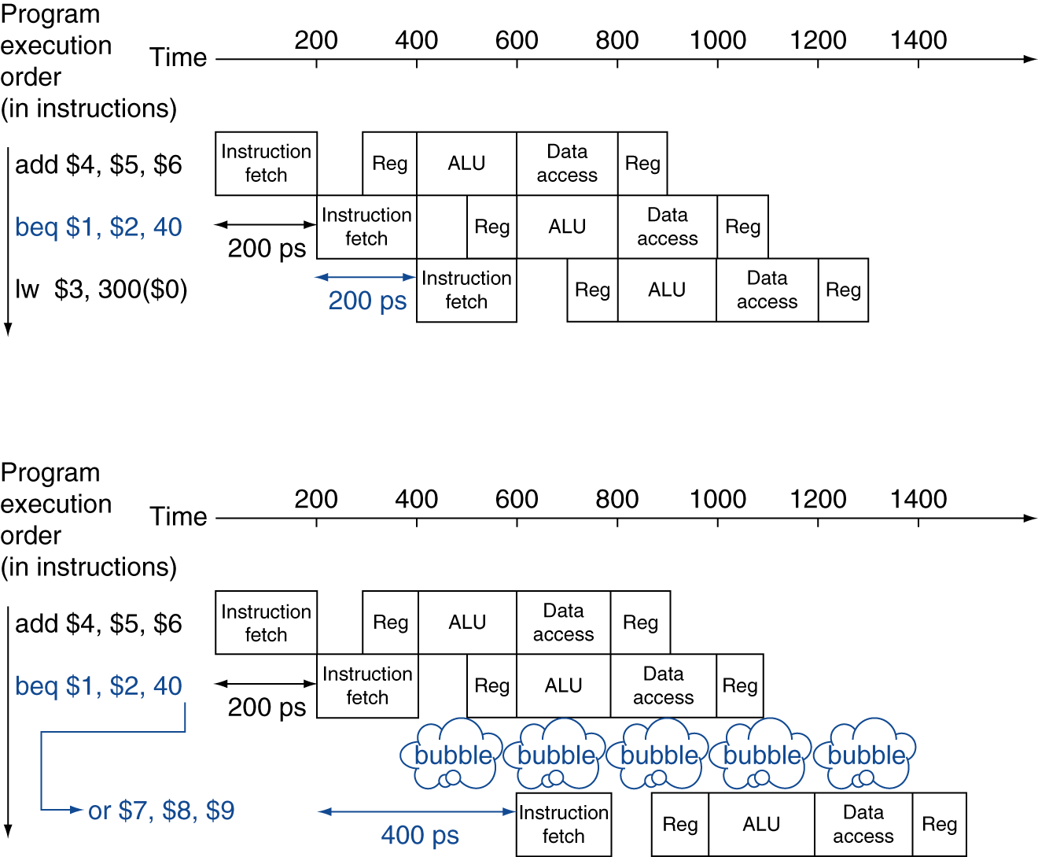
MIPS with Predict Not Taken
Prediction correct
Prediction incorrect
Chapter 4 — The Processor — <number>
P-H 342
Notes:
Morgan Kaufmann Publishers
Chapter 4 — The Processor

Slide 19
More-Realistic Branch Prediction
Static branch prediction
  Based on typical branch behavior
  Example: loop and if-statement branches
    Predict backward branches taken
    Predict forward branches not taken
Dynamic branch prediction
  Hardware measures actual branch behavior
    e.g., record recent history of each branch
  Assume future behavior will continue the trend
    When wrong, stall while re-fetching, and update history
Chapter 4 — The Processor — <number>
P-H 343
Notes:
Morgan Kaufmann Publishers
Chapter 4 — The Processor

Slide 20
Pipeline Summary
The BIG Picture
Pipelining improves performance by increasing instruction throughput
  Executes multiple instructions in parallel
  Does not reduce each instruction’s latency
Subject to hazards
  Structure, data, control
Instruction set design affects complexity of pipeline implementation
Chapter 4 — The Processor — <number>
P-H 344
Notes:
Morgan Kaufmann Publishers
Chapter 4 — The Processor

Slide 21
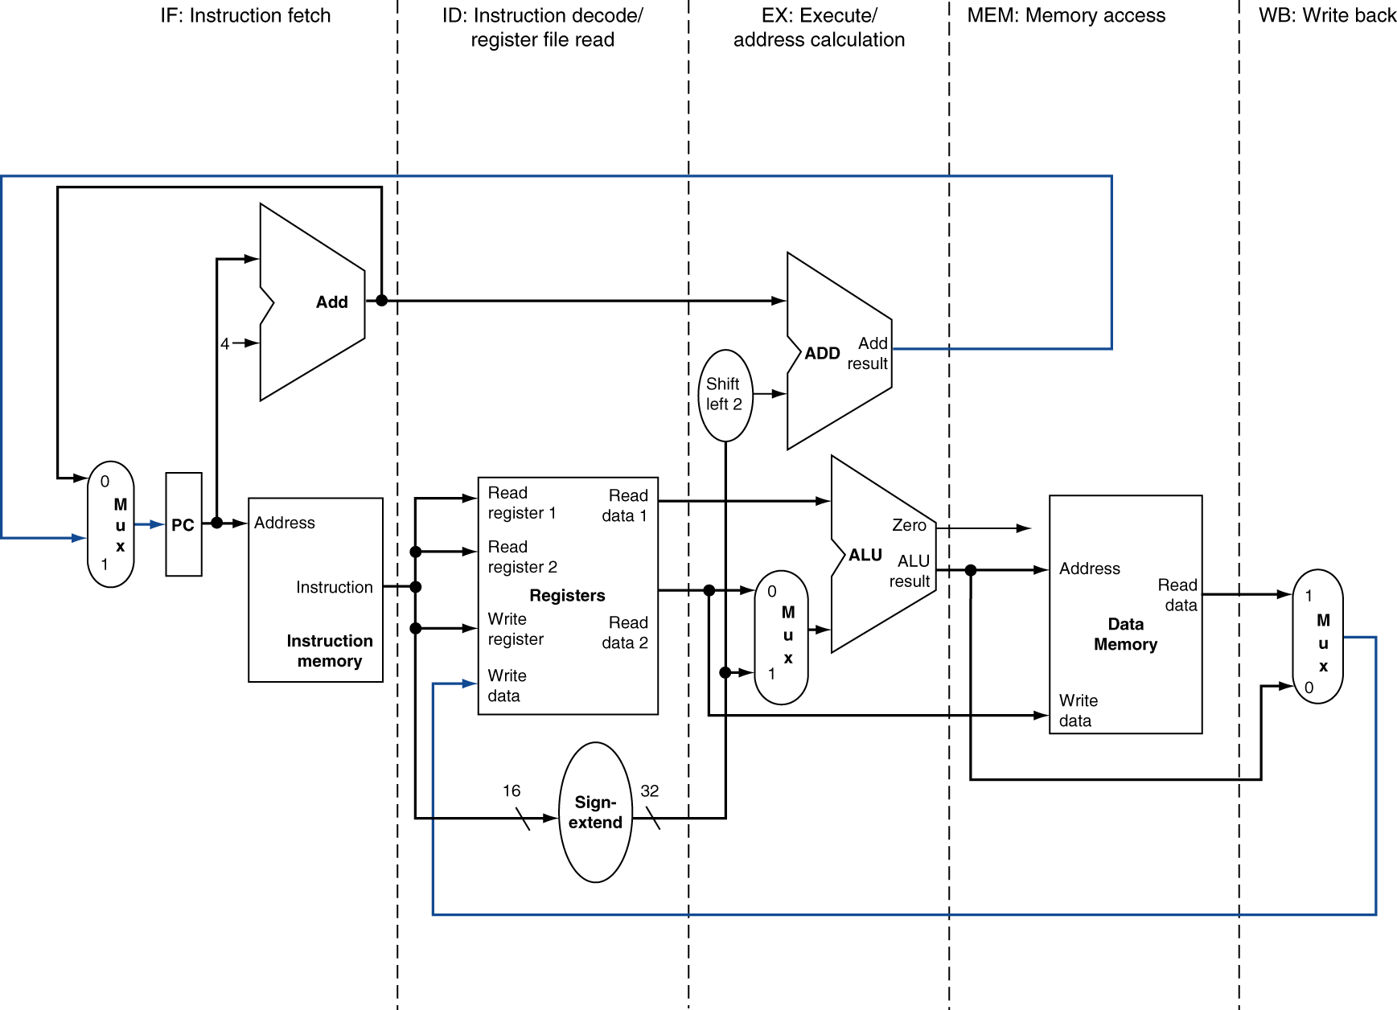
MIPS Pipelined Datapath
Signals flow left-to-right
Control hazard
§4.6 Pipelined Datapath and Control
MEM
WB
Two right-to-left flows:
write back to registers
next value of PC
Data hazard
Chapter 4 — The Processor — <number>
P-H 345
Notes:
Morgan Kaufmann Publishers
Chapter 4 — The Processor

Slide 22
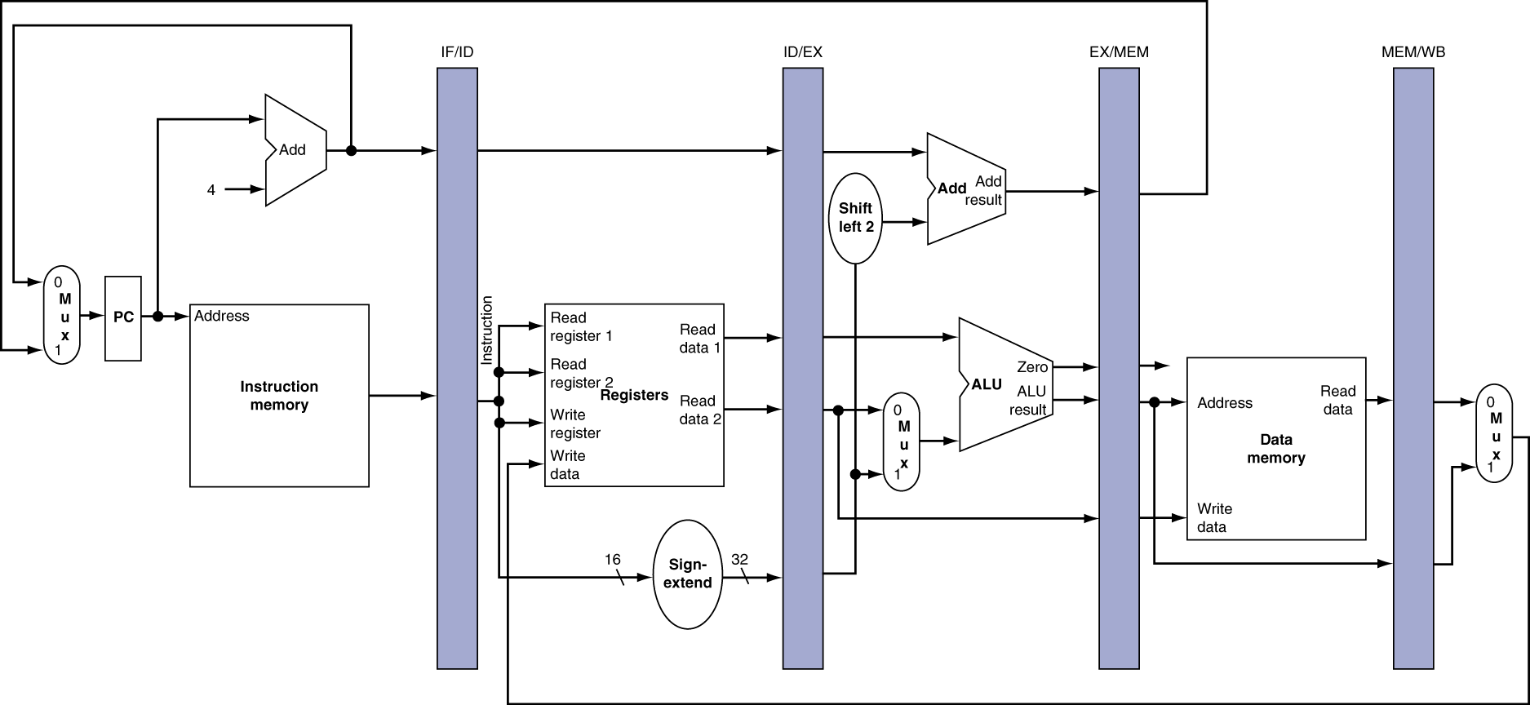
Pipeline registers
Need registers between stages
  To hold information produced in previous cycle
Chapter 4 — The Processor — <number>
P-H 347
Notes:
Morgan Kaufmann Publishers
Chapter 4 — The Processor

Slide 23
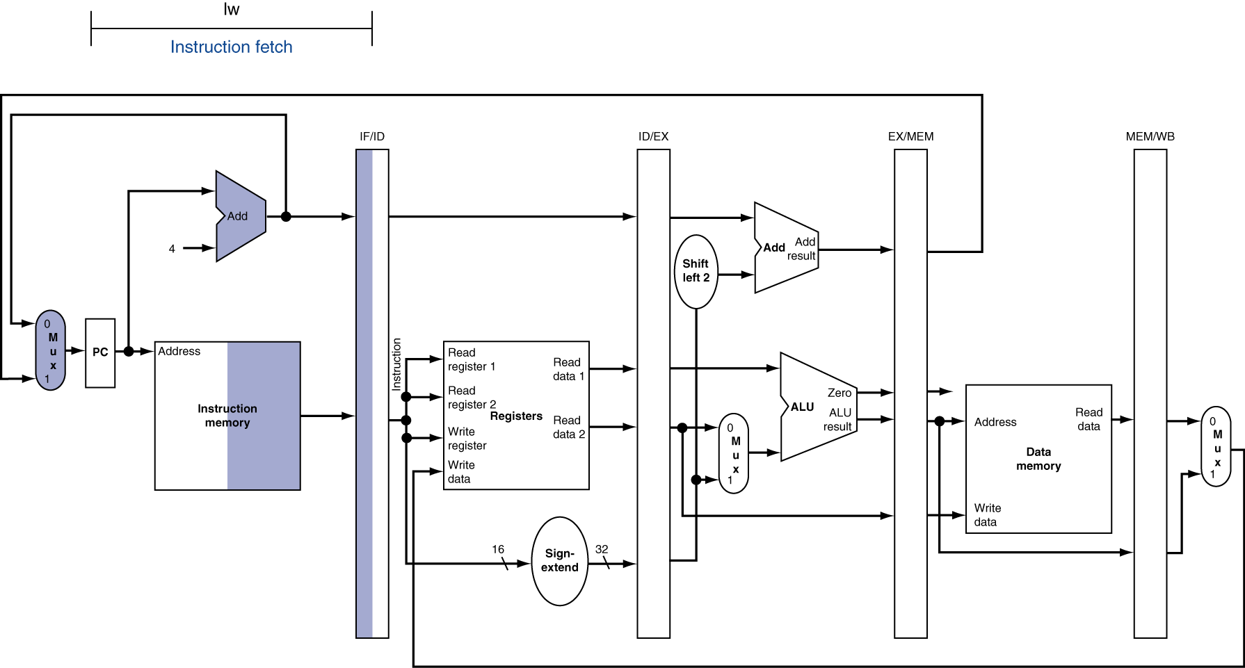
Instr. Fetch (IF) for Load, Store, …
Chapter 4 — The Processor — <number>
P-H 349
Notes:
Morgan Kaufmann Publishers
Chapter 4 — The Processor

Slide 24
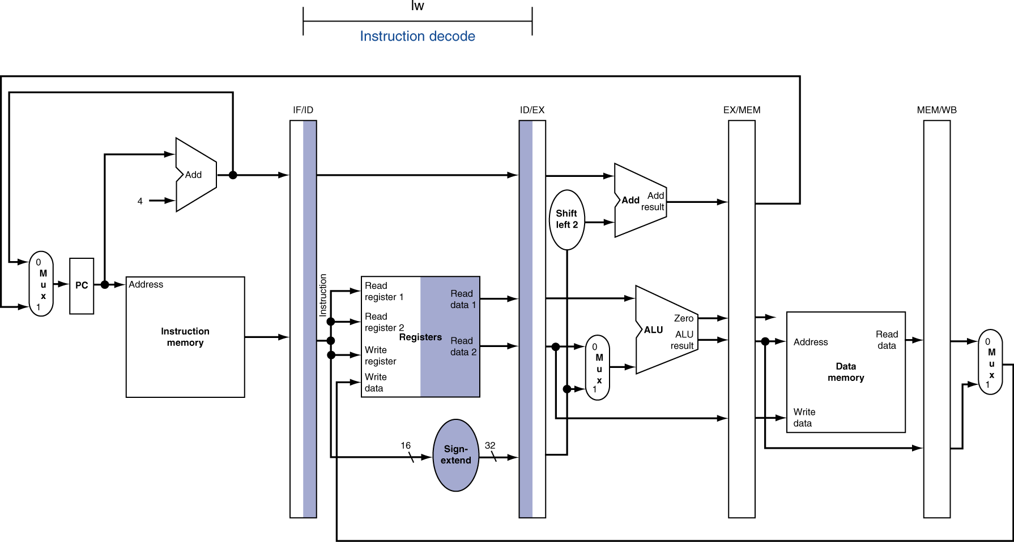
Instr. Decode (ID) for Load, Store, …
Chapter 4 — The Processor — <number>
P-H 349
Notes:
Morgan Kaufmann Publishers
Chapter 4 — The Processor

Slide 25
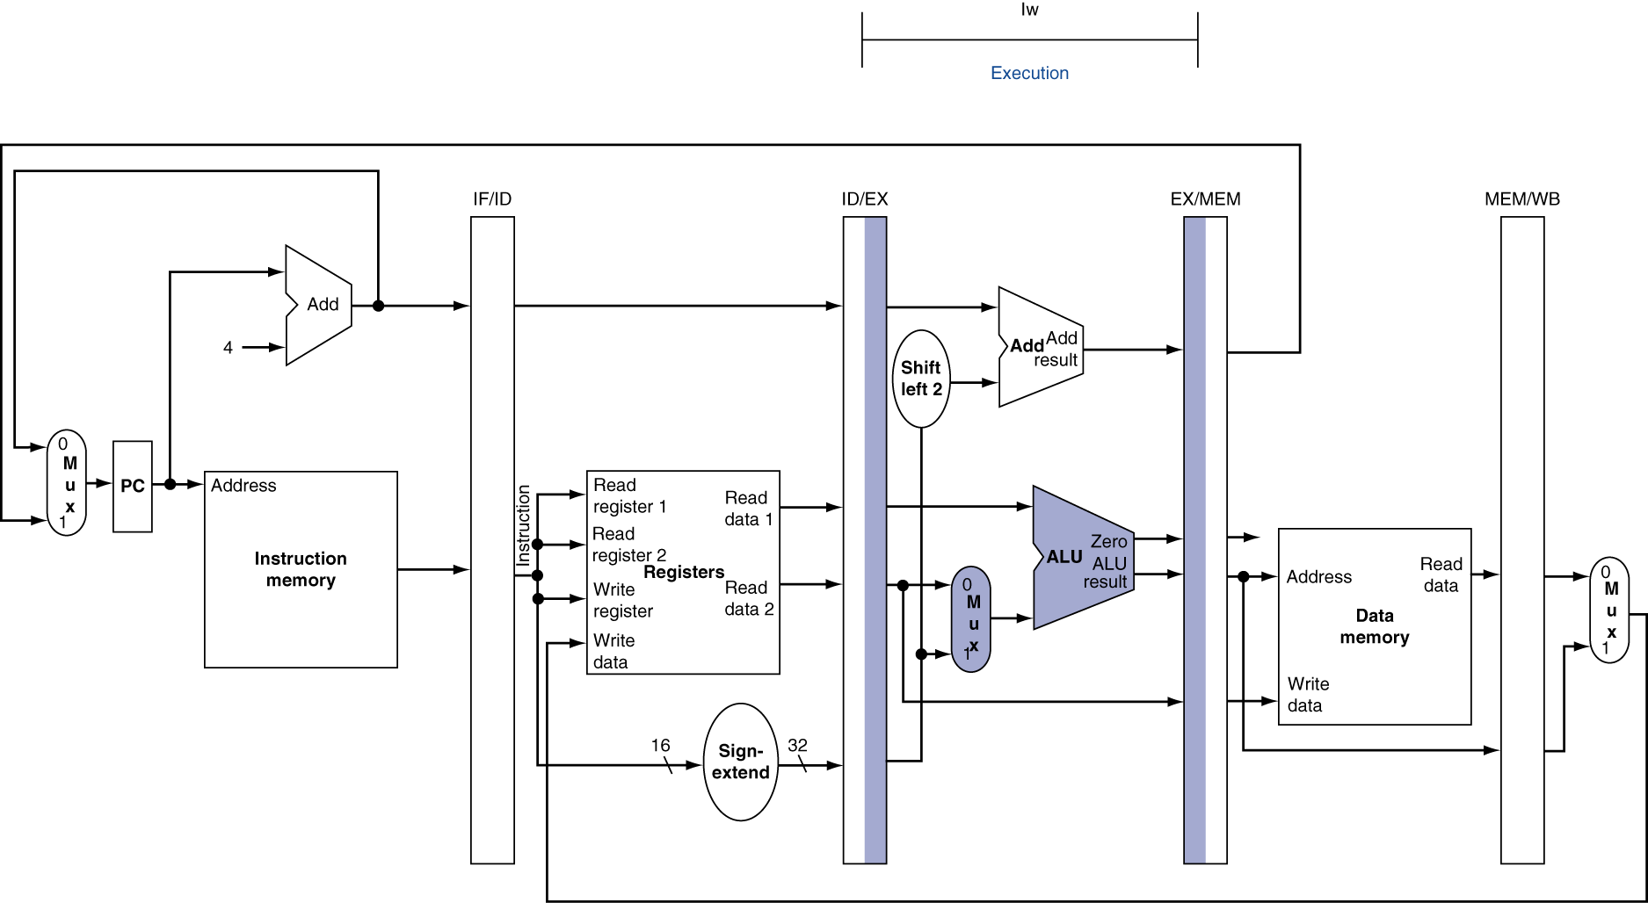
Execution (EX) for Load
Chapter 4 — The Processor — <number>
P-H 350
Notes:
Morgan Kaufmann Publishers
Chapter 4 — The Processor

Slide 26
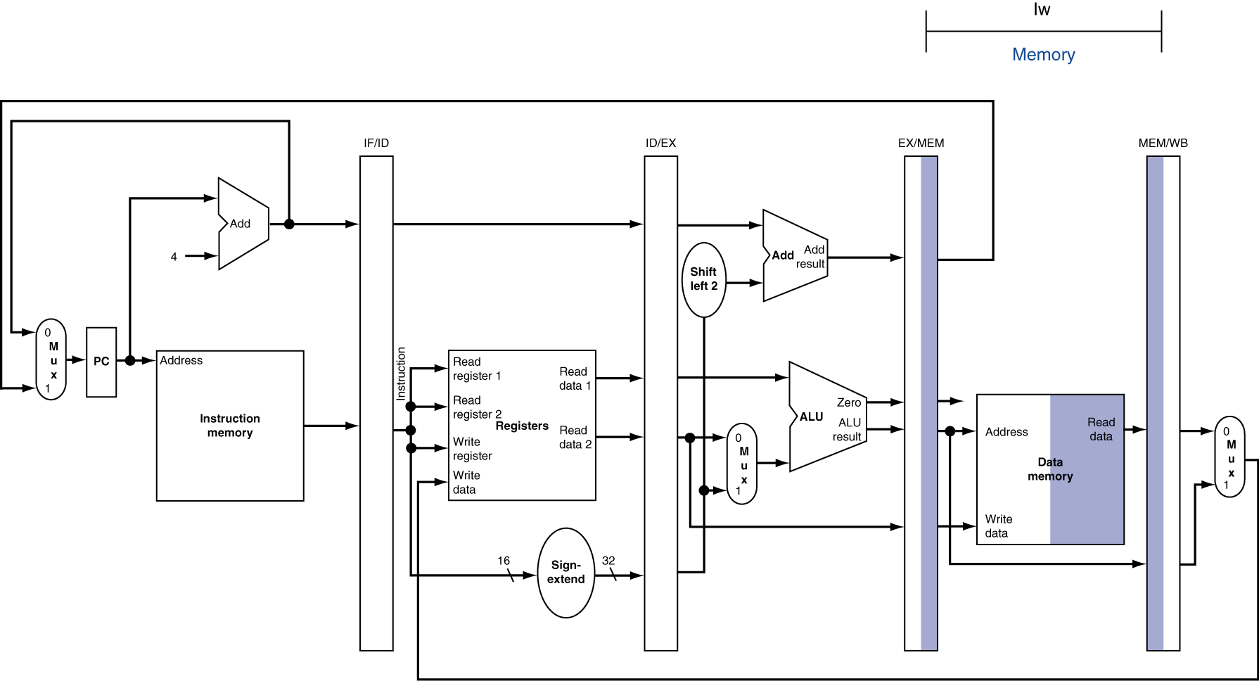
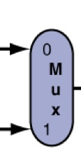
Memory (MEM) for Load
PC
Chapter 4 — The Processor — <number>
P-H 353
Notes:
Morgan Kaufmann Publishers
Chapter 4 — The Processor

Slide 27
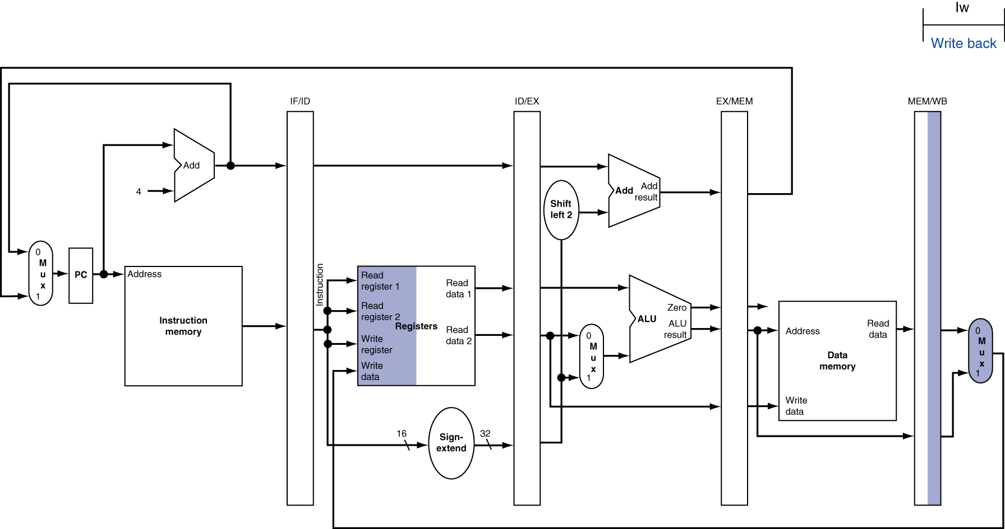
Write Back (WB) for Load
Wrong
register
number
Chapter 4 — The Processor — <number>
P-H 354
Notes:
Morgan Kaufmann Publishers
Chapter 4 — The Processor

Slide 28
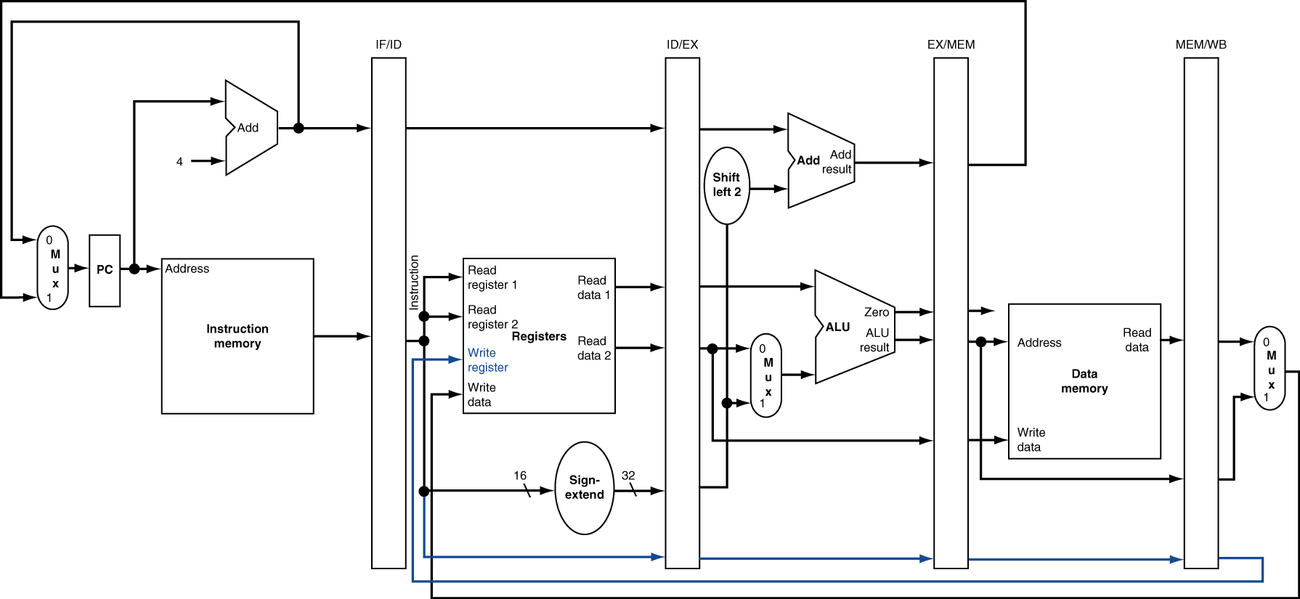
Corrected Datapath for Load
Chapter 4 — The Processor — <number>
P-H 355
Notes:
Morgan Kaufmann Publishers
Chapter 4 — The Processor

Slide 29

EX for Store
Chapter 4 — The Processor — <number>
P-H 353
Notes:
Morgan Kaufmann Publishers
Chapter 4 — The Processor

Slide 30
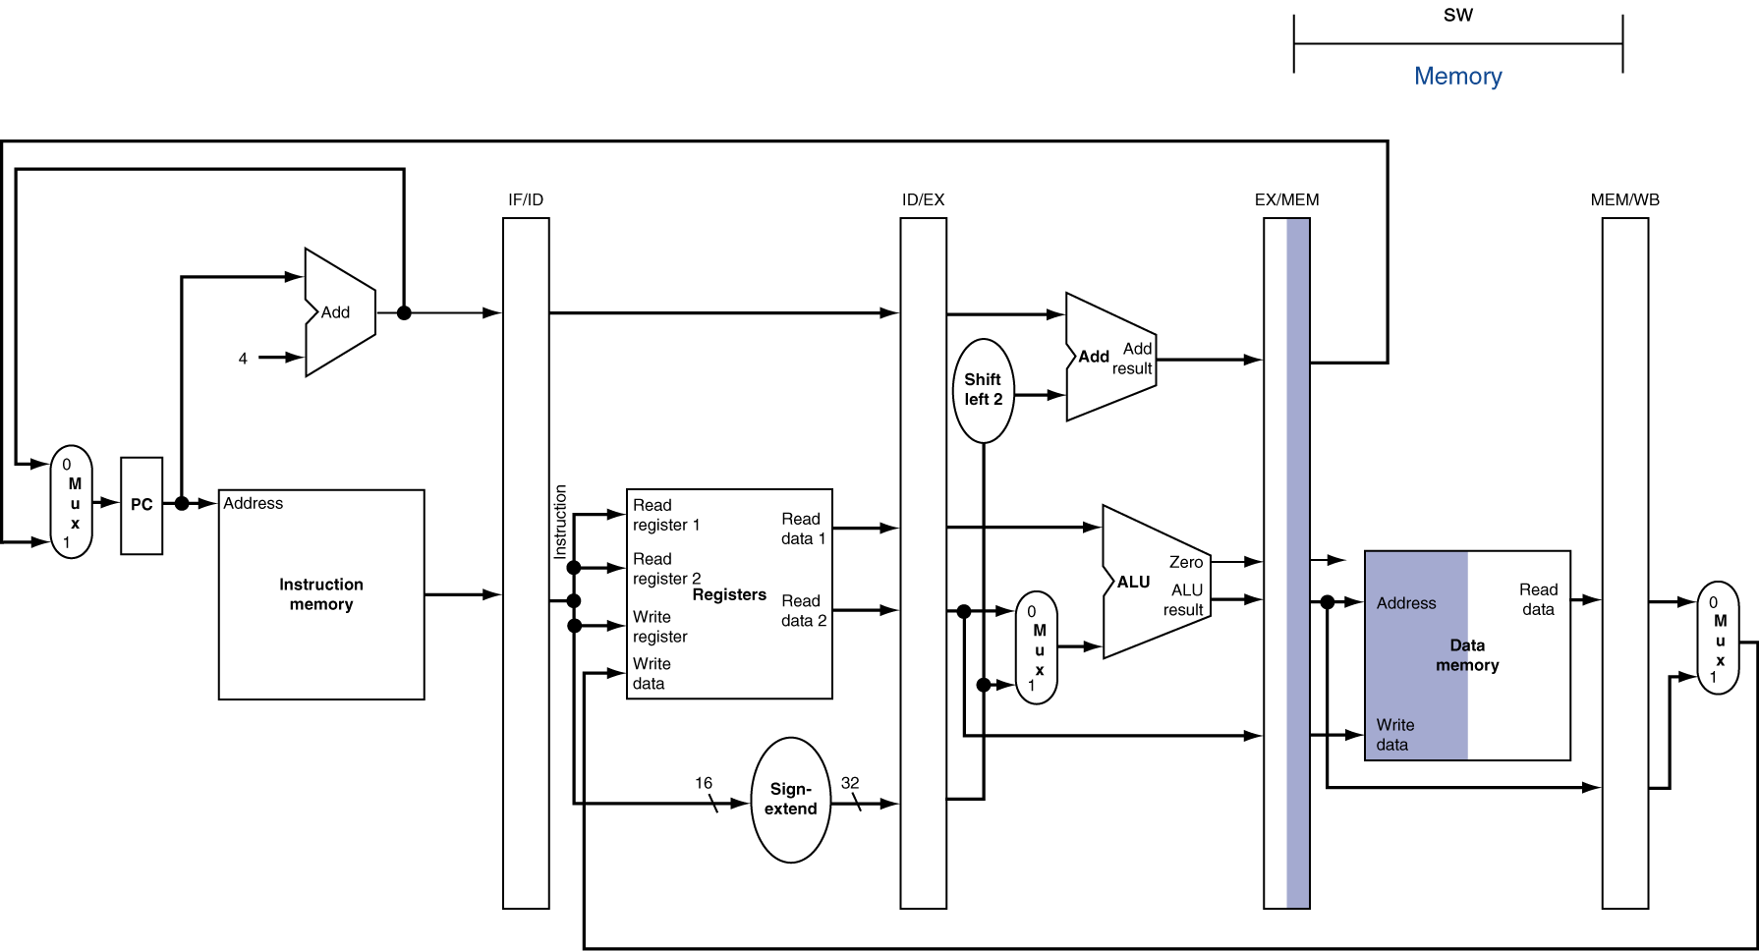
MEM for Store
Chapter 4 — The Processor — <number>
P-H 354
Notes:
Morgan Kaufmann Publishers
Chapter 4 — The Processor

Slide 31
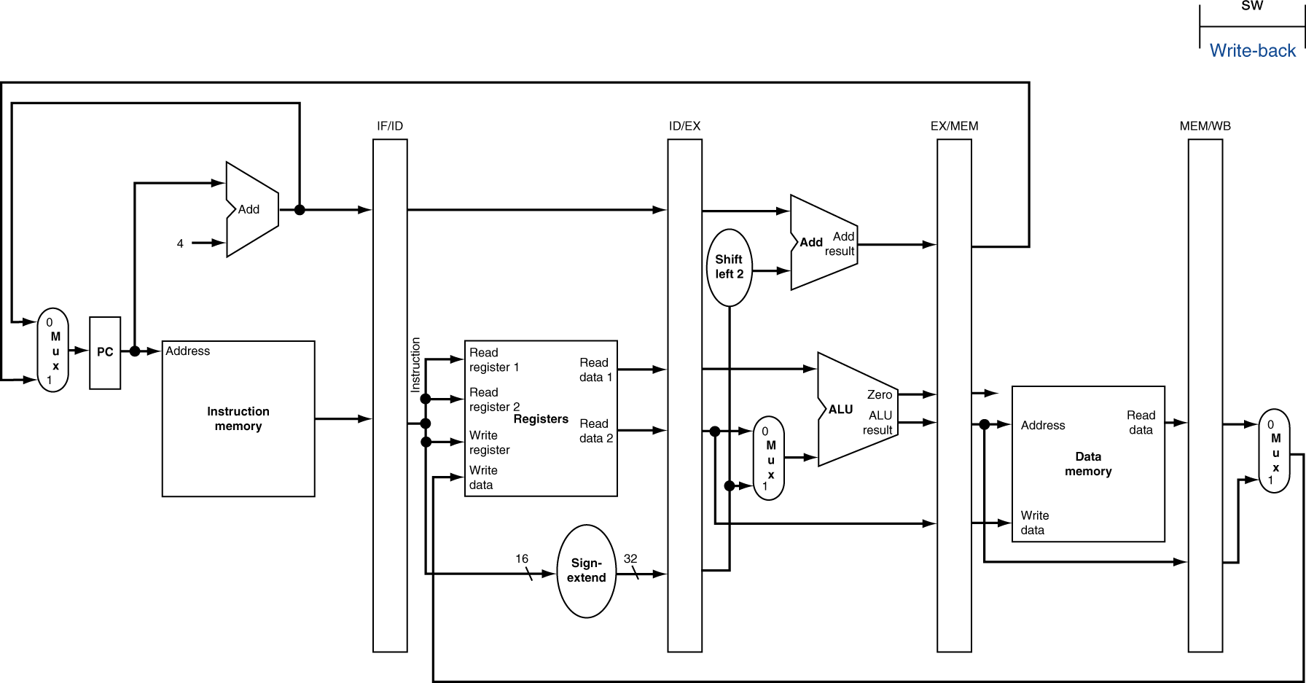
WB for Store
Chapter 4 — The Processor — <number>
P-H 354
Notes:
Morgan Kaufmann Publishers
Chapter 4 — The Processor

Slide 32
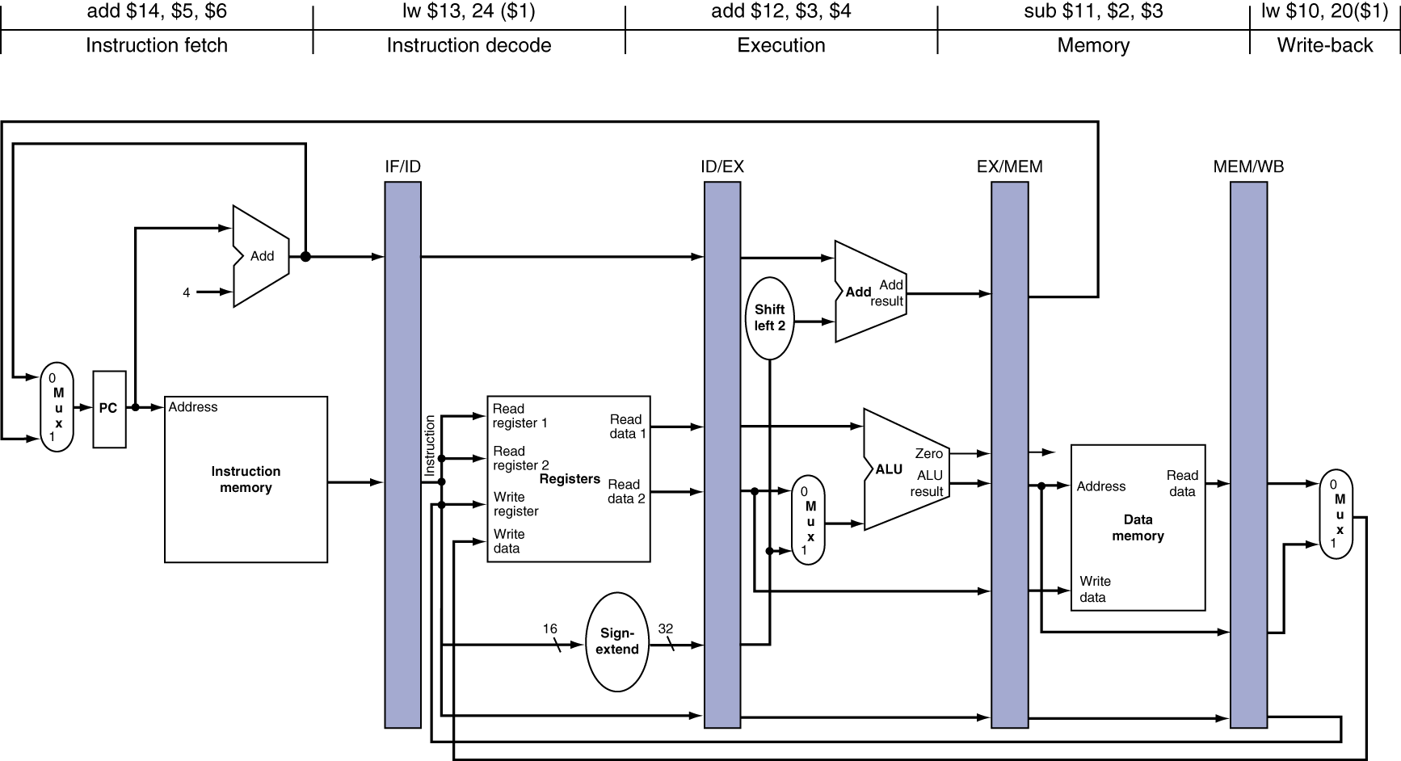
Pipeline Diagram
State of pipeline in a given cycle
Chapter 4 — The Processor — <number>
P-H 358
Notes:
Morgan Kaufmann Publishers
Chapter 4 — The Processor

Slide 33
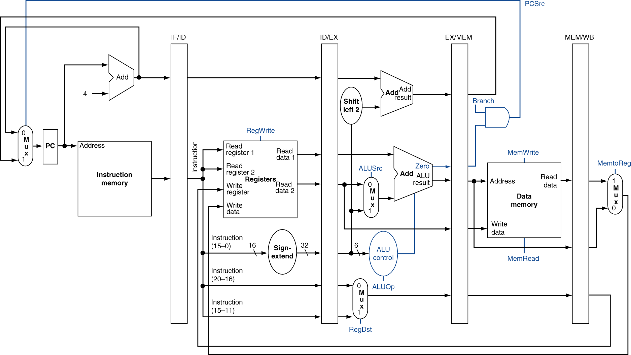
Pipelined Control (Simplified)
Control signals are
very similar to the
simple single-cycle
datapath design.
Chapter 4 — The Processor — <number>
P-H 359
Notes:
Morgan Kaufmann Publishers
Chapter 4 — The Processor

Slide 34
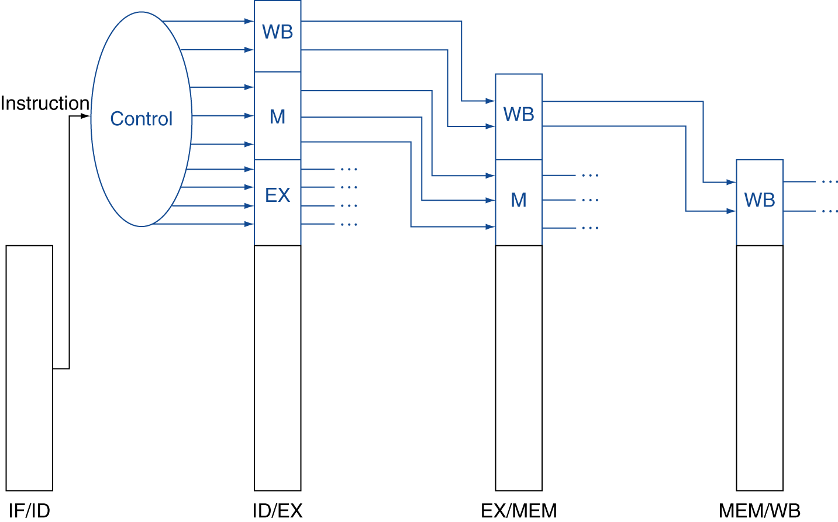
Pipelined Control
Control signals derived from instruction
  As in single-cycle implementation
All control signals
are created in the
decode stage.
Inter-stage registers only need to store
control signals that will be used later.
Chapter 4 — The Processor — <number>
P-H 361
Notes:
Morgan Kaufmann Publishers
Chapter 4 — The Processor

Slide 35
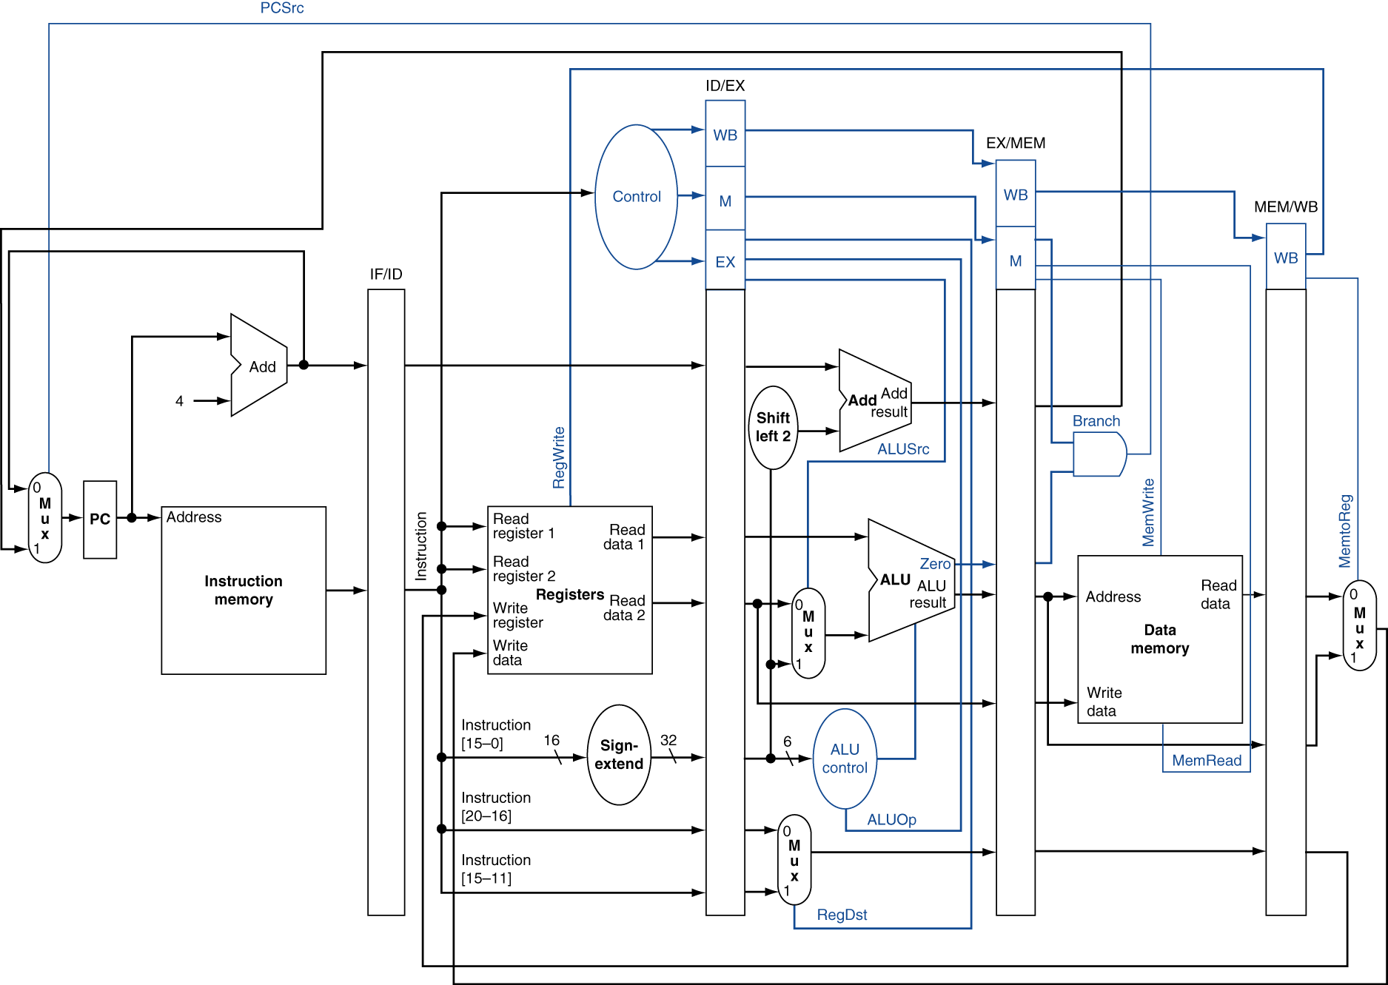
Pipelined Control
Same representation
but with control lines
connected to to proper
stages.
Chapter 4 — The Processor — <number>
P-H 362
Notes:
Morgan Kaufmann Publishers
Chapter 4 — The Processor

Slide 36
Data Hazards in ALU Instructions
Consider this sequence:
  sub $2, $1,$3
  and $12,$2,$5
  or $13,$6,$2
  add $14,$2,$2
  sw $15,100($2)
§4.7 Data Hazards: Forwarding vs. Stalling
For this example, assume that $2 = 10 before the sub instruction
and that $2 = -20 after the sub instruction.
Chapter 4 — The Processor — <number>
P-H 363
Notes:
Morgan Kaufmann Publishers
Chapter 4 — The Processor

Slide 37
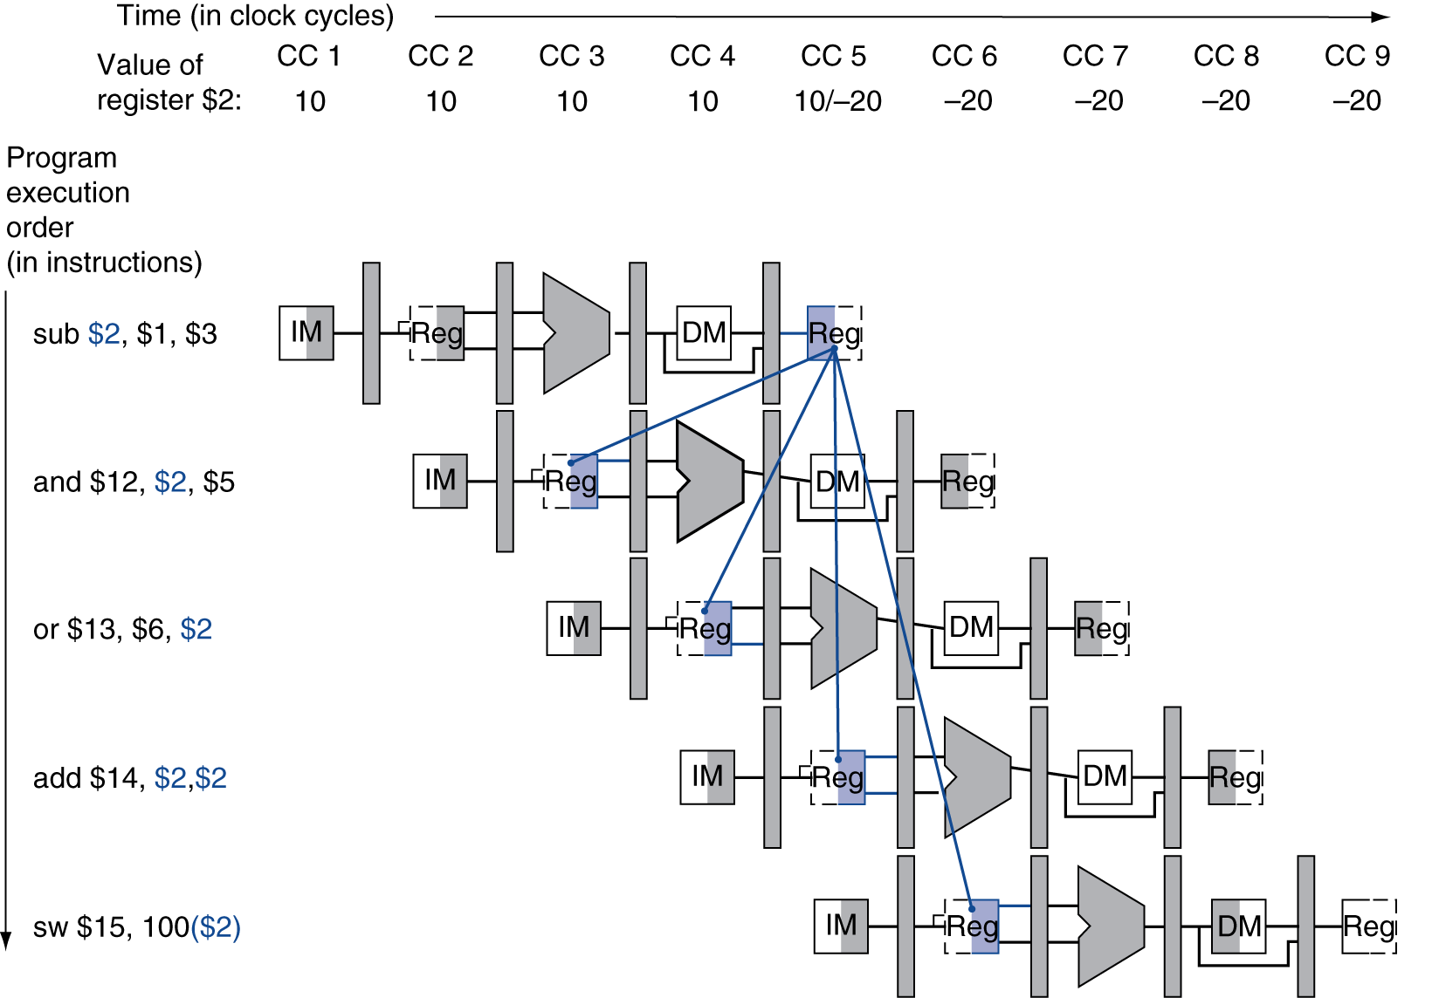
Dependencies & Forwarding
We can resolve data
hazards with forwarding
wrong
value
of $2
wrong
value
of $2
Chapter 4 — The Processor — <number>
P-H 364
Notes:
Morgan Kaufmann Publishers
Chapter 4 — The Processor

Slide 38
Detecting the Need to Forward
(only discuss forwarding to EX stage)
Notation:
  e.g., ID/EX.RegisterRs = register number for Rs sitting in ID/EX pipeline register
Chapter 4 — The Processor — <number>
P-H 365
Notes:
Morgan Kaufmann Publishers
Chapter 4 — The Processor

Slide 39
ALU operand register numbers in EX stage are given by
  ID/EX.RegisterRs
  ID/EX.RegisterRt
Chapter 4 — The Processor — <number>
P-H 365
Notes:
Morgan Kaufmann Publishers
Chapter 4 — The Processor

Slide 40
Detecting the Need to Forward
(only discuss forwarding to EX stage)
Data hazards when either:
  1a. EX/MEM.RegisterRd = ID/EX.RegisterRs
  1b. EX/MEM.RegisterRd = ID/EX.RegisterRt
Fwd from
EX/MEM
pipeline reg
  2a. MEM/WB.RegisterRd = ID/EX.RegisterRs
  2b. MEM/WB.RegisterRd = ID/EX.RegisterRt
Fwd from
MEM/WB
pipeline reg
P-H 365
Notes:
Morgan Kaufmann Publishers
Chapter 4 — The Processor

Slide 41
Detecting the Need to Forward
But only if forwarding instruction will write to a register!
  EX/MEM.RegWrite, MEM/WB.RegWrite
And only if Rd for that instruction is not $zero
  EX/MEM.RegisterRd ≠ 0,
  MEM/WB.RegisterRd ≠ 0
Chapter 4 — The Processor — <number>
P-H 365
Notes:
Morgan Kaufmann Publishers
Chapter 4 — The Processor

Slide 42
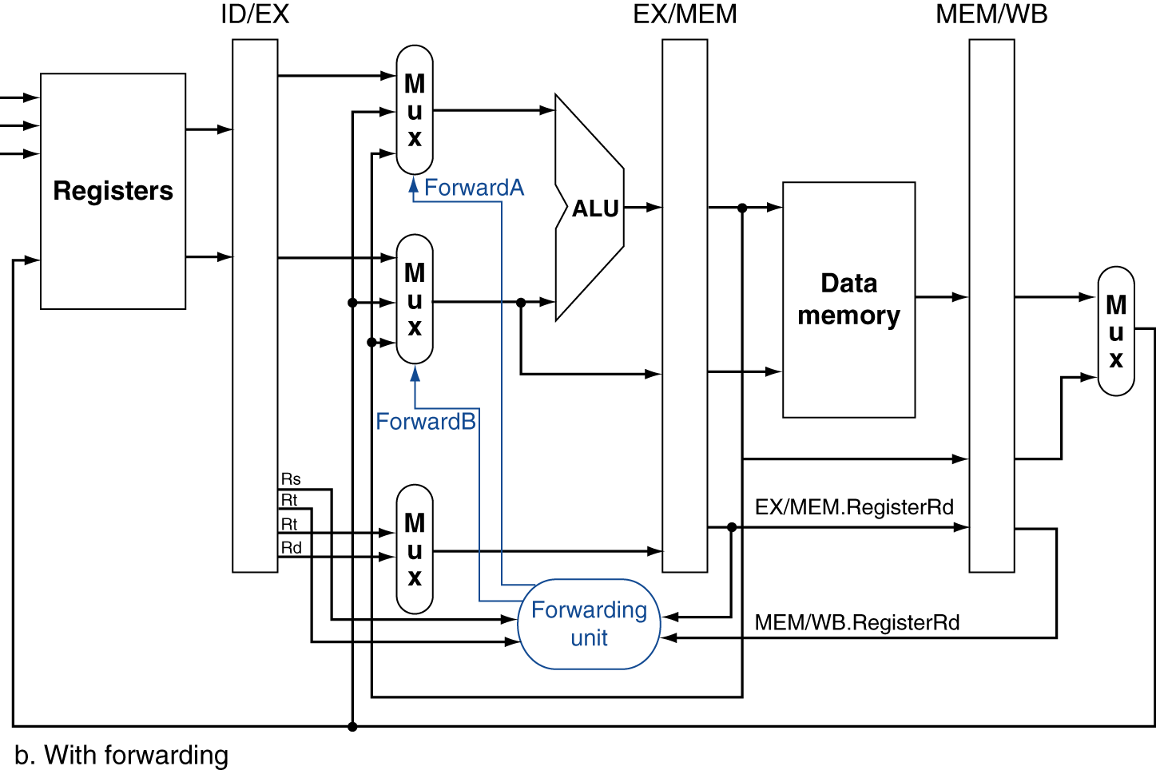
Forwarding Paths
Chapter 4 — The Processor — <number>
P-H 368
Notes:
Morgan Kaufmann Publishers
Chapter 4 — The Processor

Slide 43
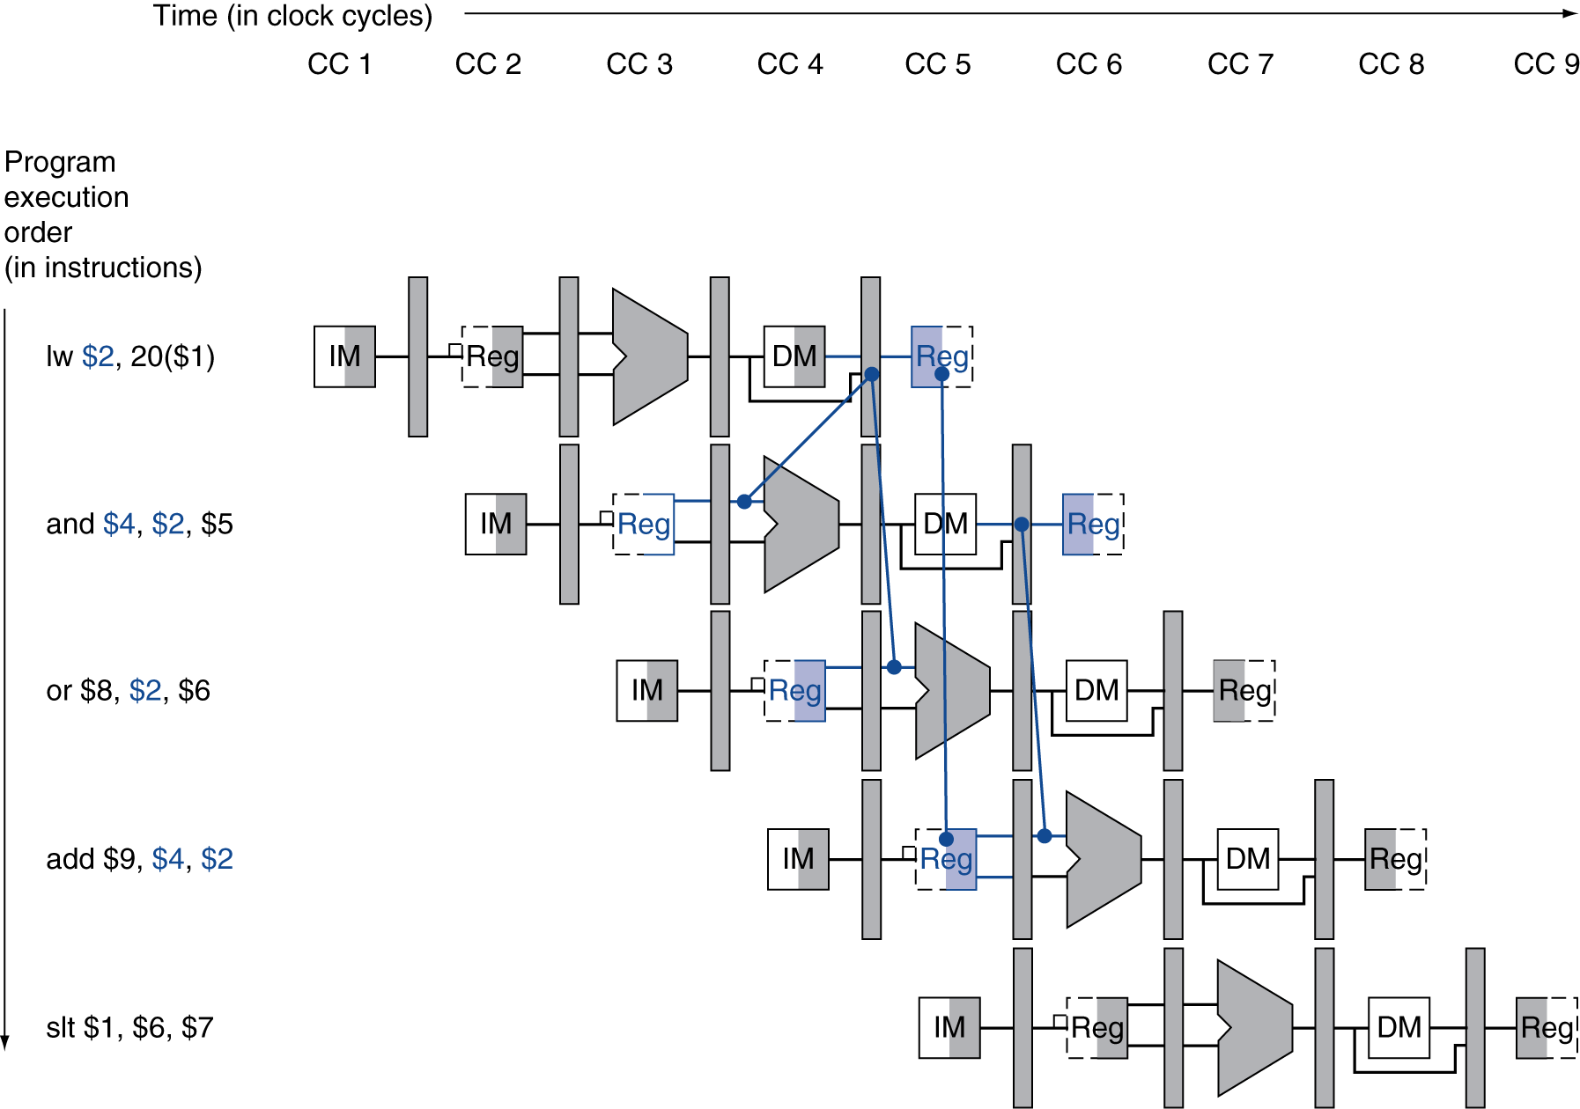
Load-Use Data Hazard
Need to stall for one cycle
Chapter 4 — The Processor — <number>
P-H 372
Notes:
Morgan Kaufmann Publishers
Chapter 4 — The Processor

Slide 44
Load-Use Hazard Detection
Check for load-use hazard:
  At the ID stage of the instruction that uses the value
ALU operand register numbers in ID stage are given by
  IF/ID.RegisterRs, IF/ID.RegisterRt
There is a load-use hazard when:
  ID/EX.MemRead and
  ((ID/EX.RegisterRt = IF/ID.RegisterRs) or
  (ID/EX.RegisterRt = IF/ID.RegisterRt))
If detected, stall and insert bubble
Check to see if it is a load.
P-H 372
Notes:
Morgan Kaufmann Publishers
Chapter 4 — The Processor

Slide 45
How to Stall the Pipeline
Force control values in ID/EX register to 0
  EX, MEM and WB do nop (no-operation)
Prevent update of PC and IF/ID register
  Instruction that uses the value of the load is decoded again
  Following instruction is fetched again
  1-cycle stall allows MEM to read data for lw
    Can subsequently forward to EX stage
Chapter 4 — The Processor — <number>
P-H 373
Notes:
Morgan Kaufmann Publishers
Chapter 4 — The Processor

Slide 46
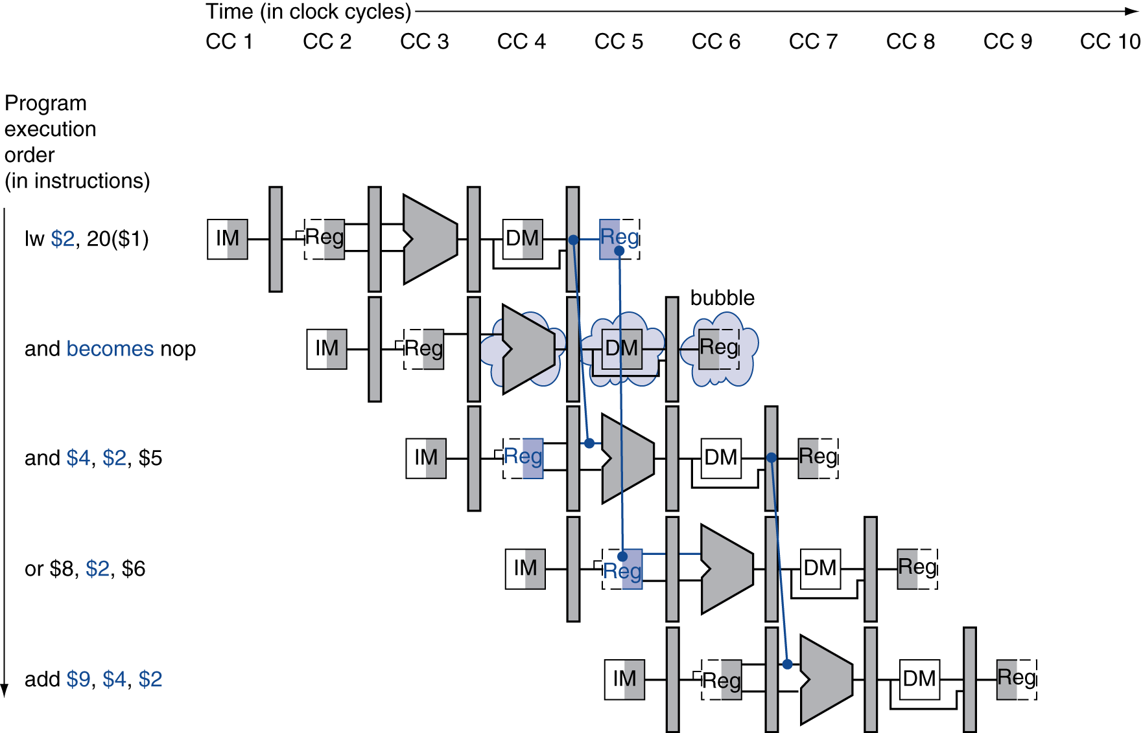
Stall/Bubble in the Pipeline
Stall inserted here
Chapter 4 — The Processor — <number>
P-H 372
Notes:
Morgan Kaufmann Publishers
Chapter 4 — The Processor

Slide 47
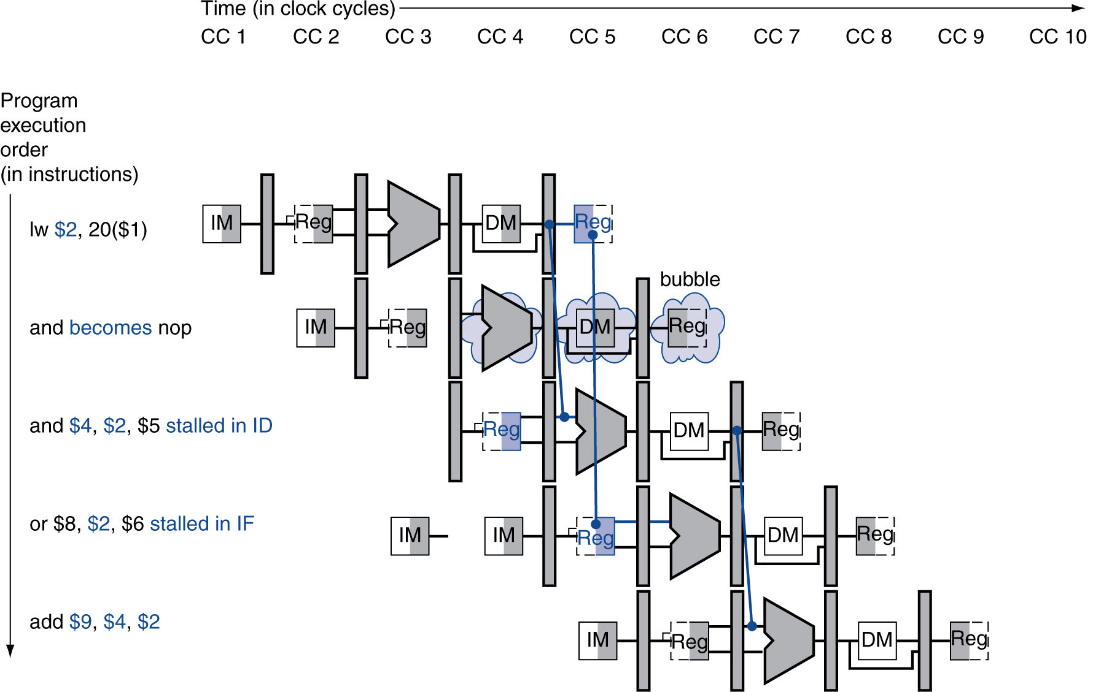
Stall/Bubble in the Pipeline
Or, more accurately…
Chapter 4 — The Processor — <number>
P-H 374
Notes:
Morgan Kaufmann Publishers
Chapter 4 — The Processor

Slide 48
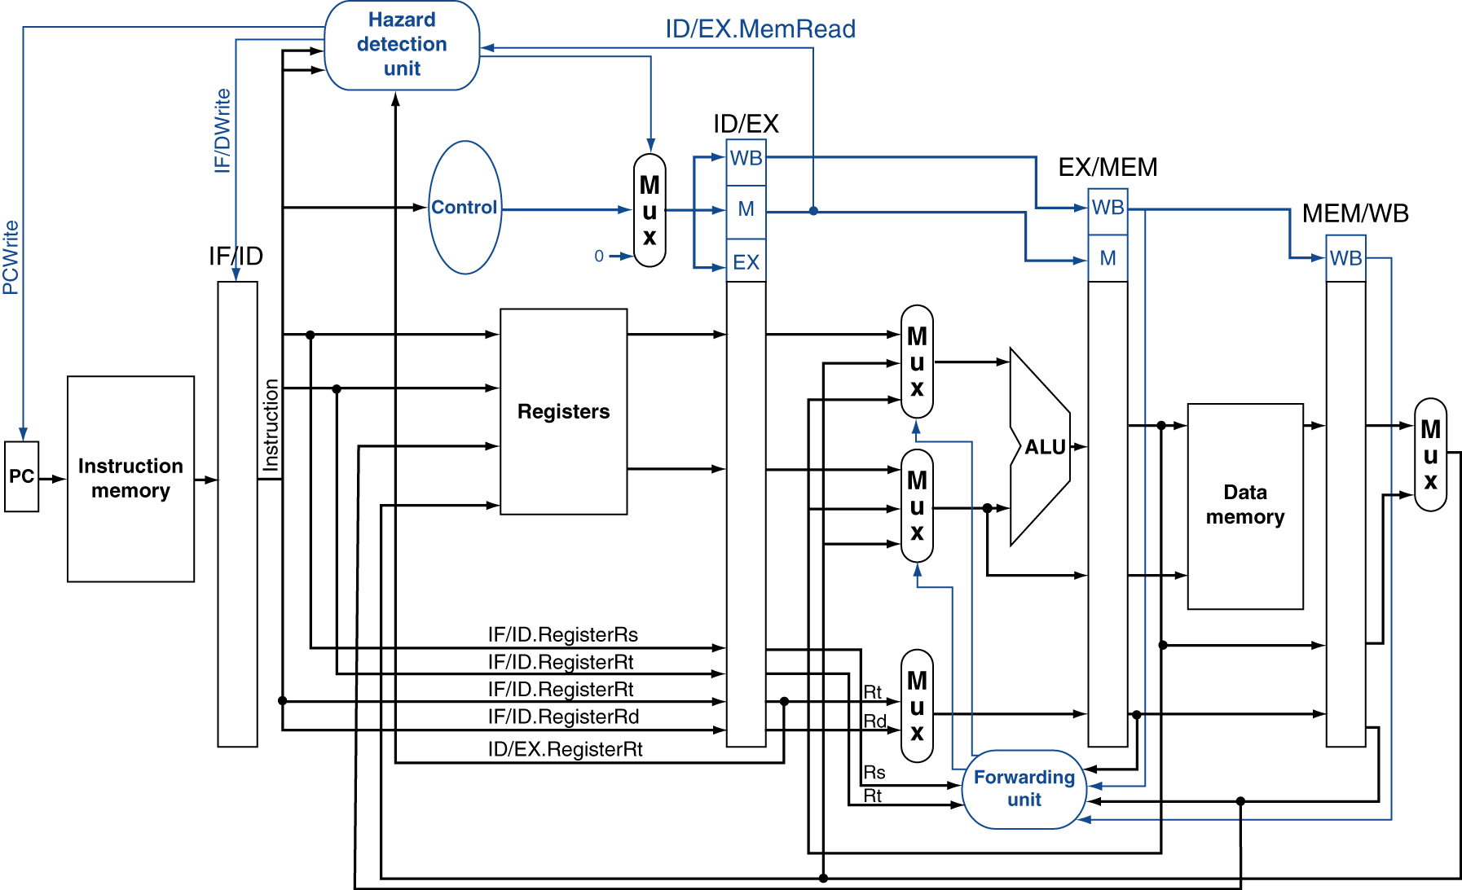
Datapath with Hazard Detection
Chapter 4 — The Processor — <number>
P-H 375
Notes:
Morgan Kaufmann Publishers
Chapter 4 — The Processor

Slide 49
Stalls and Performance
The BIG Picture
Stalls reduce performance
  But are required to get correct results
Compiler can arrange code to avoid hazards and stalls
  Requires knowledge of the pipeline structure
Chapter 4 — The Processor — <number>
P-H 374
Notes:
Morgan Kaufmann Publishers
Chapter 4 — The Processor

Slide 50
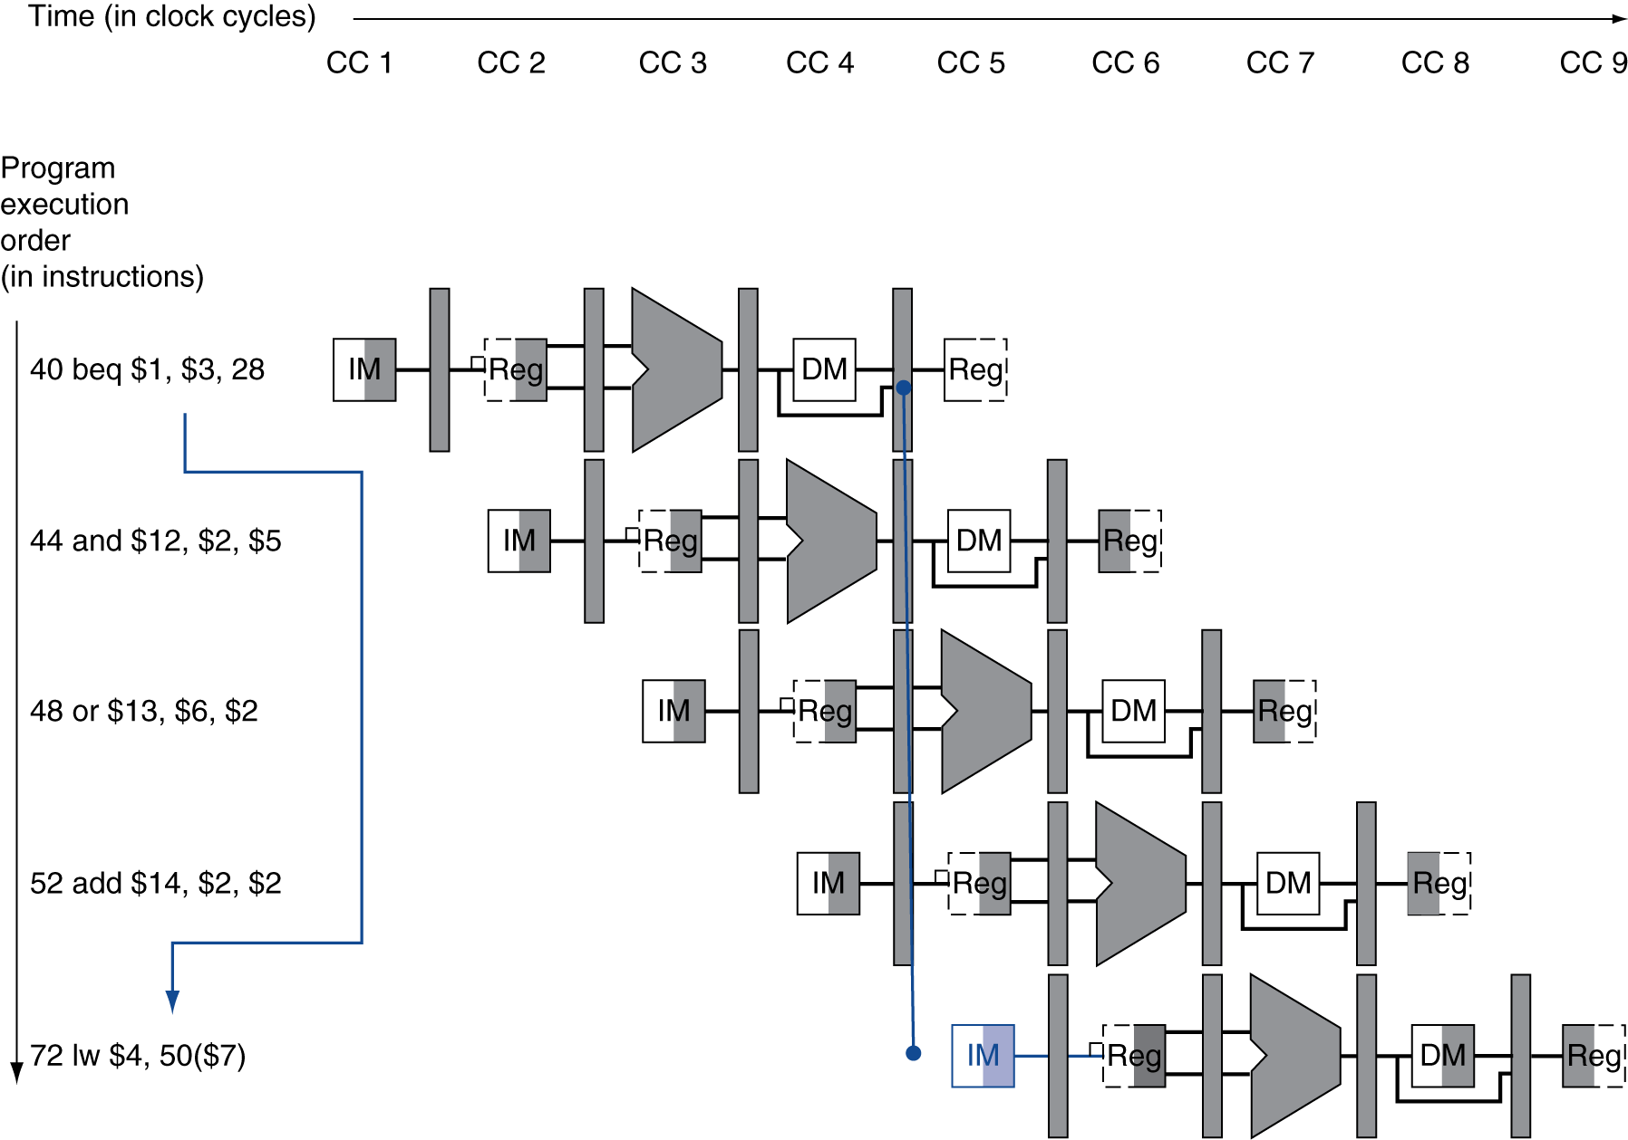
Branch Hazards
§4.8 Control Hazards
If branch outcome determined in MEM
Flush these
instructions
(Set control
values to 0)
PC
Chapter 4 — The Processor — <number>
P-H 376
Notes:
Morgan Kaufmann Publishers
Chapter 4 — The Processor

Slide 51
Reducing Branch Delay
Move hardware that determines outcome of branch to the ID stage:
  Target address adder
  Register comparator
    Will have to forward register values to an earlier pipeline stage.
Chapter 4 — The Processor — <number>
P-H 378
Notes:
Morgan Kaufmann Publishers
Chapter 4 — The Processor

Slide 52
Data Hazards for Branches
If a comparison register is a destination of 2nd or 3rd preceding ALU instruction
add $1, $2, $3
IF
ID
EX
MEM
WB
add $4, $5, $6
IF
ID
EX
MEM
WB
…
IF
ID
EX
MEM
WB
beq $1, $4, target
IF
ID
EX
MEM
WB
Can resolve using forwarding
Chapter 4 — The Processor — <number>
Notes:
Morgan Kaufmann Publishers
Chapter 4 — The Processor

Slide 53
Data Hazards for Branches
If a comparison register is a destination of preceding ALU instruction or 2nd preceding load instruction
  Need 1 stall cycle
lw $1, addr
IF
ID
EX
MEM
WB
add $4, $5, $6
IF
ID
EX
MEM
WB
beq stalled
IF
ID
beq $1, $4, target
ID
EX
MEM
WB
Chapter 4 — The Processor — <number>
Notes:
Morgan Kaufmann Publishers
Chapter 4 — The Processor

Slide 54
Data Hazards for Branches
If a comparison register is a destination of immediately preceding load instruction
  Need 2 stall cycles
lw $1, addr
IF
ID
EX
MEM
WB
beq stalled
IF
ID
beq stalled
ID
beq $1, $0, target
ID
EX
MEM
WB
Chapter 4 — The Processor — <number>
Notes:
Morgan Kaufmann Publishers
Chapter 4 — The Processor

Slide 55
Dynamic Branch Prediction
In deeper and superscalar pipelines, branch penalty is more significant
Use dynamic prediction
  Branch prediction buffer (aka branch history table)
  Indexed by recent branch instruction addresses
  Stores outcome (taken/not taken)
  To execute a branch
    Check table, expect the same outcome
    Start fetching from fall-through or target
    If wrong, flush pipeline and flip prediction
Chapter 4 — The Processor — <number>
Notes:
Morgan Kaufmann Publishers
Chapter 4 — The Processor

Slide 56
1-Bit Predictor (Example)
m ≤ 0
for(i=0 ; i < m ; i++)
for(j=0; j<n ; j++)
begin S1; S2; …; Sk end;
i ← 0
1-bit
n ≥ 0
i
j
Pred
Outc
0
0
NT
T
j ← 0
0
1
T
T
S1; S2; …; Sk
0
n
T
NT
1
0
NT
T
T
j←j+1
1
1
T
T
j < n
NT
i←i+1
2 × m misspredictions
i < m
i←i+1
Baer p. 134

Slide 57
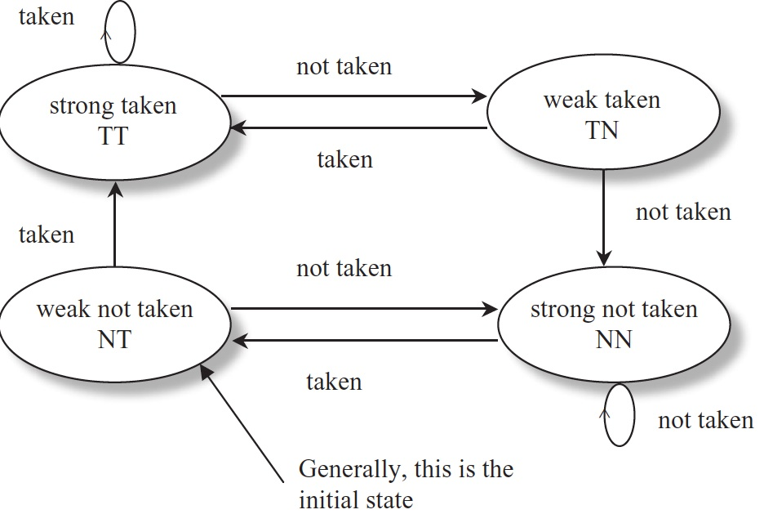
2-Bit Saturating Counter (Example)
m ≤ 0
for(i=0 ; i < m ; i++)
for(j=0; j<n ; j++)
begin S1; S2; …; Sk end;
i ← 0
1-bit
2-bit
n ≥ 0
i
j
Pred
Outc
State
Pred
Outc
0
0
NT
T
wNT
NT
T
j ← 0
0
1
T
T
sT
T
T
S1; S2; …; Sk
0
n
T
NT
sT
T
NT
1
0
NT
T
wT
T
T
T
j←j+1
1
1
T
T
sT
T
T
j < n
NT
i←i+1
i < m
m + 1 misspredictions
i←i+1
Baer p. 134

Slide 58
Calculating the Branch Target
Even with predictor, still need to calculate the target address
  1-cycle penalty for a taken branch
Branch target buffer
  Cache of target addresses
  Indexed by PC when instruction fetched
    If hit and instruction is branch predicted taken, can fetch target immediately
Chapter 4 — The Processor — <number>
Notes:
Morgan Kaufmann Publishers
Chapter 4 — The Processor

Slide 59
Branch Delay Slot
The instruction that appears immediately after a branch is always executed.
  Example:
    sub $s4, $s5, $s6
    beq $s2, $zero, dest
    add $s1, $s2, $s3
    dest: srli $s2, $s3, 4
This instruction is
always executed.

