Slide 1
Chapter 10. Hashing
Primary problem:
  Direct Access: how to accomplish index access in one seek
Three major modes of file access
  sequential access: sequence sets
  index search: B-trees
    Index Function: ( Key -----> address )
      non-computable function defined by a table
      one-to-one and on-to function
  direct access:
    find the record with a given address (efficient but not realistic)
    address obtained directly from key
      computable index function ( Key ----> address)
      record can be found in O(1) seeks (independent of file size)

Slide 2
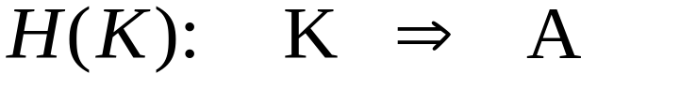
Hashing Function
Computable index function
H(k): the home address of the record with key K
Features of hashing
  Randomizing: records are randomly spread over the whole storage space
  Collision: two different keys may be hashed into the same address
0
1
2
3
4
5
.
.
Lowell 3
H(k)
Lowell

Slide 3
Key space the set of all possible values for keys
Address space the set of all storage units
      Physical location of file
In general
  File is usually a small subset of key space
  address space is usually much smaller than key space
  address space must accommodate all records in file

Slide 4
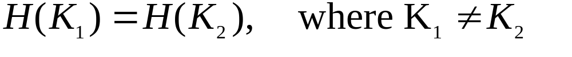
Example
Consider a set of auto parts with part # as keys
  K is in Key space = { 000. ..., 999}
  H(K) = K
the address space = key space.
If the key space is larger than address space, then collisions can occur:
  Synonyms: two keys that hashed to the same address
  collisions: the situation in which the home address has no room for the record.

Slide 5
Perfect hashing function
  One-to-one: No synonyms
  On-to: Key space = Address space
Desirable hashing function
  minimizing collision
  relatively smaller address space
Tradeoff
  the larger the address space, the easier to avoid collisions
  the larger the address space, the worse the storage utilization

Slide 6
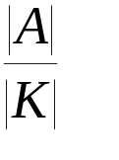
How to reduce collisions
  Spread out the records (uniform distribution)
    a hash function is uniformly random if for any key in the file, every address is equally likely to be chosen
  use extra memory
    increase the ratio
  buckets: a single address contains more than one records

Slide 7
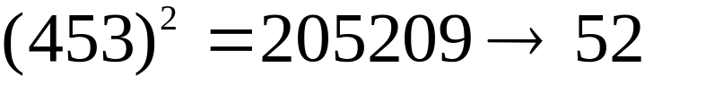
Example of hash functions
Folding
  Replace the key by numeric code
    ALBERT = 27 42 36 17 11 19
  Fold and Add
    2742 + 3617 + 1119 = 7478
  Take the module relative to the size of address space (prime)
    7478 MOD 101 = 4
Midsquare: Square key and take middle
Radix Transformation

Slide 8
Collision Resolution Techniques
Progress overflow (linear probing)
  average search length
Chained progress overflow
Buckets
Two-pass loading
Chaining with a separate overflow area
  primary data area, overflow data area
Scatter tables
Extendible hashing

Slide 9
Progress Overflow
Insertion: an overflow record is stored in the next available address after its home address
Deletion: tombstones
Search: must see until the key is found or empty record is found, or return to home address
Example: Consider insert keys such that
H(K1) = H(K2) = H(K4) = 10
H(K3) = 11,
H(K5) = 12.
What if we delete K2 and then insert K4 again?
0
10 K1
11 K2
13 K3
14 K4
15 K5
.
.
.

Slide 10
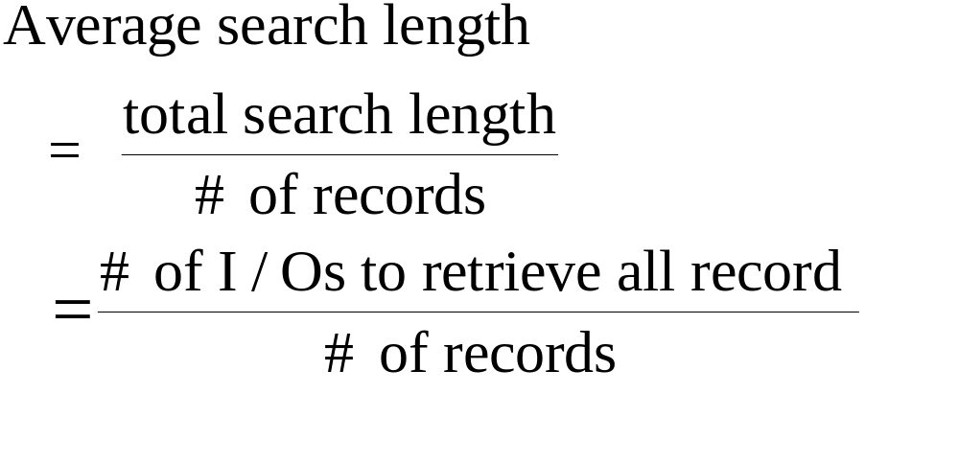
Analysis
Advantage
  simplicity
Problem
  search length: the number of disk accesses required to retrieve a record

Slide 11
Buckets
More than one record per address (in a bucket)
Stores synonyms in home (prime) bucket until full
Separate area is almost always used for overflow buckets
  other overflow strategies are also acceptable
Significantly improves hashing performance
  a bucket size of one is almost never used

Slide 12
Other Techniques
Chained progress overflow
  Linked list for overflowed records (Example)
Chained overflow area
  Primary data area = set of home addresses
  Overflow area = linked list of overflow address
  Advantage
    Keeps overflow records from occupying home addresses of other records
  Disadvantage
    overflow area often on different cylinder (more seeks)
    Solution: separate and smaller overflow areas on each cylinder

Slide 13
Double hashing
  Solutions to clustering?
    Move synonyms far away
  If collision occurs at H(key)
    compute another hash G(Key)
    store the record in H(key) + C*G(key) (H(key) + 2C*G(key)
  Problem: if collision record too far away, additional seeks required
    cycle within cylinders

Slide 14
Performance of Hashing Functions
Theme:
  Performance of some hashing functions can be predicated
Question: For a uniformly random hash function (i.e.. H(K) is equally likely to hash K to any address)
  What is the probability of hashing x records to a particular address?
  What is the expected percentage of overflow records
  What is the expected average search length?

Slide 15

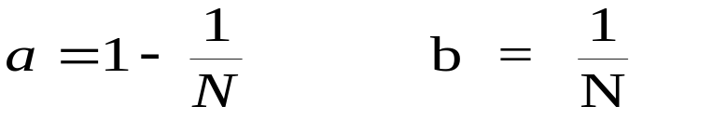
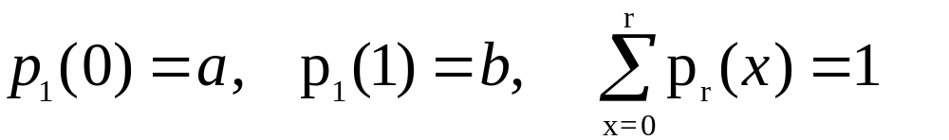
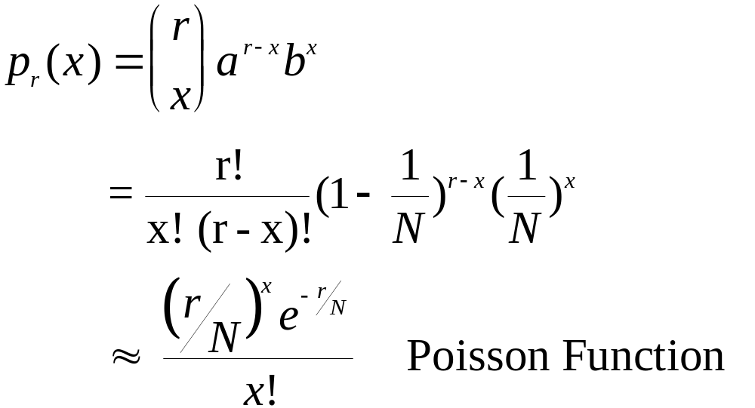
Given N address and r keys, let be the probability of
hashing x of these keys to one particular address.
For a uniformly random H(k), let
where b = P(address is chosen) and a = P(address is not choose)
Then trivially,
Theorem

Slide 16
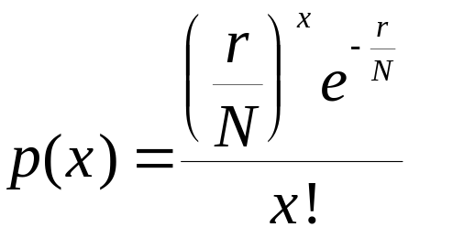
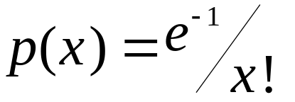
Given N address and r keys, the Poisson function
represents the probability of hashing x keys to one particular
address.
Assume r = N, then
x p(x)
0 .368
1 .368
2 .184
3 .061
...

Slide 17
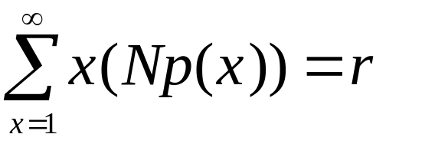
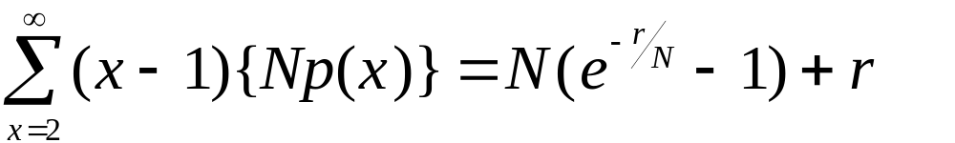
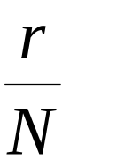
The expected number of addresses with x records
  N p(x)
The total number of records
The total synonyms
Packing density

Slide 18
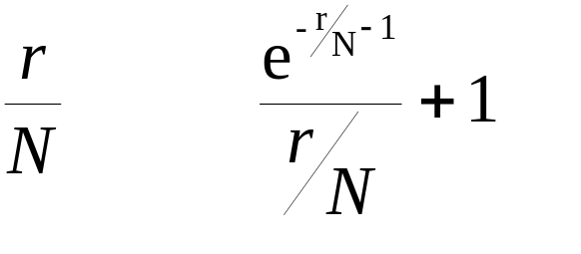
Synonyms vs. Packing density
1.0 .368
0.8 .314
0.6 .248
0.4 .176
0.2 .094

Slide 19
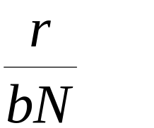
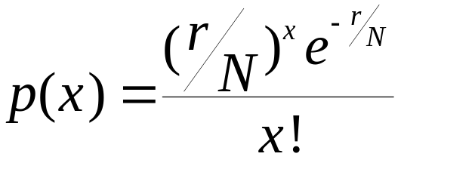
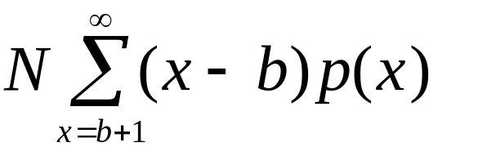
Buckets
r: # of records, N: # of addresses (buckets) b: bucket size
Packing density:
Probability of assigning x keys to a specified address
Expected # of addresses with x keys N p(x)
Expected number of overflow keys

Slide 20
Example
Given a file of 750 records, and 1000 addresses
packing density = 0.75
Consider two cases: b = 1 and b = 2
b 1 2
N 1000 500
p(0) .423 .223
p(1) .353 .335
p(2) .133 .251
p(3) .033 .126
p(4) .006 .047
Overflow records: 1000 * (.133 + 2*.033 + 3*.006 + ) = 222
500 * (.126 + 2*.047 + ) = 140

Slide 21
Percentage of overflow records
r/(bN) b=1 b=2 b=5 b=10
.20 9.4 2.2 0.1 0.0
.50 21.3 10.4 2.5 0.4
.75 29.6 18.7 8.6 4.0
.80 31.2 20.4 10.3 5.3
1.00 36.8 27.1 17.6 12.5
Conclusion: choose b as large as is reasonably possible.

Slide 22
Indexed Hashing
Application: Sequential Access + Index search
Solution 1: B+ Tree = sequence sets + B-tree of index
Solution 1: Sequential sets + Hashing function of index

Slide 23
Extendible Hashing
Binary search tree B-tree
  dynamically self-adjusted balanced page tree
Hashing: computable index function
  problem: linear search for overflowed records
  Solution: bucket size
What if we have an unlimited bucket size ?
What if we use a dynamic, self-adjusted structure with
unlimited bucket size?

Slide 24
Given r: number of records
We need to choose N: the number of addresses
b: the bucket size
If N >> r, then the chances for collision may reduce to 0.
But, ...
In fact, only r / b buckets are really needed.
What if we have r/b buckets to be used with unlimited N
available whenever needed ?

Slide 25
Radix Searching (Trie)
Basic Idea: use more as we need more
Example: Assume each hashed key is a sequence of three digits,
and in the beginning, we need only three buckets.
Usually, 8 buckets are needed for the set of all keys with three digits.
directory bucket
A
0
A
B
10
B
11
C
C

Slide 26
Example (continued)
Case 1: When A overflow, we create a new bucket D to
commemorate new records, and expanding the address of
A into two addresses
00
A
10
B
11
C
01
D
Case 2: When B overflow, then we create a new bucket D and
expand the address of B into three digits
0
A
100
B
11
C
101
D

Slide 27
Access performance
One seek if the directory can be kept in RAM
Two seeks, if otherwise
Example: Consider the social security system with
300,000,000 records, and 100 records per page.
Thus, 3,000,000 keys.
If each key has 10 bytes, then 30 Mb RAM needed
6-% space utilization, 50 Mb RAM needed.

