Slide 1
Chapter 11 Indexes
Problem
  How to specify various indexes in the database to facilitate the query/search
File structures
  B+tree
  Hash table
  Inverted index
Index types
  Primary index, secondary index
  Clustered index, unique index
  Inverted index
Goal
  Efficiency

Slide 2
Applications
Key search
  Search records with the given key value
Search on non-key fields
  Search records with the given non-key value
Sequential search
  Sequential search and/or range search
Key word search
  Search the records whose fields contain the given key word

Slide 3
Indexes
An index is a function from a given key to its physical address, and it is usually implemented using
  B+tree, or
  hash table

Slide 4
Indexes
Index types
  Primary index: the index on the primary key
  Secondary index: the index on non-primary key attribute(s)
    A function from a given value to its key
    With the key value, the address can then be obtained using the primary index
  Inverted-index
    A function from a list of (dictionary) words to the key values of documents (records)
    Usually used for the google-styled search
  Clustered index
    An index that reorders the way records in the table are physically stored.
    At most one clustered index per table

Slide 5
SQL Databases
  CREATE TABLE
    Usually create a clustered index on the primary key
    Example:
      CREATE TABLE documents (
      doc_id int primary key,
      doc_name varchar(16),
      subject varchar(256),
      content CLOB
      );

Slide 6
SQL Databases
  CREATE INDEX
    Usually create a second index on the specified columns by default
    reate an inverted index on the specified columns
      CREATE INDEX name_index on documents (doc_name);
      CREATE INDEX subject_index ON documents (subject)
      INDEXTYPE IS CTXSYS.CONTEXT;
      CREATE INDEX content_index ON documents (content)
      INDEXTYPE IS CTXSYS.CONTEXT;

Slide 7
Queries/Search with indexes
Primary and secondary indexes are transparent to queries users
  Users need not to know them
Oracle’s Inverted indexes
      SELECT doc_name, subject
      FROM documents
      WHERE contains (subject, ’ipod’, 1) > 0 AND
      contains (content, ‘ipod’, 2) > 0
      ORDER BY 10 * score(1) + score(2);

Slide 8
Cluster as used by Oracle
  a cluster is a schema object that contains one or more tables that have one or more columns in common
    To speed up join operations
    Dept( dept_no, d_name, manager, budget)
    EMP( emp_no, dept_no, e_name )
  Index for cluster:
    B+tree,
    Hash

Slide 9
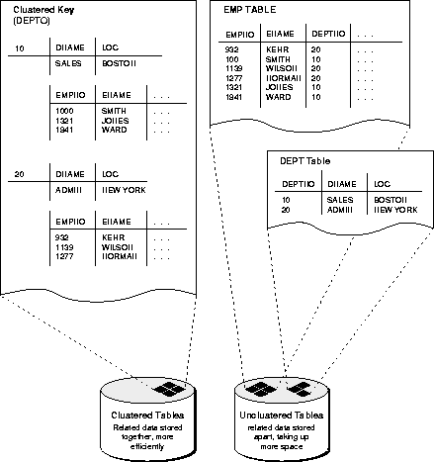

Slide 10
Choosing An Index
An index should support a query of the application that has a significant impact on performance
  Choice based on frequency of invocation, execution time, acquired locks, table size
Ex 1 SELECT E. Id
FROM Employee E
WHERE E.Salary < :upper AND E.Salary > :lower
- This is a range search on Salary.
- Since the primary key is Id, it is likely that there is a clustered,
main index on that attribute that is of no use for this query.
- Choose a secondary, B⁺ tree index with search key Salary

Slide 11
Choosing An Index
Ex 2 SELECT T.StudId
FROM Transcript T
WHERE T.Grade = :grade
- This is an equality search on Grade.
- Since the primary key is (StudId, Semester, CrsCode) it is
likely that there is a main, clustered index on these attributes
that is of no use for this query.
- Choose a secondary, B+ tree or hash index with search key
Grade

Slide 12
Choosing an Index
Ex 3 SELECT T.CrsCode, T.Grade
FROM Transcript T
WHERE T.StudId = :id AND T.Semester = ‘F2000’
- Equality search on StudId and Semester.
- If the primary key is (StudId, Semester, CrsCode) it is
likely that there is a main, clustered index on this
sequence of attributes.
- If the main index is a B⁺ tree it can be used for this search.
- If the main index is a hash it cannot be used for this
search. Choose B⁺ tree or hash with search key StudId
(since Semester is not as selective as StudId) or
(StudId, Semester)

Slide 13
Choosing An Index
Ex 3 (con’t)
SELECT T.CrsCode, T.Grade
FROM Transcript T
WHERE T.StudId = :id AND T.Semester = ‘F2000’
- Suppose Transcript has primary key (CrsCode, StudId, Semester).
Then the main index is of no use (independent of whether it is a
hash or B⁺ tree).

Slide 14
CREATE TABLE
  Usually create a clustered index on the primary key
  Index organization, disk specification
Oracle: Partitioned tables
  How to store a table of 200GB?
    store a table in several logically identical partitions.
  Store partitions of a table in separate tablespaces
    reduce the possibility of data corruption in multiple partitions
    make it possible to back up and recover each partition independently
    make it possible to control the mapping of partitions to disk drives (important for balancing I/O load)

Slide 15
Example of secondary indexes
CREATE TABLE student (
student_id int,
s_name varchar(100),
address varchar(100),
picture blob,
primary key (student_id)
)
student_id | s_name | address | picture

Slide 16
Example of secondary indexes
CREATE INDEX s_name index
ON student (s_name)
student_id | s_name | address | picture
s_name | Student_id

Slide 17
Clustered Index
Clustered index: index entries and rows are ordered in the same way
  An integrated storage structure is always clustered (since rows and index entries are the same)
  The particular index structure (eg, hash, tree) dictates how the rows are organized in the storage structure
    There can be at most one clustered index on a table
  CREATE TABLE generally generally creates an integrated, clustered (main) index

Slide 18
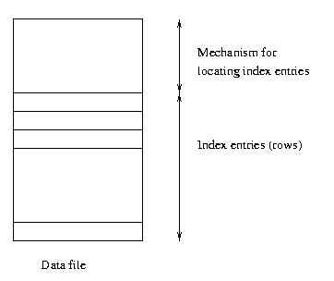
Clustered Main Index
Storage structure
contains table
and (main) index;
rows are contained
in index entries

Slide 19
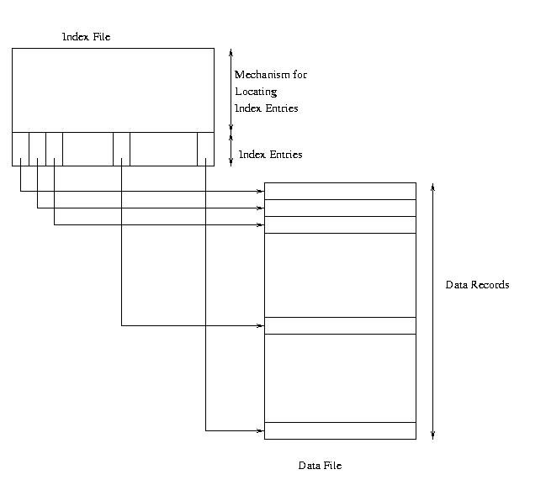
Clustered Secondary Index

Slide 20
Unclustered Index
Unclustered (secondary) index: index entries and rows are not ordered in the same way
An secondary index might be clustered or unclustered with respect to the storage structure it references
  It is generally unclustered (since the organization of rows in the storage structure depends on main index)
  There can be many secondary indices on a table
  Index created by CREATE INDEX is generally an unclustered, secondary index

Slide 21
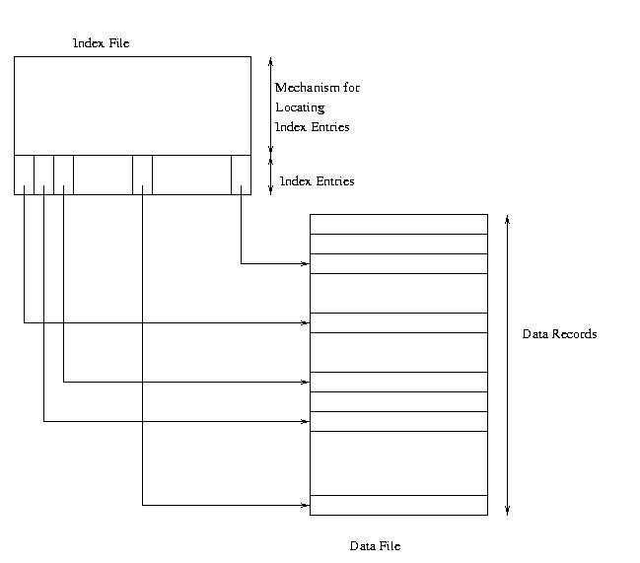
Unclustered Secondary Index

Slide 22
Clustered Index
Good for range searches when a range of search key values is requested
  Use location mechanism to locate index entry at start of range
    This locates first row.
  Subsequent rows are stored in successive locations if index is clustered (not so if unclustered)
  Minimizes page transfers and maximizes likelihood of cache hits

Slide 23
Oracle’s Cluster
CREATE CLUSTER
A cluster is a schema object that contains data
from one or more tables, all of which have
one or more columns in common.
Oracle stores together all the rows
(from all the tables) that share the same
cluster key.

Slide 24
Invested Indexes
Internet search
  How to collect the info of all the web pages
    Web crawler
  How to find relevant web pages
    Inverted index
  How to rank all the relevant web pages
    PageRank
    Relevancy and popularity

Slide 25
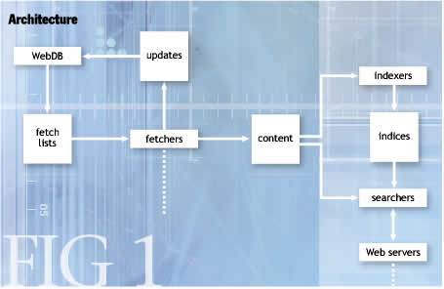
Search Engine Architecture of Nutch

Slide 26
Inverted Index
For each document
D_{i}: w_{a}, w_{b}, w_{c}…
documents
index
Document D_{i}
w_{a}: D₁, D₂, D₃ …
w_{b}: D₁ , D₃ …
w_{c}: D₁, …
w_{d}: D₂, D₃, …
…
D₁: w_{a}, w_{b}, w_{c}…
D₂: w_{a}, w_{d}, w_{e}…
D₃: w_{a}, w_{b}, w_{d}…
…
D_{n}: w_{x}, w_{y}, w_{z}…
documents
Inverted Index

Slide 27
Querying
Inverted Index
w_{a}: D₁, D₂, D₃ …
w_{b}: D₁ , D₃ …
w_{c}: D₁, …
w_{d}: D₂, D₃, …
…
Which document
contains W_{a} and W_{b} ?
D₁, D₂, D₃ …
∩
D₁ , D₃ …
Inverted Index
w_{a}: D₁, D₂, D₃ …
w_{b}: D₁ , D₃ …
w_{c}: D₁, …
w_{d}: D₂, D₃, …
…
Which document
contains W_{a} or W_{b} ?
D₁, D₂, D₃ …
∪
D₁ , D₃ …

