Slide 1

Apache Cassandra Tutorial
CMPUT391 Lab
Prepared by Lengdong

Slide 2
Outline
Introduction
Single-Node Cassandra Installation
Multiple-Node Cassandra Installation

Slide 3
Introduction
Distributed database system with combination of technologies from Amazon Dynamo and Google BigTable
Roots in the NoSQL database requirement for Facebook Corporation.
Be able to handle data spread across geographically diverse servers
Scalable and decentralized database management system
Store data in structured and indexed fashion for efficient querying using Cassandra query language (CQL)

Slide 4








Originally designed at Facebook, now is open-source by Apache Community
Some of its myriad users:

Slide 5
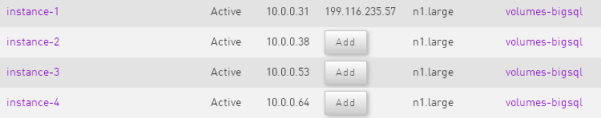
Nebula Cluster
instances (used as independent server)
  Ubuntu 12.04, 4 CPUs, 8G RAM, 500G HD

Slide 6
Connect to Nebula Instance
SSH to instance-1 with floating IP (external IP).
  Download the public key (NebulaLaunchKey.pem) from the course website into your home directory.
  cd ~
  ls NebulaLaunchKey.pem
  Connect to Instance-1 with floating IP.
  ssh -i NebulaLaunchKey.pem uraccount@199.116.235.57
uraccount: ui01, ui02, ui03, …, ui22 (the machine# you are using)
Please make sure to use the correct account!

Slide 7
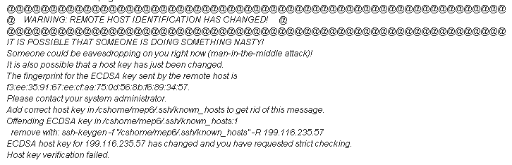
If you get the above error message try:
ssh-keygen -f "/cshome/<uraccount>/.ssh/known_hosts" -R 199.116.235.57

Slide 8
Cassandra installation on single node
1. Create a directory for Cassandra
mkdir cassandra
cd cassandra
2. Download Cassandra package from the course website or use
wget http://apache.sunsite.ualberta.ca/cassandra/2.0.5/apache-cassandra-2.0.5-bin.tar.gz
3. Extract the achieve into the directory
tar -xvzf apache-cassandra-2.0.5-bin.tar.gz
4. Set Cassandra's environment variables
export CASSANDRA_HOME=/home/<uraccount>/cassandra/apache-cassandra-2.0.5
export PATH=$PATH:$CASSANDRA_HOME/bin

Slide 9


5. Modify paths for data, commitlog, cache directories in the configuration file. (The default paths point to directories that are not accessible to common users, e.g. to /var/lib).
emacs ~/cassandra/apache-cassandra-2.0.5/conf/cassandra.yaml
Default paths:
Modify to your own home directory paths:
Line 110
Line 113
Line 188

Slide 10
6. Modify the logfile path in log4j-server.properties
(i.e. set the file to write log messages).
emacs ~/cassandra/apache-cassandra-2.0.5/conf/log4j-server.properties
Find the setting for "log4j.appender.R.File"
Default path:
Modify to your own home directory path:
Line 35

Slide 11

7. Specify storage_port
Different accounts use different storage_port to support
multiple Cassandra running on the same instance.
Please make sure to use your own storage_port number according to your account!
emacs ~/cassandra/apache-cassandra-2.0.5/conf/cassandra.yaml
Line 285
Account Storage_port
ui00 7100
ui01 7101
ui02 7102
ui03 7103
… …
ui22 7122

Slide 12

8. Specify rpc_port
Please make sure to use your own rpc_port number according to your account!
emacs ~/cassandra/apache-cassandra-2.0.5/conf/cassandra.yaml
Line 341
Account rpc_port
ui00 9100
ui01 9101
ui02 9102
ui03 9103
… …
ui22 9122

Slide 13
9. Specify native_transport_port
Please make sure to use your own native_transport_port number according to your account!
emacs ~/cassandra/apache-cassandra-2.0.5/conf/cassandra.yaml
Line 316
Account native_rpc_port
ui00 9200
ui01 9201
ui02 9202
ui03 9203
… …
ui22 9222

Slide 14
10. Specify JMX_PORT
Please make sure to use your own JMX_port number according to your account!
emacs ~/cassandra/apache-cassandra-2.0.5/conf/cassandra-env.sh
Line 154
Account JMX_port
ui00 7200
ui01 7201
ui02 7202
ui03 7203
… …
ui22 7222

Slide 15
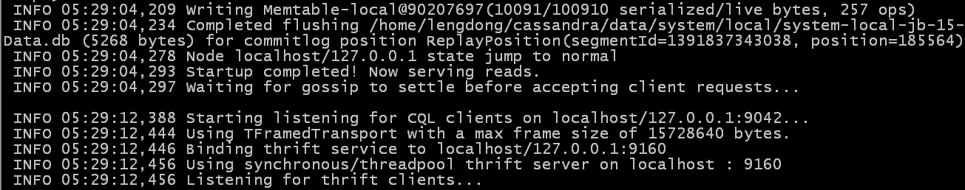
Start Cassandra
Start cassandra
cd $CASSANDRA_HOME
./bin/cassandra –f &
Cassandra should start in the foreground.

Slide 16
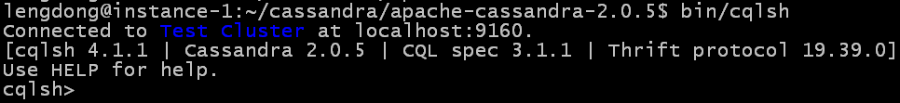
Using CQL
cqlsh is an interactive command line interface.
To start cqlsh:
cd ~/cassandra/apache-cassandra-2.0.5
./bin/cqlsh <ip_address> <rpc_port>
e.g. ./bin/cqlsh 127.0.0.1 9101 (or 9102, 9103, 91XX …)
If successfully, you should see the following prompt:
You can access the online help with 'help;' command. Commands are terminated with a semicolon (';') in cqlsh.
e.g.
help create;
help create_table;

Slide 17
Create Table
1. Create a keyspace - a namespace for tables
CREATE KEYSPACE mykeyspace WITH REPLICATION = { 'class' : 'SimpleStrategy', 'replication_factor' : 1 };
2. Authenticate to the keyspace
USE mykeyspace;

Slide 18
3. Create ‘students’ table
4. Store data into users
CREATE TABLE students (
student_id int PRIMARY KEY,
fname text,
lname text
);
INSERT INTO students (student_id, fname, lname)
VALUES (1001, 'john', 'smith');
INSERT INTO students (student_id, fname, lname)
VALUES (1002, 'john', 'doe');
INSERT INTO students (student_id, fname, lname)
VALUES (1003, 'john', 'jones');

Slide 19
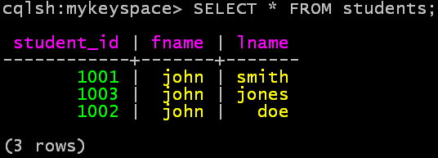

Using SELECT
Query the ‘students’ table
SELECT * FROM students;
SELECT * FROM students WHERE lname = 'smith';

Slide 20
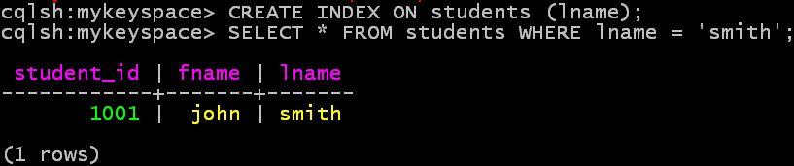
Using Index
You can only retrieve data about students whose last name is ‘smith’ by creating an index on lname column
CREATE INDEX ON students (lname);
SELECT * FROM students WHERE lname = 'smith';

Slide 21
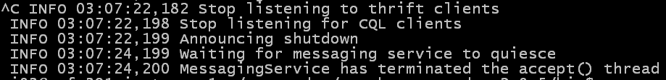
Stop Cassandra
Run “Exit” to quit cqlsh
Stop Cassandra
  “Control-C” or “pkill -f CassandraDaemon”

Slide 22
Cassandra installation on 2-nodes cluster
Start 2 terminals, connect to the instance with floating
ssh -i NebulaLaunchKey.pem uraccount@199.116.235.57
SSH to the other instances with fixed ip (internal ip)
ssh uraccount@10.0.0.38 (or instance-2)
Using ssh to make sure these two instances can communicate without problem.
i.e. ssh uraccount@10.0.0.31 from instance-2.
Input ‘yes’ for the following prompt:

Slide 23
Setting up a Cassandra cluster is almost as simple as repeating the above procedures for each node in the cluster.
To set up cassandra on instance-2, synchronize the cassandra from instance-1.Input following commands in instance-1 terminal:
1. remove old data from instance-1 at first:
  cd ~/cassandra
  rm -rf commitlog/ data/ logs/ saved_caches/ system.log
2. synchronize cassandra to instance-2
rsync -ar cassandra <uraccount>@10.0.0.38:~
Set Cassandra Path for instance-1, 2
export CASSANDRA_HOME=/home/<uraccount>/cassandra/apache-cassandra-2.0.5
export PATH=$PATH:$CASSANDRA_HOME/bin

Slide 24
Seeds
Cassandra nodes exchange information about one another using a mechanism called “Gossip”, but to get the ball rolling a newly started node needs to know of at least one other, this is called a Seed.
It is a best practice to have more than one seed node per data center.
We assume node 1 to be the seed
node 1/ instance 1: 10.0.0.31 (seed)
node 2/ instance 2: 10.0.0.38

Slide 25
IP Address
configure the IP interface to listen on for Gossip and CQL, (listen_address and rpc_address respectively).
listen_address:
  The listen address defines where the other nodes in the cluster should connect. So in a multi-node cluster it should be changed to the node IP address of Ethernet interface.
rpc_address:
  The rpc address defines where the node is listening to clients. So it can be same as node IP address or set it to wildcard 0.0.0.0 if we want to listen Thrift clients on all available interfaces.

Slide 26
Start seed node-1
Modify the following property settings in the cassandra.yaml
  cluster_name: 'MyDemoCluster'
  seeds: 10.0.0.31
  listen_address: 10.0.0.31
  rpc_address: 0.0.0.0
Start cassandra on node-1
cd $CASSANDRA_HOME
./bin/cassandra -f

Slide 27
Start node-2
Modify the following property settings in the cassandra.yaml
Need to set the listen_address different from node-1.
  cluster_name: 'MyDemoCluster'
  seeds: <10.0.0.31>
  listen_address: <10.0.0.38>
  rpc_address: 0.0.0.0
Start cassandra on node-2
cd $CASSANDRA_HOME
./bin/cassandra -f

Slide 28
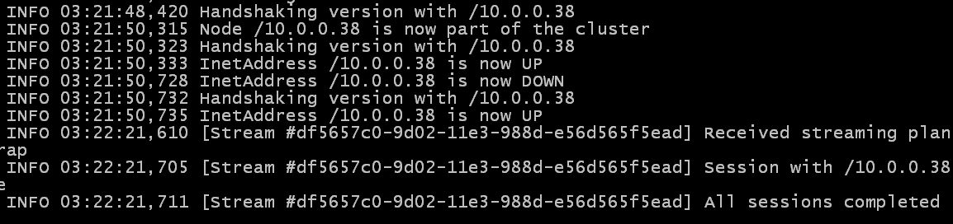
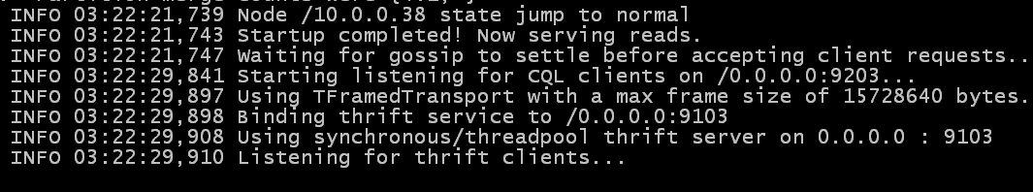
Cluster Started
Node-1
Node-2

Slide 29
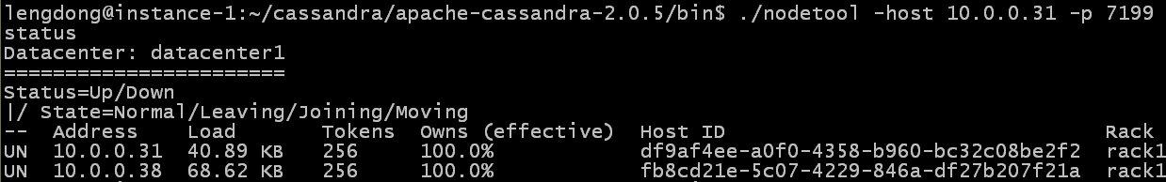
Verify Cluster
Once everything is configured and the nodes are running, use the bin/nodetool status utility to verify the properly connected cluster.
cd ~/cassandra/apache-cassandra-2.0.5/
./bin/nodetool -host 10.0.0.31 -p JMX_port status
e.g. ./bin/nodetool -host 10.0.0.31 -p 7201(or 7202, 7203, …) status

Slide 30
Using CQL
cqlsh is an interactive command line interface.
To start cqlsh:
cd ~/cassandra/apache-cassandra-2.0.5
./bin/cqlsh ip_address rpc_port
e.g. ./bin/cqlsh 10.0.0.31 9100 (or 9101, or 9102 …)
If successfully, you should see the following prompt:

