Slide 1
Topic 9
Arithmetic for Computers
(modified by J. Nelson Amaral)
Notes:
Morgan Kaufmann Publishers
Chapter 3 — Arithmetic for Computers

Slide 2
Arithmetic for Computers
§3.1 Introduction
Operations on integers
  Addition and subtraction
  Multiplication and division
  Dealing with overflow
Floating-point real numbers
  Representation and operations
Chapter 3 — Arithmetic for Computers — <number>
Notes:
Morgan Kaufmann Publishers
Chapter 3 — Arithmetic for Computers

Slide 3
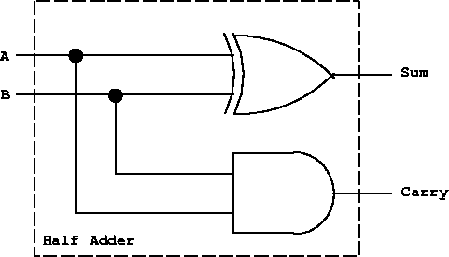
Circuit for addition
0
 | 0
+ | 0
 | 0
0
 | 0
+ | 1
 | 1
0
 | 1
+ | 0
 | 1
1
 | 1
+ | 1
 | 0
ai | bi | S | Carry
0 | 0 | 0 | 0
0 | 1 | 1 | 0
1 | 0 | 1 | 0
1 | 1 | 0 | 1
Chapter 3 — Arithmetic for Computers — <number>

Slide 4
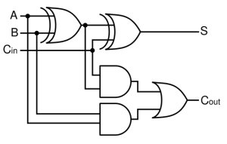
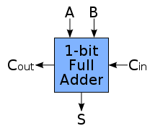
Circuit for addition
0 | 0
 | 0
+ | 0
 | 0
0 | 0
 | 1
+ | 0
 | 1
1 | 0
 | 1
+ | 1
 | 0
1 | 1
 | 1
+ | 1
 | 1
Cin | ai | bi | S | Cout
0 | 0 | 0 | 0 | 0
0 | 0 | 1 | 1 | 0
0 | 1 | 0 | 1 | 0
0 | 1 | 1 | 0 | 1
1 | 0 | 0 | 1 | 0
1 | 0 | 1 | 0 | 1
1 | 1 | 0 | 0 | 1
1 | 1 | 1 | 1 | 1
Chapter 3 — Arithmetic for Computers — <number>

Slide 5
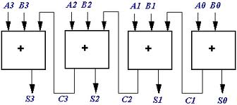
Ripple-Carry Adder
Chapter 3 — Arithmetic for Computers — <number>

Slide 6
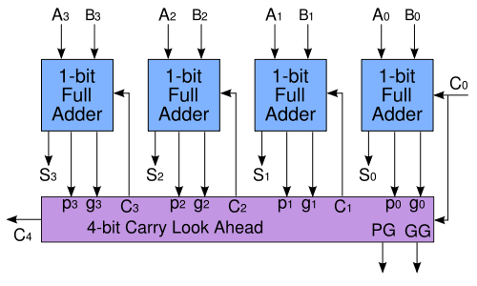
Carry Look Ahead Adder
Chapter 3 — Arithmetic for Computers — <number>

Slide 7

Integer Addition
Example: 7 + 6
§3.2 Addition and Subtraction
Overflow if result out of range
A + B |  | A
 |  | Positive | Negative
B | Positive | if (sign == 1) overflow | No overflow
 | Negative | No overflow | If (sign == 0) overflow
Chapter 3 — Arithmetic for Computers — <number>
P-H. pp. 225-226
Notes:
Morgan Kaufmann Publishers
Chapter 3 — Arithmetic for Computers

Slide 8
Integer Subtraction
Add negation of second operand
Example: 7 – 6 = 7 + (–6)
  +7 0000 0000 … 0000 0111
  –6: 1111 1111 … 1111 1010
  +1: 0000 0000 … 0000 0001
Overflow if result out of range
A - B |  | A
 |  | Positive | Negative
B | Positive | No overflow | If (sign == 0) overflow
 | Negative | If (sign == 1) overflow | No overflow
Chapter 3 — Arithmetic for Computers — <number>
P-H. pp. 225-226
Notes:
Morgan Kaufmann Publishers
Chapter 3 — Arithmetic for Computers

Slide 9
Dealing with Overflow
Some languages (e.g., C) ignore overflow
  Use MIPS addu, addui, subu instructions
Other languages (e.g., Ada, Fortran) require raising an exception
  Use MIPS add, addi, sub instructions
  On overflow, invoke exception handler
    Save PC in exception program counter (EPC) register
    Jump to predefined handler address
    mfc0 (move from coprocessor reg) instruction can retrieve EPC value, to return after corrective action
Chapter 3 — Arithmetic for Computers — <number>
P-H. pp. 227
Notes:
Morgan Kaufmann Publishers
Chapter 3 — Arithmetic for Computers

Slide 10
Arithmetic for Multimedia
Graphics and media processing operates on vectors of 8-bit and 16-bit data
  Use 64-bit adder, with partitioned carry chain
    Operate on 8×8-bit, 4×16-bit, or 2×32-bit vectors
  SIMD (single-instruction, multiple-data)
Saturating operations
  On overflow, result is largest representable value
    c.f. 2s-complement modulo arithmetic
  E.g., clipping in audio, saturation in video
Chapter 3 — Arithmetic for Computers — <number>
P-H. p. 227
Notes:
Morgan Kaufmann Publishers
Chapter 3 — Arithmetic for Computers

Slide 11

Multiplication Hardware
Start
Test
Multiplier 0
Multiplier0 = 1
Multiplier0 = 0
1a. Add multiplicand to product and place result in Product register
2. Shift the Multiplicand register left 1 bit
2. Shift the Multiplier register right 1 bit
32nd repetition?
No: <32 repetitions
Initially 0
Yes: 32 repetitions
Done
Chapter 3 — Arithmetic for Computers — <number>
P-H. pp. 231-232
Notes:
Morgan Kaufmann Publishers
Chapter 3 — Arithmetic for Computers

Slide 12
Multiplication (unsigned)
§3.3 Multiplication
Start with long-multiplication approach
multiplicand
1000
× 1001
1000
0000
0000
1000
1001000
1000 multiplicand
× 1001 multiplier
1001000 product
multiplier
product
Length of product is the sum of operand lengths
Chapter 3 — Arithmetic for Computers — <number>
Notes:
Morgan Kaufmann Publishers
Chapter 3 — Arithmetic for Computers

Slide 13



Multiplication Hardware
1000 multiplicand
× 1001 multiplier
1001000 product
multiplicand
0
0
0
0
1
0
0
0
0
0
0
0
multiplier
Add = 0
Add = 1
8-bit Adder
0
0
0
0
1
0
0
1
product
1
Control
1
Chapter 3 — Arithmetic for Computers — <number>

Slide 14



Refined Multiplication Hardware
1000 multiplicand
× 1001 multiplier
1001000 product
multiplicand
1
0
0
0
Add = 1
Add = 0
4-bit Adder
multiplier
0
0
0
0
Control
0
1
1
0
0
1
1
1
1
1
1
product
Add and shift in parallel.
Chapter 3 — Arithmetic for Computers — <number>

Slide 15
Fast Multiplication Example
1000 multiplicand
× 1001 multiplier
mplier₃× mcand<<3
mplier₂× mcand<<2
mplier₁× mcand<<1
mplier₀× mcand
01000000
00000000
00000000
00001000
01000000
00001000
01001000
Chapter 3 — Arithmetic for Computers — <number>

Slide 16
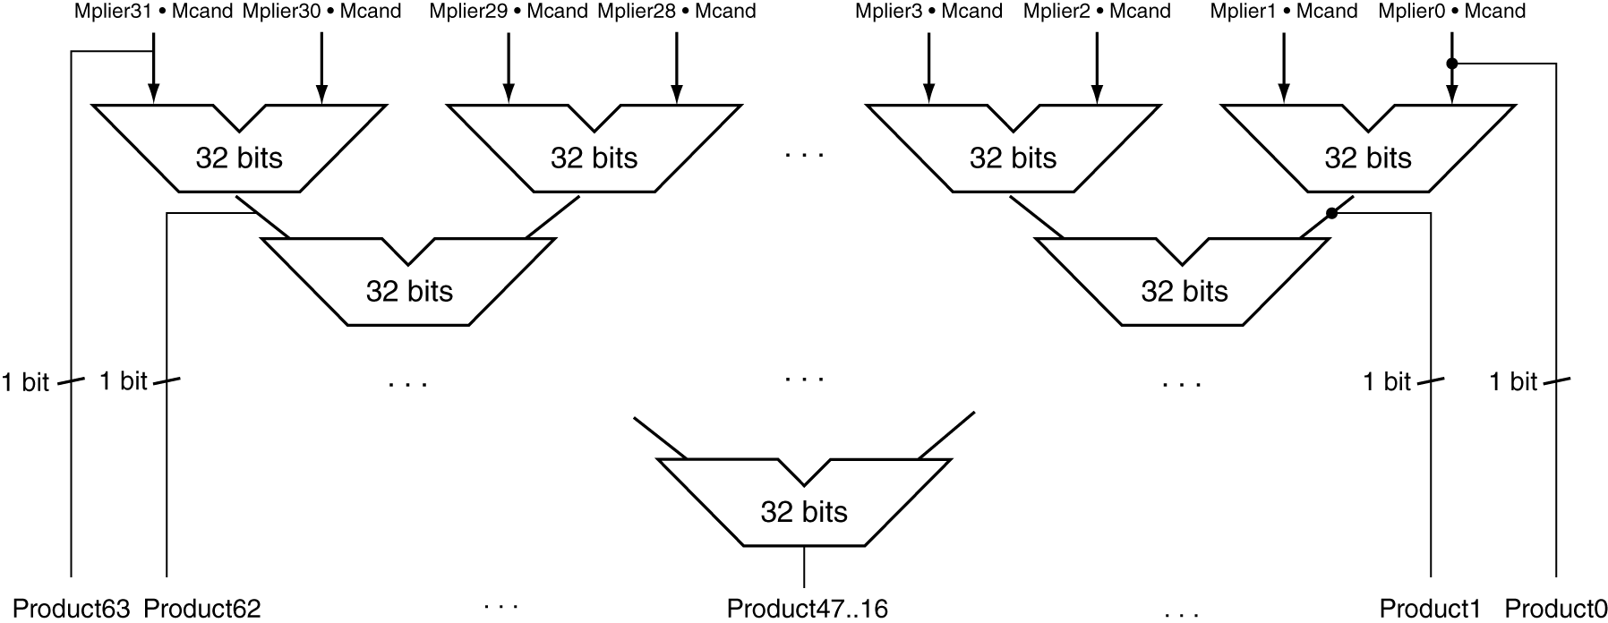
Faster Multiplier
Uses multiple adders
  Cost/performance tradeoff
Can be pipelined
  Several multiplications performed in parallel
Chapter 3 — Arithmetic for Computers — <number>
P-H. p. 235
Notes:
Morgan Kaufmann Publishers
Chapter 3 — Arithmetic for Computers

Slide 17
Pipelined Multiplication Example
1000 multiplicand
× 1001 multiplier
1010 multiplicand
× 1011 multiplier
1100 multiplicand
× 0011 multiplier
01000000
01010000
00000000
00000000
00000000
00000000
00011000
00000000
00010100
00001100
00001000
00001010
01000000
01010000
00011110
00001000
01001000
Chapter 3 — Arithmetic for Computers — <number>

Slide 18
MIPS Multiplication
Two 32-bit registers for product
  HI: most-significant 32 bits
  LO: least-significant 32-bits
Instructions
  mult rs, rt / multu rs, rt
    64-bit product in HI/LO
  mfhi rd / mflo rd
    Move from HI/LO to rd
    Can test HI value to see if product overflows 32 bits
  mul rd, rs, rt
    Least-significant 32 bits of product –> rd
Chapter 3 — Arithmetic for Computers — <number>
P-H. p. 235
Notes:
Morgan Kaufmann Publishers
Chapter 3 — Arithmetic for Computers

Slide 19
Hardware for Division
Same hardware used for multiplication can be used for division. See pages 239-241 in textbook.
Chapter 3 — Arithmetic for Computers — <number>

Slide 20
MIPS Division
Use HI/LO registers for result
  HI: 32-bit remainder
  LO: 32-bit quotient
Instructions
  div rs, rt / divu rs, rt
  No overflow or divide-by-0 checking
    Software must perform checks if required
  Use mfhi, mflo to access result
Chapter 3 — Arithmetic for Computers — <number>
P-H. p. 241
Notes:
Morgan Kaufmann Publishers
Chapter 3 — Arithmetic for Computers

