Slide 1
Topic A
Floating Point Representation
(modified by J. Nelson Amaral)
Notes:
Morgan Kaufmann Publishers
Chapter 3 — Arithmetic for Computers

Slide 2
Floating Point
§3.5 Floating Point
Representation for non-integral numbers
  Including very small and very large numbers
Like scientific notation
  –2.34 × 10⁵⁶
  +0.002 × 10^{–4}
  +987.02 × 10⁹
In binary
  ±1.xxxxxxx₂ × 2^{yyyy}
Types float and double in C
normalized
not normalized
Chapter 3 — Arithmetic for Computers — <number>
P-H. p. 242
Notes:
Morgan Kaufmann Publishers
Chapter 3 — Arithmetic for Computers

Slide 3
Floating Point Standard
Defined by IEEE Std 754-1985
Developed in response to divergence of representations
  Portability issues for scientific code
Now almost universally adopted
Two representations
  Single precision (32-bit)
  Double precision (64-bit)
Chapter 3 — Arithmetic for Computers — <number>
P-H. p. 241
Notes:
Morgan Kaufmann Publishers
Chapter 3 — Arithmetic for Computers

Slide 4
Floating Point Representation
Most standard floating point representation use:
1 bit for the sign (positive or negative)
8 bits for the range (exponent field)
23 bits for the precision (fraction field)
1
8
23
S
exponent
fraction
P-H. p. 245
From: Patt and Patel, pp. 33

Slide 5
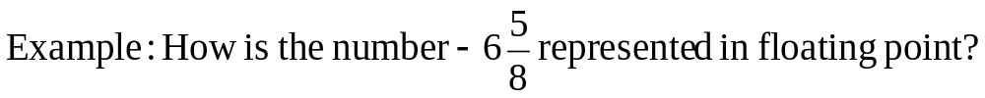
Floating Point Representation (example)
1
8
23
S
exponent
fraction
Thus the exponent is given by:
1 10000001 10101000000000000000000
P-H. p. 245
From: Patt and Patel, pp. 34

Slide 6
Floating Point Representation (example)
1
8
23
S
exponent
fraction
What is the decimal value of the following floating point number?
00111101100000000000000000000000
exponent
exponent = 64+32+16+8+2+1=(128-8)+3=120+3=123
P-H. p. 245
From: Patt and Patel, pp. 34

Slide 7
Floating Point Representation (example)
1
8
23
S
exponent
fraction
What is the decimal value of the following floating point number?
01000001100101000000000000000000
exponent
exponent =128+2+1=131
P-H. p. 245
From: Patt and Patel, pp. 35

Slide 8
Floating Point Representation (example)
1
8
23
S
exponent
fraction
What is the decimal value of the following floating point number?
11000001000101000000000000000000
exponent
exponent =128+2=130
P-H. p. 245
From: Patt and Patel, pp. 35

Slide 9
Floating Point Representation (example)
1
8
23
S
exponent
fraction
Thus the exponent is given by:
1 10000001 10101000000000000000000
P-H. p. 245
From: Patt and Patel, pp. 34

Slide 10
Floating Point
1
8
23
S
exponent
fraction
What is the largest number that can be represented in 32 bits floating
point using the IEEE 754 format above?
01111111011111111111111111111111
exponent
exponent =254
P-H. p. 247
From: Patt and Patel, pp. 35

Slide 11
A Possible Final Exam Question
Write a subroutine called fptoint that receives in a 32-bit floating
point number f in IEEE 754 format and returns i, the integer portion
of the number expressed in two-complement.
1
8
23
S
exponent
fraction
srlv rd, rt, rs
if(t2 > 0){
t5 ← 0x0080 0000
t4 ← t4 | t5
t6 ← t2-127
}
else
t6 ← t2-126
t1 ← f >> 23
t2 ← t1 & 0x00ff # t2 is the exponent
t3 ← 0x007f ffff
t4 ← f & t3 # f is the fraction
t7 = 23 – t6
i = t4 >> t7
if(f<0)
i = - i
Chapter 3 — Arithmetic for Computers — <number>

Slide 12
Floating Point
1
8
23
S
exponent
fraction
What is the largest number that can be represented in 32 bits floating
point using the IEEE 754 format above?
01111111011111111111111111111111
exponent
actual exponent =254-127 = 127
P-H. p. 247
From: Patt and Patel, pp. 35

Slide 13
Floating Point
1
8
23
S
exponent
fraction
What is the smallest number (closest to zero) that can be represented
in 32 bits floating point using the IEEE 754 format above?
00000000000000000000000000000001
exponent
actual exponent =0-126 = -126
P-H. p. 247
From: Patt and Patel, pp. 35

Slide 14
Special Floating Point Representations
In the 8-bit field of the exponent we can represent numbers from 0 to
255. We studied how to read numbers with exponents from 0 to 254.
What is the value represented when the exponent is 255 (i.e. 11111111₂)?
An exponent equal 255 = 11111111₂ in a floating point representation
indicates a special value.
When the exponent is equal 255 = 11111111₂ and the fraction is 0,
the value represented is ± infinity.
When the exponent is equal 255 = 11111111₂ and the fraction is
non-zero, the value represented is Not a Number (NaN).
P-H. p. 246
Hen/Patt, pp. 301

Slide 15
Double Precision
32-bit floating point representation is usually called single precision
representation.
A double precision floating point representation requires 64 bits.
In double precision the following number of bits are used:
1 sign bit
11 bits for exponent
52 bits for fraction (also called significand)
P-H. p. 246

Slide 16
Floating Point Addition (Decimal)
How do we perform the following addition?
9.999₁₀ × 10¹ + 1.610₁₀ × 10⁻¹
Step 1: Align decimal point of the number with smaller exponent
(notice lost of precision)
9.999₁₀ × 10¹ + 0.016₁₀ × 10¹
Step 2: Add significands:
9.999₁₀ × 10¹ + 0.016₁₀ × 10¹ = 10.015₁₀ × 10¹
Step 3: Renormalize the result:
10.015 × 10¹ = 1.0015 × 10²
Step 3: Round-off the result to the representation available:
1.0015 × 10² = 1.002 × 10²
P-H. p. 250
Hen/Patt, pp. 281

Slide 17
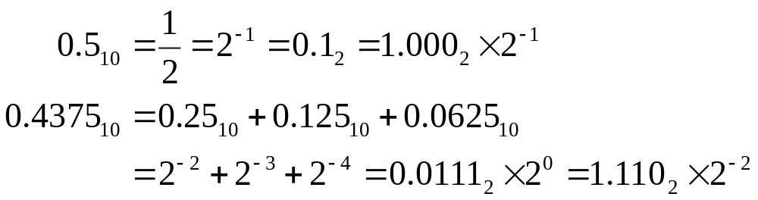

Floating Point Addition (Example)
Convert the numbers 0.5₁₀ and -0.4375₁₀ to floating point binary
representation, and then perform the binary floating point addition
of these numbers.
Which number should have its significand adjusted?
P-H. p. 249
Hen/Patt, pp. 283

Slide 18
Floating Point Multiplication (Decimal)
Assume that we only can store four digits of the significand and two
digits of the exponent in a decimal floating point representation.
How would you multiply 1.110₁₀×10¹⁰ by 9.200₁₀×10⁻⁵ in
this representation?
Step 1: Add the exponents: new exponent = 10 - 5 = 5
Step 2: Multiply the significands:
1.110
×9.200
0000
0000
2220
9990
10.212000
Step 3: Normalize the product:
10.212₁₀×10⁵ = 1.0212₁₀ ×10⁶
Step 4: Round-off the product:
1.0212₁₀×10⁶ = 1.021₁₀ ×10⁶
P-H. p. 255
Hen/Patt, pp. 286

Slide 19
Accurate Arithmetic
Assume that you only can store three significant decimal digits.
Add 2.56₁₀ × 10⁰ to 2.34₁₀ × 10²
mantissa
exponent
mantissa
exponent
2
.
5
6
0
0
.
0
2
2
2
.
3
4
2
+
2
.
3
4
2
2
.
3
6
2
Chapter 3 — Arithmetic for Computers — <number>

Slide 20
Accurate Arithmetic (cont.)
Now assume that you also have room for a guard digit and for a round digit.
Add 2.56₁₀ × 10⁰ to 2.34₁₀ × 10²
mantissa
exponent
mantissa
guard
round
exponent
2
.
5
6
0
0
.
0
2
5
6
2
2
.
3
4
2
+
2
.
3
4
0
0
2
2
.
3
6
5
6
2
We round 00 to 49 down, and 51 to 99 up. Thus the result of the sum is 2.37.
We round 50 to the nearest even number
Chapter 3 — Arithmetic for Computers — <number>

Slide 21
Sticky Bit
Ideally we would like to do the intermediate computation with infinite precision and round the result.
The problem is how to differentiate between these two numbers:
  0.50…..00₁₀
  0.50…..01₁₀
Solution: use a sticky bit that is set whenever there are non-zero bits to the right of the round bit.
Chapter 3 — Arithmetic for Computers — <number>

Slide 22
Example with no sticky bit
Add 5.01₁₀ × 10⁻¹ to 2.34₁₀ × 10² with guard and round digits and no sticky bit.
mantissa
exponent
mantissa
guard
round
exponent
5
.
0
1
-1
0
.
0
0
5
0
2
2
.
3
4
2
+
2
.
3
4
0
0
2
2
.
3
4
5
0
2
We need to round 50 to the nearest even, thus the result is 2.34
Chapter 3 — Arithmetic for Computers — <number>

Slide 23
Example with sticky bit
Add 5.01₁₀ × 10⁻¹ to 2.34₁₀ × 10² with guard and round digits and sticky bit.
mantissa
exponent
mantissa
guard
round
sticky
exponent
5
.
0
1
-1
0
.
0
0
5
0
1
2
2
.
3
4
2
+
2
.
3
4
0
0
0
2
2
.
3
4
5
0
1
2
With the sticky bit equal 1, 50 is rounded up, thus the result is 2.35
Chapter 3 — Arithmetic for Computers — <number>

Slide 24
Accurate Arithmetic
IEEE Std 754 specifies additional rounding control
  Extra bits of precision (guard, round, sticky)
  Choice of rounding modes
  Allows programmer to fine-tune numerical behavior of a computation
Not all FP units implement all options
  Most programming languages and FP libraries just use defaults
Trade-off between hardware complexity, performance, and market requirements
Chapter 3 — Arithmetic for Computers — <number>
P-H. p. 266
Notes:
Morgan Kaufmann Publishers
Chapter 3 — Arithmetic for Computers

Slide 25
Associativity of FP Addition
Assume that: x = -1.5₁₀ × 10³⁸
y = 1.5₁₀ × 10³⁸
z = 1.0₁₀
Now we need to compute x + (y+z) and (x+y)+z assuming that we only have
room to store 32 decimal digits for the significand of any number.
x + (y+z) = -1.5₁₀ × 10³⁸ + (1.5₁₀ × 10³⁸ + 1.0₁₀)
= -1.5₁₀ × 10³⁸ + (1.5₁₀ × 10³⁸ + 0.0₁₀ × 10³⁸)
= -1.5₁₀ × 10³⁸ + 1.5₁₀ × 10³⁸
= 0.0₁₀
(x + y)+z = (-1.5₁₀ × 10³⁸ + 1.5₁₀ × 10³⁸) + 1.0₁₀
= 0.0₁₀ + 1.0₁₀
= 1.0₁₀
Thus, floating-point addition is not associative.
Chapter 3 — Arithmetic for Computers — <number>

Slide 26
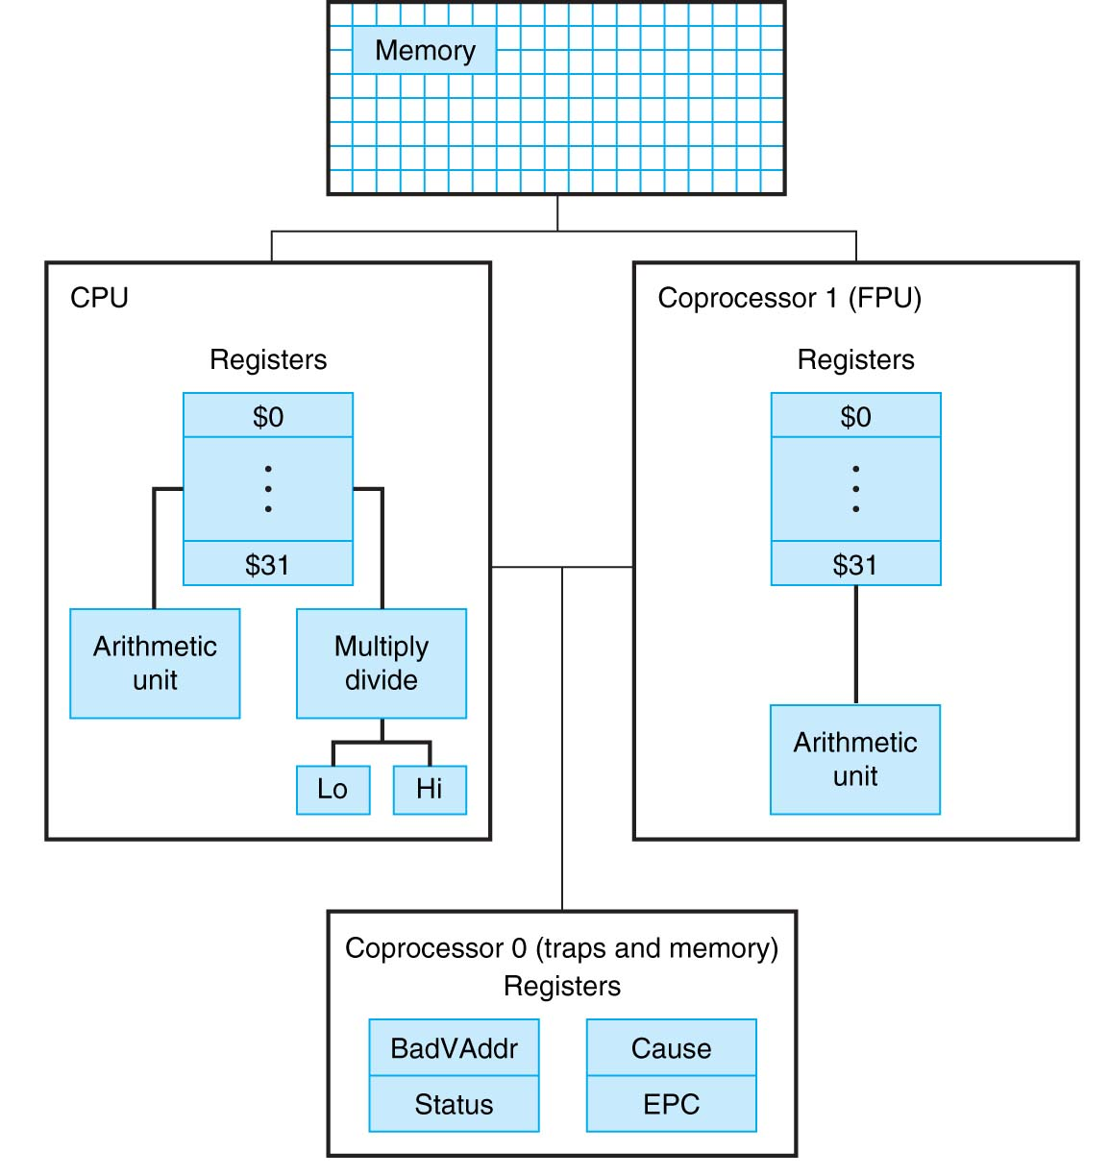
MIPS Coprocessors
COPYRIGHT 1998 MORGAN KAUFMANN PUBLISHERS, INC. ALL RIGHTS RESERVED
P-H p. B-46

Slide 27
Floating Point in MIPS
MIPS Supports the IEEE 754 single-precision and double-precision
formats.
MIPS has a separate set of registers to store floating point operands:
$f0, $f1, $f2, ...
In single precision, each individual register $f0, $f1, $f2, … contains
one single precision (32-bit) value.
In double precision, each pair of registers $f0-$f1, $f2-$f3, … contains
one double precision (64-bit) value.
P-H. p. 259

Slide 28
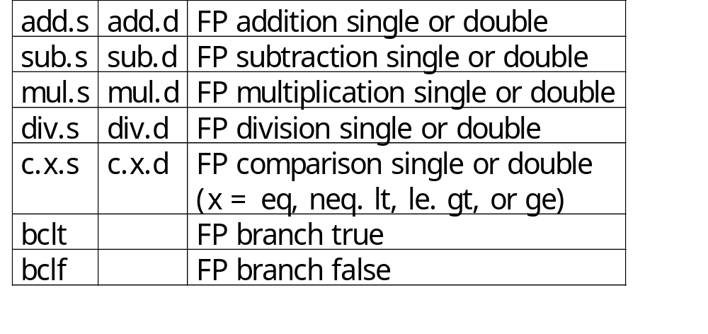
Floating Point in MIPS
In order to load a value in a floating point register, MIPS offers the
load word coprocessor, lwcz, instructions. Because the floating point
coprocessor is the coprocessor number 1, the instruction is lwc1.
Similarly to store the value of a floating point register into memory,
MIPS offers the store word coprocessor, swc1.
P-H. p. 260

Slide 29
Floating Point Instruction in MIPS
What does the following assembly code do?
lwc1 $f4, 4($sp)
lwc1 $f6, 8($sp)
add.s $f2, $f4, $f6
swc1 $f2,12($sp)
Reads two floating point values from the stack, performs
their addition and stores the result in the stack.
P-H. p. 259

Slide 30
Floating Point (example)
Parameter Passing Convention
base of x[ ] ↔ $a0
base of y[ ] ↔ $a1
base of z[ ] ↔ $a2
void mm ( double x[ ][ ], double y[ ][ ], double z[ ][ ])
{
int i, j, k;
for( i=0 ; i != 32 ; i=i+1 )
for( j=0 ; j != 32 ; j=j+1 )
{
x[i][j] = 0.0;
for( k=0 ; k != 32 ; k=k+1 )
x[i][j] = x[i][j] + y[i][k] * z[k][j];
}
}
Assumption
i ↔ $s0
j ↔ $s1
k ↔ $s2
P-H. p. 263-266

Slide 31
i←0
void mm ( double x[ ][ ], double y[ ][ ], double z[ ][ ])
{
int i, j, k;
for( i=0 ; i != 32 ; i=i+1 )
for( j=0 ; j != 32 ; j=j+1 )
{
x[i][j] = 0;
for( k=0 ; k != 32 ; k=k+1 )
x[i][j] = x[i][j] + y[i][k] * z[k][j]
}
}
i≠32
return
j←0
j≠32
x[i][j] ← 0.0
k←0
k≠32
i←i+1
load x[i][j]
load y[i][k]
load z[k][j]
d1←y[i][k]*z[k][j]
d1 = d1 + x[i][j]
x[i][j] ← d1
j←j+1
Do we need to load and
store x[i][j] in every
iteration of loop k?
k←k+1

Slide 32
i←0
void mm ( double x[ ][ ], double y[ ][ ], double z[ ][ ])
{
int i, j, k;
for( i=0 ; i != 32 ; i=i+1 )
for( j=0 ; j != 32 ; j=j+1 )
{
x[i][j] = 0;
for( k=0 ; k != 32 ; k=k+1 )
x[i][j] = x[i][j] + y[i][k] * z[k][j]
}
}
i≠32
return
j←0
j≠32
d2 ← 0.0
k←0
k≠32
i←i+1
load y[i][k]
load z[k][j]
d1←y[i][k]*z[k][j]
d2 ← d2+ d1
x[i][j]←d2
j←j+1
k←k+1
Parameter Passing Convention
base of x[ ] ↔ $a0
base of y[ ] ↔ $a1
base of z[ ] ↔ $a2
Assumption
i ↔ $s0
j ↔ $s1
k ↔ $s2

Slide 33
MIPS assembly:
li $t1, 32 # t1 ← 32
li $s0, 0 # i ← 0
L1: beq $s0, $t1, D1
li $s1, 0 # j ← 0
L2: beq $s1, $t1, D2
$f4 ← 0.0
li $s2, 0 # k ← 0
L3: beq $s2,$t1, D3
<loop body>
addiu $s2, $s2, 1 # k ← k+1
j L3
D3: x[i][j] ← $f4
addiu $s1, $s1, 1 # j ← j+1
j L2
D2: addiu $s0, $s0, 1 # i ← i+1
j L1
D1:
i←0
i≠32
return
j←0
j≠32
d2 ← 0.0
k←0
k≠32
i←i+1
load y[i][k]
load z[k][j]
d1←y[i][k]*z[k][j]
d2 ← d2+ d1
x[i][j]←d2
j←j+1
k←k+1
Parameter Passing Convention
base of x[ ] ↔ $a0
base of y[ ] ↔ $a1
base of z[ ] ↔ $a2
Assumption
i ↔ $s0
j ↔ $s1
k ↔ $s2

Slide 34
i←0
void mm ( double x[ ][ ], double y[ ][ ], double z[ ][ ])
{
int i, j, k;
for( i=0 ; i != 32 ; i=i+1 )
for( j=0 ; j != 32 ; j=j+1 )
{
x[i][j] = 0;
for( k=0 ; k != 32 ; k=k+1 )
x[i][j] = x[i][j] + y[i][k] * z[k][j]
}
}
j←0
d2 ← 0.0
k←0
load y[i][k]
load z[k][j]
d1←y[i][k]*z[k][j]
d2 ← d2+ d1
k←k+1
k≠32
x[i][j]←d2
j←j+1
j≠32
i←i+1
i≠32
return

Slide 35
i←0
Parameter Passing Convention
base of x[ ][ ] ↔ $a0
base of y[ ][ ] ↔ $a1
base of z[ ][ ] ↔ $a2
MIPS assembly:
li $t1, 32 # t1 ← 32
li $s0, 0 # i ← 0
L1: li $s1, 0 # j ← 0
L2: $f4 ← 0.0
li $s2, 0 # k ← 0
L3: <loop body>
addiu $s2, $s2, 1 # k ← k+1
bne $s2, $t1, L3
x[i][j] ← $f4
addiu $s1, $s1, 1 # j ← j+1
bne $s1, $t1, L2
addiu $s0, $s0, 1 # i ← i+1
bne $s0, $t1, L1
j←0
d2 ← 0.0
k←0
Assumption
i ↔ $s0
j ↔ $s1
k ↔ $s2
load y[i][k]
load z[k][j]
d1←y[i][k]*z[k][j]
d2 ← d2+ d1
k←k+1
k≠32
x[i][j]←d2
j←j+1
j≠32
i←i+1
i≠32
return

Slide 36
The loop body
load y[i][k]
load z[k][j]
d1←y[i][k]*z[k][j]
d2 ← d2+ d1
How do we load the y[i][k] into a floating point register?
First we have to consider how a 2-dimensional
matrix of doubles is stored in memory
Base of y[ ][ ]
Base of y[ ][ ]+8
Parameter Passing Convention
base of x[ ][ ] ↔ $a0
base of y[ ][ ] ↔ $a1
base of z[ ][ ] ↔ $a2
y[0][0]
y[0][1]
y[0][2]
y[0][31]
y[1][0]
y[1][1]
y[1][2]
y[1][31]
Base of y[ ][ ]+8×32
Assumption
i ↔ $s0
j ↔ $s1
k ↔ $s2
y[31][0]
y[31][1]
y[31][2]
y[31][31]
In general, the address of y[i][k] is given by:
add(y[i][k])= base of y[ ][ ] + ( i × 32 + k ) × 8

Slide 37
The loop body
load y[i][k]
load z[k][j]
d1←y[i][k]*z[k][j]
d2 ← d2+ d1
In general, the address of y[i][k] is given by:
add(y[i][k])= base of y[ ][ ] + ( i × 32 + k ) × 8
MIPS assembly for load y[i][k]:
L3: sll $t2, $s0, 5 # $t2 ← 32 × i
addu $t2, $t2, $s2 # $t2 ← 32 × i + k
sll $t2, $t2, 3 # $t2 ← (32 × i + k) × 8
addu $t2, $a1, $t2 # $t2 ← Addr(y[i][k])
l.d $f16, 0($t2) # $f16 ← y[i][k]
Parameter Passing Convention
base of x[ ][ ] ↔ $a0
base of y[ ][ ] ↔ $a1
base of z[ ][ ] ↔ $a2
Write the code to load z[k][j] in $f18.
Assumption
i ↔ $s0
j ↔ $s1
k ↔ $s2
MIPS assembly for load z[k][j]:
sll $t2, $s2, 5 # $t2 ← 32 × k
addu $t2, $t2, $s1 # $t2 ← 32 × k + j
sll $t2, $t2, 3 # $t2 ← (32 × k + j) × 8
addu $t2, $a2, $t2 # $t2 ← Addr(z[k][j])
l.d $f18, 0($t2) # $f16 ← z[k][j]

Slide 38
The loop body (cont.)
load y[i][k]
load z[k][j]
d1←y[i][k]*z[k][j]
d2 ← d2+ d1
Once we have loaded y[i][k] into $f16 and z[k][j] into $f18,
we can proceed to peform the multiply and the add:
Parameter Passing Convention
base of x[ ][ ] ↔ $a0
base of y[ ][ ] ↔ $a1
base of z[ ][ ] ↔ $a2
MIPS assembly for multiply and add:
mul.d $f16, $f18, $f16 # $f16 ← y[i][k]×z[k][j]
add.d $f4, $f4, $f16
Assumption
i ↔ $s0
j ↔ $s1
k ↔ $s2

Slide 39
Initializing and Storing $f4
How can we initialize $f4?
MIPS assembly:
li $t1, 32 # t1 ← 32
li $s0, 0 # i ← 0
L1: li $s1, 0 # j ← 0
L2: $f4 ← 0.0
li $s2, 0 # k ← 0
L3: <loop body>
addiu $s2, $s2, 1 # k ← k+1
bne $s2, $t1, L3
x[i][j] ← $f4
addiu $s1, $s1, 1 # j ← j+1
bne $s1, $t1, L2
addiu $s0, $s0, 1 # i ← i+1
bne $s0, $t1, L1
MIPS assembly to initialize $f4:
mtc1 $zero, $f4
mtc1 $zero, $f5
Warning: In your textbook, page A-72,
mtcz is specified as follows:
Move to coprocessor z:
mtcz rd, rt
Move CPU register rt to coprocessor z’s register rd.
Parameter Passing Convention
base of x[ ][ ] ↔ $a0
base of y[ ][ ] ↔ $a1
base of z[ ][ ] ↔ $a2
Assumption
i ↔ $s0
j ↔ $s1
k ↔ $s2

Slide 40
Initializing and Storing $f4
How can we initialize $f4?
MIPS assembly:
li $t1, 32 # t1 ← 32
li $s0, 0 # i ← 0
L1: li $s1, 0 # j ← 0
L2: $f4 ← 0.0
li $s2, 0 # k ← 0
L3: <loop body>
addiu $s2, $s2, 1 # k ← k+1
bne $s2, $t1, L3
x[i][j] ← $f4
addiu $s1, $s1, 1 # j ← j+1
bne $s1, $t1, L2
addiu $s0, $s0, 1 # i ← i+1
bne $s0, $t1, L1
MIPS assembly to initialize $f4:
mtc1 $zero, $f4
mtc1 $zero, $f5
How can we store $f4 in x[i][j]?
MIPS assembly to store $f4 in x[i][j]:
L3: sll $t2, $s0, 5 # $t2 ← 32 × i
addu $t2, $t2, $s1 # $t2 ← 32 × i + j
sll $t2, $t2, 3 # $t2 ← (32 × i + j) × 8
addu $t2, $a0, $t2 # $t2 ← Addr(x[i][j])
swc1 $f4, 0($t2) # x[i][j] ← $f4
swc1 $f5, 4($t2)
Parameter Passing Convention
base of x[ ][ ] ↔ $a0
base of y[ ][ ] ↔ $a1
base of z[ ][ ] ↔ $a2
Assumption
i ↔ $s0
j ↔ $s1
k ↔ $s2

Slide 41
MIPS assembly:
li $t1, 32 # t1 ← 32
li $s0, 0 # i ← 0
L1: li $s1, 0 # j ← 0
L2: mtc1 $zero, $f4
mtc1 $zero, $f5
li $s2, 0 # k ← 0
L3: sll $t2, $s0, 5 # $t2 ← 32 × i
addu $t2, $t2, $s2 # $t2 ← 32 × i + k
sll $t2, $t2, 3 # $t2 ← (32 × i + k) × 8
addu $t2, $a1, $t2 # $t2 ← Addr(y[i][k])
l.d $f16, 0($t2) # $f16 ← y[i][k]
sll $t2, $s2, 5 # $t2 ← 32 × k
addu $t2, $t2, $s1 # $t2 ← 32 × i + j
sll $t2, $t2, 3 # $t2 ← (32 × k + j) × 8
addu $t2, $a2, $t2 # $t2 ← Addr(z[k][j])
l.d $f18, 0($t2) # $f16 ← z[k][j]
mul.d $f16, $f18, $f16 # $f16 ← y[i][k]×z[k][j]
add.d $f4, $f4, $f16
addiu $s2, $s2, 1 # k ← k+1
bne $s2, $t1, L3
sll $t2, $s0, 5 # $t2 ← 32 × i
addu $t2, $t2, $s1 # $t2 ← 32 × i + j
sll $t2, $t2, 3 # $t2 ← (32 × i + j) × 8
addu $t2, $a0, $t2 # $t2 ← Addr(x[i][j])
swc1 $f4, 0($t2) # x[i][j] ← $f4
swc1 $f5, 4($t2)
addiu $s1, $s1, 1 # j ← j+1
bne $s1, $t1, L2
addiu $s0, $s0, 1 # i ← i+1
bne $s0, $t1, L1
Parameter Passing Convention
base of x[ ][ ] ↔ $a0
base of y[ ][ ] ↔ $a1
base of z[ ][ ] ↔ $a2
Assumption
i ↔ $s0
j ↔ $s1
k ↔ $s2

Slide 42
MIPS assembly:
li $t1, 32 # t1 ← 32
li $s0, 0 # i ← 0
L1: li $s1, 0 # j ← 0
L2: mtc1 $zero, $f4
mtc1 $zero, $f5
li $s2, 0 # k ← 0
L3: sll $t2, $s0, 5 # $t2 ← 32 × i
addu $t2, $t2, $s2 # $t2 ← 32 × i + k
sll $t2, $t2, 3 # $t2 ← (32 × i + k) × 8
addu $t2, $a1, $t2 # $t2 ← Addr(y[i][k])
l.d $f16, 0($t2) # $f16 ← y[i][k]
sll $t2, $s2, 5 # $t2 ← 32 × k
addu $t2, $t2, $s1 # $t2 ← 32 × i + j
sll $t2, $t2, 3 # $t2 ← (32 × k + j) × 8
addu $t2, $a2, $t2 # $t2 ← Addr(z[k][j])
l.d $f18, 0($t2) # $f16 ← z[k][j]
mul.d $f16, $f18, $f16 # $f16 ← y[i][k]×z[k][j]
add.d $f4, $f4, $f16
addiu $s2, $s2, 1 # k ← k+1
bne $s2, $t1, L3
sll $t2, $s0, 5 # $t2 ← 32 × i
addu $t2, $t2, $s1 # $t2 ← 32 × i + j
sll $t2, $t2, 3 # $t2 ← (32 × i + j) × 8
addu $t2, $a0, $t2 # $t2 ← Addr(x[i][j])
swc1 $f4, 0($t2) # x[i][j] ← $f4
swc1 $f5, 4($t2)
addiu $s1, $s1, 1 # j ← j+1
bne $s1, $t1, L2
addiu $s0, $s0, 1 # i ← i+1
bne $s0, $t1, L1
load y[i][k] in $f16
load z[k][j] in $f16
store $f4 in x[i][j]
Parameter Passing Convention
base of x[ ][ ] ↔ $a0
base of y[ ][ ] ↔ $a1
base of z[ ][ ] ↔ $a2
Assumption
i ↔ $s0
j ↔ $s1
k ↔ $s2

Slide 43
Interpretation of Data
The BIG Picture
Bits have no inherent meaning
  Interpretation depends on the instructions applied
Computer representations of numbers
  Finite range and precision
  Need to account for this in programs
Chapter 3 — Arithmetic for Computers — <number>
P-H. p. 269
Notes:
Morgan Kaufmann Publishers
Chapter 3 — Arithmetic for Computers

Slide 44

Associativity
Parallel programs may interleave operations in unexpected orders
  Assumptions of associativity may fail
§3.6 Parallelism and Computer Arithmetic: Associativity
Need to validate parallel programs under varying degrees of parallelism
Chapter 3 — Arithmetic for Computers — <number>
P-H. p. 270
Notes:
Morgan Kaufmann Publishers
Chapter 3 — Arithmetic for Computers

Slide 45
Streaming SIMD Extension 2 (SSE2)
Adds 4 × 128-bit registers
  Extended to 8 registers in AMD64/EM64T
Can be used for multiple FP operands
  2 × 64-bit double precision
  4 × 32-bit double precision
  Instructions operate on them simultaneously
    Single-Instruction Multiple-Data
Chapter 3 — Arithmetic for Computers — <number>
P-H. p. 274
Notes:
Morgan Kaufmann Publishers
Chapter 3 — Arithmetic for Computers

Slide 46
Who Cares About FP Accuracy?
Important for scientific code
  But for everyday consumer use?
    “My bank balance is out by 0.0002¢!” ☹
The Intel Pentium FDIV bug
  The market expects accuracy
  See Colwell, The Pentium Chronicles
Chapter 3 — Arithmetic for Computers — <number>
P-H. p. 277
Notes:
Morgan Kaufmann Publishers
Chapter 3 — Arithmetic for Computers

Slide 47
Concluding Remarks
ISAs support arithmetic
  Signed and unsigned integers
  Floating-point is an approximation of real numbers
Bounded range and precision
  Operations can overflow and underflow
MIPS ISA
  Core instructions: 54 most frequently used
    100% of SPECINT, 97% of SPECFP
  Other instructions: less frequent
§3.9 Concluding Remarks
Chapter 3 — Arithmetic for Computers — <number>
P-H. p. 280
Notes:
Morgan Kaufmann Publishers
Chapter 3 — Arithmetic for Computers

