Slide 1
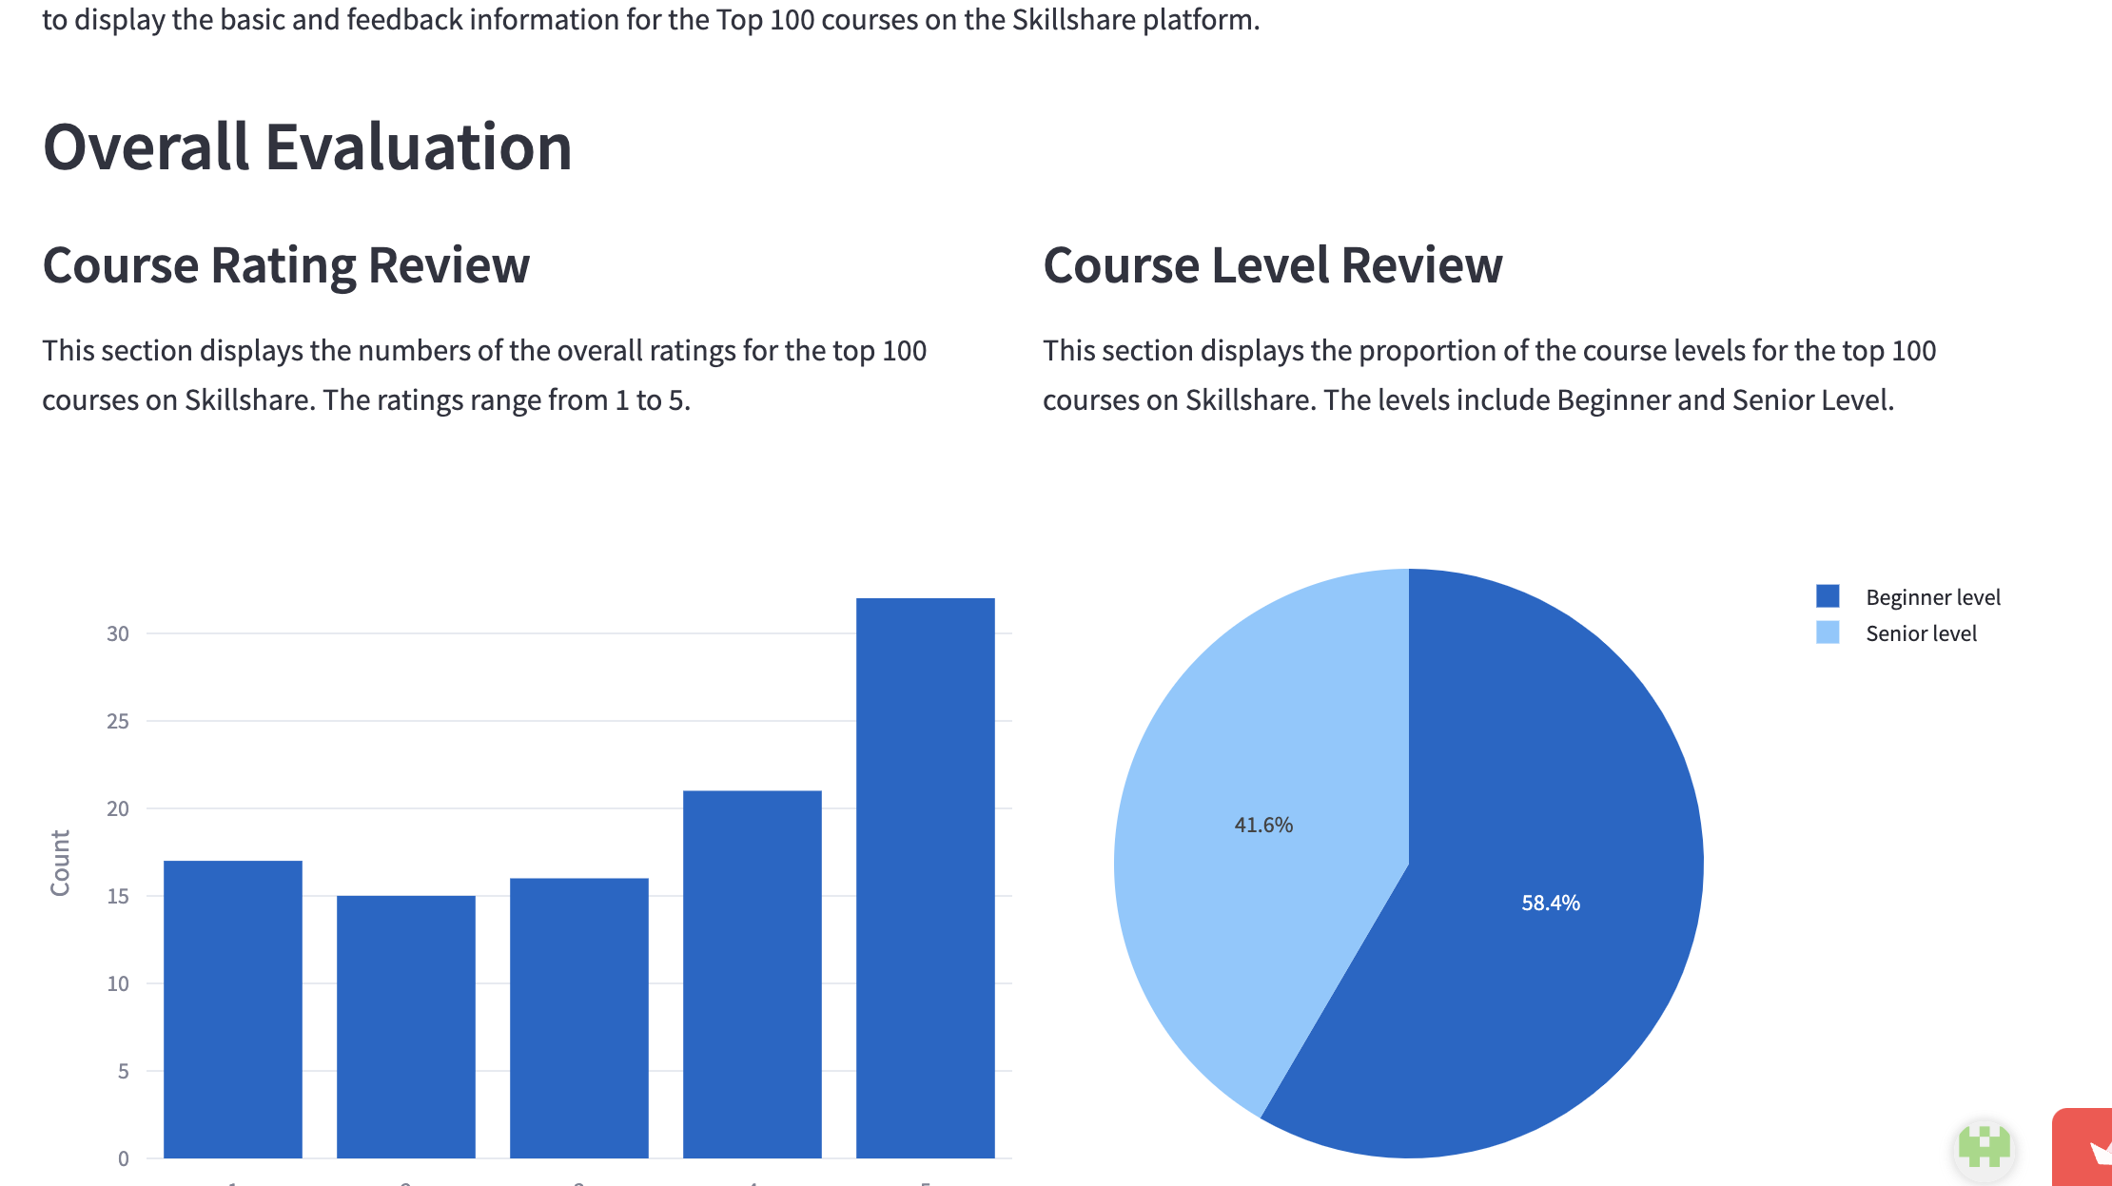
Skillshare Course Evaluation Dashboard
Review, Analyze and Compare Courses in One Dashboard

Slide 2
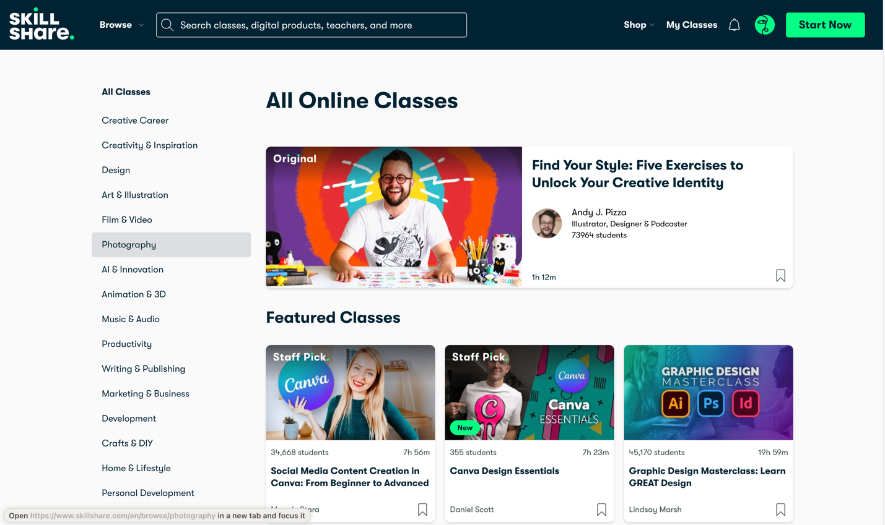
Intro: SkillShare
Skillshare is an online learning platform offering a wide range of classes in areas such as graphic design, cooking, productivity, filmmaking, content creation, UI/UX design, marketing, crafts, music, social media, and entrepreneurship. It caters primarily to creative learners, including artists, designers, and writers, who can explore courses aligned with their interests and learn at their own pace. Courses are taught by experienced professionals with years of expertise in their respective creative fields. Skillshare empowers learners to start new careers, transition to different fields, or advance in their current professions.

Slide 3
Skillshare Course Evaluation Dashboard
The Skillshare Course Evaluation Dashboard provides key information and feedback for the platform's Top 100 courses.This dashboard is designed for three primary user groups:
a) Platform managers who monitor courses. They can identify the most popular courses on the platform and analyze their shared features, enabling them to provide more targeted and constructive feedback to course creators.
b) Students looking for high-quality courses. They can explore basic course information and key statistics—such as course duration, comments, and project numbers—to make informed decisions about which courses to attend.
c) Educators seeking insights. They can analyze feedback on their courses and observe trends from the most popular ones to set goals and improve course quality.

Slide 4
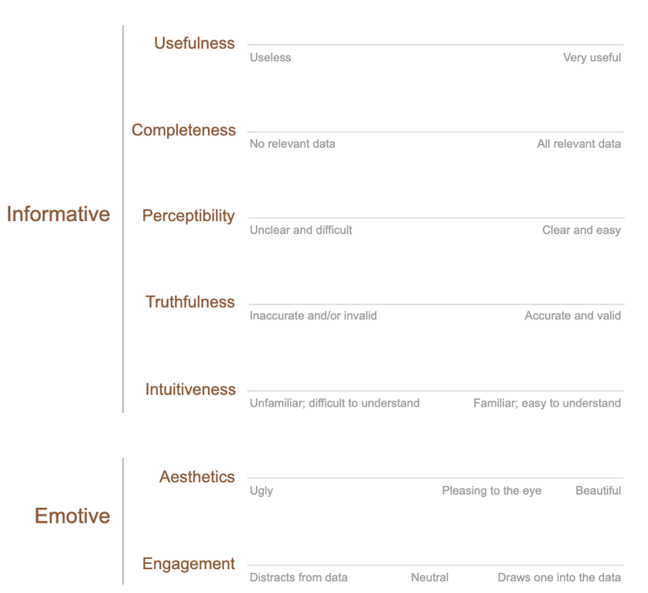
Design Principles
Stephen Few’s guidelines
I referred to Stephen Few's guidelines for balancing information vs. aesthetics. The dashboard provides statistical information for each course and displays review changes over time, ensuring the data is both useful for evaluation and accurate. Interactive and visually appealing components are incorporated to make the dashboard more engaging.

Slide 5

Bias and Accessibility
To address accessibility issues, I incorporated colorblind-friendly palettes and selected colors with high contrast. Additionally, I provided alternative text for all charts to support users relying on screen readers. The text is well-organized and large enough for easy readability. Furthermore, the dashboard is designed to be responsive, ensuring compatibility across various screen sizes.

Slide 6
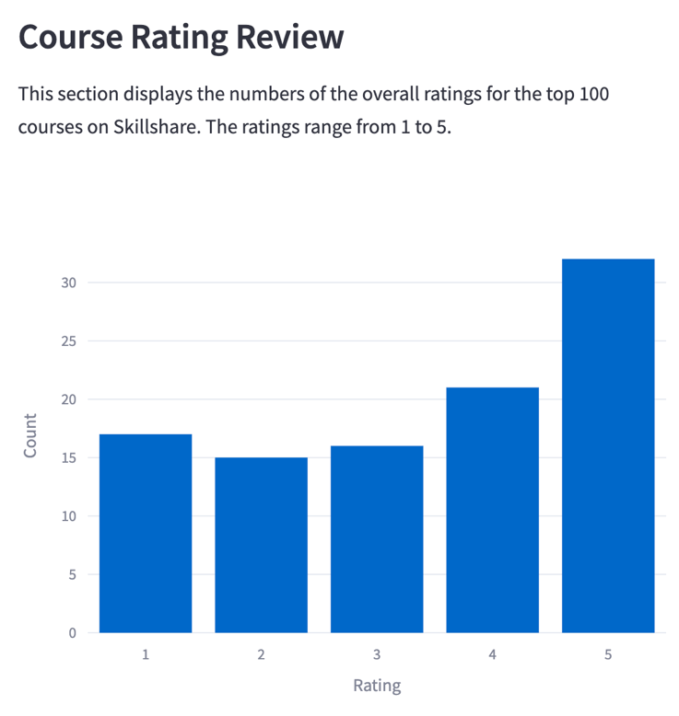
Dashboard Design
1. Course Rating Review
The course rating review displays the overall ratings for the top 100 courses on Skillshare. The ratings range from 1 to 5, providing users with a quick overview of how these courses are rated.

Slide 7
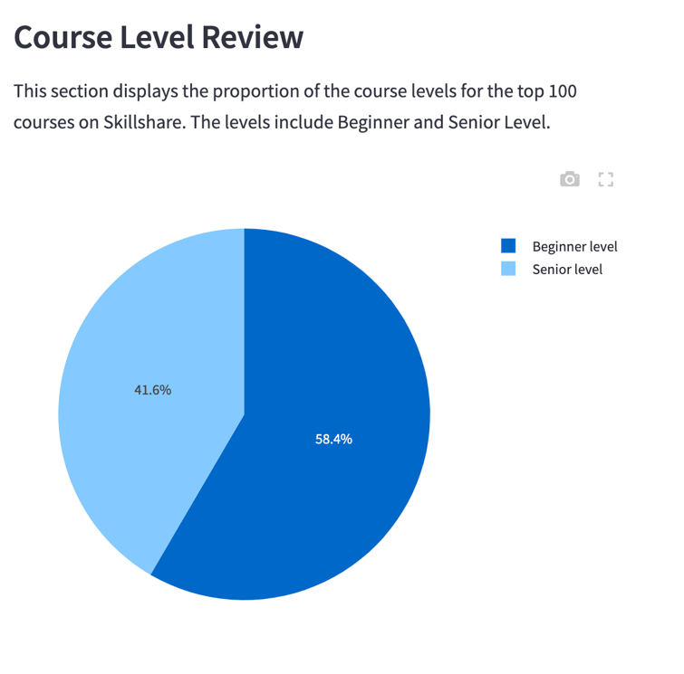
2. Course Level Review
The course level review shows the proportion of course levels for the top 100 courses on Skillshare. The levels include Beginner and Senior. Users can easily see that Beginner-level courses are more popular on the platform.

Slide 8
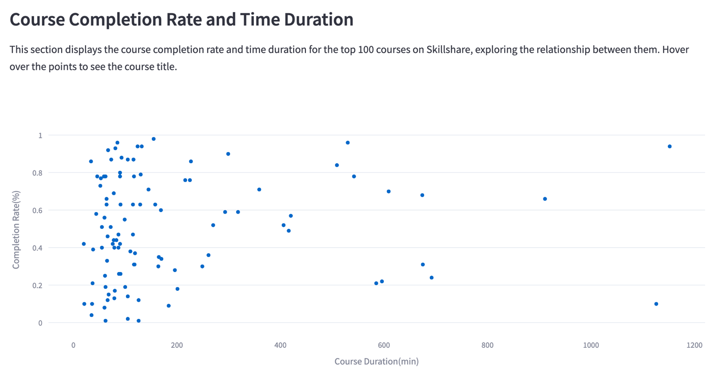
3. Course Completion Rate and Time Duration
This scatterplot displays the course completion rate and time duration for the top 100 courses on Skillshare, exploring the relationship between the two. An interactive element enhances the user experience: when users hover over the points, the detailed value and course title are displayed.

Slide 9
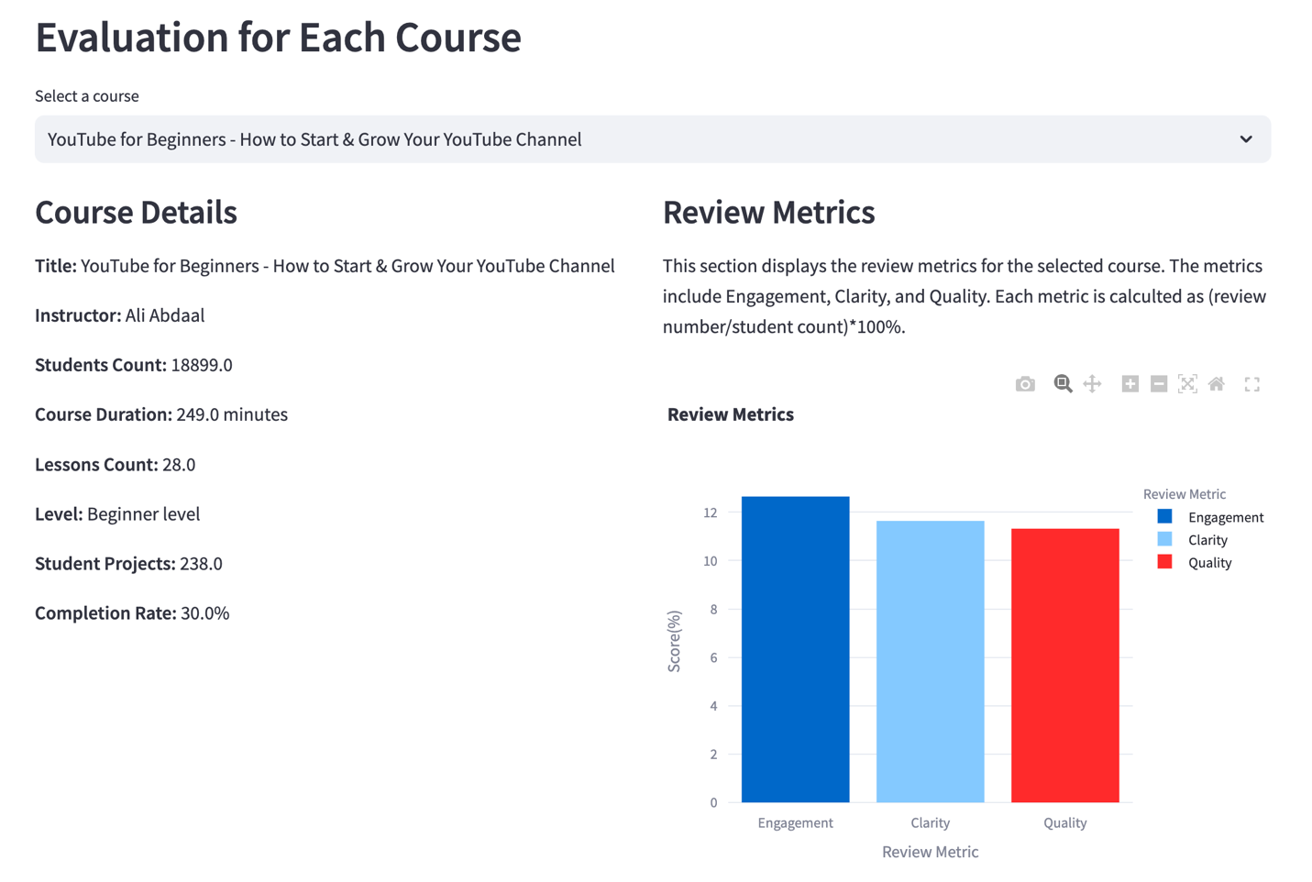
4. Evaluation for Each Course
This chart is customizable, allowing users to freely select the course they are interested in and access relevant detailed information and review metrics. The color palette is designed to be accessible for color-blind users.

Slide 10
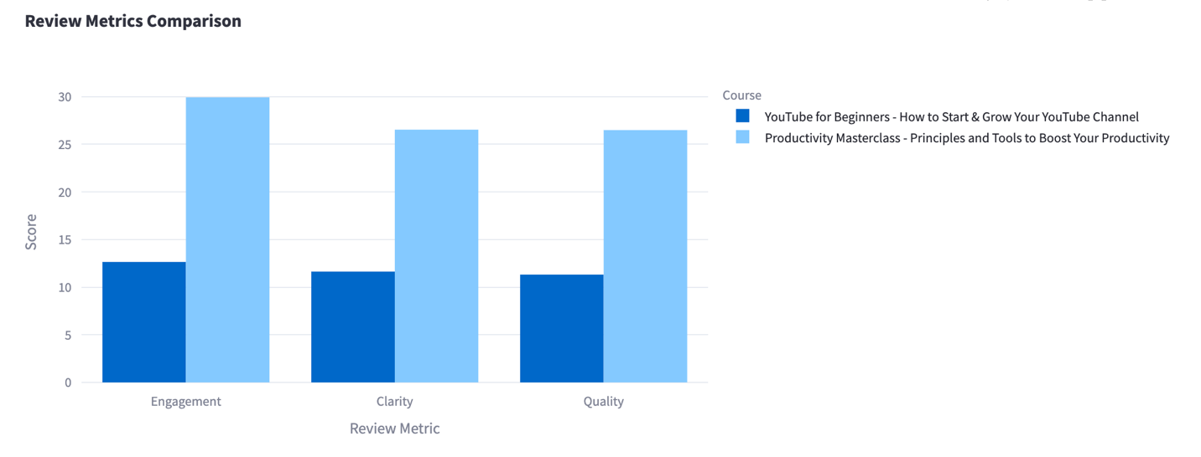
5. Comparison for Two Courses
In this section, users can select any two courses and compare their review metrics in the chart to see which course has better reviews. This design enables meaningful comparison, making the user experience more engaging.

