Slide 1

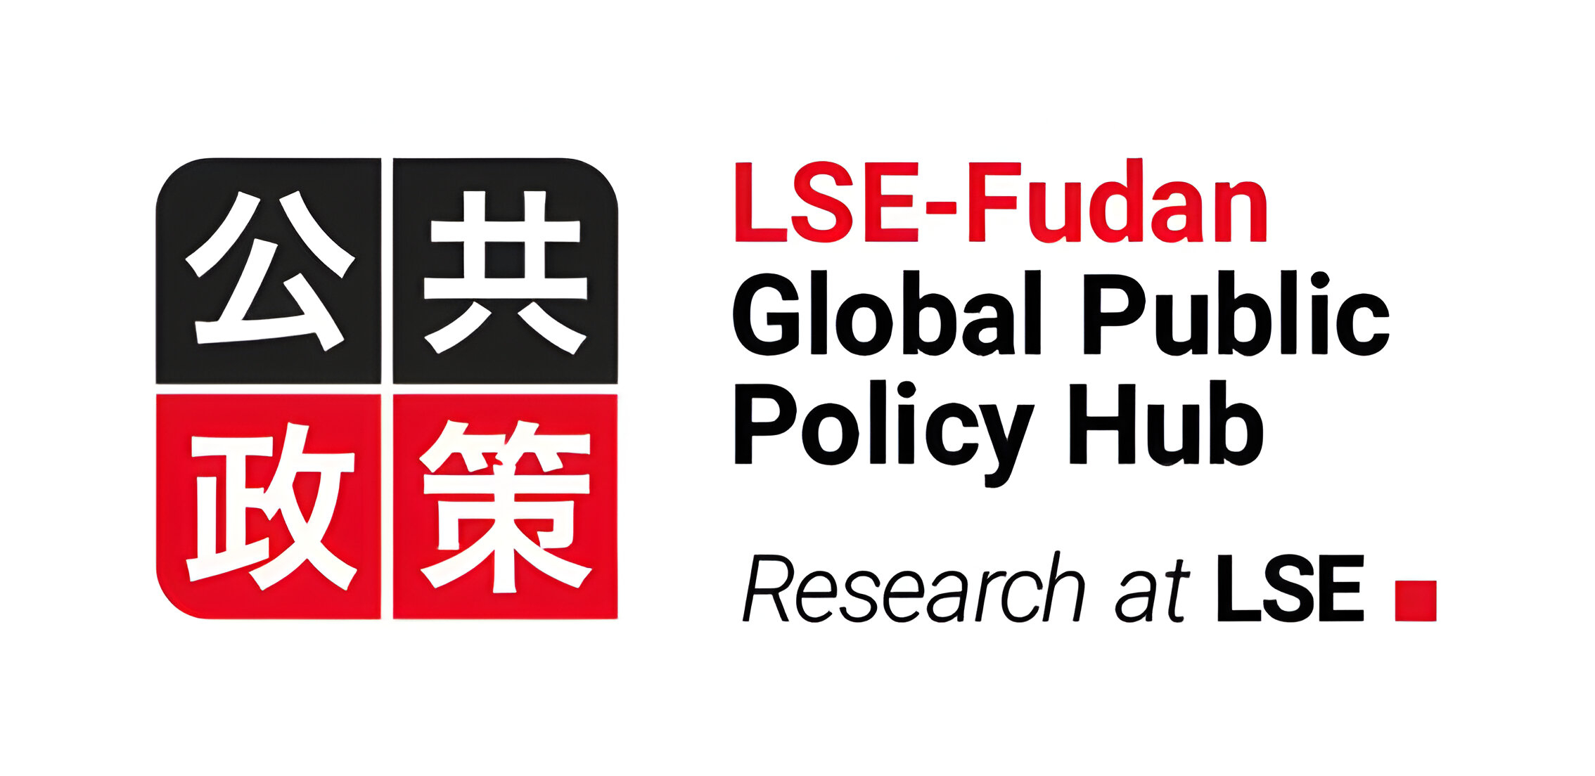

China and World Development
Academic Training for Officials of the League of Arab States
12 November 2024
Dr. Yuezhou Yang
PhD in International Development (LSE)
Research Fellow, LSE-Fudan Global Public Policy Hub
y.yang91@lse.ac.uk

Slide 2
Learning Objectives
China’s rapid economic growth and social development offer development lessons. Development is a coevolutionary process. State and markets interact and adapt each other, changing mutually over time. China’s success over the last 45 years was built on striking a balance with tensions between a) domestic reforms and globalization, b) economic and governance reforms, and c) central and local governments.
China’s ‘going out’ has contributed to an atmosphere of transition in foreign aid and development cooperation to ‘development effectiveness paradigm.’ Through the platform of Belt and Road Initiative, China provided alternative development finance and model of South-South cooperation for development.
China’s ‘going out’ has revealed fragmentation and political struggles among key central agencies as well as ‘anarchic competition’ among decentralized local states and agents.

Slide 3
Today’s lecture
1. Domestic foundation of China’s global rise
1) An overview of China’s development since 1978
2) How did China escape the poverty trap?
- coevolution of state and market
3) How did China achieve structural change?
- mayor economy
- juguo approach
4) Is there a China model?
- a dynamic China model: coevolution of economic and pollical system
2. China ‘going out’ and world development
1) International trade and OFDI
- three types of Chinese capital
2) Chinese foreign aid and development finance
- definition of Chinese foreign aid vs. OECD ODA
- Chinese development finance vs. WB
3) Development paradigm shift
- 2011 Busan high level forum
- foreign aid evolution in China: aid-trade-investment
4) China’s Belt and Road Initiative
- China’s approaches to development cooperation
- coevolutionary pragmatism

