Slide 1
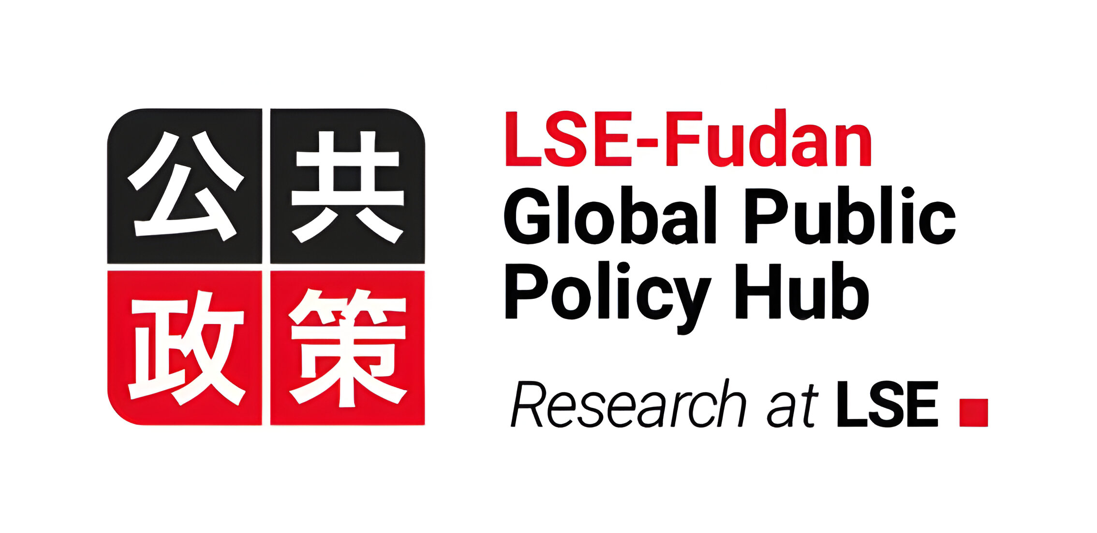

Learning Objectives
China’s rapid economic growth and social development offer development lessons. Development is a coevolutionary process. State and markets interact and adapt each other, changing mutually over time. China’s success over the last 45 years was built on striking a balance with tensions between a) domestic reforms and globalization, b) economic and governance reforms, and c) central and local governments.
China’s ‘going out’ has contributed to an atmosphere of transition in foreign aid and development cooperation to ‘development effectiveness paradigm.’ Through the platform of Belt and Road Initiative, China provided alternative development finance and model of South-South cooperation for development.
China’s ‘going out’ has revealed fragmentation and political struggles among key central agencies as well as ‘anarchic competition’ among decentralized local states and agents.

