Slide 1

Lightweight Diffusion Models:
Accelerating Training and Inference for Resource-Constrained Environments
Course: Computer Vision
Author: Yuriy Fedoryuk
Data: 15/07/2026
Key Technologies
DDPM
DDIM
PyTorch
CIFAR-10

Slide 2
Outline
Problem Statement
State of the Art
Proposed Method
Dataset
Model Architecture
Experimental Setup
DDIM Acceleration Strategy
Model Evaluation
Results and Ablation Study
Conclusions & Future Works
References

Slide 3
Problem Statement
DDPMs generate high-quality images but require ~1000 denoising steps, making inference slow.
Goals:
Implement DDPM baseline
Integrate DDIM
Measure speed-quality trade-off

Slide 4
State of the Art
Denoising Diffusion Probabilistic Models (DDPM Ho et al., 2020) based on:
Forward diffusion gradually adds noise
x₀ → x₁ → x₂ → ... → xₜ
Reverse process learns to remove noise
Excellent quality but slow sampling

Slide 5
Proposed Method
Train
DDPM
EMA
Weights
DDIM
Sampler
Evaluate
Quality
Baseline DDPM + DDIM accelerated sampling
Benefits:
No retraining required
Same U-Net weights
Deterministic sampling
10×–100× faster generation
DDIM Update Rule:
x_{t-1} = √ᾱ_{t-1} · x̂₀ + √(1-ᾱ_{t-1} - σ²) · ε_θ(x_t, t) + σ · ε

Slide 6
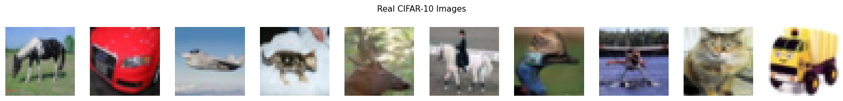
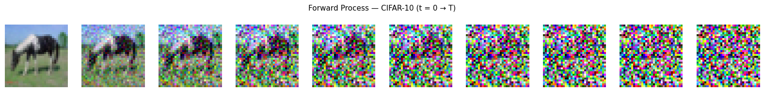
Dataset
CIFAR-10
50,000
10,000
32 × 32
10
RGB
Train images
Test images
Resolution
Classes
Channels

Slide 7
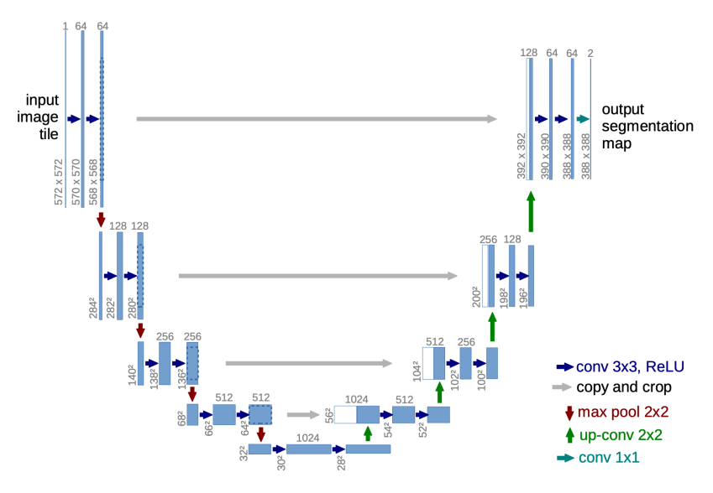
Model Architecture
Lightweight U-Net
Encoder–Decoder
Residual Blocks
Self-Attention Bottleneck
Sinusoidal Time Embeddings
Skip Connections

Slide 8
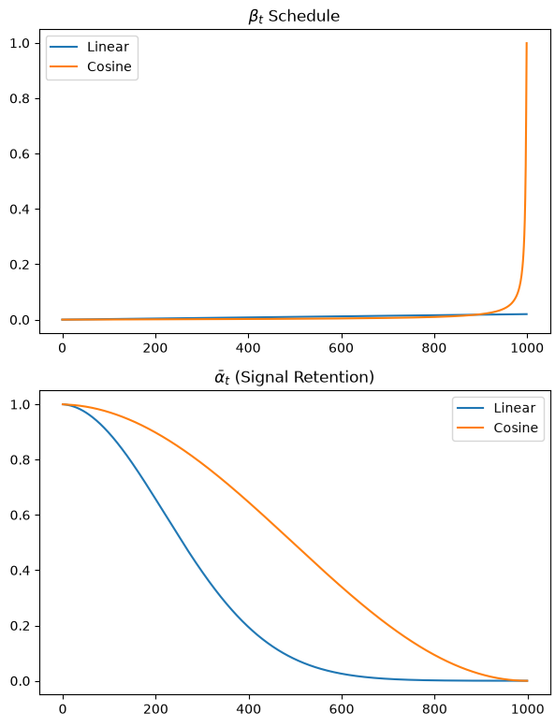
Experimental Setup
Parameter | Value
Optimizer | AdamW
Learning rate | 4e-4
Weight decay | 1°-4
Batch size | 512
Diffusion steps (T) | 1000
EMA decay | 0.9999
Scheduler | Cosine Annealing
Base dim | 32 channels
Multipliers | (1, 2, 4)
Time emb | 256
Epochs | 100
Stability Techniques
AMP + EMA + Gradient Clipping
Hardware
CPU-based PyTorch implementation

Slide 9
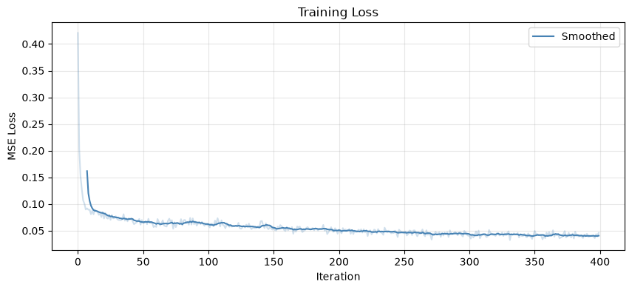
Training Results
Key Observations
Sharp drop in first 10 epochs (0.069 → 0.051)
Plateau ~0.04 after epoch 80
Smooth convergence — no instability

Slide 10
DDIM Acceleration
Method | Sampling Steps
DDPM | 1000
DDIM | 100
DDIM | 10
DDPM:
1000 steps
Stochastic process
Slow inference
DDIM:
Deterministic formulation (η = 0)
Uses fewer timesteps
No retraining required
Expected speed-up:
DDIM: 100 steps (~10× faster)
DDIM: 10 steps (~100× faster)

Slide 11
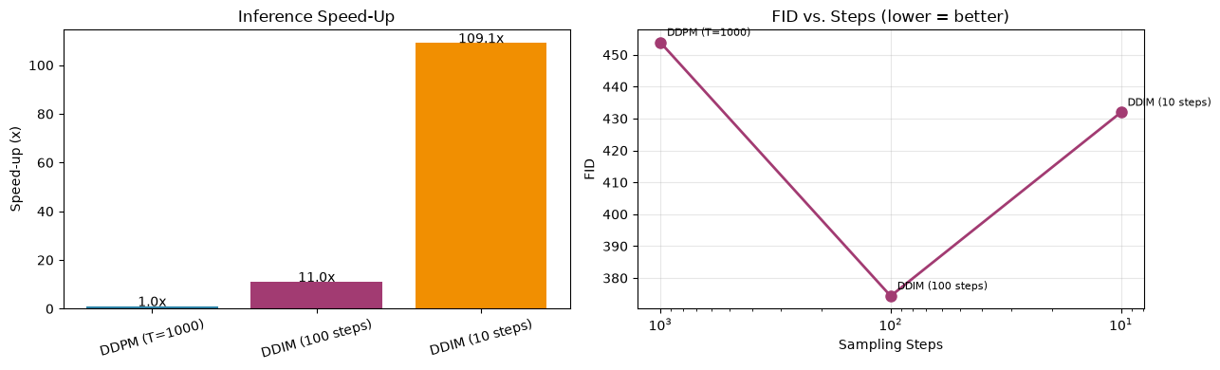
Model Evaluation
Metrics:
FID (lower is better)
Inception Score (higher is better)
Method | Steps | Time (s) | Speed-Up | FID | IS | IS_std
DDPM | 1000 | 1577.1 | 1× | 453.8732 | 1.1681 | 0.0128
DDIM | 100 | 142.8 | 11× | 374.3619 | 1.1861 | 0.0177
DDIM | 10 | 14.5 | 109.1× | 431.9409 | 1.2086 | 0.0201

Slide 12
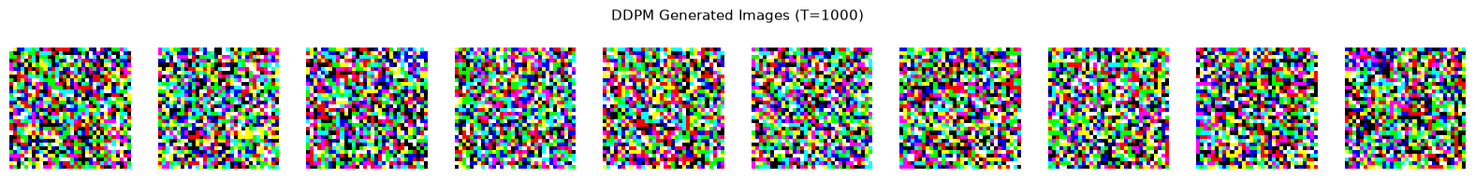
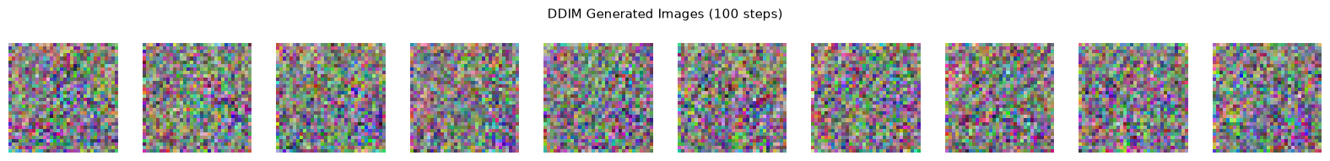
Results and Ablation Study
DDIM with 100 steps preserves most image quality while achieving significant acceleration.
DDPM (T = 1000 steps, 1577.1 s)
DDIM (100 steps, 142.8 s → 11.0× faster)

Slide 13
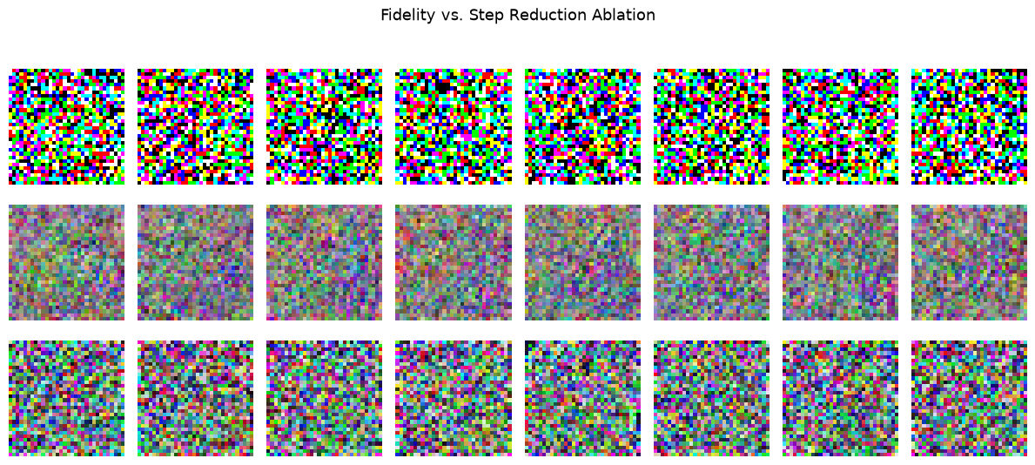
Results and Ablation Study
DDIM-100 (row 2) shows slightly smoother pixel distributions than DDPM and DDIM-10.
Speed-up: DDPM 1× → DDIM-100 11.0× → DDIM-10 109.1× (wall-clock on CPU, 1000 images).
All outputs noisy due to early training; gains expected to compound with more epochs.

Slide 14
Conclusions & Future Works
Conclusions
DDIM provides substantial acceleration with limited quality degradation.
EMA, AMP, and gradient clipping improve training stability.
Future Work
Latent Diffusion Models
Progressive Distillation
Classifier-Free Guidance
Higher-resolution datasets

Slide 15
References
Ho, J., Jain, A., & Abbeel, P. (2020). Denoising Diffusion Probabilistic Models. NeurIPS 2020.
Song, J., Meng, C., & Ermon, S. (2021). Denoising Diffusion Implicit Models. ICLR 2021.
Rombach, R., et al. (2022). High-Resolution Image Synthesis with Latent Diffusion Models. CVPR 2022.
Salimans, T., & Ho, J. (2022). Progressive Distillation for Fast Sampling of Diffusion Models. ICLR 2022.
Nichol, A., & Dhariwal, P. (2021). Improved Denoising Diffusion Probabilistic Models. ICML 2021.

