Slide 1
Methods
Three Architectures are used in the project:
• Neural Network Model using CNNs
・LeNet-5 model*
・VGG16 model
• Neural Network Model using MobileNetV2

Slide 2
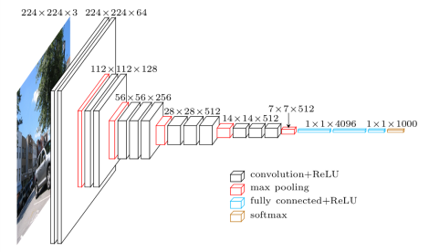
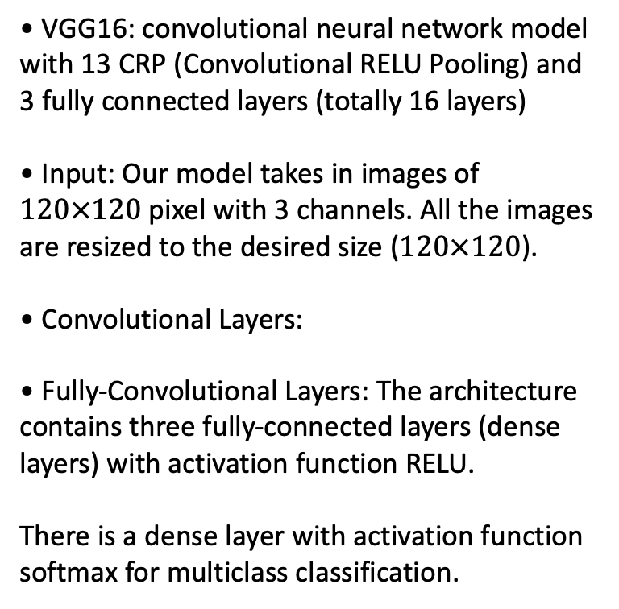
VGG(Visual Geometry Group) Model
• VGG16: convolutional neural network model with 13 CRP (Convolutional RELU Pooling) and 3 fully connected layers (totally 16 layers)
• Input: Our model takes in images of $120×120$ pixel with 3 channels. All the images are resized to the desired size ($120×120$).
• Convolutional Layers:
• Fully-Convolutional Layers: The architecture contains three fully-connected layers (dense layers) with activation function RELU.
There is a dense layer with activation function softmax for multiclass classification.

Slide 3
Transfer Learning and Fine Tuning
Transfer learning:
use the knowledge gained from other related problem
apply it to our problem
Fine tuning:
use already trained network
re-train the part of that by the new data set
Due to the limitation of the amount of masked face dataset, we only have a relatively small dataset and apply transfer learning and fine tuning to improve the accuracy.

Slide 4
Study Case 1 Mask Detection
Dataset:
Containing some masked faces by gender for the gender classification task
The following table is a summary of the number of images in each directory
Main Directory
Train
Mask
Non Mask
Validation
Mask
images
images
Non Mask
images
Images
 | Mask | Non Mask
train | 300 | 300
test | 153 | 153

Slide 5
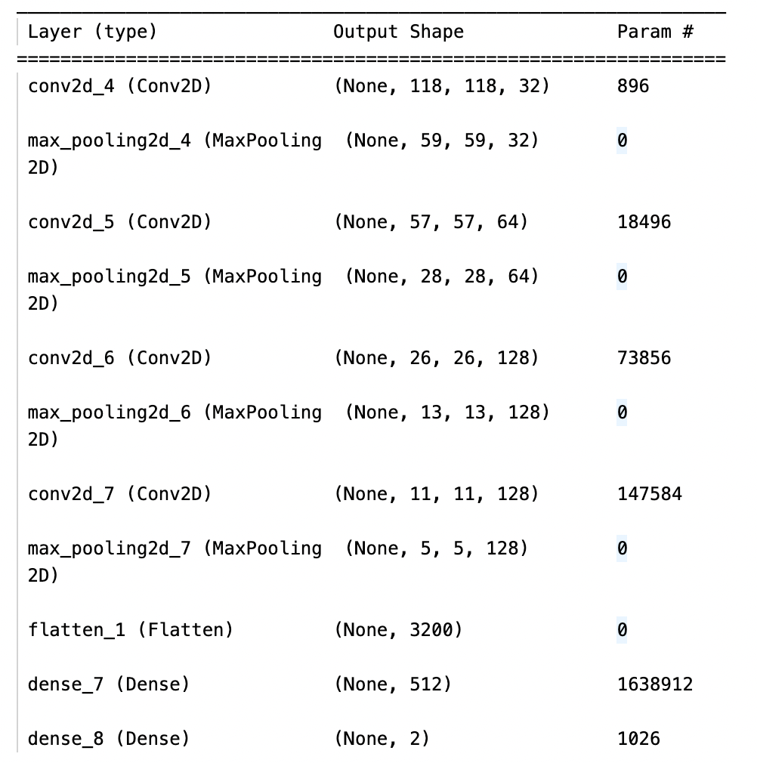
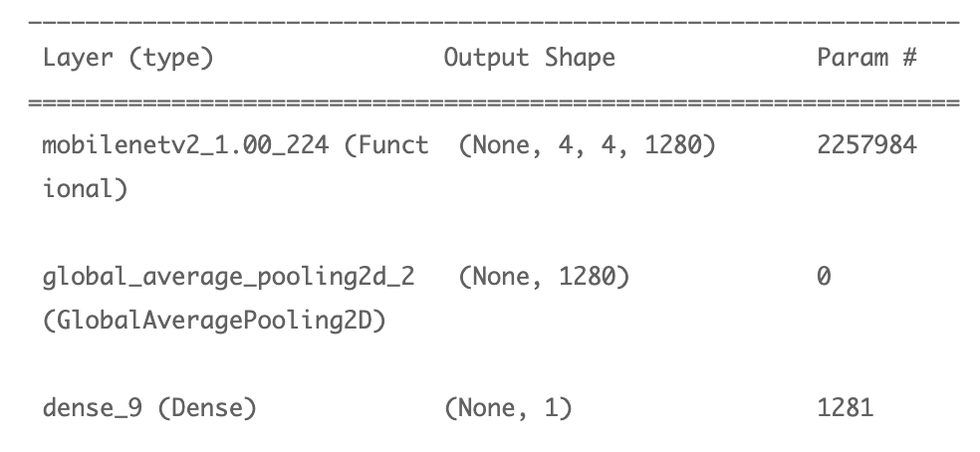
Study Case 1 Mask Detection
Models: We use both the CNN and MobileNetV2 model and examine the differences of the performance in mask detection.
・LeNet5
・MobileNetV2

Slide 6
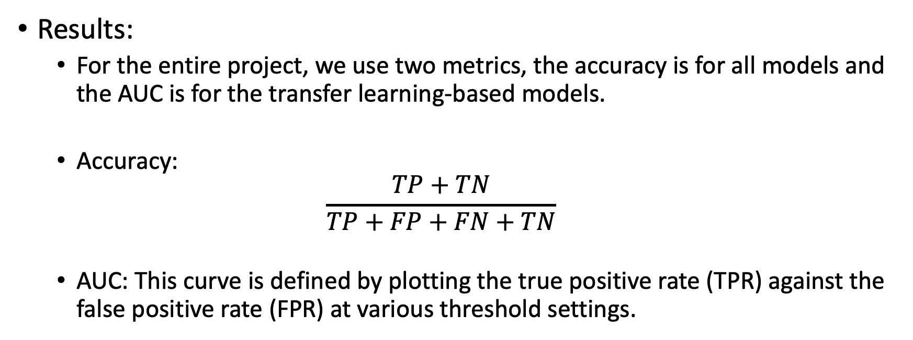
Study Case 1 Mask Detection
Results:
For the entire project, we use two metrics, the accuracy is for all models and the AUC is for the transfer learning-based models.
Accuracy:
$$\frac{TP+TN}{TP+FP+FN+TN}$$
AUC: This curve is defined by plotting the true positive rate (TPR) against the false positive rate (FPR) at various threshold settings.

Slide 7
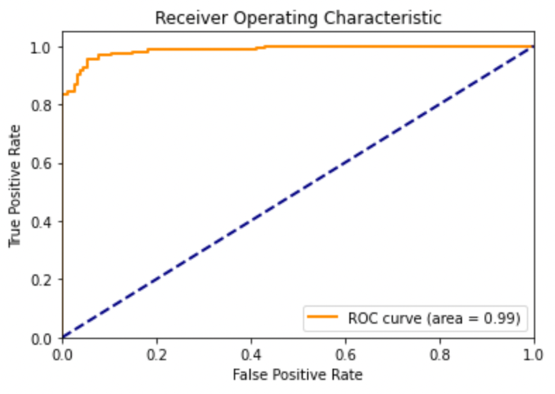
Study Case 1 Mask Detection
Results:
Due to the limitation on the GPU that we used, we do not train the model for a big number of epochs and achieve a very good precision
Result Table
Model | Accuracy | AUC
NN using LeNet5 | 0.93 in 20 epochs | --
NN using MobileNetV2 | 0.95 in 15 epochs | 0.99

Slide 8
Study Case 2 Masked Face Gender Classification
Dataset:
Containing some masked faces by gender for the gender classification task
The following table is a summary of the number of images in each directory
Main Directory
Train
women
men
Validation
women
images
images
men
images
Images
 | women | men
train | 184 | 117
test | 79 | 75

Slide 9
Study Case 2 Masked Face Gender Classification
Models: We use both the CNN and MobileNetV2 model and examine the differences of the performance in gender classification.
・LeNet5
・MobileNetV2

Slide 10
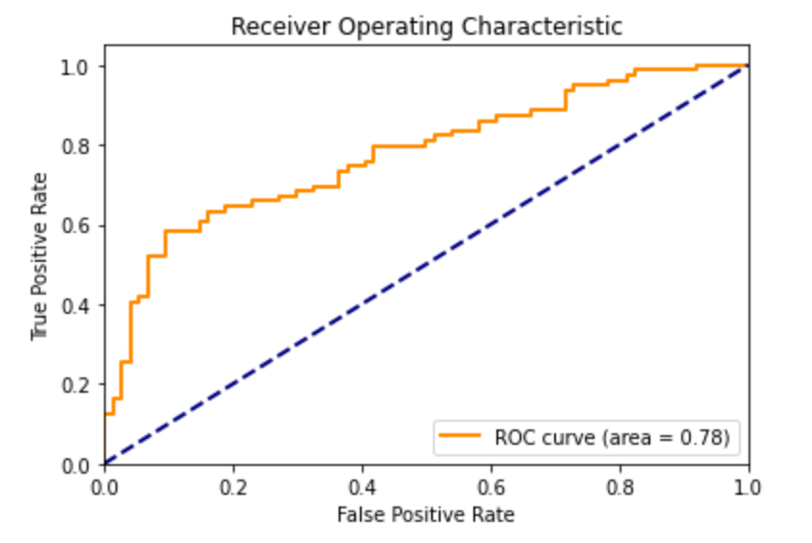
Study Case 2 Masked Face Gender Classification
Results:
Due to the limitation on the GPU that we used, we do not train the model for a big number of epochs and achieve a very good precision
Result Table
Model | Accuracy | AUC
NN using LeNet5 | 0.60 in 30 epochs | --
NN using MobileNetV2 | 0.66 in 30 epochs | 0.78

Slide 11
Study Case 3 Face Recognition
Dataset: LFW Simulated Masked Face Dataset
Containing some masked faces of people in the LFW Dataset with their identification for the face recognition task (10 classes)
The following table is a summary of the number of images in each directory
Main Directory
Train
Sharon
Putin
Validation
Sharon
...
images
images
...
Putin
images
Images
 | Sharon | Powell | Rumsfeld | Schoreder | Arroyo | Clinton | Aniston | Capriati | Koizumi | Putin
train | 64 | 222 | 114 | 100 | 41 | 13 | 19 | 38 | 56 | 45
test | 7 | 14 | 6 | 11 | 5 | 3 | 4 | 4 | 6 | 5

Slide 12
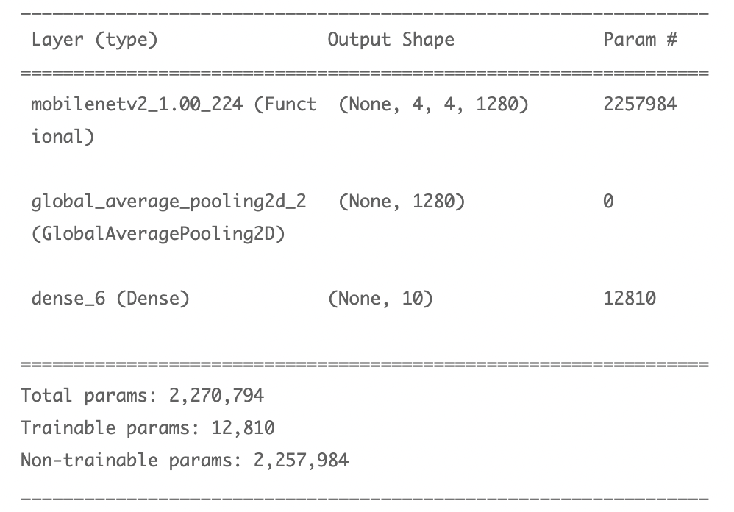
Study Case 3 Face Recognition
Models: We use both the MobileNetV2 model and VGG model and examine the differences of the performance in identity prediction.
・MobileNetV2

Slide 13
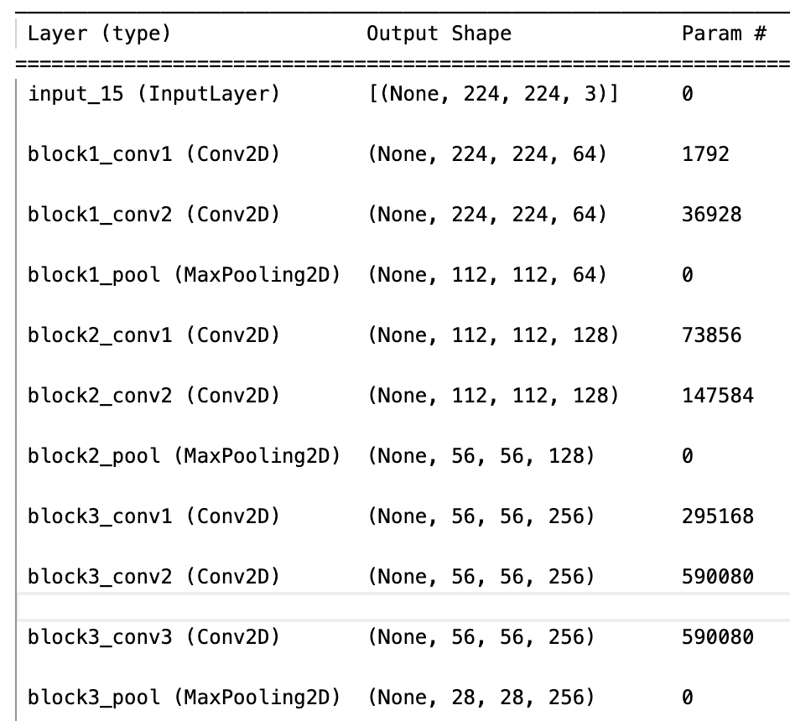
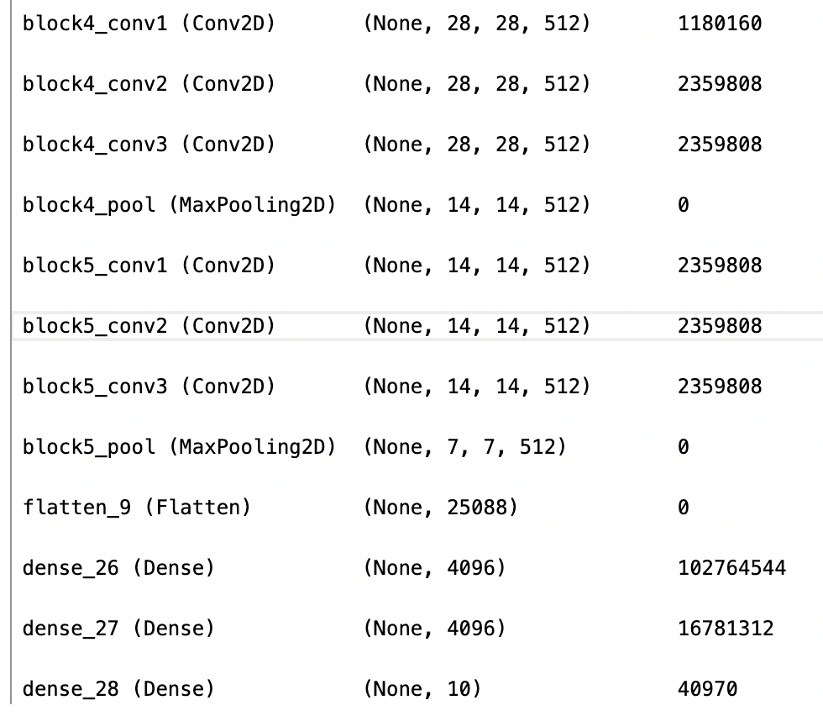
Study Case 3 Face Recognition
We apply transfer learning and fine tuning to the MobileNetV2 and VGG model for our relatively small dataset and high accuracy.
・VGG

Slide 14
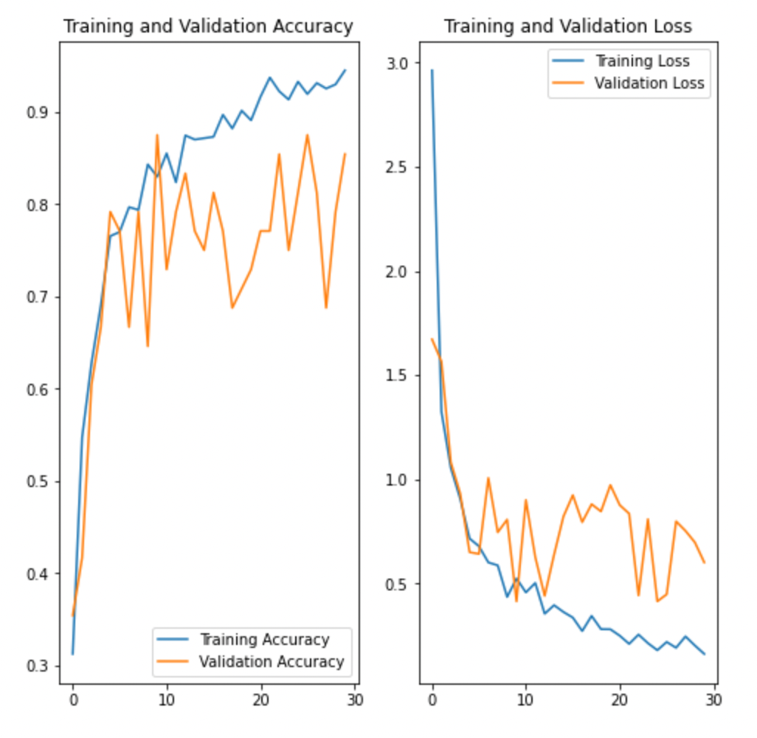
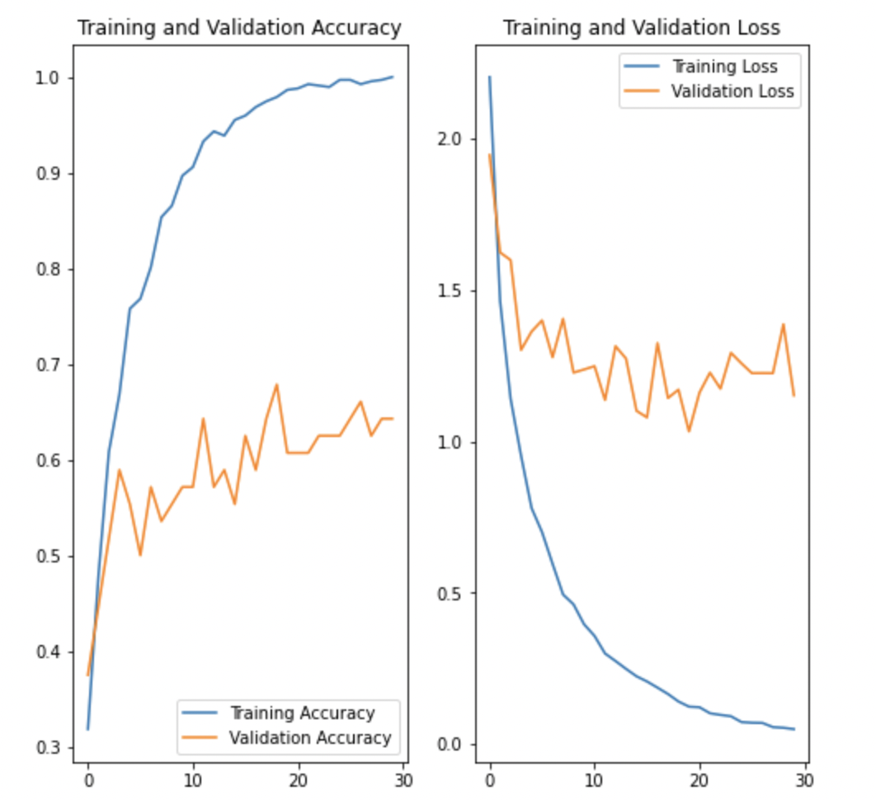
Study Case 3 Face Recognition
Results:
Due to the limitation on the GPU that we used, we do not train the model for a big number of epochs and achieve a very good precision
Result Table
Model | Accuracy
NN using MobileNetV2 | 0.65 in 30 epochs
NN using VGG16 | 0.85 in 30 epochs

Slide 15
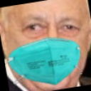
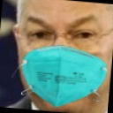
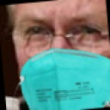
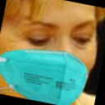
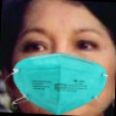
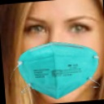
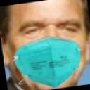
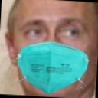
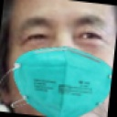
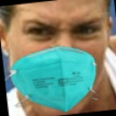
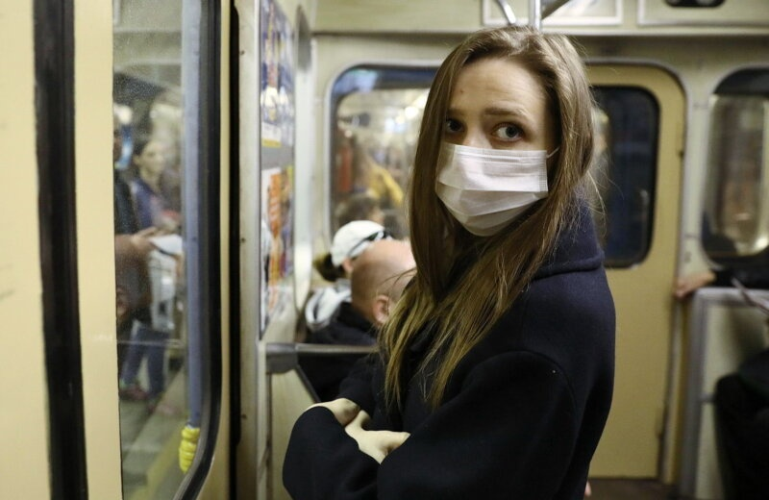
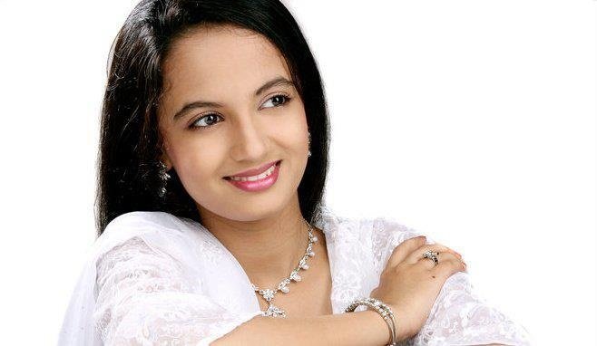
Ariel Sharon
Colin Powell
Donald Rumsfeld
Hilary Clinton
Gloria Arroyo
Jennifer Aniston
Gerhard Schroeder
Vladimir Putin
Junichiro Koizumi
Jennifer Capriati
Mask
Non-Mask

