Slide 1
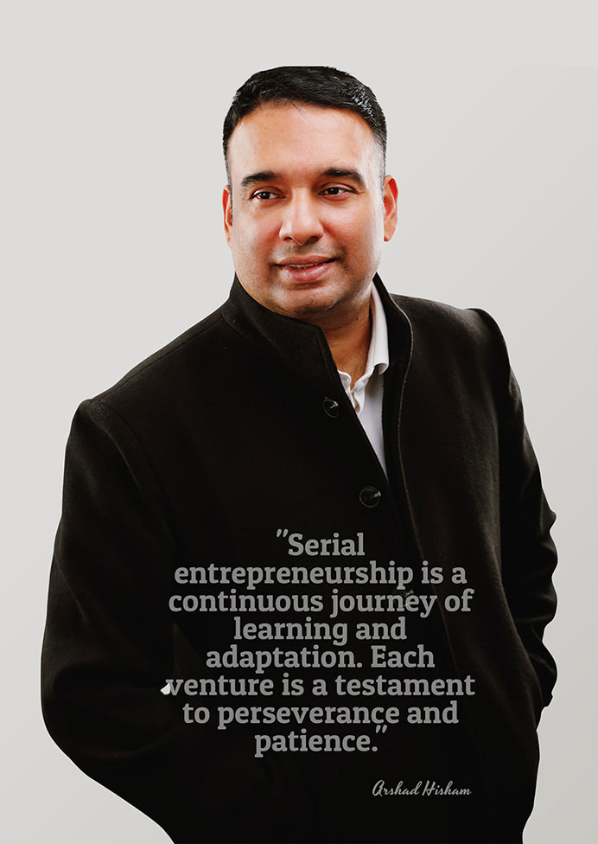
Arshad
Hisham
Leadership journey, AI & robotics contributions,
and entrepreneurial achievements
Prepared by Yufei Li / October 2026
Notes:
Sources accessed October 20, 2026:
A: https://www.arshadhisham.com/
B: https://www.sec.gov/Archives/edgar/data/1690888/000121390023031471/ea177248-1a_ingen.htm
Image: official Arshad Hisham website, portrait.jpg

Slide 2
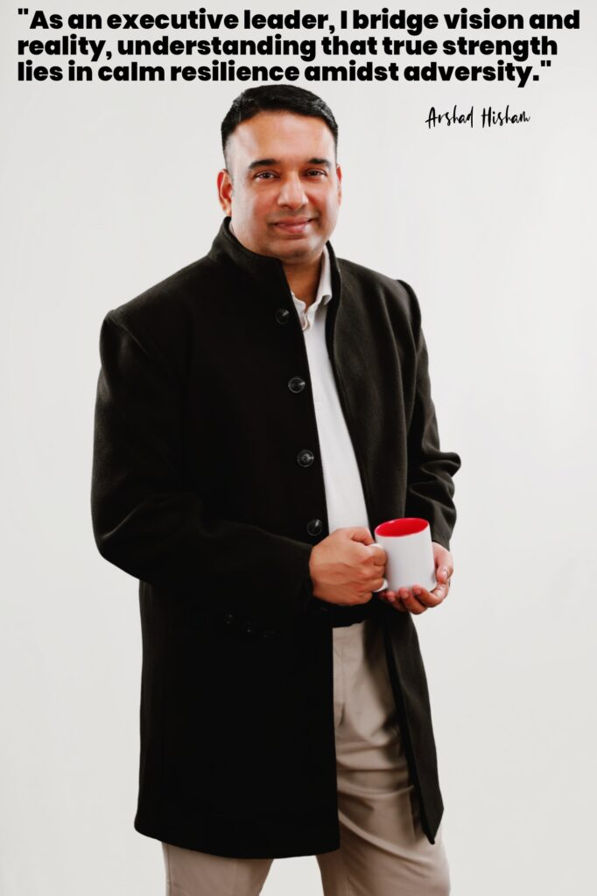
An entrepreneur connecting technology and business
Founder and CEO of inGen Dynamics
Engineering background
Experience spans enterprise software and hardware automation.
Business leadership
His work connects product development with commercial strategy.
Wider contribution
Education and research partnerships extend his role beyond the company.
ARSHAD HISHAM
Sources: B D
02
Notes:
Sources accessed October 20, 2026:
B: https://www.sec.gov/Archives/edgar/data/1690888/000121390023031471/ea177248-1a_ingen.htm
D: https://www.manchester.ac.uk/about/news/the-university-of-manchester-to-collaborate-with-leading-innovator-in-ai-driven-automation-and-robotics/
Image: official Arshad Hisham website, executive.jpg

Slide 3
Career milestones
2001–2008
Corporate experience at IBM and Bluephoenix, according to his biography.
2008–2015
Early ventures in enterprise software, retail systems and fleet analytics.
2015
Founded inGen Dynamics.
2025
Co-chairs the Manchester partnership steering committee.
ARSHAD HISHAM
Sources: A B D
03
Notes:
Sources accessed October 20, 2026:
A: https://www.arshadhisham.com/
B: https://www.sec.gov/Archives/edgar/data/1690888/000121390023031471/ea177248-1a_ingen.htm
D: https://www.manchester.ac.uk/about/news/the-university-of-manchester-to-collaborate-with-leading-innovator-in-ai-driven-automation-and-robotics/

Slide 4
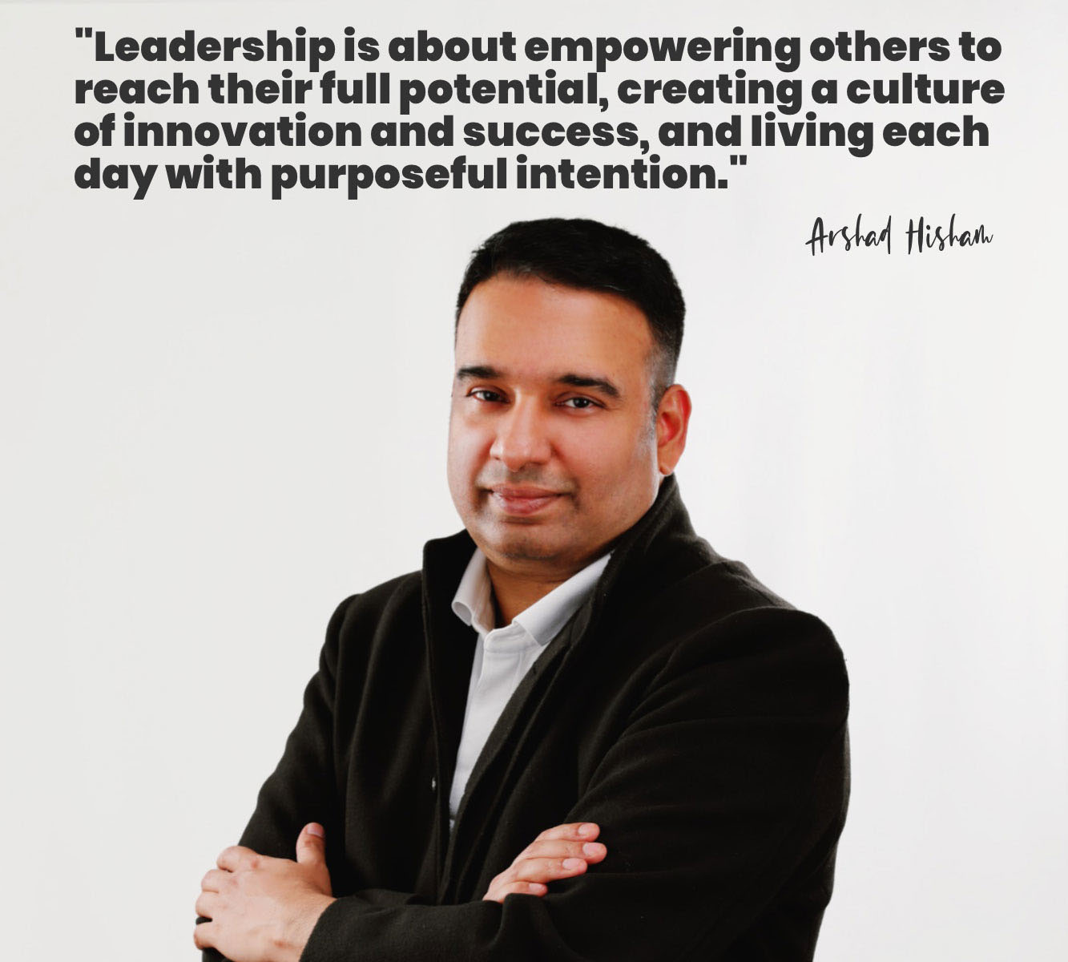
Education and early foundations
Technical training followed by business education
Engineering
B.Tech, National Institute of Technology Calicut.
Management
MBA, Cranfield School of Management.
Early interest
His biography describes childhood programming and student robotics activities.
ARSHAD HISHAM
Sources: A
04
Notes:
Sources accessed October 20, 2026:
A: https://www.arshadhisham.com/
Image: official Arshad Hisham website, leader.jpg

Slide 5
Corporate experience before entrepreneurship
Enterprise technology and international delivery
Professional background
The 2023 offering circular describes senior roles involving IBM, the Australian government and Toyota.
Relevance to entrepreneurship
This experience provides context for his later focus on enterprise applications.
ARSHAD HISHAM
Sources: B
05
Notes:
The second point is presenter analysis of the disclosed career history.
Sources accessed October 20, 2026:
B: https://www.sec.gov/Archives/edgar/data/1690888/000121390023031471/ea177248-1a_ingen.htm

Slide 6
Early entrepreneurial ventures
A portfolio of ventures before inGen Dynamics, as described in his biography
BusinessNow
Enterprise resource planning
EasyShop
Retail point-of-sale systems
EasyTrackX
GPS tracking and fleet analytics
LordofOdds
Online gaming
ARSHAD HISHAM
Sources: A
06
Notes:
Sources accessed October 20, 2026:
A: https://www.arshadhisham.com/

Slide 7
EasyTrackX: an early business milestone
Fleet technology offered a commercial application for software
Business focus
GPS tracking and fleet analytics.
Reported transaction
His biography reports a sale of 50% of the business.
Leadership perspective
The case illustrates experience developing a venture and negotiating an ownership transaction.
ARSHAD HISHAM
Sources: A
07
Notes:
Transaction details are founder-reported. No transaction value is stated. The leadership perspective is presenter analysis.
Sources accessed October 20, 2026:
A: https://www.arshadhisham.com/

Slide 8
Founding inGen Dynamics
A company focused on AI, automation and robotics
Founder’s objective
2015
Apply affordable robotics to everyday needs.
Initial direction
Aido served as a modular service robot platform.
ARSHAD HISHAM
Sources: A B
08
Notes:
Sources accessed October 20, 2026:
A: https://www.arshadhisham.com/
B: https://www.sec.gov/Archives/edgar/data/1690888/000121390023031471/ea177248-1a_ingen.htm

Slide 9
Leadership across product and business functions
Product direction
The company describes a platform strategy that connects devices with software services.
Organizational development
Its 2023 disclosures identify leadership roles in operations, strategy, technology and growth.
Partnership building
The Manchester collaboration adds an academic research relationship.
ARSHAD HISHAM
Sources: B D
09
Notes:
Presenter synthesis of organizational disclosures and the university announcement. This is not an assessment of internal management performance.
Sources accessed October 20, 2026:
B: https://www.sec.gov/Archives/edgar/data/1690888/000121390023031471/ea177248-1a_ingen.htm
D: https://www.manchester.ac.uk/about/news/the-university-of-manchester-to-collaborate-with-leading-innovator-in-ai-driven-automation-and-robotics/

Slide 10

AI and robotics applied to human needs
Examples from the company’s current product portfolio
Fari
Eldercare companion
In development
Senpai
Educational companion
In development
Sentinel Prime
Security intelligence
Operational
ARSHAD HISHAM
Sources: C
10
Notes:
Product stages follow the company website accessed October 2026. Product descriptions are intended applications, not independently verified outcomes.
Sources accessed October 20, 2026:
C: https://www.ingendynamics.com/
Image: official Arshad Hisham website, sentinel.png

Slide 11

Fari and Senpai in the research agenda
Fari
Manchester’s partnership announcement identifies elderly care as a research application.
Senpai
The announcement also identifies special needs education.
Evaluation
The MoU includes a social care testbed to evaluate robotics in real settings.
ARSHAD HISHAM
Sources: D
11
Notes:
The announcement describes planned collaboration. It does not establish clinical effectiveness or completed deployment.
Sources accessed October 20, 2026:
D: https://www.manchester.ac.uk/about/news/the-university-of-manchester-to-collaborate-with-leading-innovator-in-ai-driven-automation-and-robotics/
Image: official Arshad Hisham website, fari.jpg

Slide 12

Origami AI and the platform strategy
A shared software direction across the robotics portfolio
Company positioning
Origami AI is described as a physical intelligence platform.
Development status
The current company website labels it in development.
Academic connection
Manchester’s MoU includes hands-on learning involving Origami AI.
ARSHAD HISHAM
Sources: C D
12
Notes:
Sources accessed October 20, 2026:
C: https://www.ingendynamics.com/
D: https://www.manchester.ac.uk/about/news/the-university-of-manchester-to-collaborate-with-leading-innovator-in-ai-driven-automation-and-robotics/
Image: official Arshad Hisham website, origami.jpg

Slide 13
Financing milestones
Maximum GEM share-subscription capacity
Agreement history
$150M
The company entered the agreement in 2021 and amended it in July 2023.
Financing conditions
The 2025 annual report states that the facility is undrawn and available only after a qualifying event.
ARSHAD HISHAM
Sources: E
13
Notes:
Source: 2025 Form C-AR, Note 10. The amount is conditional financing capacity, not cash raised. Do not interpret it as revenue, current valuation or a completed public listing.
Sources accessed October 20, 2026:
E: https://www.sec.gov/Archives/edgar/data/1690888/000169088826000003/ingen_form_c-ar_20251.htm

Slide 14
Recognition for product innovation
Edison Awards silver recognition for Aido
Award category
2021
Smart Productivity Tools.
Recipient
inGen Dynamics received the award for its modular service robot.
Founder’s role
Hisham led the company as founder and CEO.
ARSHAD HISHAM
Sources: F
14
Notes:
The source is a May 18, 2021 company press release distributed by EINPresswire. The award belongs to the product/company, rather than a separate personal lifetime-achievement award.
Sources accessed October 20, 2026:
F: https://markets.financialcontent.com/wedbush/article/einpresswire-2021-5-18-ingen-dynamics-wins-silver-in-the-smart-productivity-tools-category-at-the-2021-edison-awards

Slide 15

Communicating AI and robotics
Industry talks and public discussion
Industry audiences
The 2023 filing lists IEEE, Boston Consulting Group and RoboBusiness speaking engagements.
Public conversation
His website presents talks on technology, work and AI ethics.
ARSHAD HISHAM
Sources: B A
15
Notes:
Sources accessed October 20, 2026:
B: https://www.sec.gov/Archives/edgar/data/1690888/000121390023031471/ea177248-1a_ingen.htm
A: https://www.arshadhisham.com/
Image: official Arshad Hisham website, columbia.jpg

Slide 16
A research partnership with Manchester
University of Manchester and inGen Dynamics sign an MoU
Shared agenda
2025
Joint research, curriculum development and academic exchange.
Governance
Hisham co-chairs the steering committee with Professor Andrew Weightman.
ARSHAD HISHAM
Sources: D
16
Notes:
University announcement dated April 10, 2025. An MoU establishes a collaboration agenda. Planned activities should not be described as completed results.
Sources accessed October 20, 2026:
D: https://www.manchester.ac.uk/about/news/the-university-of-manchester-to-collaborate-with-leading-innovator-in-ai-driven-automation-and-robotics/

Slide 17

Education and wider access
Futurenauts
Manchester’s MoU includes exchanges connected with this education initiative.
Workforce development
The partnership proposes AI and robotics upskilling for care and education professionals.
AH Foundation
His website describes programs intended to reduce barriers to technology education.
ARSHAD HISHAM
Sources: D A
17
Notes:
Sources accessed October 20, 2026:
D: https://www.manchester.ac.uk/about/news/the-university-of-manchester-to-collaborate-with-leading-innovator-in-ai-driven-automation-and-robotics/
A: https://www.arshadhisham.com/
Image: official Arshad Hisham website, education.png

Slide 18
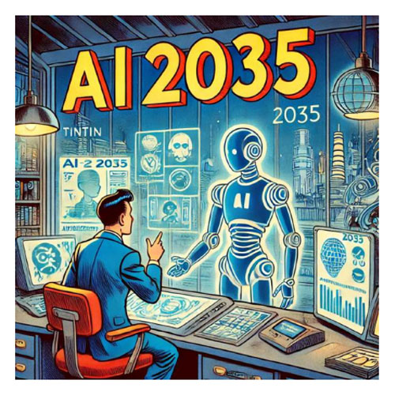
His vision for the future
AI and robotics as tools that support people
Everyday applications
Company priorities include care, education and safety.
Responsible adoption
Manchester’s collaboration agenda includes transparency, accountability and AI ethics.
Longer-term thinking
His 2035 book series explores the future of technology and education.
ARSHAD HISHAM
Sources: A C D
18
Notes:
This slide summarizes stated priorities and future themes. It does not forecast company performance or guarantee product outcomes.
Sources accessed October 20, 2026:
A: https://www.arshadhisham.com/
C: https://www.ingendynamics.com/
D: https://www.manchester.ac.uk/about/news/the-university-of-manchester-to-collaborate-with-leading-innovator-in-ai-driven-automation-and-robotics/
Image: official Arshad Hisham website, book.jpg

Slide 19
Key takeaways
Discussion: Which application offers the clearest opportunity to demonstrate measurable user value?
Leadership journey
Corporate technology experience preceded a sequence of entrepreneurial ventures.
Contribution
His company connects robotics development with software platforms and specific applications.
Future direction
Research partnerships and education initiatives complement the commercial agenda.
ARSHAD HISHAM
Sources: A B C D
19
Notes:
Presenter synthesis. The discussion question is an analytical prompt, not a statement by Arshad Hisham.
Sources accessed October 20, 2026:
A: https://www.arshadhisham.com/
B: https://www.sec.gov/Archives/edgar/data/1690888/000121390023031471/ea177248-1a_ingen.htm
C: https://www.ingendynamics.com/
D: https://www.manchester.ac.uk/about/news/the-university-of-manchester-to-collaborate-with-leading-innovator-in-ai-driven-automation-and-robotics/

Slide 20
Selected references
A
Arshad Hisham, official biography and initiatives
arshadhisham.com
B
inGen Dynamics, 2023 preliminary offering circular
SEC EDGAR, April 21, 2023
C
inGen Dynamics, current product portfolio
ingendynamics.com
D
University of Manchester, partnership announcement
April 10, 2025
E
inGen Dynamics, 2025 Form C-AR
SEC EDGAR, financial statements and Note 10
F
inGen Dynamics, Edison Awards announcement
EINPresswire, May 18, 2021
Sources accessed October 20, 2026. Full URLs and source qualifications appear in slide notes.
ARSHAD HISHAM
20
Notes:
Sources accessed October 20, 2026:
A: https://www.arshadhisham.com/
B: https://www.sec.gov/Archives/edgar/data/1690888/000121390023031471/ea177248-1a_ingen.htm
C: https://www.ingendynamics.com/
D: https://www.manchester.ac.uk/about/news/the-university-of-manchester-to-collaborate-with-leading-innovator-in-ai-driven-automation-and-robotics/
E: https://www.sec.gov/Archives/edgar/data/1690888/000169088826000003/ingen_form_c-ar_20251.htm
F: https://markets.financialcontent.com/wedbush/article/einpresswire-2021-5-18-ingen-dynamics-wins-silver-in-the-smart-productivity-tools-category-at-the-2021-edison-awards

