Slide 1
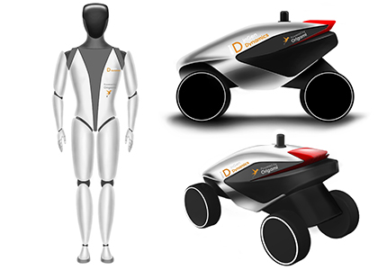
inGen
Dynamics
Company overview
AI, automation and robotics
Prepared by Yufei Li / October 2026
Notes:
Sources accessed October 20, 2026:
C: https://www.ingendynamics.com/
E: https://www.sec.gov/Archives/edgar/data/1690888/000169088826000003/ingen_form_c-ar_20251.htm
Official company imagery:
https://www.ingendynamics.com/images/ingen-roverandhumenaiod.jpg

Slide 2

Company at a glance
An AI and robotics company based in Santa Clara, California
2015
Corporate identity
InGen Dynamics, Inc., incorporated in Delaware in July 2015.
Leadership
Founder and CEO Arshad Hisham leads product strategy and business operations.
INGEN DYNAMICS
Sources: E
02
Notes:
Sources accessed October 20, 2026:
E: https://www.sec.gov/Archives/edgar/data/1690888/000169088826000003/ingen_form_c-ar_20251.htm
Official company imagery:
https://www.ingendynamics.com/images/KaiserandSentinal.jpg

Slide 3
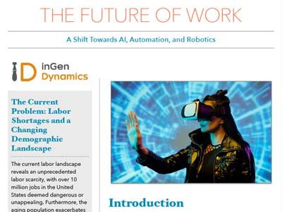
Mission and strategic focus
Practical applications of intelligent machines
Mission
Improve daily life through affordable AI and robotics.
Strategic direction
Connect software intelligence with devices that interact with the physical world.
Business perspective
Customer adoption depends on useful, reliable applications.
Company publication: The Future of Work
INGEN DYNAMICS
Sources: A B C
03
Notes:
The business perspective is presenter analysis.
Sources accessed October 20, 2026:
A: https://www.arshadhisham.com/
B: https://www.sec.gov/Archives/edgar/data/1690888/000121390023031471/ea177248-1a_ingen.htm
C: https://www.ingendynamics.com/
Official company imagery:
https://ingendynamics.com/blog/wp-content/themes/getaido/PDF/thumbs/TheFutureOfWork.jpg

Slide 4
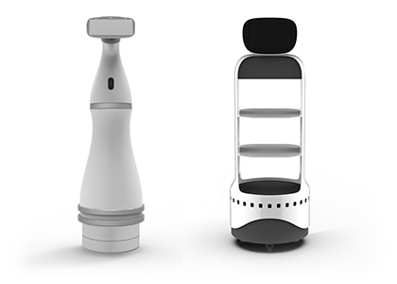
Development milestones
2015
Incorporation and the start of Aido development.
2021
Aido receives an Edison Awards silver medal.
2022
First-generation Aido units begin shipping, per company filings.
2025
Manchester announces an academic collaboration MoU.
Aido modular platform
INGEN DYNAMICS
Sources: B D E F
04
Notes:
Sources accessed October 20, 2026:
B: https://www.sec.gov/Archives/edgar/data/1690888/000121390023031471/ea177248-1a_ingen.htm
D: https://www.manchester.ac.uk/about/news/the-university-of-manchester-to-collaborate-with-leading-innovator-in-ai-driven-automation-and-robotics/
E: https://www.sec.gov/Archives/edgar/data/1690888/000169088826000003/ingen_form_c-ar_20251.htm
F: https://markets.financialcontent.com/wedbush/article/einpresswire-2021-5-18-ingen-dynamics-wins-silver-in-the-smart-productivity-tools-category-at-the-2021-edison-awards
Official company imagery:
https://www.ingendynamics.com/images/getaido-home.png

Slide 5
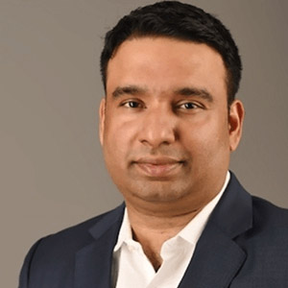

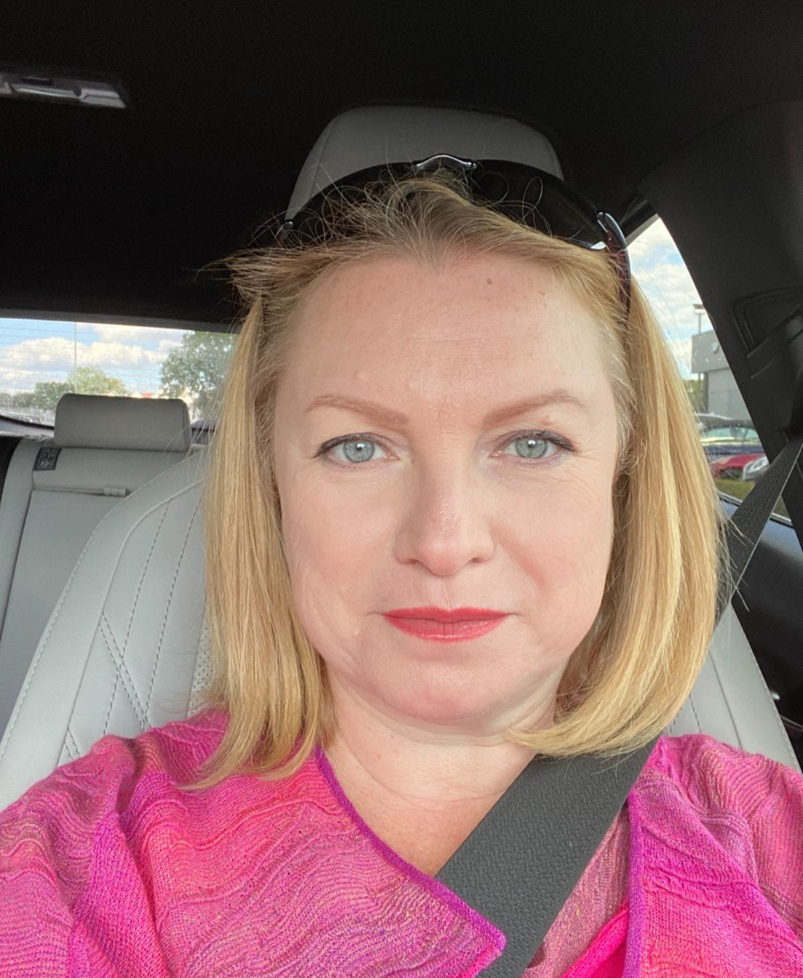
Leadership and operating capabilities
Arshad Hisham
Rajeev Verma
Diana Chuyko
Founder & CEO
Chief Technology Officer
Vice President, Marketing
Product strategy and business leadership
Engineering and product development
Brand positioning and demand generation
INGEN DYNAMICS
Sources: E
05
Notes:
Roles follow the annual report dated April 30, 2026. The company has no separately designated COO or CFO in that filing.
Sources accessed October 20, 2026:
E: https://www.sec.gov/Archives/edgar/data/1690888/000169088826000003/ingen_form_c-ar_20251.htm
Official company imagery:
https://www.ingendynamics.com/images/team/photo-1.jpg
https://www.ingendynamics.com/images/team/Rajeeb-Verma.jpg
https://www.ingendynamics.com/images/team/Diana_Chuyko.jpg
Marketing role and responsibilities follow the April 30, 2026 annual report.

Slide 6
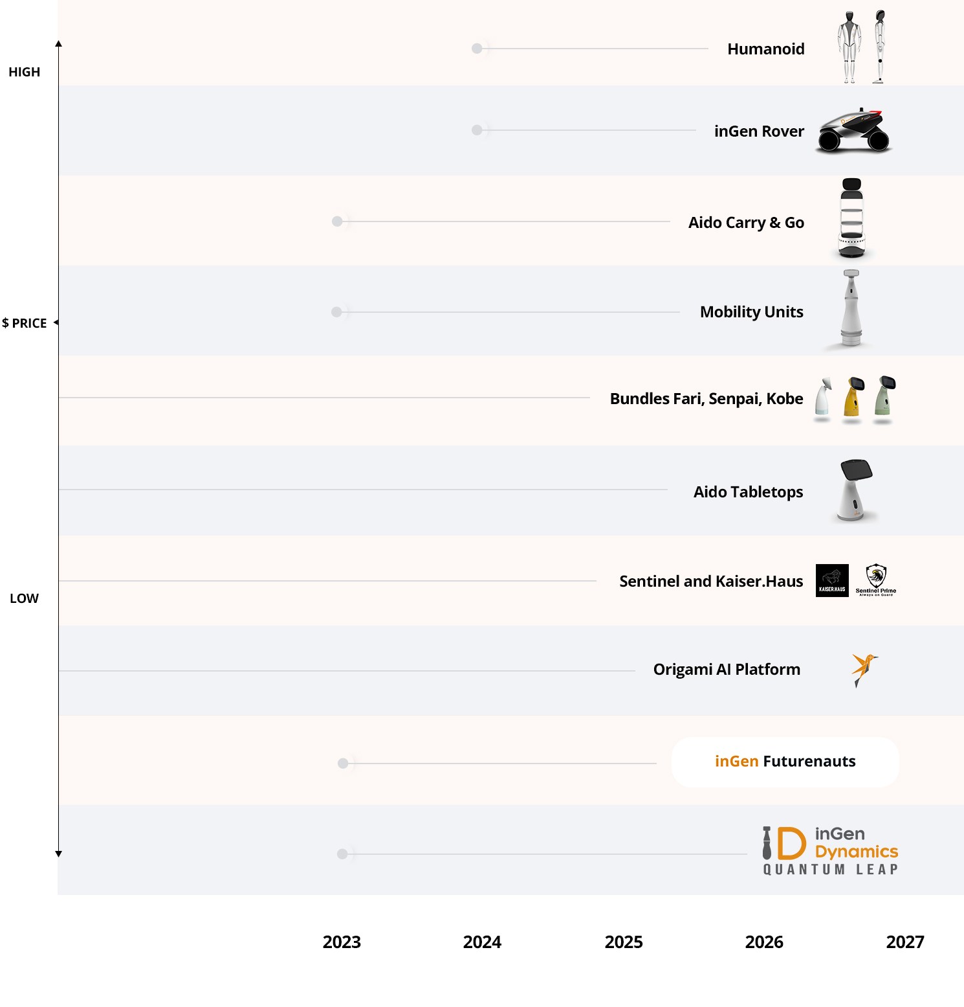
Product portfolio and maturity
Company website status as of October 2026
Operational
Sentinel Prime, Kaiser.Haus, Futurenauts
In development
Aido, Carry & Go, Fari, Senpai, Kobe, Origami AI
Research
Aido Rover and Aido Humanoid
Official roadmap illustration; current status at left
INGEN DYNAMICS
Sources: C
06
Notes:
These are company website labels, not independent certifications. The 2026 annual report also describes earlier Aido shipments. Shipping an earlier generation does not establish that the full current platform is complete.
Sources accessed October 20, 2026:
C: https://www.ingendynamics.com/
Official company imagery:
https://www.ingendynamics.com/images/oursolution-Info-graphics.jpg
The roadmap artwork is a company illustration, not proof of product availability or a verified launch schedule. Current status follows the labels in the slide text.

Slide 7

Origami AI
Shared intelligence platform / In development
Platform concept
Common AI software across the product portfolio.
Commercial direction
The company describes platform services and enterprise licensing.
Strategic implication
Shared development may reduce duplicated engineering work.
INGEN DYNAMICS
Sources: B C E
07
Notes:
The strategic implication is presenter analysis, not a proven cost saving.
Sources accessed October 20, 2026:
B: https://www.sec.gov/Archives/edgar/data/1690888/000121390023031471/ea177248-1a_ingen.htm
C: https://www.ingendynamics.com/
E: https://www.sec.gov/Archives/edgar/data/1690888/000169088826000003/ingen_form_c-ar_20251.htm
Official company imagery:
https://www.ingendynamics.com/images/origami-product.jpg

Slide 8


Sentinel Prime
Enterprise security intelligence / Operational
Application
Video analytics and sensor-based event detection.
Customer setting
Buildings, campuses and other monitored facilities.
Evaluation priority
Detection accuracy and false alarms matter to customers.
INGEN DYNAMICS
Sources: B C
08
Notes:
Evaluation priority is presenter analysis. No independent accuracy measurement is provided.
Sources accessed October 20, 2026:
B: https://www.sec.gov/Archives/edgar/data/1690888/000121390023031471/ea177248-1a_ingen.htm
C: https://www.ingendynamics.com/
Official company imagery:
https://ingendynamics.com/blog/wp-content/themes/getaido/PDF/thumbs/04TheFutureOfSecurityandSurveilance.jpg
https://www.ingendynamics.com/images/Sentinel-Prime.jpg

Slide 9
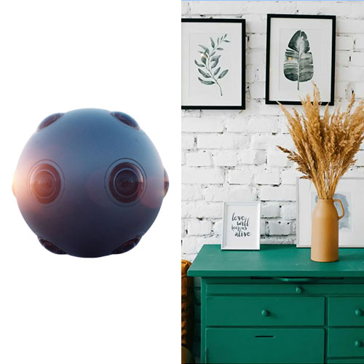
Kaiser.Haus
Smart home automation / Operational
Application
Integrated automation for residential environments.
User value
Coordinated control of connected home functions.
Evaluation priority
Installation quality and dependable service support adoption.
INGEN DYNAMICS
Sources: A B C
09
Notes:
Evaluation priority is presenter analysis. This image is the company’s combined Kaiser and Sentinel artwork.
Sources accessed October 20, 2026:
A: https://www.arshadhisham.com/
B: https://www.sec.gov/Archives/edgar/data/1690888/000121390023031471/ea177248-1a_ingen.htm
C: https://www.ingendynamics.com/
Official company imagery:
https://www.ingendynamics.com/images/KaiserPicutre.jpg

Slide 10
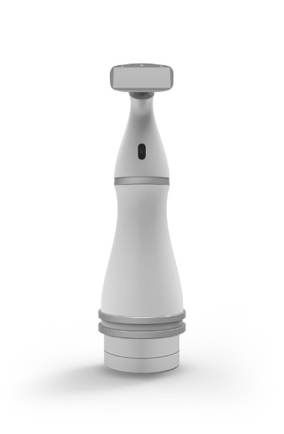
Aido
Modular service robot / Current platform in development
Design
Customizable hardware and software for different settings.
Interaction
Audio, lidar, cameras and sensors support user interaction.
Development history
Filings describe initial shipments in late 2022.
INGEN DYNAMICS
Sources: B E C
10
Notes:
Current website maturity and historical first-generation shipments describe different stages of the platform.
Sources accessed October 20, 2026:
B: https://www.sec.gov/Archives/edgar/data/1690888/000121390023031471/ea177248-1a_ingen.htm
E: https://www.sec.gov/Archives/edgar/data/1690888/000169088826000003/ingen_form_c-ar_20251.htm
C: https://www.ingendynamics.com/
Official company imagery:
https://www.ingendynamics.com/images/Mobility-11.jpg

Slide 11

Carry & Go
Autonomous indoor delivery / In development
Application
Transport of items within commercial buildings.
Target settings
Restaurants, retail and offices.
Evaluation priority
Safe navigation and successful deliveries per shift.
INGEN DYNAMICS
Sources: C
11
Notes:
Evaluation priority is presenter analysis. Intended functions do not establish deployed performance.
Sources accessed October 20, 2026:
C: https://www.ingendynamics.com/
Official company imagery:
https://www.ingendynamics.com/images/products/carry_go-1.jpg

Slide 12
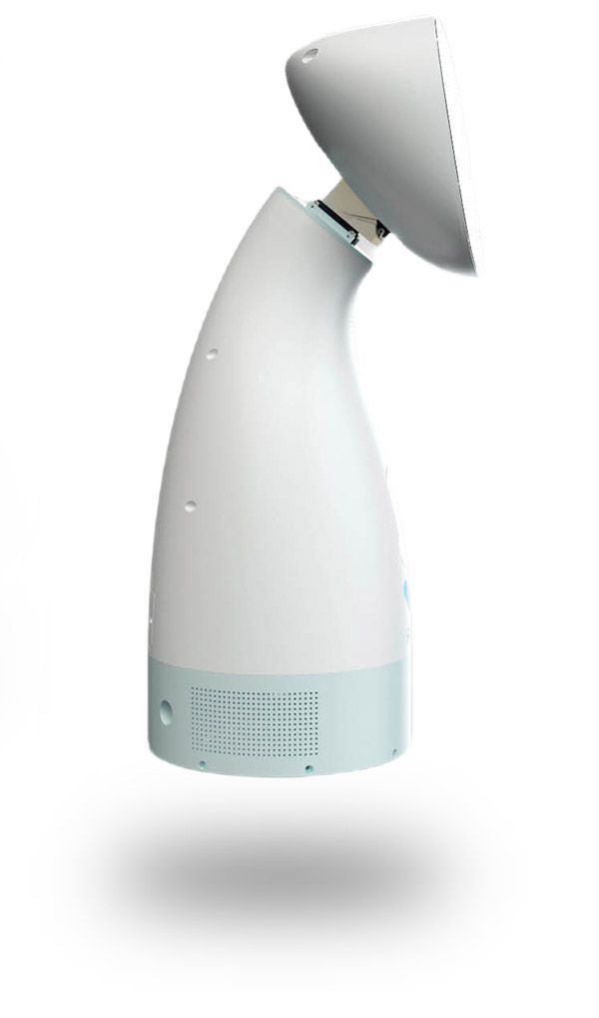
Fari
Eldercare companion / In development
Design focus
Support engagement and connection for older adults.
Research connection
Manchester identifies Fari in its elderly care research agenda.
Evaluation priority
Usability, privacy and the quality of human interaction.
INGEN DYNAMICS
Sources: B D C
12
Notes:
Evaluation priority is presenter analysis. No clinical effectiveness claim is made.
Sources accessed October 20, 2026:
B: https://www.sec.gov/Archives/edgar/data/1690888/000121390023031471/ea177248-1a_ingen.htm
D: https://www.manchester.ac.uk/about/news/the-university-of-manchester-to-collaborate-with-leading-innovator-in-ai-driven-automation-and-robotics/
C: https://www.ingendynamics.com/
Official company imagery:
https://www.ingendynamics.com/images/fari.jpg

Slide 13
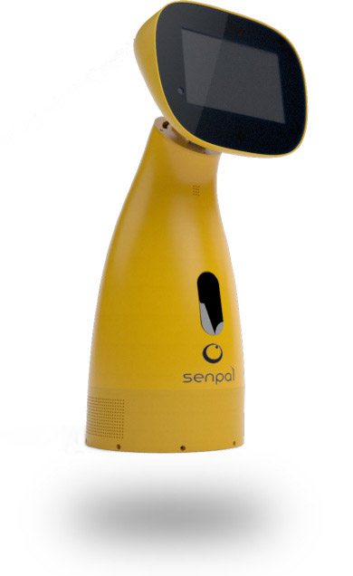
Senpai and education
Educational companion / In development
Design focus
An educational robot for children.
Research application
Manchester’s proposed work includes special needs education.
Evaluation priority
Learning outcomes and support for teachers.
INGEN DYNAMICS
Sources: B D C
13
Notes:
Evaluation priority is presenter analysis. The university announcement sets out planned work, rather than completed outcome studies.
Sources accessed October 20, 2026:
B: https://www.sec.gov/Archives/edgar/data/1690888/000121390023031471/ea177248-1a_ingen.htm
D: https://www.manchester.ac.uk/about/news/the-university-of-manchester-to-collaborate-with-leading-innovator-in-ai-driven-automation-and-robotics/
C: https://www.ingendynamics.com/
Official company imagery:
https://www.ingendynamics.com/images/senpai-picture.jpg

Slide 14
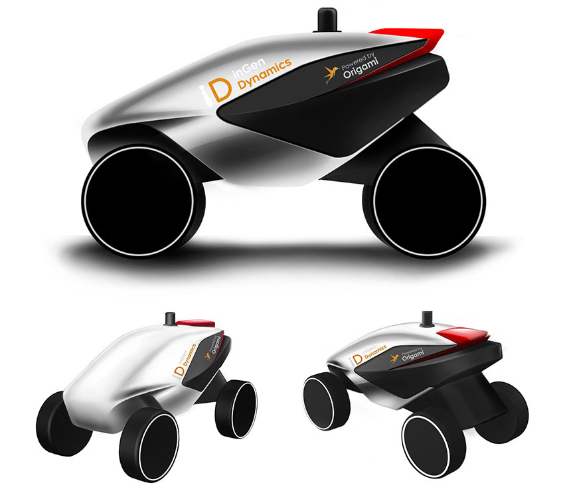
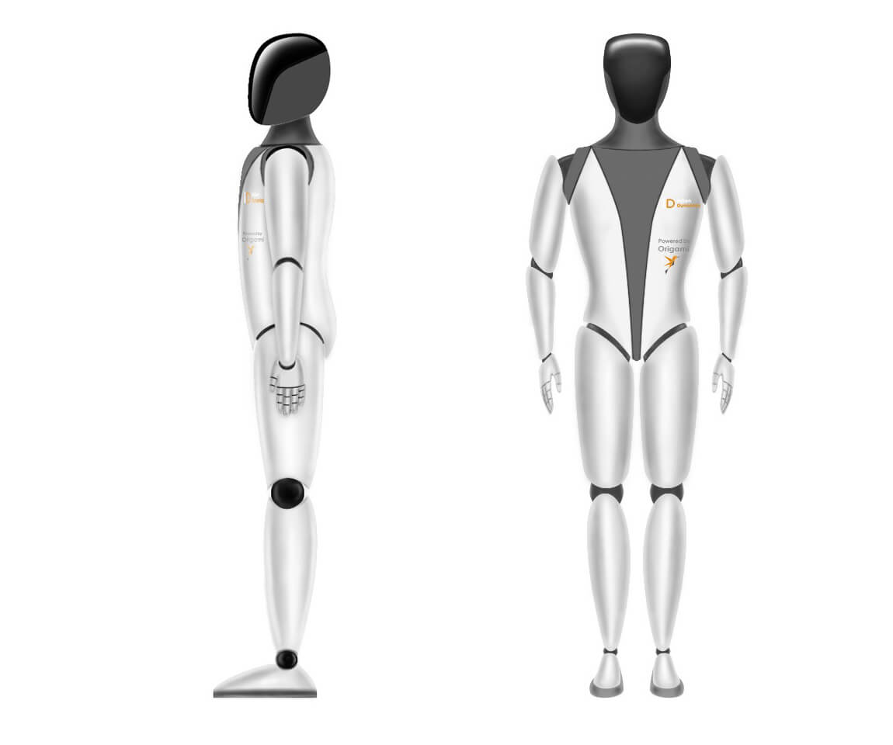
Rover and humanoid research
Longer-term hardware programmes / Research stage
Aido Rover
Outdoor patrol and inspection.
Aido Humanoid
General-purpose physical assistance research.
Development challenge
Complex movement requires extensive safety and reliability testing.
Aido Rover
Aido Humanoid
INGEN DYNAMICS
Sources: C
14
Notes:
Development challenge is presenter analysis. The official image depicts a company research concept, not evidence of commercial availability.
Sources accessed October 20, 2026:
C: https://www.ingendynamics.com/
Official company imagery:
https://www.ingendynamics.com/images/inGen-Rover.jpg
https://www.ingendynamics.com/images/inGen-Humanoid0001.jpg

Slide 15
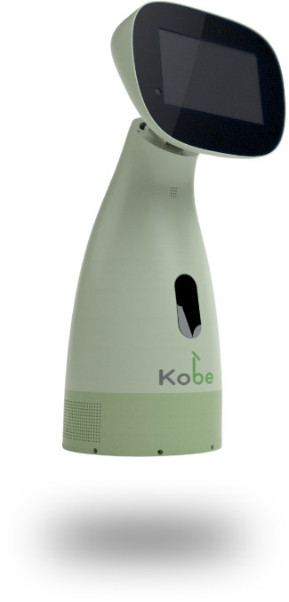
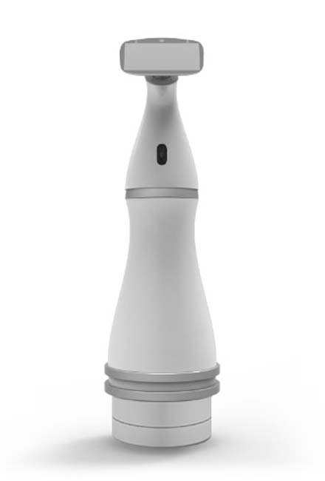
Business model
Hardware sales with planned recurring services
Hardware
One-time device purchases for consumers and organizations.
Services
Subscriptions, enterprise licenses and platform services.
Education
Training programmes provide a separate revenue route.
Kobe companion
Wheel Mobility
INGEN DYNAMICS
Sources: B E
15
Notes:
The 2025 annual report says recurring software and platform services remain under development. These channels are a business model, not an assertion that each generates material current revenue.
Sources accessed October 20, 2026:
B: https://www.sec.gov/Archives/edgar/data/1690888/000121390023031471/ea177248-1a_ingen.htm
E: https://www.sec.gov/Archives/edgar/data/1690888/000169088826000003/ingen_form_c-ar_20251.htm
Official company imagery:
https://www.ingendynamics.com/images/Kobe-picture.jpg
https://www.ingendynamics.com/images/products/wheel_Mobility.jpg

Slide 16


Education and research partnerships
Futurenauts
Manchester’s MoU connects students and researchers with the education initiative.
Joint development
The collaboration proposes research, curricula and academic exchanges.
Responsible AI
Planned work includes transparency, accountability and evaluation in social care.
INGEN DYNAMICS
Sources: D
16
Notes:
Source: University of Manchester, April 10, 2025. An MoU sets out a collaboration agenda. Do not interpret proposed activities as completed programmes or measured outcomes.
Sources accessed October 20, 2026:
D: https://www.manchester.ac.uk/about/news/the-university-of-manchester-to-collaborate-with-leading-innovator-in-ai-driven-automation-and-robotics/
Official company imagery:
https://www.ingendynamics.com/images/products/inGen_futurenauts.jpg
https://assets.manchester.ac.uk/corporate/images/design/logo-university-of-manchester.png

Slide 17
Commercial progress and funding
Conditional GEM share-subscription capacity
$150M
Facility status
Undrawn at December 31, 2025, pending a qualifying event.
Reported operating revenue
The filing reports $11,649 for 2025, from U.S. education receipts.
INGEN DYNAMICS
Sources: E
17
Notes:
The annual report is dated April 30, 2026. Figures relate to the U.S. issuer and its reporting perimeter. Conditional capacity is not cash raised. Website revenue pipeline is not recognized revenue. India related-party activities are not consolidated as company revenue in this filing.
Sources accessed October 20, 2026:
E: https://www.sec.gov/Archives/edgar/data/1690888/000169088826000003/ingen_form_c-ar_20251.htm
Official company imagery:

Slide 18
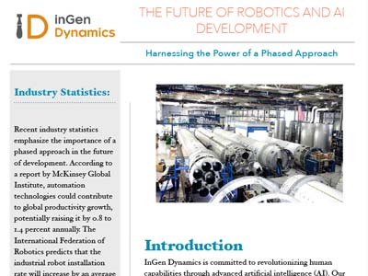
Growth priorities and execution
Presenter analysis based on the product roadmap and disclosures
Commercial focus
Prioritize applications with demonstrable customer value.
Delivery capability
Improve product readiness, installation and after-sales support.
Financial discipline
Connect development spending with funding availability and measurable milestones.
Company publication: AI, Automation & Robotics
INGEN DYNAMICS
Sources: B C E
18
Notes:
These are presenter recommendations, not commitments or guidance issued by the company. Relevant disclosed risks include financing dependence, product development, competition and supply-chain disruption.
Sources accessed October 20, 2026:
B: https://www.sec.gov/Archives/edgar/data/1690888/000121390023031471/ea177248-1a_ingen.htm
C: https://www.ingendynamics.com/
E: https://www.sec.gov/Archives/edgar/data/1690888/000169088826000003/ingen_form_c-ar_20251.htm
Official company imagery:
https://ingendynamics.com/blog/wp-content/themes/getaido/PDF/thumbs/12TheFutureofroboticsAIDevelopment.jpg

Slide 19

Key takeaways
An ambitious platform strategy with products at different stages
Company direction
AI software connects a broad robotics and automation portfolio.
Evidence of progress
Aido’s award and the Manchester MoU are documented milestones.
Next test
Product readiness and repeatable customer demand will determine commercial scale.
INGEN DYNAMICS
Sources: B C D E F
19
Notes:
The final point is presenter analysis, not a forecast. Product availability, commitments and completed revenues should be assessed separately.
Sources accessed October 20, 2026:
B: https://www.sec.gov/Archives/edgar/data/1690888/000121390023031471/ea177248-1a_ingen.htm
C: https://www.ingendynamics.com/
D: https://www.manchester.ac.uk/about/news/the-university-of-manchester-to-collaborate-with-leading-innovator-in-ai-driven-automation-and-robotics/
E: https://www.sec.gov/Archives/edgar/data/1690888/000169088826000003/ingen_form_c-ar_20251.htm
F: https://markets.financialcontent.com/wedbush/article/einpresswire-2021-5-18-ingen-dynamics-wins-silver-in-the-smart-productivity-tools-category-at-the-2021-edison-awards
Official company imagery:
https://ingendynamics.com/blog/wp-content/themes/getaido/PDF/thumbs/05TheFutureOfHomeAutomation.jpg

Slide 20
Selected references
A
Arshad Hisham, official biography and initiatives
arshadhisham.com
B
inGen Dynamics, 2023 preliminary offering circular
SEC EDGAR, April 21, 2023
C
inGen Dynamics, current product portfolio
ingendynamics.com
D
University of Manchester, partnership announcement
April 10, 2025
E
inGen Dynamics, 2025 Form C-AR
SEC EDGAR, financial statements and Note 10
F
inGen Dynamics, Edison Awards announcement
EINPresswire, May 18, 2021
Source URLs, image credits and qualifications appear in slide notes.
INGEN DYNAMICS
20
Notes:
Sources accessed October 20, 2026:
A: https://www.arshadhisham.com/
B: https://www.sec.gov/Archives/edgar/data/1690888/000121390023031471/ea177248-1a_ingen.htm
C: https://www.ingendynamics.com/
D: https://www.manchester.ac.uk/about/news/the-university-of-manchester-to-collaborate-with-leading-innovator-in-ai-driven-automation-and-robotics/
E: https://www.sec.gov/Archives/edgar/data/1690888/000169088826000003/ingen_form_c-ar_20251.htm
F: https://markets.financialcontent.com/wedbush/article/einpresswire-2021-5-18-ingen-dynamics-wins-silver-in-the-smart-productivity-tools-category-at-the-2021-edison-awards
Official company imagery:

