Slide 1
Middleware Support for RDMA-based Data Transfer in Cloud Computing
Yufei Ren, Tan Li, Dantong Yu, Shudong Jin, Thomas Robertazzi
Department of Electrical and Computer Engineering
Stony Brook University

Slide 2
Outline
Introduction and Background
Middleware Design and RFTP application
Experimental Results
Conclusion

Slide 3
Outline
Introduction and Background
Overview
RDMA Semantics
Middleware Design and RFTP application
Experimental Results
Conclusion

Slide 4
Today’s Data-intensive Applications
Explosion of data, and massive data processing
Scalable storage systems
Ultra-high speed network for data transfer: 40/100Gbps networks
Reliable Transfer (error checking and recovery) at 40/100G speed, burden on processing power
Notes:
Data copy vs. Zero copy
High performance network application is required to transfer tera-scale even peta-scale data between data centers.

Slide 5
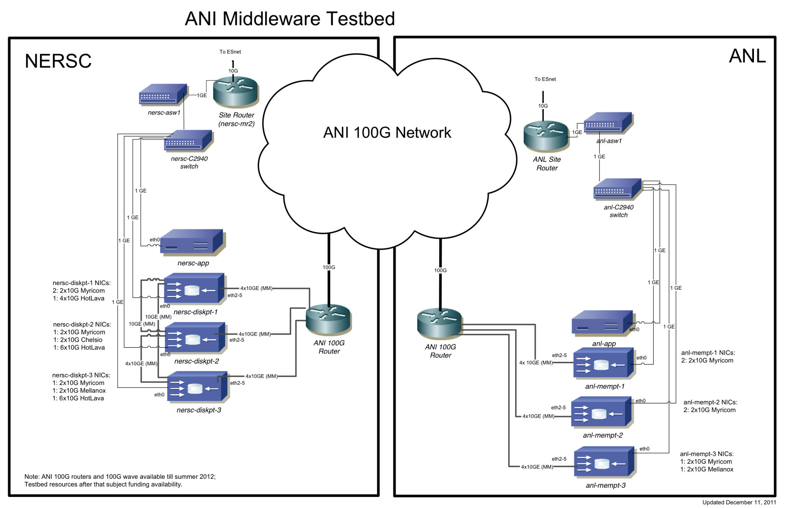
ANI Ultra-high Speed Network
Notes:
Our project is running over ANI 100G testbed.
Here is a real 100Gbps links between two data centers: NERSC near Berkerley and ANL near Chicago, apart from each other 2000 miles.

Slide 6

End-to-End 40/100G Networking
End-to-End Networking at 40/100 Gbits/s
100G APPS
100 G APPS
FTP 100
FTP 100
Our project and its role
40/100G NIC
40/100G NIC
40/100 Gbps
Backbone

Slide 7
Protocol Offload and Hardware Acceleration
TCP/IP Offload Engine (TOE)
Protocol Offload Engine (POE)
Remote Directory Memory Access (RDMA)
Kernel by pass
Zero-copy
Notes:
Since there are several data copies step in triditional TCP/IP stack, CPU is expected to be a bottleneck in high speed network. Several …

Slide 8
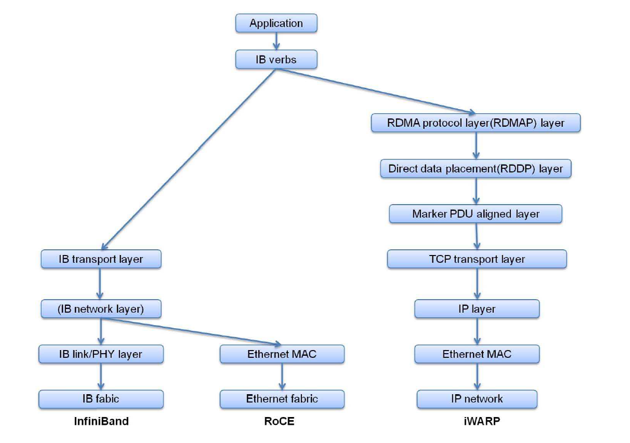
Applications over different RDMA implementations
Notes:
In our experience, iWARP performs good with multiple queue pairs, but not I/O depth, while IB and RoCE are much more sensitive to I/O depth rather than numbers of queue pairs.
RDMA is known as a promising high

Slide 9
RDMA Semantics
Channel Semantic – SEND/RECV
Two-side operation
Both data source and data sink are involved. The sink pre-posts a list of buffers into receive queue.
Memory Semantic – RDMA WRITE/RDMA READ
One-side operation
Credit-based. The sink advertises its available registered memory to the source for RDMA_WRITE operation.
We use RDMA WRITE operation to deliver user payload(128KB ~ 4MB per block), while use SEND/RECV to exchange control messages( ~2KB).
Notes:
Memory Semantic achieves lower latency.
D.K. Panda’s group has implemented FTP by SEND/RECV.

Slide 10
Outline
Introduction and Backgroud
Middleware Design and RFTP application
Middleware Layer
Middleware Software Architecture
Asynchronous Communication Events design
RFTP Modules
RDMA extension to standard FTP protocol
Experimental Results
Conclusion

Slide 11
Middleware Layer
Application
Application
Middleware
Buffer
Management
Connection
Management
Event
Dispatch/Join
Task
Scheduling
IB Verbs
libibverbs
RDMA CM
librdmacm
OFED
InfiniBand
RoCE
iWARP
Hardware
Notes:
1. RDMA-Software Complexity:
RDMA-Software is much more complex compare to socket programming, we prefer to give an simpler but efficient layer between the transport layer and the application.
Buffer reuse
Connection Management
Event-driven programming paradigm
Task scheduling
Multi-streams and

Slide 12
Middleware – Multi-threaded Architecture
Data Structure
Threads
Data Block List
Sender
Receive Control Message List
CE dispatcher
4
3
2
Send Control Message List
CE slave-1
CE slave-2
...
Remote MR Info List
CE slave-n
Queue Pair List
Logger
application
Memory
1
system
QP-1
QP-2
QP-n
CQ
Hardware
HCA
Notes:
Resource abstraction: HCA and Memory
And takes advantage of Multi-core environment with multi-threaded implementation
Take receive data as an example

Slide 13
Communication Events
Session ID negotiation
Each data transfer task will be assigned a unique session ID
Number of data connection negotiation
Establish several parallel connections
Memory region credit request and response
The source issues request of Memory regions’ information
The sink feedbacks several credit according to buffer status
Block completion notification
The source issues a notification to the sink which block’s data is ready
Notes:
Multi-tasks
Multi-streams
There are several control messages for data transfer.

Slide 14
Parallel and Pipelined Data Transfer
Explore parallelism of RDMA operations
Multiple active data streams
Each stream uses a pipelined execution
Out-of-order blocks
Reorder
Deliver in-order blocks to application

Slide 15
RDMA-enabled FTP - RFTP
FTP
…
Application
API
API
RDMA Middleware
Disk I/O Module
Buffer Manage
Connection Manage
I/O Scheduling
Middleware
API
Event Dispatch
Task Scheduling
Direct I/O
Communication manager
Operating
System
Verbs
Disk Driver
InfiniBand
iWARP
RoCE
SSD
Magnetic
Hardware

Slide 16
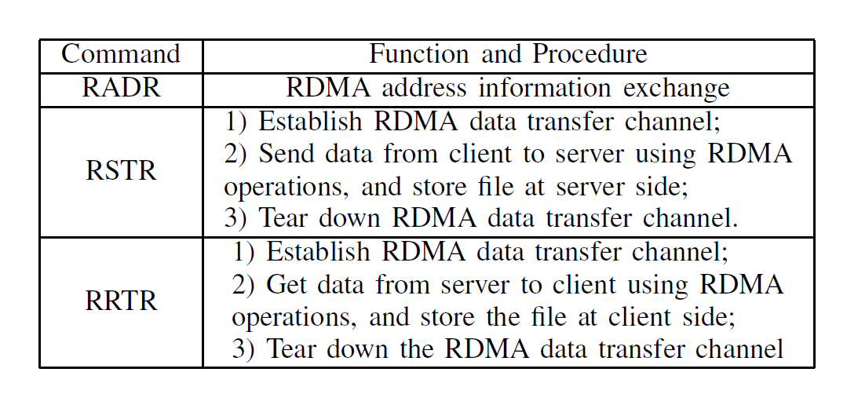
RDMA extension to standard FTP protocol
Notes:
rfc959

Slide 17
Outline
Introduction and Backgroud
Middleware Design and RFTP application
Experimental Results
Testbed Setup
LAN results
MAN results
Conclusion

Slide 18
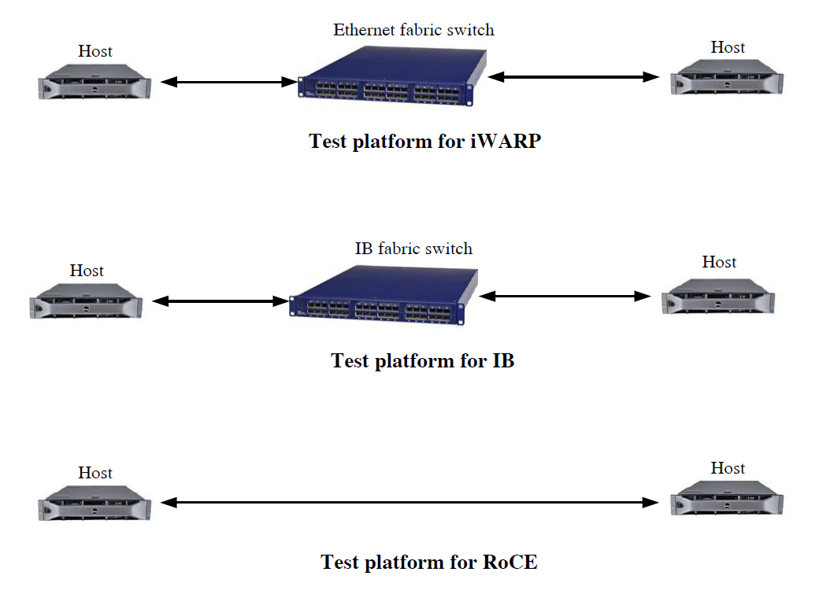
Testbed Setup - LAN
10Gbps
40Gbps
40Gbps
Notes:
8 lanes PCI Express 2.0 – 32Gbps
32 * 80% = 25.6Gbps

Slide 19
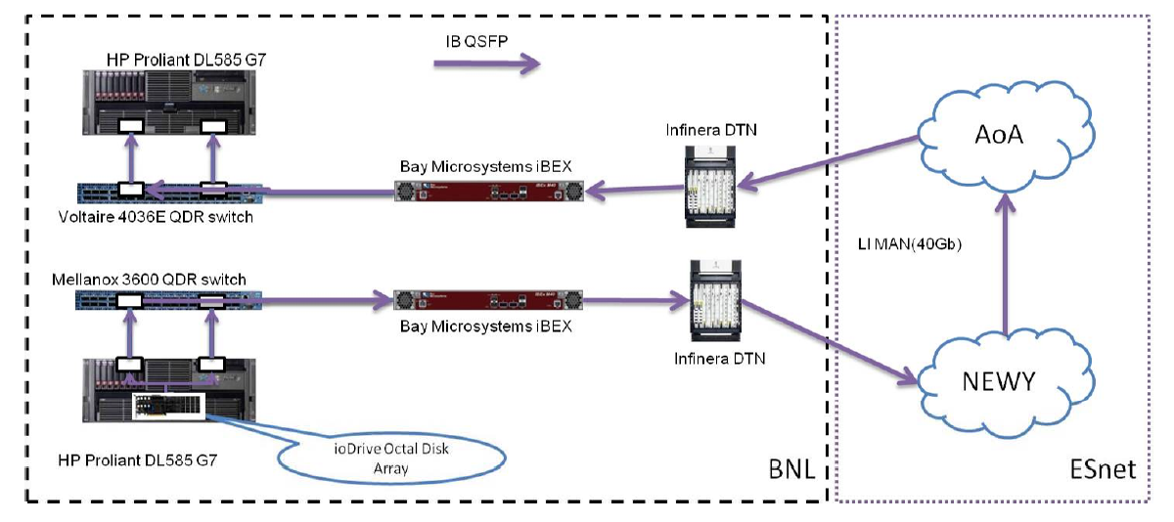
Testbed Setup - MAN
40Gbps RoCE link
RTT = 3.6ms

Slide 20
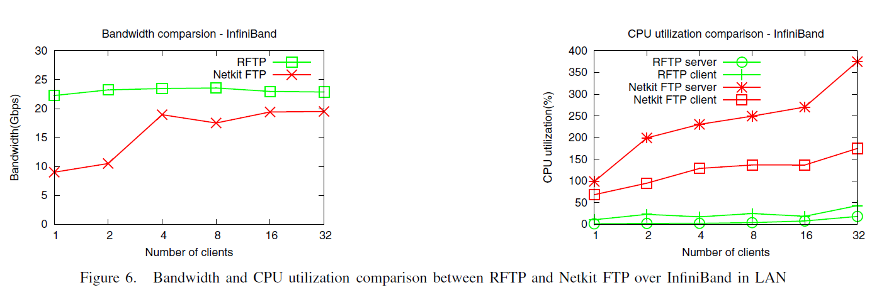
LAN – Bandwidth and CPU Usage Comparison
Notes:
First, RFTP utilizes the bare metal bandwidth better with few concurrent clients.
Second, RFTP improves the bandwidth performance at significantly lower CPU consumption.

Slide 21
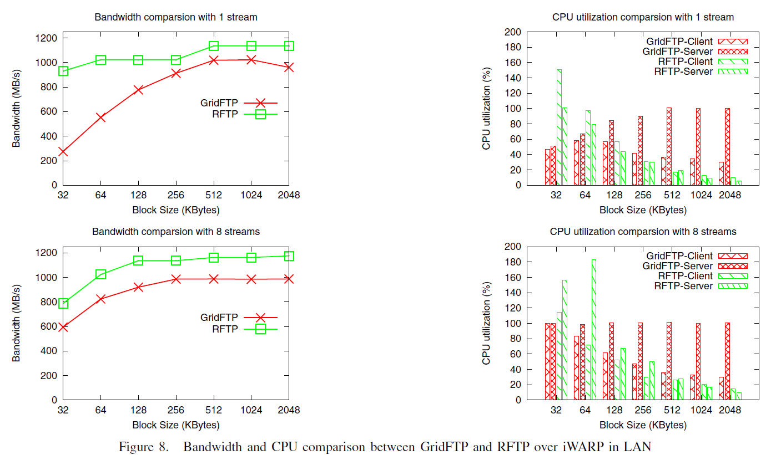
LAN – Bandwidth and CPU Usage Comparison
Notes:
RFTP and GridFTP comparison in iWARP LAN environment.
First, with a small block size, both RFTP client and server run at higher CPU utilization, due to higher overhead for handling more control message and completion event.
Second, because our middleware has a multi-threaded design, RFTP takes advantage of multi-core CPU resources efficiently. When the block size is larger enough, say 256KB, the CPU consumption of RFTP drops drastically, as much of the protocol processing and data copy has been offloaded.
On the other hand, GridFTP requires almost a constant CPU consumption even when block size is large.

Slide 22
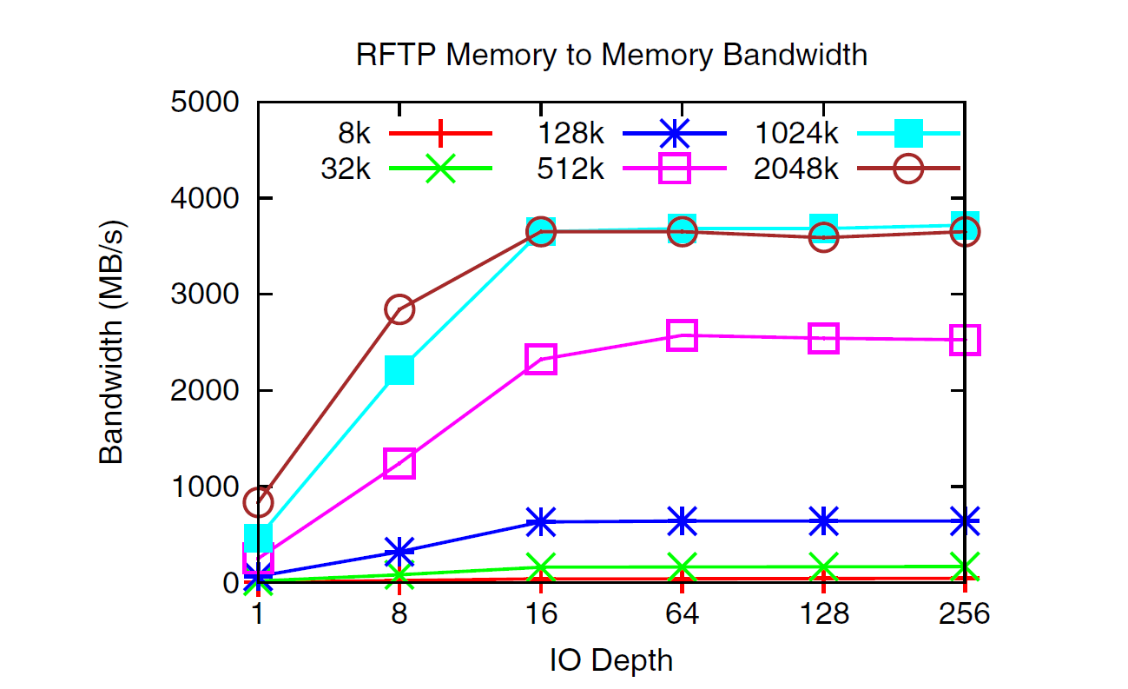
MAN – RFTP evaluation
Notes:
This figure shows the bandwidth of the RFTP payload in the memory(/dev/zero) to memory(/dev/null) test.
The throughput of the middleware increases as the size of each data block increases.
2MB block size results in the same throughput as 1MB when I/O depth is greater than 16.
Our design supports multiple packets inflight in each transfer pipeline.

Slide 23
Outline
Introduction and Background
Middleware Design and RFTP application
Experimental Results
Conclusion

Slide 24
Conclusion
Data-intensive application in cloud computing require efficient data transfer protocols to fully utilize the capacity of advanced network infrastructure
Designed and implemented a RDMA-based middleware layer
Developed a FTP application based on this middleware layer
Tested the performance of our design and implementation on both LAN and long-haul MAN links

Slide 25
Thank you

