Slide 1


Design and Performance Evaluation of NUMA-Aware RDMA-Based End-to-End Data Transfer System
Yufei Ren, Tan Li, Dantong Yu, Shudong Jin, and Thomas Robertazzi
Notes:
Welcome to my presentation. I’m Yufei Ren, a PhD student from Stony Brook University. Today I’m going to present “Design and performance evaluation of NUMA-aware RDMA-based end-to-end data transfer system”. This is a joint work with Tan Li, Dantong Yu, Shudong Jin, and Thomas Robertazzi.

Slide 2
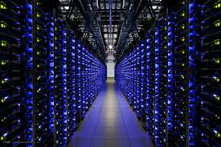
Massive Data Output
Big data in pata-/exa-bytes scale
Climate Simulation
High-energy physics
System biology
Notes:
The cutting edge of HPC and large scientific experiments generate petabytes and exa-bytes of data. Such large volumes of data require advances in computing, networking, storage, and software.
Introduction:
Massive data output
Abstraction: end-to-end data transfer, storage – app – app – storage
Hardware Upgrade: Host(NUMA), network, storage.
Our goal: design and deliver an efficient, extremely high performance data transfer tool and scale up data transfer to 100 Gbps and higher in an high efficient manner.
Our solution: front-end and back-end.

Slide 3
Massive Data Output
Big data in pata-/exa-bytes scale
Data transfer and data synchronization
Climate Simulation
High-energy physics
System biology
LAN
WAN
Notes:
For example, those data often transferred and synchronized by geographically distributed terms of users for data analysis, virtualization, and backup.

Slide 4



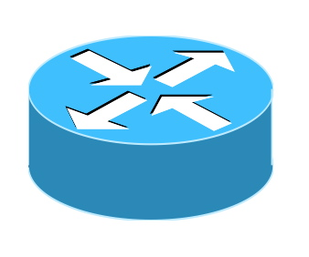
End-to-End Data Transfer
1~10 Gbps Ethernet
1~10 Gbps Ethernet
Ethernet
SAN
Gateways
Gateways
SAN
TCP-based Data Transfer Software: : GridFTP, scp, BBCP
SAN storage: iSCSI
Notes:
Regarding end-to-end data transfer in and between data centers, it normally involves storage area networks and data transfer gateway hosts. 1/10 Gbps networks are standard configuration for commodity environments. Current software solution on both data transfer and SAN are mostly TCP-based and implemented via socket interfaces. For example, GridFTP and scp for data transfer, and iSCSI for storage area networks.

Slide 5
RDMA is a Game-Changer
100 Gbps
100 Gbps
Ethernet
SAN
Gateways
Gateways
SAN
Notes:
In recent years, RDMA, remote memory direct access, changes the landscape of network performance. For example, 100 Gbps networks are available in end host and both local and wide area networks.

Slide 6
RDMA is a Game-Changer
100 Gbps
100 Gbps
Ethernet
SAN
Gateways
Gateways
SAN
RoCE, iWARP
InfiniBand
Notes:
InfiniBand, one of the most popular RDMA implementation, is standard facilities to construct high performance storage area networks, while RoCE and iWARP extends RDMA’s capability into wide area networks.

Slide 7
RDMA is a Game-Changer
100 Gbps
100 Gbps
Ethernet
SAN
Gateways
Gateways
SAN
Q1: Scalability and efficiency of TCP-based software in high speed?
Q2: How to utilize advanced RDMA technology to transfer data with high bandwidth and low cost?
Notes:
Because of this rapid incensement of network performance, we have two questions regarding end-to-end data transfer? First, will TCP-based data transfer solutions still be scalable and efficient for large scale data transfer requirement? And second, how to efficiently utilize RDMA technologies to transfer data with high bandwidth and low cost?

Slide 8
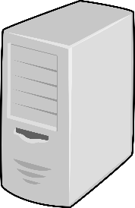
A Preliminary Experiment
3 x 40 Gbps RoCE
Notes:
To answer the first question about scalability of TCP-based software, we conducted a preliminary experiment. We connected two host with three pairs of 40 Gbps back-to-back RoCE connections. So the total network capacity is 120 Gbps. We ran both TCP and RDMA benchmarks. We aware of several TCP tuning issues including multi-stream, jumbo frame, irq affinity, enlarging sending and receiving buffers, etc.

Slide 9
A Preliminary Experiment
3 x 40 Gbps RoCE
117.6
TCP wasn’t able to saturate this fat link.
RDMA achieved 98% bare-metal throughput.
TCP: 35% CPU is used for memory copy
copy_user_generic_string()
91.8
91.8
83.5
Notes:
The TCP benchmark got 91.8 Gbps while RDMA benchmark got 117.6 Gbps. First, TCP-based iperf solution is not able to saturate this fat link. Second, RDMA achieved over 98% of bare-metal bandwidth. Third, by monitoring application CPU utilization by `Perf’, the most CPU consuming system call in TCP was for data copy between user space and kernel space.

Slide 10
Goals
Better practice in high-speed data transfer
High throughput
Achieve line speed
Low cost
CPU utilization
Memory footprints
Scalability
100 Gbps and Beyond
Wide Area Networks
Notes:
We divide the second question which is about RDMA usage into three parts. First, through the end-to-end data path, this solution could achieve line speed of the high performance network. Second, the solution should take low overhead in terms of CPU utilization and memory footprints. Third, scalability, including scale to high performance network with over 100 Gbps bandwidth, and to wide ware networks with long latency.

Slide 11
Hardware Development and Zero-copy
Notes:
The term RDMA itself determines zero-copy is the key to achieve high performance. I’d like to revisit the hardware development and why zero-copy is so critical to data transfer in modern systems.

Slide 12
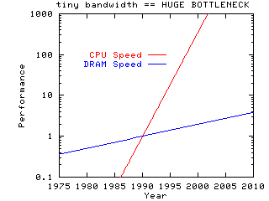
Hardware Development
Single-core
Memory Wall
Power Wall
Frequency Wall
1990
Processor-Memory Performance Gap: (grows 50% / year)
2000
2010
© John D. McCalpin
Notes:
In single core era, the term “memory wall” predicted that speed disparity between CPU and memory was becoming larger and larger, and the memory latency would becomes an overwhelming bottleneck in computer performance.

Slide 13
Hardware Development
Single-core
Memory Wall
Power Wall
Frequency Wall
1990
2000
c
c
c
c
Multi-core
2010
Memory
Controller
Memory
Notes:
Because of power wall and frequency wall, CPU architecture turns into multi-core era. Multiple CPU cores are using a shared system bus for both memory accesses and cache coherent traffic.

Slide 14
Hardware Development
Single-core
Memory Wall
Power Wall
Frequency Wall
1990
2000
c
c
c
c
c
c
c
c
Multi-core
2010
Memory
Controller
Memory
Notes:
The use of a system bus has scalability problems when the processor count is increased, due to contention for the shared bus resources. This also makes the aggregate CPU throughput even larger than memory throughput.

Slide 15
Hardware Development
Single-core
Memory Wall
Power Wall
Frequency Wall
1990
Memory
Memory
2000
c
c
c
c
Multi-core
c
c
c
c
2010
NUMA
c
c
c
c
c
c
c
c
Memory
Memory
Notes:
In recent years, modern servers are typically multiprocessor with NUMA architecture. It uses a CPU interconnect to replace a shared system bus.

Slide 16
Hardware Development
Single-core
Memory Wall
Power Wall
Frequency Wall
1990
Memory
Memory
2000
c
c
c
c
Multi-core
c
c
c
c
2010
NUMA
c
c
c
c
c
c
c
c
Memory
Memory
Notes:
Although the CPU interconnects distribute contention by integrating a memory controller in each NUMA node, the performance gap between the CPU and memory are still not resolved. Also, in NUMA architecture, access on different memory banks results performance disparity in terms of memory latency and throughput. In most cases, local memory access is better than remote ones.

Slide 17
Hardware Development
1990
Single-core
Gigabit Ethernet
2000
Multi-core
10 Gigabit Ethernet/InfiniBand
2010
NUMA
40/56/100 Gigabit Ethernet/InfiniBand
Notes:
In sum, CPU always surpasses memory performance and the disparity is growing continuously. On the other hand, a single network interface improved its performance in an exponential increasing manner. In the meanwhile, NUMA architecture enlarges the number of I/O devices in a single host. Therefore, NUMA hosts with multiple high performance network interfaces are bridging the performance gap between memory and network I/O.

Slide 18
Therefore …
High speed data transfer should pay high attention to data copy, and use more efficient zero copy to address performance bottlenecks.
Notes:
Therefore, high speed data transfer applications should pay more attention to data copy, and use more efficient zero copy mechanism, such as RDMA, to address performance bottlenecks.

Slide 19
Cost: Data Copy vs. Zero Copy
40 Gbps RoCE
RDMA
RFTP
RFTP
/dev/null
/dev/zero
iperf
iperf
TCP
Notes:
We conducted another experiment to investigate the cost difference between TCP and RDMA. The two host are connected with a 40 Gbps RoCE link, and we ran both TCP and RDMA based data transfer application transfer data from /dev/zero to /dev/null. Both TCP and RDMA are able to achieve line speed at 39 Gbps.

Slide 20
Cost: Data Copy vs. Zero Copy
40 Gbps RoCE
RDMA
RFTP
RFTP
/dev/null
/dev/zero
iperf
iperf
TCP
Loading
Transmission
Offloading
Notes:
We divide the whole data transfer into three parts: Data loading, data transmission, and data offloading.

Slide 21
Cost Breakdown
Loading
Transmission
Offloading
Notes:
In data loading step, both solutions flush there memory with 0s by using 60% CPU of a single core.

Slide 22
Cost Breakdown
Loading
Transmission
Offloading
111%
101%
152%
158%
Notes:
In the transmission step, its cost is divided into protocol processing (shown in the orange color) and data copy (shown in gray). First, iperf consumes more than 200% CPU or 2 CPU cores to copy data between kernel space and user space. RDMA was using zero-copy to bypass the kernel, hence saved more than 2 CPU cores on data copy. Second, TCP protocol processing cost is also much larger than that of RDMA’s. RDMA offload some transmission part into the hardware, hence got lower CPU on protocol processing.

Slide 23
Cost Breakdown
Loading
Transmission
Offloading
Notes:
Because we dump data into /dev/null, the data offloading cost is negligible.

Slide 24
RDMA-Based End-to-End Data Transfer
Notes:
I’m going to introduce an RDMA-based end-to-end data transfer solution in the following section.

Slide 25
RDMA-based End-to-End Solution
iSER
iSCSI Extentions for RDMA
100 Gbps
100 Gbps
Ethernet
SAN
Gateways
Gateways
SAN
Notes:
In our solution, to achieve true zero-copy along the whole data transfer path, we deploy iSER protocol to contruct a high performance storage area networks. The iSER is iSCSI Extentions for RDMA. It transfers iSCSI command and user payload by RDMA operations.

Slide 26
RDMA-based End-to-End Solution
iSER
iSCSI Extentions for RDMA
RFTP
RDMA enabled FTP service
100 Gbps
100 Gbps
Ethernet
SAN
Gateways
Gateways
SAN
Notes:
Also, we deploy our RDMA enabled FTP service, RFTP, in front-end data transfer gateways. It supports point-to-point RDMA data transfer mechanism.
Also, we did NUMA-aware tuning along the whole data transfer path.

Slide 27
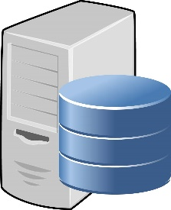
End-to-End: TCP vs. RDMA
iSER
iSCSI
User Buffer
RDMA
TCP
Kernel Buffer
NIC
IB
IB
RoCE
iWARP
RoCE
iWARP
IB
IB
Loading
Transmission
Offloading
Notes:
Here, I’m giving out the data path in an end-to-end data transfer on both TCP-based and RDMA-based solution. The green blocks are user buffers while the red blocks are kernel buffers. The green arrows stands for RDMA data path, while the red arrow stands for TCP data path.
In the data loading step, RDMA saves two data copies and totally bypass the kernel buffer.

Slide 28
End-to-End: TCP vs. RDMA
iSER
RFTP
iSCSI
GridFTP, SCP
User Buffer
RDMA
TCP
Kernel Buffer
NIC
IB
IB
RoCE
iWARP
RoCE
iWARP
IB
IB
Loading
Transmission
Offloading
Notes:
In the data transmission part, RFTP are sending data to remote user space memory directly.

Slide 29
End-to-End: TCP vs. RDMA
iSER
RFTP
iSER
iSCSI
GridFTP, SCP
iSCSI
User Buffer
RDMA
TCP
Kernel Buffer
NIC
IB
IB
RoCE
iWARP
RoCE
iWARP
IB
IB
Loading
Transmission
Offloading
Notes:
Again, in the offloading step, iSER saves another two data copy overhead.

Slide 30
SAN: NUMA-Agnostic iSER
iSER
SAN
tgtd
c
c
Initiator
Memory
c
c
c
c
Initiator
Memory
c
c
tgtd
Notes:
In our later experiments, we used large memory in the storage server as storage media to simulate high performance storage system. Also, memory storage, such as RamCloud and key-value store are becoming popular. We consider memory storage tuning in the target hosts. Without NUMA tuning, a long term running system eventually distribute its data randomly across different nodes and results high internode traffic and remote data access overhead.

Slide 31
SAN: NUMA-Aware iSER
iSER
SAN
numactl tgtd
c
c
Initiator
Memory
c
c
c
c
Initiator
Memory
c
c
numactl tgtd
Notes:
To go over this problem, we use numactl to align the iSER service process, tgtd, with the memory storage to achieve the best performance.

Slide 32
RFTP: RDMA-based FTP Service
RDMA Pros
Save CPU & Memory Resource
Low latency & high throughput
RDMA Cons
Explicit memory management
Asynchronous, event-driven programming interfaces
The application has to pipeline RDMA operations itself and manage in-flight memory status.
Notes:
Although RDMA uses zero-copy to save CPU resource and memory bandwidth, it also introduce implementation difficulties to achieve line speed, especially in wide area networks. The most important reason is the memory status has to be synchronous with remote host. For example, in one memory block transfer, the memory should be protected unless the last byte of the block is acknowledges by the remote side. If the application waits there, it blocks the whole process.

Slide 33
Front-end: RFTP Software More in : Protocols for Wide-Area Data-Intensive Applications: Design and Performance Issues, SC ‘12
One dedicated Reliable Connection queue pair for exchanging control messages, and one or more for actual data transfer
Multiple memory blocks in flight
Multiple reliable queue pairs for data transfer
Proactive feedback
Process Load Data
Process Offload Data
put_ready_blk
get_free_blk
get_ready_blk
put_free_blk
Data
Source
Control Msg QP
Data
Sink
Bulk Data Transfer QPs
Notes:
To overcome this problem, First, RFTP keeps multiple outstanding memory blocks in flight to achieving good performance. Second, use multiple reliable queue pairs to eliminate the performance limitation of a single queue pair. Third, since the protocol uses RDMA WRITE to deliver bulk user payload, credits (tokens with destination address) are required before transmitting the data. RFTP adopts proactive feedback mechanism to proactively send available memory information to data source.
For more details, please refer our SC12 paper. In this paper, we are more focuses on RFTP cost analysis and extreme high performance evaluation in both LAN and WAN.

Slide 34
End-to-End Performance Evaluation
Notes:
Here comes to performance evaluation.

Slide 35
Testbed Setup
Testbed
LAN: 3 * 40 Gbps RoCE, 2 * 56 Gbps InfiniBand
WAN: 40 Gbps RoCE
384 GB memory as storage media to simulate real high performance storage system
GridFTP vs. RFTP
Bandwidth
CPU Utilization
Load data from storage server and dump data to storage server
TCP tuning
Jumbo Frame, IRQ affinity, TCP buffer etc.
Notes:
We evaluation software performance in both local area network and wide area network. We deploy large memory into storage server as the storage media to simulate real high performance storage system. We compare the performance of TCP-based GridFTP and RDMA-based RFTP in terms of bandwidth CPU utilization. Both applications are loading data from and dumping data to real storage server instead of pseudo storage such as /dev/zero and /dev/null.

Slide 36
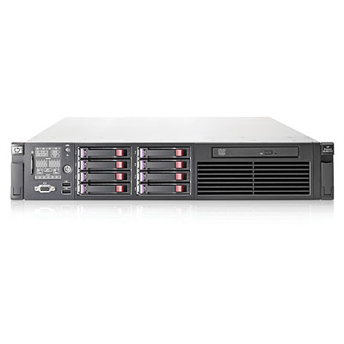
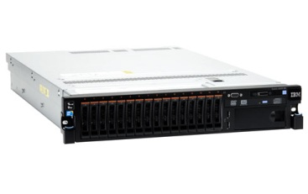
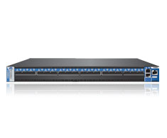
Storage Performance
tgtd
fio
HP DL380
IBM X3650
Mellanox FDR Switch
InfiniBand SX6018
NUMA-aware tgtd vs. NUMA agnostic tgtd
Notes:
First, we investigate the performance of backend system. In the iSER target host, we install Linux SCSI target framework, tgtd process and it exports memory disks to the initiators. In the initiator, it use flexiable I/O test, fio, to generate workloads against the storage server.
We investigate the best performance that tgtd is able to deliver with or without NUMA tuning.
FIO
4 threads in each LUN

Slide 37
Storage Performance - Read
7.6%
Notes:
The left figure shows the read throughput with and without NUMA tuning. The x-axis is the size of I/O requests and the Y-axis is the throughput in GB unit. The bandwidth improvement is merely 7.6% at most. The CPU consumption of the tgtd process is shown in the right figure.
For read operations, the bandwidth improvement is merely 7.6% with NUMA binding
CPU is the tgtd process CPU usage

Slide 38
Storage Performance - Write
19%
300%
Cache coherent traffic in NUMA architecture
Read: cached/shared
Write: modified
Notes:
For write operations, we observed an improvement in bandwidth up to 19% for the block size larger than 4 megabytes, and using the default Linux bind policy increases CPU consumption threefold.
A write operation results a modified status in CPU cache line. Any future operations related to this cache line needs to synchronous its status with all the other NUMA nodes. The huge CPU usage differential is also coming from inter-node traffic cost and cache coherent protocol.

Slide 39
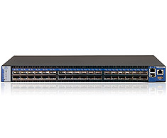
LAN Testbed
HP DL380
IBM X3650
Mellanox FDR Switch
InfiniBand SX6018
Mellanox QDR Switch
Ethernet SX1036
HP DL380
IBM X3650
Mellanox ConnectX 3 VPI
56Gbps FDR
Mellanox
ConnectX 3 Ethernet
40Gbps QDR
Notes:
We setup two HP host with large memory capacity as backend hosts and two IBM host as frontend data transfer application hosts. In the storage area networks, each host has two 56 Gbps Mellanox InfiniBand NICs. Two data transfer host are connected with 3 pairs of 40 Gbps RoCE link.

Slide 40
LAN Testbed
iSER
RFTP
GridFTP
HP DL380
IBM X3650
Mellanox FDR Switch
InfiniBand SX6018
Mellanox QDR Switch
Ethernet SX1036
HP DL380
IBM X3650
Mellanox ConnectX 3 VPI
56Gbps FDR
Mellanox
ConnectX 3 Ethernet
40Gbps QDR
Notes:
Again, we use iSER to construct a storage area network and we deploy GridFTP and RFTP in frontend hosts.

Slide 41
LAN: End-to-End Performance
3x
Notes:
In this test, we run RFTP and GridFTP for 25 minutes. The left figure shows their bandwidth comparison. RFTP achieved 90 Gbps and 3 times faster than GridFTP.

Slide 42
LAN: End-to-End Performance
Storage Threshold
3x
Notes:
The storage system can deliver 95 Gbps and RFTP got 96% effective bandwidth of the whole end-to-end system. As shown in the right figure, TCP-based GridFTP solution leads to extreme high CPU utilization, and can not fully utilize this high performance network resources.
GridFTP only 30% utilization.
Multiple data copy in TCP stack. High sys CPU consumption.
Direct I/O.

Slide 43
End-to-End Performance: Bi-directional
RFTP: 83% improvement vs. unidirectional
GridFTP: 33% improvement vs. unidirectional
Notes:
To further clarify the best end-to-end host performance in terms of bandwidth and CPU utilization, we performed bi-directional data transfer. RFTP got 83% throughput improvement comparing to its single directional test, while GridFTP only got 33% better performance.

Slide 44
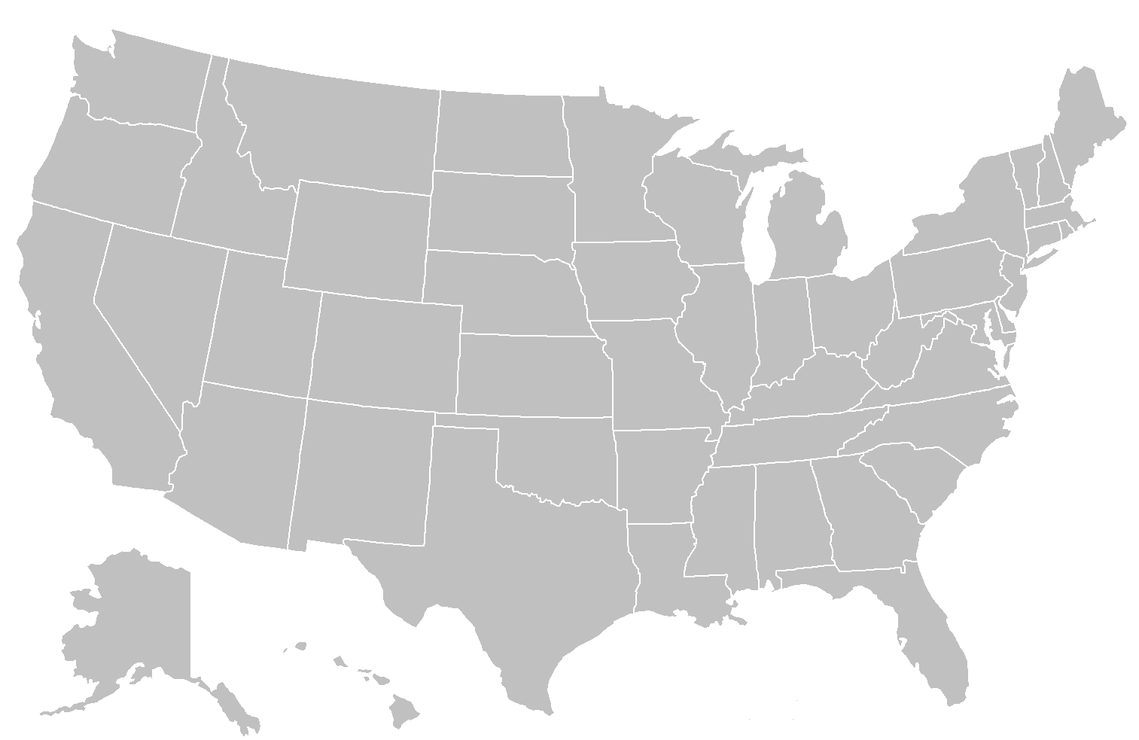
40 Gbps WAN Testbed
ANL
NERSC
40 Gbps RoCE WAN
4,000 miles
RTT: 95 millisecond
BDP: 500 MB
Will RFTP be scalable in WAN?
Notes:
In addition to these local area network tests, we also deploy RFTP in DoE’s WAN testbed. This 4,000 miles RoCE link is a loopback from National Energy Research Scientific Computing Center(NERSC) located in Oakland, CA to Argonne National Laboratory near Chicago, and then back to NERSC. In this long fat link, the bandwidth delay product is 500 MB which means the application has to manage such large in-flight packets.

Slide 45
RFTP Bandwidth in 40 Gbps WAN
# of streams
Notes:
This figure shows the bandwidth performance of RFTP in such high bandwidth wide area network. The x-axis is the block size and y-axis is throughput. Different color stands for different number of streams. We verify that RFTP utilizes 97% of the raw bandwidth of the testbed.
Although we were not able to deploy our RDMA-based storage area network, these experiments shows our RDMA-based solution can get maximum performance along each segment of end-to-end LAN and WAN data transfer. The RDMA-based solution is feasible both local and wide area networks.
Note, bandwidth is the user payload.
Small amount of control messages.
RFTP performance is not affected by long distance with long latency.
We conclude that RFTP is …

Slide 46
Scale RDMA to WAN
RoCE and iWARP
RoCE requires a complicated layer-2 configuration for lossless operation.
iWARP: ToE
iWARP operate with standard switches
Notes:
In our paper, we utilized the RoCE link in wide area network, and RoCE requires a complicated layer-2 configuration for lossless operation. And recently, iWARP is becoming a more feasible solution to scale RDMA into wide area networks. iWARP NIC includes a TCP offloading engine in the hardware to deal with packet loss which is more commen in wide area networks. We replace our local RoCE NIC with iWARP NIC, and run RFTP.
http://www.chelsio.com/nic/rdma-iwarp/

Slide 47
Conclusion
HPC data transfer
Hardware advances need advanced software
Efficient memory usage in HPC
RDMA-based design
NUMA-aware tuning
Testbed in LAN and WAN validated our design
Notes:
Here comes to our conclusion. HPC generates large volume data that needs to be transferred and synchronized in an high efficient manner. While hardware advances improved bare-metal performance, advanced software design and tuning is critical to fully take advantages of those advances. We claim that in HPC, efficient memory usage is the sweet spot to get the best performance. We proposed an RDMA-based end-to-end data transfer system. It utilize RDMA and NUMA-aware binding along the whole data transfer path to achieve the best performance. The performance metrics in both LAN and WAN validated our design choice.

Slide 48
Q & A
RFTP Software
http://ftp100.cewit.stonybrook.edu/rftp
RFTP runs on
Caltech booth
Stony Brook University
http://ftp100.cewit.stonybrook.edu/ganglia
Notes:
Thank you for your listening. I’d very glad to take questions.
bout RDMA (iWARP results)

