Slide 1



Protocols for Wide-Area Data-intensive Applications: Design and Performance Issues
Yufei Ren, Tan Li, Dantong Yu, Shudong Jin, Thomas Robertazzi, Brian Tierney, Eric Pouyoul
Notes:
Abstract
Providing high-speed data transfer is vital to various data-intensive applications, such as those in cloud computing, grid computing, and data centers. While remarkable advances in hardware technology have provided ultra-high-speed network bandwidth, the existing protocols and applications may not yet fully utilize the bare-metal bandwidth due to their inefficient design and expensive OS kernel processing. Remote Direct Memory Access (RDMA) offers a promising technology to offload software protocols to hardware devices, and directly can move bulk data from the source memory to the remote host memory with kernel-bypass and zero-copy operations. However, RDMA originally was designed for transferring data with low latency, and its benefits have not been fully exploited in remote data transfers due to the complex programming requirement to handle high latency while affording high performance. In this paper, we address this challenge and design an efficient RDMA data transfer protocol that is implemented as general communication middleware.
The protocol includes flow control and task synchronization, and maximizes the parallelism of RDMA operations between the data sources and destinations. The resulting middleware greatly simplifies RDMA-based data transfer, and is suitable for various data transfer applications. We demonstrate the benefit in performance of this protocol and middleware on various local and wide area testbeds, including that of the DOE's Advanced Networking Initiative (ANI) with both RoCE and InfiniBand links.
Hello everyone. I’m Yufei Ren from Stony Brook University. Today, I’m going to present a research paper published by some of my colleagues and me, including my adviser Dantong from BNL, Brian and Eric from LBL.

Slide 2
Project Background
Protocol Design and Implementation
Testbed Evaluation
Notes:
First, I will describe the background of our project.

Slide 3
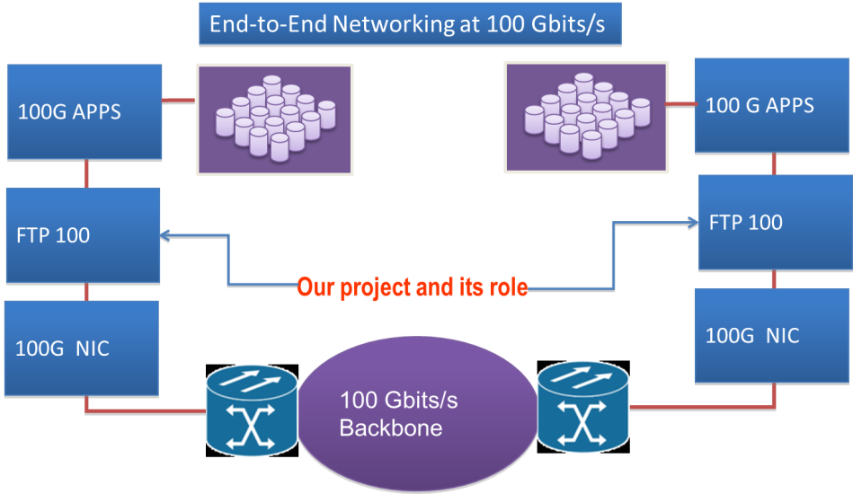
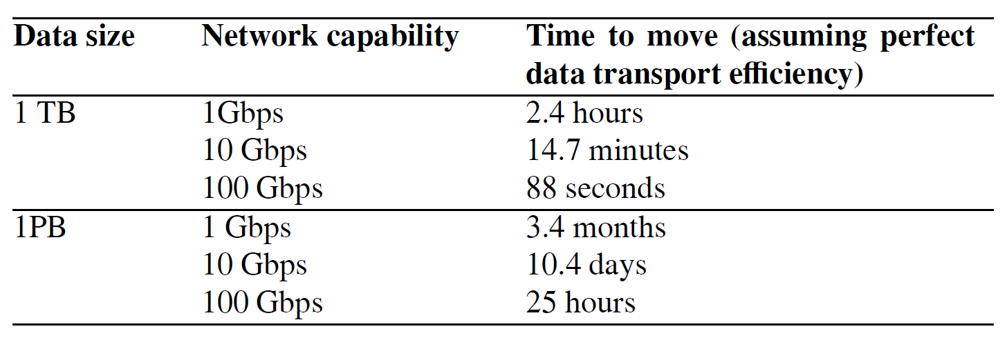
Data-intensive Applications
Examples
DOE Leadership Computing Facilities, Data centers, Grid and cloud computing, Network storage
Characteristics
Explosion of data, and massive data processing
Central but scalable storage systems
Ultra-high speed network for data transfer: 100Gbps networks
Notes:
In todays data centers and high performance computing, both software and hardware improve their performance and capabilities in an exponential increasing manner. Specifically, in data centers of DOE’s national labs, data intensive applications generate extremely high volumes of data everyday. Those data has to be transferred and synchronized either in data center via local area networks or between data centers via wide area networks. In network aspect, 40 giga-bit-per-second QDR and 56 giga-bit-per-second FDR link speed improves both throughput and latency for data center networks. Experimental 100 giga-bit-per-second wide area netwoks emerges, and gives us both opportunities and challenges.

Slide 4
TCP or RDMA?
Why not TCP?
Data copies
CPU intensive
Complex kernel tuning issues
Why RDMA (Remote Direct Memory Access)?
Zero-copy, kernel bypass
Low latency, high throughput
InfiniBand, RoCE (RDMA over Converged Ethernet)
RDMA challenges
To achieve near line-speed data transfer
Explicit memory management by application developers
Asynchronous work queues, event-based programming paradigm
Notes:
We aware that there are several data transfer tools based on TCP socket. Although performance of TCP based applications is scalable by enabling multiple tcp connections, data copies between network layers introduce performance penalties and high CPU consumption. Also, end host performance tuning is complex in high performance computing. Remote Direct Memory Access (RDMA) is the remote memory management capability that allows server to server data movement directly between application memory without any CPU involvement. And RDMA is often used to refer to network technologies. InfiniBand and RoCE are examples which implement RDMA technologies. InfiniBand is often used in Data Center local area networks, while RoCE makes it possible for RDMA to be used over long distance networks. But, there are several challenges to archive line-speed data transfer rate by using RDMA technologies. In RDMA, memory management should be done by application instead of kernel. And RDMA is a kind of asynchronous, event-based programming interface which is much more complex than traditional socket programming.
1. Why TCP?
All complicated processing functions are implemented by kernel.
Socket is an outstanding programming interface.
Makes application simple but efficient in giga-bit-per-second era.
Multiple streams is not scalable well in real system. NUMA introduced even more complicated case for TCP tuning.
2. Performance of one TCP stream is always limited by the capabilities of a single-core of CPU, normally resides in the receiver side. The performance of TCP based applications is scalable by enabling multiple streams. But it consumes more CPU usage and includes complex tuning issues, such as buffer size, NUMA, interrupt.

Slide 5
RDMA Transport Services
source
sink
source
sink
Post Receive
Key
SEND
RDMA Write
Unsolicited Message
Solicited Message
Comp Notify
Comp Notify
Notification
Channel Semantic: Send/Recv
Memory Semantic: RDMA Read, RDMA Write
Our choice considers both performance and software design perspectives.
Notes:
Before we dive into the detailed design, let’s talk about RDMA transport service first. There are two types. The first one is called Send/Recv. (click) For example, before data transfer happened, the data sink post a memory block into local receive queue. After that, the source issues a send work request to transfer a memory block. Once data transfer finished, both side will get a completion notification. In this type, the source side doesn’t have to know the exact memory information of the sink side. Another type of service is memory semantic, RDMA Write or RDMA Read. (Click) In this type, the source side needs to know the exact memory information of the sink side before it issues the RDMA Write work request. Also, since data sink is not aware of the completion of data transfer. The source has to send another notification to the sink to indicate which memory block is filled up with user payload.
RDMA provides four kinds of message transport services: Send/Recv, RDMA Read and Write, Atomic, Multicast
Send/Recv
Source side sends unsolicited message to receiver side.
Problem:
1. Waste memory usage. Since receiver side didn’t know the message properties, it has to prepare the largest size of memory to

Slide 6
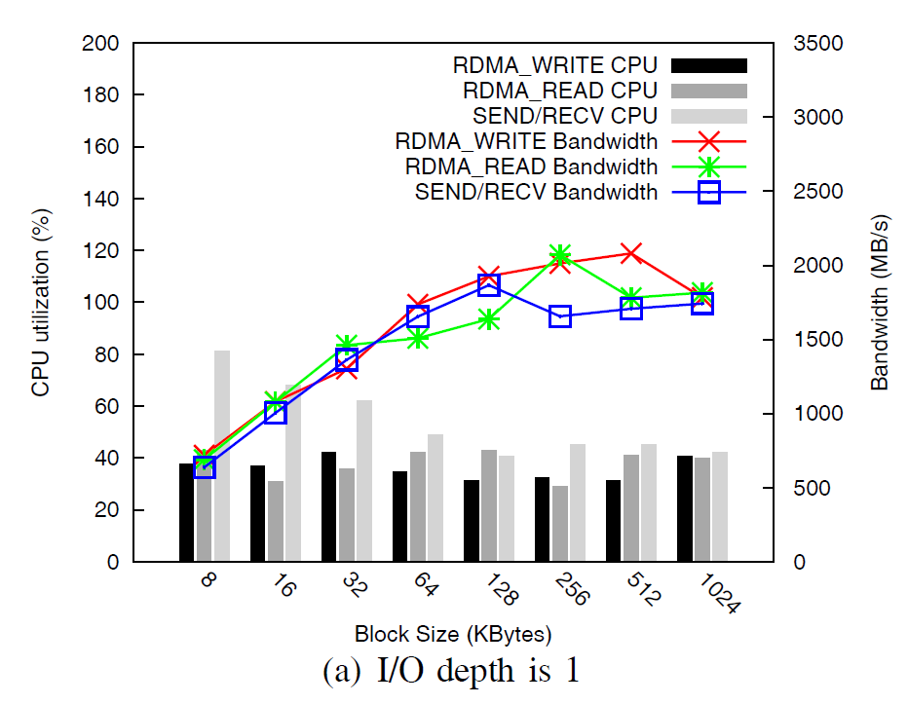
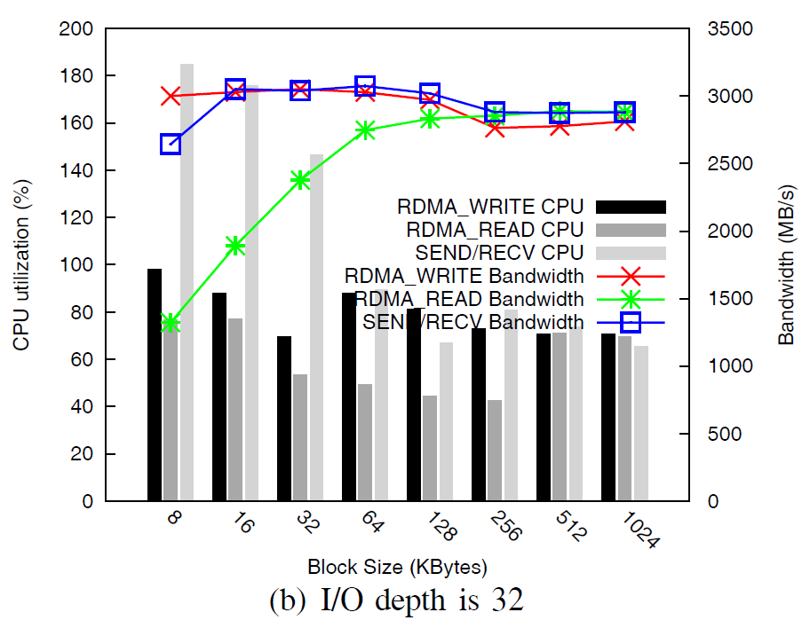
Evaluation of RDMA Services
Contribute an RDMA I/O engine for Flexible I/O Tester (fio).
Key parameters
I/O depth (# of memory blocks in flight)
Block size
Use one side operation (RDMA Write) to transfer user payload, and two side operation for control messages.
Notes:
To evaluate performance of RDMA service, we developed a new IO engine for Flexible IO Tester, a popular IO evaluation tool in community. Here are two performance result in 40 giga-bit-per-second InfiniBand environment with various memory block sizes. The left figure shows the performance metrics when the I/O depth is 1, while the right side’s I/O depth is 32. X-axis is the size of memory block, and Y-axis is the CPU utilization and throughput. First, by comparing the black bar and light-dark bar which represent the CPU utilization, two side operation consumes higher CPU than that of one side operation. That’s because the two side operation involves both source and sink side’s CPU during data transfer. Second, RDMA Write and send/recv archives compatible throughput. Third, throughput improves as I/O depth becomes larger. High performance networks needs more packages in flight to fill up the fat pipe. (click) As a result, we use one side operation to transfer user payload, and two side operation to exchange control message.
1. IO depth is a key parameter to improve application’s throughput.
2. Memory block size is not the larger the better. Determines by your testbed configuration.
Q: Why isn’t the memory block size the larger the better?
A: Each block is trunked into MTU size to transfer. So the larger the block size is, the more tracking context should be maintained.
3. Number of control messages are related to block size.
4. Send/Recv for bulk data transfer RNR error.
We choose memory semantics because of its better performance we observed from real experiments send/recv to exchange control messages.
Explain X-axis, Y-axis.

Slide 7
Project Background
Protocol Design and Implementation
Testbed Evaluation

Slide 8
Protocol Overview
One dedicated Reliable Connection queue pair for exchanging control messages, and one or more for actual data transfer
Multiple memory blocks in flight
Multiple reliable queue pairs for data transfer
Proactive feedback
Process Load Data
Process Offload Data
put_ready_blk
get_free_blk
get_ready_blk
put_free_blk
Data
Source
Control Msg QP
Data
Sink
Bulk Data Transfer QPs
Notes:
First, the protocol keeps multiple outstanding memory blocks in flight to achieving good performance.
Second, use multiple reliable queue pairs to eliminate the performance limitation of a single queue pair.
Third, since the protocol uses RDMA WRITE to deliver bulk user payload, credits (tokens with destination address) are required before transmitting the data. Our protocol adopts active feedback mechanism to proactively send available memory information to data source.
To implement the protocol, we need to be careful about the state transition at both the data source and the data sink.

Slide 9
FSM Modeling
Finite state machines model buffer blocks and their status at both the data source and sink
State changing is caused by associated control messages and RDMA completion event
Free
RDMA Write
Operation success
Waiting
get_free_blk
Load data failed
Loading
Task post
success
RDMA Write Operation failed
Load data
success
Loaded
Ready to send out
Start Sending
Task post failed
FSM of the data source
Free
put_free_blk
Offloading
Request block notification
Memory semantic failed
Offload data failed
get_ready_blk
Waiting
Data block transfer
completion notification
Data Ready
FSM of the data sink
Notes:
For that purpose, we model the state transition of the memory block at both side. We use fsm modeling.
The upper figure shows the FSM of the source side, and the lower one shows that of sink side. The status change is caused by various RDMA completion event and control messages associated with such memory block.

Slide 10
Data Transfer Scenario
Initialization and parameter negotiation
Block size, # of data channels, session id
data transfer and reordering
Bulk user payload transfer
Memory information request/response
Comp notification
connection teardown
Event Type (16bits)
Response Code(16bits)
Associated Data Length (32bits)
Type Associated Data
(a)
Session ID (32bits)
Sequence Number (32bits)
Offset (64bits)
User Payload Length (32bits)
Reserved
Payload
(b)
Message Format of
Control message
User payload data
Notes:
Each instance of data transfer includes three phases:
Session id: for multi-task.

Slide 11
Our Design: Software Architecture
Data Structure
Threads
Data Block List
Sender
Our design includes a middleware layer, which is responsible for resource management, task scheduling and synchronization, and parallelism of RDMA operations.
Receive Control Message List
CE dispatcher
4
3
2
Send Control Message List
CE slave-1
CE slave-2
...
Remote MR Info List
CE slave-n
Queue Pair List
Logger
application
Memory
1
system
QP-1
QP-2
QP-n
CQ
Receive a Block of User Payload
Hardware
HCA
Notes:
Based on our protocol description, we show our software architecture.
Our software design includes two sections. The data structures section is used for resources abstraction, such as memory blocks, connections. Threads section includes a thread pool to handle various kinds of tasks and events. Our software is a combination of pipeline and master/worker model. That is useful to take advantage of multi-core environment. Let’s explain how this model works by an example about receiving a memory block.

Slide 12
RFTP: an end-to-end example
Send you a file ‘F1.txt’, size is 4MB, bs is 1MB.
Let’s establish 3 connections for data transfer.
Memory
Memory
OK. ‘F1.txt’, session id = 1
Send me some memory credits immediately.
a
d
4
1
1
4
Credit a, b
b
RDMA Write block 1
2
2
RDMA Write block 2
c
Block 1 is ready
3
3
OK. You may need more credits. c, d
RDMA Write block 3
RDMA Write block 4
F1.txt
F1.txt
Block 3,4 is ready
1
2
3
4
1
2
3
4
Block 2 is ready
Notes:
Multi-stream, proactive feedback, sequential I/O.
The left party is client, and the right party is server.

Slide 13
Project Background
Protocol Design and Implementation
Testbed Evaluation

Slide 14
Testbed Setup
GridFTP vs. RFTP
Bandwidth
CPU Utilization
Load data from /dev/zero, dump to /dev/null
Testbed
40Gbps InfiniBand, RoCE
LAN, WAN
TCP tuning
Jumbo Frame, IRQ affinity, etc

Slide 15
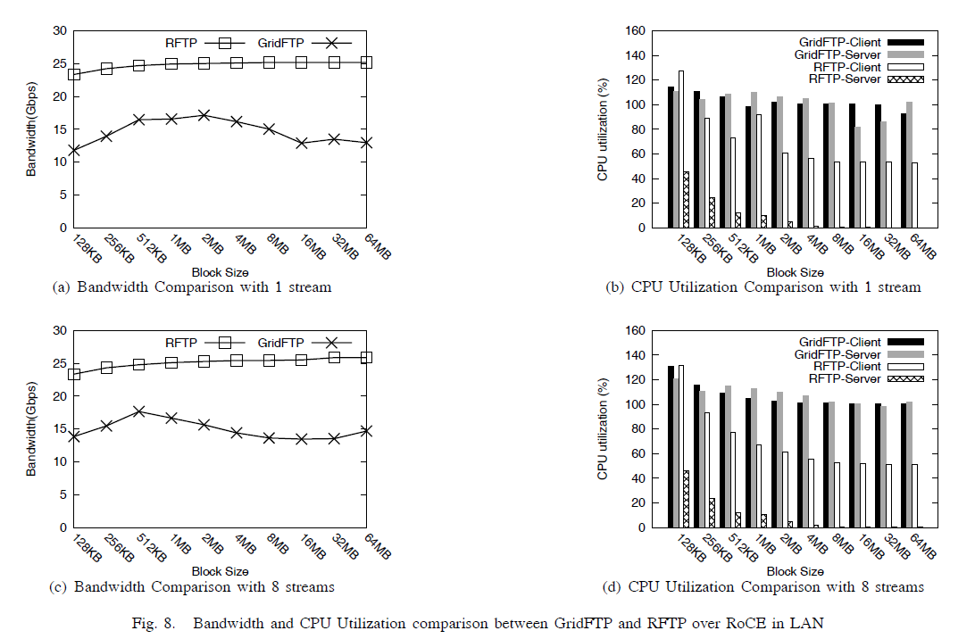
RoCE Results in LAN
Notes:
X-axis is … Y-axis is …
PCI Gen 2
500MB/s per lane, 4Gbps per lane. 8 lanes = 32Gbps
QDR encoding is 8/10
So, 32 * 4/5 = 25.6 Gbps
PCIe 2.0 uses an 8b/10b encoding scheme, therefore delivering an effective 4 Gbit/s max transfer rate from its 5 GT/s raw data rate.

Slide 16
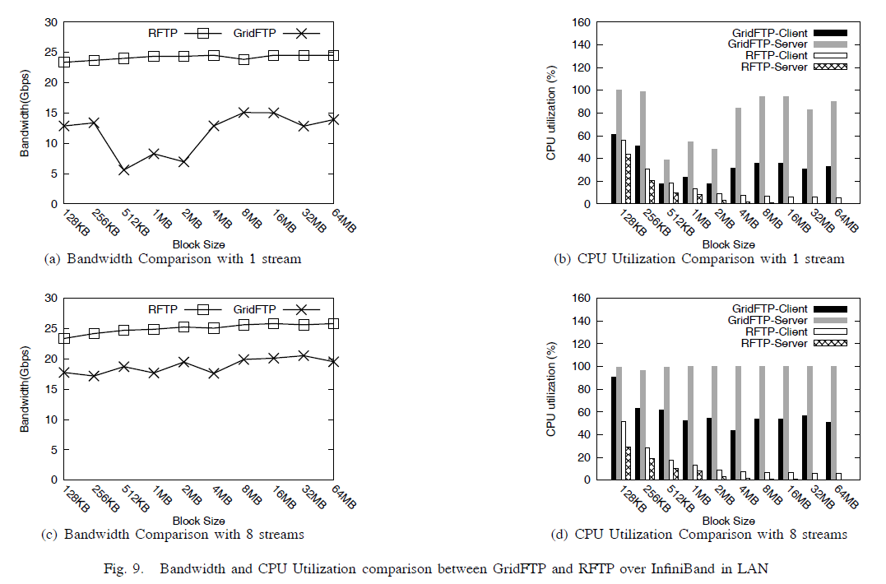
InfiniBand Results in LAN

Slide 17
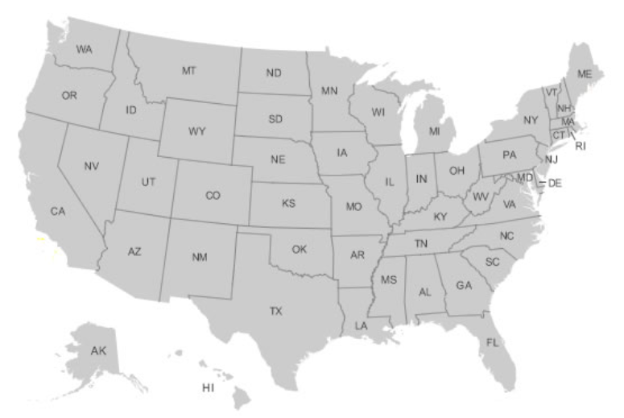
ANI WAN Link
National Energy Research Scientific Computing (NERSC) to Argonne National Laboratory (ANL)
2000 miles away
RTT: 50ms
10Gbps RoCE NIC
Notes:
BDP = 63MB

Slide 18
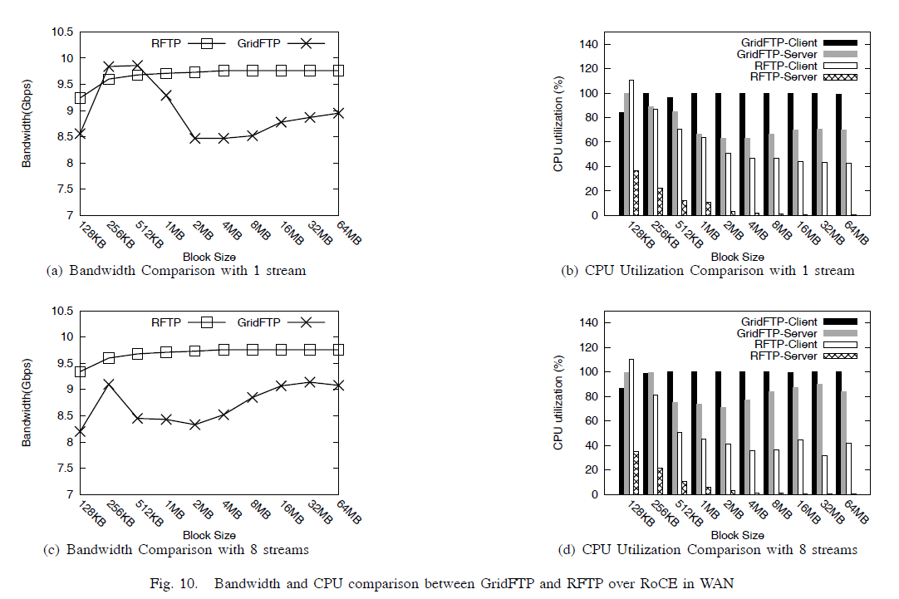
Test results in WAN
Notes:
60MB.
First, RFTP is able to fill up this long fat link and achieves near the link speed.
Second,

Slide 19
Conclusions
Our contributions
The design and performance issues of data transfer tools for high-speed networks such as 40 Gbps Ethernet and InfiniBand.
First study of RDMA based protocol performance in wide-area networks.
ANI testbed experiments and results
Ongoing and future work
100Gbps networks, backend storage systems
* This research is supported by the Office of Science of the U.S. Department of Energy.

Slide 20
Live Data Demo
Mellanox Booth (#1531)
11:45am Wednesday, November 14th
http://ftp100.cewit.stonybrook.edu/sc12
Try RFTP
http://ftp100.cewit.stonybrook.edu/rftp

Slide 21
Thank You

