Slide 1
Deep Learning
NYCU AI college 2026 fall

Slide 2
Overall assignments
Homeworks:
Team projects:
1. Midterm presentation
2. Final project
Pytorch Basic (5%)
Backpropagation (10%)
Image Classification (15%)
Semantic segmentation (15%)
Objects detection (15%)
Sequence to sequence (15%)
Image generation (15%)
Reinforcement learning (10%)
P.S The percentages above indicate the weight of each assignment within homework grade, not within overall semester grade.

Slide 3
HW1:
Pytorch Basic

Slide 4

Why Pytorch :
It widely supports various type of GPU.
Efficient gradient computing.
Big communities.
PyTorch documentation — PyTorch 2.14 documentation
Notes:
deep learning 很多運算會放到 GPU 上，PyTorch 有很完整的 GPU 支援。
之後大家在訓練模型的時候，需要做 backpropagation、計算 gradient。PyTorch 可以幫我們處理這些事情，所以不需要每一層的 gradient 都自己手動推導、自己實作。
PyTorch 現在有非常大的使用者與研究社群，所以大家之後看到很多 paper 的程式碼，也都很常是基於 PyTorch。

Slide 5
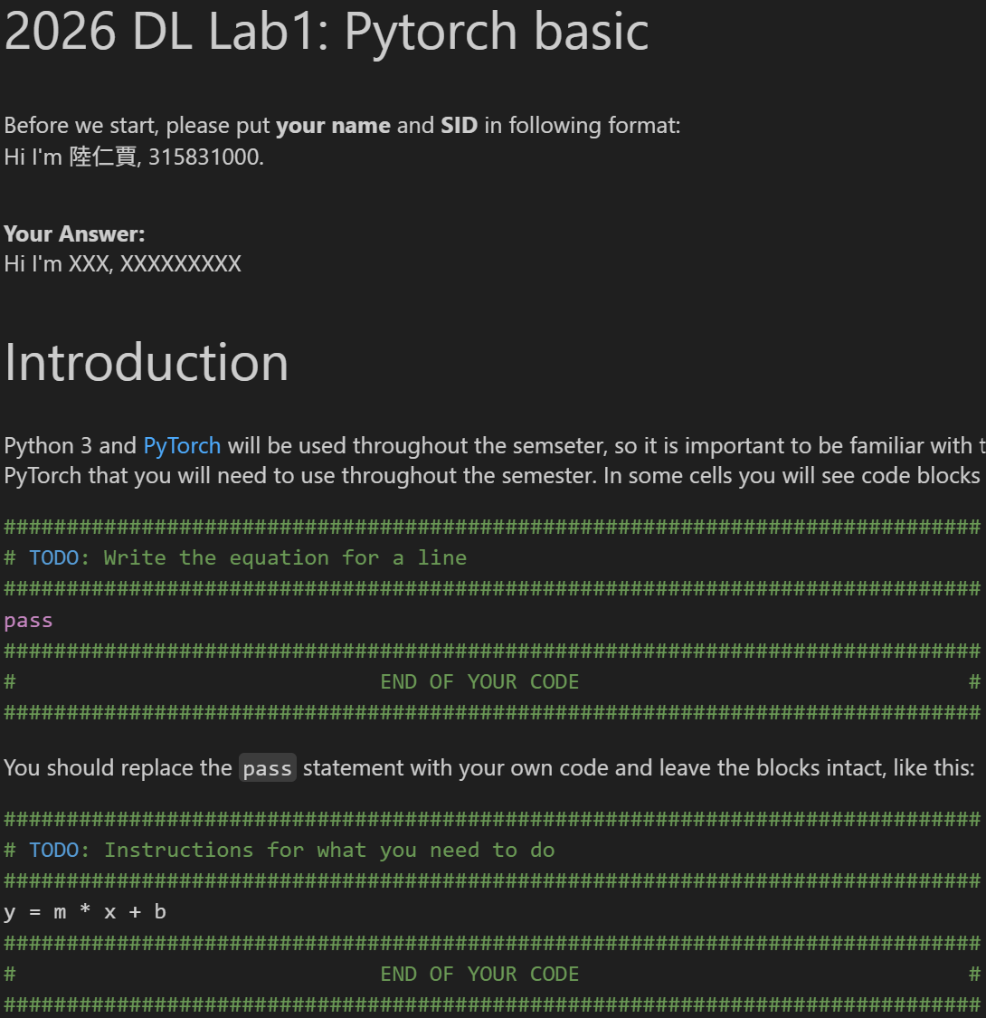



How to do this HW:

Slide 6
Assignment requirements:
Deadline: 9/21 23:59
Only ipynb file is acceptable. Or you will get 0 score.
Please strictly follow the provided code framework.
Do not copy others code.
Hand on Filename : HW1_SID.ipynb
e.g HW1_313831019.ipynb

Slide 7
TAs :
吳仁傑
wljurse.ai14@nycu.edu.tw
李俊彥
jimmyli90719.ai14@nycu.edu.tw
Feel free to email us
or meet up at 224 room, Go Far building.

