Slide 1


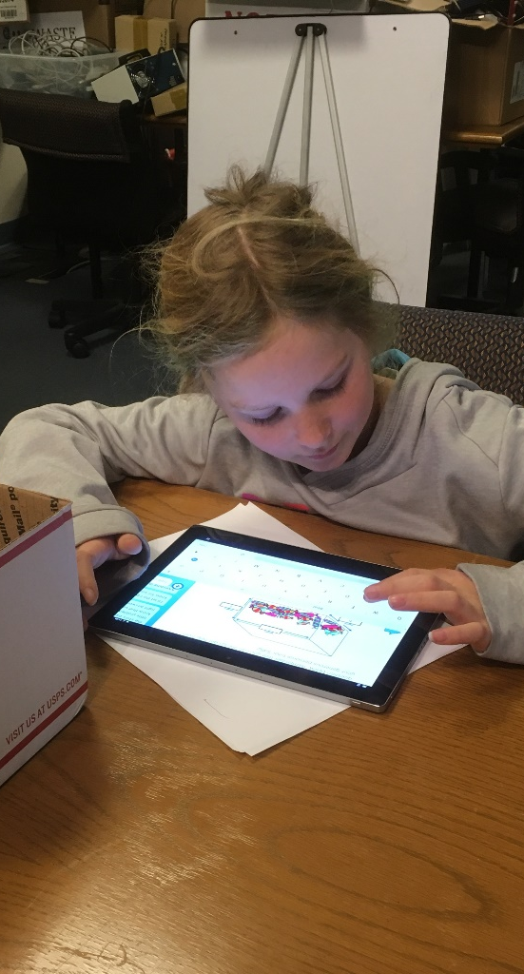
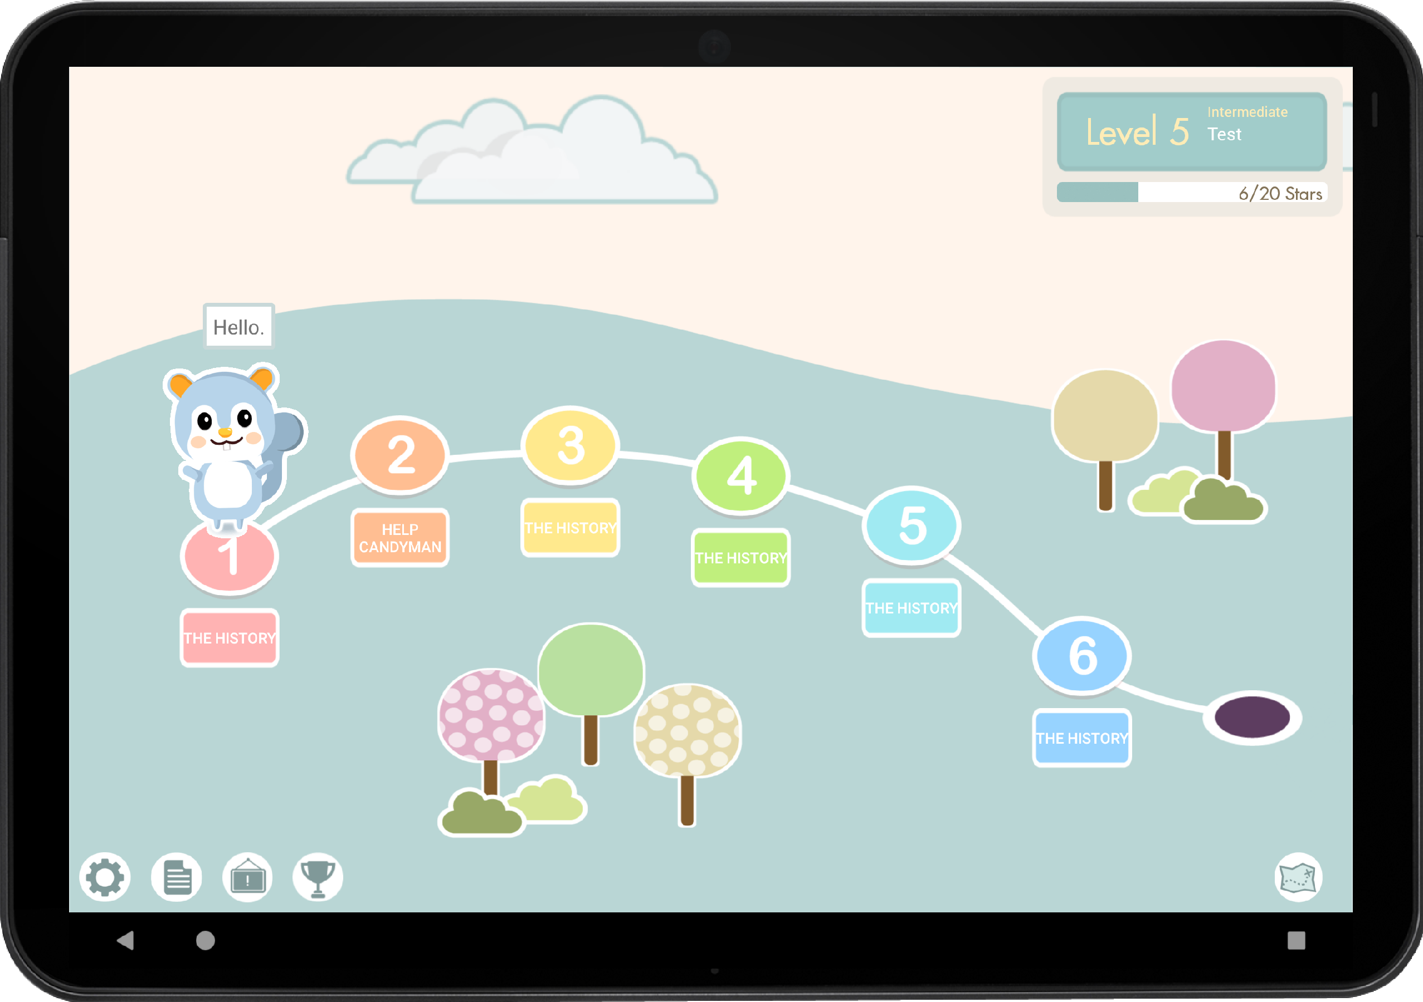
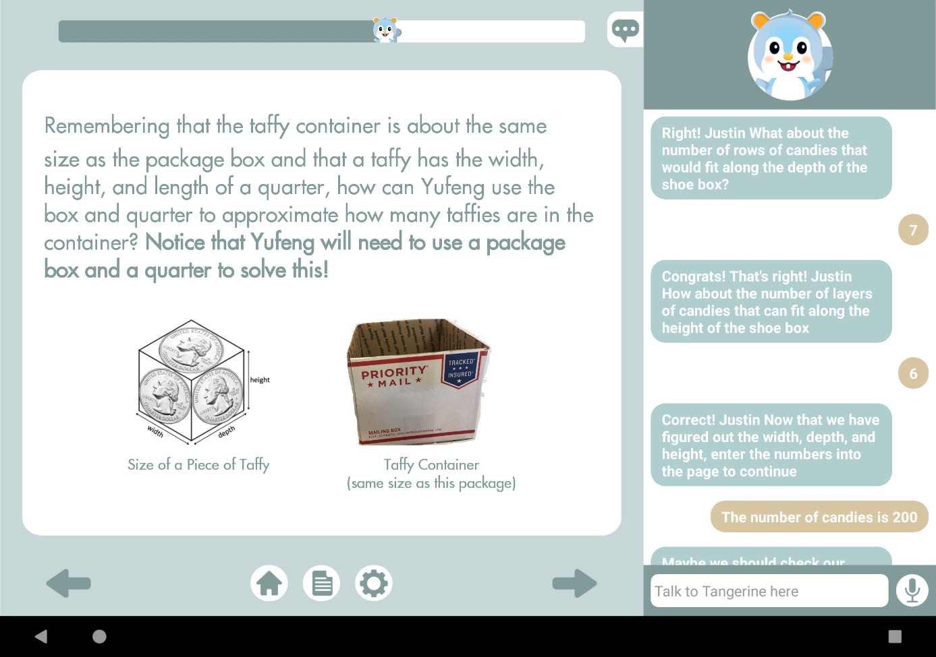
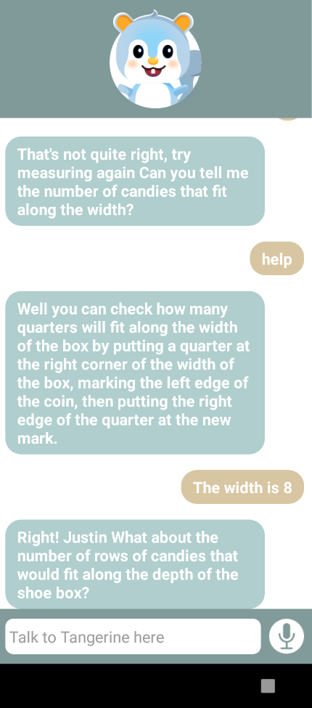

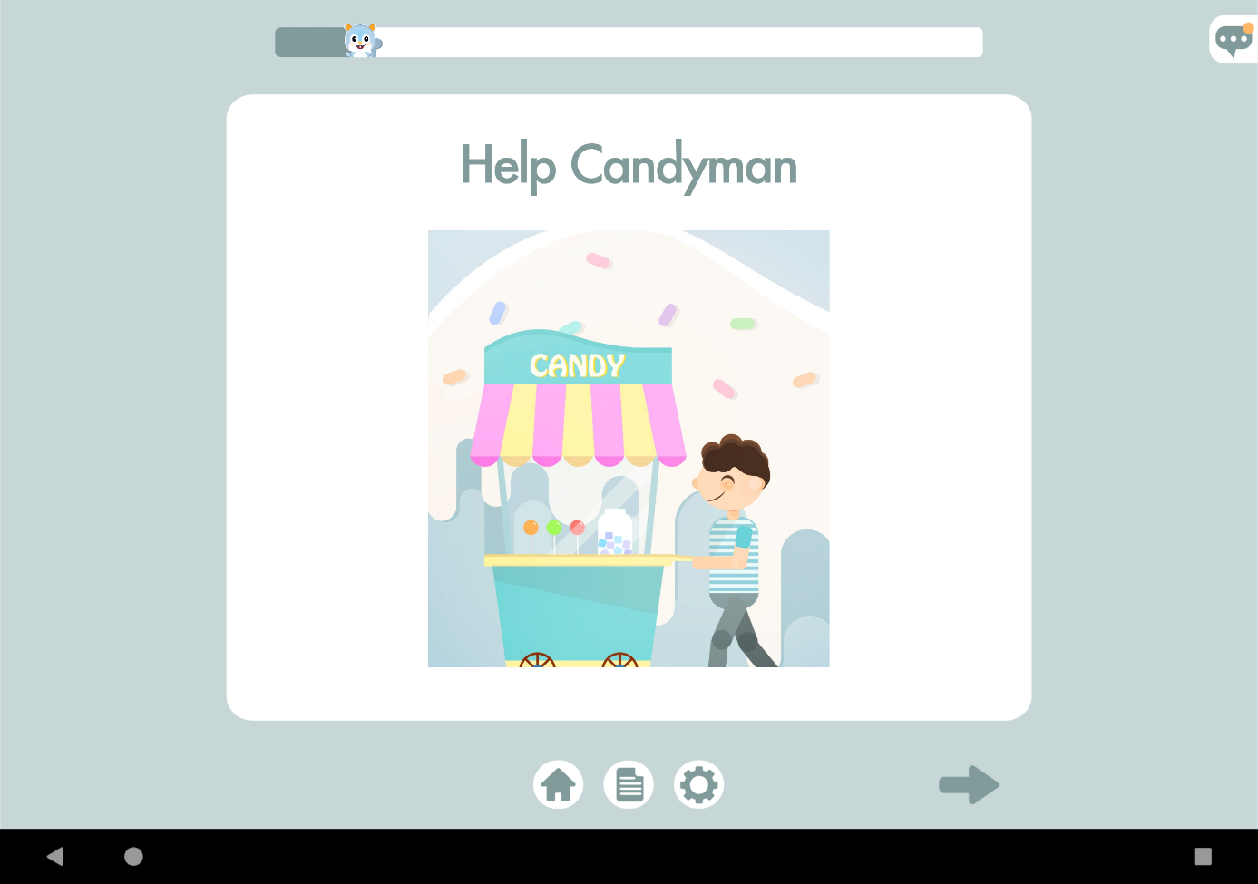
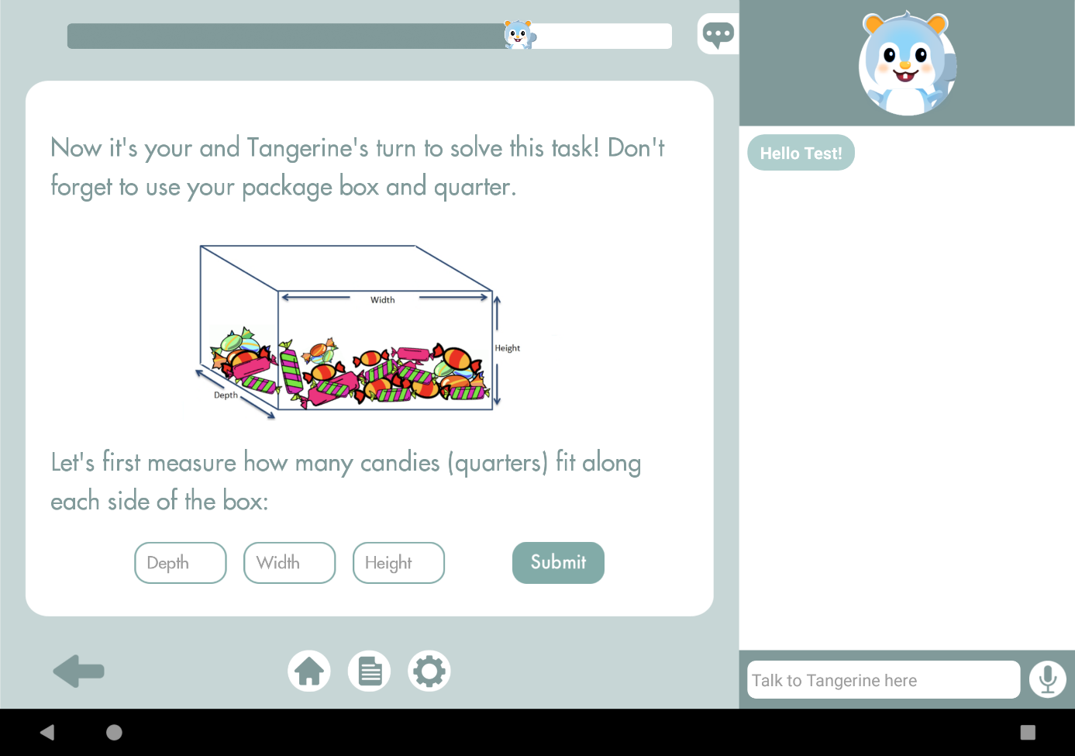
Smart Primer: An Interactive,
Narrative-based Learning System
Yufeng Yin, Dunia Hakim, Anna Wang, Justin Xu, Sherry Ruan, Prof. Emma Brunskill and Prof. James Landay
What is Smart Primer?
Interface Design
AI Chat Bot Design
Neil Stephenson’s The Diamond Age describes a special electronic book.
General Purpose Chatbot - Tangerine’s personality was added to a general purpose conversational agent.
The Smart Primer is a personal tutor using narrative and embedded physical world activities to enhance learning.
Students select missions containing narrative & tasks
Users chat with Tangerine using voice or text. We synthesize a child-like voice to engage users by using Acapela TTS Voices API.
Tangerine guides student to estimate number of candies
Task Assisting Chatbot - Trained the chatbot with user data from pilot studies and dialog scripts to guide users through specific tasks.
The Smart Primer combines a general purpose chatbot, a task assisting chatbot, and speech recognition and synthesis.
Future Work
Tangerine: Chatbot avatar guides learners through tasks
Design more tasks and missions
Establish an achievement and coin system
Recognize emotions to drive learning
Users can focus on reading (left) or chat with Tangerine for guidance (right)

