Slide 1
Smart Primer: An Interactive,
Narrative-based Learning System
Yufeng Yin
Yufeng Yin | Dunia Hakim | Anna Wang | Justin Xu | Sherry Ruan | Prof. Emma Brunskill | Prof. James Landay
Notes:
Hello everyone! I am Yufeng Yin. Tonight I’m gonna show you our summer project: Smart Primer, an interactive, narrative-based learning system.

Slide 2
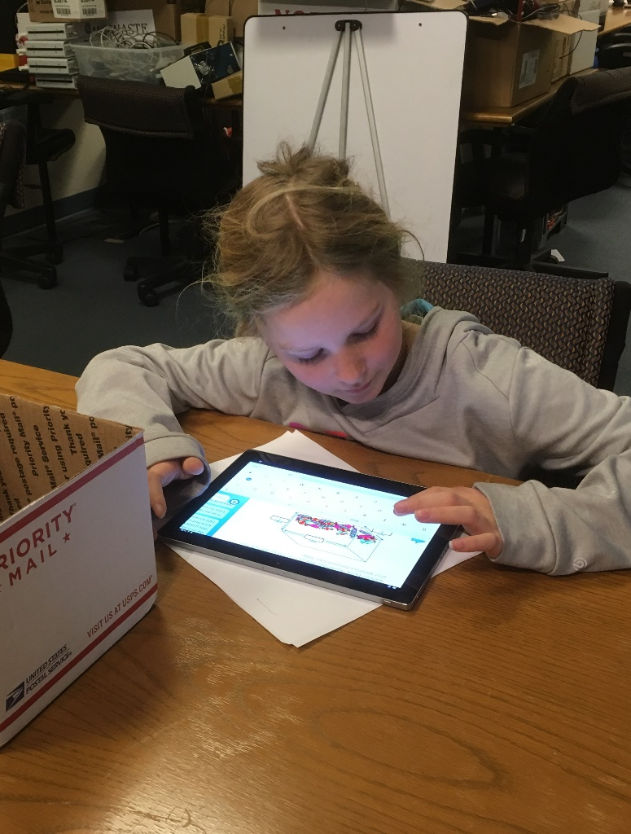
What is Smart Primer?
Neil Stephenson’s science fiction, The Diamond Age: Or, A Young Lady’s Illustrated Primer.
A personal tutor that uses narrative and physical world activities to enhance learning.
Yufeng Yin | Dunia Hakim | Anna Wang | Justin Xu | Sherry Ruan | Prof. Emma Brunskill | Prof. James Landay
Notes:
To begin with, let me introduce what Smart Primer is. The word first appeared in Neil Stephenson’s science fiction, the diamond age. In the story, the author described it as a personal tutor for readers to enhance their learning experience based on narrative explorations. Here is an example. The little girl is using the Smart Primer and you can see she is reading the passage and engaged in learning.

Slide 3

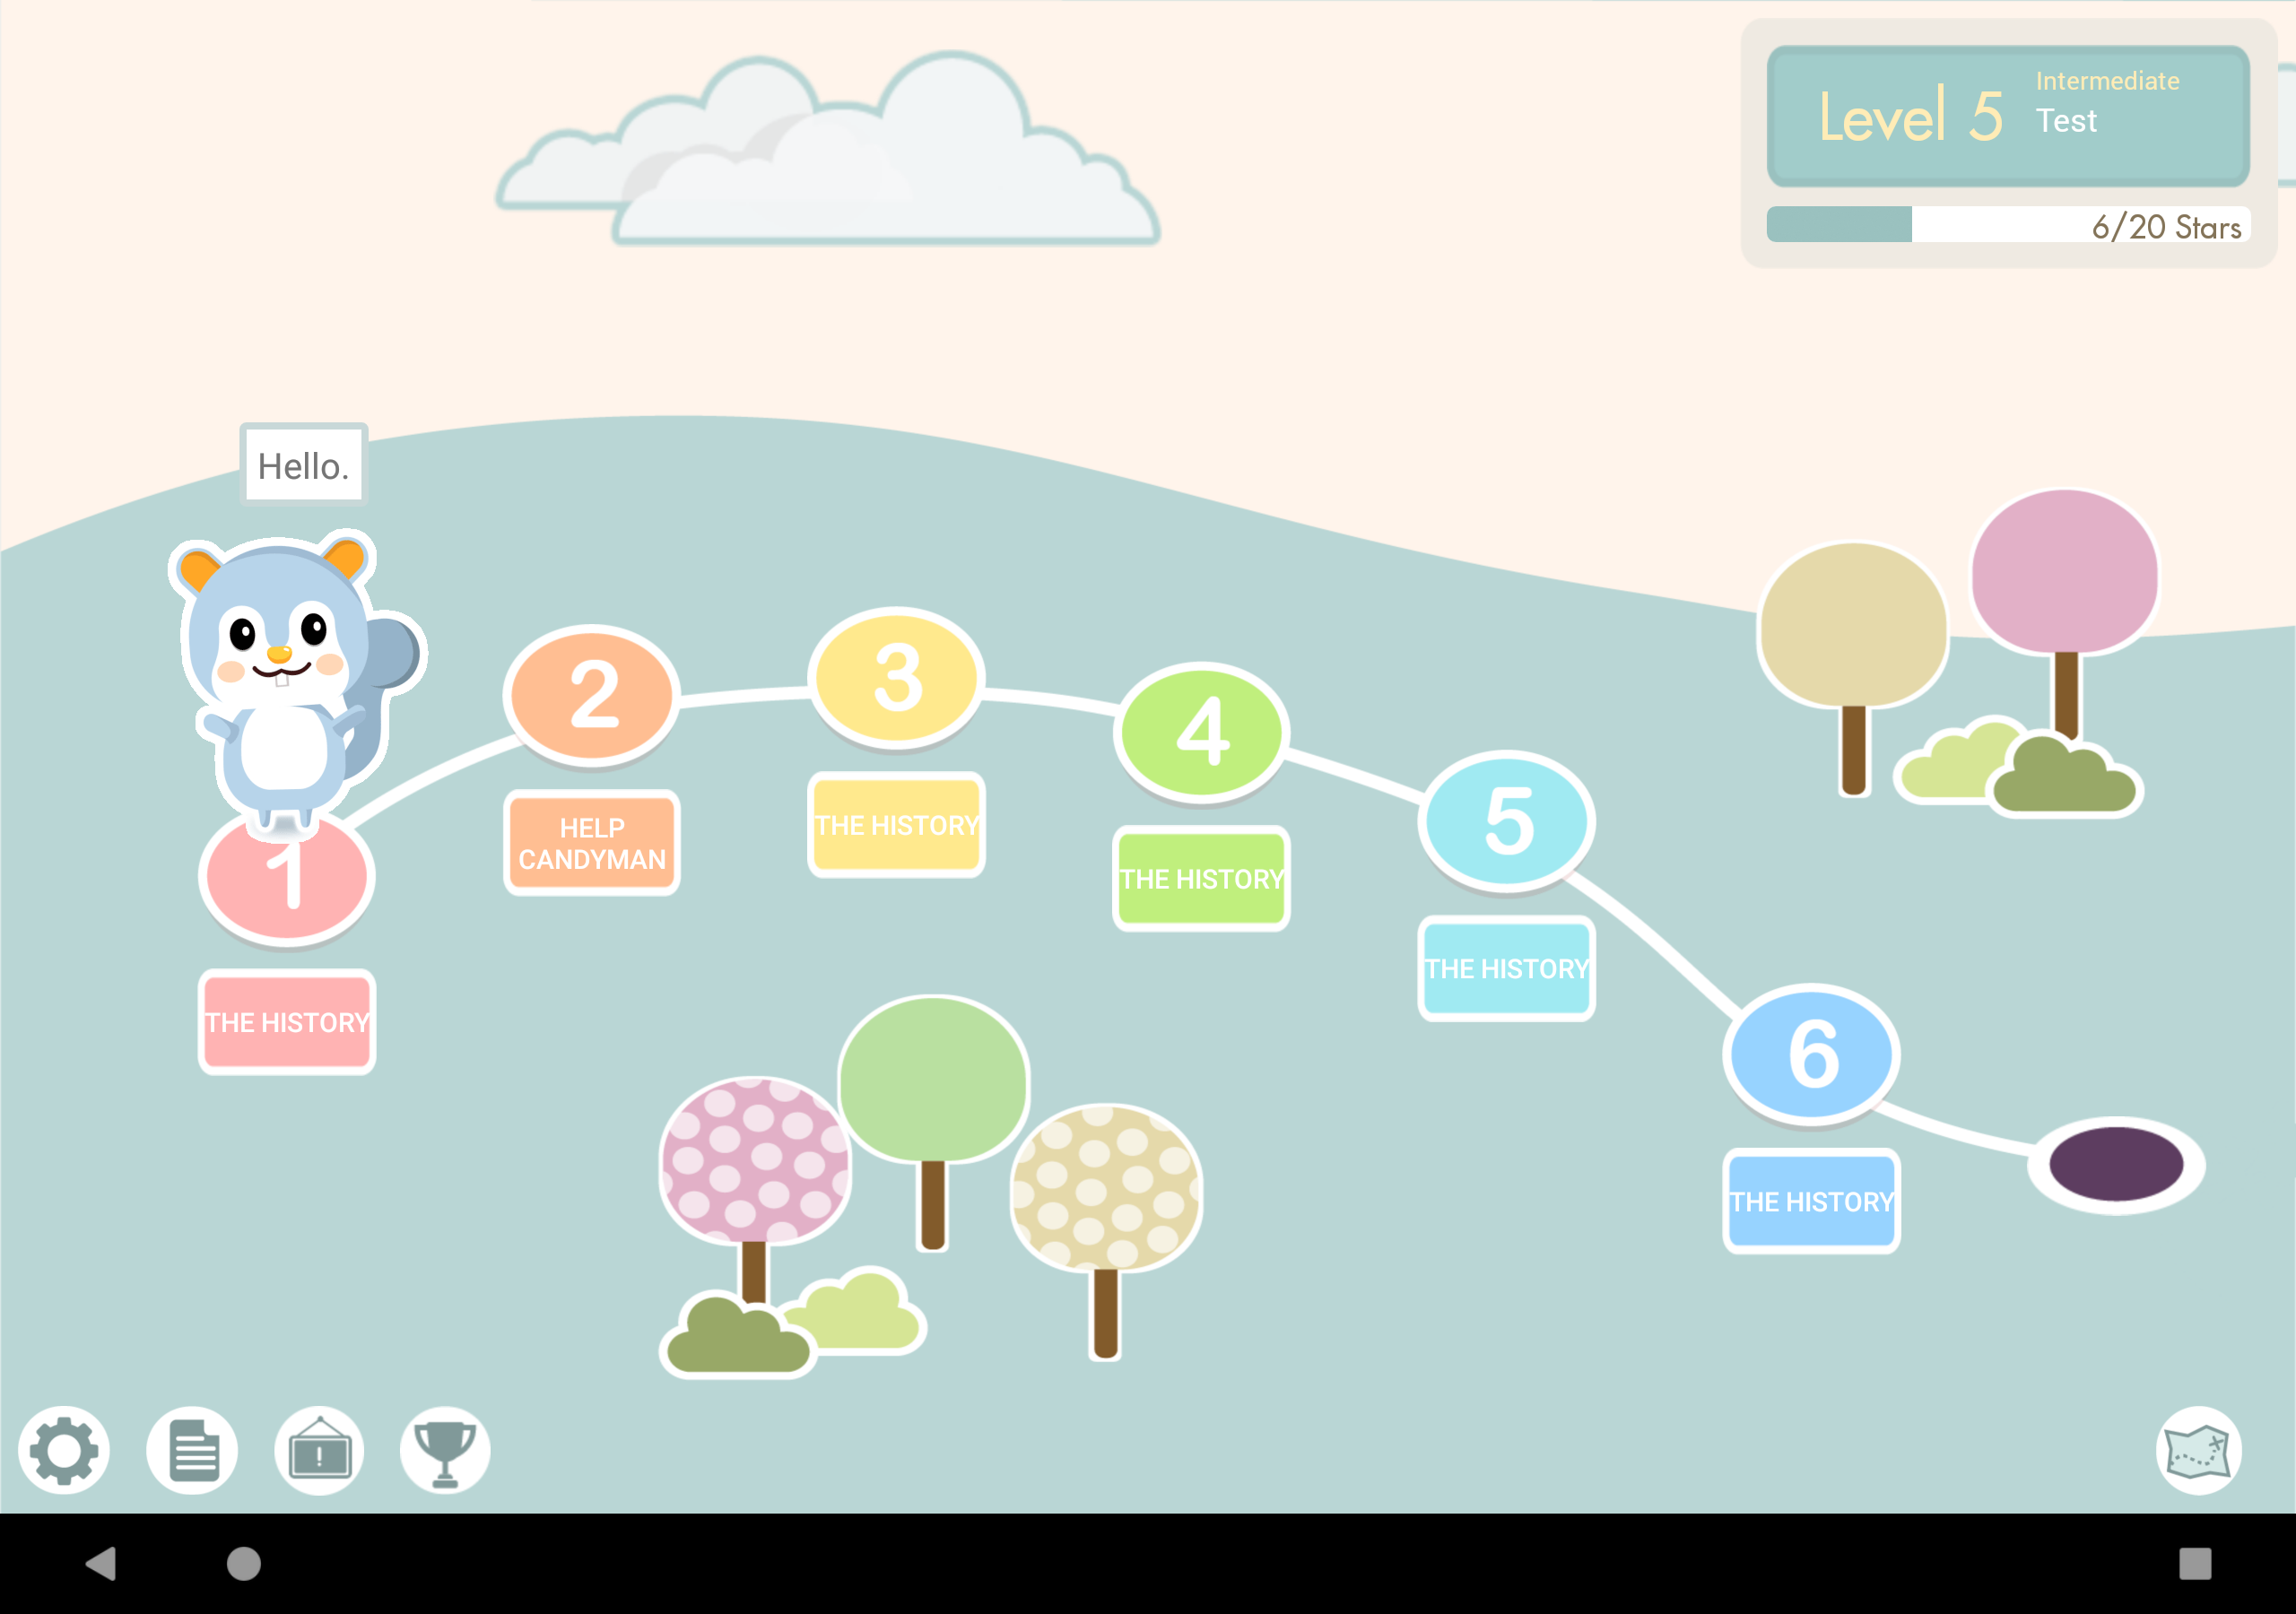
Motivation
Target: 5-year-old to 12-year-old children
Characteristics
Personalized teaching
Interactive learning
Goal: Engaging children in learning earlier on
Yufeng Yin | Dunia Hakim | Anna Wang | Justin Xu | Sherry Ruan | Prof. Emma Brunskill | Prof. James Landay
Notes:
Therefore, inspired by the novel, we want to create the real Smart Primer. We want to create a smart system for young kids to give them personalized teaching and interactive learning. As you can see in the picture, our interfaces are kid-friendly and all of these buttons are touchable. You can even touch the lovely chipmunk and chat with it. Its name is tangerine. The screen shot was taken when I said hi to tangerine and it replied hello.

Slide 4
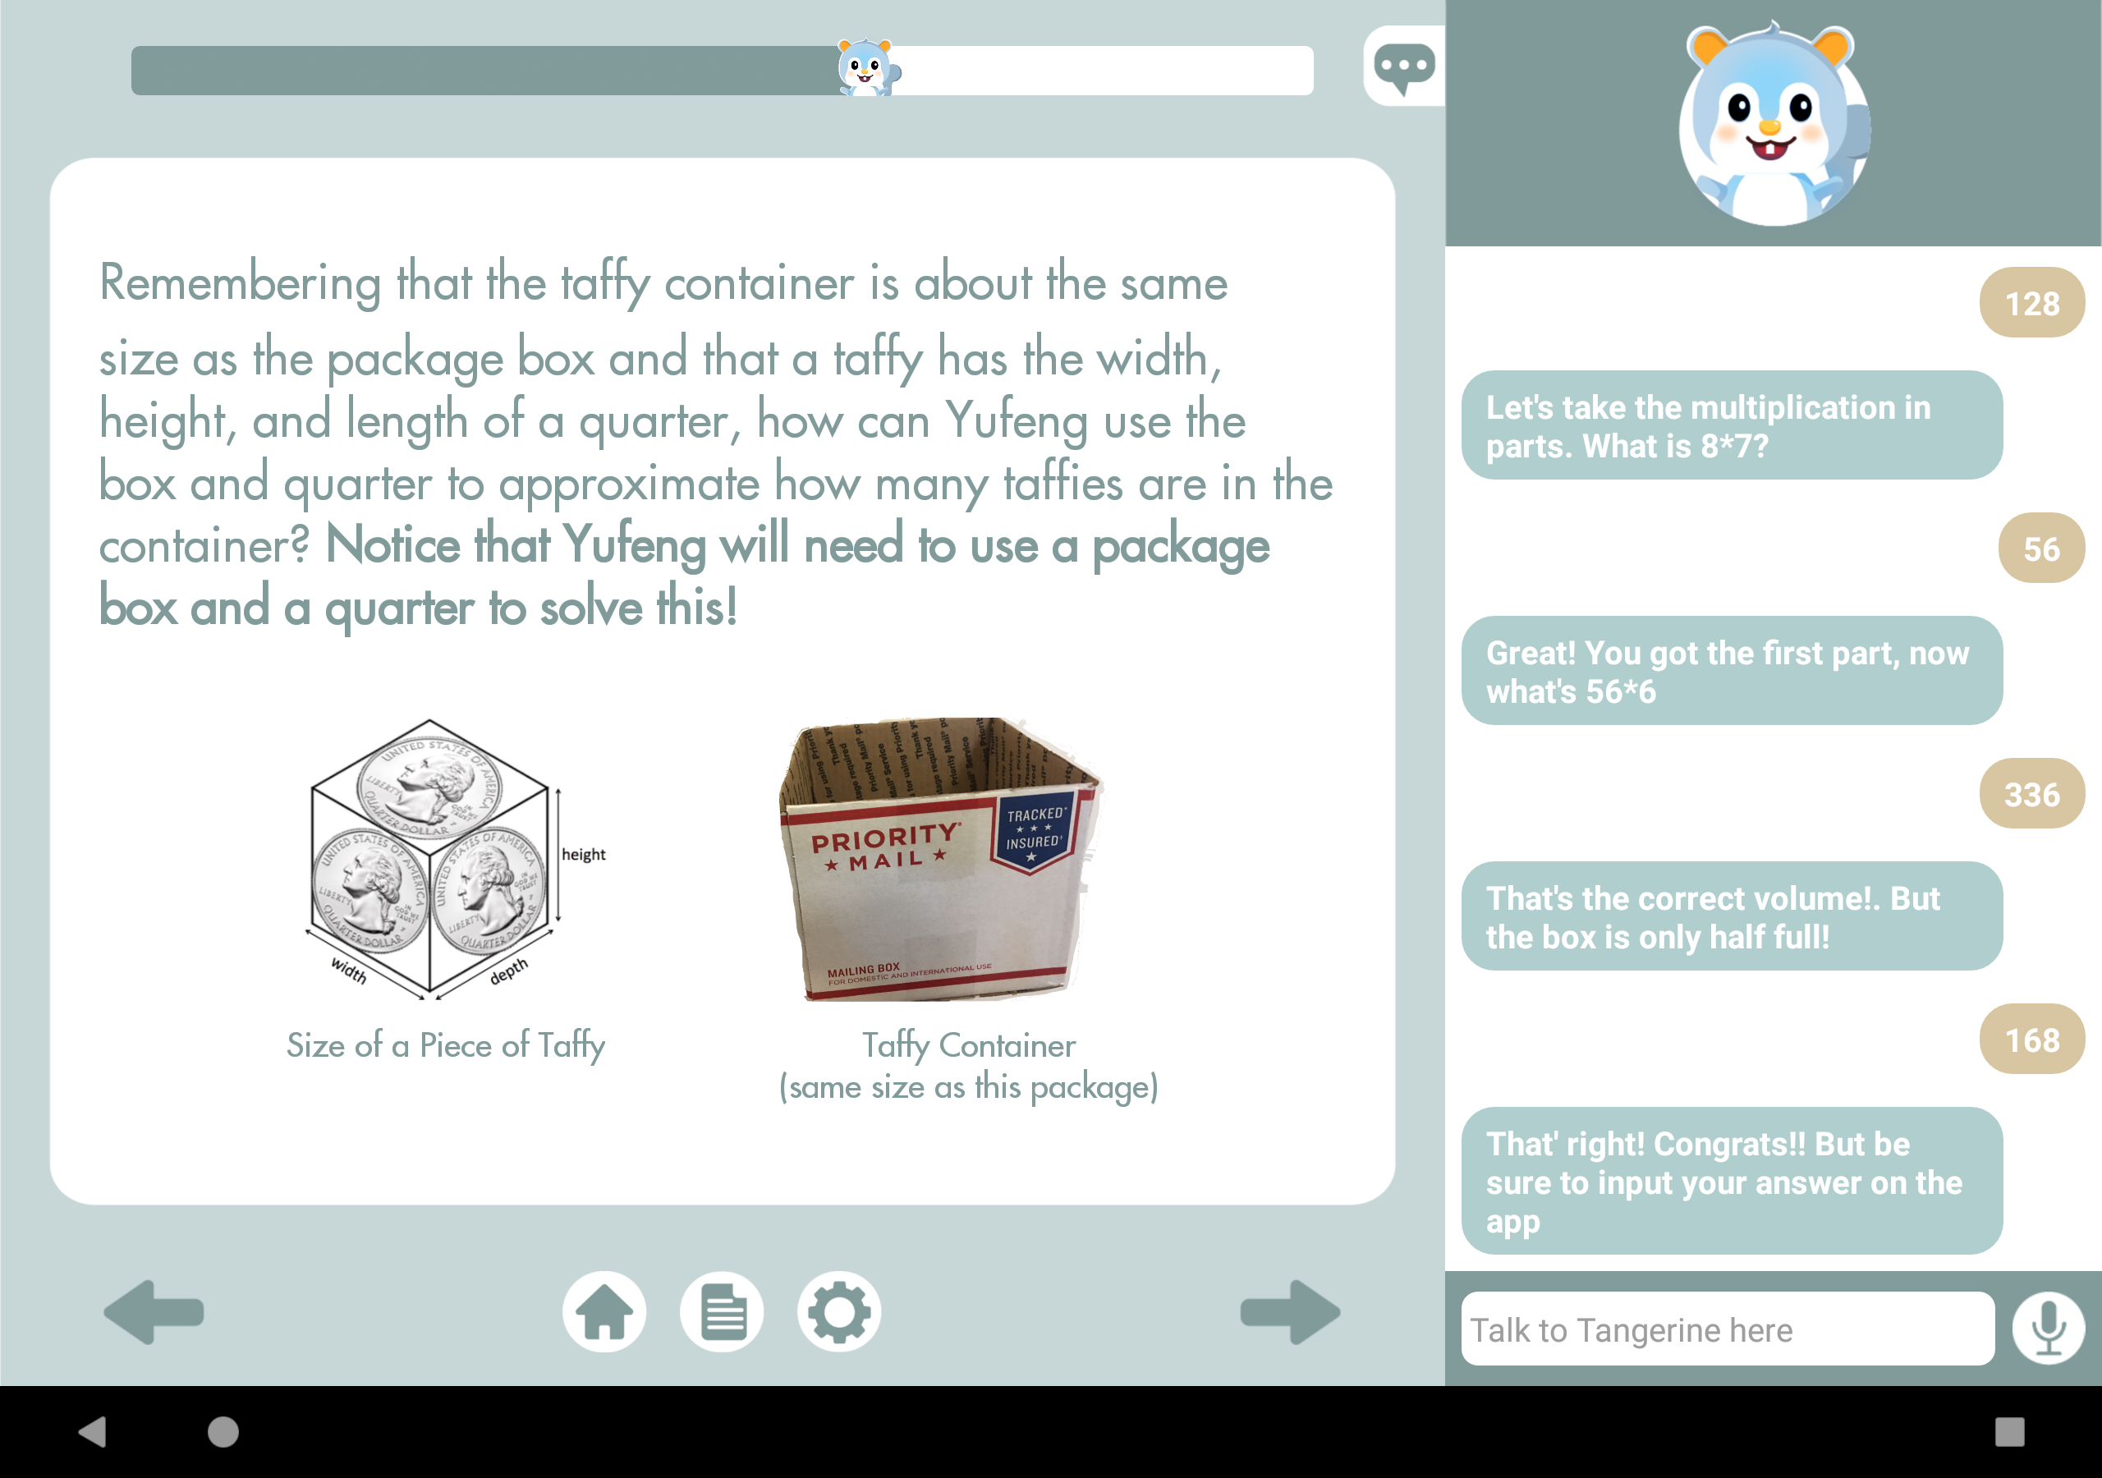
What have we done in this summer?
We implemented a REAL app on the tablet:
General purpose chat bot
Task assisting chat bot
Speech recognition
Speech synthesis
Yufeng Yin | Dunia Hakim | Anna Wang | Justin Xu | Sherry Ruan | Prof. Emma Brunskill | Prof. James Landay
Notes:
So, what we have done in this summer? We actually designed a real app on the tablet. As is shown in the previous page, we have a general purpose chat bot. Also, we have a task assisting chat bot. As you can see in this picture, readers can stay focused on reading or chat with tangerine if they have difficulties and tangerine will guide them through the learning tasks. In addition, you can see here is a microphone button. Users can chat with Tangerine either using voice or text. Moreover, we have speech synthesis function which I think is one of our best features. I bring the tablet running the app today so if you are interested in our project. I hope you can come and see my poster session. My poster number is 14. Thank you!

