Slide 1
Predicting Hospital Readmission Rates Using Machine Learning Algorithms
TEAM 6:
Movses Musaelian
Revathi Bhuvaneswari
Youfei Zhang

Slide 2
Overview
Data Cleaning & Pre-Processing
Model Fitting & Ensembles
Final Model & Results

Slide 3
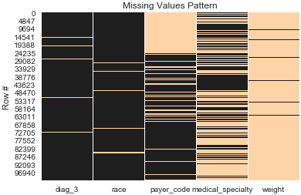
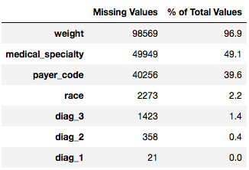
Missing Values
Mode Imputation
Drop Sparse Features

Slide 4
Feature Encoding - General Approach
Numeric
Bin-Counting
Binary Encoding → # Outpatient and # Emergency
Categorical
Ordinal Encoding
Binary Encoding
One-Hot Encoding

Slide 5
Reducing Levels in Categorical Features
 | BEFORE | AFTER
Admission Source ID | 25 | 3
Admission Type ID | 8 | 5
Discharge Disposition ID | 30 | 4
Diagnosis - 1 | 717 | 10

Slide 6
Cleaning Remarks - 23 Medications Features
Keep 14 Medications
Feature Engineering
# Changes → ‘Up’ + ‘Down’
# Medications → ‘Steady’ + ‘Up’ + ‘Down’
Special Encoding Scheme:
 | NO | STEADY | UP | DOWN
CODE | 0 | 1 | 2 | 3

Slide 7
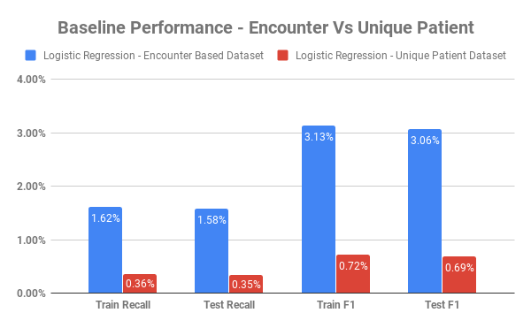
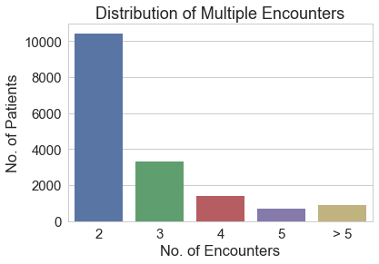
Encounters Vs. Unique Patients

Slide 8
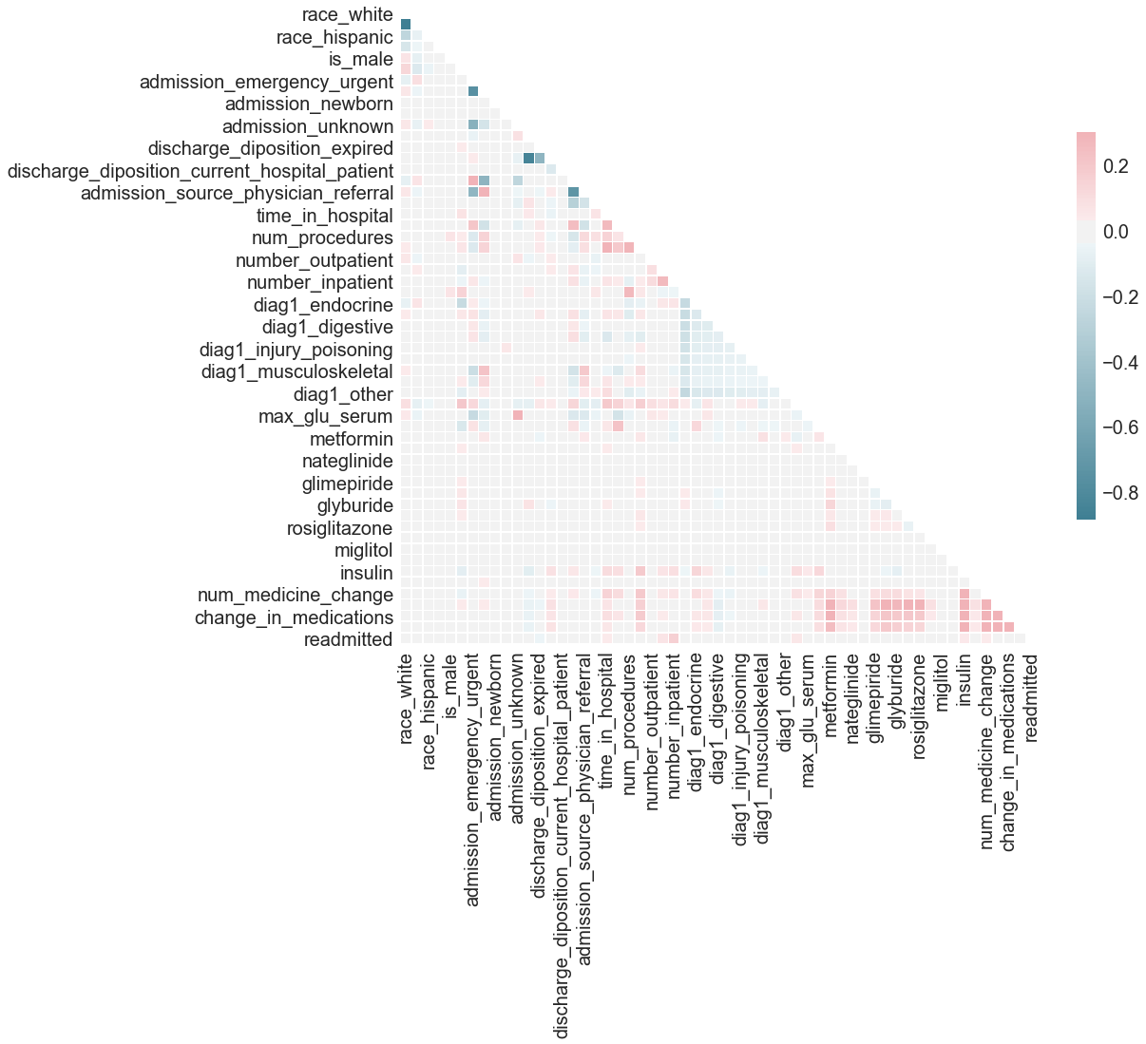
Final Cleaned Dataset
101, 766 Instances
56 Features
1 Target Variable

Slide 9
Parameter Tuning & Feature Selection
Grid Search
Optimize for ‘balanced accuracies’ and ‘recall’
Filter Feature Selection
PCA
Random Forest Feature importance

Slide 10
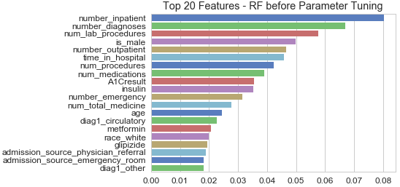

Slide 11
Imbalance Data Treatment
Under/Over Sampling
SMOTE
Optimization in Tuning -> imbalanced data and context leads to our objective for a robust model

Slide 12
Ensemble Modelling Approaches
Soft/Hard Majority Voting
Hard Voting with Logistic Regression
Custom threshold approach with Logistic Regression
𝌀𝌀𝌀
Candidate Model Construction
Itertools.combinations → gather all possible ensembles
Test candidate ensembles with differing settings (Baseline/Sampling Type/Normalization)

Slide 13
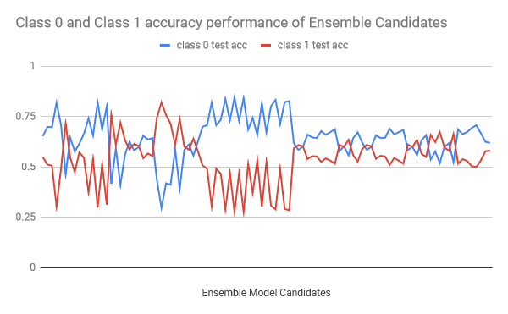

Slide 14
Final Chosen Model
Our final ensemble model contains:
Multinomial Naive Bayes,
Gradient Boosting,
Random Forest
with hard majority voting
no normalization or sampling applied to the data
using just the 38 important features obtained from RF
Confusion Matrix |  | Predicted
 |  | Class 0 | Class 1
Actual | Class 0 | 53,327 | 37,082
 | Class 1 | 4,476 | 6,881
 | Train | Test | class_0_test | class_1_test
Accuracy | 59.4% | 59.2% | 59.0% | 60.6%
Recall | 61.6% | 60.6% | 59.0% | 60.6%
Precision | 15.9% | 15.7% | - | -
F1 | 25.3% | 24.9% | - | -
ROC | 60.3% | 59.8% | - | -

Slide 15
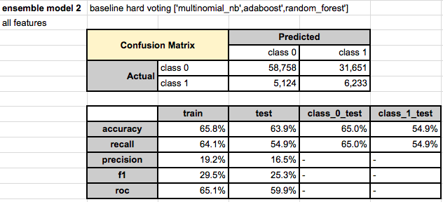
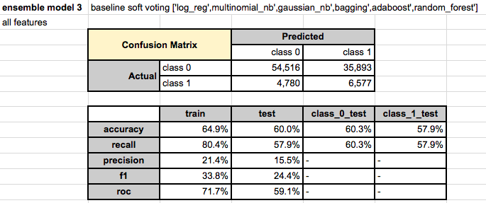
Optimization Goal
Problem Context:
The Centers for Medicare and Medicaid Services announced that they would no longer reimburse hospitals for services rendered if a patient was readmitted with complications within 30 days of discharge.
no-information classifier: ~88% of class 0
Balanced result for train and test
Balanced accuracy for class 1 and class 0 that is better than random guessing (there is signal captured)

Slide 16
Concluding Remarks & Lessons Learned
Maximisation of accuracies for both class 1 and class 0 at stable level, with no overfitting issues
Difficult to increase balanced accuracy of both classes given an imbalanced data
Parameter tuning must reflect model objective

Slide 17
Thank You!
Questions?

