Slide 1

Computer-Intensive Statistics in R: Bootstrapping and Permutation
Thanks go to John Fox’s CAR Appendix & Thomas Lumley lecture for help creating this presentation

Slide 2
Traditional inference
From any sample, we can figure only one of each statistic Ω (mean, var, max, cor, t, F, AIC, etc.)
What we don’t know is information on the distribution of Ω (e.g., shape, variance, skewness, etc.)
Using mathematical proofs that 99.9% of users do not understand, traditional inference infers the distribution of Ω given that certain assumptions are met; typically:
  Independence of residuals
  Normality of residuals
  Equality of variance of residuals across y-hat

Slide 3
Traditional inference, cont.
Centering the sampling distribution around null gives the % of Ω’s that would be this big or bigger given the null (p-values)
Centering the sampling distribution around the observed statistic gives a likely range of Ω’s (the confidence interval)

Slide 4
Violation of linear model assumptions
Assumption | Effect if violated
Independence of residuals | Incorrect degrees of freedom; variance and covariance of sampling distributions are biased, but point estimates are unbiased
Normality of residuals | Unbiased point estimates, but the shape of the sampling distribution may not follow assumed distribution. Not important if n is large.
Equality of variance of residuals across y-hat | The variance and covariance of sampling distributions are biased
Statistics follow the t-, F-, chi-square, z-, etc.. distributions given the above assumptions, which can be difficult to test and often are violated.

Slide 5
Limitations to traditional inference
p-values and confidence intervals are suspect when assumptions are violated
The sampling distribution of Ω is often unknown and prohibitively difficult to derive
  What is the sampling distribution of:
    The time since most recent common ancestor of all humans?
    The adjusted R-squared?
    The AIC?
    The beta coefficient when independence is violated?
    The number of connections in a neural net?
    The eigenvalues of PCA?
    A bifurcation point in a phylogenetic tree?
  Answer: no one knows!

Slide 6

Enter the bootstrap!
B

Slide 7

The bootstrap
The bootstrap seeks to find the distribution of any possible Ω
  without assumptions about the population distribution
  without deriving the sampling distribution explicitly
  only from knowledge of the sample itself; i.e., the sample pulls itself up by its bootstraps

Slide 8

“Pulling oneself up by one’s bootstraps”
“I found myself stunned, and in a hole nine fathoms under the grass, when I recovered, hardly knowing how to get out again. Looking down, I observed that I had on a pair of boots with exceptionally sturdy straps. Grasping them firmly, I pulled with all my might. Soon I had hoist myself to the top and stepped out on terra firma without further ado." -- Campaigns and Adventures of Baron Munchausen, 1786.

Slide 9
How the bootstrap works
Take a sample S₁* of size n from your original sample S with replacement
  If you sampled without replacement, you’d just recreate S
Calculate your statistic of interest, Ω*₁
Repeat the two steps above many (t) times, each time saving Ω*_{1…t}
The distribution of the t Ω*’s is a good estimate of the true distribution of Ω

Slide 10
How the bootstrap works
(cont.)
Once the distribution of Ω* is found, use it as you would use any sampling distribution
  To find “empirical p-values”: the percent of absolute Ω*’s as big or bigger than the one observed if the null is true. Note that there is a complication to this (later).
  To construct “bootstrapped confidence intervals”: the two extreme values that 2.5% of Ω*’s are above or below

Slide 11
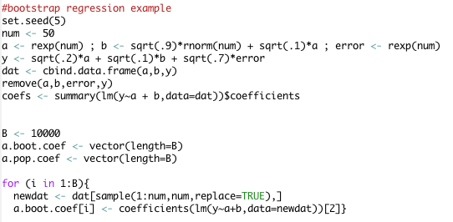
Example R Code
Setting up the problem (simulation)
bootstrapping

Slide 12

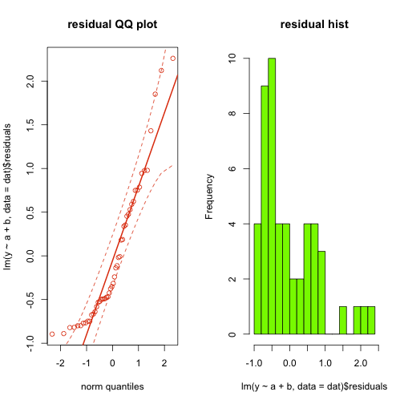
Non-normal residuals

Slide 13
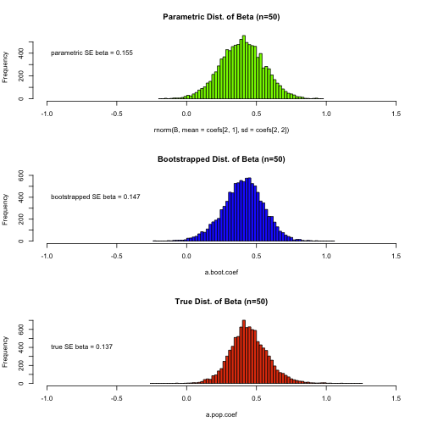
Parametric vs. bootstrap vs. true

Slide 14
The key assumption
The bootstrap is nearly assumption free. The key assumption is that the distribution of your sample, S, is a close approximation to the population distribution.
  Tends to be true as n becomes large
  But if n is small, this is precisely when violations of assumptions for traditional statistics matters most
  The bootstrap has been criticized on these grounds: it can’t help us precisely when we need it most!
  In my view, this misses the point: inference will always be suspect for small samples. No statistical hocus-pocus can make that go away. But the bootstrap obviates the need for assumptions that had to be made before modern computing, and it allows us to estimate heretofore unknowable sampling distributions.

Slide 15

The devil in the (bootstrapping) details
There are several complications re bootstrapping that we should touch on:
  Problems with getting good confidence intervals
  Alternative to sampling cases
  Statistics not to bootstrap
  Problems with getting valid p-values

Slide 16
Getting good bootstrapped confidence intervals
Good CI’s will contain the true Ω 95% of time and have 2.5% in each tail
While the approach described above for finding CI’s empirically is intuitively appealing, it can be inaccurate when estimated Ω is biased, when Ω* is skewed, or when n is small
  E.g., figuring the median with small samples will lead to a discrete, skewed sampling distribution

Slide 17
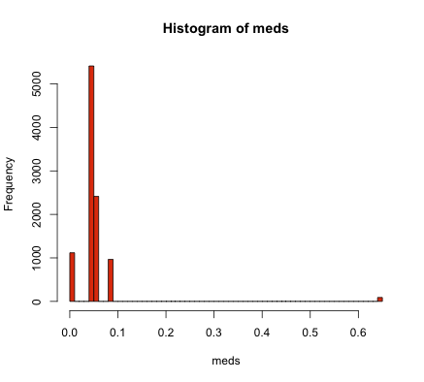
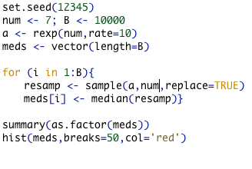

A bad bootstrapped CI
11%
1%

Slide 18
How to get good bootstrapped confidence intervals
Normal-theory interval: use the bootstrap only to get the standard error of Ω; assume normality to construct the CI
  Works well in precisely the circumstances where we don’t need the bootstrap!
Bias-corrected, accelerated (BCa) percentile intervals: corrects for the bias and skewness of Ω - shown to work well and is widely used
Note: once again, nothing helps small samples

Slide 19
Alternative to sampling cases
Sampling cases can introduce error in fixed designs. E.g., in a 2x2 experiment, equal n’s in each cell ensure effects are independent. Random sampling of cases will destroy this orthogonality
To deal with this and other fixed-x designs, only resample residuals:
  Find y-hat and residual for each case
  Keep the model matrix X the same, and randomly sample residuals, adding them to y-hats associated with each x_{i} to create new y_{i}*’s.
  Find Ω* based on these y_{i}*’s. Repeat many times
This resamples the random aspect of X and retains the fixed aspect of X

Slide 20
Not all statistics behave well when bootstrapped
Many Ω’s “work well” (give good CIs and inferences) in bootstraps: means, variances, typical inferential stats, eigenvalues, etc.
Some Ω’s require larger n’s to work well: medians, percentiles
Some Ω’s don’t work well at all: min, max, unique values
How to know which ones will work? The higher the variance and skewness of Ω, the less well bootstraps work. You might try simulating to get an idea about these.

Slide 21
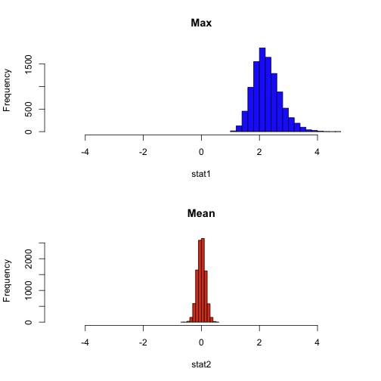
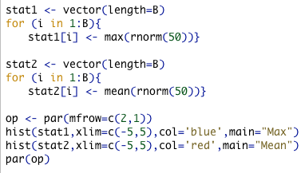
Distribution of the max versus the mean

Slide 22
Getting valid p-values
Before, we said to recenter the distribution around the null. Assuming that your observed Ω is above the null value:
  p = 2 % of recentered Ω*’s > observed Ω.
  OR p = % of recentered Ω*’s > |observed Ω|
The problem: this assumes that your sampling distribution doesn’t change when recentered around the null.
  This is the case for some distributions (normal, chi-square)
  This is not always the case (e.g., some distributions have mean-variance relationships)
  What to do when we want nonparametric p-values?

Slide 23

Enter the permutation test!
P

Slide 24

The permutation test
The permutation test attempts to find the appropriate null distribution of Ω by destroying the appropriate dependency between X & Y
Traditionally, this is done by finding every permutation (matching) of X & Y and finding the % of Ω*’s greater than that observed
In practice, most people take a large number of random samples without replacement, each sample simulating the null
But sampling with replacement works fine too

Slide 25
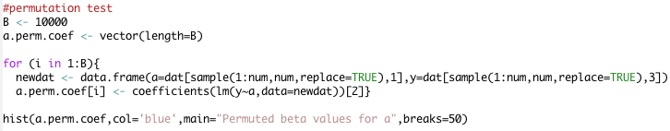
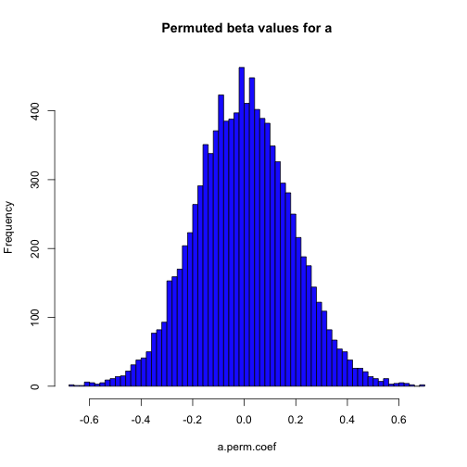
Example of the permutation test

Slide 26
The devil in the (permutation) details
There are important complications re permutation that we should touch on:
  Difficulties with exchangeability of the x variable
  Difficulties in simulating your data under the null hypothesis

Slide 27
Exchangeability
Permutation works by mixing the labels of x, scrambling the relationship between x & y.
Exchangeability means that exchanging the x labels will maintain all aspects of X (e.g., inter-relationships within X; stratification, etc.) except for x’s relationship with y
  Easy for t-tests, ANOVA, simple regression
  More involved for multiple regression, stratified samples

Slide 28
Exchangeability: simple regression & t-tests
Two-sample permutation just involves permuting which group each observation is in
The two-sample permutation test will not violate the exchangeability assumption unless
  There are distributional (variance, skewness) differences between the two groups
Similarly, in a regression context, we must assure that residuals are homoscedastic
Such strong assumptions lessen the appeal of permutation testing

Slide 29
Exchangeability: multiple regression
In a multiple regression, exchangeability is violated if the variable of interest (x_{P}) is simply permuted because it destroys the inter-relationships between the X variables
One solution: to find the significance of partial slope of x_{P}, first residualize y and x_{P} (controlling for all other variables), then permute x_{P} as in simple regression.

Slide 30
Exchangeability: stratified samples and dependencies
If dependencies exist in your data (e.g., twins exist, sampling is stratified, etc), simple permutation will destroy these relationships, leading to false null distributions
One solution: keep the stratification intact; permute within each strata for individual-level tests and between strata for higher-level tests.
  This can become very difficult or intractable

Slide 31
Simulating data under the null
Permutation is often far trickier than bootstrapping because
  the user must identify the correct null hypothesis
  Figure out how to rearrange their data to simulate the null
In more complicated designs or with more complicated null hypotheses, this becomes difficult or intractable.
HW example to follow…

Slide 32
R packages
boot - has more options; more up-to-date
bootstrap - by the original founder of bootstrapping, Efron
For our HW, we won’t use these. Rather, for the purpose of understanding bootstrapping, we’ll use base R. If you want options like BCa Confidence Intervals, use the packages above.

Slide 33
Summary
When assumptions are violated, resampling techniques can provide more accurate sampling distributions
More importantly, resampling techniques allow estimations of sampling distributions that otherwise cannot be found
This isn’t a free lunch: they work less well for some statistics, it can be difficult to construct proper CI’s, and it can be very difficult to construct proper null distributions.

