Slide 1
Bootstrap and Cross-Validation

Slide 2
Review/Practice:
What is the standard error of…?
And what shape is the sampling distribution?
A mean?
A difference in means?
A proportion?
A difference in proportions?
An odds ratio?
The ln(odds ratio)?
A beta coefficient from simple linear regression?
A beta coefficient from logistic regression?

Slide 3
Where do these formulas for standard error come from?
Mathematical theory, such as the central limit theorem.
Maximum likelihood estimation theory (standard error is related to the second derivative of the likelihood; assumes sufficiently large sample)
In recent decades, computer simulation…

Slide 4
Computer simulation of the sampling distribution of the sample mean:
1. Pick any probability distribution and specify a mean and standard deviation.
2. Tell the computer to randomly generate 1000 observations from that probability distributions
  E.g., the computer is more likely to spit out values with high probabilities
3. Plot the “observed” values in a histogram.
4. Next, tell the computer to randomly generate 1000 averages-of-2 (randomly pick 2 and take their average) from that probability distribution. Plot “observed” averages in histograms.
5. Repeat for averages-of-10, and averages-of-100.
Notes:
IF the true mean was 128 with an average variability of 15 lbs….

Slide 5
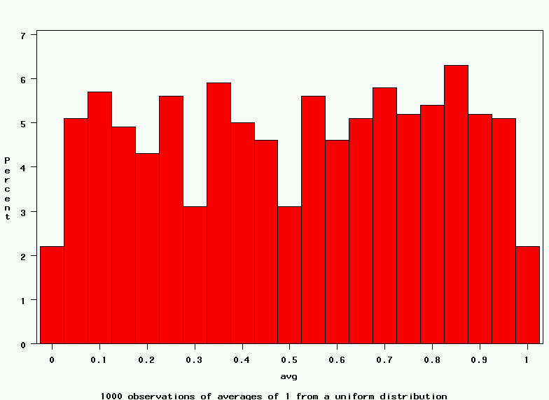
Uniform on [0,1]: average of 1
(original distribution)
Notes:
It turns out that if you were to go out and sample many, many times, most sample statistics that you could calculate would follow a normal distribution.
What are the 2 parameters (from last time) that define any normal distribution?
Remember that a normal curve is characterized by two parameters, a mean and a variability (SD)
What do you think the mean value of a sample statistic would be? The standard deviation?
Remember standard deviation is natural variability of the population
Standard error can be standard error of the mean or standard error of the odds ratio or standard error of the difference of 2 means, etc. The standard error of any sample statistic.

Slide 6
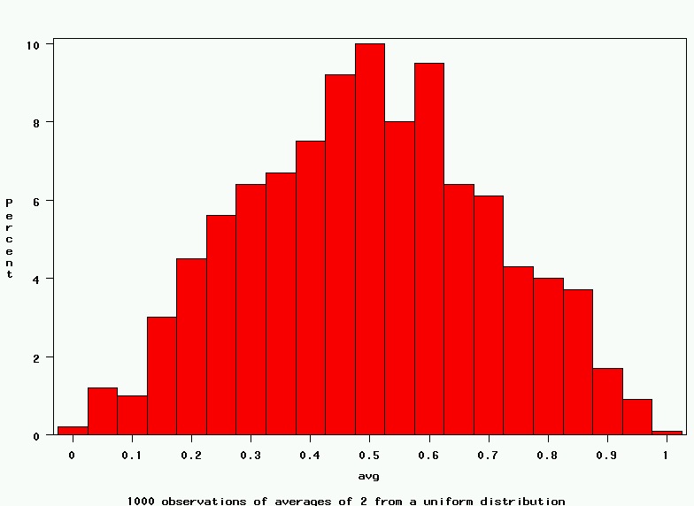
Uniform: 1000 averages of 2
Notes:
It turns out that if you were to go out and sample many, many times, most sample statistics that you could calculate would follow a normal distribution.
What are the 2 parameters (from last time) that define any normal distribution?
Remember that a normal curve is characterized by two parameters, a mean and a variability (SD)
What do you think the mean value of a sample statistic would be? The standard deviation?
Remember standard deviation is natural variability of the population
Standard error can be standard error of the mean or standard error of the odds ratio or standard error of the difference of 2 means, etc. The standard error of any sample statistic.

Slide 7
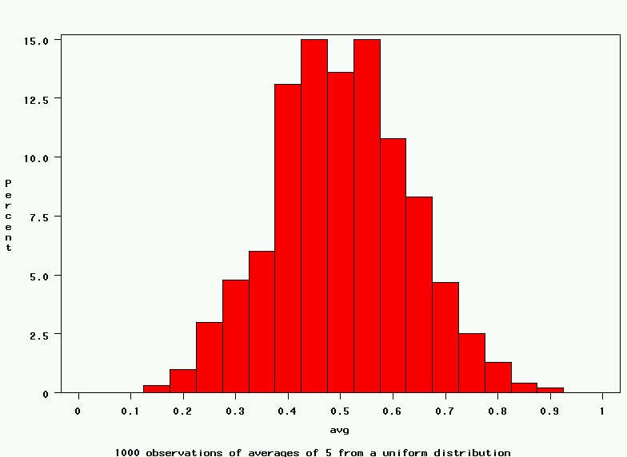
Uniform: 1000 averages of 5
Notes:
It turns out that if you were to go out and sample many, many times, most sample statistics that you could calculate would follow a normal distribution.
What are the 2 parameters (from last time) that define any normal distribution?
Remember that a normal curve is characterized by two parameters, a mean and a variability (SD)
What do you think the mean value of a sample statistic would be? The standard deviation?
Remember standard deviation is natural variability of the population
Standard error can be standard error of the mean or standard error of the odds ratio or standard error of the difference of 2 means, etc. The standard error of any sample statistic.

Slide 8
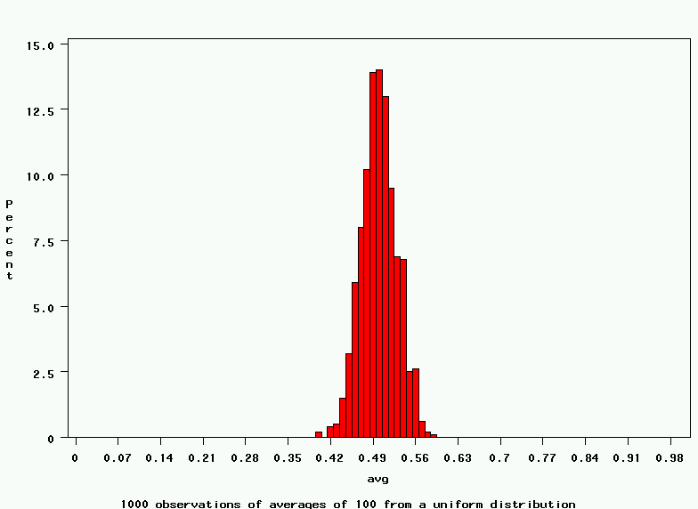
Uniform: 1000 averages of 100
Notes:
It turns out that if you were to go out and sample many, many times, most sample statistics that you could calculate would follow a normal distribution.
What are the 2 parameters (from last time) that define any normal distribution?
Remember that a normal curve is characterized by two parameters, a mean and a variability (SD)
What do you think the mean value of a sample statistic would be? The standard deviation?
Remember standard deviation is natural variability of the population
Standard error can be standard error of the mean or standard error of the odds ratio or standard error of the difference of 2 means, etc. The standard error of any sample statistic.

Slide 9
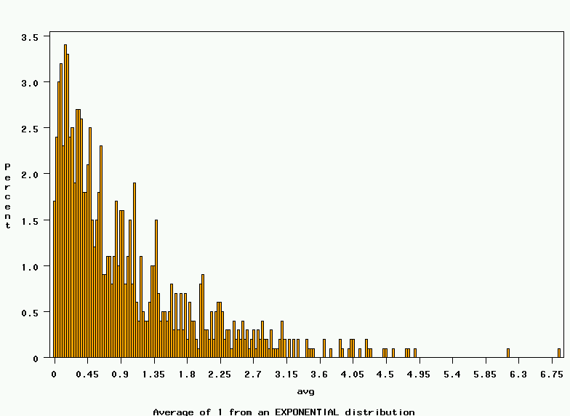
~Exp(1): average of 1
(original distribution)
Notes:
It turns out that if you were to go out and sample many, many times, most sample statistics that you could calculate would follow a normal distribution.
What are the 2 parameters (from last time) that define any normal distribution?
Remember that a normal curve is characterized by two parameters, a mean and a variability (SD)
What do you think the mean value of a sample statistic would be? The standard deviation?
Remember standard deviation is natural variability of the population
Standard error can be standard error of the mean or standard error of the odds ratio or standard error of the difference of 2 means, etc. The standard error of any sample statistic.

Slide 10
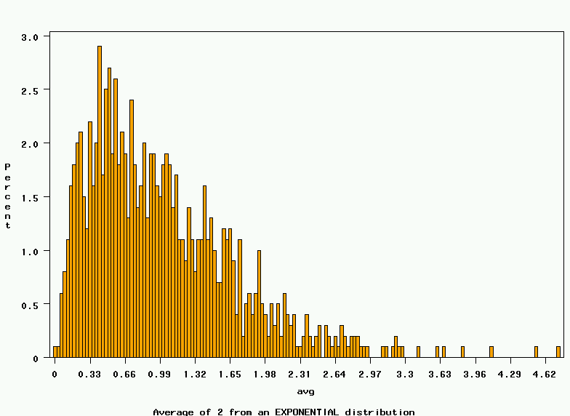
~Exp(1): 1000 averages of 2
Notes:
It turns out that if you were to go out and sample many, many times, most sample statistics that you could calculate would follow a normal distribution.
What are the 2 parameters (from last time) that define any normal distribution?
Remember that a normal curve is characterized by two parameters, a mean and a variability (SD)
What do you think the mean value of a sample statistic would be? The standard deviation?
Remember standard deviation is natural variability of the population
Standard error can be standard error of the mean or standard error of the odds ratio or standard error of the difference of 2 means, etc. The standard error of any sample statistic.

Slide 11
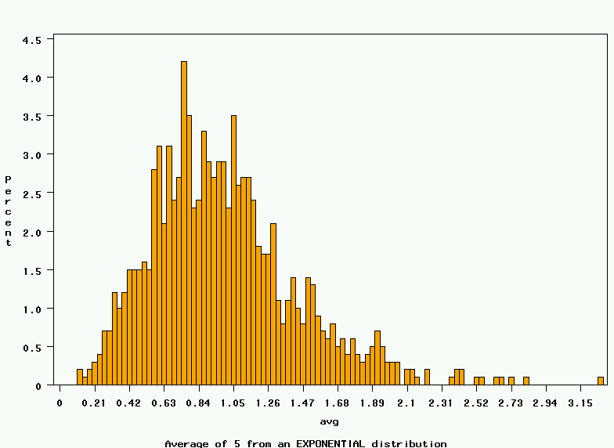
~Exp(1): 1000 averages of 5
Notes:
It turns out that if you were to go out and sample many, many times, most sample statistics that you could calculate would follow a normal distribution.
What are the 2 parameters (from last time) that define any normal distribution?
Remember that a normal curve is characterized by two parameters, a mean and a variability (SD)
What do you think the mean value of a sample statistic would be? The standard deviation?
Remember standard deviation is natural variability of the population
Standard error can be standard error of the mean or standard error of the odds ratio or standard error of the difference of 2 means, etc. The standard error of any sample statistic.

Slide 12
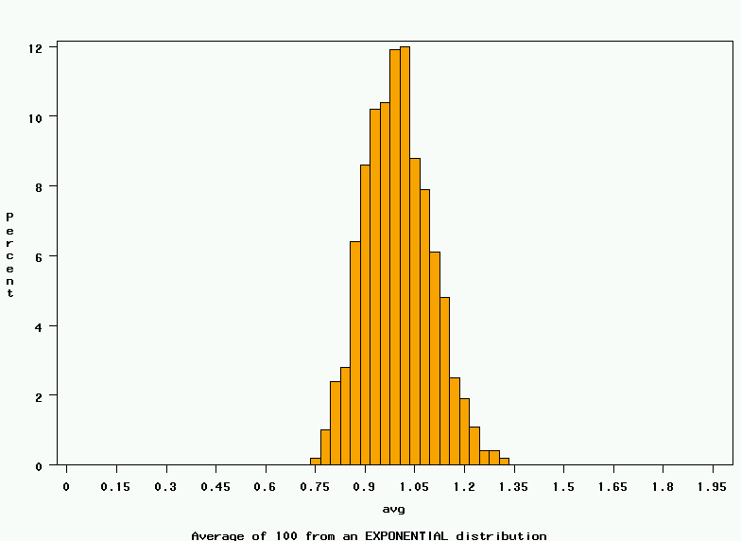
~Exp(1): 1000 averages of 100
Notes:
It turns out that if you were to go out and sample many, many times, most sample statistics that you could calculate would follow a normal distribution.
What are the 2 parameters (from last time) that define any normal distribution?
Remember that a normal curve is characterized by two parameters, a mean and a variability (SD)
What do you think the mean value of a sample statistic would be? The standard deviation?
Remember standard deviation is natural variability of the population
Standard error can be standard error of the mean or standard error of the odds ratio or standard error of the difference of 2 means, etc. The standard error of any sample statistic.

Slide 13
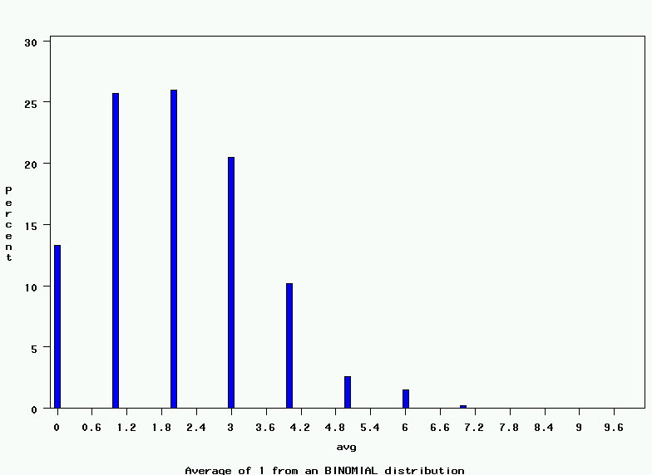
~Bin(40, .05): average of 1
(original distribution)
Notes:
It turns out that if you were to go out and sample many, many times, most sample statistics that you could calculate would follow a normal distribution.
What are the 2 parameters (from last time) that define any normal distribution?
Remember that a normal curve is characterized by two parameters, a mean and a variability (SD)
What do you think the mean value of a sample statistic would be? The standard deviation?
Remember standard deviation is natural variability of the population
Standard error can be standard error of the mean or standard error of the odds ratio or standard error of the difference of 2 means, etc. The standard error of any sample statistic.

Slide 14
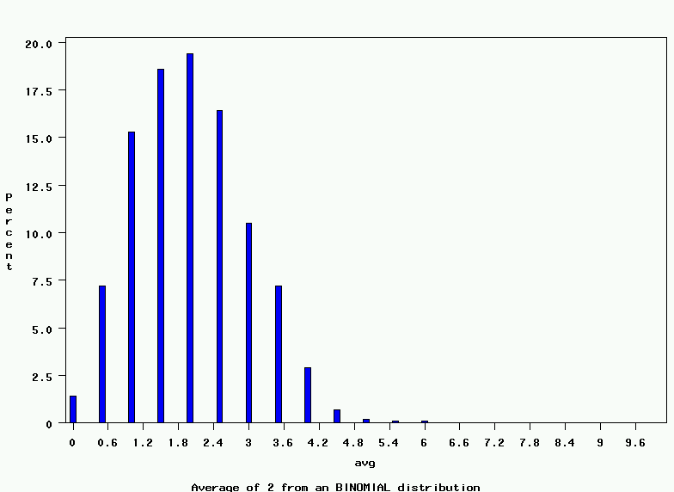
~Bin(40, .05): 1000 averages of 2
Notes:
It turns out that if you were to go out and sample many, many times, most sample statistics that you could calculate would follow a normal distribution.
What are the 2 parameters (from last time) that define any normal distribution?
Remember that a normal curve is characterized by two parameters, a mean and a variability (SD)
What do you think the mean value of a sample statistic would be? The standard deviation?
Remember standard deviation is natural variability of the population
Standard error can be standard error of the mean or standard error of the odds ratio or standard error of the difference of 2 means, etc. The standard error of any sample statistic.

Slide 15
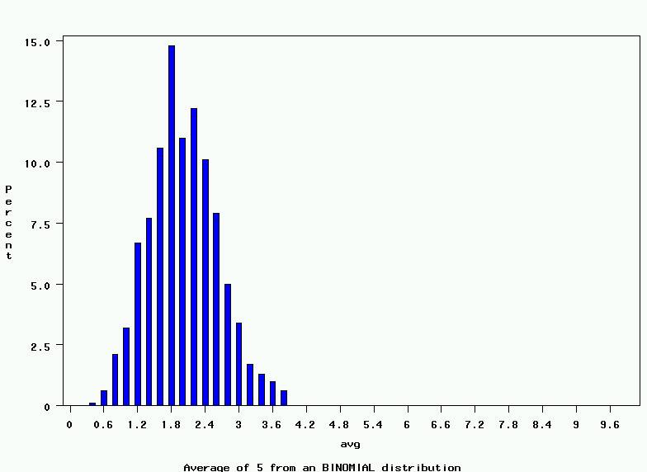
~Bin(40, .05): 1000 averages of 5
Notes:
It turns out that if you were to go out and sample many, many times, most sample statistics that you could calculate would follow a normal distribution.
What are the 2 parameters (from last time) that define any normal distribution?
Remember that a normal curve is characterized by two parameters, a mean and a variability (SD)
What do you think the mean value of a sample statistic would be? The standard deviation?
Remember standard deviation is natural variability of the population
Standard error can be standard error of the mean or standard error of the odds ratio or standard error of the difference of 2 means, etc. The standard error of any sample statistic.

Slide 16
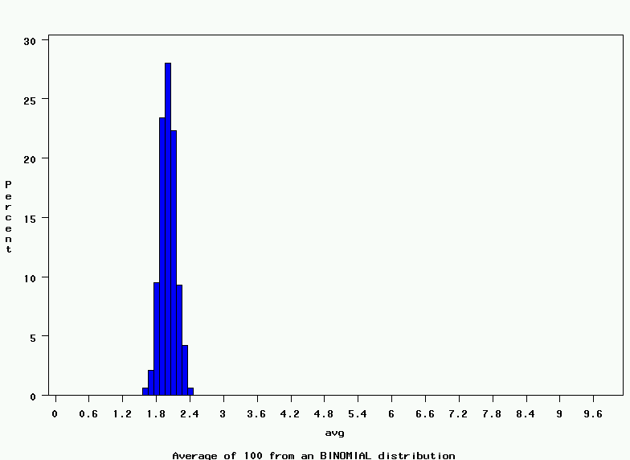
~Bin(40, .05): 1000 averages of 100
Notes:
It turns out that if you were to go out and sample many, many times, most sample statistics that you could calculate would follow a normal distribution.
What are the 2 parameters (from last time) that define any normal distribution?
Remember that a normal curve is characterized by two parameters, a mean and a variability (SD)
What do you think the mean value of a sample statistic would be? The standard deviation?
Remember standard deviation is natural variability of the population
Standard error can be standard error of the mean or standard error of the odds ratio or standard error of the difference of 2 means, etc. The standard error of any sample statistic.

Slide 17
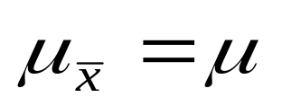
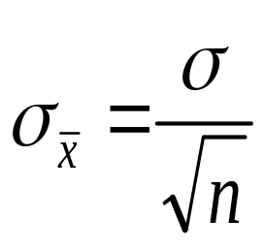
The Central Limit Theorem:
If all possible random samples, each of size n, are taken from any population with a mean μ and a standard deviation σ, the sampling distribution of the sample means (averages) will:
1. have mean:
2. have standard deviation:
3. be approximately normally distributed regardless of the shape of the parent population (normality improves with larger n)
Notes:
It turns out that if you were to go out and sample many, many times, most sample statistics that you could calculate would follow a normal distribution.
What are the 2 parameters (from last time) that define any normal distribution?
Remember that a normal curve is characterized by two parameters, a mean and a variability (SD)
What do you think the mean value of a sample statistic would be? The standard deviation?
Remember standard deviation is natural variability of the population
Standard error can be standard error of the mean or standard error of the odds ratio or standard error of the difference of 2 means, etc. The standard error of any sample statistic.

Slide 18
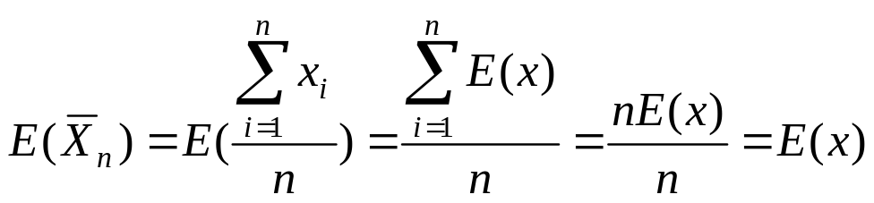
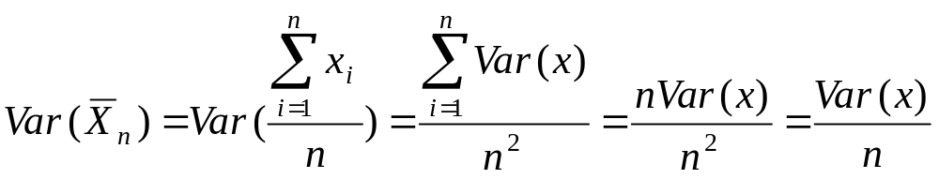
Mathematical Proof
If X is a random variable from any distribution with known mean, E(x), and variance, Var(x), then the expected value and variance of the average of n observations of X is:

Slide 19
Computer simulation for the OR…
We have two underlying binomial distributions…
The cases are distributed as a binomial with N=number of cases sampled for the study and p=true proportion exposed in all cases in the larger population.
The controls are distributed as a binomial with N=number of controls sampled for the study and p=true proportion exposed in all controls in the larger population.

Slide 20
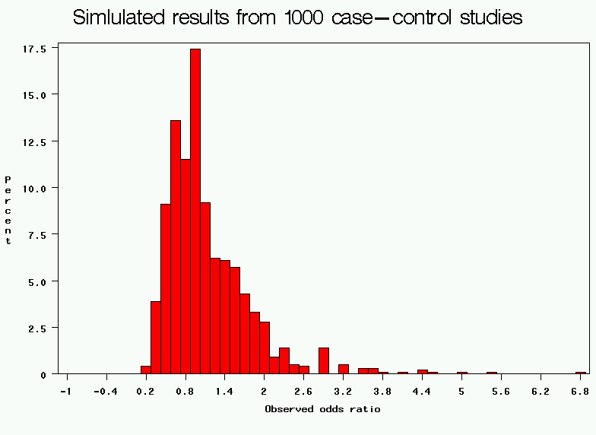
Properties of the OR (simulation)
(50 cases/50 controls/20% exposed)
If the Odds Ratio=1.0 then with 50 cases and 50 controls, of whom 20% are exposed, this is the expected variability of the sample OR→note the right skew

Slide 21
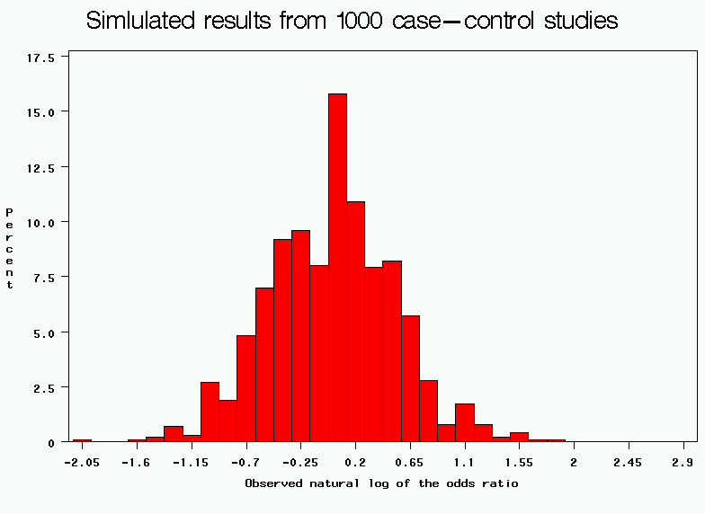
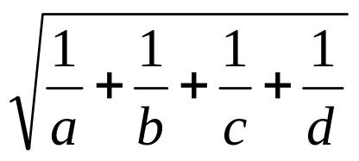
Properties of the lnOR
Standard deviation =

Slide 22
The Bootstrap standard error
Described by Bradley Efron (Stanford) in 1979.
Allows you to calculate the standard errors when no formulas are available.
Allows you to calculate the standard errors when assumptions are not met (e.g., large sample, normality)

Slide 23
Why Bootstrap?
The bootstrap uses computer simulation.
But, unlike the simulations I showed you previously that drew observations from a hypothetical world, the bootstrap:
  draws observations only from your own sample (not a hypothetical world)
  makes no assumptions about the underlying distribution in the population.

Slide 24
Bootstrap re-sampling…getting something for nothing!
The standard error is the amount of variability in the statistic if you could take repeated samples of size n.
How do you take repeated samples of size n from n observations??
Here’s the trick→Sampling with replacement!

Slide 25
Sampling with replacement
Sampling with replacement means every observation has an equal chance of being selected (=1/n), and observations can be selected more than once.

Slide 26
Sampling with replacement
Original sample of n=6 observations.
Possible new samples:
A
B
C
D
E
F
A
A
A
D
C
C
B
A
C
E
Re-sample with replacement
D
C
B
C
D
F
E
F
**What’s the probability of each of these particular samples discounting order?

Slide 27
Bootstrap Procedure
1. Number your observations 1,2,3,…n
2. Draw a random sample of size n WITH REPLACEMENT.
3. Calculate your statistic (mean, beta coefficient, ratio, etc.) with these data.
4. Repeat steps 1-3 many times (e.g., 500 times).
5. Calculate the variance of your statistic directly from your sample of 500 statistics.
6. You can also calculate confidence intervals directly from your sample of 500 statistics. Where do 95% of statistics fall?

Slide 28
When is bootstrap used?
If you have a new-fangled statistic without a known formula for standard error.
  e.g. male: female ratio.
If you are not sure if large sample assumptions are met.
  Maximum likelihood estimation assumes “large enough” sample.
If you are not sure if normality assumptions are met.
  Bootstrap makes no assumptions about the distribution of the variables in the underlying population.

Slide 29
Bootstrap example:
Hypothetical data from a case-control study…
 | Case | Control
Exposed | 17 | 2
Unexposed | 7 | 22
Calculate the risk ratio and 95% confidence interval…

Slide 30
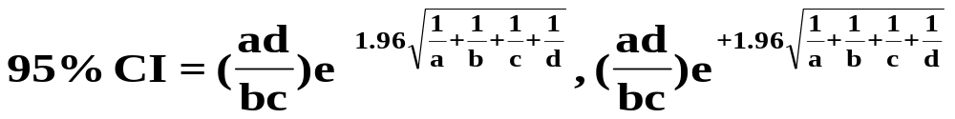
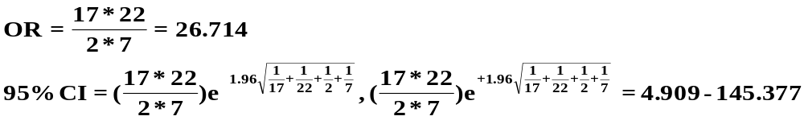
Method 1: use formula
Use the formula for calculating 95% CIs for ORs:
In SAS, see output from PROC FREQ.

Slide 31
Method 2: use MLE
Calculate the OR and 95% CI using logistic regression (MLE theory)
In SAS, use PROC LOGISTIC:
From SAS, Beta and standard error of beta are: 3.2852+/-0.8644
From SAS, OR and 95% CI are: 26.714 (4.909,145.376)

Slide 32
Method 3: use Bootstrap…
1. In SAS, re-sample 500 samples of n=48 (with replacement).
2. For each sample, run logistic regression to get the beta coefficient for exposure.
3. Examine the distribution of the resulting 500 beta coefficients.
4. Obtain the empirical standard error and 95% CI.

Slide 33
Bootstrap results…
1 3.2958
2 2.9267
3 2.5257
4 4.2485
5 3.2607
6 3.5040
7 2.4343
8 14.7715
9 13.9865
10 3.1711
11 2.2642
12 1.5378
13 14.2988
.
.
.
.
Recall: MLE estimate of beta coefficient was
3.2852
Etc. to 500…

Slide 34
Bootstrap results
N Mean Std Dev
ƒƒƒƒƒƒƒƒƒƒƒƒƒƒƒƒƒƒƒƒƒƒƒƒƒƒƒƒƒƒƒƒƒƒƒ
500 4.8685208 3.8538840
ƒƒƒƒƒƒƒƒƒƒƒƒƒƒƒƒƒƒƒƒƒƒƒƒƒƒƒƒƒƒƒƒƒƒƒ
This is a far cry from: 3.2852+/-0.8644

Slide 35
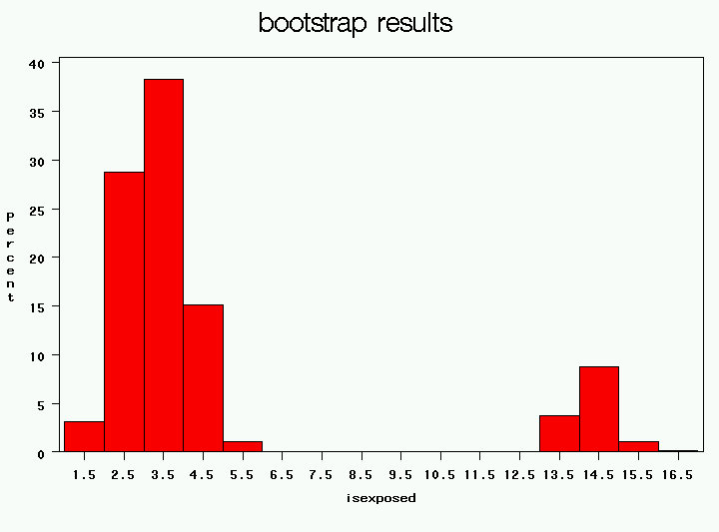
What’s happening here???
95% confidence interval is the interval that covers 95% of the observed statistics…(2.5% area in each tail)
Beta coefficient for exposure

Slide 36
Results…
95% CI (beta) = 1.8871-14.6034
95% CI (OR) = 6.6-2258925

Slide 37
We will implement the bootstrap in the lab on Wednesday (takes a little programming in SAS)…

Slide 38
Validation
Validation addresses the problem of over-fitting.
Internal Validation: Validate your model on your current data set (cross-validation)
External Validation: Validate your model on a completely new dataset

Slide 39
Holdout validation
One way to validate your model is to fit your model on half your dataset (your “training set”) and test it on the remaining half of your dataset (your “test set”).
If over-fitting is present, the model will perform well in your training dataset but poorly in your test dataset.
Of course, you “waste” half your data this way, and often you don’t have enough data to spare…

Slide 40
Alternative strategies:
Leave-one-out validation (leave one observation out at a time; fit the model on the remaining training data; test on the held out data point).
K-fold cross-validation—what we will discuss today.

Slide 41
When is cross-validation used?
Very important in microarray experiments (“p is larger than N”).
Anytime you want to prove that your model is not over-fit, that it will have good prediction in new datasets.

Slide 42
10-fold cross-validation (one example of K-fold cross-validation)
1. Randomly divide your data into 10 pieces, 1 through k.
2. Treat the 1st tenth of the data as the test dataset. Fit the model to the other nine-tenths of the data (which are now the training data).
3. Apply the model to the test data (e.g., for logistic regression, calculate predicted probabilities of the test observations).
4. Repeat this procedure for all 10 tenths of the data.
5. Calculate statistics of model accuracy and fit (e.g., ROC curves) from the test data only.

Slide 43
Example: 10-fold cross validation
Gould MK, Ananth L, Barnett PG; Veterans Affairs SNAP Cooperative Study Group A clinical model to estimate the pretest probability of lung cancer in patients with solitary pulmonary nodules. Chest. 2007 Feb;131(2):383-8.
Aim: to estimate the probability that a patient who presents with solitary pulmonary nodule (SPNs) in their lungs has a malignant lung tumor to help guide clinical decision making for people with this condition.
Study design: n=375 veterans with SPNs; 54% have a malignant tumor and 46% do not (as confirmed by a gold standard test). The authors used multiple logistic regression to select the best predictors of malignancy.

Slide 44
Results from multiple logistic regression:
Table 2. Predictors of Malignant SPNs
Predictors
OR
95% CI
Smoking history*
7.9
2.6–23.6
Age per 10-yr increment
2.2
1.7–2.8
Nodule diameter per 1-mm increment
1.1
1.1–1.2
Time since quitting smoking per 10-yr increment
0.6
0.4–0.7
* Ever vs never.
Gould MK, et al. Chest. 2007 Feb;131(2):383-8.

Slide 45
Prediction model:
Predicted Probability of malignant SPN = e^{x}/(1+e^{x})
Where X=-8.404 + (2.061 x smoke) + (0.779 x age 10) +
(0.112 x diameter) – (0.567x years quit 10)
Gould MK, et al. Chest. 2007 Feb;131(2):383-8.

Slide 46
Results…
To evaluate the accuracy of their model, the authors calculated the area under the ROC curve.
Review: What is an ROC curve?
  Calculate the predicted probability (p_{i}) for every person in the dataset.
  Order the p_{i}’s from 1 to n (here 375).
  Classify every person with p_{i} > p₁ as having the disease. Calculate sensitivity and specificity of this rule for the 375 people in the dataset. (sensitivity will be 100%; specificity should be 0%).
  Classify every person with p_{i} > p₂ as having the disease. Calculate sensitivity and specificity of this cutoff.

Slide 47
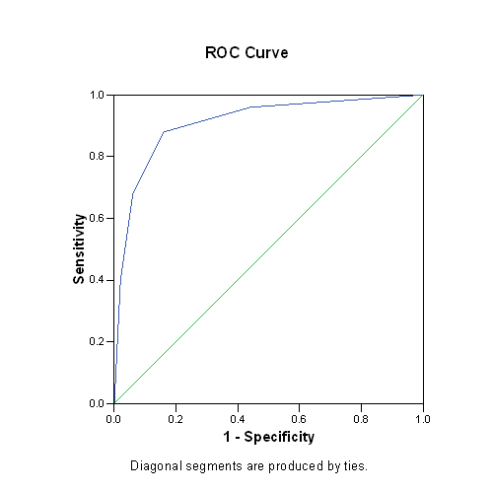
ROC curves continued…
  Repeat until you get to p₃₇₅. Now specificity will be 100% and sensitivity will be 0%
  Plot sensitivity against 1 minus the specificity:
AREA UNDER THE CURVE is a measure of the accuracy of your model.

Slide 48
Results
The authors found an AUC of 0.79 (95% CI: 0.74 to 0.84), which can be interpreted as follows:
  If the model has no predictive power, you have a 50-50 chance of correctly classifying a person with SPN.
  Instead, here, the model has a 79% chance of correct classification (quite an improvement over 50%).

Slide 49
A role for 10-fold cross-validation
If we were to apply this logistic regression model to a new dataset, the AUC will be smaller, and may be considerably smaller (because of over-fitting).
Since we don’t have extra data lying around, we can use 10-fold cross-validation to get a better estimate of the AUC…

Slide 50
10-fold cross validation
1. Divide the 375 people randomly into sets of 37 and 38.
2. Fit the logistic regression model to 337 (nine-tenths of the data).
3. Using the resulting model, calculate predicted probabilities for the test data set (n=38). Save these predicted probabilities.
4. Repeat steps 2 and 3, holding out a different tenth of the data each time.
5. Build the ROC curve and calculate AUC using the predicted probabilities generated in (3).

Slide 51
Results…
After cross-validation, the AUC was 0.78 (95% CI: 0.73 to 0.83).
This shows that the model is robust.

Slide 52
We will implement 10-fold cross-validation in the lab on Wednesday (takes a little programming in SAS)…

