Slide 1

An introduction to the
Bootstrap method
Hugh Shanahan
University College London
November 2001
I know that it will happen,
Because I believe in the certainty of chance
The Divine Comedy

Slide 2
Outline
Origin of Statistics
  Central Limit Theorem
Difficulties in “Standard Statistics”
Bootstrap - the basic idea
A simple example
Case Study I : Phylogenetic Trees
Case Study II : Bayesian Networks
Conclusions

Slide 3
Statistics 101
We want the ‘average’ and ‘error’ for some variable
  Time between first and second division of frog embryo
  Half-life of a radioactive sample
  How many days does Wimbledon get delayed by (grrr……..)

Slide 4
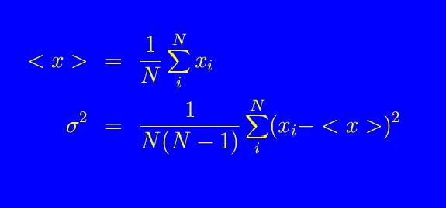
Strategy
Assuming only statistical variation
Carry out measurement “many” times
Error decreases as number of measurements increase

Slide 5
In fact, there’s a huge amount of statistical
machinery going on with this…….
Assume the Central Limit Theorem
“If random samples of n observations y₁, y₂, …y_{n} are
drawn from a population of finite mean μ and variance
σ², then when n is sufficiently large, the sampling
distribution of the sample mean can be approximated
by a normal density with mean μ_{y} = μ and standard
deviation σ_{y} = σ/n^{1/2}”
THE MOST IMPORTANT THEOREM OF STATISTICS

Slide 6
Consequences of CLT
Averages taken from any distribution
(your experimental data) will have a normal
distribution
The error for such an observable will
decrease slowly as the number of
observations increase
But nobody tells you how big the sample has to be..

Slide 7
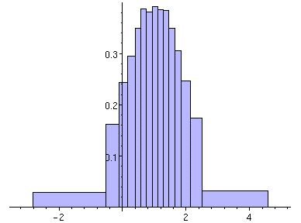
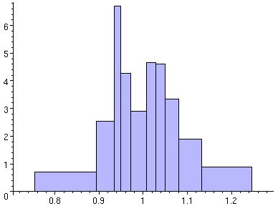
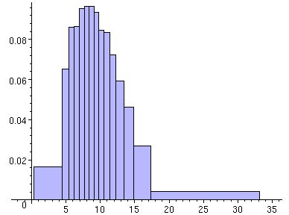
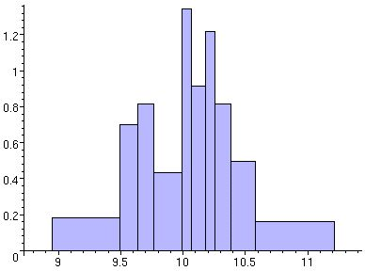
Normal distribution
Averages of N.D.
χ² distribution
Averages of χ² distribution

Slide 8
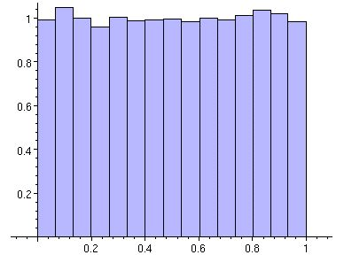
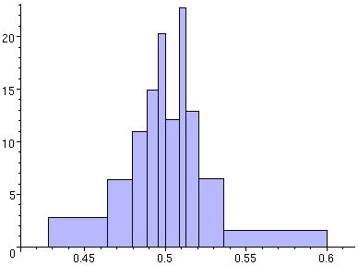
Uniform distribution
Averages of U.D.

Slide 9
Research is more than Statistics 101 !!
Very often, we are looking at quite complicated objects, not just single variables. Even if we assume CLT, then it is not clear how to propagate the uncertainty through to the final objects we are looking at.
It is not clear when we have a large enough sample, we should do a histogram, but this may not be possible.

Slide 10
What the statistician sees….
(or rather what they talk about)
The probability distribution rather than the data
But we just have the data !
The bootstrap method attempts to determine
the probability distribution from the data
itself, without recourse to CLT.
The bootstrap method is not a way of reducing
the error ! It only tries to estimate it.

Slide 11
Basic idea of Bootstrap
Originally, from some list of data, one computes an object.
Create an artificial list by randomly drawing elements from that list. Some elements will be picked more than once.
Compute a new object.
Repeat 100-1000 times and look at the distribution of these objects.

Slide 12
A simple example
Data available comparing grades before and after leaving graduate school amongst 15 U.S. Universities.
Some linear correlation between grades (high incoming usually means high outgoing). ρ=0.776
But how reliable is this result ?

Slide 13
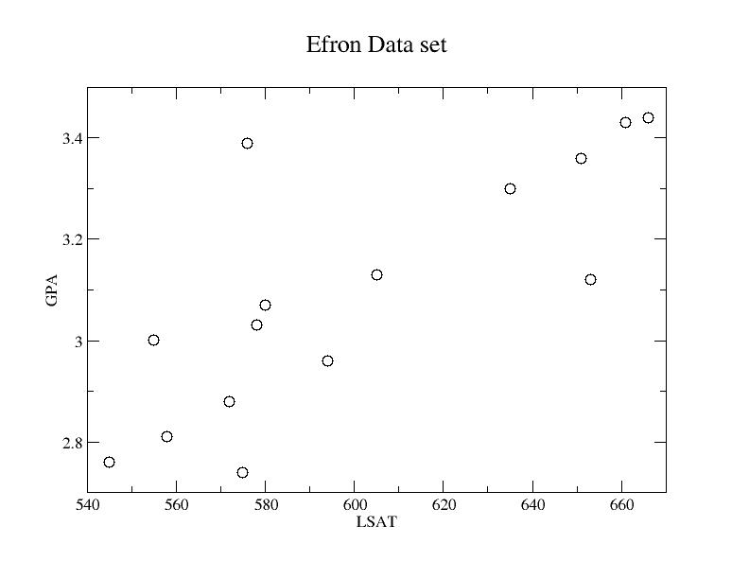

Slide 14
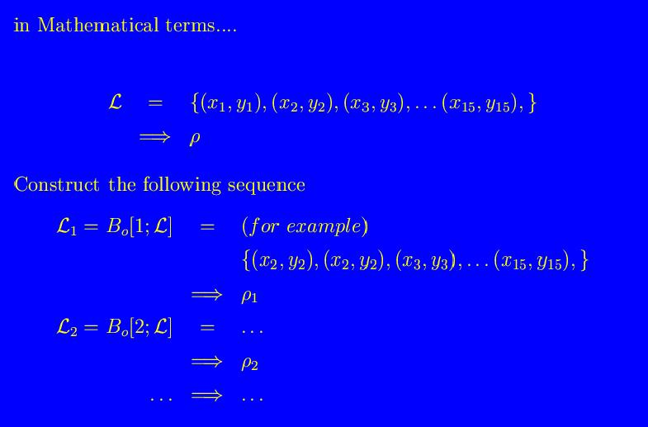

Slide 15
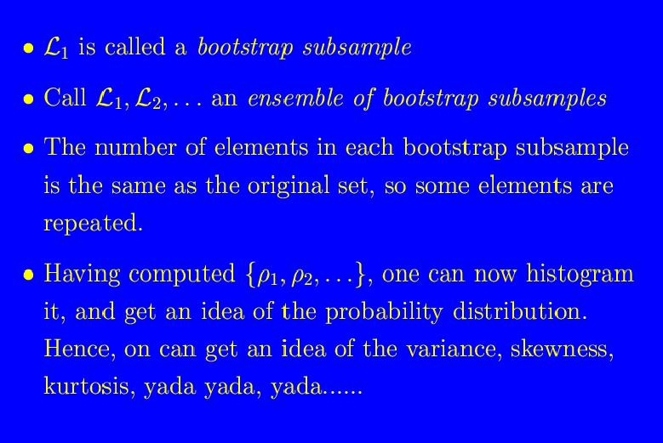

Slide 16
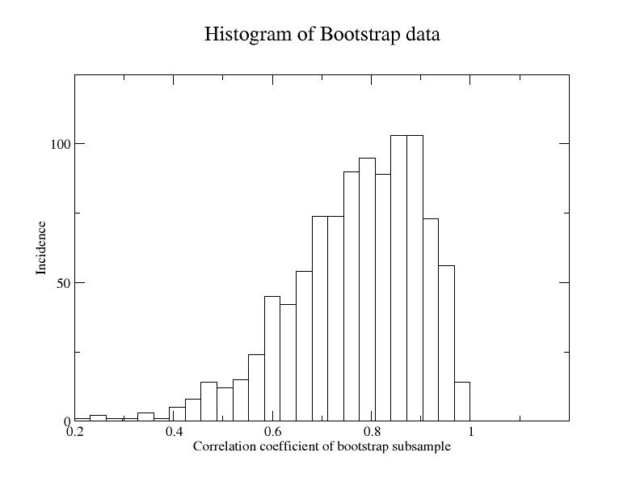

Slide 17
Addendum : The Jack-knife
Jack-knife is a special kind of bootstrap.
Each bootstrap subsample has all but one of the original elements of the list.
For example, if original list has 10 elements, then there are 10 jack-knife subsamples.

Slide 18
How many bootstraps ?
No clear answer to this. Lots of theorems on asymptotic convergence, but no real estimates !
Rule of thumb : try it 100 times, then 1000 times, and see if your answers have changed by much.
Anyway have N^{N} possible subsamples

Slide 19
Is it reliable ?
A very very good question !
Jury still out on how far it can be applied, but for now nobody is going to shoot you down for using it.
Good agreement for Normal (Gaussian) distributions, skewed distributions tend to more problematic, particularly for the tails, (boot strap underestimates the errors).

Slide 20
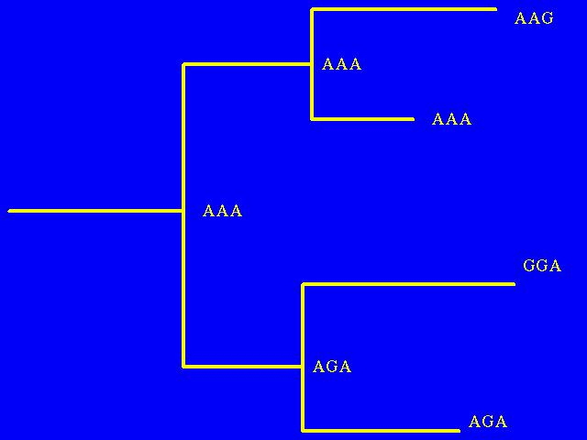
Case Study I : Phylogenetic Trees
Get a multiple sequence alignment
C1 C2 C3
S1 A A G
S2 A A A
S3 G G A
S4 A G A
Construct a Tree using your favourite method
(Parsimony, ML, etc..)

Slide 21
How confident are we of this tree ?
For example, how confident are we that two sequences are in the same clade ?
I.E. what is the probability distribution of our confidence of the branches ?
Certainly not a problem that Stat. 101 can handle !
Bootstrap can provide a way of determining this (first thought of by Felsenstein, 1985)

Slide 22
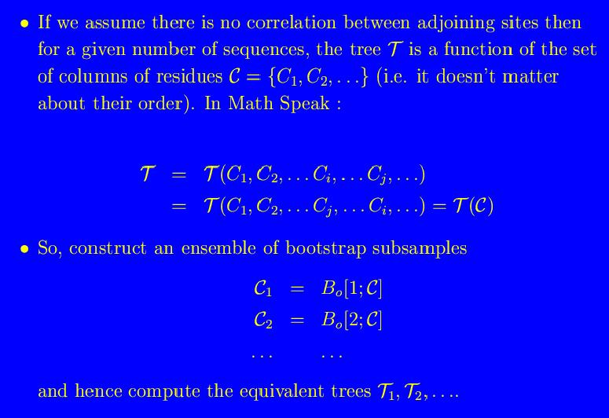

Slide 23

Having created an ensemble of Phylogenetic trees,
one can elucidate the statistical frequency of various
features of the tree.
E.G. Do two sequences lie in the same clade ?
Can this be used for statistical significance ?
This is very much an open question !!!!
(Be cautious, and assume not…...)

Slide 24
Case Study II : Gene expression data and Bayesian (Probabilistic) networks
A method for elucidating which genes is regulating the production of what genes.
Problem is that it is difficult to determine how reliable the edges of the network is
The bootstrap method is the favoured approach…..

Slide 25
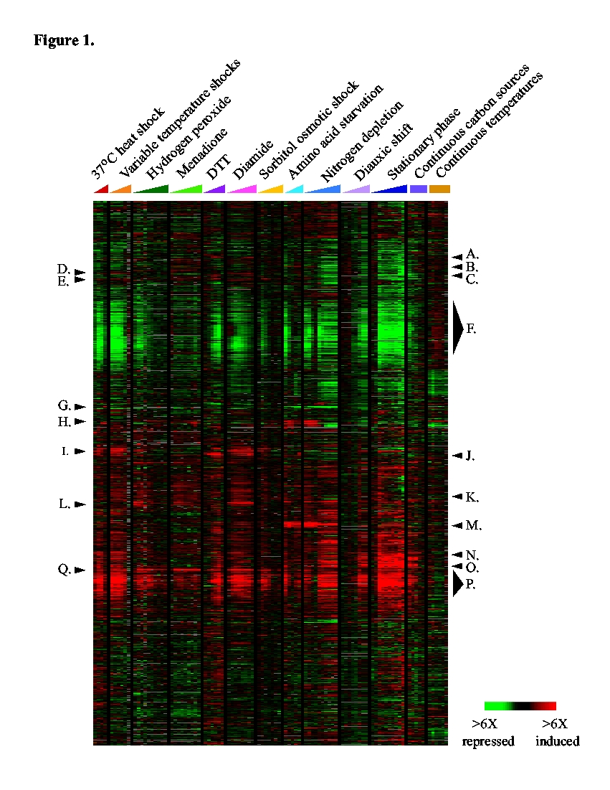

Slide 26
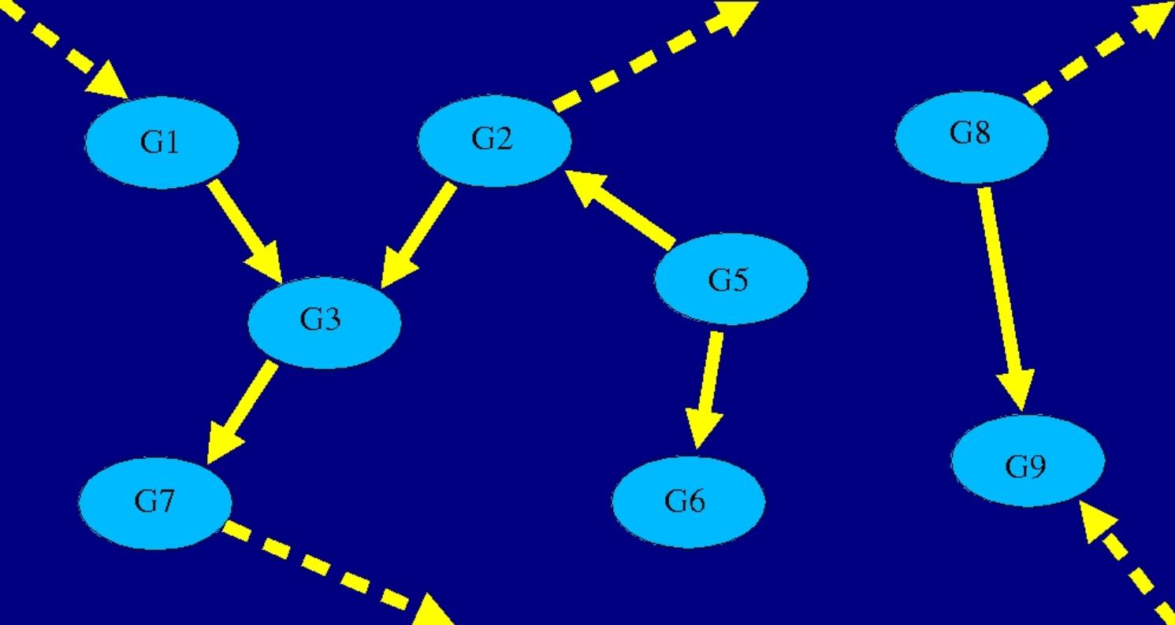
Ideally, what you want is the following

Slide 27
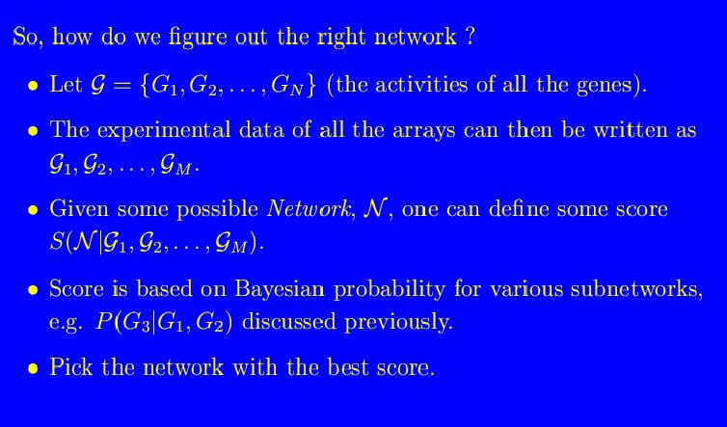

Slide 28
Formally, we get a joint probability distribution
which takes the form :
P(G1,G2,….) = … x P(G3 | G1, G2 ) x …
… x P(G7 | G3 ) x …
etc….
More importantly, we can tell which genes
directly affect which genes (e.g. G1 and G2
acting on G3) and which ones are indirect
(e.g. G6 acting on G3)

Slide 29
But there is a problem….
Finding the right network is an NP-hard problem.
Have to apply various heuristic techniques….
Also, given the paucity of data it is not clear that any given connection between two genes is not a spurious correlation that will vanish with more statistics.

Slide 30
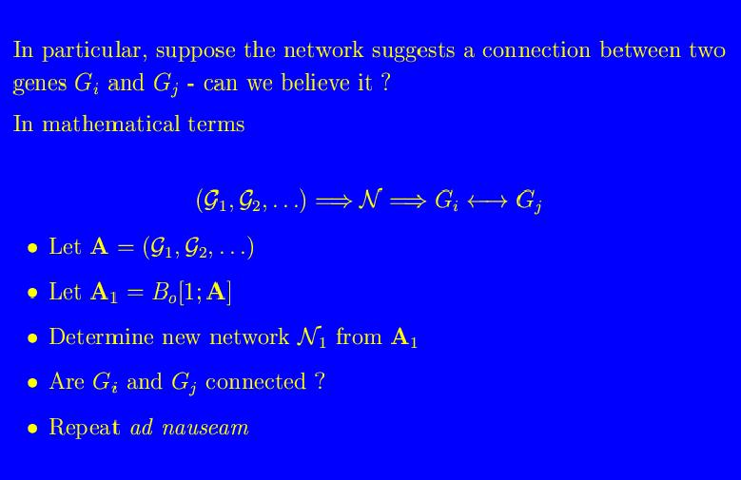

Slide 31
Summary of the Bootstrap method
Original object O (a tree, a best fit...) is computed from a “list of data” (numbers, sequences, microarray data,….).
Construct a new list, with the same number of elements, from the original list by randomly picking elements from the list. Any one element from the list can be picked any number of times.
Compute new object, call it O₁
Repeat the process many times (typically 100-1000).
The elements {O₁ , O₂ , ……} are assumed to be taken from a statistical distribution, so one can compute averages, variances, etc.

Slide 32
Conclusions
Don’t feel bad if this went over your head !
  I’m happy to explain this again……..
Textbook : Randomization, Bootstrap and Monte Carlo Methods in Biology, B.F.J. Manly, Chapman & Hall
Many extra subtleties, (parametric, non-parametric, random numbers) have not been discussed.
Do NOT scrimp on the explanation of this method when you are writing it up !!!

