Slide 1


Organic Stable Isotope Analysis with GC-qMS for PBDEs in a molecular view
Miao Yu, Jiyan Liu, Guibin Jiang
State Key Laboratory of Environmental Chemistry and Ecotoxicology
Research Center for Eco-Environmental Sciences
Chinese Academy of Sciences
Isotopes 2015, Jerusalem, Israel

Slide 2
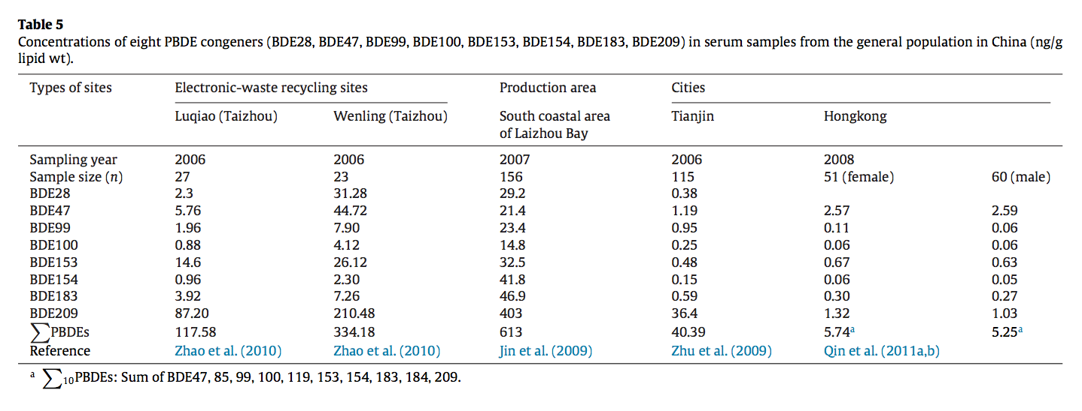
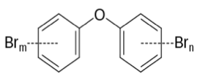
PBDEs:Brominated Flame Retardant & Persistent Organic Pollutants
Ni Kun et.al 2013 Int J Hyg Environ Healthntal Health
Sources of high concentration BDE-47 in Environmental samples
Release from e-waste
Debromination from high brominated PBDEs

Slide 3

ISOTOPE
We need another method to get the sources of PBDEs
Δ

Slide 4
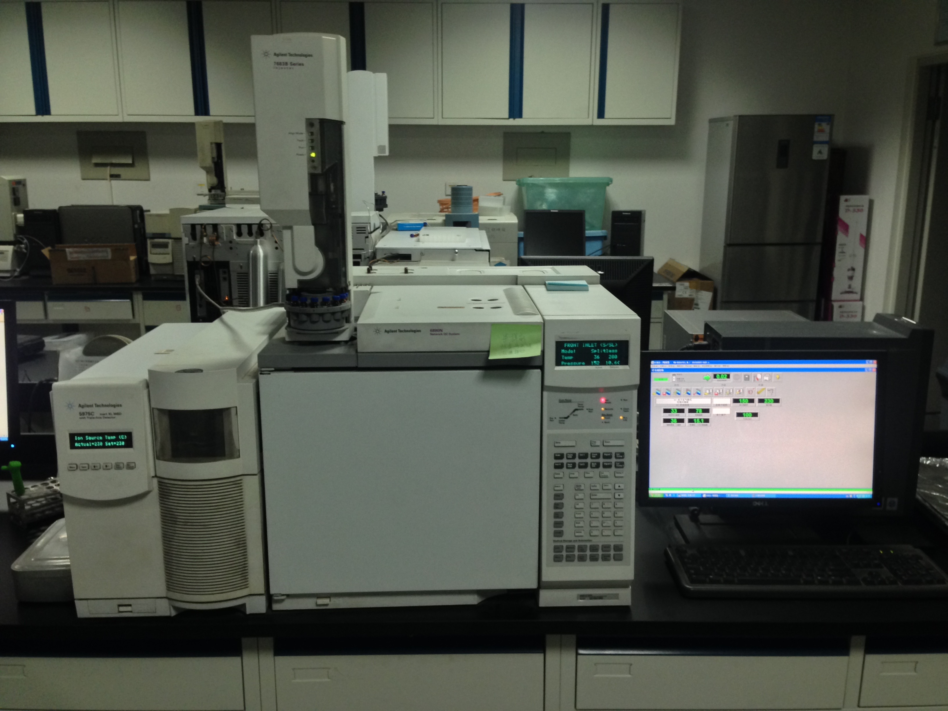
Why molecular?

Slide 5
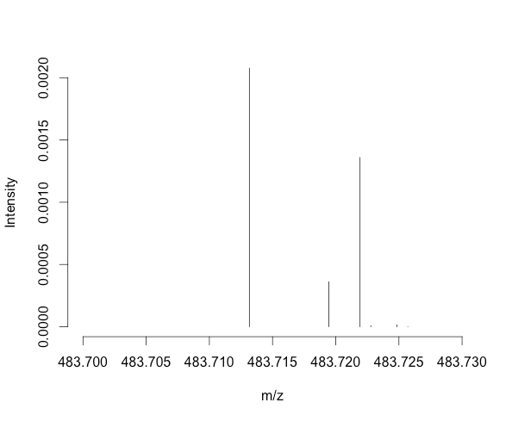
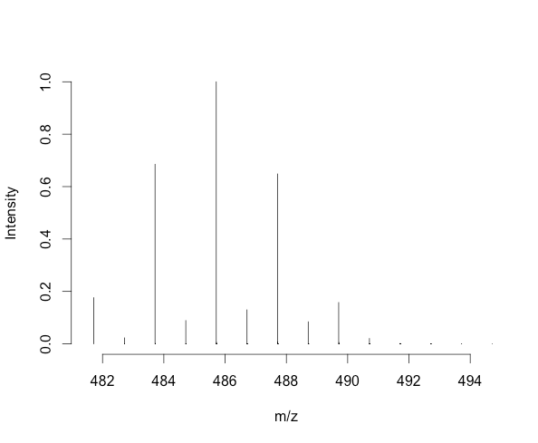
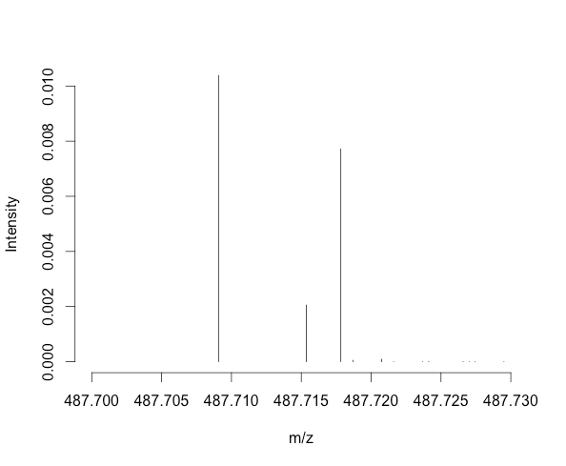
m/z 483.7
Isotopolugue are actually isotopolugues
m/z 487.7

Slide 6
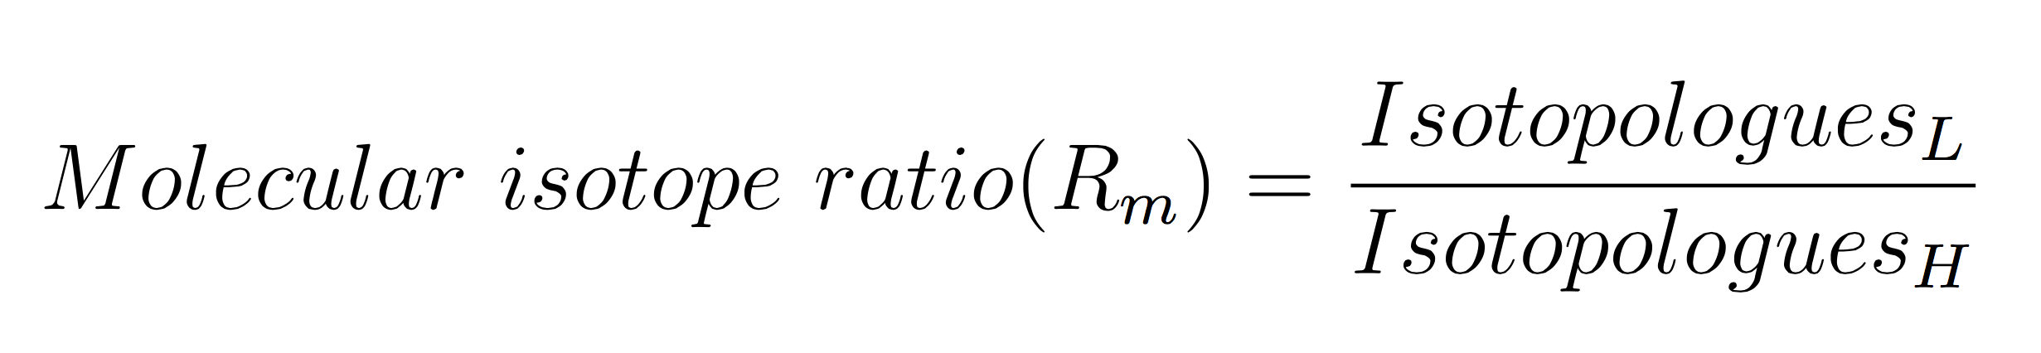
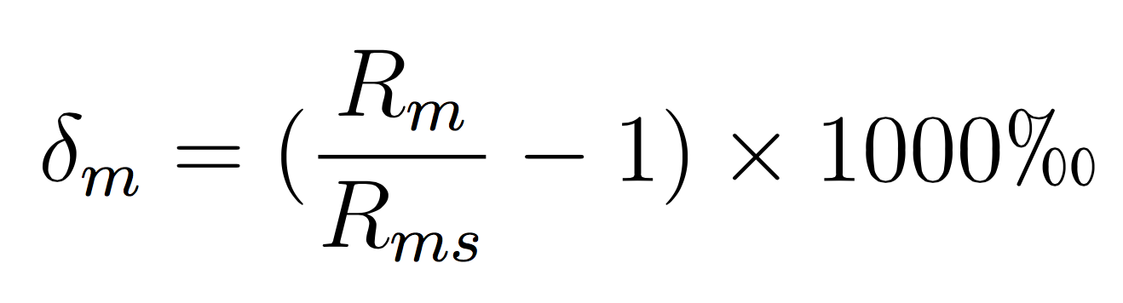
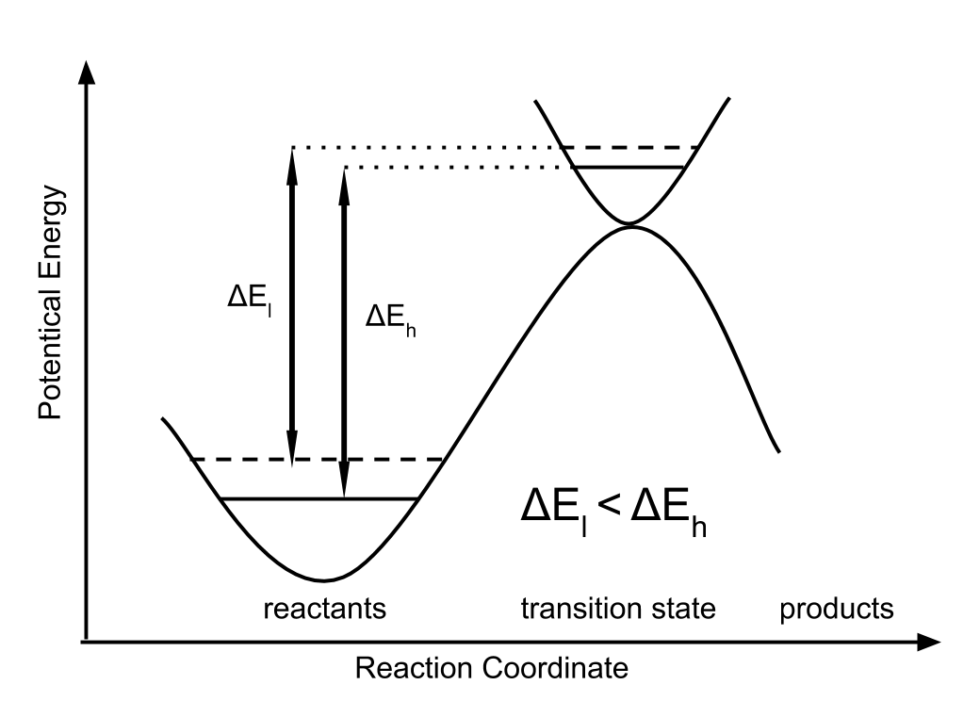
Molecular Isotope Ratio

Slide 7
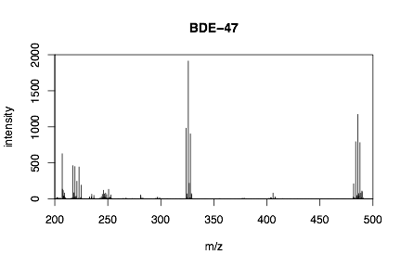
Which pair?
[M-2Br]⁺
[M]⁺

Slide 8
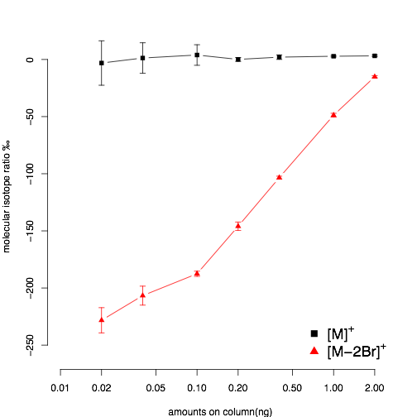
Which pair?

Slide 9
How to make the results comparable?

Slide 10
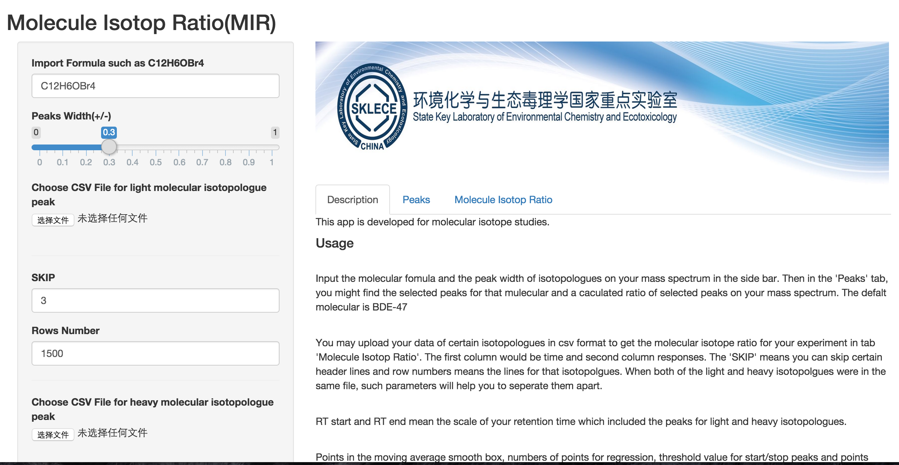
General web app
https://yufree.shinyapps.io/MIRtools/

Slide 11
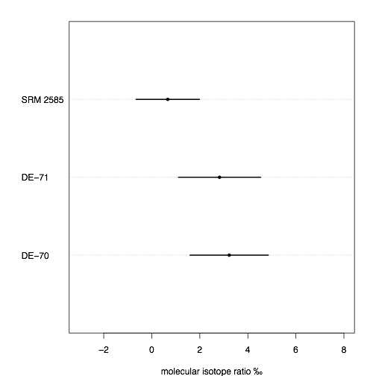
BDE-47 in SRM

Slide 12
Summary
GC-qMS could be used to get molecular isotope ratio
In-source fractionation phenomena for fragmental ions
BDE-47 in SRM has different MIR compared with technical product DE-70

Slide 13
Thank you for your attention!
Email: yumiao210@mails.ucas.ac.cn
http://yufree.cn

