Slide 1
TRIVIUM CIPHER
Yugam Parashar

Slide 2
PRESENTATION FLOW
Motivation
Brief Introduction
eSTREAM Project
Trivium
Dissected circuit
Initialization
Implementation
References

Slide 3
MOTIVATION
No known attacks⚠ till date
Fast⚡!! theoretical encryption rate of 1 Gbit/sec[2]
Selected and is still in eStream[1] project portfolio.

Slide 4
Trivium
Trivium[3] is a fast and secure stream hardware focused cipher. It offers high-speed data encryption.
It is a part of eStream portfolio[1].

Slide 5
eStream Project
Project to promote the design of efficient and compact stream ciphers.
Organized by ECRYPT(European Network of Excellence in Cryptology)
First call for paper: 2004
Project completion: 2008

Slide 6
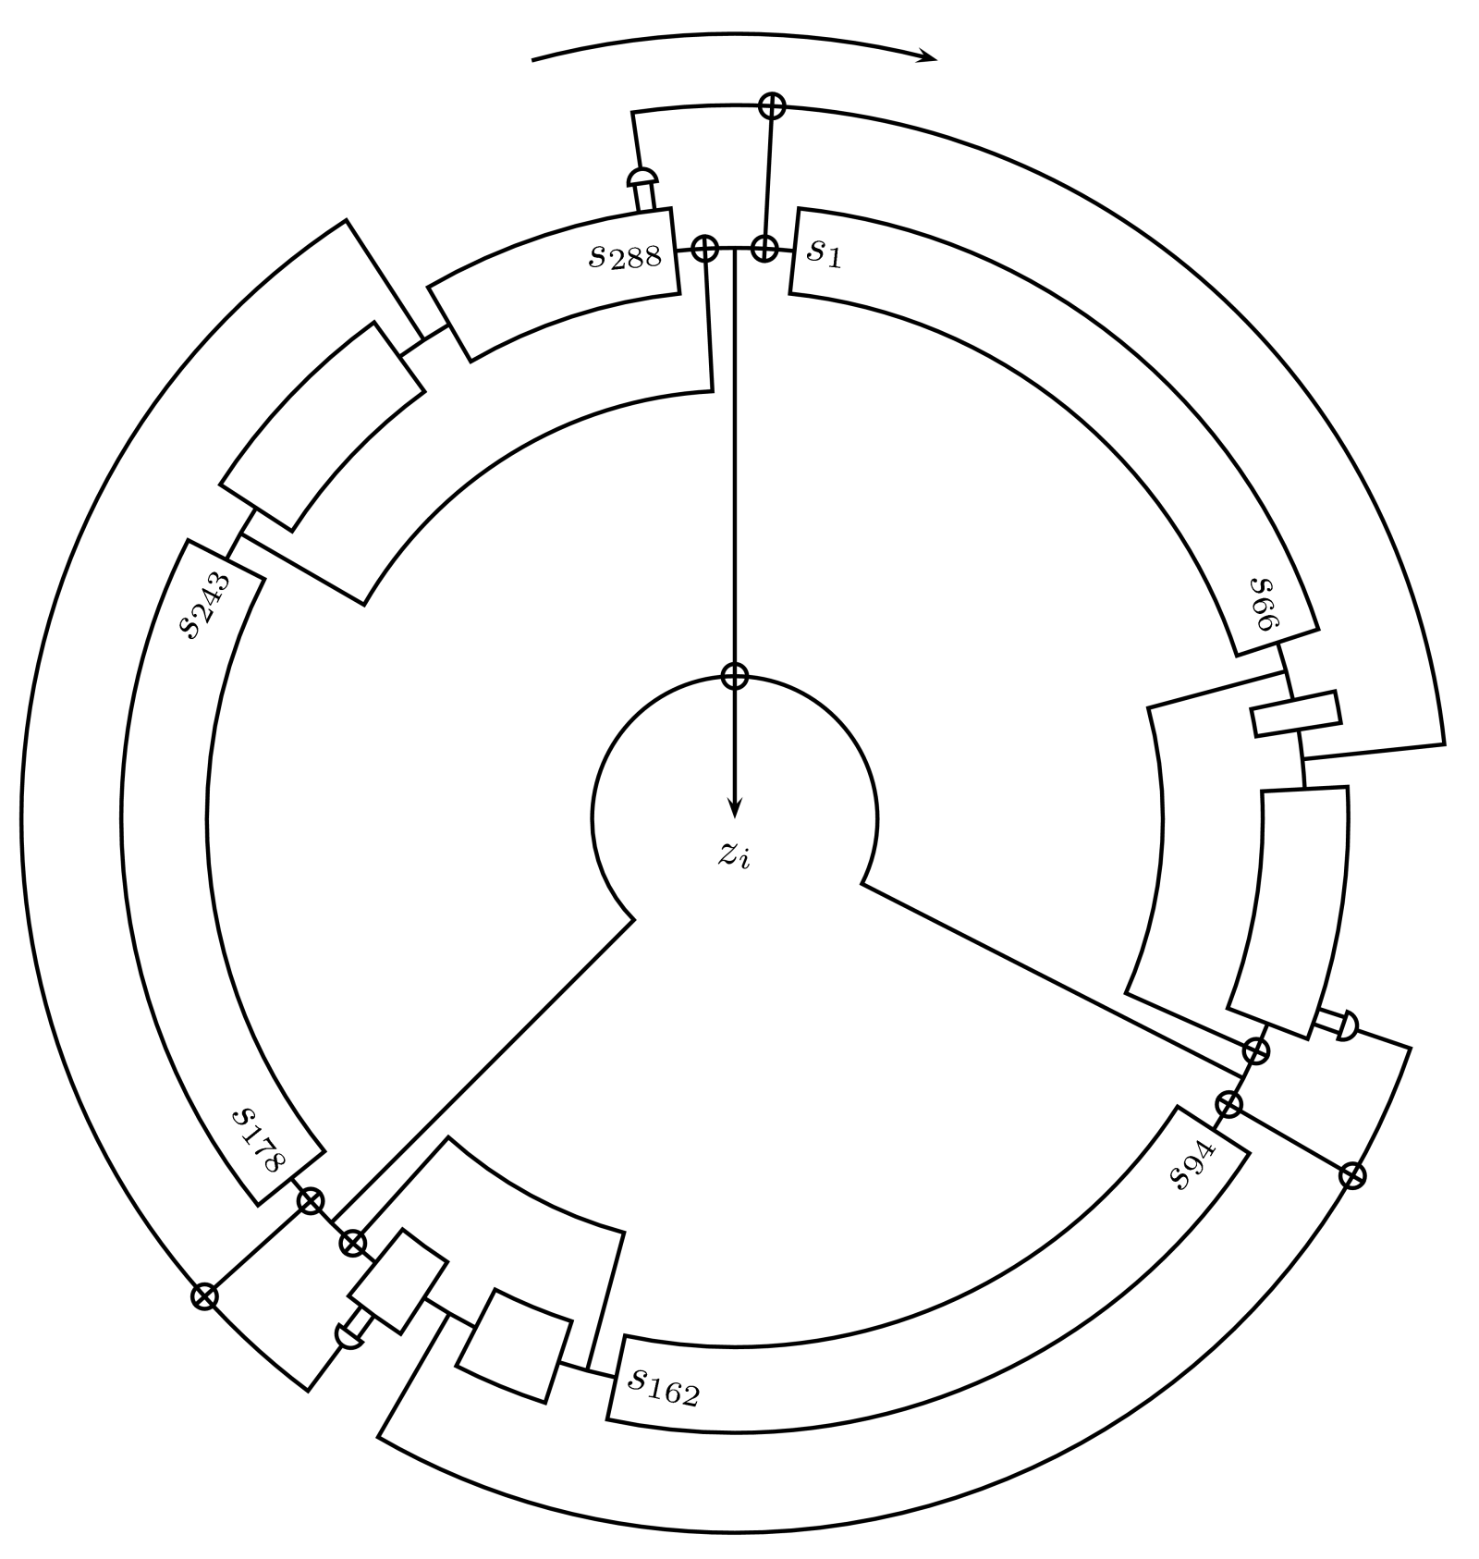
TRIVIUM CIPHER
synchronous stream cipher designed by Christophe De Canniere and Bart Preneel.[4]
Notes:
Technically this is whole cipher one image that could replace this PPT

Slide 7
TRIVIUM TEAM
Christophe De Cannière and Bart Preneel
Christophe De Cannière from the Katholieke Universiteit Leuven in Belgium.
Bart Preneel and Anne Canteaut from the French research institute INRIA.
Notes:
Honourable mention and may come for bonus marks in class test

Slide 8
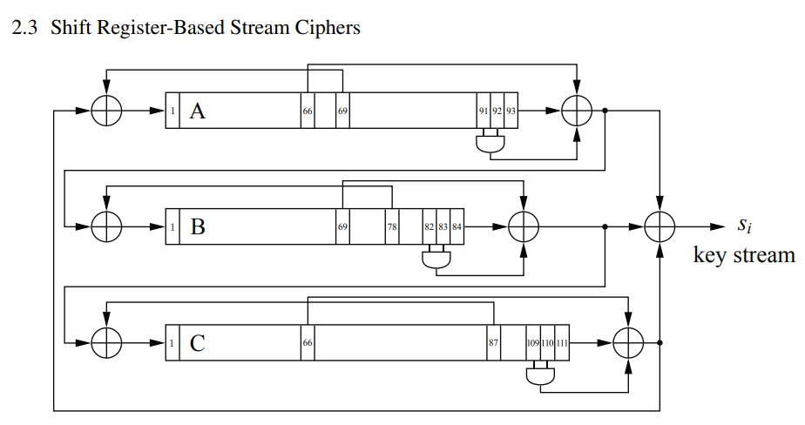
DEMYSTIFYING TRIVIUM CIRCUIT[2]

Slide 9
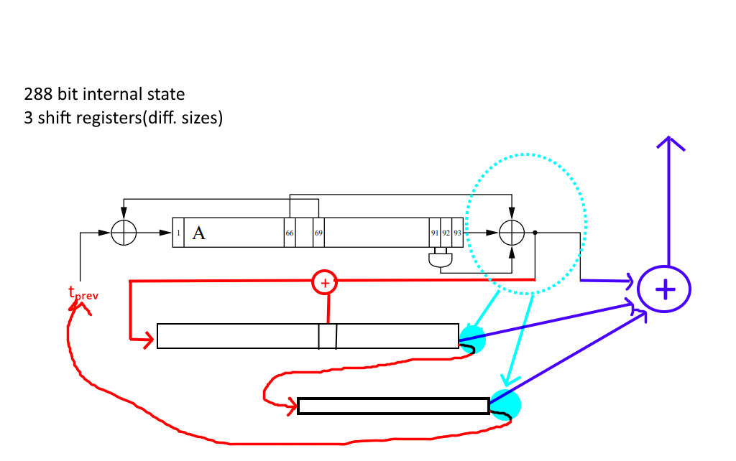
DISSECTED TRIVIUM CIRCUIT SKETCH

Slide 10
Initialization
Key🔑: bit 1 to 80
IV (Initialization Vector):94 to 178(Public)
Constant 000000111 bit 1281 to 288
Warm up Phase: No cipher output
First bit of stream is result of round 1153

Slide 11
Implementation[2]
Implementation requires 288-bit shift register and a few Boolean operations.
Hardware implementation requires about 3500 to 5500 gates depending on performance and components tradeoff
It is considerably smaller than most block ciphers such as AES and is very fast.
1.5 GHz Intel CPU can give theoretical encryption rate of 1 Gbit/sec

Slide 12
Parallelizability
State bits are not used for at least 64 rounds, and thus, 64 state bits can be generated in parallel with 5504 gates.
The above property allows an efficient bitslice implementation in software.

Slide 13
REFERENCES
Estream: The Ecrypt Stream Cipher Project. The eSTREAM portfolio page. (n.d.). Retrieved March 29, 2023, from https://www.ecrypt.eu.org/stream/
Paar, C., & Pelzl, J. (2010). Understanding Cryptography: Stream Ciphers, Trivium Cipher. Springer. ISBN: 978-3-642-04100-6.
"Trivium." eSTREAM. European Network of Excellence for Cryptology. Accessed on March 29, 2023. https://www.ecrypt.eu.org/stream/e2-trivium.html.
De Cannière, C., & Preneel, B. (2006). Trivium: A Stream Cipher Construction Inspired by Block Cipher Design Principles. eSTREAM Specification. Accessed on March 29, 2023, from https://www.ecrypt.eu.org/stream/ciphers/trivium/trivium.pdf.

Slide 14
Thanks!
ANY QUESTIONS AND FEEDBACK?

