Slide 1
Capstone Project - Car accident severity
By Yugal Kumar

Slide 2
Introduction
Car accidents can occur all the time, however there are some conditions were the probabilities of have an accident arise due multiple variables.
This report has as purpose develop a model for Seattle government to predict the probabilities of have a car accident and severity, based on different conditions as weather or road conditions.
The information was provided by Seattle Police Department from 2004 to 2020.
This analysis has multiple applications like an app that will prompt the drivers to be more careful depending on the weather and road conditions on any given day or a way for the police to enforce more safety protocols. In this instance, I am using the data from the City of Seattle’s police department showing all the collisions from 2004 till present.

Slide 3
Business Problem
Identify the conditions that can cause future car accidents in order to alarm the people with anticipation to be aware and drive more carefully.
The avoid of accidents will result in multiples benefits:
Save lives as main benefit
Reduce costs in damage infrastructure
Reduce cost from police and paramedics to attend each accident

Slide 4
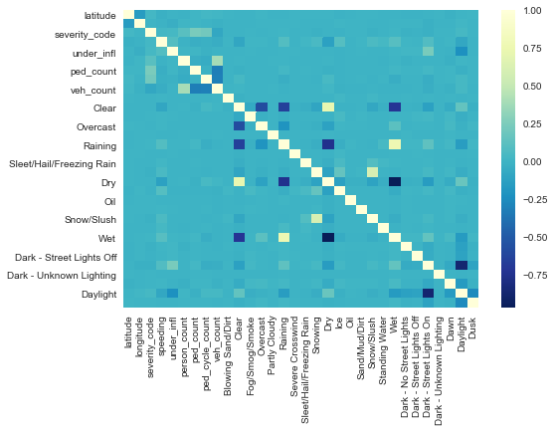
EDA – Exploration Data Analysis

Slide 5
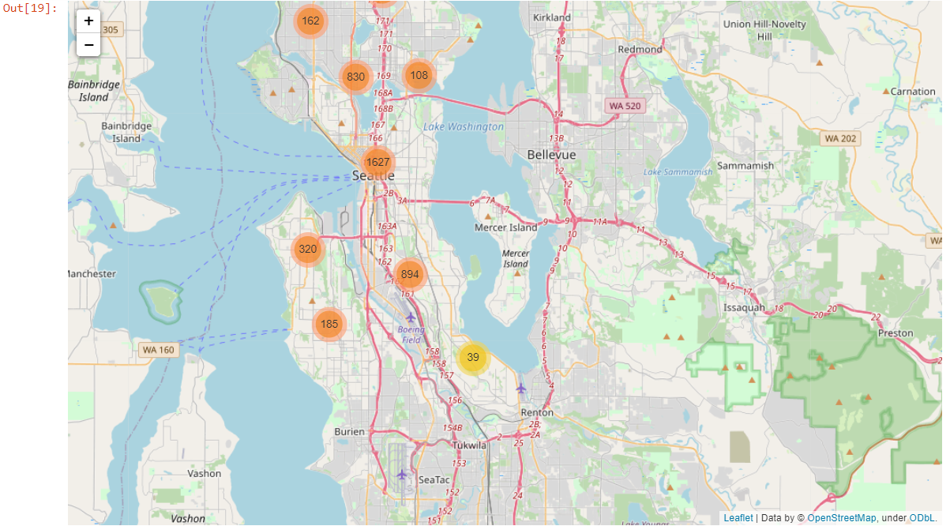
FoliumMap

Slide 6
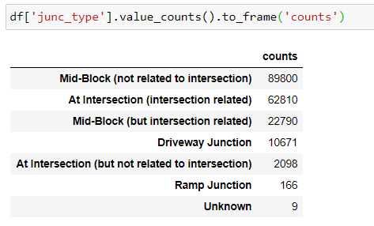
Junction Counts

Slide 7
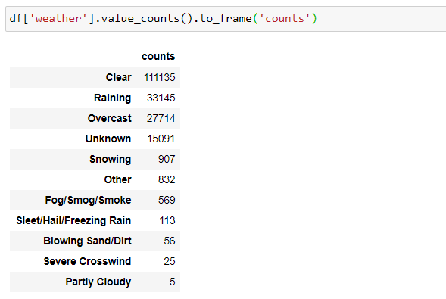
Weather Counts

Slide 8
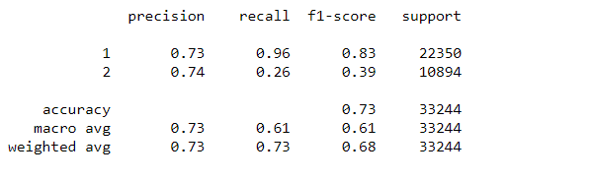
Model Score – DecisionTreeClassifier – 73% Accuracy

Slide 9
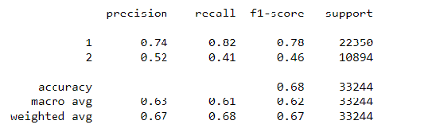
Model Score – RandomForestClassifier 68% Accuracy

Slide 10
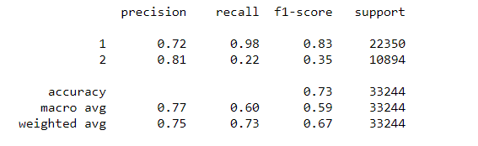
Model Score – Logistic Regression 72% Accuracy

Slide 11
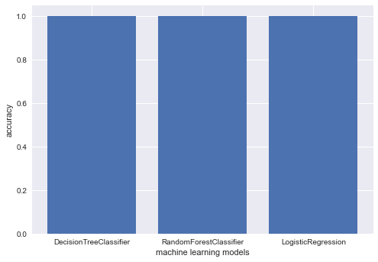

Slide 12
Conclusion
Initially, The classifiers had an prediction accuracy of 66%-71%, however, upon going back to the data preparation and taking additional fields in the dataset improved the overall accuracy of all models.
The accuracy of the classifiers is excellent, i.e. 100%. This means that the model has trained well and fits the training data and performs well on the testing set as well as the training set. We can conclude that this model can accurately predict the severity of car accidents in Seattle.

Slide 13
THANK YOU

