Slide 1
Computer Graphic
Homework 1
梁家葳 P76144540@gs.ncku.edu.tw
曾紹宇 P76144304@gs.ncku.edu.tw
實驗室：資訊新館65701

Slide 2
Objective
Write an OpenGL application with the following features
Load and render the 3d model
Render the model with the texture
Requirements
You can modify the sample code (recommend) or write your own code.
No limitation on Programming Language (sample is written in C++)
No limitation on Operating System

Slide 3
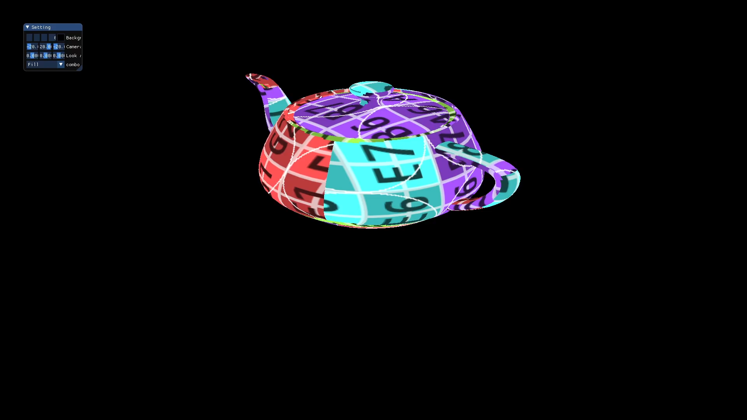
Example

Slide 4
Submission
Compress your file into <student ID>_<student Name>.zip
  e.g., P76144540_梁家葳.zip
Your zip file should include
      Source Code (Modified Only)
  Demo Video (Scoring heavily depends on the demo video)
  Report (pdf)
Upload to Moodle

Slide 5
Scoring Standard
Submitted on time
basic score 70
each bonus +3 or +5
report +1~3
Late submission
final score * 0.7
Incomplete 50
Not submitted 0
0
Plagiarism

Slide 6
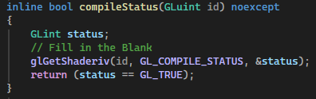
Modification Instructions
Only five files need to be modified for this homework
OpenGLShader.cpp
OpenGLTexture.cpp
OpenGLBufferObject.cpp
OpenGLShaderProgram.cpp
OpenGLVertexArrayObject.cpp
Find the // Fill in the blank Sections
Write the relevant OpenGL functions
See the corresponding .hpp file for function descriptions and object IDs

Slide 7
Homework1 Bonus
Basic Bonuses +3 (up to 4)
change Camera Position
change Look At
…
Advanced Bonuses +5 (only 2)
change model
change texture
Relevant model and texture examples are available at the following link.
https://free3d.com/3d-models/obj
https://sketchfab.com/search?q=.obj&type=models

Slide 8
Deadline
10/05 (Mon.) 12:00
TAs will post the scores on Moodle. If you have any questions about your score, please email the TA as soon as possible.
Late submission deadline 10/18 (Sun.) 23:59 (two weeks after the deadline)

Slide 9
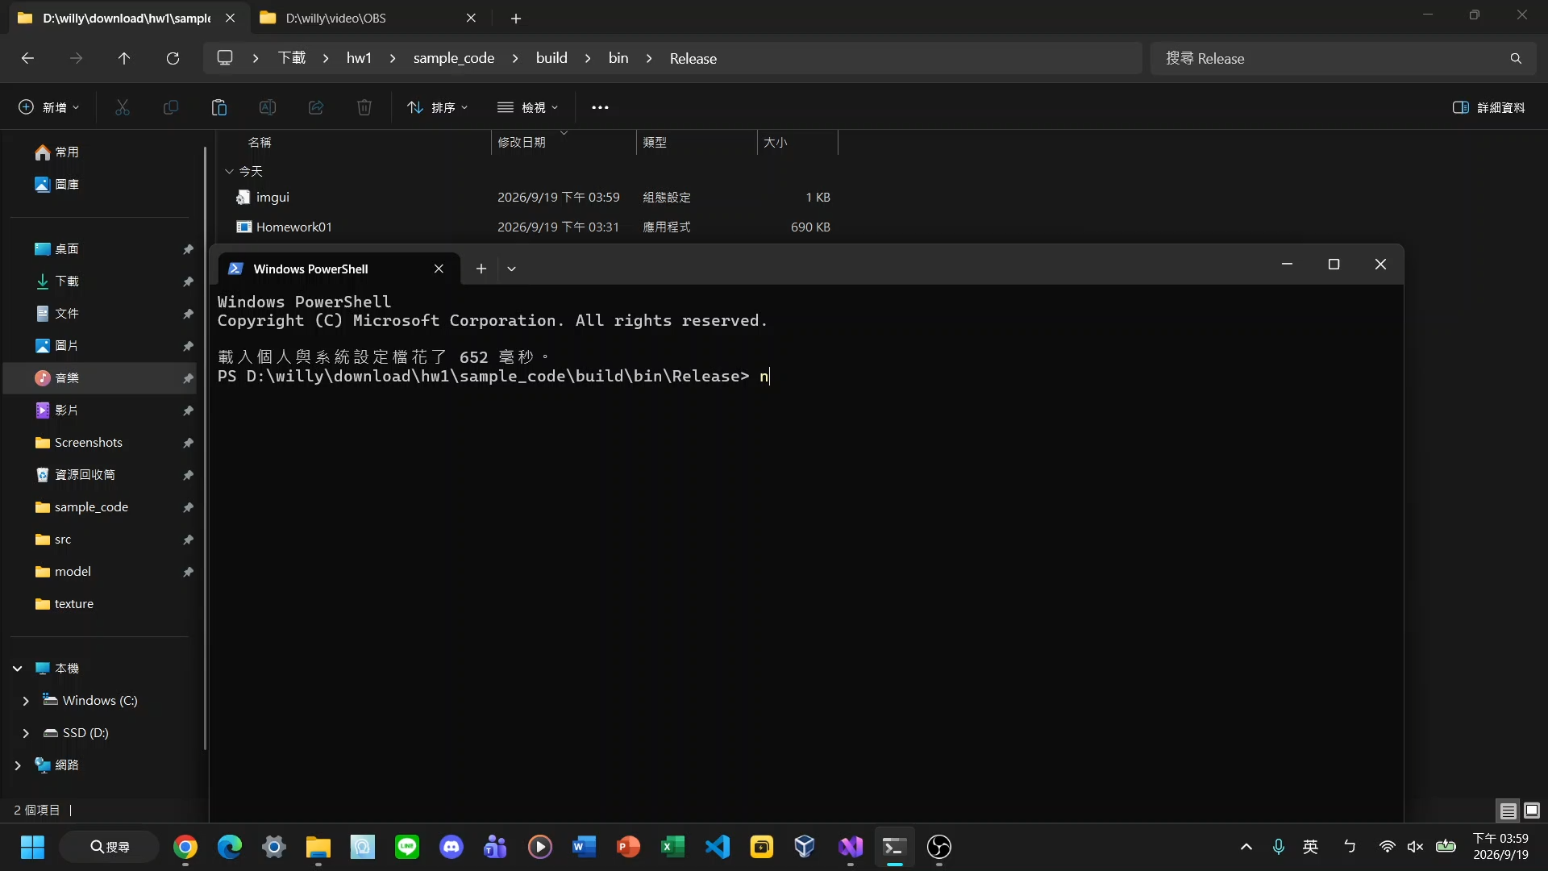
Demo Video Example
The video MUST include
How to run the program
The 3D model with texture
Bonus
  Scoring heavily depends on the demo video

Slide 10
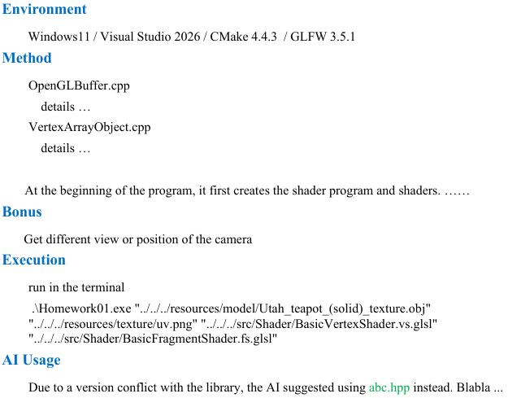
Report PDF Example
The report should contain
1. Environment
2. Method Description
3. Bonus
4. How to run the program
5. AI Usage
Please write in English/Chinese.

Slide 11
Sample Code

Slide 12
Enviroment
C++ & Cmake (Cross Platform)
OpenGL 3.3
Libraries
      glfw (download yourself) Creating windows,contexts and surfaces,handling events, etc.
      glad OpenGL loading library.
      glm (v0.9.9.8) Mathematic library.
      stb_image (v2.25) Image loader.
      tinyobjloader (v0.9.20) Obj file (3D model) loader.
      dear imgui (v1.77) Graphical user interface.
All under the thirdparty folder.

Slide 13
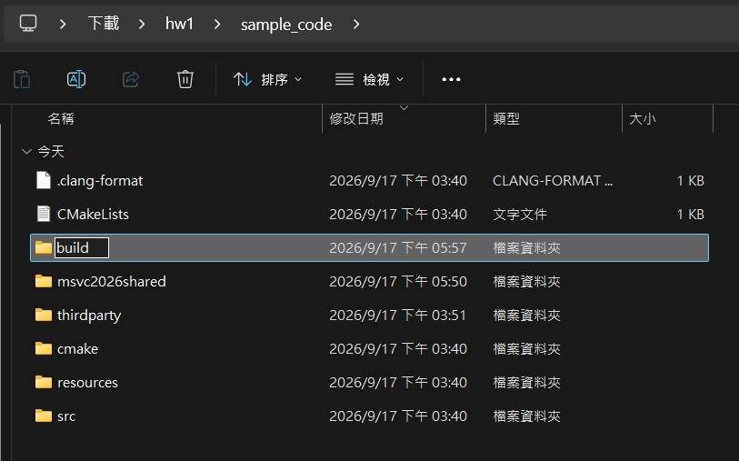
Environment Setup
1. Download & Unzip Hw1 from the course website http://graphics.csie.ncku.edu.tw/
Create a build folder under the sample code directory.

Slide 14

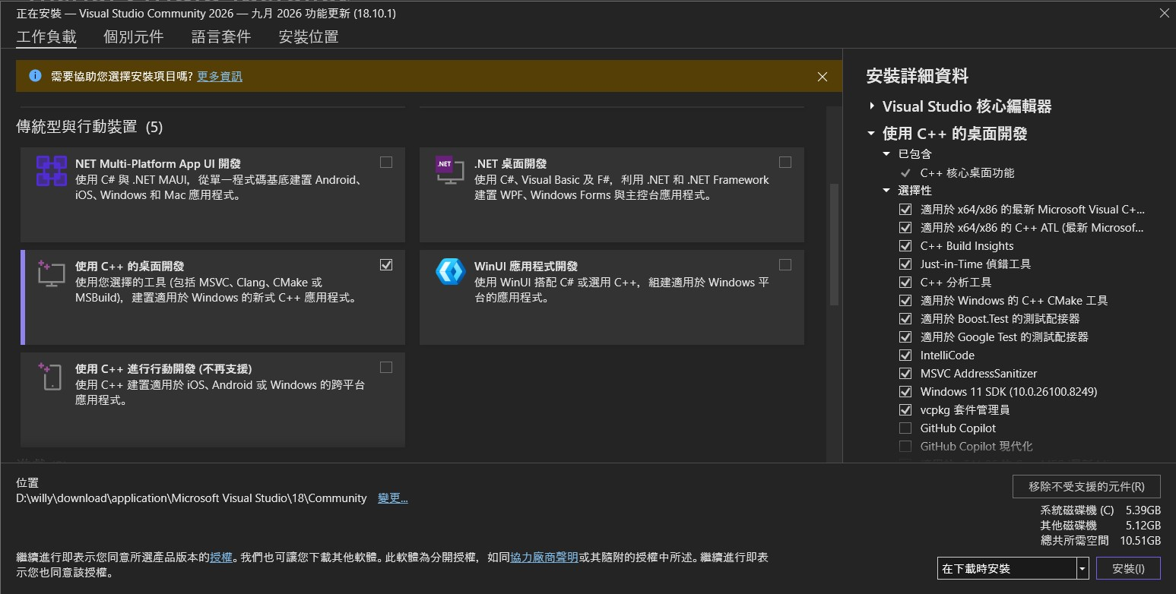
Environment Setup
2. Download & Install Visual Studio
The following instructions are for Visual Studio 2026
If you are using an older version, please refer to the [2025CG] → HW1 instructions

Slide 15
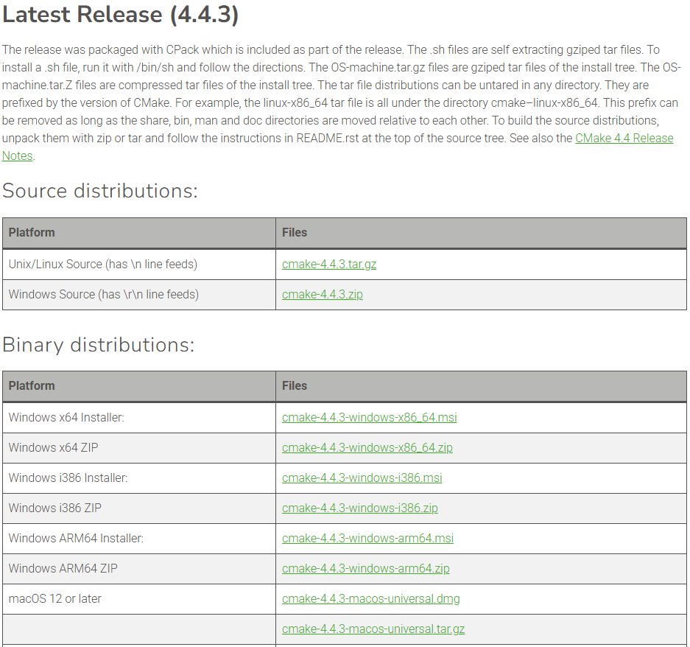
Environment Setup
3. Download & Install Cmake
Choose the appropriate version based on your computer.

Slide 16
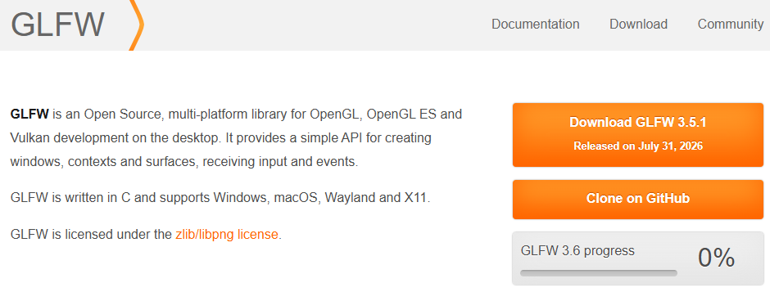
Environment Setup
4. Download GLFW

Slide 17
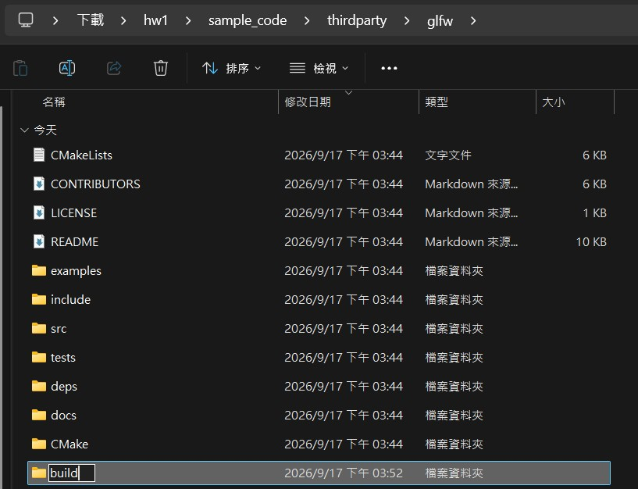
Build GLFW
Extract the files and create a build folder inside the glfw folder

Slide 18
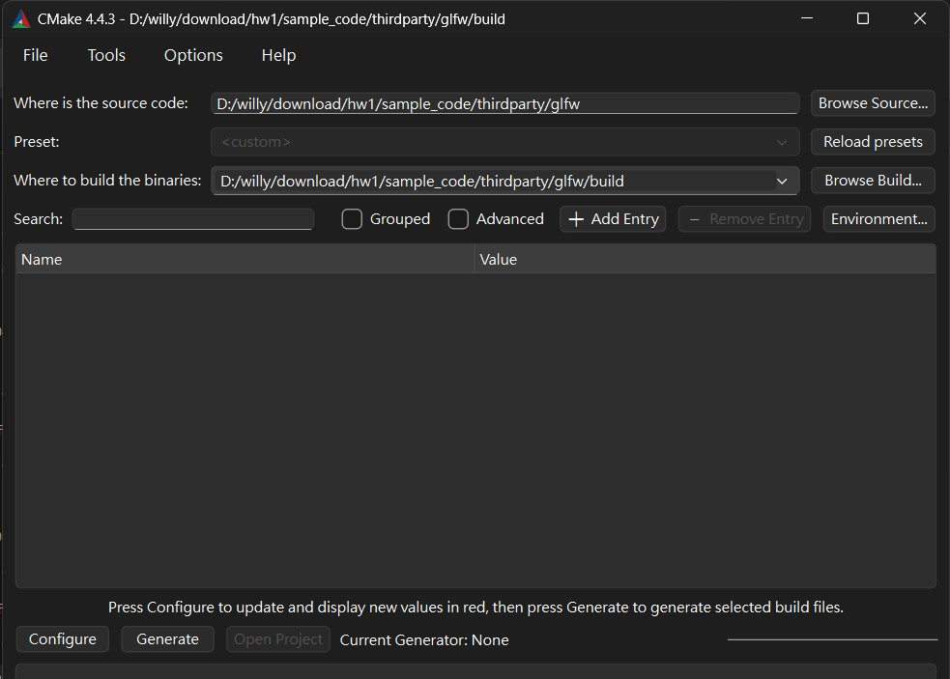
Build GLFW
Open CMake and set the paths

Slide 19
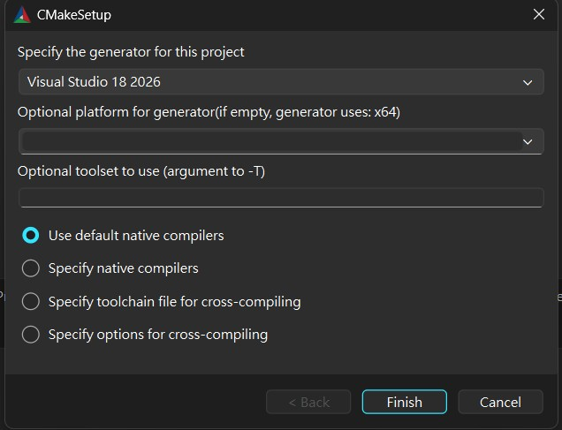
Build GLFW
Generator settings
Specify the IDE to use for project generation
Specify the target architecture, indicating CPU architecture the generated program will run on
Specify the compiler toolchain version.
If left empty, CMake uses the default toolset associated with the selected generator
If no other changes are needed, click Finish

Slide 20
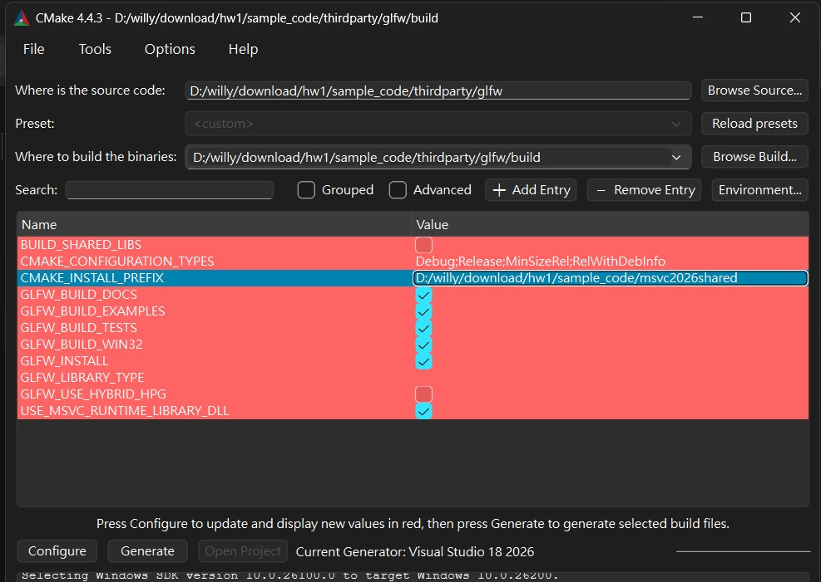
Build GLFW
Setting the installation path
The default installation path is
C:/Program Files (x86)/GLFW.
CMake may encounter permission issues when writing files to this directory
Therefore, it is strongly recommended to create a new directory, such as sample_code/msvc2026shared, and set CMAKE_INSTALL_PREFIX to directory
Click Configure again, then click Generate

Slide 21
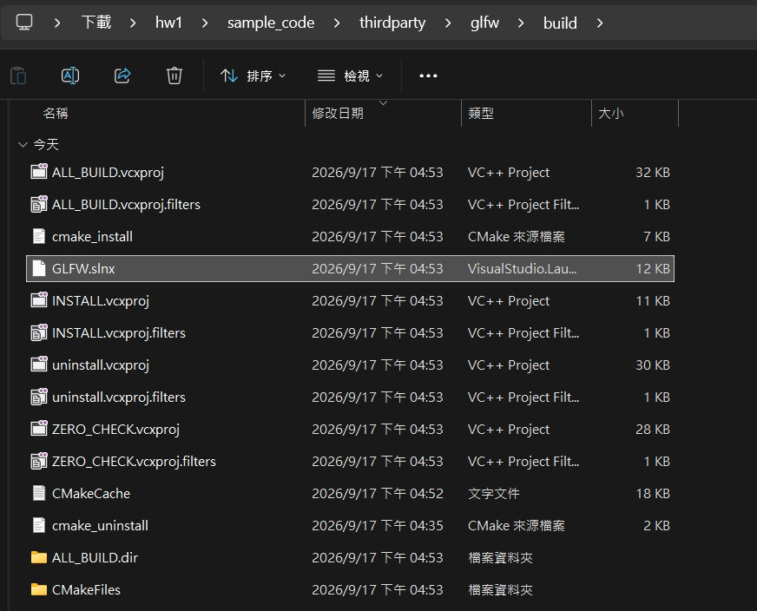
Build GLFW
Open build/GLFW.slnx

Slide 22
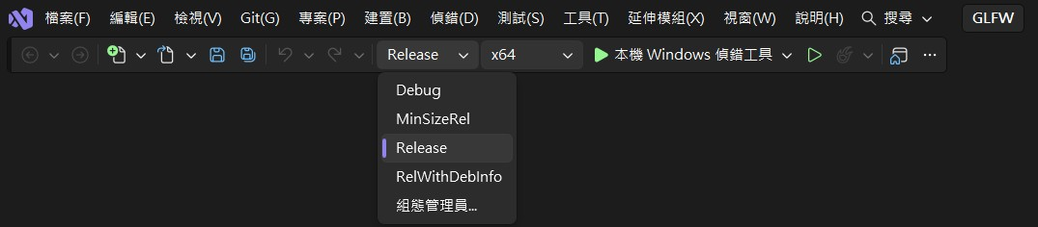
Build GLFW
Switch to Release mode

Slide 23
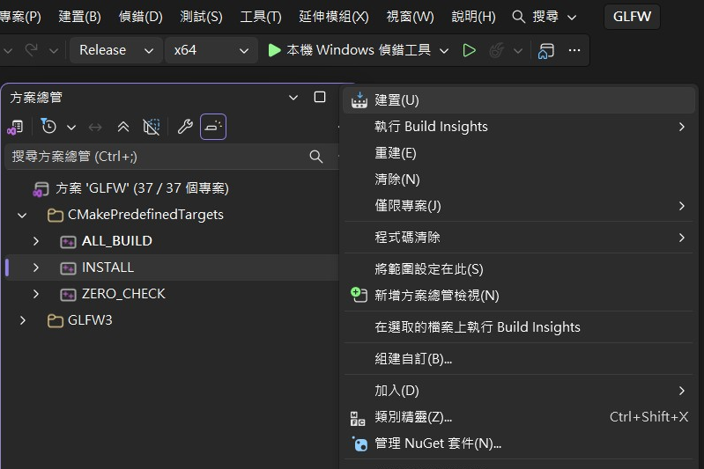
Build GLFW
Right-click INSTALL and select Build

Slide 24
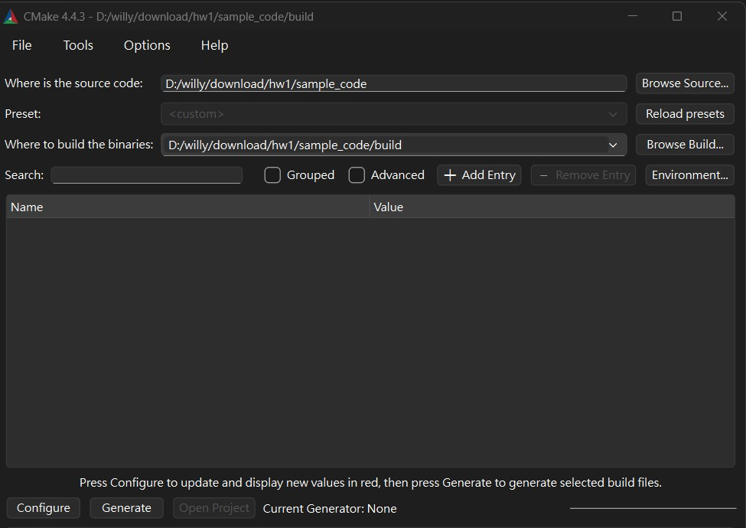
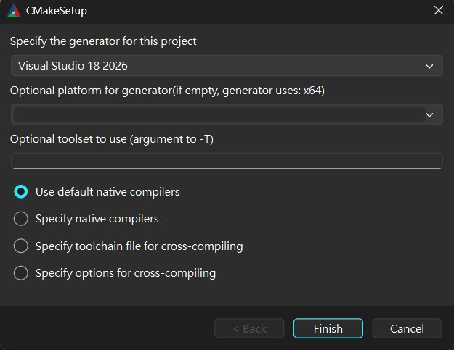
Build the sample code
Open CMake and set the paths
Use the same setting as before

Slide 25
Build the sample code
Modify three CMake configuration files
If you encounter the following error message, you can resolve it using the steps shown on the next slide

Slide 26
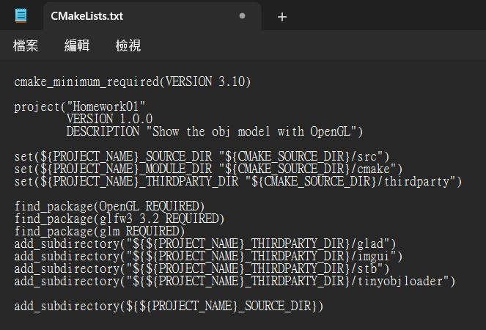
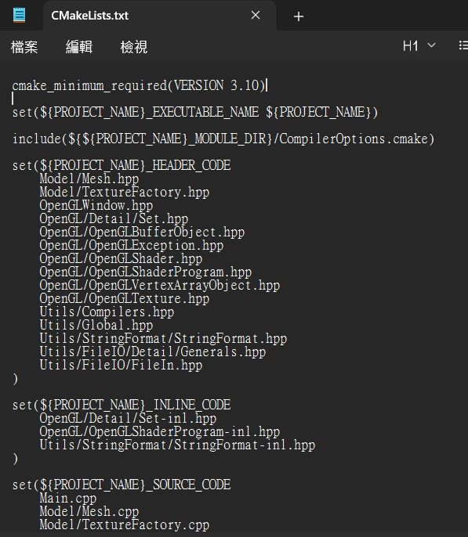
Build the sample code
Modify three CMake configuration files
cmake_minimum_required(VERSION 3.10)
sample_code\CMakeLists.txt
sample_code\src\CMakeLists.txt

Slide 27
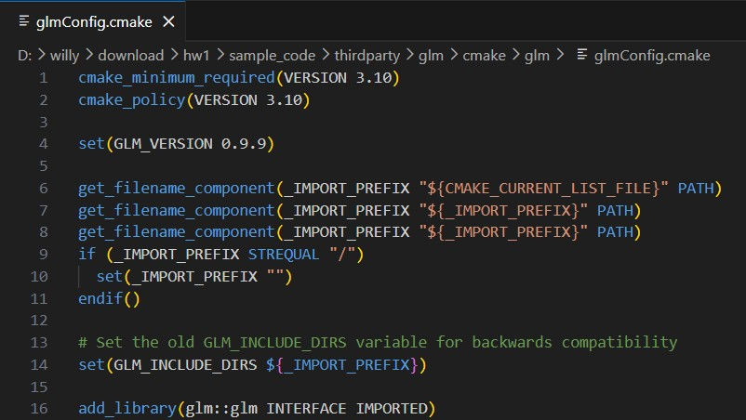
Build the sample code
Modify three CMake configuration files
cmake_minimum_required(VERSION 3.10)
cmake_policy(VERSION 3.10)
sample_code\thirdparty\glm\cmake\glm\glmConfig.cmake

Slide 28
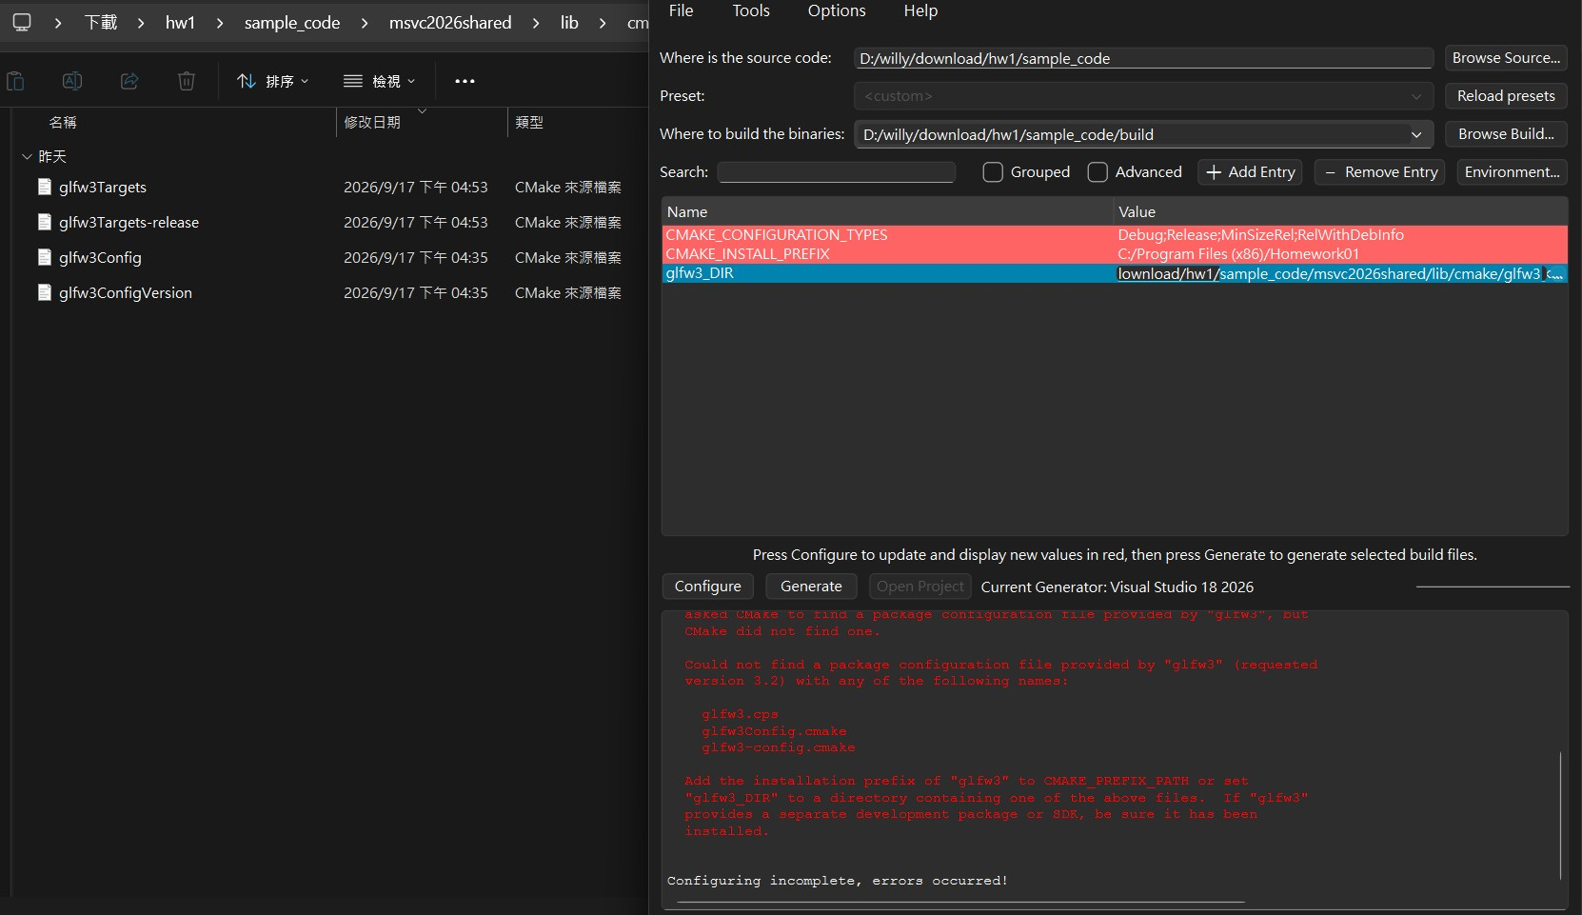
Build the sample code
Set glfw3_DIR
The first Configure step is expected to fail
Make sure these files are in the folder
set glfw3_DIR to the previously created /msvc2026shared/lib/cmake/glfw3

Slide 29
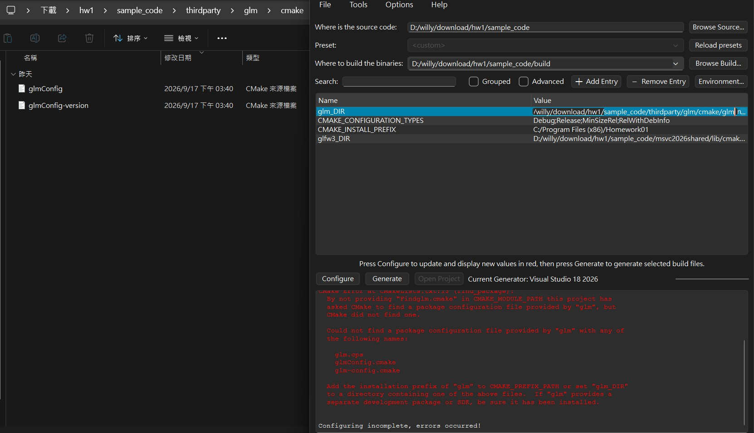
Build the sample code
Set glm_DIR
The second Configure step is expected to fail
set glm_DIR to sample_code/thirdparty/glm/cmake/glm
click Configure again. Once it completes successfully, click Generate
If there is still an error, carefully read the error message and try to fix it

Slide 30
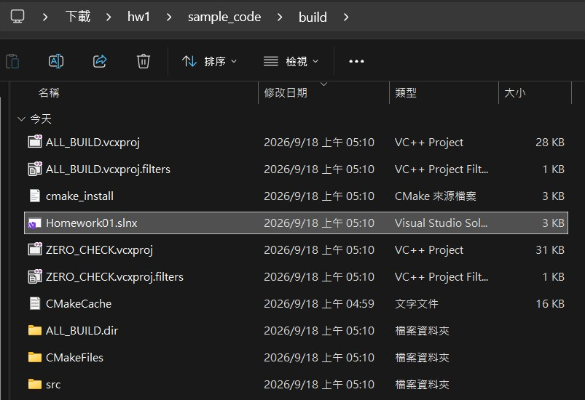
Build the sample code
Open sample_code/build/Homework01.slnx

Slide 31
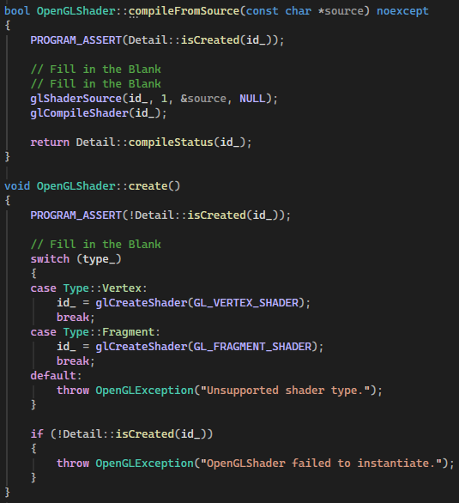
Modification Sample Code
Edit Sample Code
please refer to the earlier slide for instructions

Slide 32
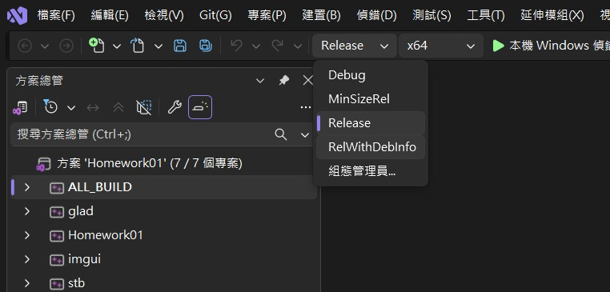
Build the sample code
Switch to Release mode

Slide 33
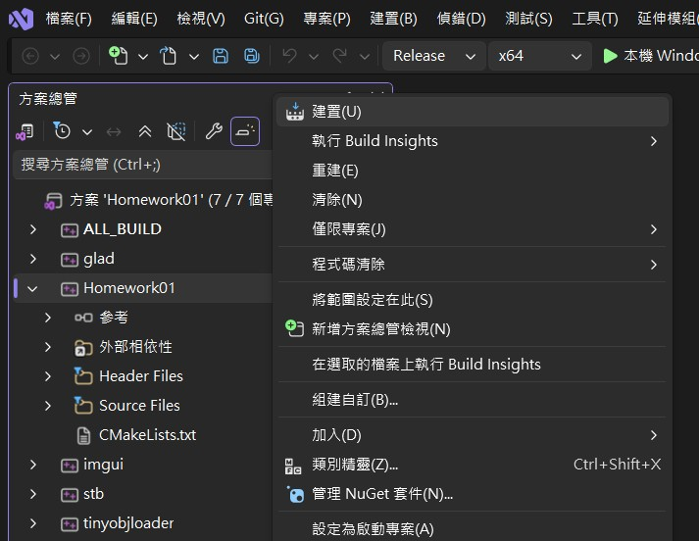
Build the sample code
Right-click Homework01 and select Build

Slide 34
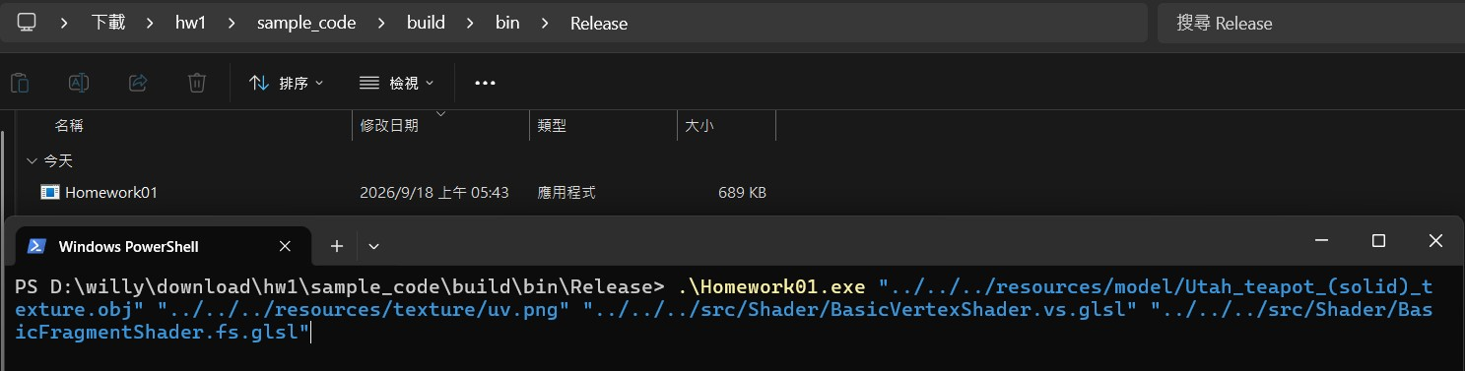
Run the sample code
1. Run in terminal
If the build is successful, you will find Homework01.exe under sample_code/build/bin/Release
Run the following command
.\Homework01.exe "../../../resources/model/Utah_teapot_(solid)_texture.obj" "../../../resources/texture/uv.png" "../../../src/Shader/BasicVertexShader.vs.glsl" "../../../src/Shader/BasicFragmentShader.fs.glsl"
Arguments: " model_path " " texture_path " " VertexShader_path " " Fragment_path "

Slide 35
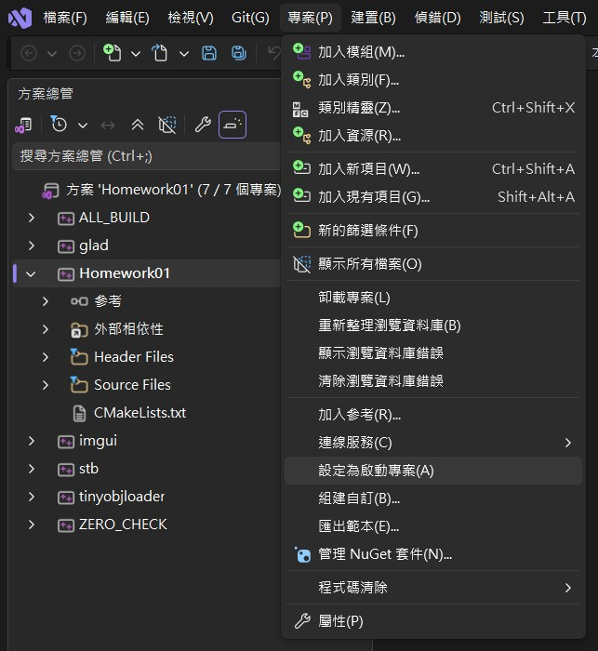
Run the sample code
2. Run in Visual Studio
Right-click Homework01 and select Set as Startup Project

Slide 36
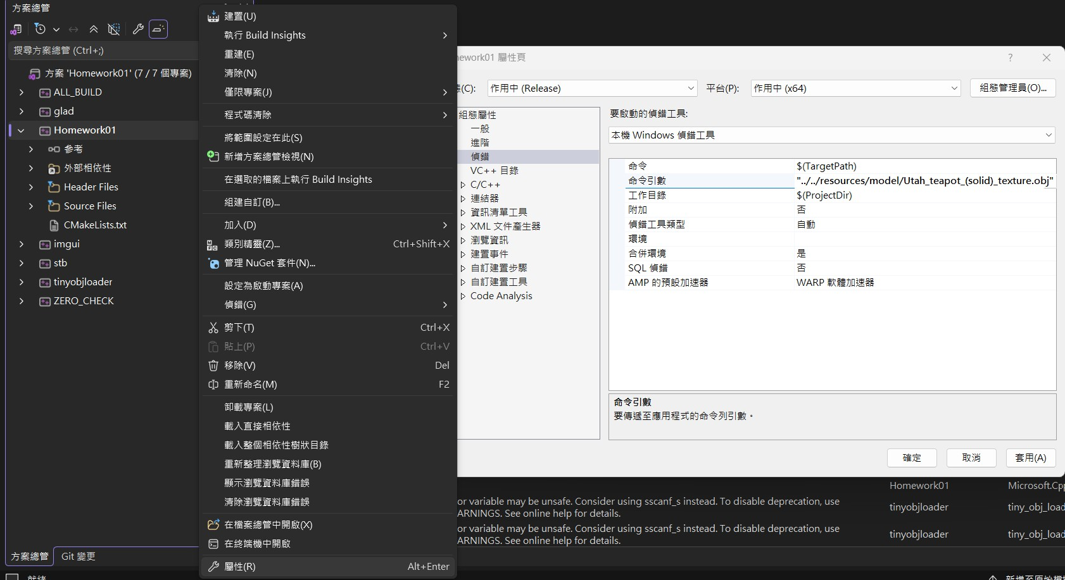
Run the sample code
2. Run in Visual Studio
Right-click Homework01 and select Properties
since debugging starts from build/src
Click Debugging and enter the following arguments in the Command Arguments
"../../resources/model/Utah_teapot_(solid)_texture.obj" "../../resources/texture/uv.png" "../../src/Shader/BasicVertexShader.vs.glsl" "../../src/Shader/BasicFragmentShader.fs.glsl"

Slide 37
Linux
# Install required dependencies
sudo apt update
sudo apt install build-essential cmake libglfw3-dev libglm-dev
# 1. After extracting Hw1, enter the project directory
cd Hw1/sample_code
# 2. Create the build directory
mkdir -p build
cd build
# 3. CMake configure
cmake ..
# 4. Modify the C++ source code
# 5. Compile
cmake --build .
# 6. Enter the executable directory
cd bin
# 7. Execute
./Homework01 \
"./resources/model/Utah_teapot_(solid)_texture.obj" \
"./resources/texture/uv.png" \
"./Shader/BasicVertexShader.vs.glsl" \
"./Shader/BasicFragmentShader.fs.glsl"

