Slide 1
chem_corp

Slide 2
Company lost five long term customers who generated companies 10% of sales revenue. We need an immediate short-term action plan to prevent further loss of customers and protect the existing market share!
New startups are offering optimized delivery channels for chemicals; a few companies have started using new technologies like machine learning and artificial intelligence to create new chemicals and lower the production costs for existing chemicals.
five long-term customers revealed that ChemCorp was no longer these firms’ preferred provider of chemicals. After these customers left, the sales management team found that ~ 10% of sales revenue ca
ChemCorp’s market share and potential customer-base would gradually erode, damaging the board’s confidence in existing management. This unchecked trend could also indicate a potential risk in the company’s ability to make dividend payments to shareholders if losses prove to be too steep.
me from these customers

Slide 3
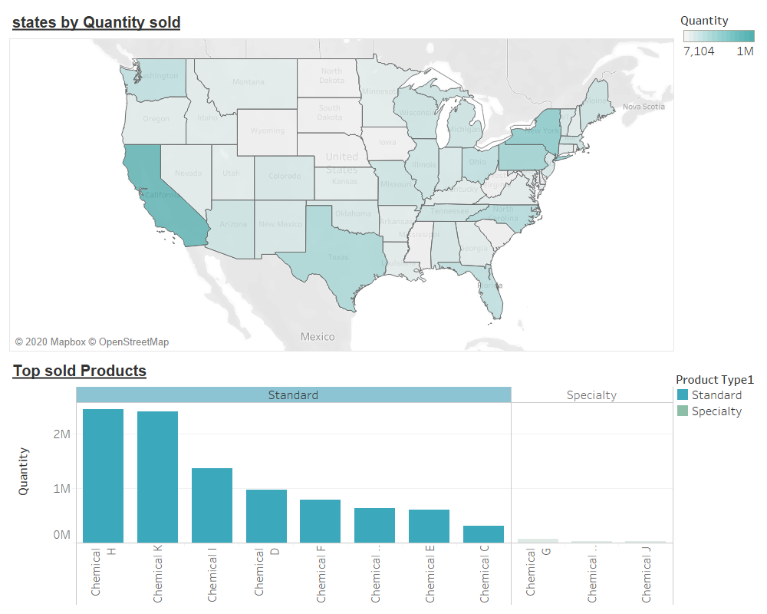
Customer Strategy:
Most successful sales are for Chemical H and Chemical K
Top states with maximum sales are seen by darker green color. California is almost 40% higher than rest of the states.
Standard business type is the best selling business across all the Products and states.

Slide 4
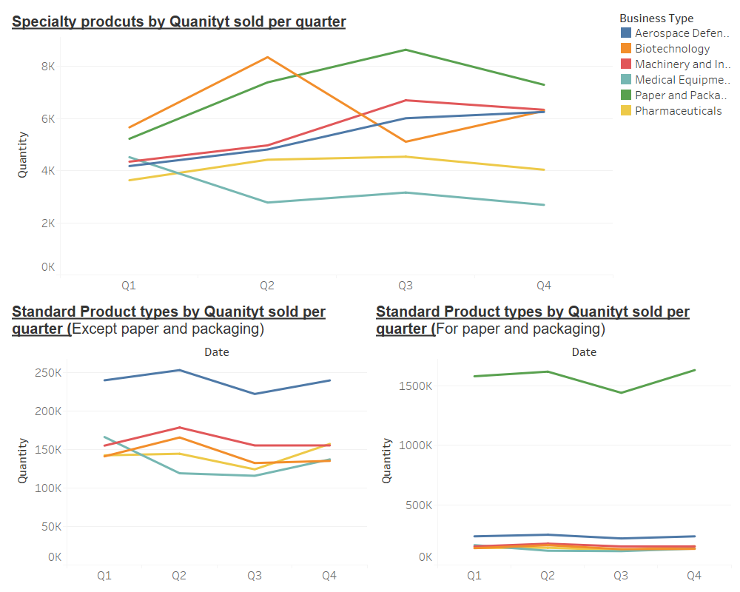
Customer Strategy:
Looking at the sales across quarters:
Most of the specialty products have seen a slightly upward trend in sales. Strong variation is seen only in Biotechnology.
Need to asses declining Medical Equipment sales across both specialty and standard products.

Slide 5
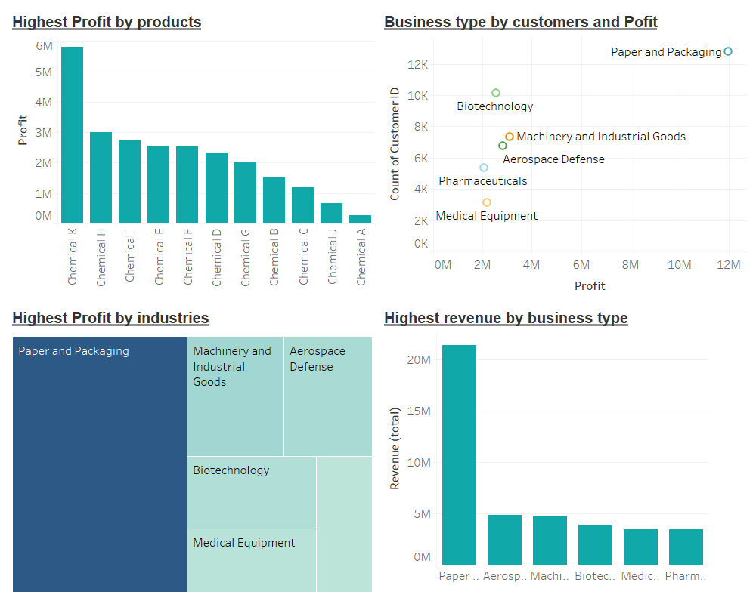
Market Opportunities
Highest Profitable Business is Paper and Packaging but interestingly also has lowest Profit Margin.
There is not much dependability between Profit margin and number of customers per segment.

Slide 6
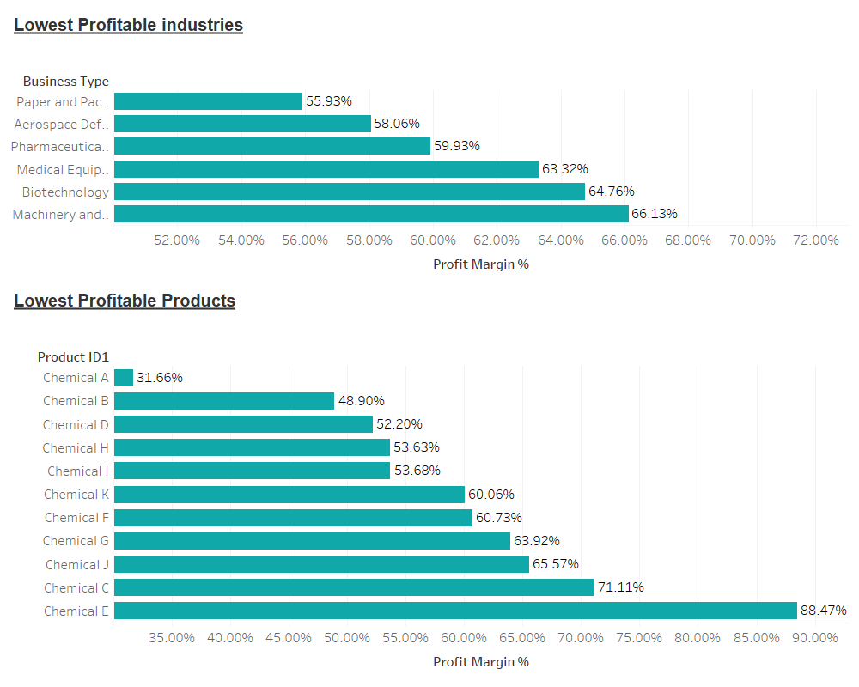
Product Divestment:

