Slide 1


Slide 2
Agenda
Problem Statement 03
Data Mining - 01 04
Data Mining - 02 05
Exploratory Data Analysis (EDA) 06
Data Visualization 07
Algorithms Used 08
Analysis of Results 09
Conclusion & Future Work 10

Slide 3
Problem Statement
To design a predictive model with the use of machine learning and datasciencealgorithms to forecast whether or not it will rain tomorrow in Australia
The dataset is taken from Kaggle and contain about 10 years daily weather observations from many locations across Australia

Slide 4
Data Mining - 01
Weather In Australia dataset is saved to another backup file
Display all information it consists
Float64(17)
Object(7)
Checking the missing values/null vales in the data set

Slide 5
Data Mining - 02
Identify the proportion of target variable(RainTomorrow)
Check the duplicate values
Drop duplicates if any
Dropping of columns which not effect the target variable
Identify the dependent and independent variables in the data set

Slide 6
Exploratory Data Analysis (EDA)
Split the data into two types
Train-70%
Test-30%
Scaling of data set by using min max scaler
Now continue the classification analysis by apply the different algorithms to dataset
Observe the accuracy
Compare all algorithms and identify the most relevant features that contribute significantly to the credit card approval task

Slide 7
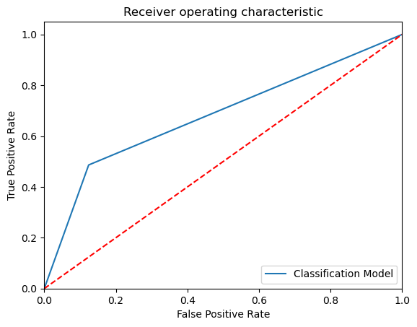
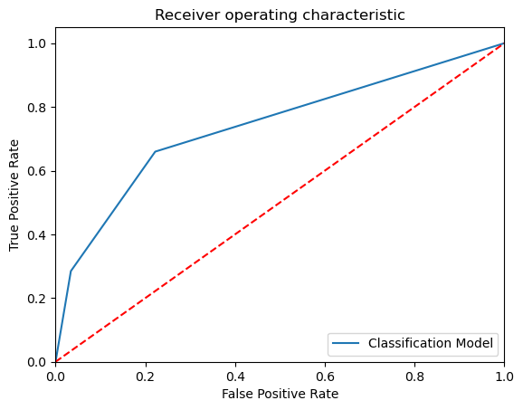
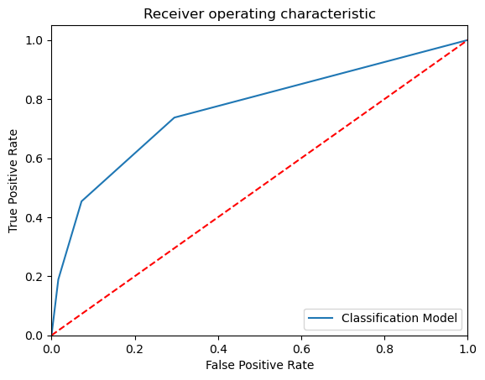
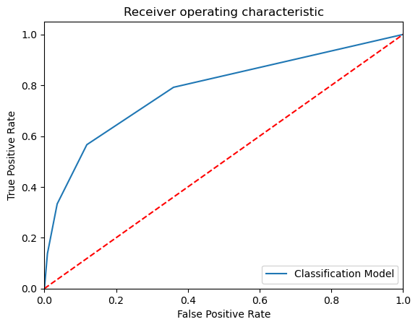
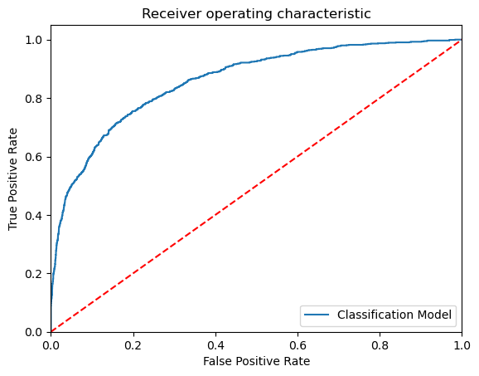
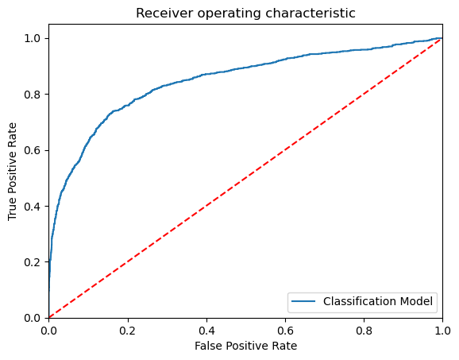
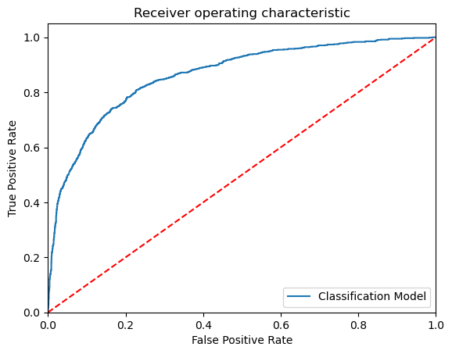
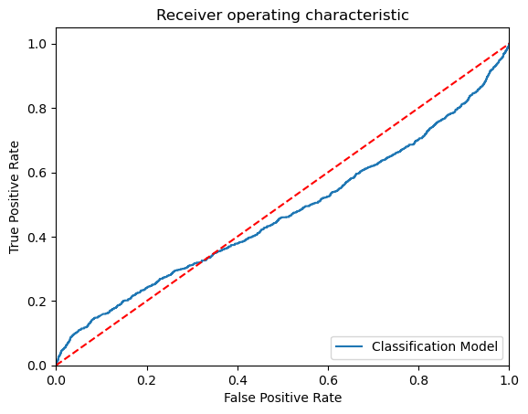
Data Visualization
In [62]:
KNN_K_value = 1
KNN_K_value = 2
KNN_K_value = 3
KNN_K_value = 4
Model Name: SVM - Linear
Model Name: SVM - Polynominal
Model Name: SVM - Sigmoid
Model Name: SVM - Gaussian

Slide 8
Algorithms Used
Some common use algorithms for credit card approval are
Logistic regression
Decision tree
Random forest
KNN
Support vector machines(SVM)
GaussianNB

Slide 9
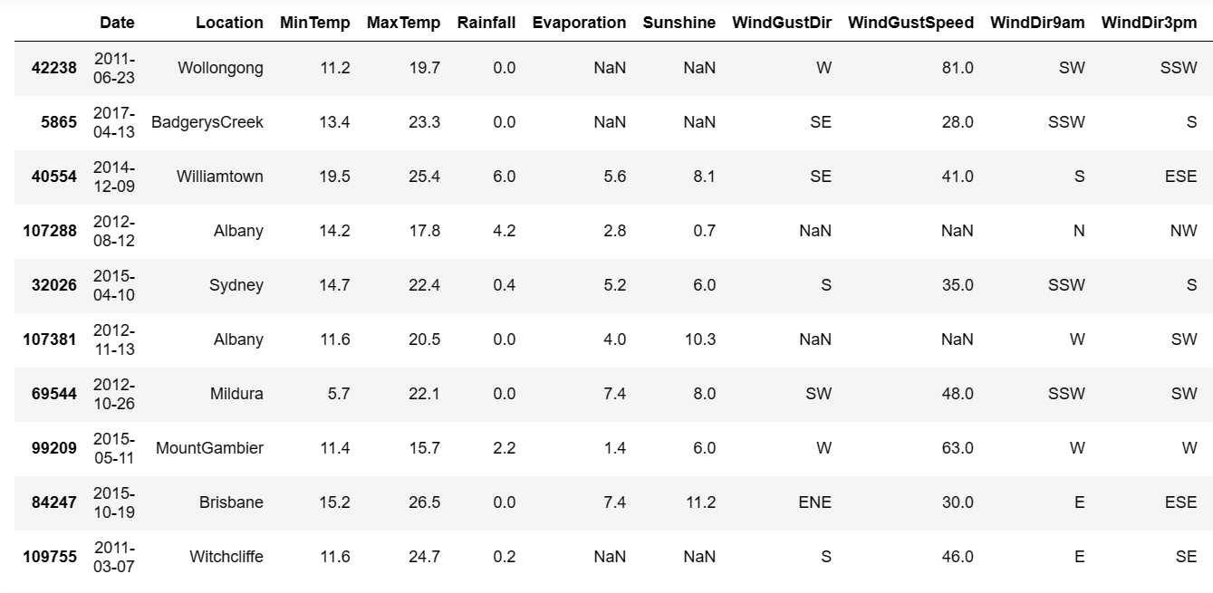
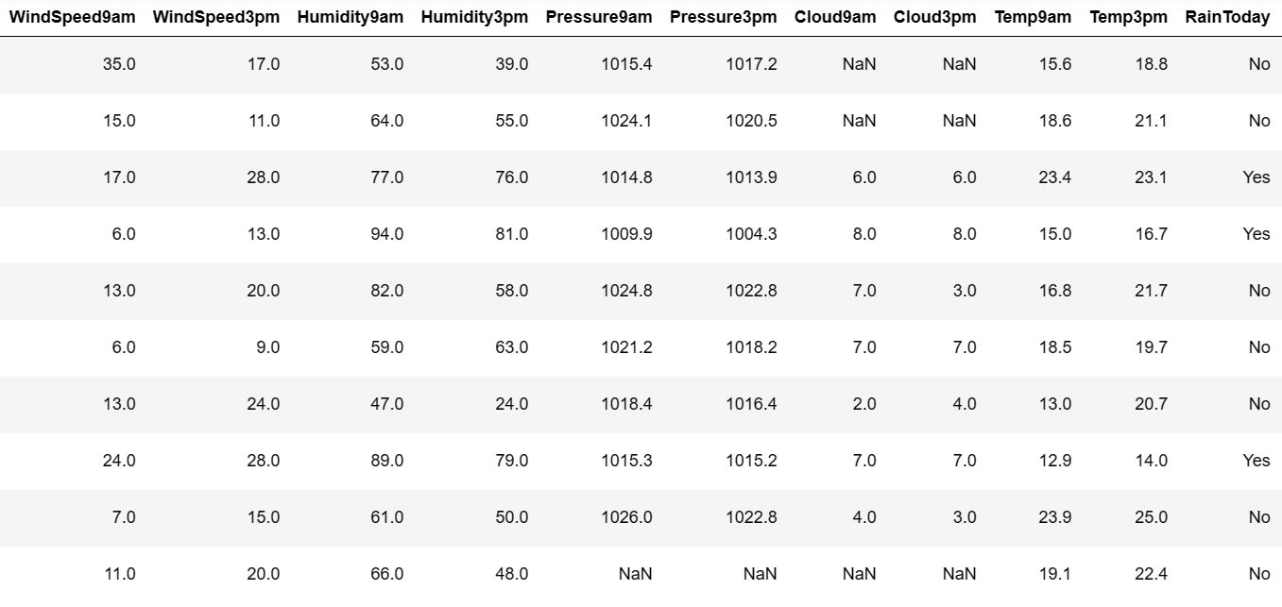
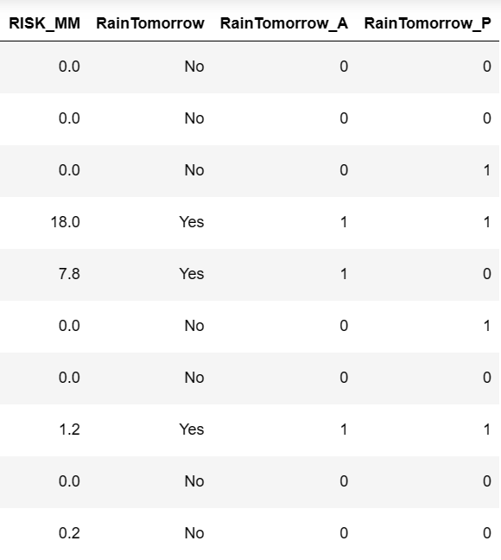
Analysis of Results

Slide 10
Conclusion and Future Work
Conclusion :
The DecisionTreeClassifier() model accuracy score is 0.853 . The model does a
very good job of predicting
Future work:
Future work includes refining the model by integrating behavioral analytics and real-time data for more accurate credit card approval predictions.

Slide 11
Thank You
Q & A
Student Name : BUDUMURU YUGANDHAR
Roll Number : 21B91A0426
SRKR Engineering College
Mobile: +91 8125727045
Email: 21B91A0426@srkrec.ac.in
Bhimavaram - India

