Slide 1
Bettle Track Application
Application Directory Structure
v1.0
Author: Yugandhar Gangu

Slide 2
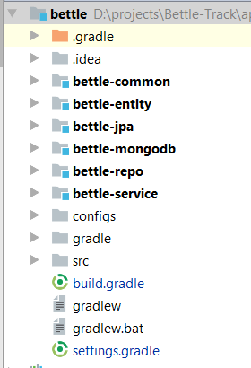
1. Project location
Main project
Sub modules
Config files for multi war file generations
Main project source directory

Slide 3
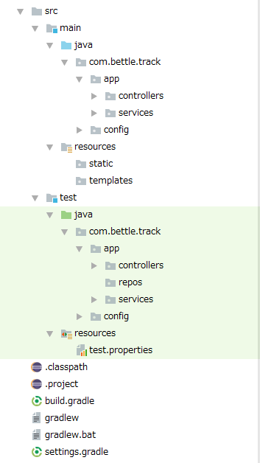
2. Main Project files
Source Code Location
src
|- main (Main application source files)
|- java (JAVA class files)
|- com.bettle.track.* (Package)
|- resources (Resource files)
|- static (All public access files, css, js, images etc)
|- templates (Thymeleaf HTML files)
|- test (Test application source files)
|- java (JAVA test class files)
|-resources (Test configuration files)
Gradle script file location
Contains:
Controller and Service classes
Repository interfaces
- These interfaces will implemented by sub modules
bettle-jpa and betle-mongodb
HTML, CSS, JS, Image and etc files
To include sub modules

Slide 4
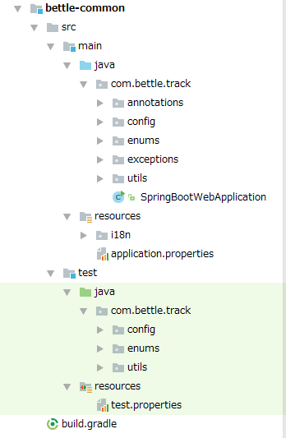
3. Bettle-Common module files
-src => source files
-main => Main application files
-java => JAVA class files
-com.bettle.track => Root package name
-annotations => All custom annotations
-config => Spring Boot configuration classes
-enums => All common enums
-exceptions => All custom exceptions
-utils => All utility classes
-SpringBootWebApplication.java => Spring boot application class (Main method class)
-resources => Resource files
-i18n => All i18n properties files
-application.properties => Spring boot config file
-test => Test files
-java => JAVA test classes
-com.bettle.track.* => Package
-resources => Test resource files
-test.properties => Test configuration files
-build.gradle => bettle-common sub module gradle file
Contains:
Springboot config files, i18n message files, Utility classes and Common classes

Slide 5
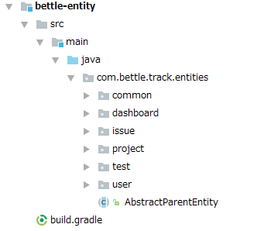
4. Bettle-Entity modules files
-src
-main
-java
-com.bettle.track.entities => Root package for database entities
-common => Common entities
-dashboard => Dashboard module entities
-issue => Issues module entities
-project => Project module entities
-test => Test module entities
-user => User module entities
-AbstractParentEntity.java => Parent entity class of all entities
-build.gradle => Bettle-Entity sub module gradle file
Contains:
Database entities

Slide 6
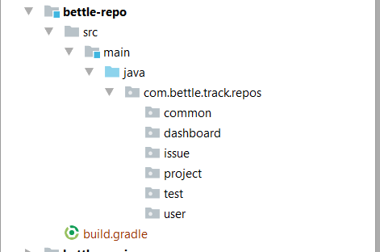
5. Bettle-Repo modules files
-src
-main
-java
-com.bettle.track.repos => Root package for repository interfaces
-common => Common repos
-dashboard => Dashboard module repos
-issue => Issues module repos
-project => Project module repos
-test => Test module repos
-user => User module repos
-build.gradle => Bettle-Repo sub module gradle file
Contains:
Repository interfaces
- Will be implemented by bettle-jpa and bettle-mongodb modules
- Will be used in bettle-service module as AutoWired objects

Slide 7
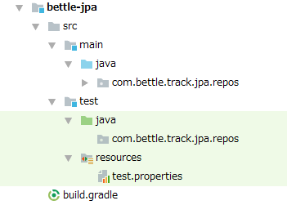
6. Bettle-JPA module files
-src
-main => Main application files
-java => JAVA classes
-com.bettle.track.jpa.repos.* => Root package
-test => Testing files
-java => JAVA test classes
-com.bettle.track.jpa.repos.* => Root package
-resources => Test resource files
-test.properties => Test configuration
-build.gradle => Bettle-JPA sub module gradle file
Contains:
Repository implemented classes for all databases
- MySql
- Oracle
- PostgreSQL
- DB2
- SQL server

Slide 8
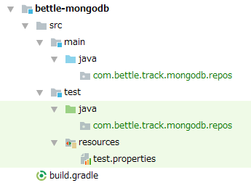
7. Bettle-MongoDB module files
-src
-main => MongoDB application files
-java => JAVA classes
-com.bettle.track.mongodb.repos.* => Root package
-test => Test files
-java => JAVA classes
-com.bettle.track.mongodb.repos* => Root package
-resources => Test resource files
-test.properties => Test configuration file
-build.gradle => Bettle-MongoDB module gradle file
Contains:
Repository implemented classes for MongoDB

Slide 9
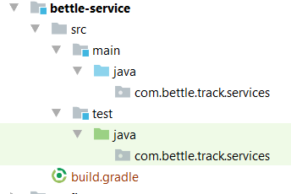
8. Bettle-Service module files
-src
-main => All service layer files
-java => JAVA classes
-com.bettle.track.services.* => Root package
-test => Test files
-java => JAVA classes
-com.bettle.track.services.* => Root package
-build.gradle => Bettle-Service module gradle file
Contains:
Service layer service classes
- Will uses the bettle-repo interfaces
- Will use in controller layer

Slide 10
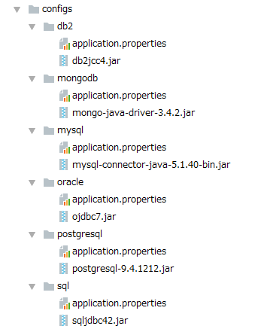
9. Configs Directory
-configs
-db2
-mongodb
-mysql
-oracle
-postgresql
-sql
Note:
application.properties file is SpringBoot and Database config file
*.jar file is JAVA database driver file
Contains:
All config files for war generation.
Build.gradle includes these files while generating the war files

Slide 11
EOF

