Slide 1

AI-Based UAV Communication Digital Twin for Throughput Prediction and Reliability Assessment
In simple words: predicting a drone's 5G download speed, and telling how far we can trust that prediction.
TEAM
D. Karthik | 2520040082
S. Karthikeya | 252004004
P. Yugandhar | 2520040027
Guide: N. Lava Prasad | KL University
Notes:
UPLOAD (optional): a UAV photo or KL University logo in the dashed box at top-right. Check roll number 252004004 (9 digits, others have 10).

Slide 2
Problem Statement
01 | PROBLEM STATEMENT
1
What is happening
WHAT A DIGITAL TWIN SHOULD GIVE
A UAV flying over a 5G/LTE link sees changing signal quality (SNR), position, speed and battery, so its download speed keeps changing.
Usual model
one value
2
What goes wrong
Our digital twin
Normal models give one number with no sign of how reliable it is, and fail silently when conditions change.
value ± uncertainty + mismatch alert
Why it is hard
Knowing when the prediction is shaky is as useful as the prediction itself.
3
The recorded flight is short and conditions shift over time, so what the model learned early may not hold later.
Goal: predict UAV download throughput with uncertainty and check whether the twin can be trusted.
Notes:
UPLOAD: nothing required. Optional drone/5G sketch in the right panel.

Slide 3
Proposed Methodology / Algorithm
02 | PROPOSED METHODOLOGY / ALGORITHM
1
Merge the data
SNR, download and telemetry files are matched by timestamp (within 2 s).
MONTE CARLO DROPOUT
1 pass
Mean
= prediction
2
Split by time
First 70% train, next 15% validation, last 15% test (no shuffling).
2 pass
→
3
Scale features
… 100 passes
Std
= uncertainty
StandardScaler fitted on training data only.
4
Train models
Random Forest baseline and a neural network (FidelityNet).
Same input, slightly different network each time. If the answers spread out, the model is unsure.
5
Add uncertainty
Keep dropout ON and predict 100 times: mean = answer, std = uncertainty.
6
Check the twin
Fidelity score, persistence baseline and mismatch alerts from validation errors.
Notes:
UPLOAD: nothing required.

Slide 4
Input Features and Targets
03 | PROPOSED METHODOLOGY / ALGORITHM
16 INPUT FEATURES
4 TARGETS (what we predict)
1
snr_lw1
9
Yaw
dl_lw1 download, link 1
2
snr_lw2
10
Roll
dl_lw2 download, link 2
3
snr_lw3
11
VelocityX
dl_lw3 download, link 3
4
snr_lw4
12
VelocityY
5
Longitude
13
VelocityZ
dl_lw4 download, link 4
6
Latitude
14
BatteryVolts
Cyan = signal quality (SNR) | Purple = UAV flight state. Links lw1 to lw4 are four separate wireless links measured in the same flight.
7
Altitude
15
GPSFix
8
Pitch
16
NumberOfSatellites
Notes:
UPLOAD: nothing required.

Slide 5
Project Workflow / Implementation
04 | PROJECT WORKFLOW / IMPLEMENTATION
SNR file
653 rows
Random Forest
(baseline)
Download file
652 rows
Merge by time
+ clean
652 × 22
Scale + split
456 / 98 / 98
Neural net
FidelityNet
MC Dropout
100 passes
→
→
→
→
Telemetry file
716 rows
Persistence
(baseline)
Outputs: predicted download, uncertainty (std), relative-error fidelity score per link, and a mismatch alert when a test error exceeds the 95th-percentile validation error.
Notes:
UPLOAD: nothing required (diagram is built in).

Slide 6
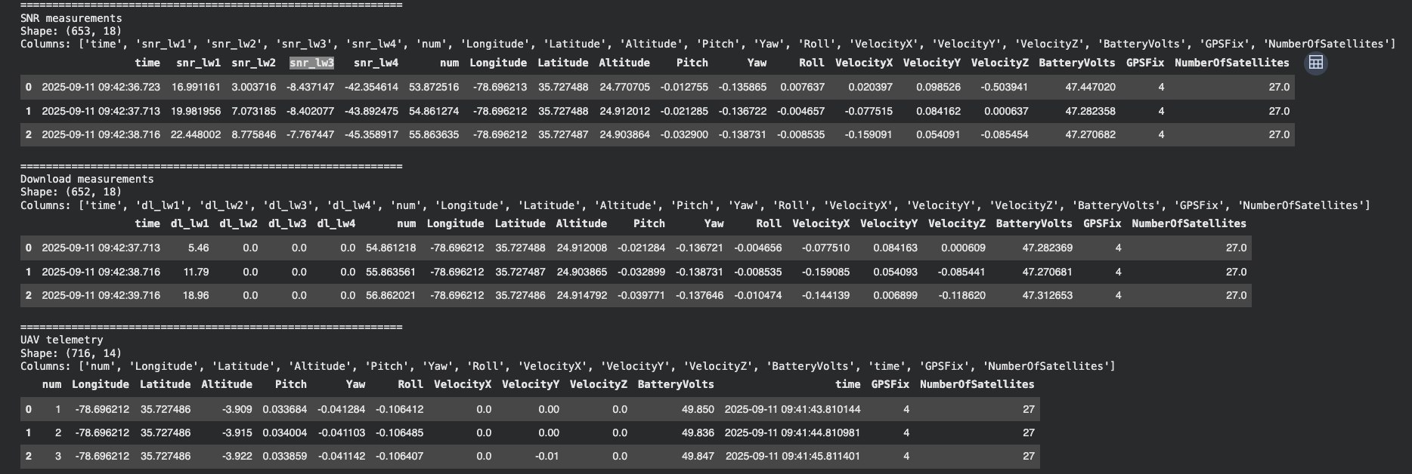
Dataset
05 | SIMULATION / EXPERIMENTAL RESULTS
File | Rows | Columns
SNR measurements | 653 | 18
Download measurements | 652 | 18
UAV telemetry | 716 | 14
Merged + cleaned | 652 | 22
SCREENSHOT
Data preview (.head())
456
98
98
Notebook cell 3 / cell 6 output
Train (70%)
Validation (15%)
Test (15%)
One flight, 2025-09-11, 09:42 to 09:53 (about 11 minutes). No missing values or duplicates after merging.
Notes:
UPLOAD (right box): screenshot of Notebook cell 3 or cell 6 output showing the .head() tables / 'Cleaned dataset shape: (652, 22)'. Crop to the output only.

Slide 7
Code: Merge and Split
06 | CODE
communication_df = pd.merge_asof(download_sorted, snr_sorted[[...]],
on="time", direction="nearest", tolerance=pd.Timedelta("2s"))
communication_df = pd.merge_asof(communication_df, telemetry_sorted[telemetry_cols],
on="time", direction="nearest", tolerance=pd.Timedelta("2s"))
# 16 input features, 4 download targets
X = communication_df[feature_cols]; y = communication_df[target_cols]
# chronological split (no shuffling)
train_end = int(n * 0.70); val_end = int(n * 0.85)
X_train, y_train = X.iloc[:train_end], y.iloc[:train_end]
X_val, y_val = X.iloc[train_end:val_end], y.iloc[train_end:val_end]
X_test, y_test = X.iloc[val_end:], y.iloc[val_end:]
scaler_X = StandardScaler(); X_train_scaled = scaler_X.fit_transform(X_train)
Notes:
UPLOAD: nothing. If you prefer screenshots over text, replace this text box with a screenshot of notebook cells 5 and 8.

Slide 8
Code: Model and Training
07 | CODE
class FidelityNet(nn.Module):
def __init__(self, input_size=16, output_size=4):
super().__init__()
self.network = nn.Sequential(
nn.Linear(input_size, 64), nn.ReLU(), nn.Dropout(0.2),
nn.Linear(64, 32), nn.ReLU(), nn.Dropout(0.2),
nn.Linear(32, output_size))
def forward(self, x): return self.network(x)
criterion = nn.MSELoss()
optimizer = optim.Adam(model.parameters(), lr=0.001)
for epoch in range(200): # 3,300 trainable parameters
model.train(); optimizer.zero_grad()
loss = criterion(model(X_train_tensor), y_train_tensor)
loss.backward(); optimizer.step()
Notes:
UPLOAD: nothing. Optional: screenshot of cell 14 output (model summary, 3300 parameters) and cell 16 learning curve.

Slide 9
Code: Uncertainty and Mismatch Detection
08 | CODE
model.train() # keep dropout ON during prediction
mc_predictions = []
with torch.no_grad():
for _ in range(100):
pred = model(X_val_tensor).numpy()
mc_predictions.append(scaler_y.inverse_transform(pred))
mc_mean = np.array(mc_predictions).mean(axis=0) # prediction
mc_std = np.array(mc_predictions).std(axis=0) # uncertainty
fidelity = max(0, 1 - mae / np.mean(np.abs(actual))) * 100
val_errors = np.abs(val_actual - val_pred)
threshold = np.percentile(val_errors, 95) # learned on validation only
mismatch_flags = test_errors > threshold
Notes:
UPLOAD: nothing.

Slide 10
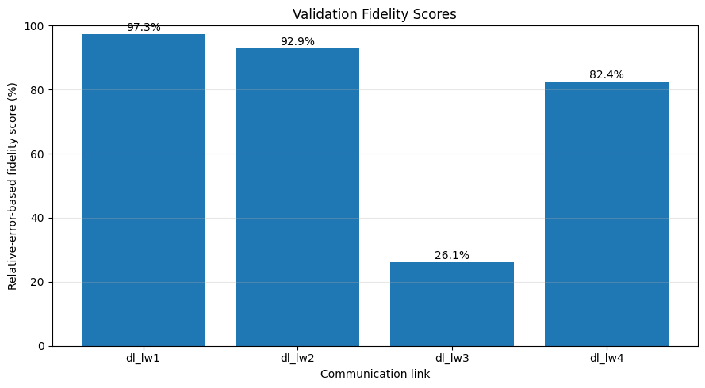
Validation Results (MC Dropout)
09 | SIMULATION / EXPERIMENTAL RESULTS
Link | RF MAE | NN MAE | MC MAE | Mean σ | Fidelity
dl_lw1 | 73.815 | 12.092 | 16.251 | 33.296 | 97.3%
dl_lw2 | 114.705 | 38.806 | 42.480 | 64.520 | 92.9%
dl_lw3 | 428.039 | 372.602 | 374.042 | 29.677 | 26.1%
dl_lw4 | 5.780 | 3.801 | 3.659 | 3.224 | 82.4%
SCREENSHOT
Validation predictions + uncertainty band
Notebook cell 19 plot (Actual vs MC mean ± 2 std)
What this shows
The neural network beats Random Forest on all four links. Uncertainty is large on dl_lw1 and dl_lw2, and fidelity is lowest on dl_lw3, where predictions miss badly.
Notes:
UPLOAD (left box): the plot from notebook cell 19 ('Validation Predictions and MC Dropout Uncertainty'). Ready-made PNG: figs/cell19_mc_dropout_validation.png. Optional second image: cell 22 fidelity bar chart (figs/cell22_fidelity_scores.png).

Slide 11
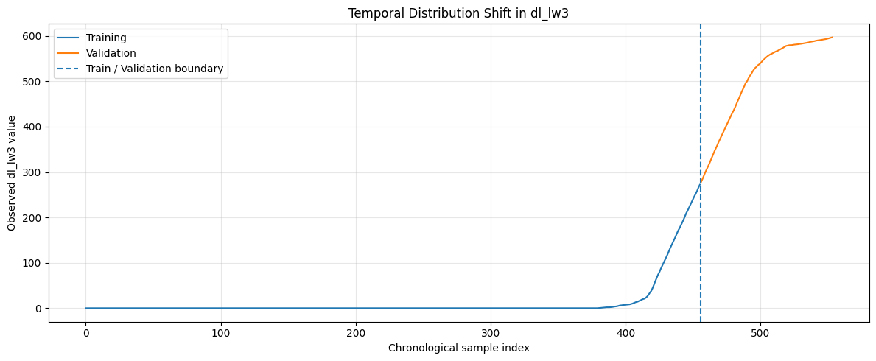
Why dl_lw3 Fails: Distribution Shift
10 | SIMULATION / EXPERIMENTAL RESULTS
83.3%
0%
of dl_lw3 training readings are zero
zeros in validation
13.5
506
SCREENSHOT
mean in training
mean in validation
dl_lw3: training vs validation
Notebook cell 24 plot (train / validation boundary)
What this shows
The model trained on a mostly-zero link, then met a link at 278 to 597 in validation. Altitude and SNR distributions also moved. The network predicts what it saw, so error is large.
Notes:
UPLOAD (left box): notebook cell 24 plot 'Temporal Distribution Shift in dl_lw3' (figs/cell24_dl_lw3_shift.png). Optional: cell 27 SNR histograms (figs/cell27_snr_distribution_shift.png).

Slide 12
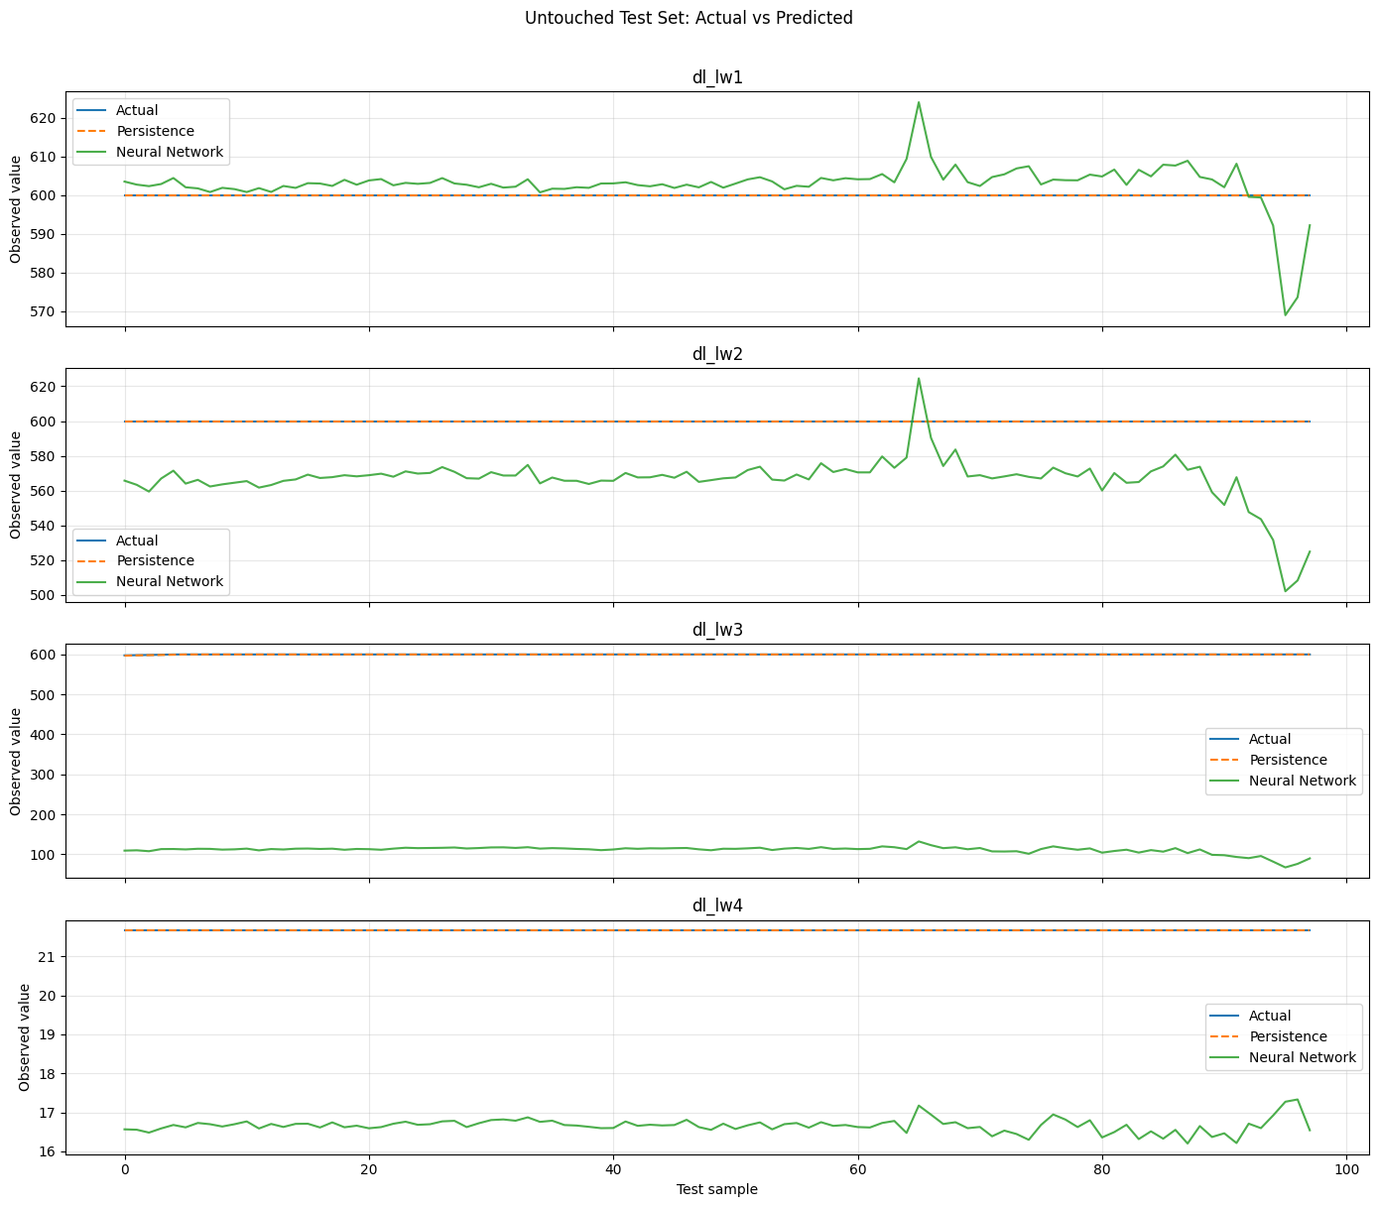
Untouched Test Set: Neural Network vs Persistence
11 | SIMULATION / EXPERIMENTAL RESULTS
Link | NN MAE | Persist. MAE | Better
dl_lw1 | 4.366 | 0.000 | Persistence
dl_lw2 | 33.869 | 0.000 | Persistence
dl_lw3 | 488.849 | 0.032 | Persistence
dl_lw4 | 5 | 0.000 | Persistence
Overall | 133.021 | 0.008 | Persistence
SREENSHOT
Test: actual vs predicted
Notebook cell 30 plot
What this shows
Test values barely move (lw1, lw2, lw4 are constant; lw3 spans 2.3), so "repeat the last reading" is nearly perfect. This reflects this flight segment, not general performance.
Notes:
UPLOAD (left box): notebook cell 30 plot 'Untouched Test Set: Actual vs Predicted' (figs/cell30_test_actual_vs_pred.png). Optional: cell 29 persistence plot.

Slide 13
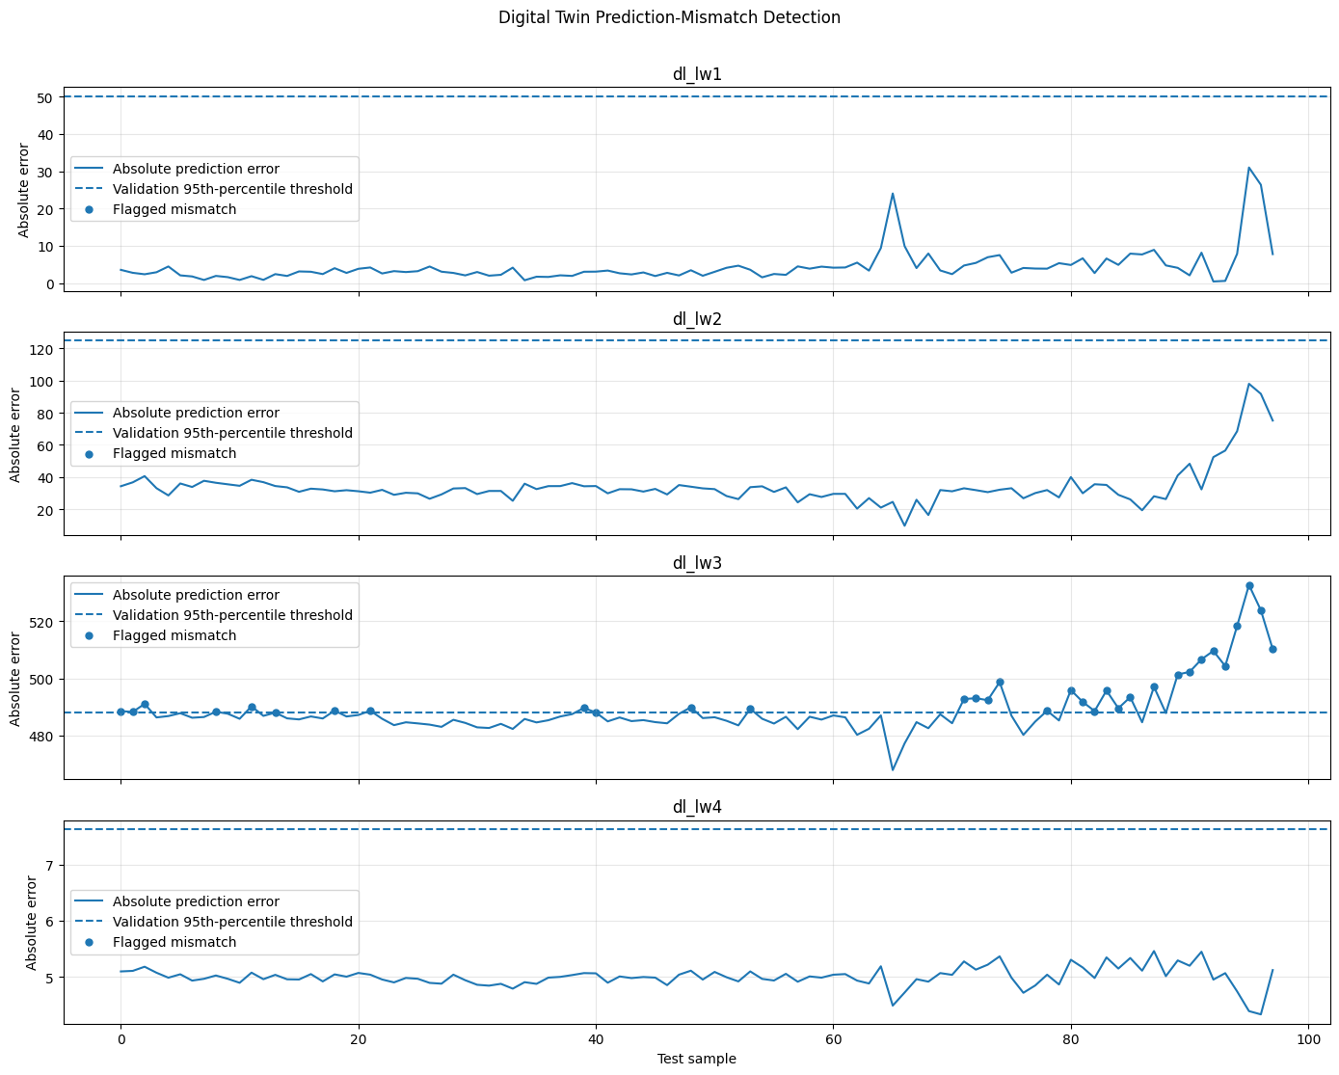
Digital Twin Mismatch Detection
12 | SIMULATION / EXPERIMENTAL RESULTS
Link | 95th pct. threshold | Flagged / 98
dl_lw1 | 50.105 | 0
dl_lw2 | 124.740 | 0
dl_lw3 | 487.914 | 33 (33.7%)
dl_lw4 | 7.630 | 0
SCREENSHOT
Test error vs threshold
Notebook cell 33 plot (flagged mismatches)
What this shows
Thresholds come from validation errors only. The twin raised alerts on dl_lw3, exactly the link where it was unreliable.
Notes:
UPLOAD (left box): notebook cell 33 plot 'Digital Twin Prediction-Mismatch Detection' (figs/cell33_mismatch_detection.png). Optional: cell 31 error timeline.

Slide 14
Progress
13 | PROGRESS
COMPLETED
REMAINING WORK
1
Three data files merged and cleaned
1
Test on more flights, not one segment
2
Chronological train / val / test split
2
Reduce the dl_lw3 shift (more varied training data)
3
Random Forest and neural network trained
3
Calibrate uncertainty and add OOD detection
4
MC Dropout uncertainty (100 passes)
4
Build the Streamlit dashboard
5
Fidelity score and distribution-shift analysis
5
Final end-to-end demonstration
6
Persistence baseline and mismatch alerts
Notes:
UPLOAD: nothing. Edit the 'Remaining' list to match your real plan.

Slide 15
Conclusion
14 | CONCLUSION
Built a UAV 5G digital twin that predicts download throughput on four links, with MC Dropout uncertainty.
1
The neural network beat Random Forest on validation, but dl_lw3 failed because training and validation behaved differently.
2
A persistence baseline wins on this nearly constant test segment, so the result is flight-specific, not general.
3
Mismatch alerts correctly flagged dl_lw3, showing the twin can warn when it is unreliable.
4
From UAV measurements to a twin that knows when it cannot be trusted. Thank You
Notes:
UPLOAD: nothing.

