Slide 1


AI-Based UAV Communication Digital Twin for Throughput Prediction and Reliability Assessment
Monte Carlo Dropout Uncertainty and Mismatch Detection on a 5G/LTE UAV Flight
Course: Machine Learning (25SC2107E) | A.Y. 2026-27
Department: Electronics & Communication Engineering
Institution: KL University
Guide: Mr. N. Lava Prasad, Assistant Professor, ECE
Team Members
D. Karthik - 2520040082
S. Karthikeya - 252004004
P. Yugandhar - 2520040027
Notes:
SAY: Introduce the project, team and guide.
CHECK: roll number 252004004 (S. Karthikeya) has 9 digits while the others have 10. Correct it before presenting.
OPTIONAL UPLOAD: replace the drone icon with the KL University logo or a UAV photo.

Slide 2
Presentation Outline
Problem Statement & Motivation
Project Objectives & Key Metrics
1
2
Unreliable UAV 5G links, single-value predictions and silent model failures.
Predict throughput, quantify uncertainty, score fidelity and flag mismatch.
Proposed Approach & Tools
Dataset & Feature Design
3
4
6-stage pipeline using Pandas, scikit-learn and PyTorch with MC Dropout.
652 merged samples, 16 input features and 4 download targets from one flight.
Training & Comparative Results
Conclusions & Next Steps
5
6
FidelityNet vs Random Forest and persistence, with shift analysis and alerts.
Key findings, honest limitations, multi-flight data and a Streamlit dashboard.
Notes:
SAY: Walk through the six parts of the talk (about 1 minute).
UPLOAD: nothing.

Slide 3



Problem Statement & Motivation
Changing Link Conditions
THE CORE RESEARCH GAP IDENTIFIED:
SNR, position, speed and battery change continuously in flight.
Four wireless links (lw1 to lw4) are measured in the same flight.
Download throughput therefore keeps changing from link to link.
Standard throughput predictors give a single number with no uncertainty and no mismatch warning. When flight conditions drift they keep predicting confidently while being wrong, and nothing tells the operator the twin can no longer be trusted.
Single-Value Predictions
Usual models return one number with no sign of reliability.
They fail silently when flight conditions change.
Knowing when a prediction is shaky is as useful as the value.
PROJECT GOAL:
value ± uncertainty + mismatch alert
Short Recording, Shifting Conditions
Only one flight of about 11 minutes (652 samples) is available.
Behaviour learned early in the flight may not hold later.
Time-ordered splitting exposes this problem honestly.
Predict UAV download throughput with uncertainty and check whether the twin can be trusted.
Notes:
SAY: A drone on a 5G link gets different download speeds as it flies; normal models give one number and no warning when they stop being reliable.
UPLOAD: nothing (optional: a small drone / 5G sketch).

Slide 4




Project Objectives & Evaluation Metrics
Predict Download Throughput
Quantify Prediction Uncertainty
Predict the download measurement of four wireless links (dl_lw1 to dl_lw4) from SNR and UAV flight state.
Use Monte Carlo Dropout (100 passes) to return a mean and a standard deviation instead of a single number.
Score Twin Fidelity
Detect Twin-Reality Mismatch
Score fidelity per link with a relative-error metric and compare against Random Forest and persistence.
Raise an alert when a test error exceeds the 95th-percentile validation error, so shaky predictions are caught.
CORE METRICS EVALUATED: 1. MAE / RMSE | 2. Mean Predictive σ | 3. Fidelity Score (%) | 4. Mismatch Alerts (count, %)
Notes:
SAY: Four objectives, each matched to a metric we actually measure in the notebook.
UPLOAD: nothing.

Slide 5
Proposed 6-Step Methodology & System Workflow
1
2
3
4
5
6
Merge the Data
Split by Time
Scale Features
Train Models
Add Uncertainty
Check the Twin
Match SNR, download and telemetry files by timestamp (within 2 s): 652 × 22.
First 70% train, next 15% validation, last 15% test: 456 / 98 / 98, no shuffling.
StandardScaler fitted on training data only, for inputs and targets.
Random Forest baseline and the FidelityNet neural network (3,300 parameters).
Keep dropout ON and predict 100 times: mean = answer, std = uncertainty.
Fidelity score, persistence baseline and mismatch alerts from validation errors.
KEY PHILOSOPHY: Everything is learned from the past and judged on the future. Scalers and alert thresholds use earlier data only, and the test segment stays untouched until final evaluation, so results show how the twin would behave on new flight data.
Notes:
SAY: Six steps from raw files to a twin that reports value, uncertainty and alerts.
UPLOAD: nothing (the flow is built in).

Slide 6
Software Stack & Technical Tools
Tool / Framework | Specific Project Purpose | Engineering Role
Python 3 | Primary language for data merging, the training loop and evaluation | Core Development
Google Colab | Notebook environment with Google Drive access to the flight files (CPU runtime) | Training Platform
NumPy 2.1 & Pandas 2.2 | Timestamp merging (merge_asof), cleaning, percentiles and error computation | Data & Math Computation
Matplotlib | Uncertainty bands, learning curves, shift and mismatch plots | Visual Analytics
scikit-learn | RandomForestRegressor baseline, StandardScaler, MAE / RMSE / R² metrics | Classical ML Toolkit
PyTorch 2.11 (CPU) | FidelityNet (16 → 64 → 32 → 4), Adam optimiser and MC Dropout inference | Neural Network Engine
Streamlit (planned) | Interactive dashboard for the final end-to-end demonstration | Planned Deliverable
Notes:
SAY: Everything runs in a Colab notebook on CPU; PyTorch for the network, scikit-learn for the baseline.
UPLOAD: nothing.

Slide 7
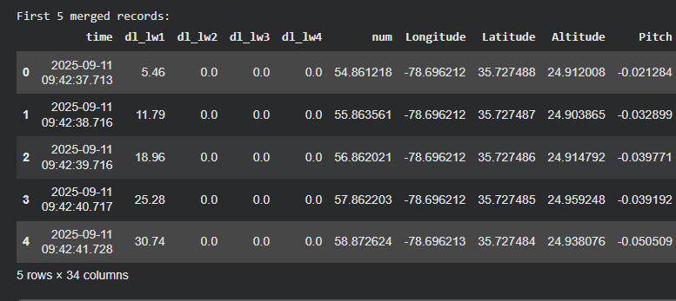
Dataset: Merged UAV 5G Flight Measurements
652
16
4
~11 min
Merged Samples
Input Features
Download Targets
One Flight, 11 Sep 2025
File | Rows | Columns
SNR measurements | 653 | 18
Download measurements | 652 | 18
UAV telemetry | 716 | 14
Merged + cleaned | 652 | 22
456
98
98
Train (70%)
Validation (15%)
Test (15%)
Chronological split, no missing values or duplicates after merging.
Notes:
SAY: Three CSV files from one UAV flight on 11 Sep 2025 are merged by timestamp into 652 clean samples.
UPLOAD (right box): screenshot of Notebook cell 3 output (the .head(3) tables) or cell 6 output ('Cleaned dataset shape: (652, 22)'). Crop to the output only.

Slide 8
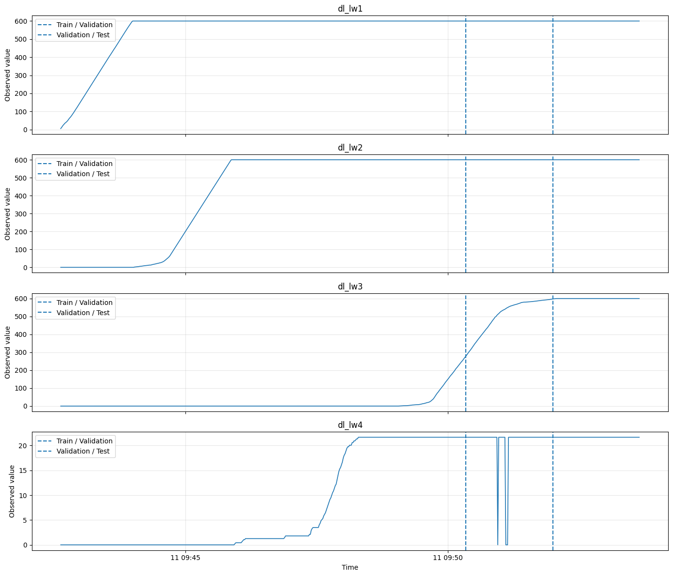

Download Behaviour Over the Flight & Chronological Split
WHAT THE TARGET PLOT SHOWS
Ramp, then plateau: each link climbs, then saturates near 600 (lw1 to lw3) or 21.7 (lw4).
Staggered start: lw1 rises first; lw3 stays at zero until late in training.
Many zeros: 83 (lw2), 380 (lw3) and 200 (lw4) of 652 readings are exactly 0.
Dashed lines: validation starts at 09:50:20 and test at 09:51:59.
Implication: shuffling would leak the future, so a chronological split is essential.
UPLOAD SCREENSHOT HERE
Notebook Cell 10 plot
Capture the full 4-panel figure (dl_lw1 to dl_lw4 over time) including the two dashed Train/Validation and Validation/Test lines. Crop to the figure only.
Notes:
SAY: Each link ramps up and then saturates, and they start at different times. That is why a random split would leak the future.
UPLOAD (left box): Notebook cell 10 plot (four panels dl_lw1 to dl_lw4 with the two dashed split lines).
OPTIONAL: cell 11 correlation heatmap as an extra backup slide.

Slide 9


Input Features & Prediction Targets
Signal Quality
UAV Flight State
Targets
4 inputs
12 inputs
4 outputs
snr_lw1
snr_lw2
snr_lw3
snr_lw4
Position: Longitude, Latitude, Altitude
Attitude: Pitch, Yaw, Roll
Velocity: VelocityX, VelocityY, VelocityZ
Health: BatteryVolts, GPSFix, NumberOfSatellites
dl_lw1 (link 1)
dl_lw2 (link 2)
dl_lw3 (link 3)
dl_lw4 (link 4)
SNR measured on each of the four wireless links.
Download per link, predicted jointly.
16
4
± 2 s
Train only
Input Features
Download Targets
Merge Tolerance
Scaler Fitting
Notes:
SAY: 16 inputs (4 SNR values and 12 flight-state values) predict 4 download values with one network.
UPLOAD: nothing.

Slide 10
Baseline: Random Forest vs Train-Mean Guess
Link | RF MAE | RF RMSE | Train-Mean MAE
dl_lw1 | 73.815 | 138.265 | 54.704
dl_lw2 | 114.705 | 214.562 | 201.115
dl_lw3 | 428.039 | 468.400 | 492.431
dl_lw4 | 5.780 | 8.803 | 13.988
BASELINE OBSERVATIONS
Beats the guess on three links: lw2 (114.7 vs 201.1), lw3 (428.0 vs 492.4), lw4 (5.8 vs 14.0).
Loses on dl_lw1: 73.8 vs 54.7 for a plain train-mean guess.
dl_lw3 misses by 428: the first sign of distribution shift.
R² not meaningful: near-constant validation targets give zero or negative R², so MAE and RMSE are used.
RANDOM FOREST SETTINGS
200 trees, max depth 12, min samples per leaf 2, random seed 42.
Trained on 456 samples and evaluated on the 98 validation samples.
Metrics are in the original download units (MAE and RMSE).
Notes:
SAY: Random Forest is our classical baseline. It beats a plain train-mean guess on three links but not on dl_lw1.
UPLOAD: nothing. Optional: screenshot of notebook cell 9 and cell 12 output tables.

Slide 11
FidelityNet Architecture & Training Setup
Hyperparameter | Assigned Value
Architecture | 16 → 64 → 32 → 4 (ReLU)
Regularisation | Dropout 0.2 after each hidden layer
Trainable Parameters | 3,300
Loss Function | MSE on standardised targets
Optimiser | Adam, learning rate 0.001
Training Epochs | 200 (full batch, 456 samples)
Scaling | StandardScaler on X and y, train only
FIDELITYNET TRAINING LOOP (3-STAGE CYCLE)
1. Stage 1: Forward Pass: The 456 × 16 training tensor runs through the network (dropout ON) and the MSE loss is computed.
2. Stage 2: Backpropagation: Gradients flow back and Adam updates all 3,300 weights with learning rate 0.001.
3. Stage 3: Validate and Repeat: Validation loss is logged in eval mode every epoch; the cycle repeats for 200 epochs.
Input
16
→
Dense 64
ReLU, Drop
→
Dense 32
ReLU, Drop
→
Output
4
The same dropout (p = 0.2) is reused at prediction time.
Notes:
SAY: A small fully connected network with dropout; the same dropout is reused later to estimate uncertainty.
UPLOAD: nothing. Optional: screenshot of Notebook cell 14 output (model summary, 3300 parameters).

Slide 12
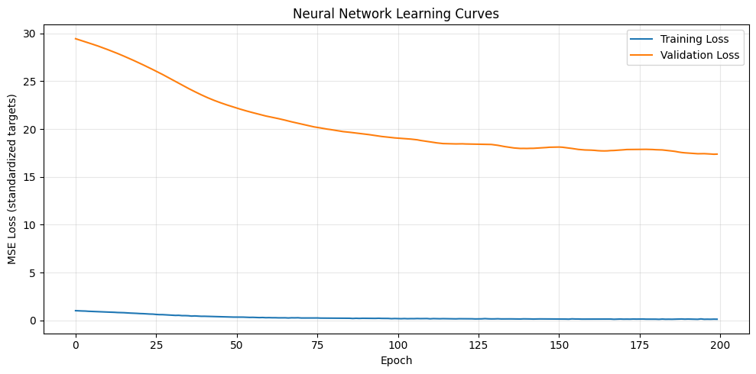
Training Progress: Learning Curves
200
Epochs (full-batch Adam)
UPLOAD SCREENSHOT HERE
0.738 → 0.128
Notebook Cell 16 plot
Training loss, epoch 20 → 200
Capture the 'Neural Network Learning Curves' figure (training and validation loss vs epoch). Crop to the figure only.
27.02 → 17.38
Validation loss, epoch 20 → 200
TRAINING INSIGHT: The network fits the early flight well (training loss 0.13), but validation loss stays about 130 times higher (17.4). The later segment behaves differently from what it learned, which motivates the distribution-shift analysis.
Notes:
SAY: Training loss keeps falling but validation loss stays far higher, which hints that the later validation segment behaves differently.
UPLOAD (left box): Notebook cell 16 plot 'Neural Network Learning Curves'.

Slide 13

Uncertainty, Fidelity Score & Mismatch Rule
KEY FORMULAS (PER LINK):
ŷ = mean(100 passes) | σ = std(100 passes) | Fidelity = max(0, 1 − MAE / mean|actual|) × 100
MC Dropout Uncertainty
Fidelity Score
Mismatch Alert
Dropout stays ON at prediction time.
100 passes: mean = prediction, std = uncertainty.
A wide spread means the model is unsure.
Relative-error project metric, not a calibrated standard.
100% = no error; 0% = error as large as the signal.
Computed per link on validation data.
Threshold = 95th percentile of validation absolute error.
Learned from validation only, so no test leakage.
A test sample is flagged when its error exceeds it.
Notes:
SAY: Three ideas: MC Dropout gives uncertainty, the fidelity score summarises accuracy per link, and the alert rule uses only validation errors.
UPLOAD: nothing.

Slide 14
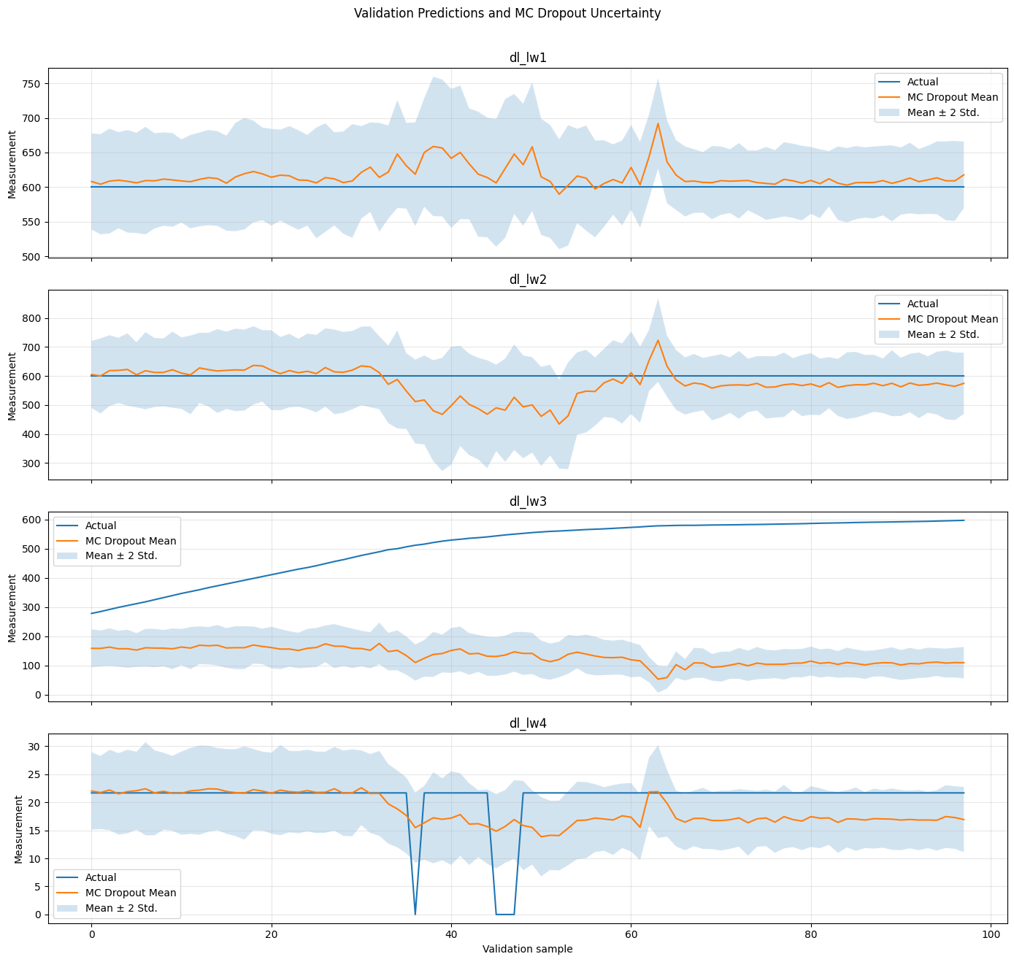
Validation Results (MC Dropout)
Link | RF MAE | NN MAE | MC MAE | Mean σ | Fidelity
dl_lw1 | 73.815 | 12.092 | 16.251 | 33.296 | 97.3%
dl_lw2 | 114.705 | 38.806 | 42.480 | 64.520 | 92.9%
dl_lw3 | 428.039 | 372.602 | 374.042 | 29.677 | 26.1%
dl_lw4 | 5.780 | 3.801 | 3.659 | 3.224 | 82.4%
UPLOAD SCREENSHOT HERE
Notebook Cell 19 plot
Capture the 4-panel figure 'Validation Predictions and MC Dropout Uncertainty' (Actual, MC Dropout mean and ±2 std band). Crop to the figure only.
The neural network beats Random Forest on all four links.
The MC mean is slightly less accurate than one deterministic pass, but adds a σ to every prediction.
dl_lw3 fails: MAE 374 and fidelity only 26.1%.
Notes:
SAY: The neural network beats Random Forest on all four links. Uncertainty is large on lw1 and lw2; fidelity is lowest on lw3, where predictions miss badly.
UPLOAD (left box): Notebook cell 19 plot 'Validation Predictions and MC Dropout Uncertainty'.

Slide 15
Fidelity Score & Uncertainty vs Actual Error
Link | Mean σ | MC MAE | σ ÷ MAE
dl_lw1 | 33.3 | 16.3 | 2.0×
dl_lw2 | 64.5 | 42.5 | 1.5×
dl_lw3 | 29.7 | 374.0 | 0.08×
dl_lw4 | 3.22 | 3.66 | 0.88×
READING σ ÷ MAE
Above 1: cautious (lw1, lw2).
Near 1: well matched (lw4).
Far below 1: overconfident (lw3).
CONFIDENTLY WRONG: on dl_lw3 the uncertainty (σ ≈ 29.7) is over 12× smaller than the real error (MAE ≈ 374), so MC Dropout alone cannot warn about a distribution shift.
Notes:
SAY: Fidelity is high on lw1, lw2, lw4 but low on lw3. On lw3 the model is confidently wrong: its uncertainty is far smaller than its error.
UPLOAD: nothing (native chart). OPTIONAL: replace the chart with a screenshot of notebook cell 22 bar chart.

Slide 16
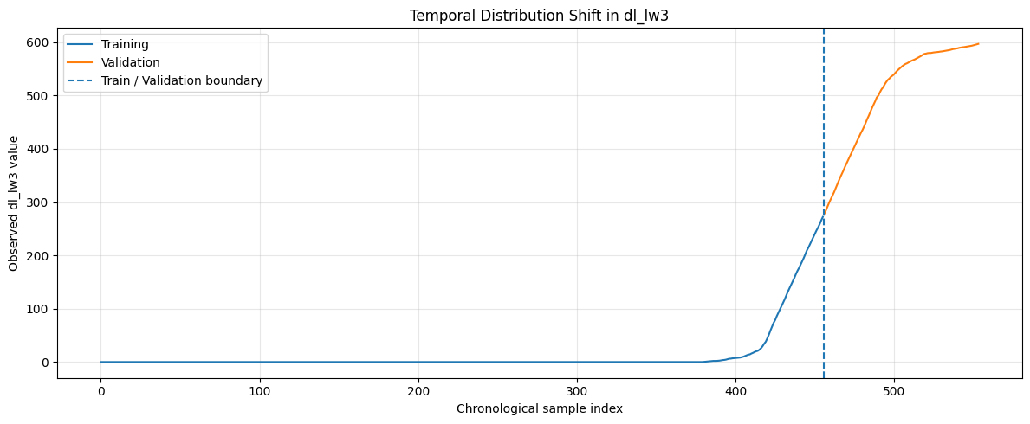
Why dl_lw3 Fails: Temporal Distribution Shift
83.3%
0%
13.5 → 506
13.7 → 0.05
zeros in dl_lw3 training
zeros in dl_lw3 validation
dl_lw3 mean, train → val
altitude std, train → val
INPUT FEATURES ALSO SHIFTED (MEAN)
Feature | Train | Validation
Altitude | 38.33 | 24.99
snr_lw1 | 3.55 | −2.05
snr_lw3 | −9.80 | 9.23
snr_lw4 | −24.05 | −42.53
VelocityY | 0.82 | −1.96
UPLOAD SCREENSHOT HERE
Notebook Cell 24 plot
Capture 'Temporal Distribution Shift in dl_lw3' (training vs validation with the boundary line). Crop to the figure only.
WHY dl_lw3 FAILS: the network learned from a mostly-zero link (training max 272.1), then met values from 278.5 to 596.9 in validation. A model predicts what it has seen, so the error is structural, not random.
Notes:
SAY: The network trained on a link that was almost always zero, then met a link at 278 to 597 in validation. Altitude and SNR distributions also moved.
UPLOAD (left box): Notebook cell 24 plot 'Temporal Distribution Shift in dl_lw3'.
OPTIONAL: add notebook cell 27 (SNR histograms) as a backup slide.

Slide 17
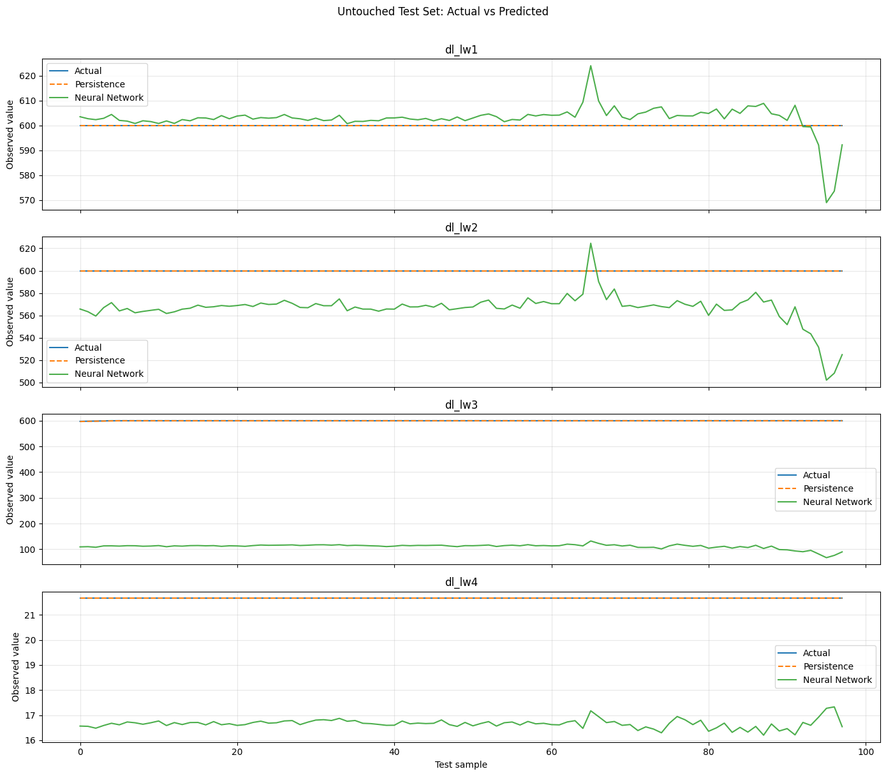
Untouched Test Set: Neural Network vs Persistence
Link | NN MAE | Persistence MAE | Better
dl_lw1 | 4.366 | 0.000 | Persistence
dl_lw2 | 33.869 | 0.000 | Persistence
dl_lw3 | 488.849 | 0.032 | Persistence
dl_lw4 | 5.000 | 0.000 | Persistence
Overall | 133.021 | 0.008 | Persistence
UPLOAD SCREENSHOT HERE
Notebook Cell 30 plot
Capture the 4-panel figure 'Untouched Test Set: Actual vs Predicted' (Actual, Persistence, Neural Network). Crop to the figure only.
Test targets barely move: lw1, lw2, lw4 are constant and lw3 spans only 2.3.
Repeating the last reading is almost perfect (overall MAE 0.008 vs 133.0).
Persistence also leads on validation (dl_lw3: 3.3 vs 374.0).
Notes:
SAY: On the test segment the values barely move, so repeating the last reading is nearly perfect. This reflects this flight segment, not general performance.
UPLOAD (left box): Notebook cell 30 plot 'Untouched Test Set: Actual vs Predicted'.
OPTIONAL: cell 29 persistence plot.

Slide 18
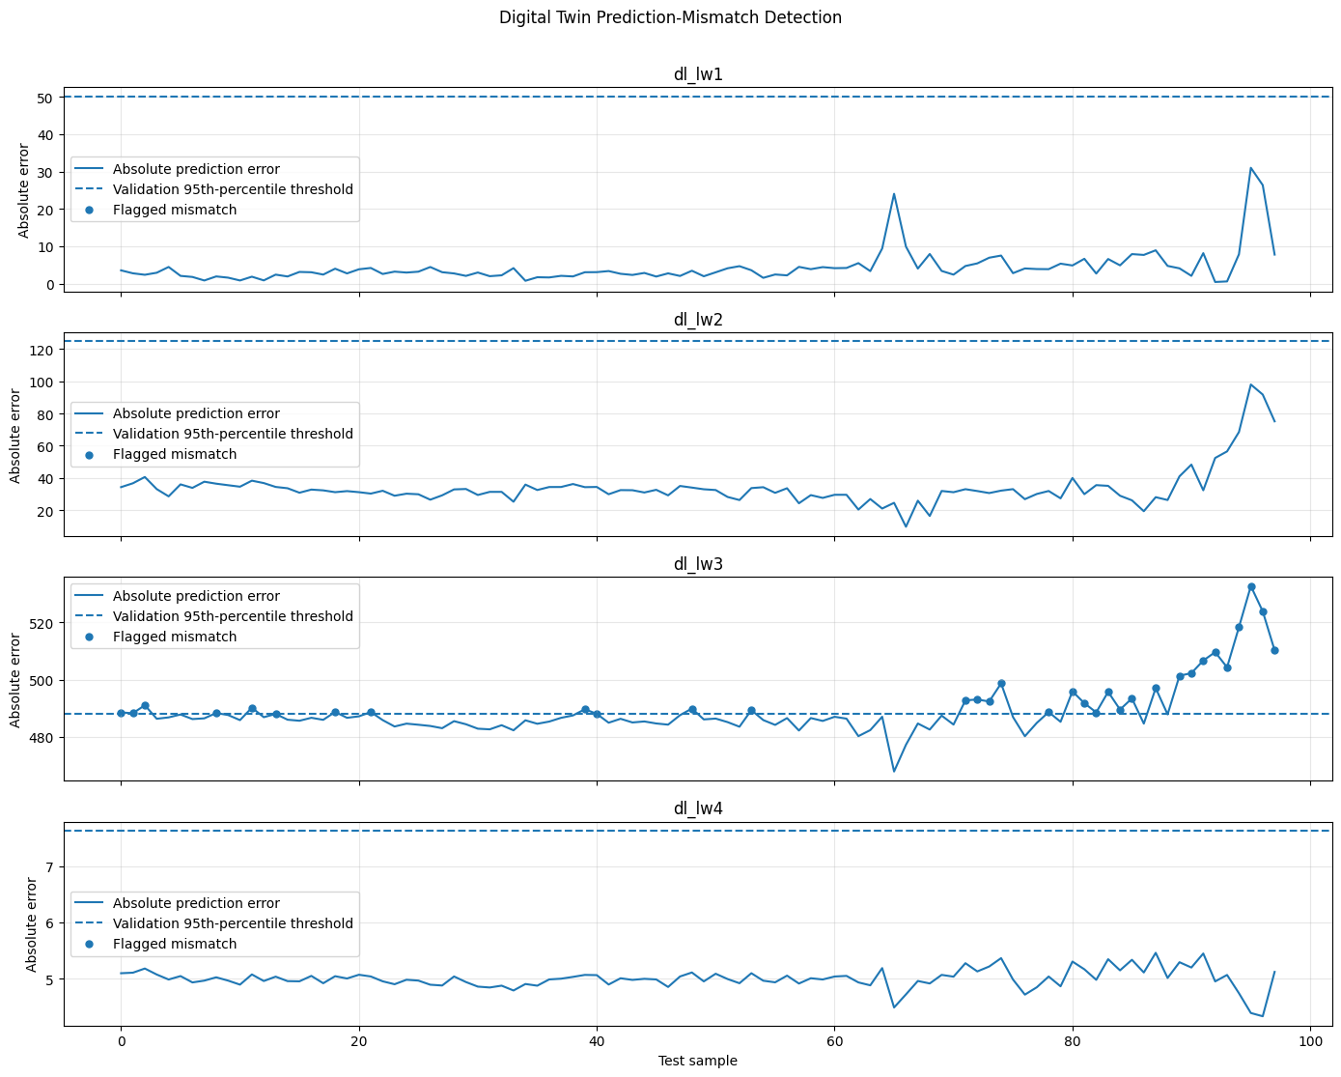
Digital Twin Mismatch Detection
Link | 95th pct. threshold | Flagged / 98
dl_lw1 | 50.105 | 0
dl_lw2 | 124.740 | 0
dl_lw3 | 487.914 | 33 (33.7%)
dl_lw4 | 7.630 | 0
UPLOAD SCREENSHOT HERE
Notebook Cell 33 plot
Alerts fire only on dl_lw3: 33 of 98 samples, the link the model could not predict.
No false alarms on dl_lw1, dl_lw2, dl_lw4.
Limitation: lw3 error is ~489 on every test sample, but the 487.9 threshold came from already-large validation errors, so only a third trigger.
Capture the 4-panel figure 'Digital Twin Prediction-Mismatch Detection' (error, dashed threshold and flagged points). Crop to the figure only.
Notes:
SAY: Thresholds come from validation errors only. The twin raised alerts on dl_lw3, exactly the link where it was unreliable.
UPLOAD (left box): Notebook cell 33 plot 'Digital Twin Prediction-Mismatch Detection'.
OPTIONAL: cell 31 error timeline.

Slide 19
Comparative Analysis: All Models on Validation
COMPARISON SYNTHESIS
FidelityNet cuts MAE vs Random Forest about 6× on dl_lw1 and 3× on dl_lw2.
Random Forest is worse than a train-mean guess on dl_lw1.
Persistence is hardest to beat on this near-constant flight.
The twin's value is its uncertainty and alerts, not raw accuracy.
BEST LEARNED MODEL PER LINK (MAE): dl_lw1 NN 12.1 | dl_lw2 NN 38.8 | dl_lw3 NN 372.6 | dl_lw4 MC Dropout 3.7
Notes:
SAY: Among learned models FidelityNet is best; persistence is hardest to beat on this near-constant flight, so the twin's value is in its uncertainty and alerts.
UPLOAD: nothing (native chart).

Slide 20
Key Observations & Limitations
WHAT WORKED SUCCESSFULLY
LIMITATIONS & NEXT STEPS
✓ Better than baseline: NN beats Random Forest on all four validation links (dl_lw1: 73.8 → 12.1).
✓ Uncertainty on demand: MC Dropout returns a σ with every prediction.
✓ High fidelity: 97.3%, 92.9% and 82.4% on lw1, lw2 and lw4.
✓ Useful alerts: mismatch flags appear only on dl_lw3, where the twin was unreliable.
✓ No leakage: time-ordered split; scalers and thresholds use earlier data only.
➜ Single flight: test on more flights, not one 11-minute segment.
➜ dl_lw3 shift: add more varied training data to reduce it.
➜ Overconfident σ: calibrate uncertainty and add OOD detection.
➜ Near-constant test set: persistence wins here; evaluate on varying segments.
➜ Dashboard: build the Streamlit app and a final end-to-end demo.
Notes:
SAY: Be upfront that the test segment is nearly constant and covers one flight. List next steps from the 'Remaining Work' of Review 1.
UPLOAD: nothing.

Slide 21


Project Conclusion & Summary
1. Digital Twin Built
Merged UAV telemetry, SNR and download data into a twin that predicts four link downloads with MC Dropout uncertainty.
2. Neural Network Beat Random Forest
FidelityNet had lower validation MAE on all four links; fidelity reached 97.3% on dl_lw1 but only 26.1% on dl_lw3.
3. Distribution Shift Exposed
dl_lw3 was 83.3% zeros in training and at least 278 in validation. Persistence wins on the near-constant test segment, so results are flight-specific.
4. Twin Knows When It Fails
Mismatch alerts flagged dl_lw3 (33.7% of test samples) and stayed silent elsewhere. Next: more flights, calibrated uncertainty, Streamlit dashboard.
From UAV measurements to a twin that knows when it cannot be trusted.
Notes:
SAY: Close with the tagline: a twin that knows when it cannot be trusted.
UPLOAD: nothing.

Slide 22
Thank You!
Questions & Open Discussion
Project: AI-Based UAV Communication Digital Twin for Throughput Prediction and Reliability Assessment
Course: Machine Learning (25SC2107E) | Academic Year: 2026 – 2027
Project Guide: Mr. N. Lava Prasad, Assistant Professor
Department of Electronics & Communication Engineering, KL University
Notes:
UPLOAD: nothing.

