Slide 1
Student Depression Analysis
Final Report

Slide 2

Why This Project Matters ?
🔹 Rising student depression rates are a global concern, especially in higher education.
🔹 Data-driven insights can help identify academic, lifestyle, and financial risk factors.
🔹 This project explores patterns in student well-being and suggests actionable recommendations.

Slide 3
Agenda
This project is important because student mental health is a critical issue. wanted to use data to move beyond assumptions and find concrete, actionable insights.
By analyzing responses from over 27,000 students, this project does three important things
Identifies Real Drivers
This analysis demonstrates how lifestyle and experience are more important than grades!
Pinpoints Vulnerable Groups
Financial Stress combined with Academic Stress is an Amplifier of Depression Rates (85% – 95%)
From Insights to Action
Academic Support
Financial & Social Support
Lifestyle Interventions

Slide 4
Contents
1. Questions & Hypotheses
2. Approach and Analysis
3. Technical Challenges
4. Q1: CGPA and Depression
5. Q2: Academic Pressure and Study Satisfaction
6. Q3: Lifestyle Factors
7. Q4: Family History of Mental illness
8. Q5: Financial Stress
9. Q6: Academic Degrees
10. Q7: Suicidal Thoughts
11. Deeper analysis
12. Results
13. Recommendation

Slide 5
Questions & Hypotheses
Q1.What is the relationship between CGPA and the likelihood of depression?
Hypothesis : Students with lower academic performance (CGPA) are more likely to report depression.
Q2.How do 'Academic Pressure' and 'Study Satisfaction' relate to depression?
Hypothesis: Higher academic pressure and lower study satisfaction are associated with higher rates of depression.
Q3.Which lifestyle factors (Sleep Duration, Dietary Habits) show the strongest correlation with depression?
Hypothesis : Poorer lifestyle habits, such as insufficient sleep and unhealthy diets, are linked to a higher prevalence of depression.
Q4.What is the impact of a family history of mental illness on student depression?
Hypothesis : Students with a family history of mental illness will have a higher rate of depression.
Q5.Does 'Financial Stress' amplify the negative effect of 'Academic Pressure' on depression?
Hypothesis : Yes, the negative impact of academic pressure is more severe for students also experiencing high financial stress.
Q6.Which academic degrees are associated with the highest rates of depression?
Hypothesis : Certain high-stress fields of study will show higher depression rates than others.
Q7. Among students with suicidal thoughts, what’s the depression prevalence?
Hypothesis : Students reporting depression are more likely to report suicidal thoughts.

Slide 6

Approach and Analysis
1. Load dataset from CSV (Kaggle source)
2. Clean and preprocess: handle missing values, encode categories
3. Identify key features: Sleep, Dietary Habits, Financial and Academic Stress, CGPA
4. Perform EDA using Python Libraries
5. Apply statistical analysis to verify key results(chi-square tests)
6. Use visualization for trend discovery (bar charts, boxplots, heatmaps)
7. Prepare a final report with all the key findings and recommendations

Slide 7

Technical Challenges
Self-reported data → risk of bias
Potential class imbalance (Depressed vs Not)
Encoding categorical variables (Sleep Duration, Dietary Habits, Family History)
Data formatting issues → e.g., extra quotes around Sleep Duration values ('5-6 hours’) created parsing problems.
Handling high-cardinality features (Cities, Degrees)
Power BI integration → building DAX measures (e.g., depression rate %) and risk factor KPIs was time-consuming but crucial for storytelling.

Slide 8
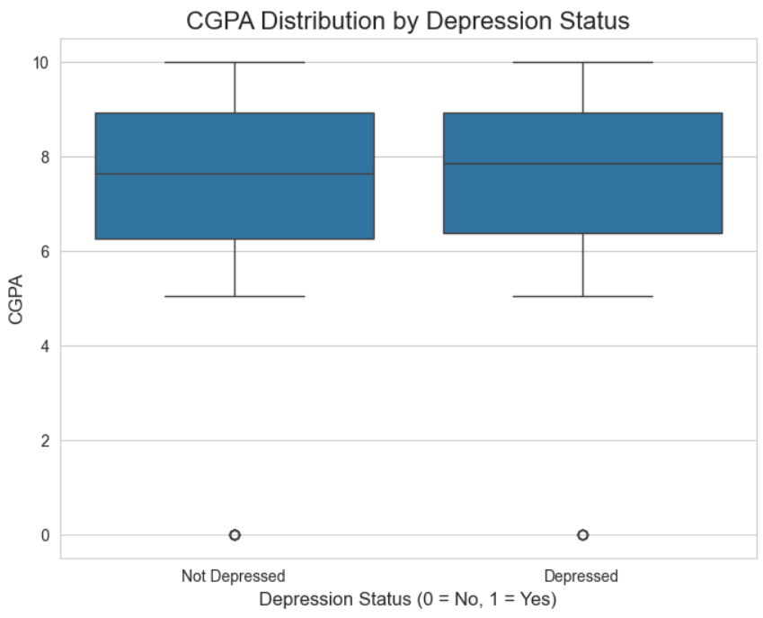
Q1: CGPA and Depression
This plot gives us a clear answer to our first question.
Insight: The data suggests that students at the higher end of the CGPA scale are also reporting depression.
CGPA Doesn't play a significant role in causing depression!

Slide 9
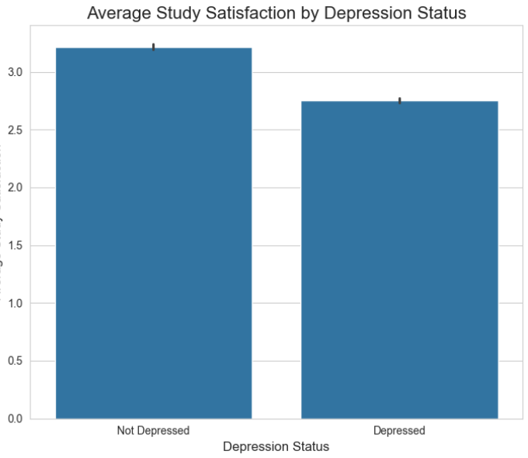
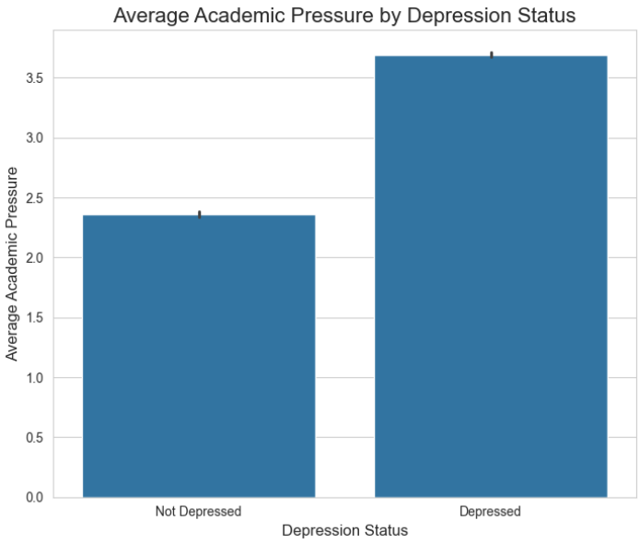
Q2: Academic Pressure vs Study Satisfaction
Depressed students show a notably lower satisfaction with their studies, averaging 2.75 out of 5, while their non-depressed peers are higher at 3.21
Students who report depression experience significantly higher levels of academic pressure

Slide 10
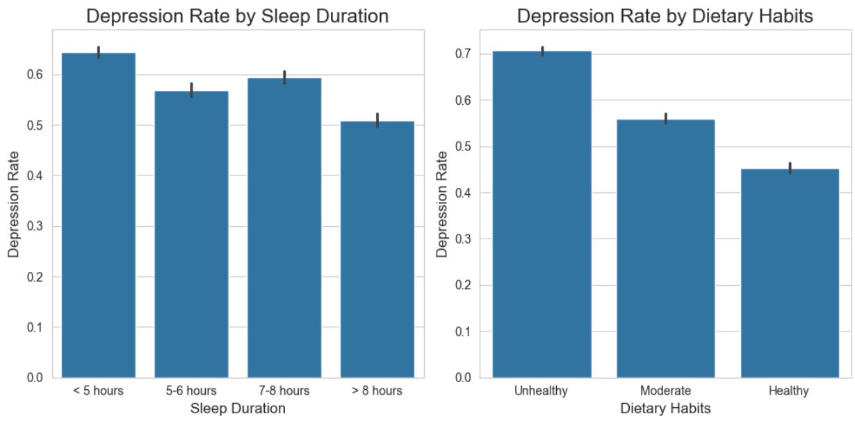
Q3: Lifestyle factors
Students with unhealthy eating habits show the highest rate of depression. 70.7% of students in this group report being depressed (7,289 out of 10,309)
The depression rate improves for those getting less than 5 hours of sleep, dropping to around 64%

Slide 11
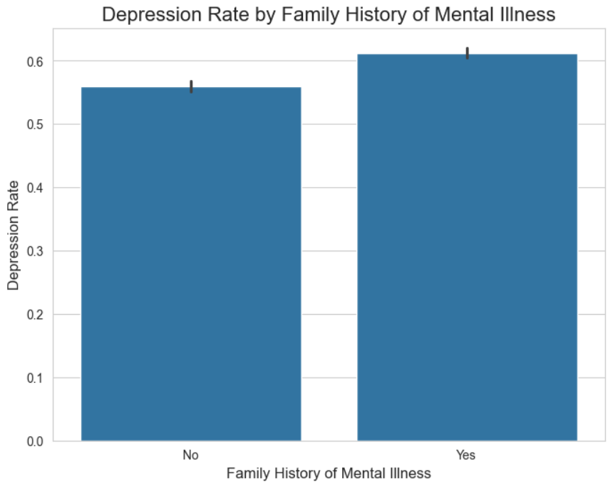
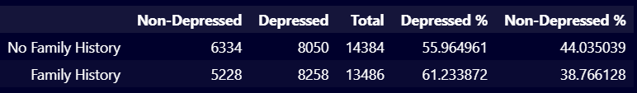
Q4: Family history of Mental Illness
Students with a family history of mental illness have a depression rate of 61.2% 🧬
Students without a family history have a depression rate of 56.0%.

Slide 12
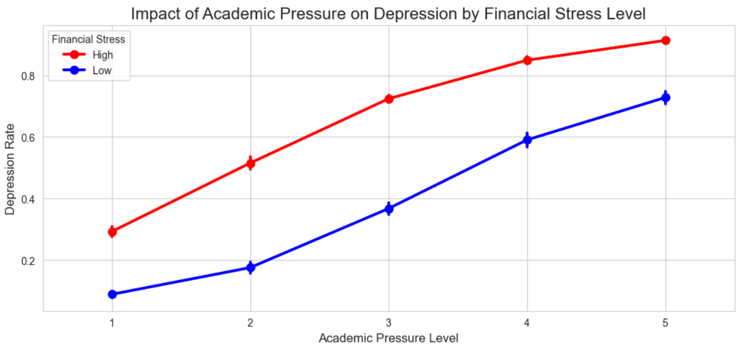
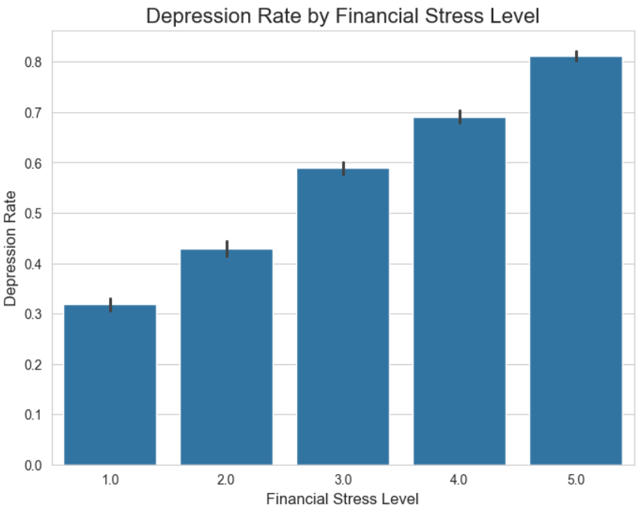
Q5. Financial Stress
Financial Stress Significantly Amplifies the Impact of Academic Pressure
At every single level of academic pressure, the red line (High Financial Stress) is significantly above the blue line (Low Financial Stress).
Students with high financial stress have a much higher baseline rate of depression, regardless of how much academic pressure they feel.

Slide 13
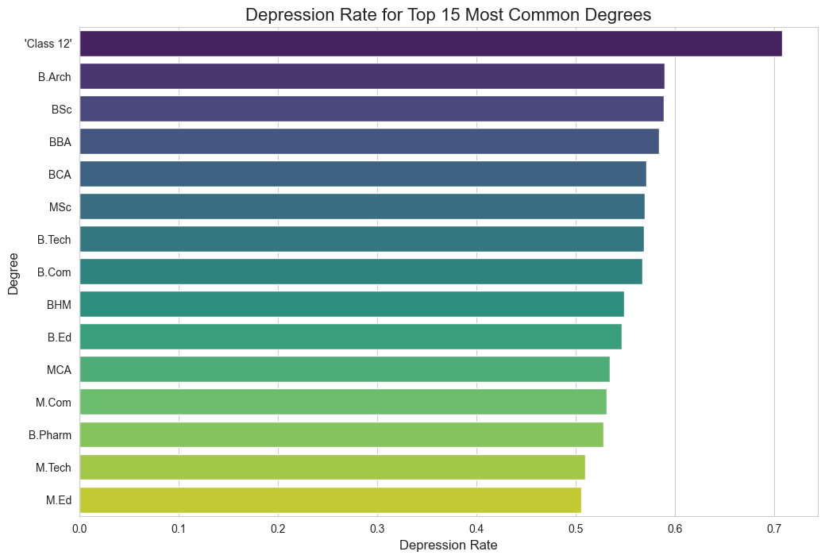
Q6. Academic Degrees
Class 12' has the highest depression rate among the top 15 most common degrees.
Several Bachelor's degrees like B.Arch, BSc, BBA, and BCA show relatively high depression rates, clustering together.
The depression rates for the top 15 degrees generally range from around 50% to over 70%

Slide 14
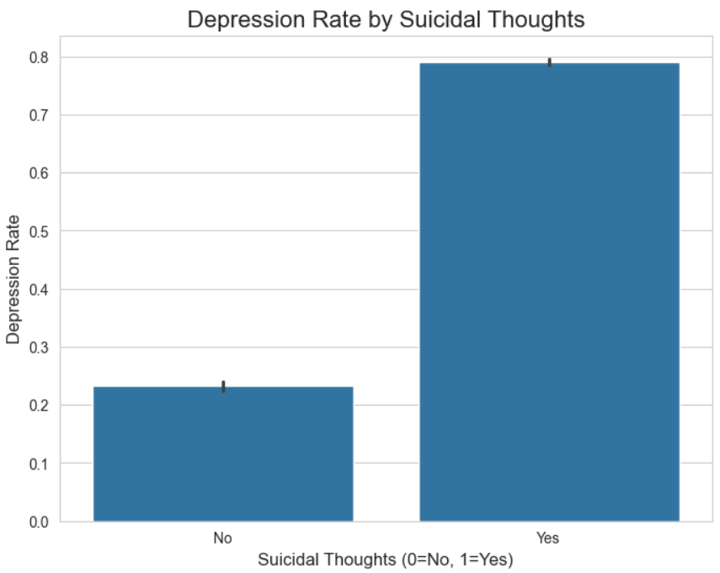
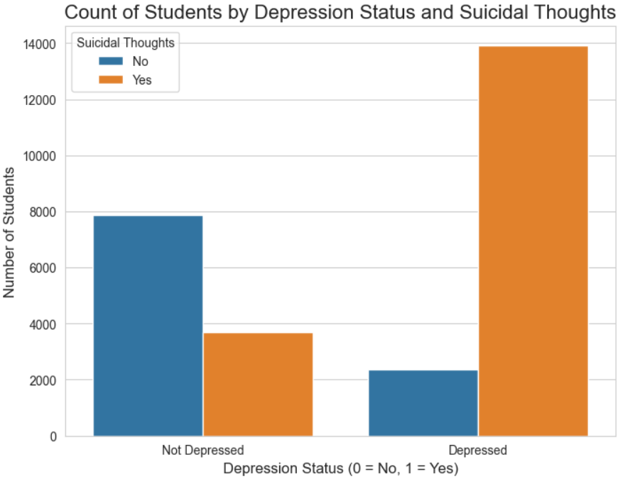
Q7. Suicidal Thoughts
The orange bar ('Yes' suicidal thoughts) is much taller for the 'Depressed' group than the 'Not Depressed' group.
Similarly, the blue bar ('No' suicidal thoughts) is much taller for the 'Not Depressed' group.
Out of the 17,631 students with suicidal thoughts, 13,934 are depressed.
79.03% of depressed students have suicidal thoughts
Only 23.19% of non-depressed students have suicidal thoughts

Slide 15
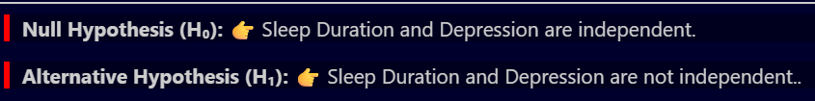
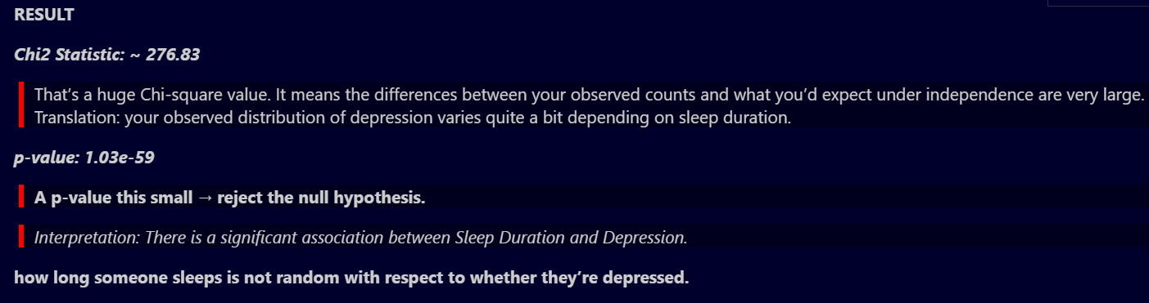
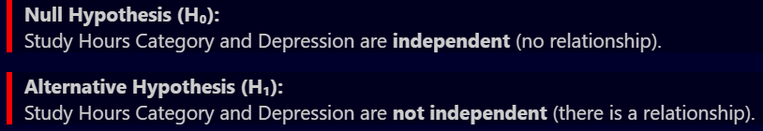
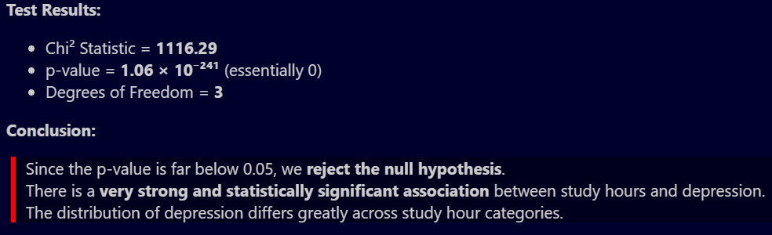
Deeper Analysis
We performed additional statistical and SQL-based analyses to validate patterns and uncover hidden relationships:
1. Statistical Validation (Python)
Chi-square tests showed strong associations between sleep duration, financial stress, and depression.
A sample for the chi - square tests for (sleep duration vs depression) and Work Hours Vs Depression is shown in the two snapshots.

Slide 16
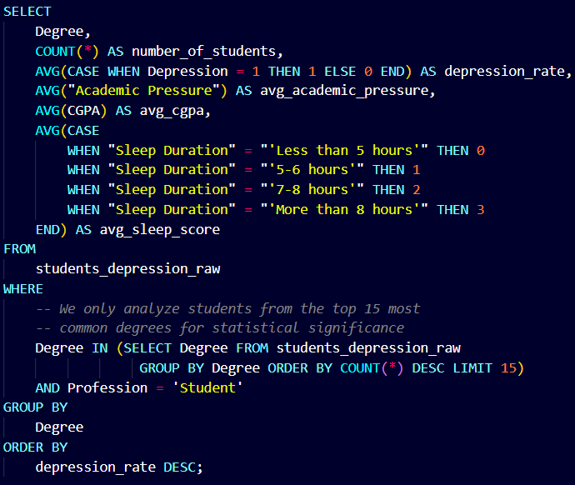
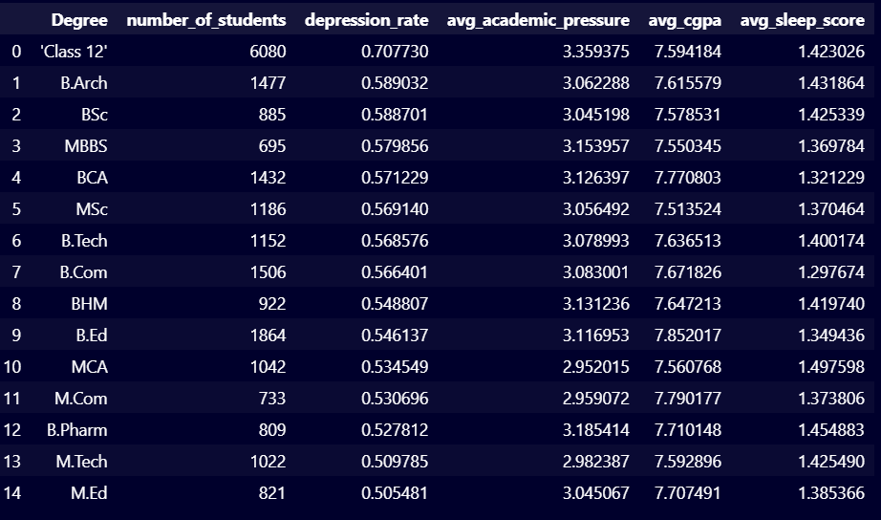
Deeper Analysis
2. SQL Based Aggregations
Top 15 degrees analyzed: depression rates varied significantly across fields of study.
Many other such aggregations are performed while doing the deeper analysis.

Slide 17
Results - What the Data Revealed ?
Academic Factors
High academic pressure strongly linked with higher depression.
Surprisingly, CGPA had a weak correlation with depression → performance ≠ mental health.
Lifestyle Factors
Students with <5 hours of sleep and an unhealthy diet had
depression rates in the range of 70% - 80%.
Balanced sleep & diet reduced risk significantly.
Financial
Financial stress amplifies depression risk.
Financial condition of a student act as a critical amplier and when combined
with academic stress can increase the depression rates in the range of 85%-95%.
Family history of mental illness
Students with a family history of mental illness have a depression rate of 61.2% 🧬
Suicidal thoughts
Suicidal thoughts are common in the depressed category.
Only 23.19% of non-depressed students have suicidal thoughts
Students without a family history have a depression rate of 56.0%.
79.03% of depressed students have suicidal thoughts

Slide 18
Recommendations Moving from Data to Action
Academic Support
Reduce unnecessary academic pressure by encouraging flexible grading and counseling.
Provide study satisfaction surveys → act early if students feel overwhelmed.
Lifestyle Interventions
Promote sleep hygiene programs (awareness campaigns, workshops).
Provide access to healthy & affordable meals on campus.
Financial & Social Support
Offer financial aid schemes or micro-grants for stressed students.
Provide free/affordable mental health counseling services.
Create peer support groups to reduce stigma.
Early Detection
Use surveys/dashboards to flag at-risk groups (e.g., high stress + poor sleep cluster).
Run periodic screenings for depression and suicidal thoughts.
Workload Management
Promote balanced workloads, flexible deadlines, and stress management sessions.

Slide 19
THANK YOU

