Slide 1
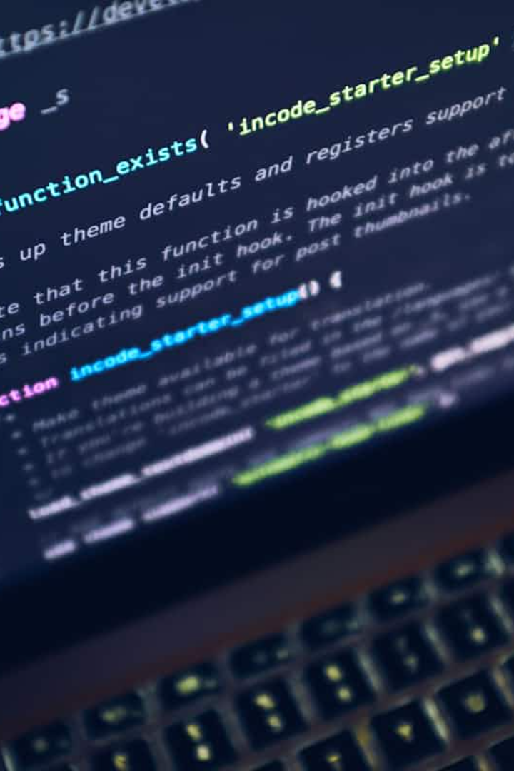

PrivAI: A Privacy-First Multimodal AI Assistant
PrivAI is an AI assistant designed with a core emphasis on user privacy while offering multimodal interaction capabilities. It addresses concerns about data privacy and user control common in traditional cloud-based AI systems. The project envisions a future where privacy-first AI applications blend usability, intelligence, and privacy seamlessly.
This presentation explores PrivAI's motivation, architecture, features, and future vision, highlighting its commitment to ethical AI and data sovereignty.
by Yugansh Gupta

Slide 2
Problem Statement and Motivation
Privacy Risks in Cloud AI
Need for Multimodal Support
Mainstream AI assistants rely on cloud infrastructure that collects and stores user data, posing privacy risks. Users have limited control and transparency over their data.
Traditional assistants mostly support text-based interaction, lacking multimodal capabilities. PrivAI aims to handle diverse inputs while prioritizing privacy and user control.

Slide 3
Core Philosophy and Objectives
Privacy-First Ethos
PrivAI avoids logging or storing user data, ensuring sensitive information remains secure with minimal processing.
Key Objectives
Develop a privacy-focused AI assistant with multimodal interaction
Provide an intuitive, modern user interface
Plan for future local LLM hosting and minimal logging
Build a scalable, modular framework for offline and personalized features
Deliver educational and productivity value through summarization and extraction

Slide 4
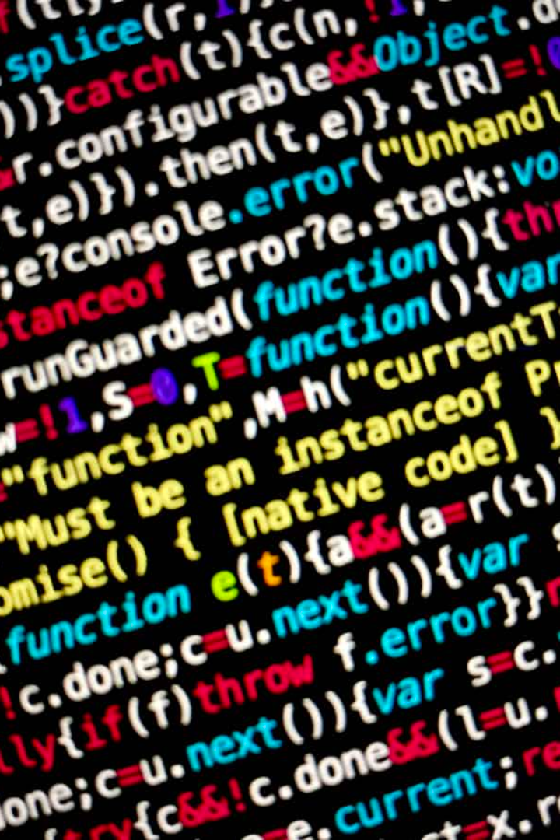
Multimodal Capabilities
Text Queries
Supports natural language text input for versatile communication.
Image Uploads
Processes images for understanding and question-answering.
PDF Documents
Analyzes and summarizes PDF content for efficient information extraction.
YouTube Links
Summarizes and answers questions based on video transcripts.

Slide 5
Current Architecture and Implementation
Modular Design
Processing Pipelines
Includes Frontend UI, Backend API, File Handling, and Model Interaction layers.
Text sent to backend prompt
PDF text extracted with PyMuPDF and chunked
Uses cloud-hosted Google Gemini Pro Vision for multimodal AI capabilities.
Images encoded for multimodal prompts
YouTube transcripts fetched for summarization

Slide 6




Data Privacy Mechanisms
Ephemeral Data Handling
No logging or persistent storage of user data beyond active sessions.
Secure Cloud API Use
User inputs sent securely to cloud APIs only for immediate processing.
Future Local Processing
Plans to enable on-device LLM hosting to keep sensitive data fully under user control.

Slide 7




Future Vision and Scope
Local Model Hosting
Voice and Multilingual Support
Support for LLaMA 3, Phi-3, and GPT4All running offline on user devices.
1
2
Adding speech input/output and expanding language capabilities.
Advanced File Handling & UI Enhancements
4
Mobile App & Personalization
3
Cross-platform deployment and privacy-preserving adaptive learning.
Support for more document types and refined user experience.

Slide 8

Technical Details and Performance
Hardware Requirements
Intel i5/Ryzen 5, 8GB RAM, 256GB SSD minimum; GPU recommended for local LLMs
Software Stack
Python 3.10+, Streamlit UI, PyMuPDF, Langchain, Google Gemini API
Performance Metrics
Response time 2–4 seconds; 92% UI ease of use; 89% response quality satisfaction

Slide 9
Significance and Project Details
Ethical AI and Privacy
Project Background
PrivAI balances powerful multimodal AI with strong user privacy, aligning with global data sovereignty trends.
Developed by Yugansh Gupta under guidance of Ms. Ankita Luke at Institute of Information Technology and Management, New Delhi.
It lays groundwork for personalized, localized, and privacy-preserving AI systems.
Licensed under MIT License, emphasizing open and ethical development.

Slide 10
THANK YOU

