Slide 1
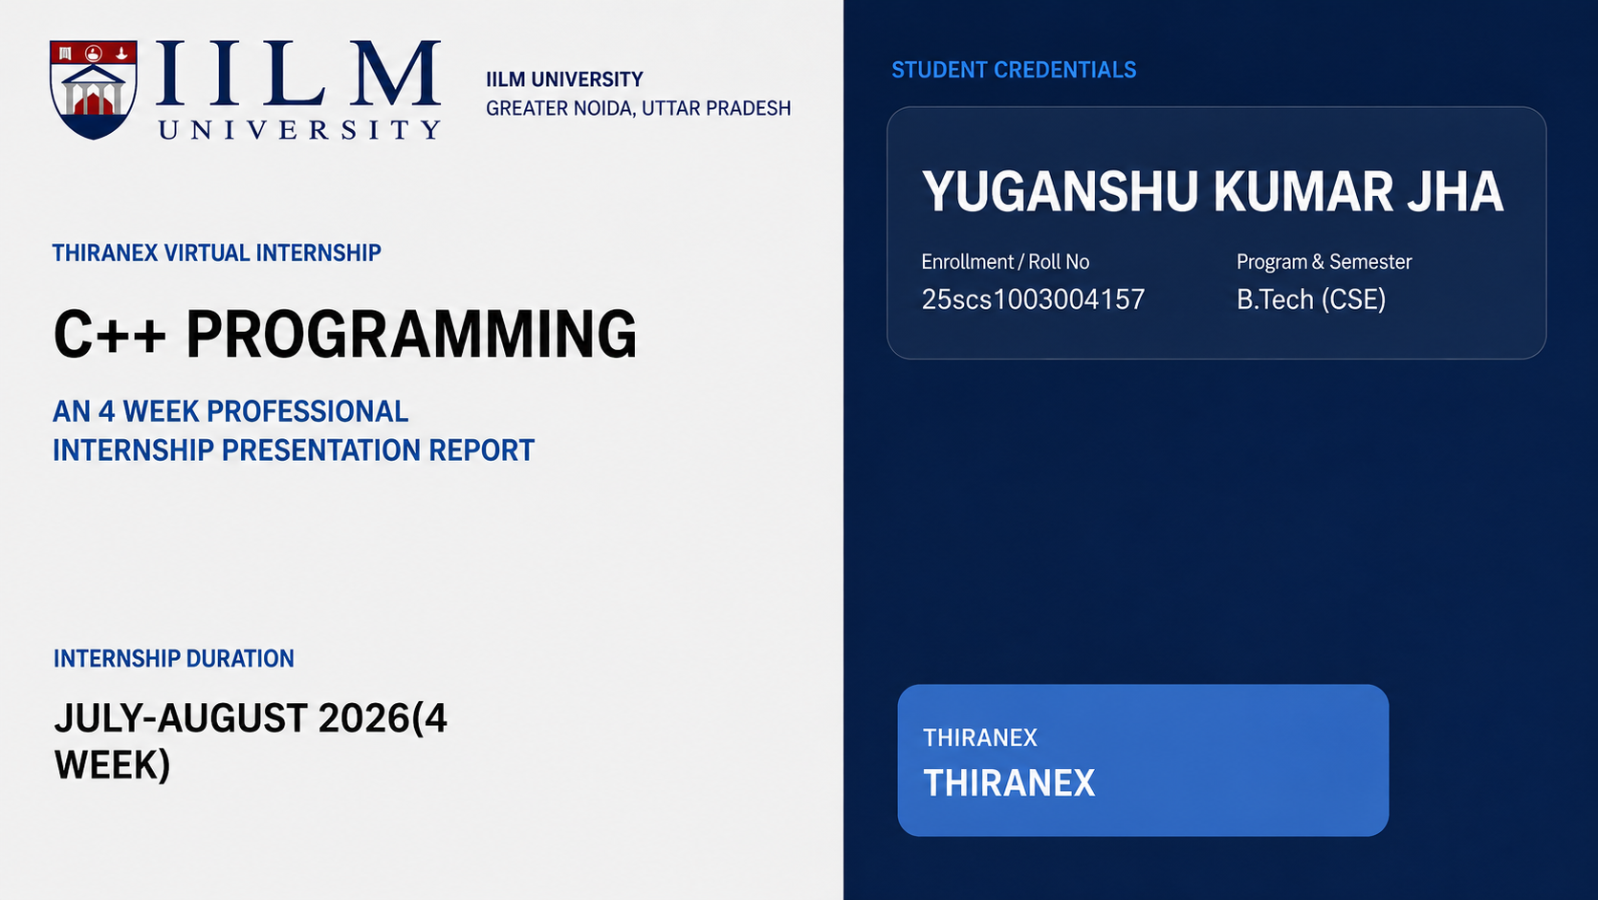

Slide 2
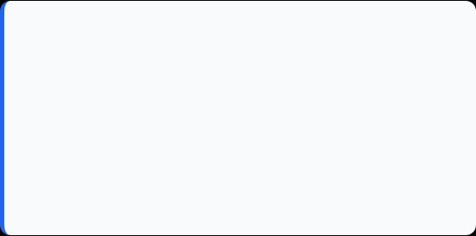
Candidate & Program Overview
Candidate Details
Internship Profile
Student Name: Yuganshu Kumar Jha
Program Name: Thiranex Internship
Roll Number: 25SCS1003004157
Internship Domain: C++ Programming
Degree: B.Tech (Computer Science & Engineering)
Duration: 4.WEEKS (01th AUG 2026 – 02th SEP 2026)
Academic Batch: 2025-2029
STUDENT ID: THX-AUG0326-424
University: IILM University, Greater Noida, U.P.
Issue Date: 01th August

Slide 3
Organization Profile: CodeAlpha
THIRANEX is a technology and software development organization committed to empowering students and aspiring professionals by providing practical learning experiences through internships and real-world project
Industry-Oriented Internship Programs
Offers internships in domains such as Web Development, App Development, Python, Data Science, Machine Learning, Java, and more.
Practical Learning & Projects
Focuses on hands-on training, real-time projects, and problem-solving to enhance technical skills and industry readiness.
Mission
To bridge the gap between academic knowledge and industry requirements by providing quality learning, mentorship, and exposure to modern technologies.

Slide 4

Problem Statement & Industry Context
The Industry Challenge
The Solution Scope
While academic curriculum extensively covers building Machine Learning and Deep Learning models, students often lack hands-on exposure to deploying models into real-world production systems.
This internship addresses the complete end-to-end lifecycle of production AI: model serving, container packaging, cloud hosting, automated scaling, observability, and retraining triggers.
A high-performing ML model in a Jupyter Notebook provides zero business value until it is exposed as a reliable, scalable
,and secure API service.
Mastering industry-grade tools (FastAPI, Docker, Kubernetes, LangChain, SageMaker) to transform research prototypes into enterprise AI solutions.

Slide 5
Curriculum Timeline (Weeks 1 to 4)
1. Student Management System
To develop a console-based Student Management System in C++ that efficiently manages student records using file handling and menu-driven operations.
A functional application that allows users to add, update, delete, and display student information with persistent data storage for reliable record management.
2. Bank Management Application
To design and implement a C++ based Bank Management Application that simulates core banking operations using object-oriented programming and file handling.
A secure and functional banking system capable of performing deposits, withdrawals, and balance inquiries while maintaining persistent customer records.
3. Library Management System
To develop a Library Management System that efficiently manages books, members, and borrowing records using structured or object-oriented programming.
A functional application that enables book addition, issue and return processing, and search by title or author for streamlined library operations.
4. Mini Game Project (Tic Tac Toe / Snake Game)
To create a console-based mini game in C++ that demonstrates core programming concepts such as loops, arrays, and conditional logic.

Slide 6
Certification & Official Verification
Verification Metric | Official Record / Credential Details
Internship Title | C++ Programming Virtual Internship
Issuing Organization | THIRANEX
Academic Patronage | Thiranex Virtual Internship Program
Certificate ID | THX-AUG0326-424

Slide 7
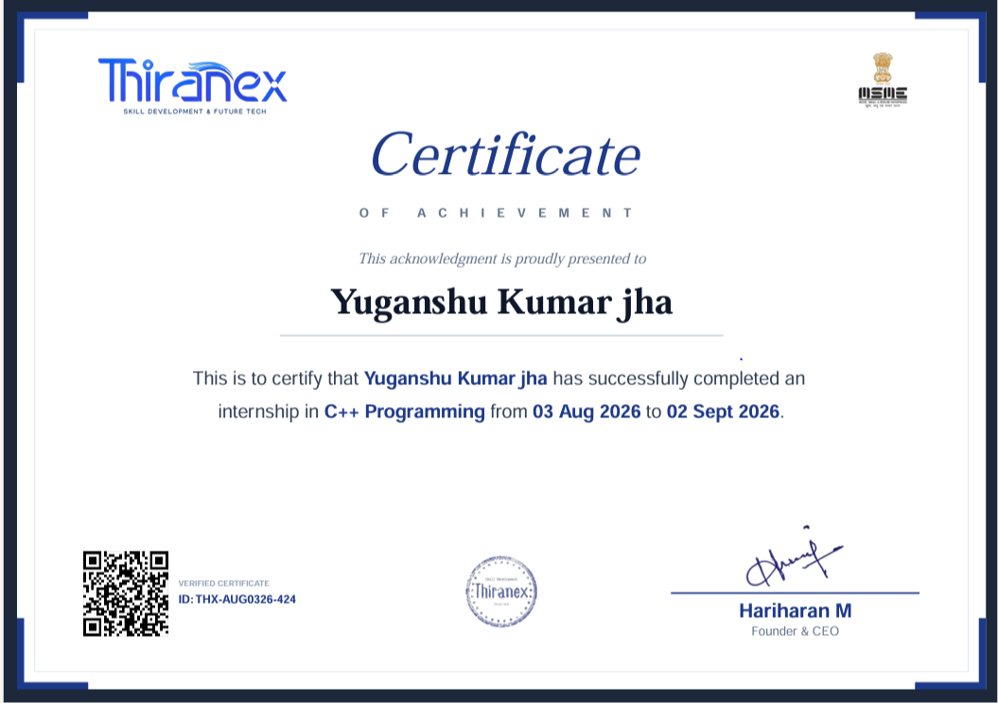
Certification & Official Verification

Slide 8

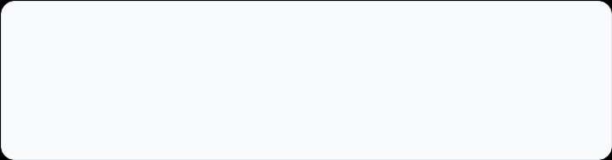
Thank You!
Yuganshu Kumar Jha
School of Computer Science & Engineering
Roll No: 25SCS1003004157
IILM University, Greater Noida, U.P.

