Slide 1
Hashing
Lecture-17
Hashing Techniques
Separate Chaining
Linear Probing
Kartik Mathur

Slide 2
Any doubts?

Slide 3
Overview
Hash Table Data Structure : Purpose
To support insertion, deletion and search in average-case constant time
Assumption: Order of elements irrelevant
data structure *not* useful for if you want to maintain and retrieve some kind of an order of the elements
Hash function
Hash[ “string key”] ==> integer value
*Value is a unique attribute

Slide 4
Key Components
Hash Table
0
1
2 | John 2500
3 | Phil 31250
4
5
6 | Mary 2432
7 | Dave 3242
8
9
Hash Index
H(“John”)
Table Size
“John”
Key
Hash Function
How to determine Hash Function and Table Size?

Slide 5
Hash Table
Hash table is an array of fixed size TableSize
Array elements indexed by a key, which is mapped to an array index (0 to TableSize -1)
Mapping (hash function) h from key to index
e.g., h(“john”) = 2

Slide 6
Hash Table Operations
Insert – T[h(key)] = value;
Delete – T[h(key)] = NULL;
Search – return T[h(key)];
What happens if h(“john”) == h(“joe”)
Collision!
Notes:
T

Slide 7
Factors!
Hash Function
Table Size – usually fixed at the beginning
Collision handling Scheme

Slide 8
Hash Function
h(key) => hash table index
Collisions cannot be avoided but its chances can be reduced using a “good” hash function.
A “good” hash function should have the properties:
Reduced chance of collision - Distribute keys uniformly over table
Should be fast to compute

Slide 9
Effective use of Table Size
Simple hash function (assume integer keys)
h(Key) = Key % TableSize
For random keys, h() distributes keys evenly over table
What if TableSize = 100 and keys are ALL multiples of 10?
Better if TableSize is a prime number

Slide 10
What about strings?
Add up character ASCII values (0-255) to produce integer keys
E.g., “abcd” = 97+98+99+100 = 394
h(“abcd”) = 394 % TableSize
Potential problems:
Anagrams will map to the same index [h(“abcd”) == h(“dbac”)]
Small strings may not use all of table –
[Strlen(S) * 255 < TableSize]
Time proportional to length of the string

Slide 11
So lets try something else?
Treat first 3 characters of string as base-27 integer (26 letters plus space)
Key = S[0] + (27 * S[1]) + (27² * S[2])
Potential problems:
Assumes first 3 characters randomly distributed – Not true English
Notes:
Not true of English
English is not random. Although there are 26 3 =
17,576 possible combinations of three characters (ignoring blanks), a check of a
reasonably large on-line dictionary reveals that the number of different
combinations is actually only 2,851

Slide 12

Another attempt!
Use all N characters of string as an N-digit base-K number
Choose K to be prime number larger than number of different digits (characters). i.e k = 29, 31, 37 etc.

Slide 13
How to handle Collisions?
Open Hashing – Separate Chaining
Closed Hashing – Open Addressing
Linear Probing
Quadratic Probing
Double Hashing

Slide 14
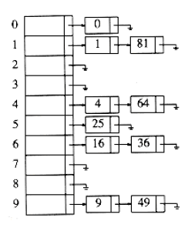
Separate Chaining
Implemented using Linked Lists.
Key k is stored in list at T[h(k)]
E.g., TableSize = 10
h(k) = k mod 10
Insert first 10 perfect squares

Slide 15
Lets see implementation!

Slide 16
Disadvantages
Linked lists could get long which impacts performance
More memory because of pointers
Absolute worst-case (even if N << M)
All N elements in one linked list!
Typically the result of a bad hash function

Slide 17
Open Addressing
When a collision occurs, look elsewhere in the table for an empty slot.
Advantages over chaining
No need for list structures
No need to allocate/deallocate memory during insertion/deletion (slow)
Disadvantages
Slower insertion – May need several attempts to find an empty slot
Table needs to be bigger (than chaining-based table) to achieve average-case constant-time performance

Slide 18
Probe Sequence
A “Probe sequence” is a sequence of slots in hash table while searching for an element
h0(x), h1(x), h2(x), …
Needs to visit each slot exactly once
Needs to be repeatable (so we can find/delete what we’ve inserted)
Hash Function
hi(x) = (h(x) + f(i)) mod TableSize
f(0) = 0
f is the collision resolution strategy

Slide 19
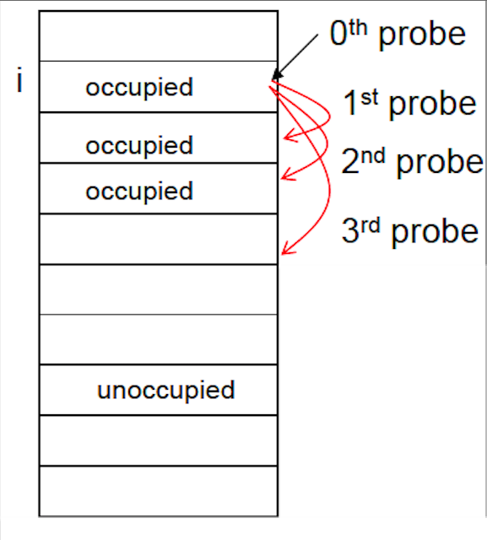
Linear Probing
f(i) = is a linear function of i e.g., f(i) = i

Slide 20
Quadratic Probing
Avoids primary clustering
f(i) is quadratic in i - f(i)= i²
Theorem – New element can always be inserted into a table that is at least half empty and TableSize is prime
Otherwise, may never find an empty slot, even is one exists
Ensure table never gets half full. If close, then expand it

Slide 21
Double Hashing
Use a second hash function for all tries of i other than 0: f(i) = i * h2(x)
Good choices for h2(x) ?
Should never evaluate to 0
h2(x) = R – (x mod R), where R is prime number less than TableSize

Slide 22
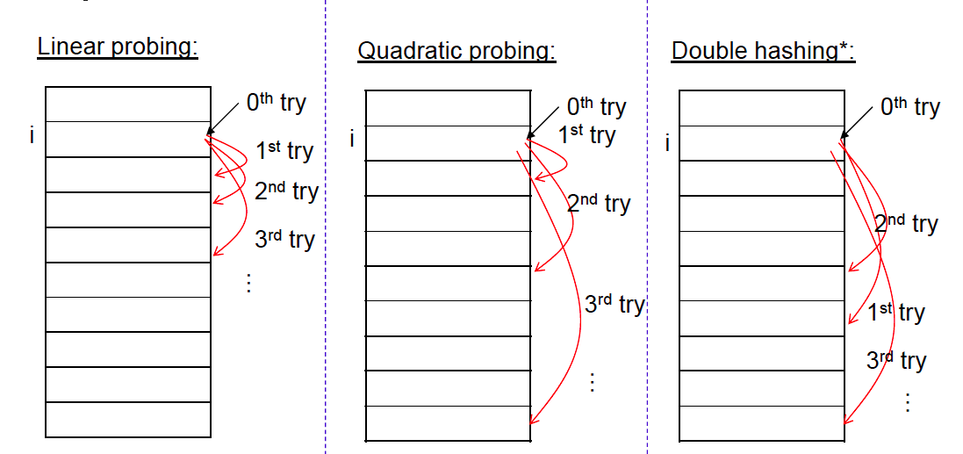
Probing Techniques - review

Slide 23
Load Factor
Load factor λ of a hash table T is defined as follows:
N = number of elements in T (“current size”)
M = size of T (“table size”)
λ = N/M (“ load factor”)
If the load factor is kept reasonable, the hash table should perform well, provided the hashing is good.
If the load factor grows too large, the hash table will become slow, or it may fail to work (depending on the method used).
For a fixed number of buckets, the time for a lookup grows with the number of entries and so does not achieve the desired constant time.
Ideally we want λ <= 1, Not a function of N.

Slide 24
Rehashing
Increases the size of the hash table when load factor becomes “too high” (defined by a cutoff)
Anticipating that prob(collisions) would become higher
Typically expand the table to twice its size (but still prime)
Need to reinsert all existing elements into new hash table

Slide 25
CPP Implementation
Unordered Set [unordered_set]
Unordered Map[unordered_map]-
Separate Chaining
Map [ map ]
- Self-Balancing BST / Red-Black Tree
They were incorporated into the C++11 revision of the C++ standard.

Slide 26
Implement Quadratic Probing yourself!

Slide 27
Lets discuss some problems
Find intersection of two sorted arrays. What about unsorted arrays?
Print a Binary Tree in Vertical Order
1
/ \
2 3
/ \ / \
4 5 6 7
\ \
8 9
The output of print this tree vertically will be:
4
2
1 5 6
3 8
7
9

Slide 28
Time to try?
Find pair of elements which sum to zero.
Union and Intersection of two Linked Lists
Remove duplicates from arrays.

Slide 29
C++ Vectors
#include<vector>
Just like arrays, vectors use contiguous storage locations for their elements, which means that their elements can also be accessed using offsets on regular pointers to its elements, and just as efficiently as in arrays.
But unlike arrays, their size can change dynamically, with their storage being handled automatically by the container
Common Operations
push_back
pop_back
clear
empty
insert
erase
[]
at
front
back

Slide 30
C++ Lists
#include<list>
List containers are implemented as doubly-linked lists; Doubly linked lists can store each of the elements they contain in different and unrelated storage locations. The ordering is kept internally by the association to each element of a link to the element preceding it and a link to the element following it
Common Operations
push_back
pop_back
push_front
pop_front
clear
empty
Insert
erase
front
back
size

Slide 31
STL Reference & Tutorials
http://www.cplusplus.com/reference/stl/
http://www.codeguru.com/cpp/cpp/cpp_mfc/stl/article.php/c4027/C-Tutorial-A-Beginners-Guide-to-stdvector-Part-1.htm
http://www.mochima.com/tutorials/vectors.html

Slide 32
Misc Problems on Recursion
Rat in a Maze
Knights Problem
Sudoku Solver

Slide 33
Thank You!
Kartik Mathur

