Slide 1
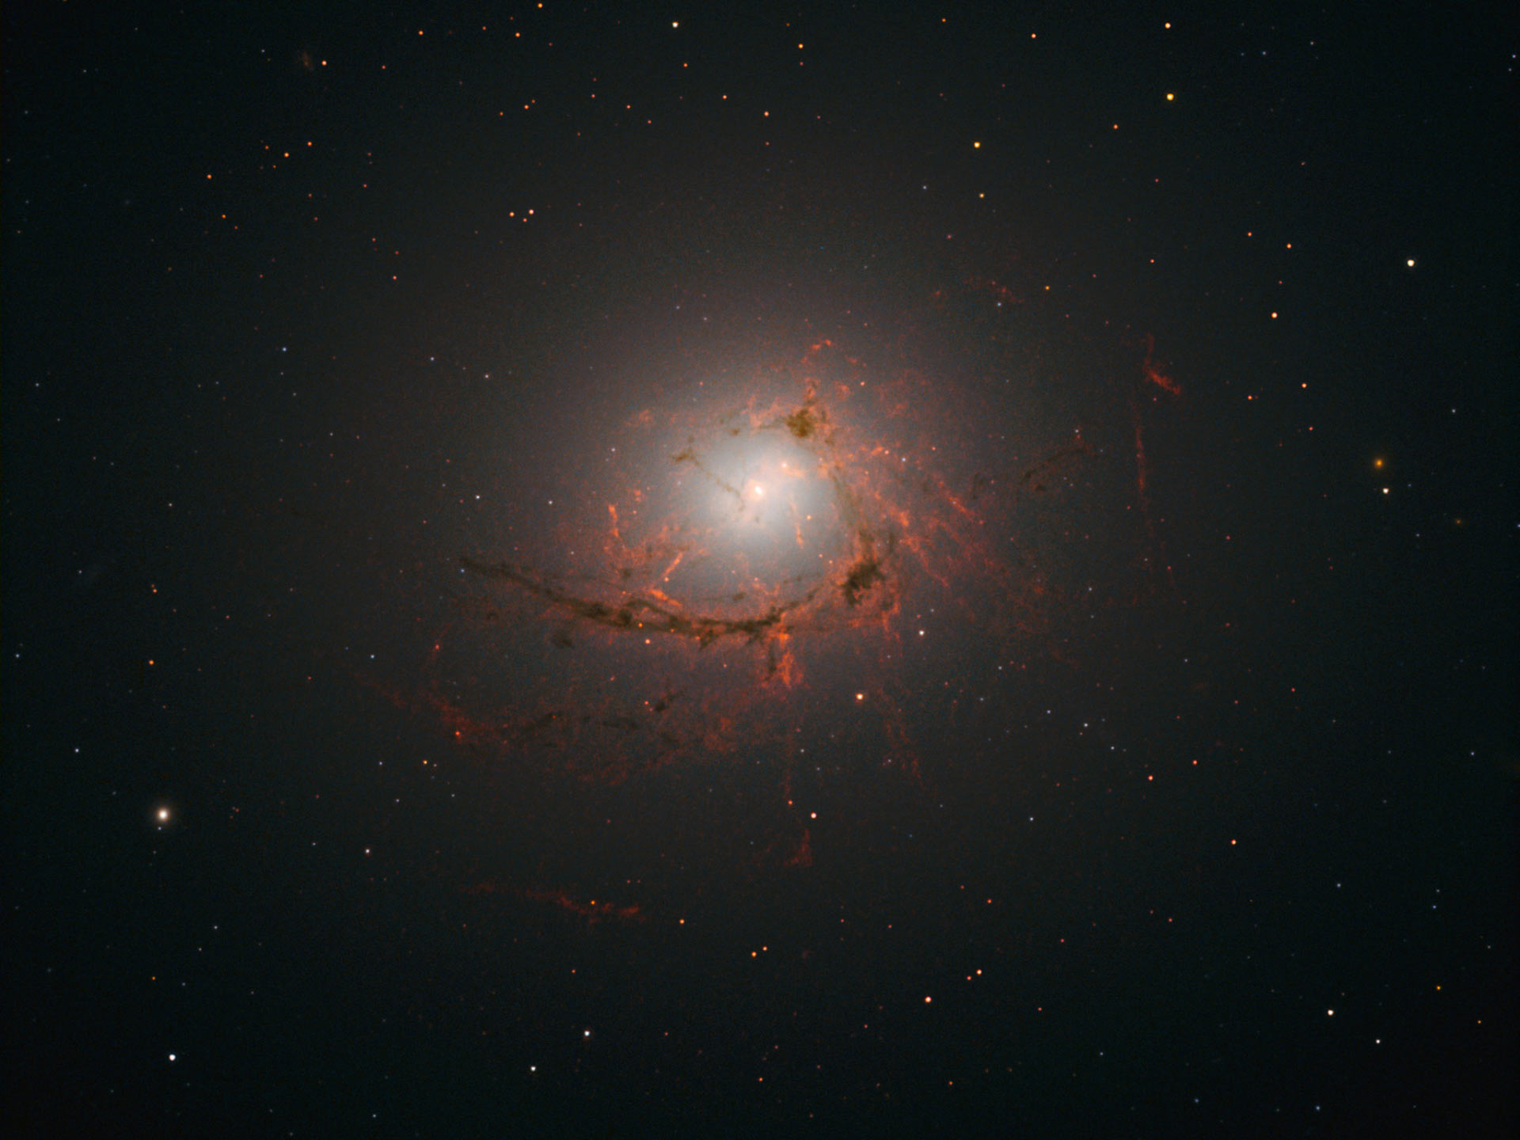
Finding the Magnetic Field in Cool Core Filaments from imaging polarimetry
Bouke Jung (s1499440)
Supervision: Raymond Oonk
Frans Snik
28 Feb 2017 1

Slide 2


Supervisors
Raymond Oonk
  HL423
  Role of atomic and molecular gas on galaxy evolution
Frans Snik
  Oort 570
  Astronomical Polarimetry
  (exo)planetary atmosphere characterization
  Stellar magnetic fields
2

Slide 3
Cool Core Clusters
Discrepancy
  Low star formation rate
  (0.1 Ms / yr)
  Short radiative cooling time
  (30 mln years)
Radiative cooling is stifled!
By what cause?
3

Slide 4
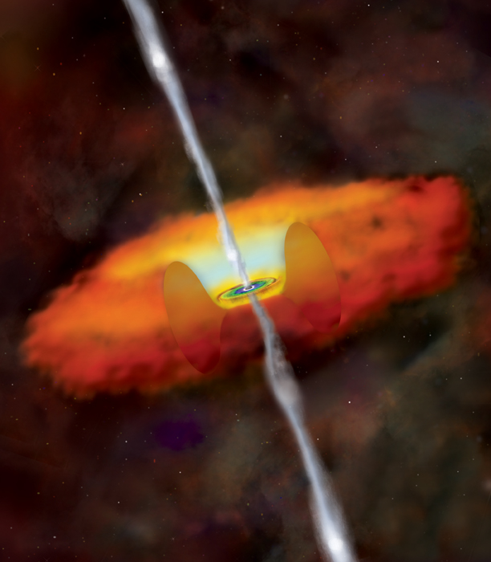
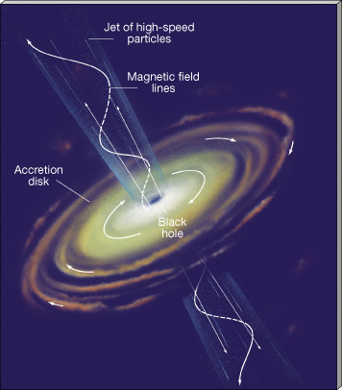
AGN feedback
Two modes of energy transfer
  Radiative mode
  Kinetic mode
Neither is sufficient
Magnetic fields!
  No direct observational evidence yet
  → Use polarimetry
3

Slide 5
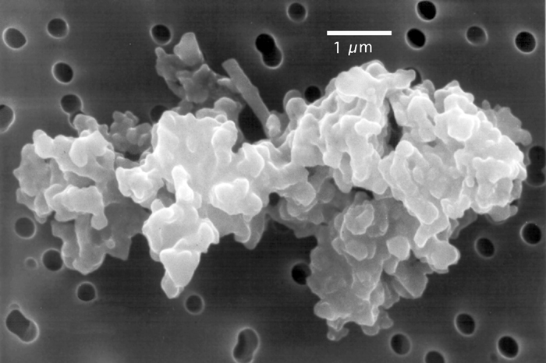
Polarimetry
Scattering polarization
  Aligned dust particles
  Causes partial polarization
Description and measurement
  Jones vector inapplicable
  Stokes vector
3
Images: E.K.Jessberger et al.; Interplanetary Dust; pp. 253-294, Springer-Verlag

Slide 6
FORS2
VLT
Polarimetric optics
  Retarder wave plate
  Wollaston prism
3

