Slide 1
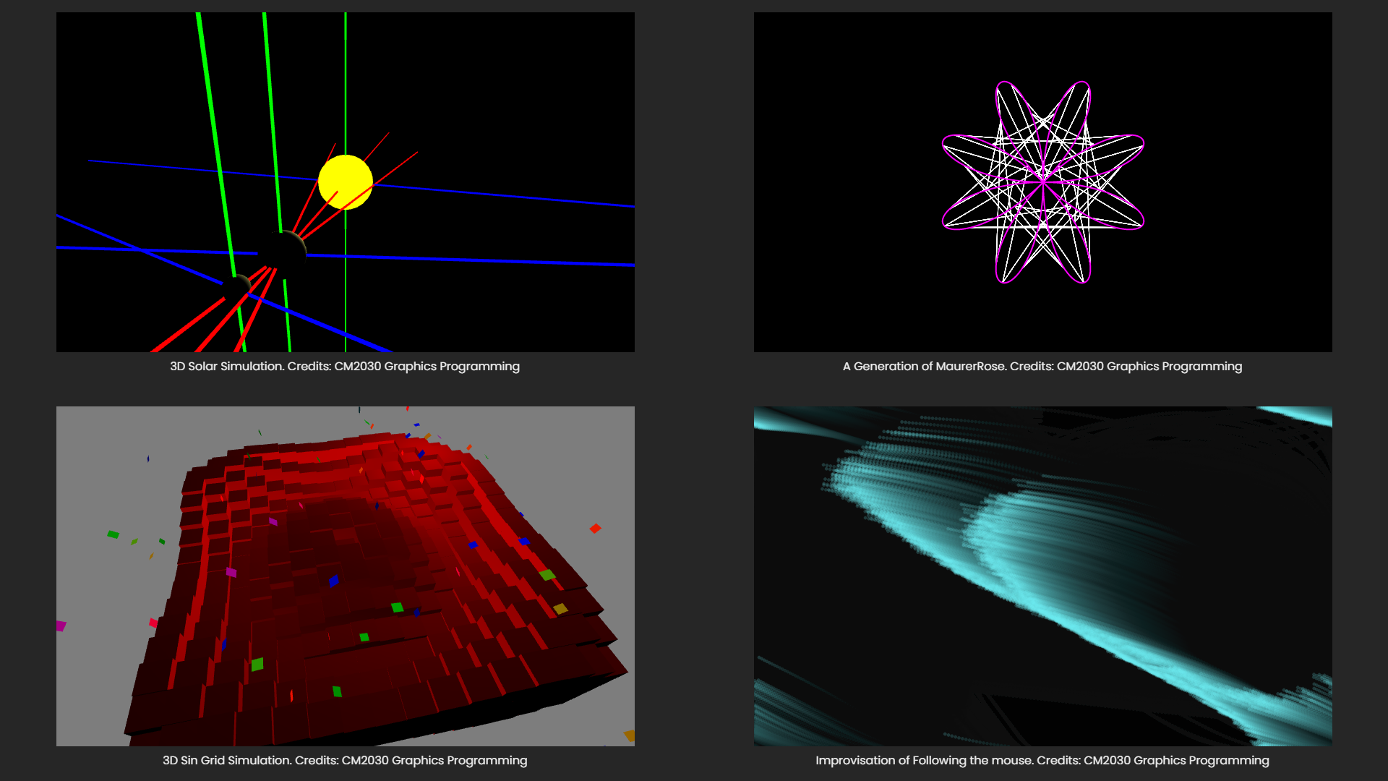

Slide 2
A Visualization of Graphical Programing:
Description: Graphical Programing …. Look at code come to life I guess ¯\_(ツ)_/¯
The Graphical Programing visualization project displays a visual interpretation of the following modelling.
A 3D model of the Sun, Earth and Moon
A 3D model of a Sin wave interaction with a block of grid
A creative art of Maurer Roses
A creative art of tracing the mouse
p.s: I’m bad at naming my projects.
Application of use: Simulation and Modeling
Data Visualization
Prototyping

Slide 3
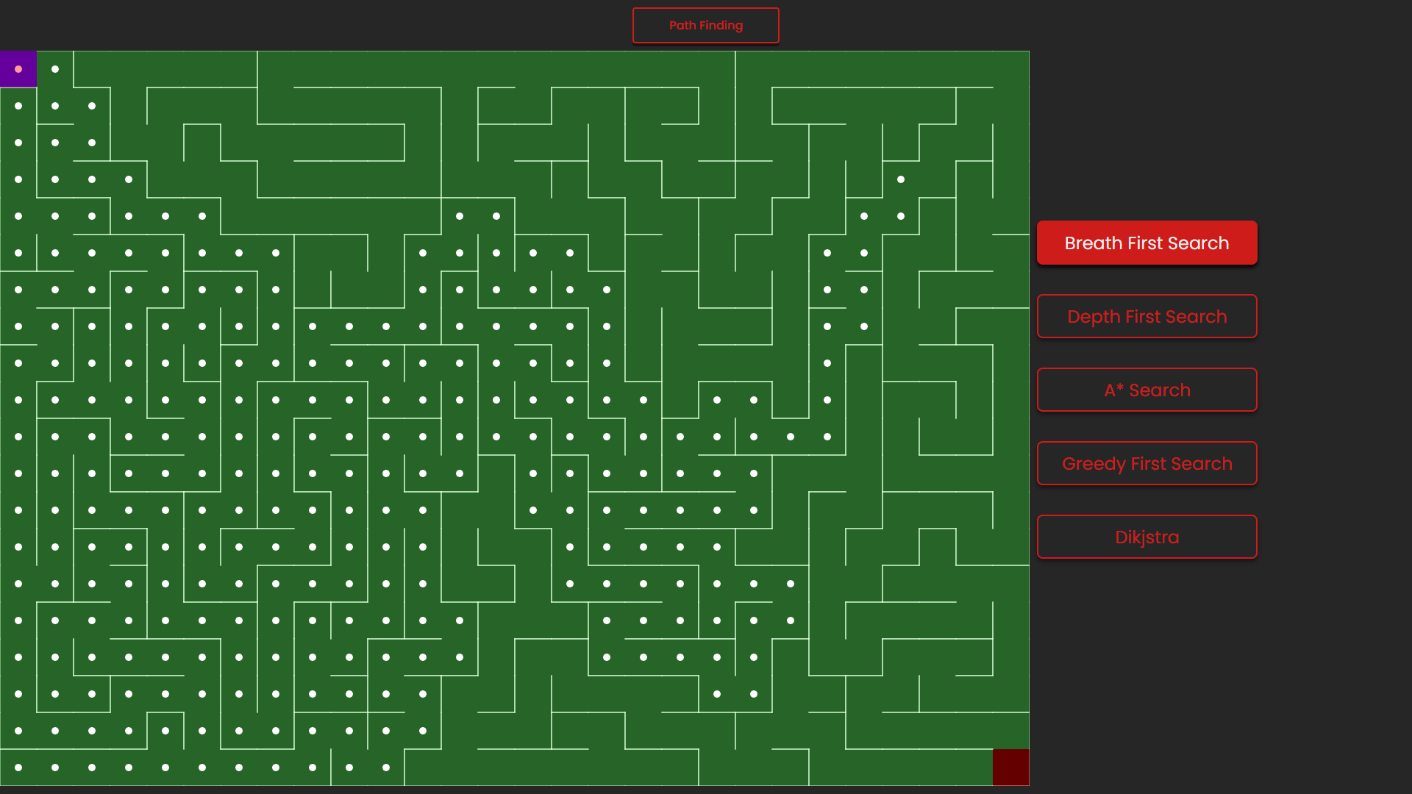

Slide 4
A Visualization of Path Finding algorithms:
Description: Path finding algorithms are build on top of graph searching algorithm (graph theory).
It explores edges between nodes at the root node, traversing through the relationship until the
destination is reached.
The path finding visualization project displays a visual interpretation of the listed algorithm would
behave. Initially, a maze is generated with a Depth First Search approach. After the maze generation,
we can apply the following algorithms: Breath First Search, Depth First Search, A Start, Greedy First
Search and Dikjstra to find a solution from the start point (Top-Left) to end point (Bottom-Right).
p.s: A Star, Greedy and Dikjstra may not have the best interpretation as heuristic to approach each
node are set to the same value a.k.a they are not weigthed
Application of use: Finding the shortest path from Point A – Point B
Finding the best cost-effective path from Point A – Point B
Navigation Systems
Network Routing Optimization

Slide 5
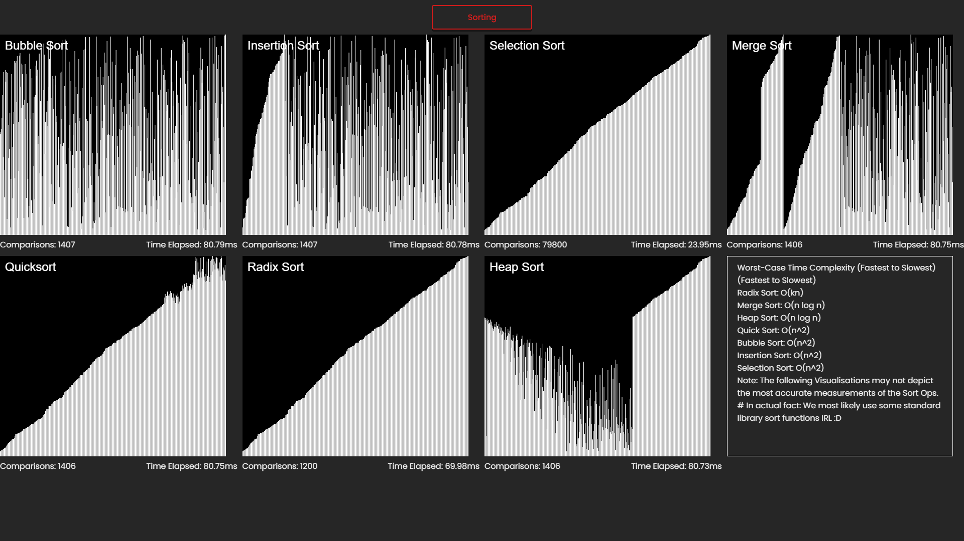

Slide 6
A Visualization of sorting algorithms:
Description: Sorting algorithms take a list of item as input data and deliver an ordered array as an output
Operations performed in the sorting process is what we are interested in here.
The sorting visualization project displays a visual interpretation of how the operation will look like.
It takes in a randomly generate list of number as an input, maps it into an unordered frame of
lines of length N where N is the input integer and provides a sorted array at the end.
From what we can see here, some algorithms perform better then the rest, p.s: the selection sort is too fast.
However, it is just a visual interpretation, modern day computer performs much faster operation than this.
Application of use: Determining the order of sites on a search engine results page (SERP)
Ordering a collection of books in a library.
Ordering large dataset

Slide 7
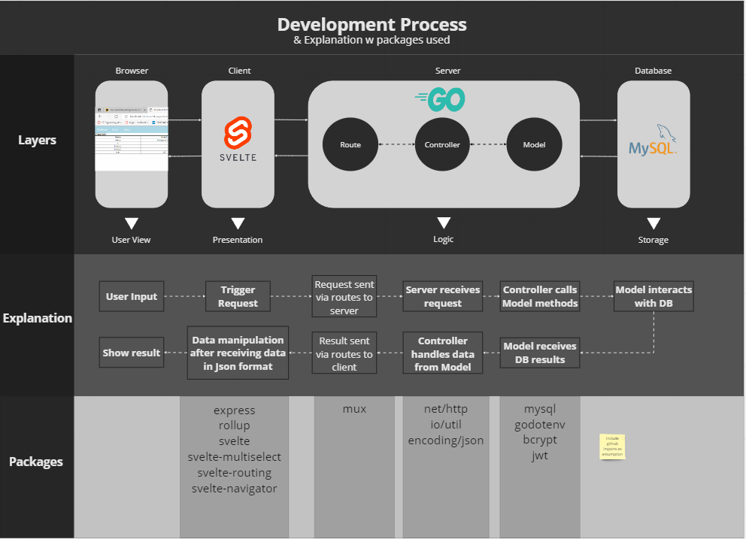



N-TIER APPLICATION DESIGN
Axios
Express Routers

Slide 8
TMS and IAM Application:
Description: TMS (Task Management System) and IAM(Identity Access Management System)
The project compromised of 2 parts. Firstly, a IAM feature that most application would have built on, one way or another. Have Identity access management allows the play of user rights policy within an application. This mean that who have access to what data and information and who have access to perform certain actions.
Secondly, the TMS feature demonstrates the IAM in play for certain task performed. It mimics the development life cycle of an agile scenario where task can be in different states, Open, To-do, Doing, Done and Closed. Different persona of the application can perform different actions to the task within these states.
The application is built with a N-Layer architecture where 2 different back ends are running, Node and GoLang,
packaged into Docker containers. The reason to build it in such a way is that should there be a need where request are overflowing what resource can manage, we can pivot the API and break it down into
micro-services.

Slide 9
