Slide 1
i 4 u
it all starts here<<<3

Slide 2
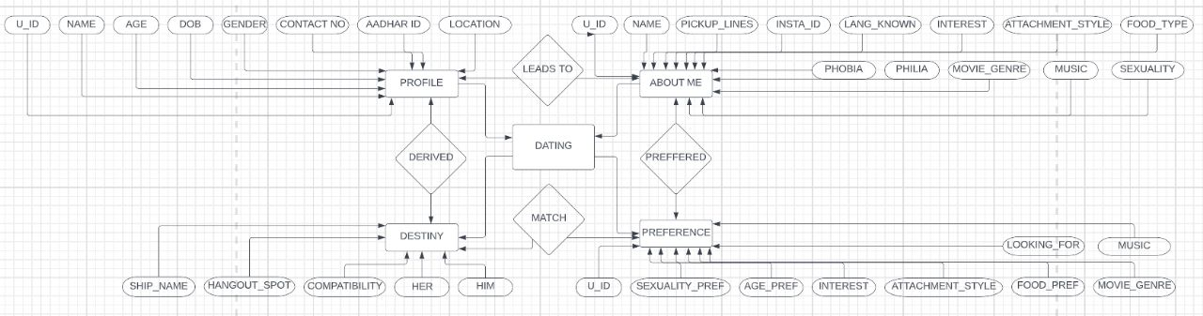
ER DIAGRAM

Slide 3
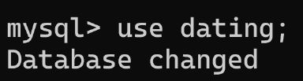
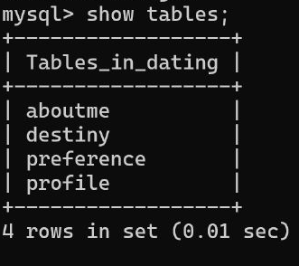
About the database
OUR DATABASE:
OUR TABLES:

Slide 4
Table name :
PROFILE: Contains all the basic details of each and every individual. .
ABOUT ME : It displays the required stuff of the customer.
PREFERENCES : It displays the preferences of the customer in his partner .
DESTINY : It displays the “Perfect-Together”couples .

Slide 5
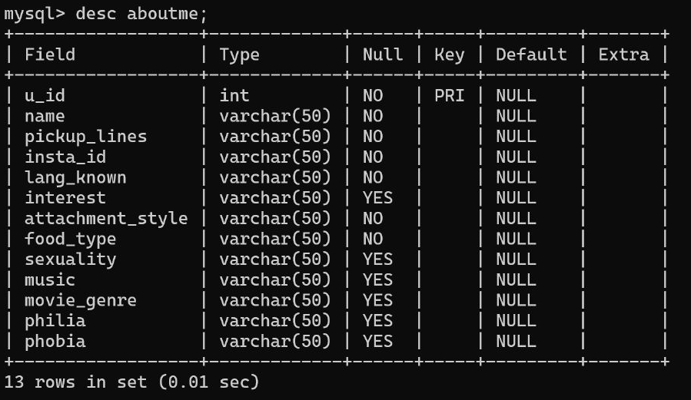
Structure of table “about me”

Slide 6
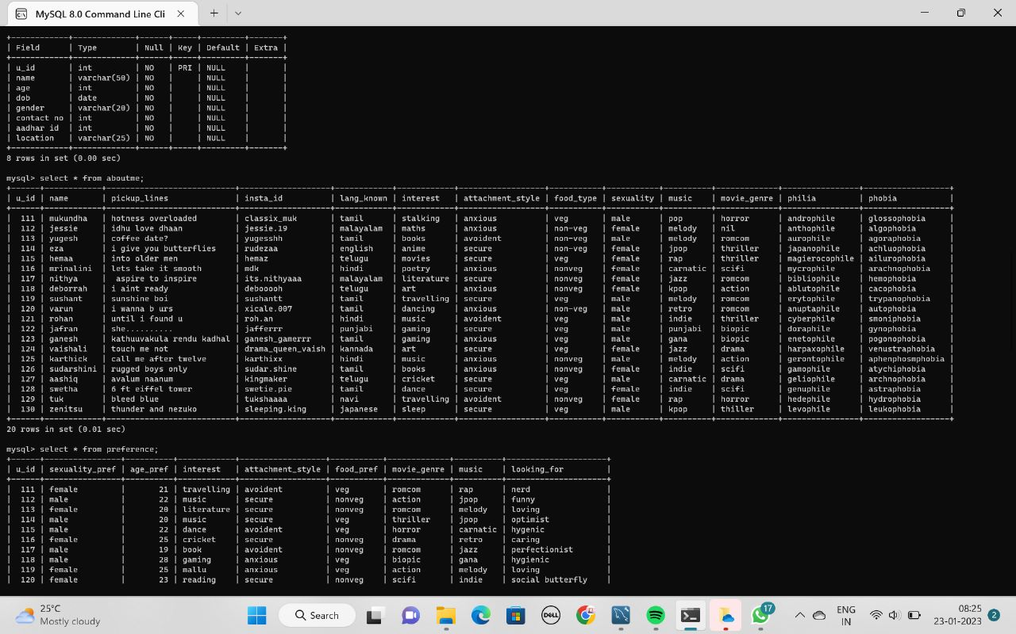
“about me”

Slide 7
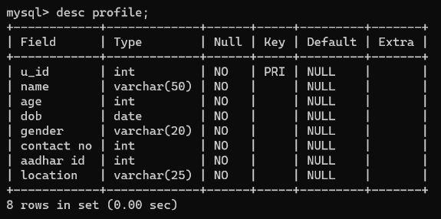
Structure of table “profile”

Slide 8
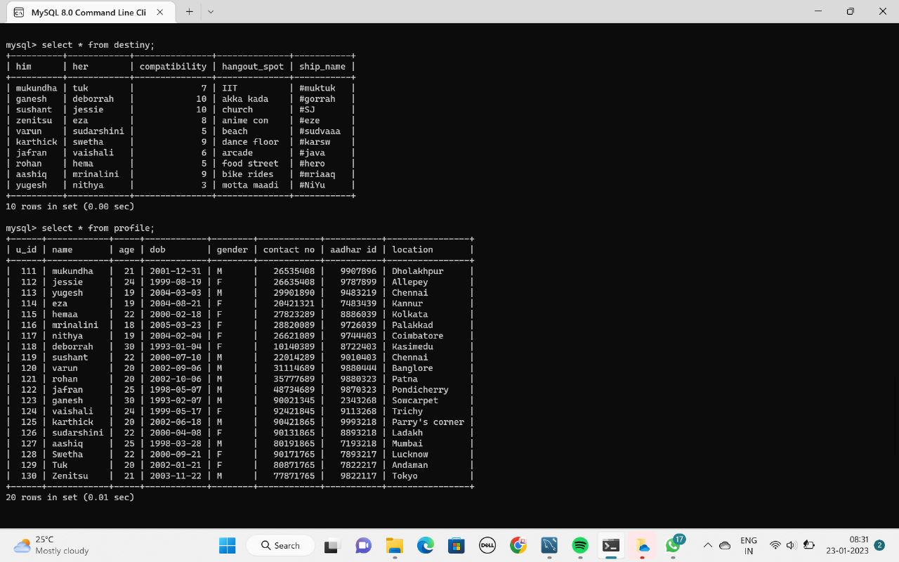
“profile”

Slide 9
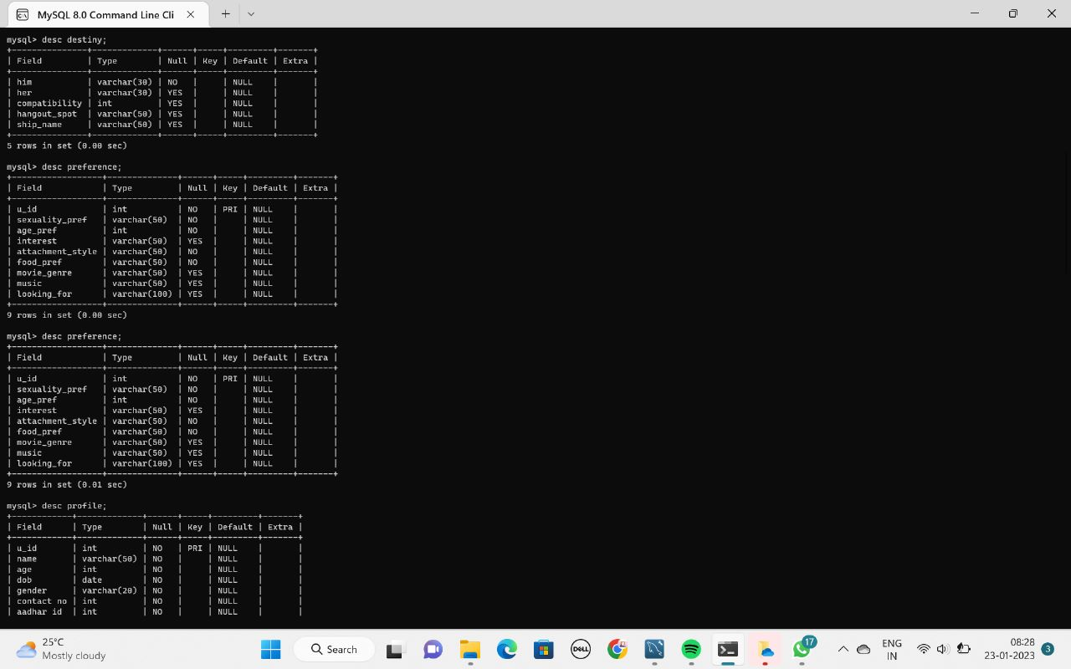
Structure of table “preference”

Slide 10
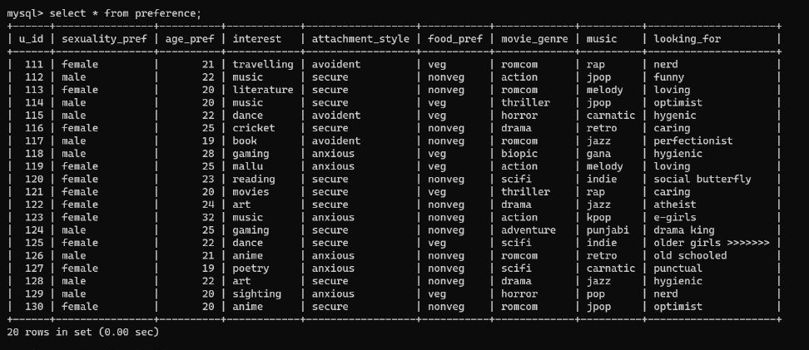
“preference”

Slide 11
Structure of table “destiny”

Slide 12
“destiny”

Slide 13
Queries

Slide 14
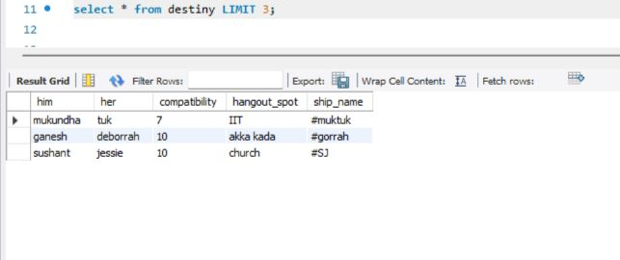

Slide 15
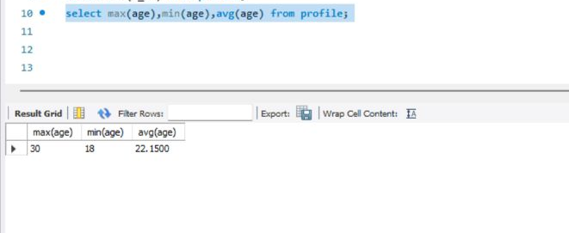

Slide 16
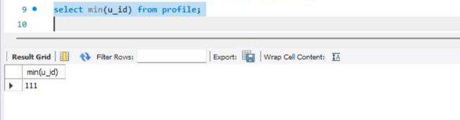

Slide 17
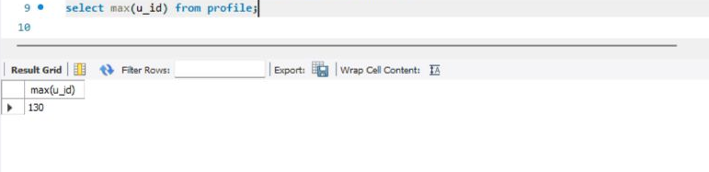

Slide 18
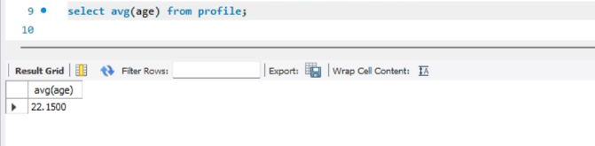

Slide 19
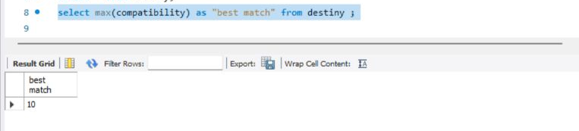

Slide 20
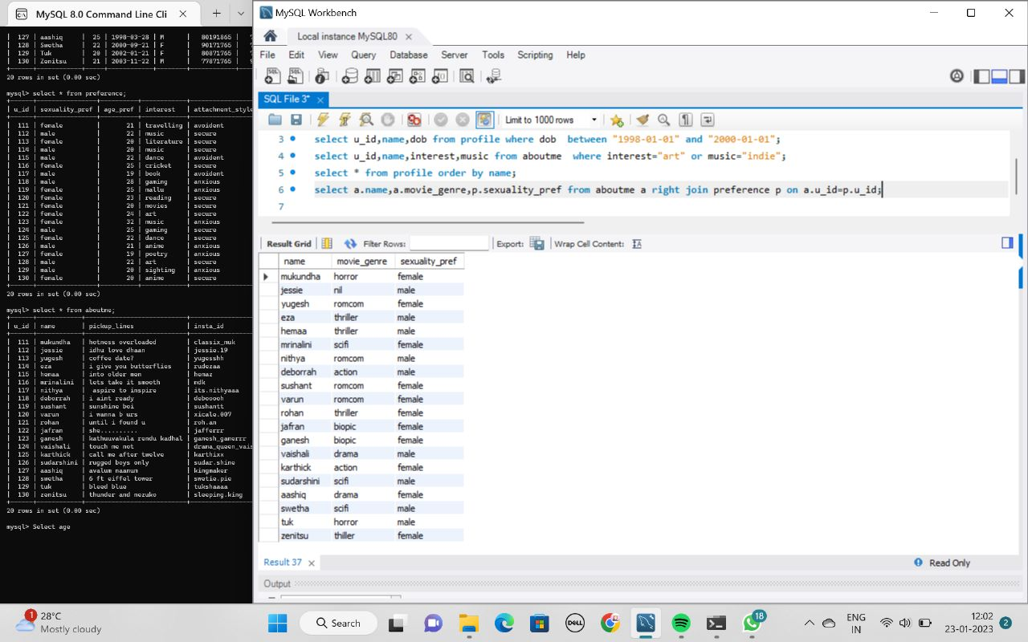

Slide 21
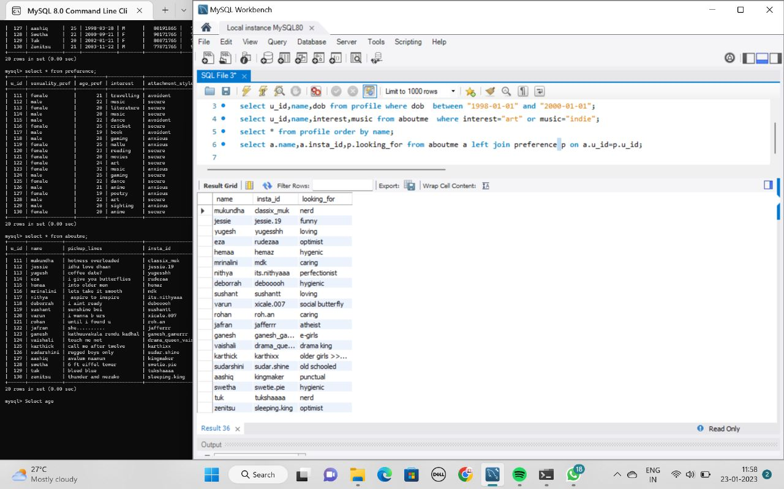

Slide 22
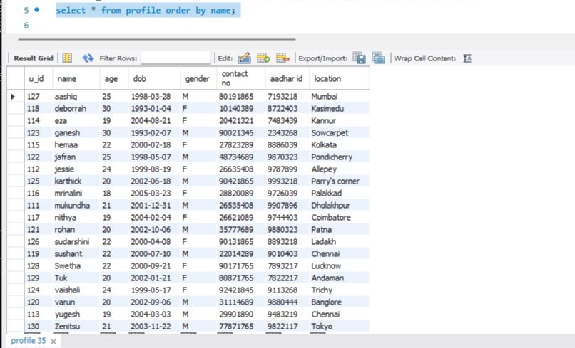

Slide 23
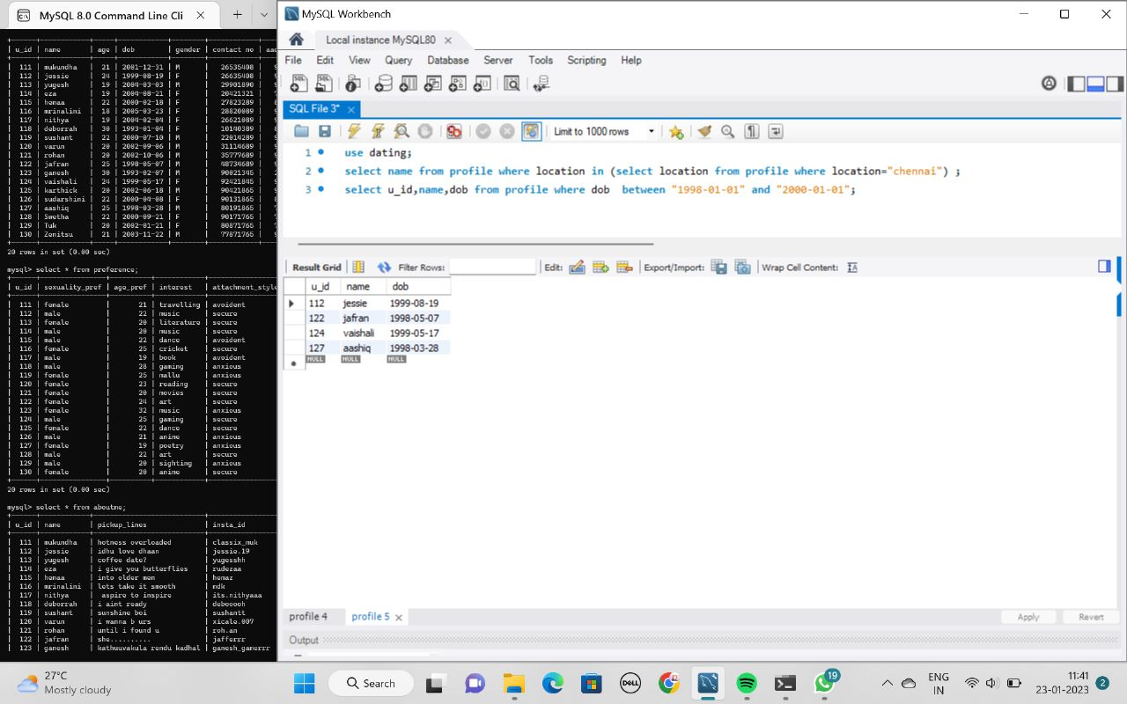

Slide 24
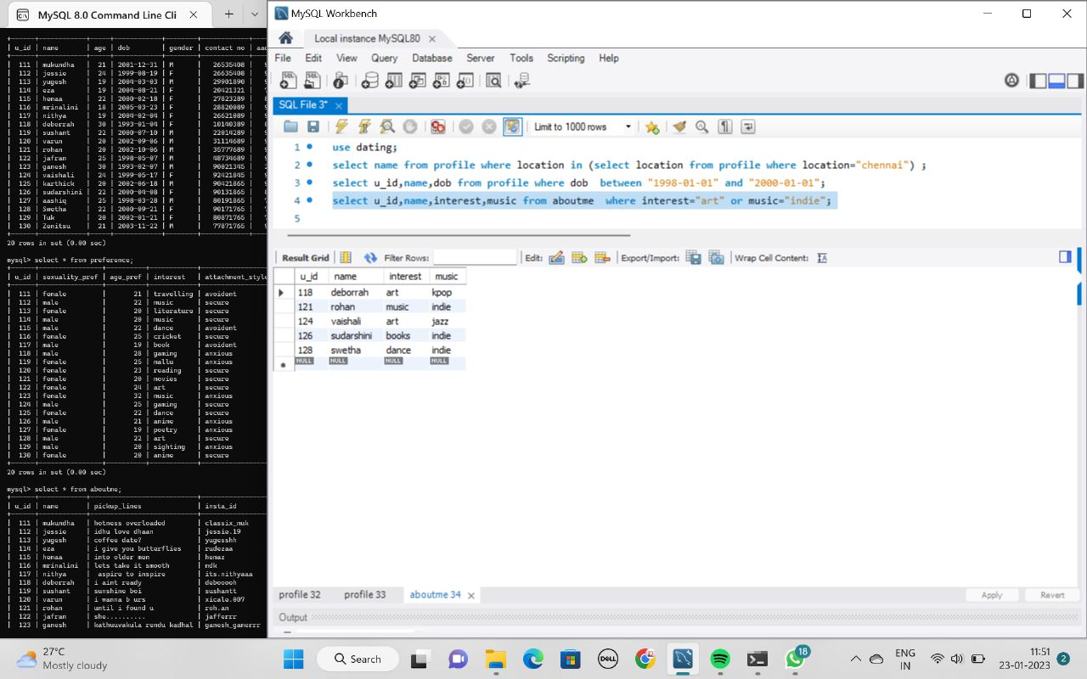

Slide 25
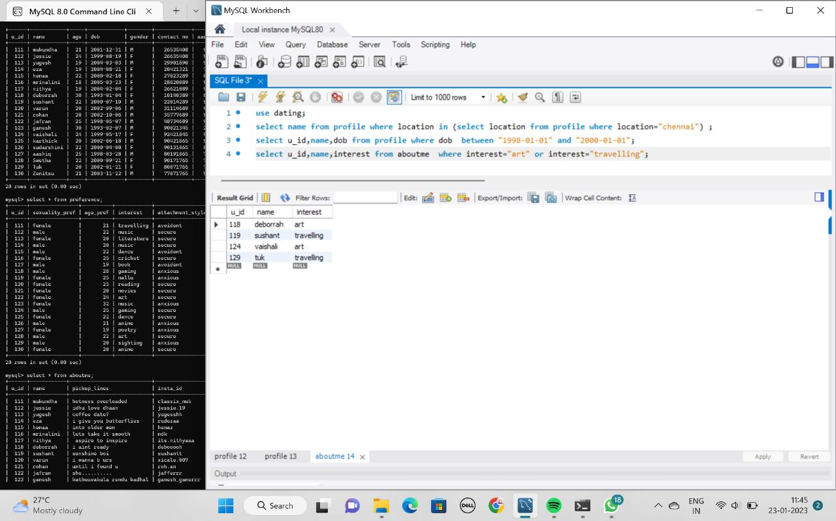

Slide 26
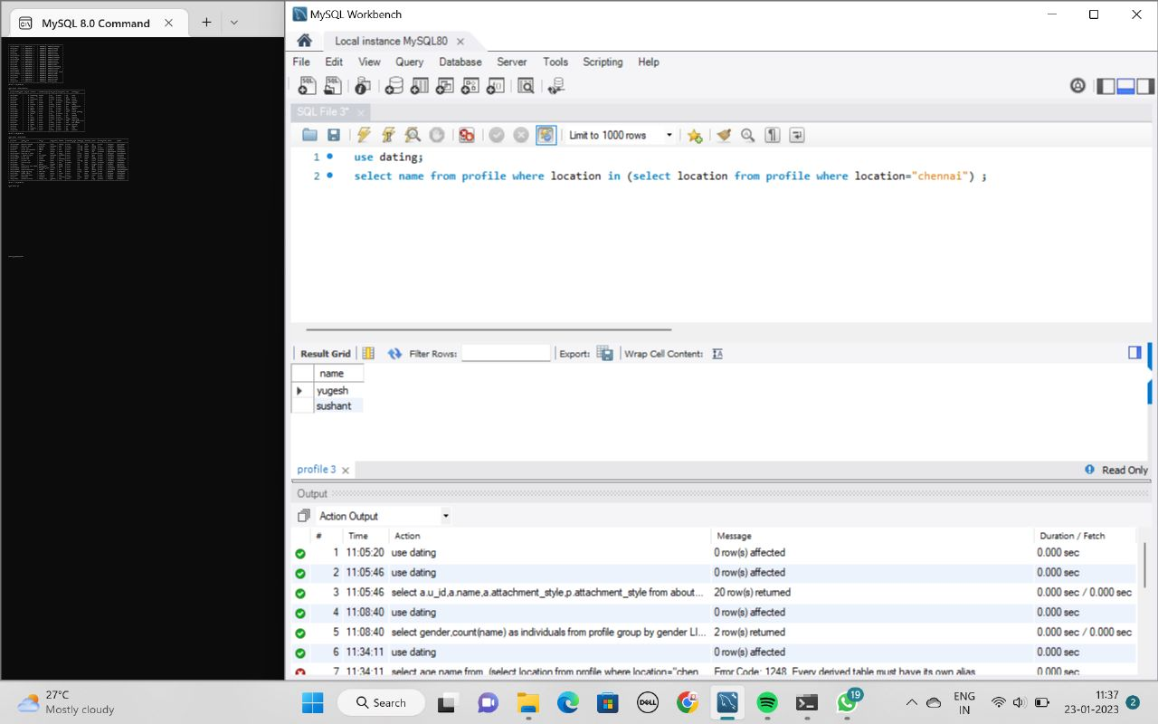

Slide 27
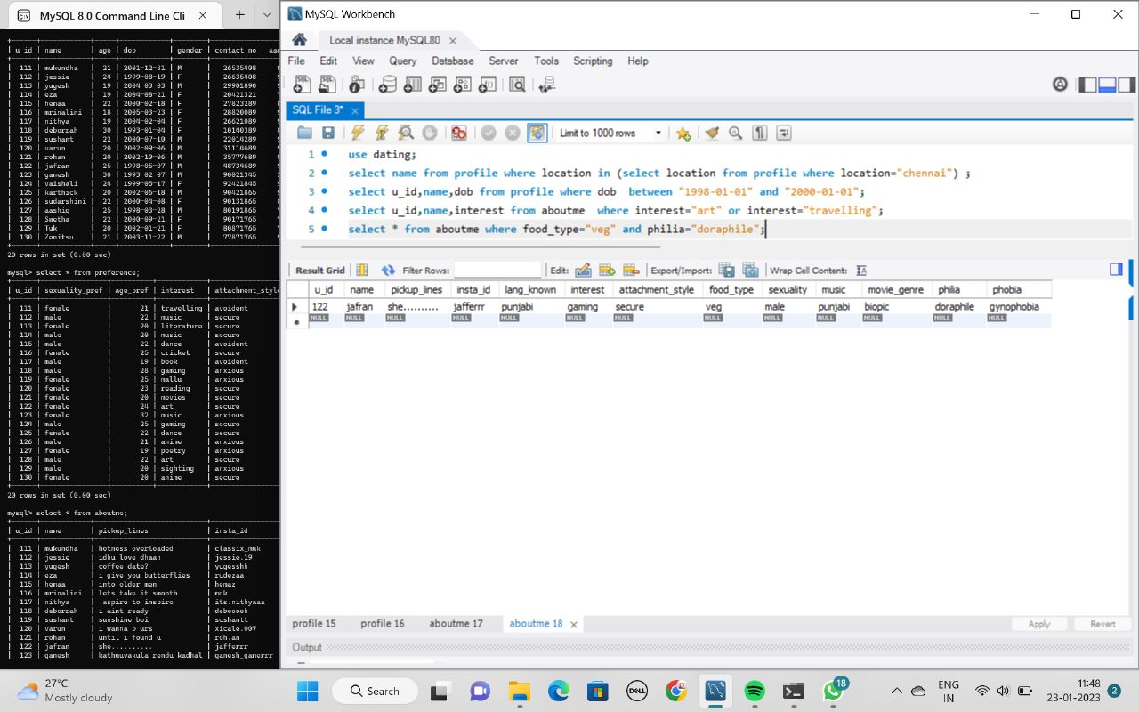

Slide 30
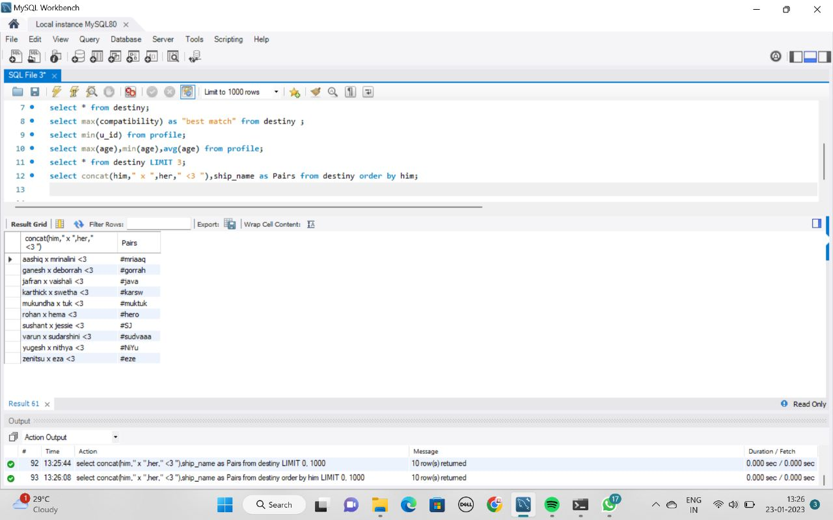

Slide 31
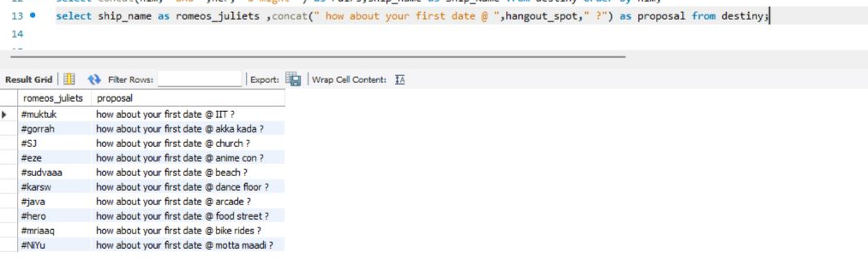

Slide 32
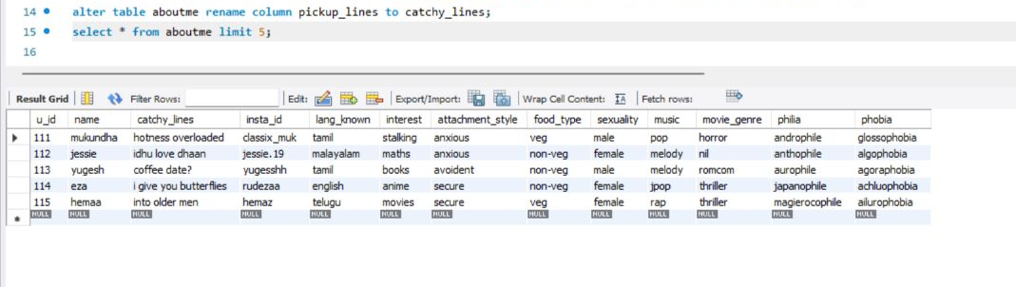

Slide 33
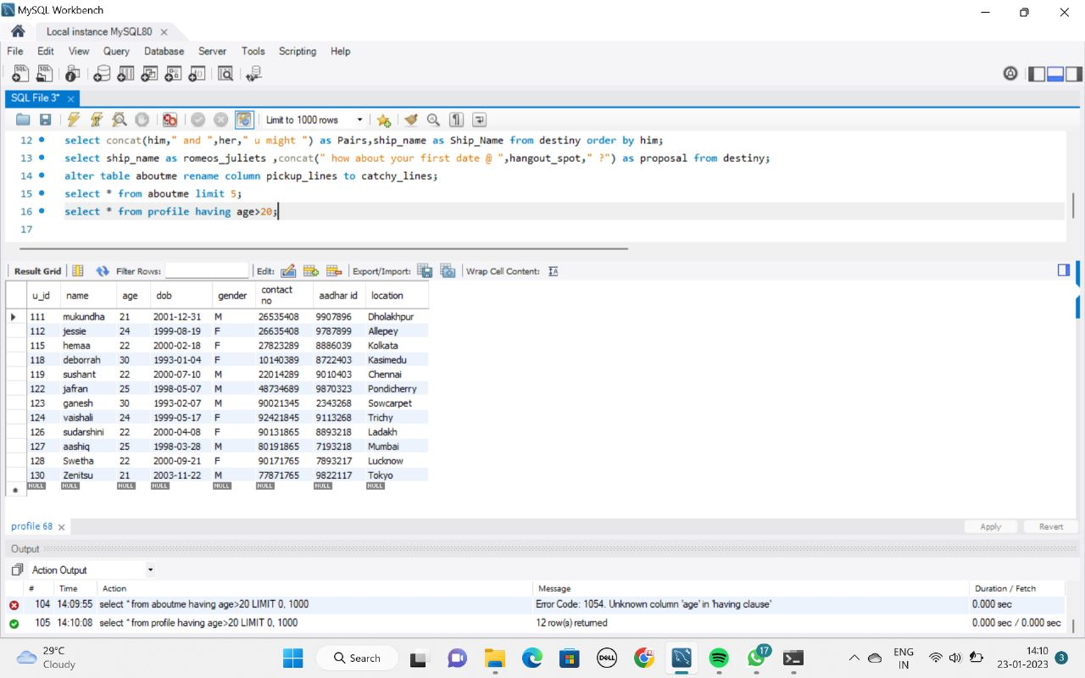

Slide 35

Done by:
Yugesh Padmanaban [E0222008]
Eshaa Sumesh [E0222058]
Sushant S [E0222012]
Deborrah Anglyn [E0222061]
Mukundha S [E0222050]
Hemaa[E0222038]

Slide 36
MetiLDa
Meet>Love>Date

